Slide 1
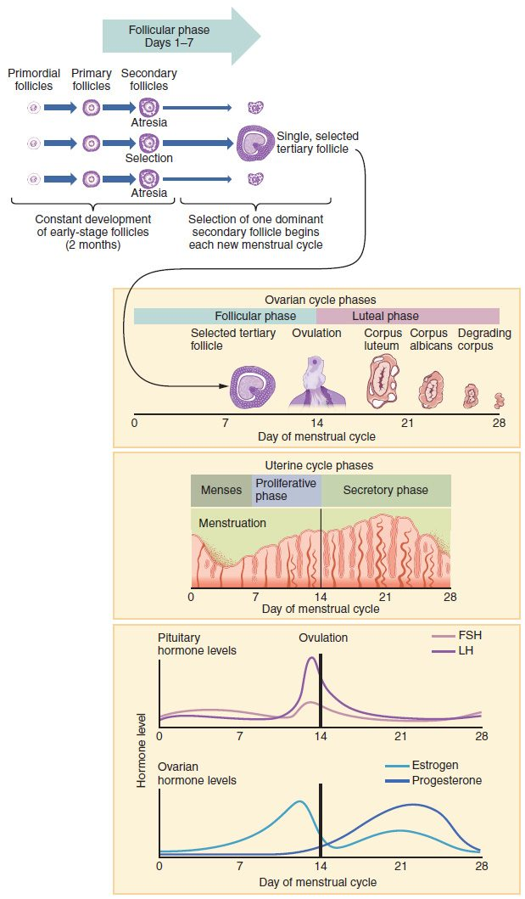
CHAPTER 27
The Reproductive System
The organs of reproduction and how new life begins.
Anatomy & Physiology · Broward-Miami Health Institute
FACULTY EDITION

Slide 2
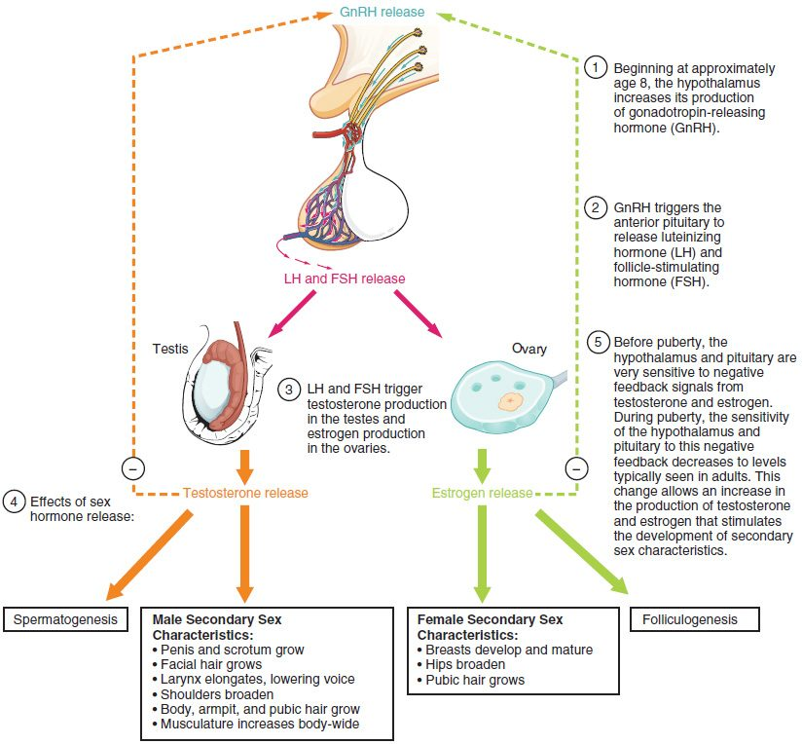
CHAPTER 27
Learning Objectives
After studying this chapter, students will be able to:
1
Describe the anatomy of the reproductive systems, including their accessory structures
2
Explain the role of hypothalamic and pituitary hormones in reproductive function
3
Trace the path of a sperm cell from its initial production through fertilization of an oocyte
4
Explain the events in the ovary prior to ovulation
Reproductive development and its hormones.
PN 104 · Ch 27 — The Reproductive System
2
Notes:
Preview the reproductive system: the male organs and sperm production, the female organs, egg formation, and the menstrual cycle, and how both systems develop and mature at puberty under hormonal control.

Slide 3
27.1
SECTION
Anatomy and Physiology of the Testicular Reproductive System
The male reproductive organs and sperm production.

Slide 4
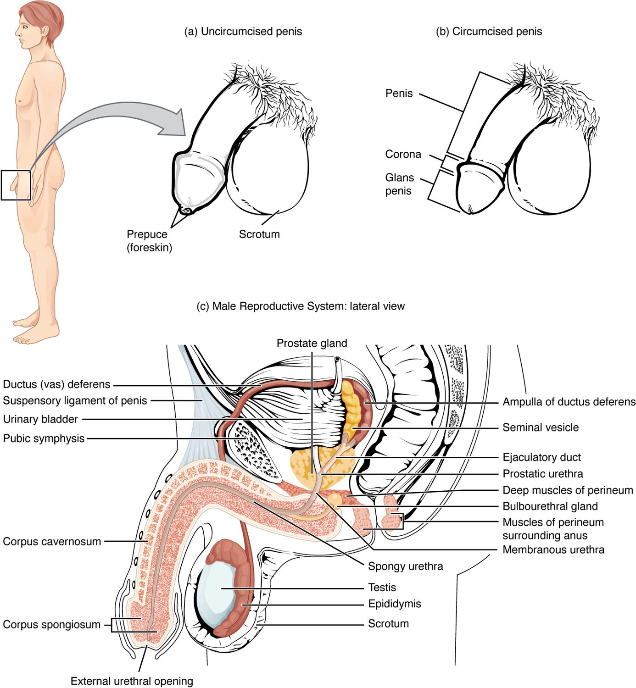
SECTION 27.1
The Male Reproductive System
Produces and delivers sperm
Testes make sperm and testosterone
Ducts carry sperm out
Glands add seminal fluid
The male reproductive system
PN 104 · Ch 27 — The Reproductive System
4
Notes:
The male reproductive system produces sperm and the hormone testosterone, and delivers sperm to the female tract. The testes (in the scrotum) make sperm; a series of ducts (epididymis, ductus deferens, urethra) transports them; and accessory glands add fluid to form semen.

Slide 5
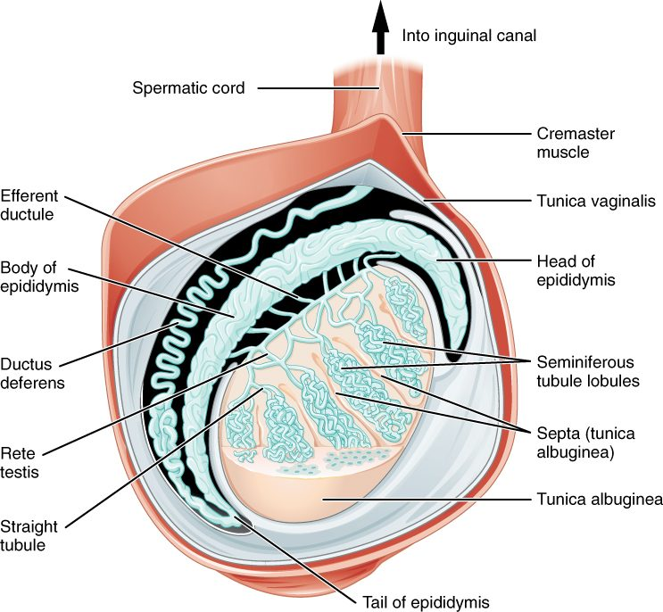
SECTION 27.1
The Testis & Epididymis
The testes sit in the scrotum
Sperm form in seminiferous tubules
They mature in the epididymis
The scrotum keeps them cool
The testis and epididymis
PN 104 · Ch 27 — The Reproductive System
5
Notes:
Inside each testis, sperm are produced in tightly coiled seminiferous tubules, then pass to the epididymis to mature and be stored. The scrotum holds the testes outside the body cavity, keeping them slightly cooler than core temperature — a requirement for healthy sperm production.

Slide 6
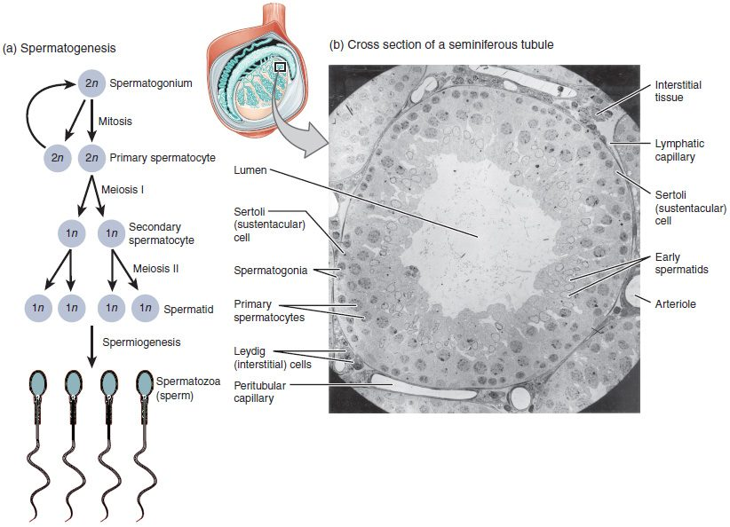
SECTION 27.1
Spermatogenesis
The making of sperm
Begins at puberty
Continues throughout life
Each sperm carries half the chromosomes
Spermatogenesis
PN 104 · Ch 27 — The Reproductive System
6
Notes:
Spermatogenesis is the formation of sperm in the seminiferous tubules, beginning at puberty and continuing for life. Through meiosis, each sperm ends up with half the genetic material (23 chromosomes), so that fertilization restores the full set. Millions are produced daily.

Slide 7
27.2
SECTION
Anatomy and Physiology of the Ovarian Reproductive System
The female reproductive organs, the egg, and the menstrual cycle.

Slide 8
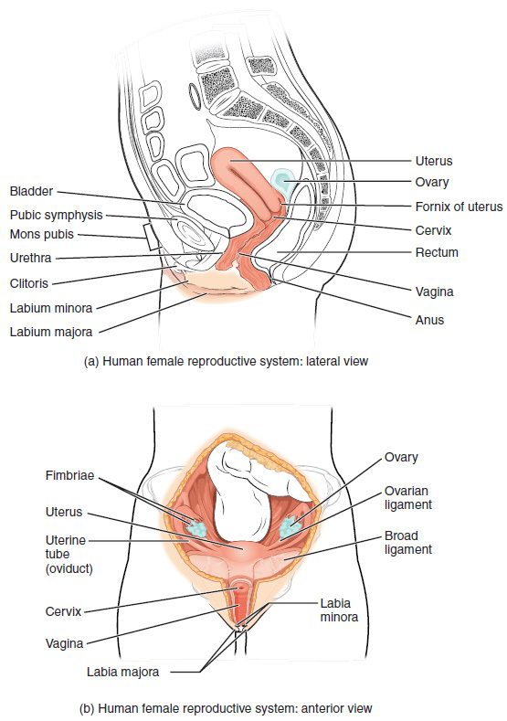
SECTION 27.2
The Female Reproductive System
Produces eggs and supports pregnancy
Ovaries make eggs and hormones
Uterine tubes carry the egg
The uterus houses a pregnancy
The female reproductive system
PN 104 · Ch 27 — The Reproductive System
8
Notes:
The female reproductive system produces eggs, secretes hormones, and supports pregnancy and birth. The ovaries release eggs and make estrogen and progesterone; the uterine (fallopian) tubes carry the egg toward the uterus; and the muscular uterus houses and nourishes a developing fetus. The external genitalia make up the vulva.

Slide 9
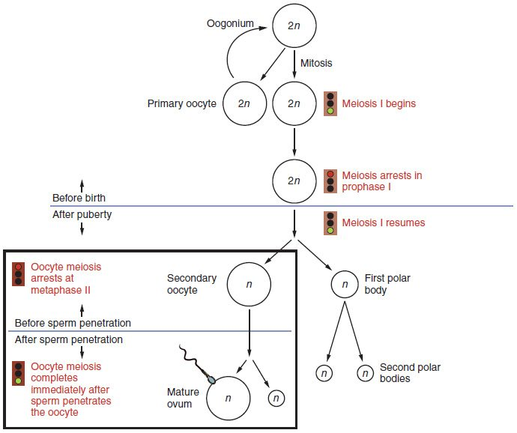
SECTION 27.2
Oogenesis
The making of eggs
Begins before birth
One egg matures each cycle
Each egg carries half the chromosomes
Oogenesis
PN 104 · Ch 27 — The Reproductive System
9
Notes:
Oogenesis, the formation of eggs, begins before birth — a female is born with all her immature eggs. After puberty, typically one matures and is released each menstrual cycle. Like sperm, the mature egg carries half the chromosomes (23), so fertilization restores the full complement.

Slide 10
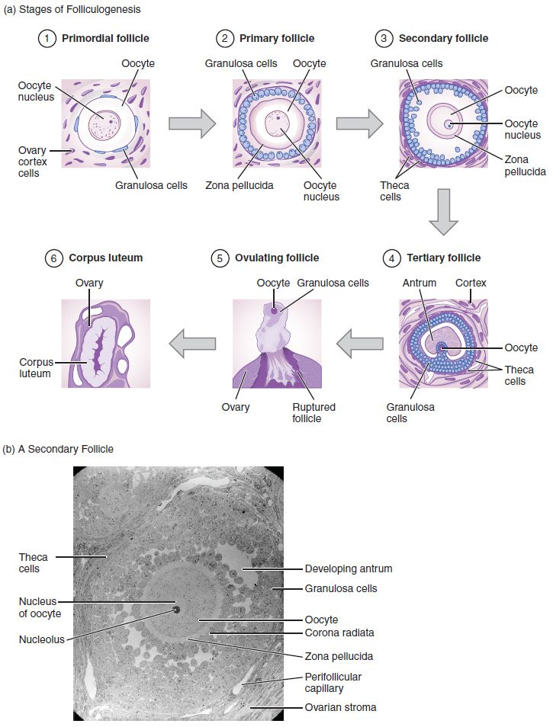
SECTION 27.2
The Ovarian Cycle
Follicles develop in the ovary
One matures and ovulates
The empty follicle becomes the corpus luteum
It secretes hormones
Follicle development in the ovary
PN 104 · Ch 27 — The Reproductive System
10
Notes:
Each cycle, several follicles begin developing in the ovary, but usually one matures and releases its egg at ovulation. The ruptured follicle then becomes the corpus luteum, which secretes progesterone to prepare the uterus for a possible pregnancy; if none occurs, it breaks down and the cycle repeats.

Slide 11
SECTION 27.2
The Menstrual Cycle
A roughly monthly cycle
Hormones drive ovarian and uterine changes
The uterine lining builds up
It sheds as menstruation if no pregnancy
The ovarian and menstrual cycle
PN 104 · Ch 27 — The Reproductive System
11
Notes:
The menstrual cycle (about 28 days) coordinates ovarian events with the uterine lining under hormonal control. Rising estrogen builds up the endometrium; after ovulation, progesterone maintains it. If no pregnancy occurs, hormone levels fall and the lining is shed as menstruation, beginning a new cycle.

Slide 12
27.3
SECTION
Development of the Male and Female Reproductive Systems
How the reproductive systems develop and mature at puberty.

Slide 13
SECTION 27.3
Reproductive Development & Puberty
Sex is determined at fertilization
Systems develop before birth
They mature at puberty
Driven by reproductive hormones
Reproductive development at puberty
PN 104 · Ch 27 — The Reproductive System
13
Notes:
Genetic sex is set at fertilization, and the reproductive structures form before birth. They remain immature until puberty, when the hypothalamus signals the pituitary to release FSH and LH, driving the gonads to mature and produce sex hormones. These bring the secondary sex characteristics and the start of fertility.

Slide 14
CHAPTER 27
Key Takeaways
The male system produces and delivers sperm; the female system produces eggs and supports pregnancy.
Sperm and eggs each carry half the chromosomes, restored to a full set at fertilization.
The testes make sperm and testosterone; the ovaries make eggs, estrogen, and progesterone.
The menstrual cycle coordinates ovulation with the uterine lining each month.
Reproductive organs mature at puberty under control of the pituitary hormones.
PN 104 · Ch 27 — The Reproductive System
14

Slide 15
CLINICAL CONNECTIONS
Why the Reproductive System Matters in Practical Nursing
Contraception
STIs
Methods work at different points in reproduction.
Sexually transmitted infections require prevention and treatment.
Menstrual Disorders
Menopause
Irregularities can signal hormonal or other issues.
The natural end of the reproductive years.
Prostate Health
Fertility
The prostate commonly enlarges with age in men.
Many factors affect the ability to conceive.

