Slide 1
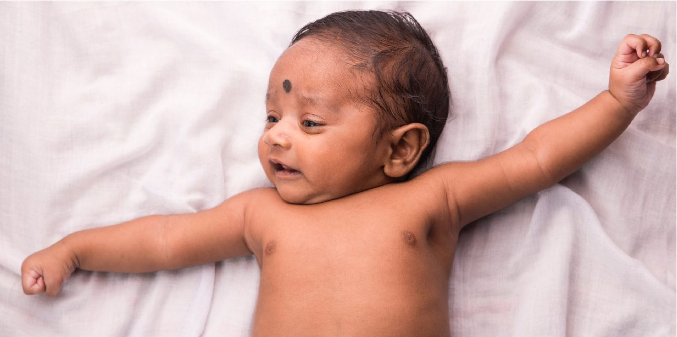
CHAPTER 28
Development and Inheritance
From fertilization to birth, and how traits are passed on.
Anatomy & Physiology · Broward-Miami Health Institute
FACULTY EDITION

Slide 2
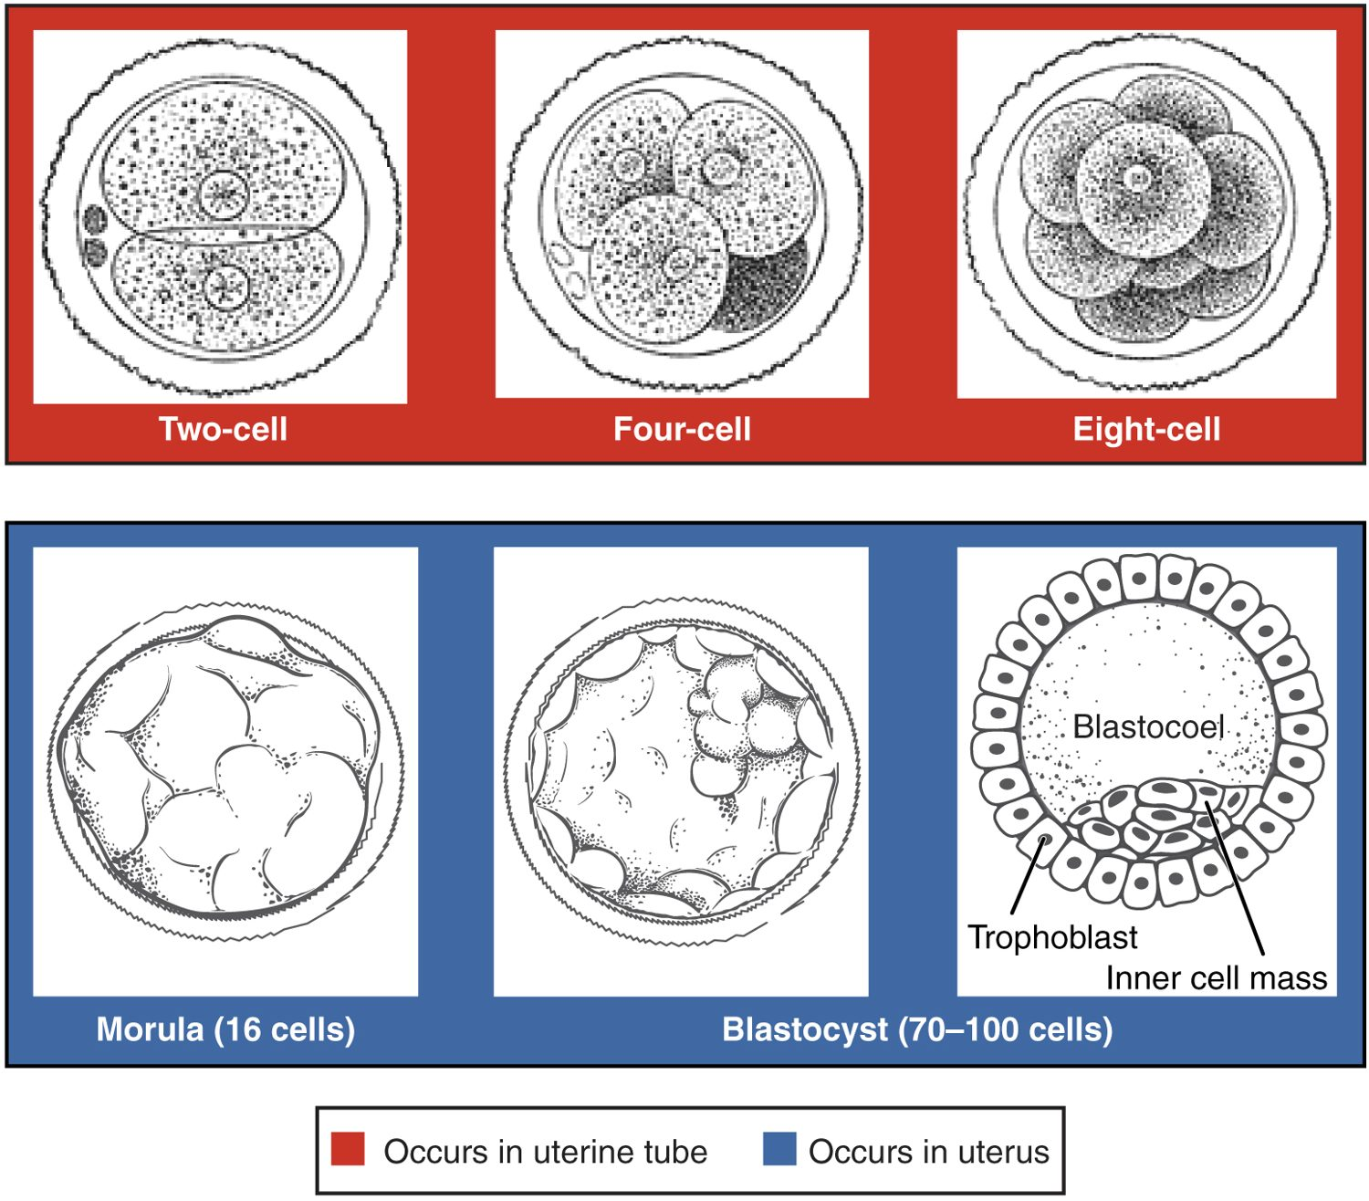
CHAPTER 28
Learning Objectives
After studying this chapter, students will be able to:
1
List and explain the steps involved in fertilization
2
Describe the major events in embryonic development
3
Describe the major events in fetal development
4
Discuss the adaptations of the body to pregnancy
5
Describe the physiologic adjustments that the newborn must make in the first hours of extrauterine life
6
Summarize the physiology of lactation
Early cleavage of the fertilized egg.
PN 104 · Ch 28 — Development and Inheritance
2
Notes:
Preview development and inheritance: fertilization, the stages of embryonic and fetal development, the changes of pregnancy and birth, the newborn's adjustment and lactation, and the basic patterns by which traits are inherited.

Slide 3
28.1
SECTION
Fertilization
How sperm and egg unite to begin a new life.

Slide 4
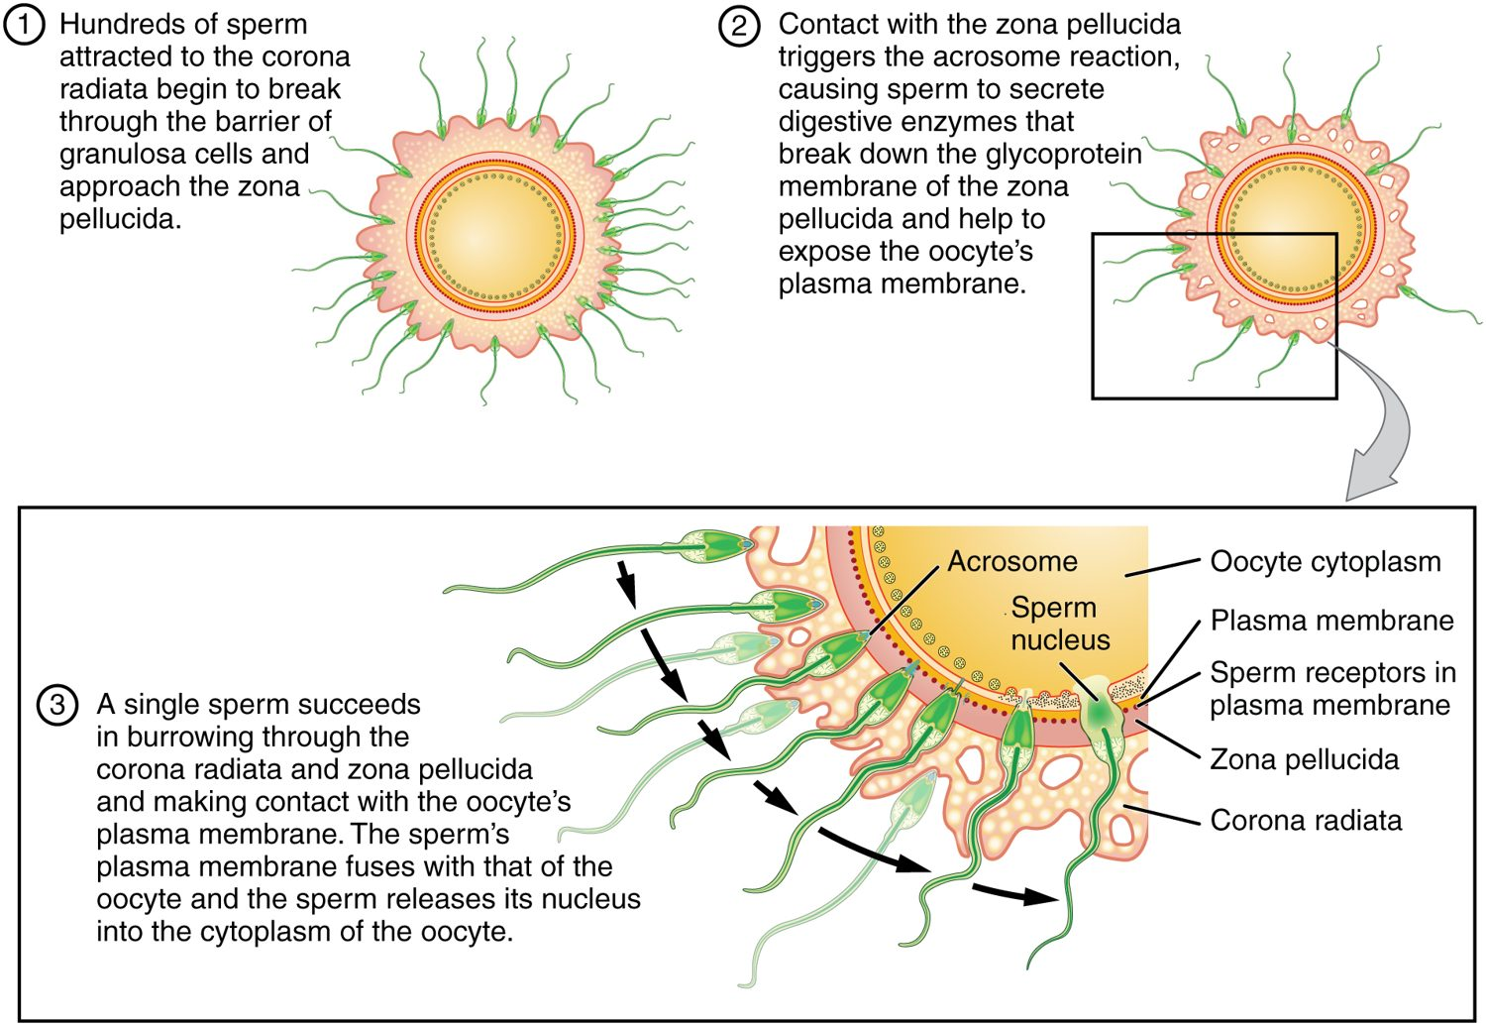
SECTION 28.1
Fertilization
Sperm meets egg in the uterine tube
One sperm penetrates the egg
Their chromosomes combine
Forms a single-celled zygote
Fertilization
PN 104 · Ch 28 — Development and Inheritance
4
Notes:
Fertilization usually occurs in the uterine tube. Many sperm reach the egg, but only one penetrates its outer layers; the egg then blocks others. The sperm and egg nuclei fuse, combining their chromosomes into a full set, and form a zygote — the first cell of a new individual.

Slide 5
28.2
SECTION
Embryonic Development
From a single cell to an implanted embryo with three germ layers.

Slide 6
SECTION 28.2
Cleavage
The zygote divides repeatedly
2-cell, 4-cell, 8-cell stages
Becomes a solid morula
Then a hollow blastocyst
Cleavage of the zygote
PN 104 · Ch 28 — Development and Inheritance
6
Notes:
After fertilization, the zygote undergoes cleavage — rapid cell divisions without growth — passing through 2-, 4-, and 8-cell stages to a solid ball (morula) and then a fluid-filled blastocyst. This all happens as the developing embryo travels down the uterine tube toward the uterus over several days.

Slide 7
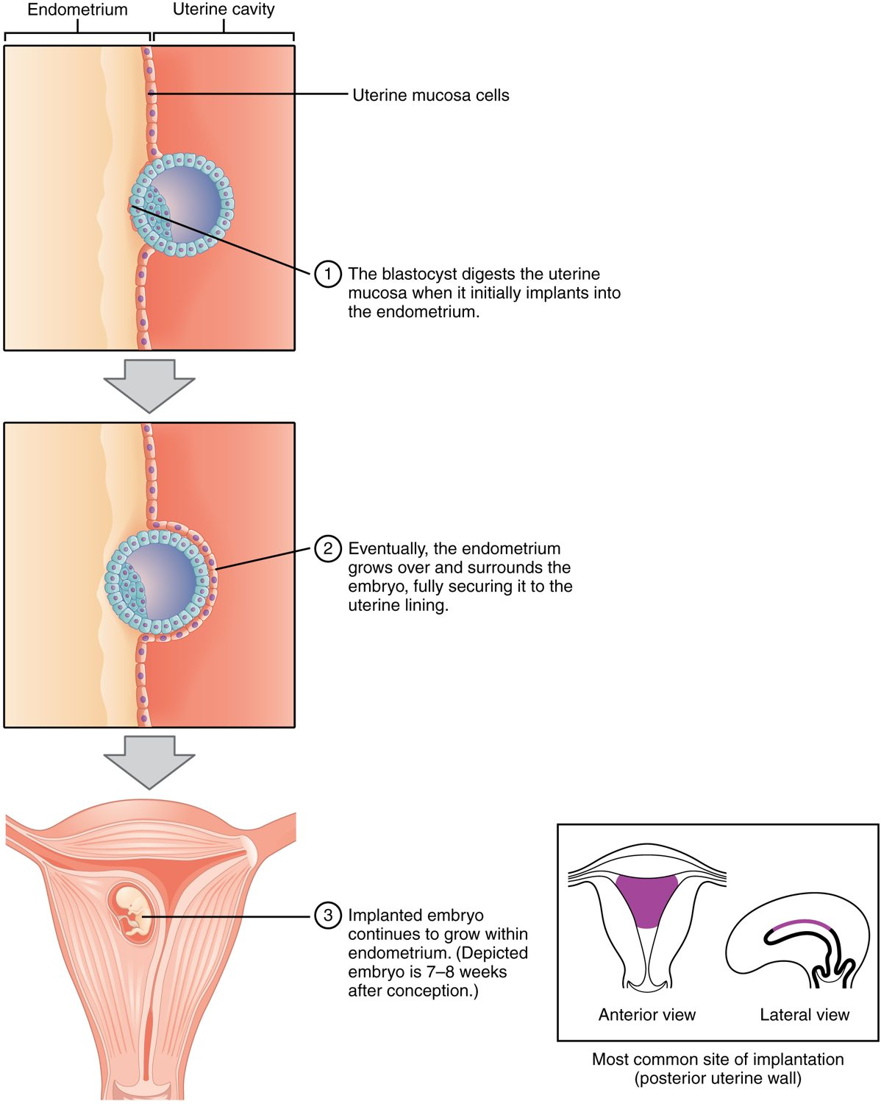
SECTION 28.2
Implantation
The blastocyst reaches the uterus
It embeds in the uterine lining
This is implantation
It establishes the pregnancy
Implantation in the uterus
PN 104 · Ch 28 — Development and Inheritance
7
Notes:
About a week after fertilization, the blastocyst reaches the uterus and burrows into the prepared endometrium — implantation. This anchors the embryo and begins forming the connections that will become the placenta. Implantation marks the true establishment of pregnancy.

Slide 8
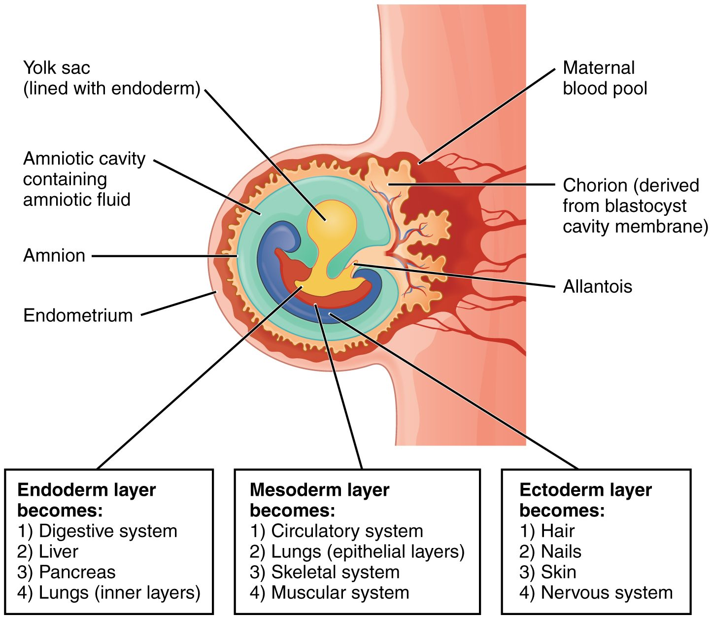
SECTION 28.2
The Germ Layers
The embryo forms three layers
Ectoderm: skin and nervous system
Mesoderm: muscle, bone, heart
Endoderm: gut and glands
The three primary germ layers
PN 104 · Ch 28 — Development and Inheritance
8
Notes:
Early in development the embryo organizes into three primary germ layers, each giving rise to specific tissues: ectoderm forms the skin and nervous system; mesoderm forms muscle, bone, blood, and the heart; and endoderm forms the lining of the digestive and respiratory tracts and many glands. Every organ traces back to these layers.

Slide 9
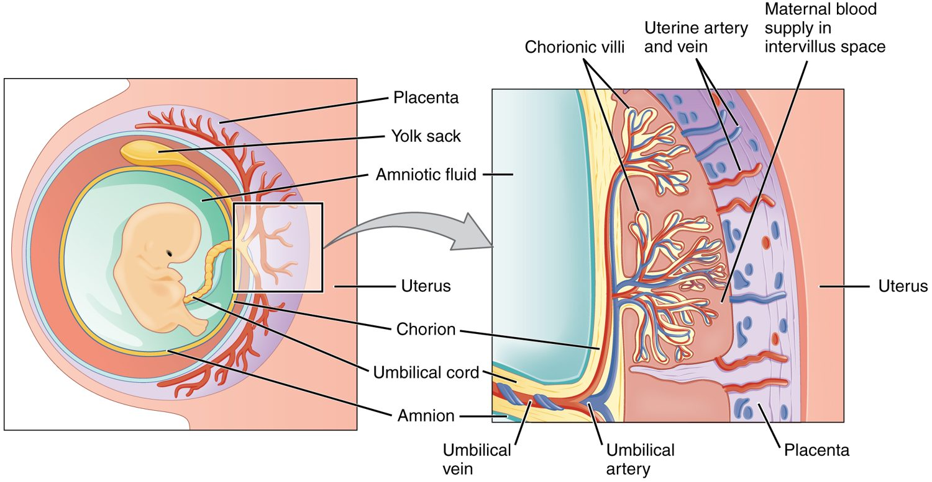
SECTION 28.2
The Placenta
The placenta
The lifeline between mother and fetus
Forms from embryo and uterus
Exchanges oxygen and nutrients
Removes fetal wastes
PN 104 · Ch 28 — Development and Inheritance
9
Notes:
The placenta is the organ of exchange between mother and fetus, formed from both embryonic and maternal tissue. Across it, oxygen, nutrients, and antibodies pass to the fetus and wastes pass back to the mother — without their blood directly mixing. The umbilical cord connects the fetus to the placenta.

Slide 10
28.3
SECTION
Fetal Development
The growth and maturation of the fetus.

Slide 11
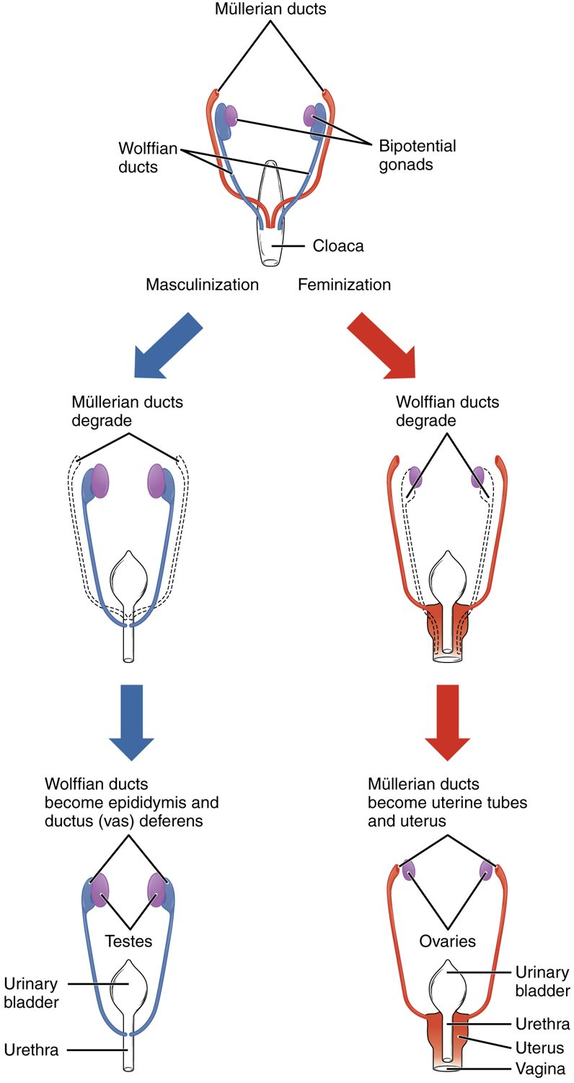
SECTION 28.3
Sexual Differentiation
Early structures are the same
Sex develops over the fetal period
Determined by the sex chromosomes
Male or female structures form
Development of the reproductive structures
PN 104 · Ch 28 — Development and Inheritance
11
Notes:
Early embryos have identical, unspecialized reproductive structures. During the fetal period, the genetic sex (set at fertilization) directs these to develop into male or female organs — under the influence of hormones in males. The fetal period overall is mainly one of growth and maturation of organs formed earlier.

Slide 12
28.4
SECTION
Changes During Pregnancy, Labor, and Birth
How the mother's body changes through pregnancy and birth.

Slide 13
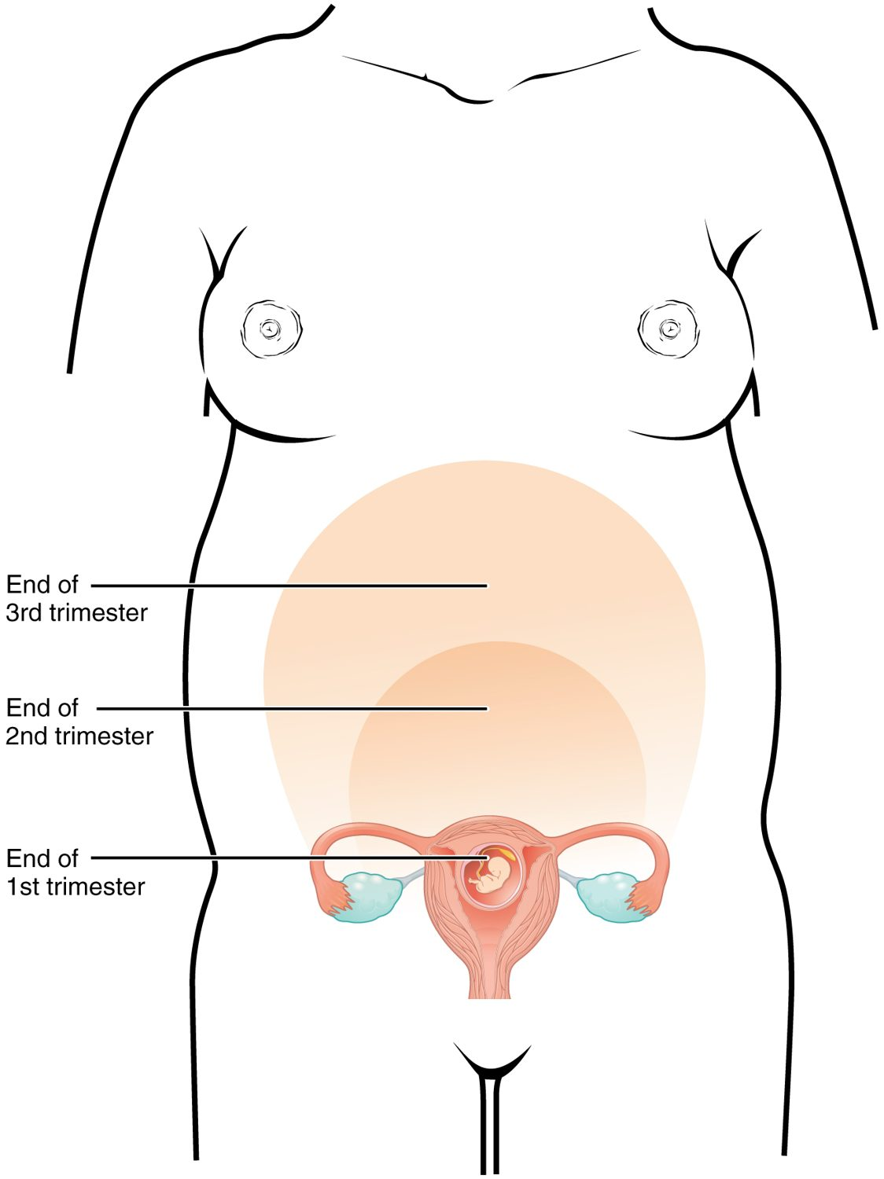
SECTION 28.4
Changes During Pregnancy
The body adapts to support the fetus
The uterus expands greatly
Trimesters mark the stages
Many systems adjust
Maternal changes by trimester
PN 104 · Ch 28 — Development and Inheritance
13
Notes:
Pregnancy is divided into three trimesters, during which the mother's body changes dramatically. The uterus expands from fist-sized to filling the abdomen, blood volume rises, and the heart, lungs, and other systems adapt to support the growing fetus. These changes reverse after birth.

Slide 14
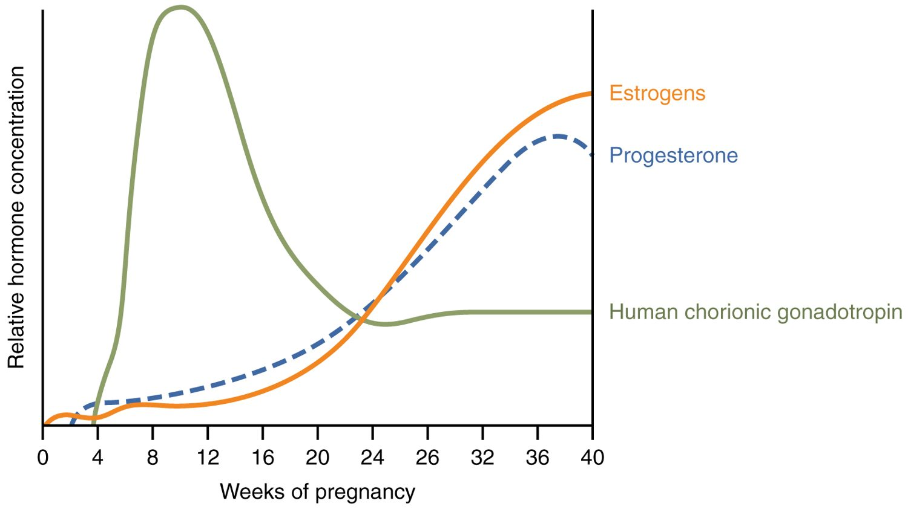
SECTION 28.4
Hormones of Pregnancy
Hormone levels during pregnancy
Hormones maintain the pregnancy
hCG signals early pregnancy
Estrogen and progesterone rise
hCG is what pregnancy tests detect
PN 104 · Ch 28 — Development and Inheritance
14
Notes:
Pregnancy is sustained by hormones. Human chorionic gonadotropin (hCG), made by the early embryo, maintains the corpus luteum and is the hormone detected by pregnancy tests. Estrogen and progesterone rise throughout, supporting the uterus and breasts and preventing further ovulation.

Slide 15
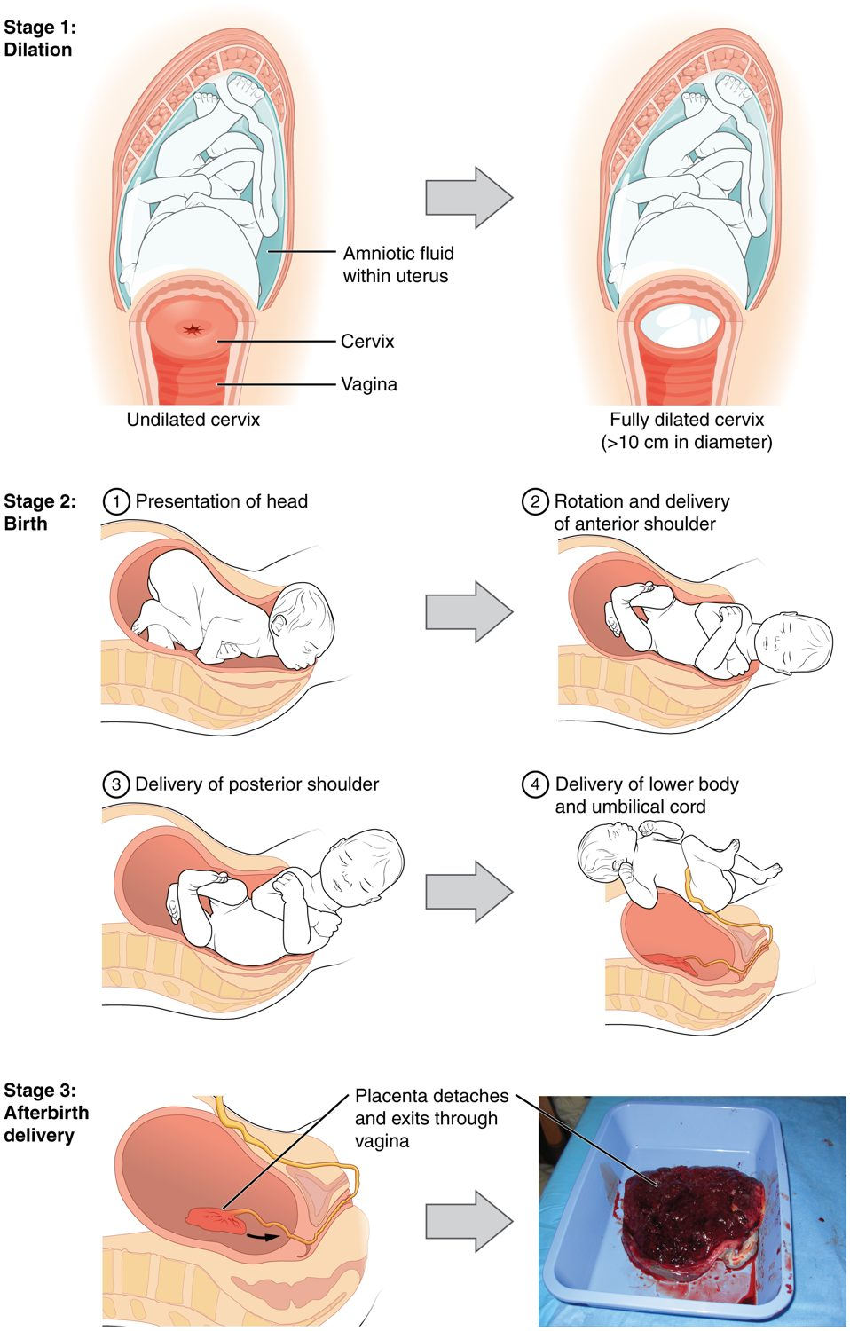
SECTION 28.4
Labor & Birth
Labor delivers the baby
Stage 1: the cervix dilates
Stage 2: the baby is born
Stage 3: the placenta is delivered
The stages of labor
PN 104 · Ch 28 — Development and Inheritance
15
Notes:
Labor proceeds in three stages: the cervix dilates and effaces (the longest stage), the baby is pushed out through the birth canal (delivery), and finally the placenta is expelled (afterbirth). Powerful uterine contractions, driven by oxytocin, accomplish each stage.

Slide 16
28.5
SECTION
Adjustments of the Infant at Birth and Postnatal Stages
How the newborn's body adjusts to life outside the womb.

Slide 17
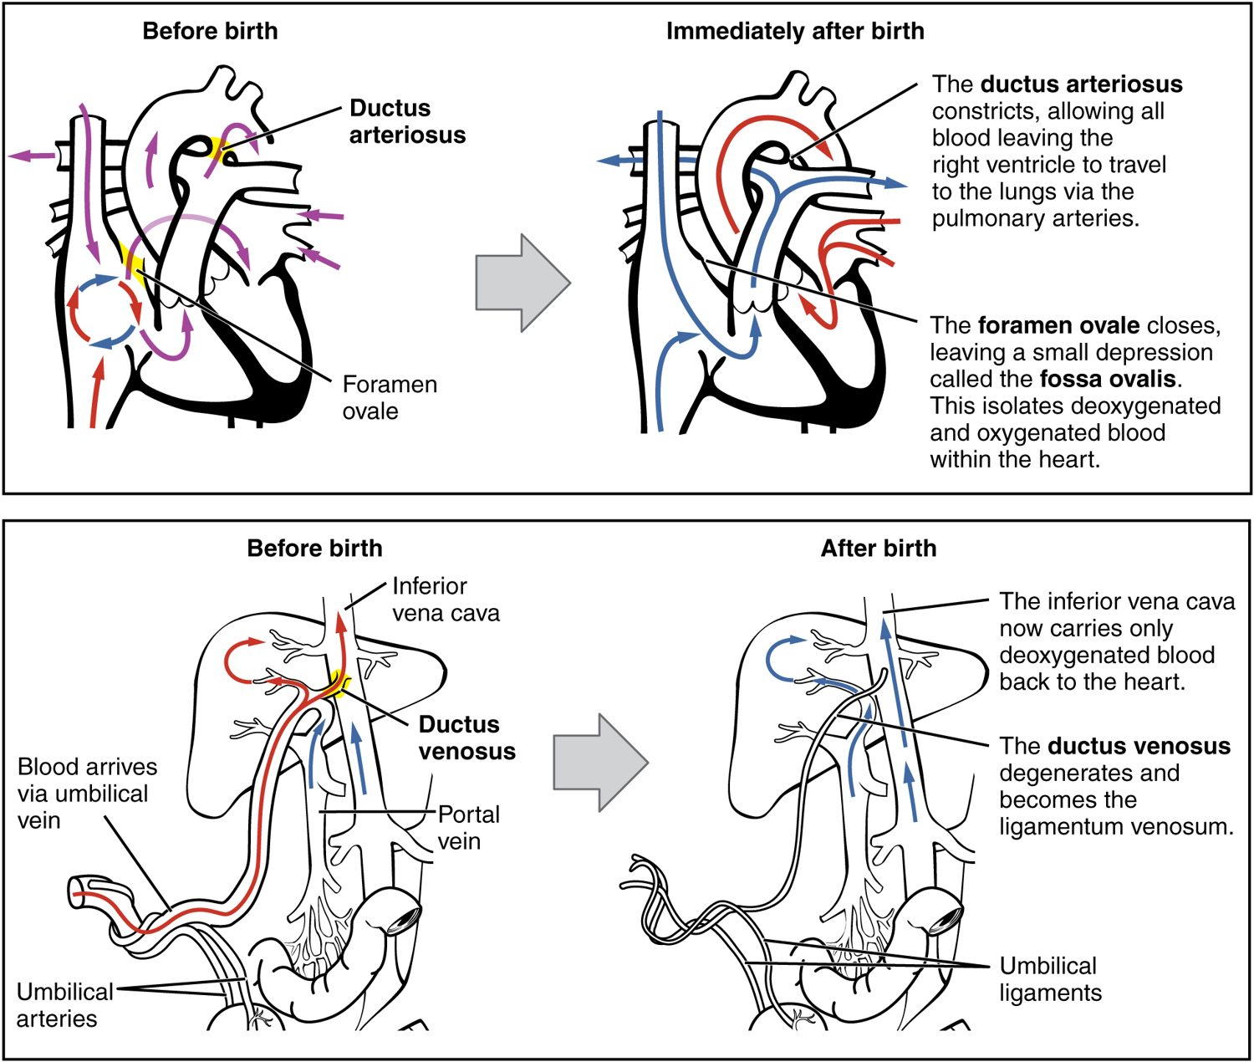
SECTION 28.5
Adjustments at Birth
Big changes at the first breath
The lungs inflate and take over
Fetal circulation shunts close
The newborn becomes independent
Circulatory changes at birth
PN 104 · Ch 28 — Development and Inheritance
17
Notes:
At birth the newborn must suddenly breathe and circulate blood on its own. The first breaths inflate the lungs, and the fetal shunts that bypassed them (the foramen ovale and ductus arteriosus) close, rerouting blood through the lungs. The newborn also begins regulating its own temperature and feeding.

Slide 18
28.6
SECTION
Lactation
How the breasts produce milk to nourish the newborn.

Slide 19
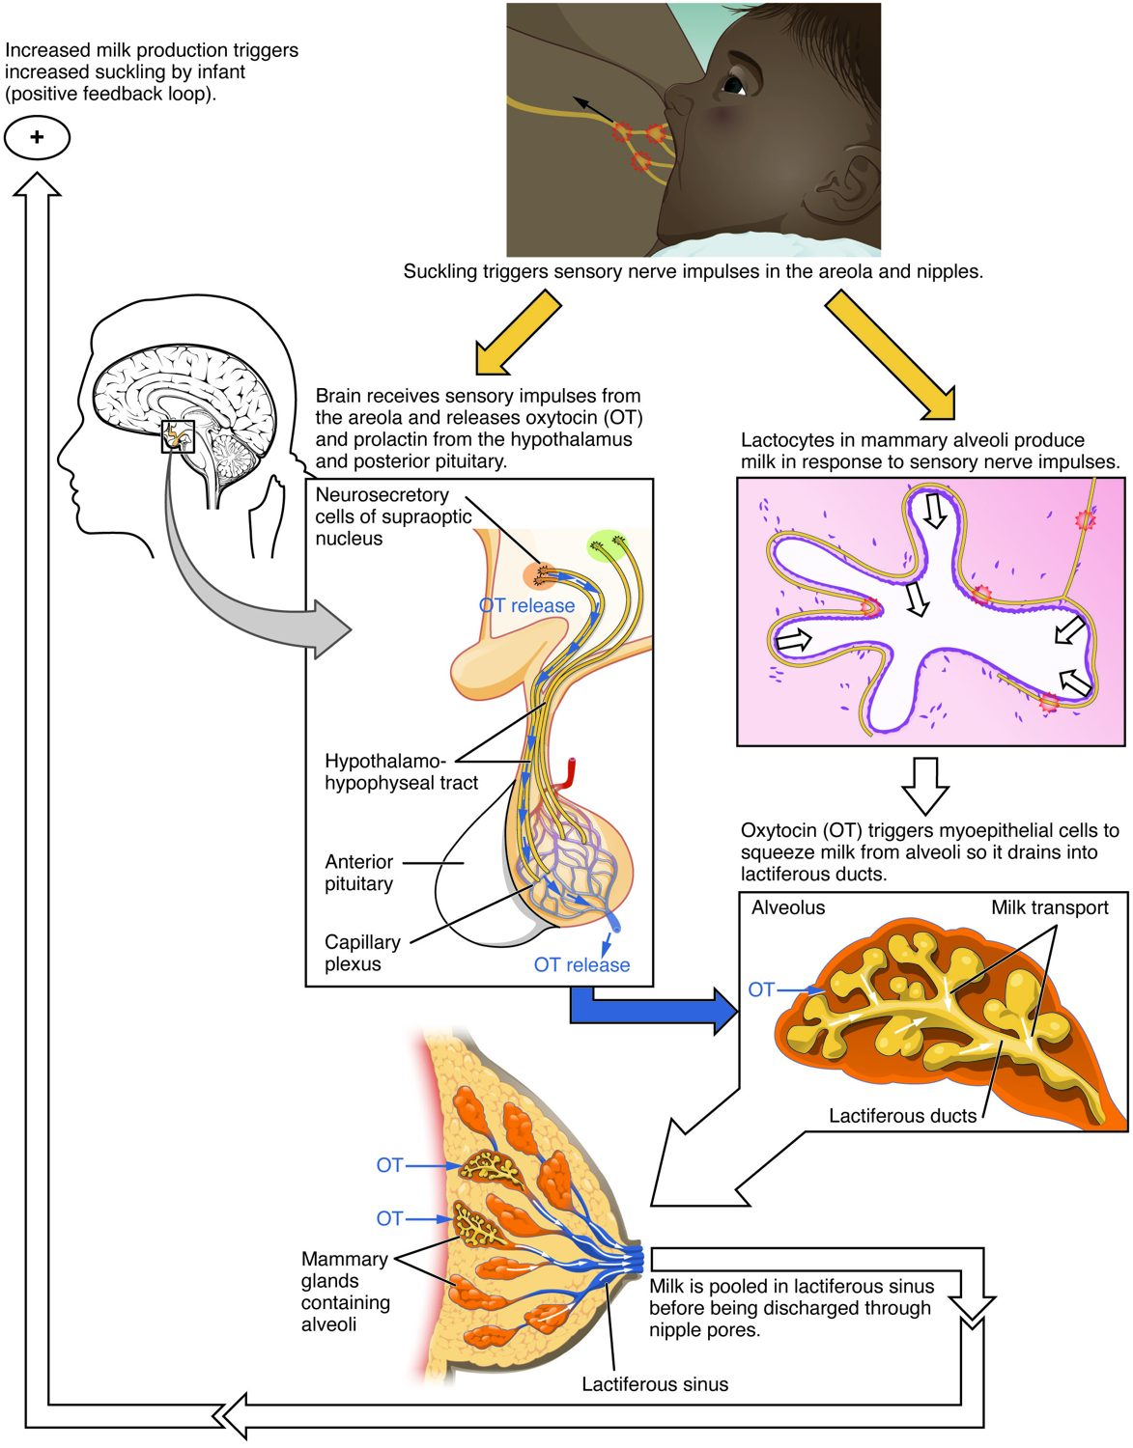
SECTION 28.6
Lactation
The breasts make milk after birth
Prolactin drives milk production
Oxytocin triggers milk letdown
Suckling sustains the supply
Lactation
PN 104 · Ch 28 — Development and Inheritance
19
Notes:
After birth, the breasts produce milk to feed the infant. The hormone prolactin stimulates milk production, while oxytocin causes the letdown (ejection) of milk during nursing. The infant's suckling keeps both hormones flowing, so demand maintains supply. The first milk, colostrum, is rich in protective antibodies.

Slide 20
28.7
SECTION
Patterns of Inheritance
How traits are passed from parents to children.

Slide 21
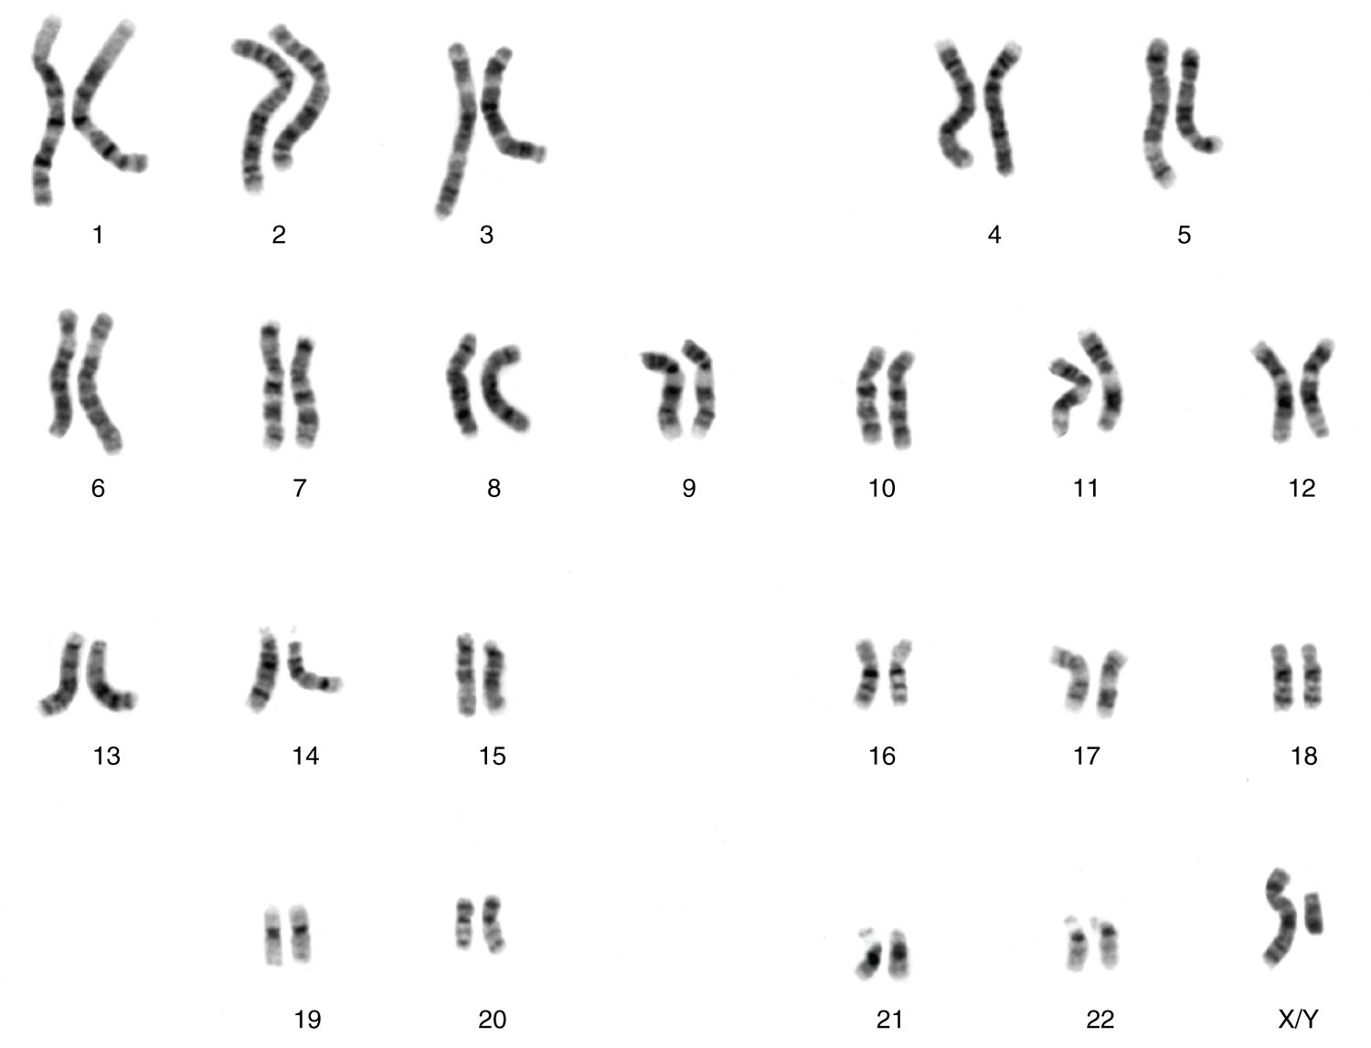
SECTION 28.7
The Karyotype
Traits are carried on chromosomes
46 chromosomes in 23 pairs
22 pairs plus the sex chromosomes
XX is female, XY is male
A human karyotype
PN 104 · Ch 28 — Development and Inheritance
21
Notes:
A karyotype displays a person's chromosomes — 46 arranged in 23 pairs. Twenty-two pairs are autosomes; the last pair are the sex chromosomes (XX in females, XY in males). Errors in chromosome number, like an extra chromosome 21 in Down syndrome, can be seen on a karyotype.

Slide 22
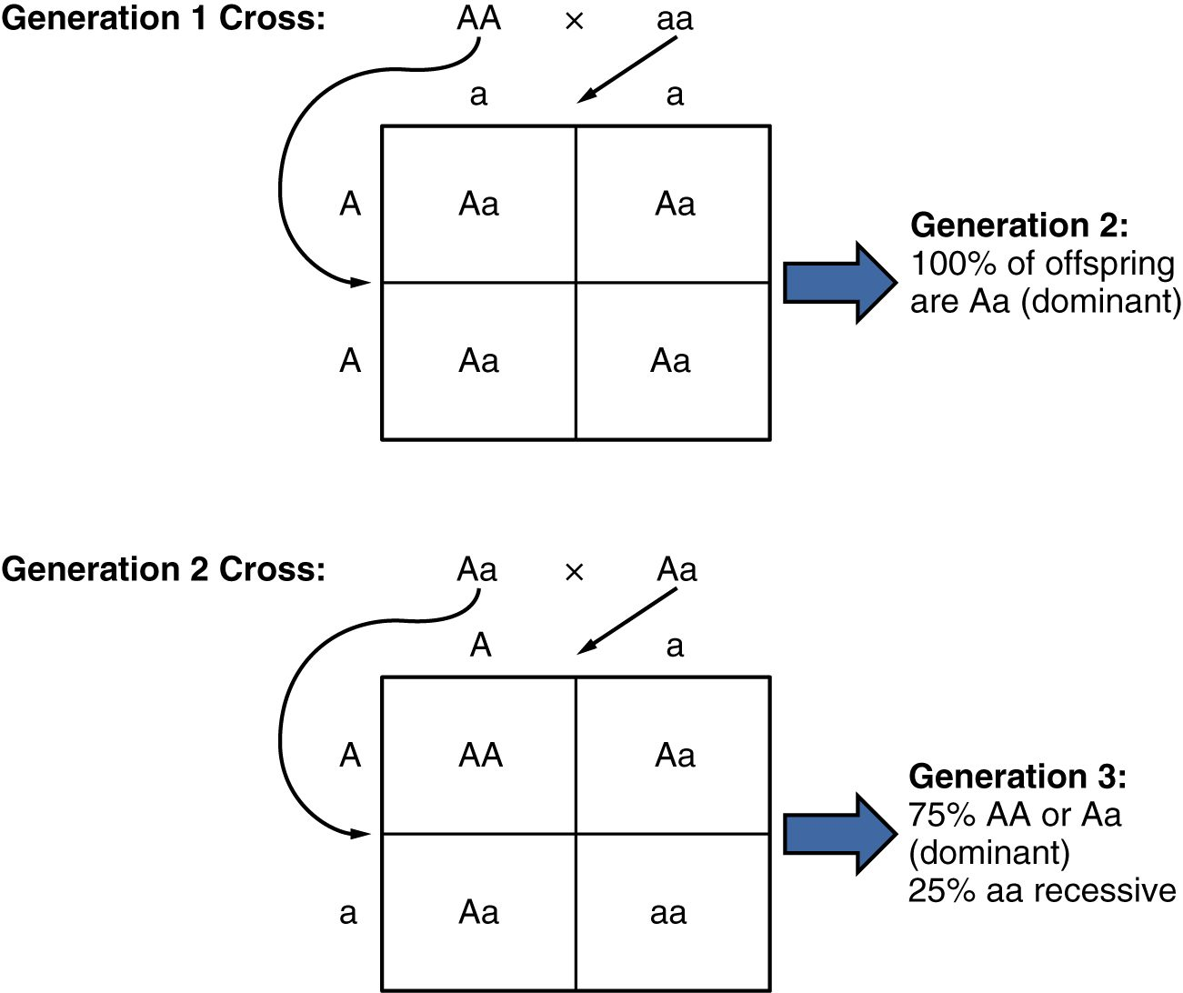
SECTION 28.7
Patterns of Inheritance
Genes come in alternate forms (alleles)
Dominant alleles mask recessive ones
A Punnett square predicts offspring
Explains many inherited traits
A Punnett square
PN 104 · Ch 28 — Development and Inheritance
22
Notes:
We inherit two copies of each gene, one from each parent, and these can be different versions (alleles). A dominant allele shows its effect even with one copy; a recessive allele needs two. A Punnett square charts the possible combinations, predicting the odds of a trait appearing in the children.

Slide 23
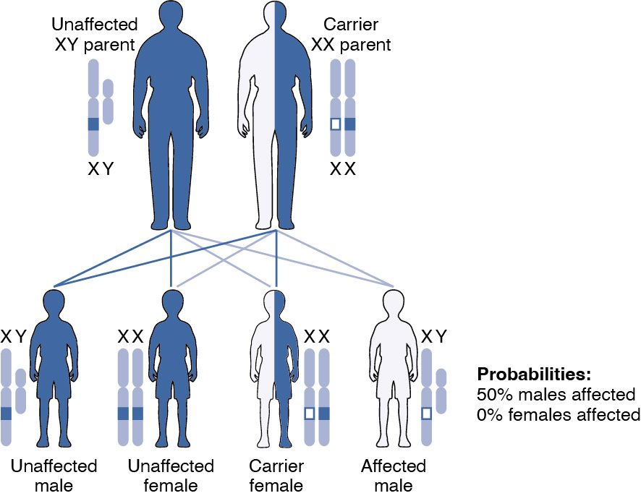
SECTION 28.7
Sex-Linked Inheritance
Some genes sit on the X chromosome
These show different patterns
More common in males
Examples: hemophilia, color blindness
X-linked inheritance
PN 104 · Ch 28 — Development and Inheritance
23
Notes:
Genes on the X chromosome follow special inheritance patterns. Because males have only one X, a single recessive allele there will show — so X-linked recessive conditions like hemophilia and red-green color blindness are far more common in males, while females are often unaffected carriers.

Slide 24
CHAPTER 28
Key Takeaways
Fertilization unites sperm and egg into a zygote with a full set of chromosomes.
The embryo develops through cleavage, implantation, and the three germ layers.
The placenta exchanges nutrients, oxygen, and wastes between mother and fetus.
Labor delivers the baby in three stages, and the newborn adjusts to breathing on its own.
Traits are inherited through chromosomes and genes following predictable patterns.
PN 104 · Ch 28 — Development and Inheritance
24

Slide 25
CLINICAL CONNECTIONS
Why Development & Inheritance Matter in Practical Nursing
Prenatal Care
Labor & Delivery
Monitoring supports a healthy pregnancy and fetus.
Understanding the stages guides safe nursing care.
Newborn Assessment
Breastfeeding
The first checks confirm a healthy transition.
Supports infant nutrition and immunity.
Genetic Disorders
Congenital Conditions
Inherited and chromosomal conditions affect care.
Some problems arise during development.

