Slide 1

BROWARD-MIAMI HEALTH INSTITUTE
Venipuncture Standards and Practice
Module 7 | 30-Hour Basic Intravenous Therapy
Student presentation • clinical examples • guided practice
Notes:
HEYGEN INSTRUCTOR SCRIPT
Welcome to Venipuncture Standards and Practice, Module 7 of the BMHI thirty-hour intravenous therapy course. Explain that this module prepares learners for safe practice and the supervised in-person competency day. Preview the learning objectives and remind learners to complete the matching portal lesson and assessment.
PRODUCTION DIRECTION
Use a professional nursing instructor avatar, calm pace, neutral clinical background, and captions. Pronounce IV as I-V and IVPB as I-V piggyback.
SOURCES
Supplied Basic Intravenous Therapy Certification manual, pages 80; BMHI IVT 030 course content. Cover media: Pexels photo by Sahil Singh, https://www.pexels.com/photo/nurses-training-with-medical-mannequin-in-simulation-lab-35645529/, downloaded October 23, 2026 under the Pexels License.
Current legal reference: Florida Administrative Code Rule 64B9-12.005, effective July 20, 2023; Florida Statutes section 464.003 (2026). Instructor must verify current institutional policy and current drug/device guidance before use.

Slide 2
Learning objectives
02
MODULE 7
Select an appropriate peripheral vein and catheter
Perform aseptic insertion and securement on a task trainer
Assess, maintain, and discontinue a peripheral IV safely
Notes:
HEYGEN INSTRUCTOR SCRIPT
Welcome to this lesson segment on the learning objectives. First, Select an appropriate peripheral vein and catheter Next, Perform aseptic insertion and securement on a task trainer Next, Assess, maintain, and discontinue a peripheral IV safely Pause here and ask learners to identify the safety check they would complete before proceeding. Reinforce that students must follow current orders, facility policy, their authorized scope, and the supervising registered nurse's direction. Invite learners to replay this segment and record questions for the instructor.
PRODUCTION DIRECTION
Use a professional nursing instructor avatar, calm pace, neutral clinical background, and captions. Pronounce IV as I-V and IVPB as I-V piggyback.
SOURCES
Supplied Basic Intravenous Therapy Certification manual, pages 80; BMHI IVT 030 course content.
Current legal reference: Florida Administrative Code Rule 64B9-12.005, effective July 20, 2023; Florida Statutes section 464.003 (2026). Instructor must verify current institutional policy and current drug/device guidance before use.

Slide 3
Site and device selection
03
MODULE 7
Begin distally when appropriate.
Avoid compromised extremities and sites of infection, flexion, poor circulation, or prior complications.
Select the smallest gauge and shortest catheter that can support the ordered therapy.
Use current orders, facility policy, and authorized scope when applying this information.
Notes:
HEYGEN INSTRUCTOR SCRIPT
Welcome to this lesson segment on Site and device selection. First, Begin distally when appropriate. Next, Avoid compromised extremities and sites of infection, flexion, poor circulation, or prior complications. Next, Select the smallest gauge and shortest catheter that can support the ordered therapy. Pause here and ask learners to identify the safety check they would complete before proceeding. Reinforce that students must follow current orders, facility policy, their authorized scope, and the supervising registered nurse's direction. Invite learners to replay this segment and record questions for the instructor.
PRODUCTION DIRECTION
Use a professional nursing instructor avatar, calm pace, neutral clinical background, and captions. Pronounce IV as I-V and IVPB as I-V piggyback.
SOURCES
Supplied Basic Intravenous Therapy Certification manual, pages 80-108; BMHI IVT 030 course content.
Current legal reference: Florida Administrative Code Rule 64B9-12.005, effective July 20, 2023; Florida Statutes section 464.003 (2026). Instructor must verify current institutional policy and current drug/device guidance before use.

Slide 4
Aseptic insertion
04
MODULE 7
Perform hand hygiene, prepare and position the patient, apply the tourniquet, cleanse the site with the approved antiseptic, let it dry, stabilize the vein, observe flashback, thread the catheter, and activate sharps protection.
Use current orders, facility policy, and authorized scope when applying this information.
Notes:
HEYGEN INSTRUCTOR SCRIPT
Welcome to this lesson segment on Aseptic insertion. First, Perform hand hygiene, prepare and position the patient, apply the tourniquet, cleanse the site with the approved antiseptic, let it dry, stabilize the vein, observe flashback, thread the catheter, and activate sharps protection. Pause here and ask learners to identify the safety check they would complete before proceeding. Reinforce that students must follow current orders, facility policy, their authorized scope, and the supervising registered nurse's direction. Invite learners to replay this segment and record questions for the instructor.
PRODUCTION DIRECTION
Use a professional nursing instructor avatar, calm pace, neutral clinical background, and captions. Pronounce IV as I-V and IVPB as I-V piggyback.
SOURCES
Supplied Basic Intravenous Therapy Certification manual, pages 80-108; BMHI IVT 030 course content.
Current legal reference: Florida Administrative Code Rule 64B9-12.005, effective July 20, 2023; Florida Statutes section 464.003 (2026). Instructor must verify current institutional policy and current drug/device guidance before use.

Slide 5
Securement and maintenance
05
MODULE 7
Connect a primed extension aseptically, assess patency without force, secure the catheter, apply and label the dressing, trace tubing, start the ordered therapy, and reassess the site and patient.
Use current orders, facility policy, and authorized scope when applying this information.
Notes:
HEYGEN INSTRUCTOR SCRIPT
Welcome to this lesson segment on Securement and maintenance. First, Connect a primed extension aseptically, assess patency without force, secure the catheter, apply and label the dressing, trace tubing, start the ordered therapy, and reassess the site and patient. Pause here and ask learners to identify the safety check they would complete before proceeding. Reinforce that students must follow current orders, facility policy, their authorized scope, and the supervising registered nurse's direction. Invite learners to replay this segment and record questions for the instructor.
PRODUCTION DIRECTION
Use a professional nursing instructor avatar, calm pace, neutral clinical background, and captions. Pronounce IV as I-V and IVPB as I-V piggyback.
SOURCES
Supplied Basic Intravenous Therapy Certification manual, pages 80-108; BMHI IVT 030 course content.
Current legal reference: Florida Administrative Code Rule 64B9-12.005, effective July 20, 2023; Florida Statutes section 464.003 (2026). Instructor must verify current institutional policy and current drug/device guidance before use.

Slide 6
Complication cues
06
MODULE 7
Cool swelling suggests infiltration.
Pain, warmth, redness, or a venous cord suggests phlebitis.
Burning or tissue injury with a vesicant suggests extravasation.
Stop unsafe therapy and follow the condition-specific protocol.
Use current orders, facility policy, and authorized scope when applying this information.
Notes:
HEYGEN INSTRUCTOR SCRIPT
Welcome to this lesson segment on Complication cues. First, Cool swelling suggests infiltration. Next, Pain, warmth, redness, or a venous cord suggests phlebitis. Next, Burning or tissue injury with a vesicant suggests extravasation. Next, Stop unsafe therapy and follow the condition-specific protocol. Pause here and ask learners to identify the safety check they would complete before proceeding. Reinforce that students must follow current orders, facility policy, their authorized scope, and the supervising registered nurse's direction. Invite learners to replay this segment and record questions for the instructor.
PRODUCTION DIRECTION
Use a professional nursing instructor avatar, calm pace, neutral clinical background, and captions. Pronounce IV as I-V and IVPB as I-V piggyback.
SOURCES
Supplied Basic Intravenous Therapy Certification manual, pages 80-108; BMHI IVT 030 course content.
Current legal reference: Florida Administrative Code Rule 64B9-12.005, effective July 20, 2023; Florida Statutes section 464.003 (2026). Instructor must verify current institutional policy and current drug/device guidance before use.

Slide 7
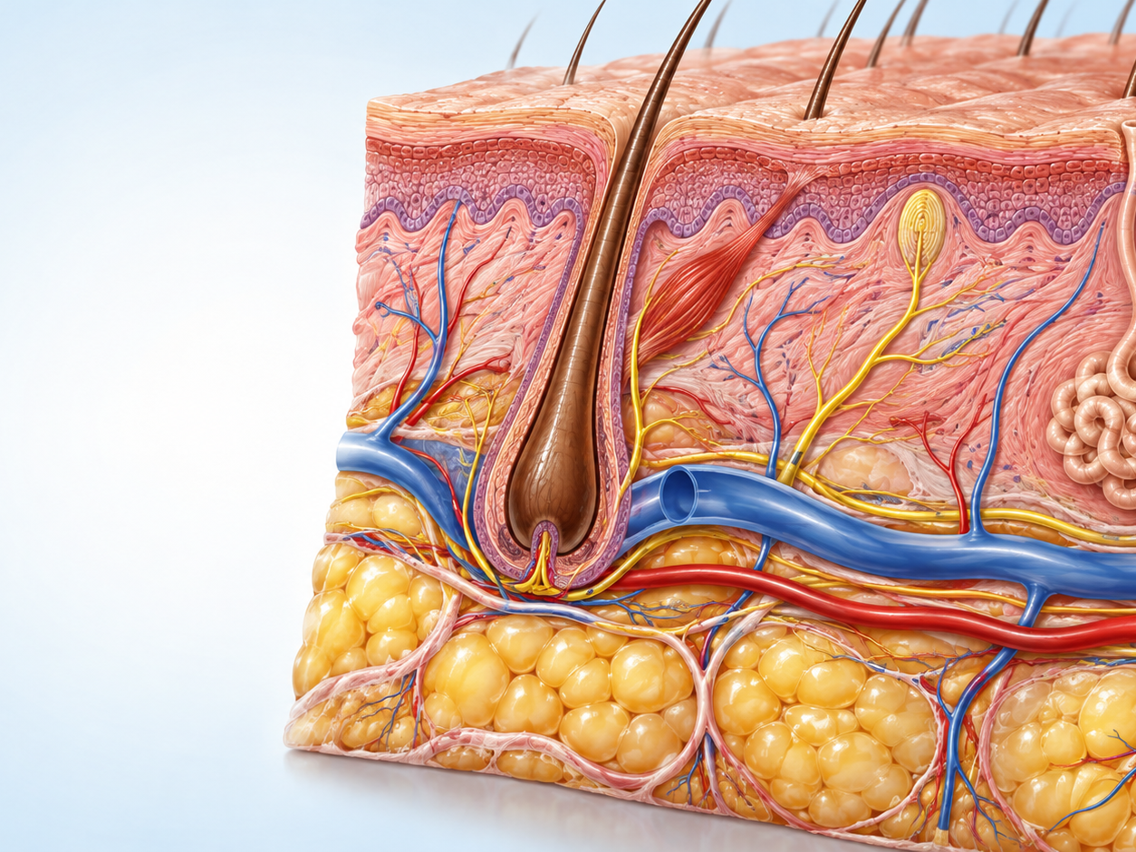
Skin anatomy for peripheral IV insertion
07
MODULE 7
Epidermis: the outer protective barrier.
Dermis: connective tissue with sensory structures, glands, vessels, and nerves.
Subcutaneous tissue: variable adipose and connective tissue above deeper structures.
Superficial vein: the intended peripheral catheter target; nearby arteries and nerves must be avoided.
Educational visual. Verify device-specific technique during supervised practice.
Notes:
HEYGEN INSTRUCTOR SCRIPT
Welcome to this lesson segment on Skin anatomy for peripheral IV insertion. First, Epidermis: the outer protective barrier. Next, Dermis: connective tissue with sensory structures, glands, vessels, and nerves. Next, Subcutaneous tissue: variable adipose and connective tissue above deeper structures. Next, Superficial vein: the intended peripheral catheter target; nearby arteries and nerves must be avoided. Pause here and ask learners to identify the safety check they would complete before proceeding. Reinforce that students must follow current orders, facility policy, their authorized scope, and the supervising registered nurse's direction. Invite learners to replay this segment and record questions for the instructor.
PRODUCTION DIRECTION
Use a professional nursing instructor avatar, calm pace, neutral clinical background, and captions. Pronounce IV as I-V and IVPB as I-V piggyback.
SOURCES
Supplied Basic Intravenous Therapy Certification manual, pages 80-108; BMHI IVT 030 course content. Original BMHI educational visual generated October 23, 2026. Source: 30 Hour IV Certification Study Guide, revised March 2013, PDF pages 19-21.
Current legal reference: Florida Administrative Code Rule 64B9-12.005, effective July 20, 2023; Florida Statutes section 464.003 (2026). Instructor must verify current institutional policy and current drug/device guidance before use.

Slide 8
Why the skin layers matter
08
MODULE 7
Layer or structure
Function
IV implication
Epidermis
Mechanical barrier against microorganisms
Antisepsis and no-touch technique protect the breached barrier
Dermis
Contains sensory receptors, vessels, follicles, and glands
Penetration causes sensation and requires controlled technique
Subcutaneous tissue
Provides padding and contains variable fat and connective tissue
Changes vein depth, palpation, stabilization, and insertion angle
Peripheral nerve
Carries sensation and motor signals
Electric pain, paresthesia, or radiating symptoms require an immediate stop
Artery
High-pressure pulsatile vessel
Pulsation or unexpected blood return requires stopping and escalation
Notes:
HEYGEN INSTRUCTOR SCRIPT
Welcome to this lesson segment on Why the skin layers matter. First, Epidermis: Mechanical barrier against microorganisms; Antisepsis and no-touch technique protect the breached barrier Next, Dermis: Contains sensory receptors, vessels, follicles, and glands; Penetration causes sensation and requires controlled technique Next, Subcutaneous tissue: Provides padding and contains variable fat and connective tissue; Changes vein depth, palpation, stabilization, and insertion angle Next, Peripheral nerve: Carries sensation and motor signals; Electric pain, paresthesia, or radiating symptoms require an immediate stop Next, Artery: High-pressure pulsatile vessel; Pulsation or unexpected blood return requires stopping and escalation Pause here and ask learners to identify the safety check they would complete before proceeding. Reinforce that students must follow current orders, facility policy, their authorized scope, and the supervising registered nurse's direction. Invite learners to replay this segment and record questions for the instructor.
PRODUCTION DIRECTION
Use a professional nursing instructor avatar, calm pace, neutral clinical background, and captions. Pronounce IV as I-V and IVPB as I-V piggyback.
SOURCES
Supplied Basic Intravenous Therapy Certification manual, pages 80-108; BMHI IVT 030 course content. Source: 30 Hour IV Certification Study Guide, revised March 2013, PDF pages 19-21.
Current legal reference: Florida Administrative Code Rule 64B9-12.005, effective July 20, 2023; Florida Statutes section 464.003 (2026). Instructor must verify current institutional policy and current drug/device guidance before use.

Slide 9
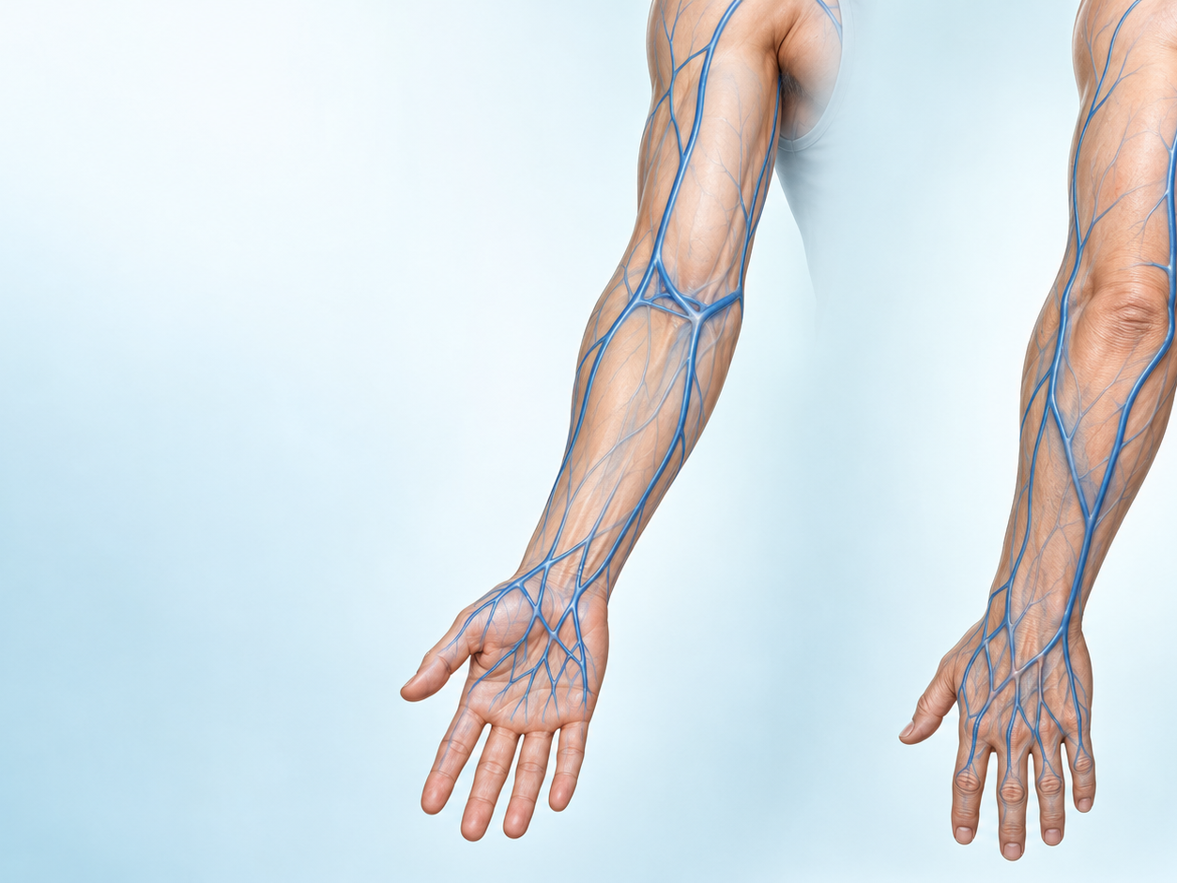
Superficial veins of the hand and forearm
09
MODULE 7
Begin with a complete inspection and palpation of both appropriate extremities.
Follow the vein's direction, depth, resilience, length, and branching.
Start distally when the therapy and patient condition permit.
Preserve stronger proximal options for future access.
Educational visual. Verify device-specific technique during supervised practice.
Notes:
HEYGEN INSTRUCTOR SCRIPT
Welcome to this lesson segment on Superficial veins of the hand and forearm. First, Begin with a complete inspection and palpation of both appropriate extremities. Next, Follow the vein's direction, depth, resilience, length, and branching. Next, Start distally when the therapy and patient condition permit. Next, Preserve stronger proximal options for future access. Pause here and ask learners to identify the safety check they would complete before proceeding. Reinforce that students must follow current orders, facility policy, their authorized scope, and the supervising registered nurse's direction. Invite learners to replay this segment and record questions for the instructor.
PRODUCTION DIRECTION
Use a professional nursing instructor avatar, calm pace, neutral clinical background, and captions. Pronounce IV as I-V and IVPB as I-V piggyback.
SOURCES
Supplied Basic Intravenous Therapy Certification manual, pages 80-108; BMHI IVT 030 course content. Original BMHI educational visual generated October 23, 2026. Source: 30 Hour IV Certification Study Guide, revised March 2013, PDF pages 21-23.
Current legal reference: Florida Administrative Code Rule 64B9-12.005, effective July 20, 2023; Florida Statutes section 464.003 (2026). Instructor must verify current institutional policy and current drug/device guidance before use.

Slide 10
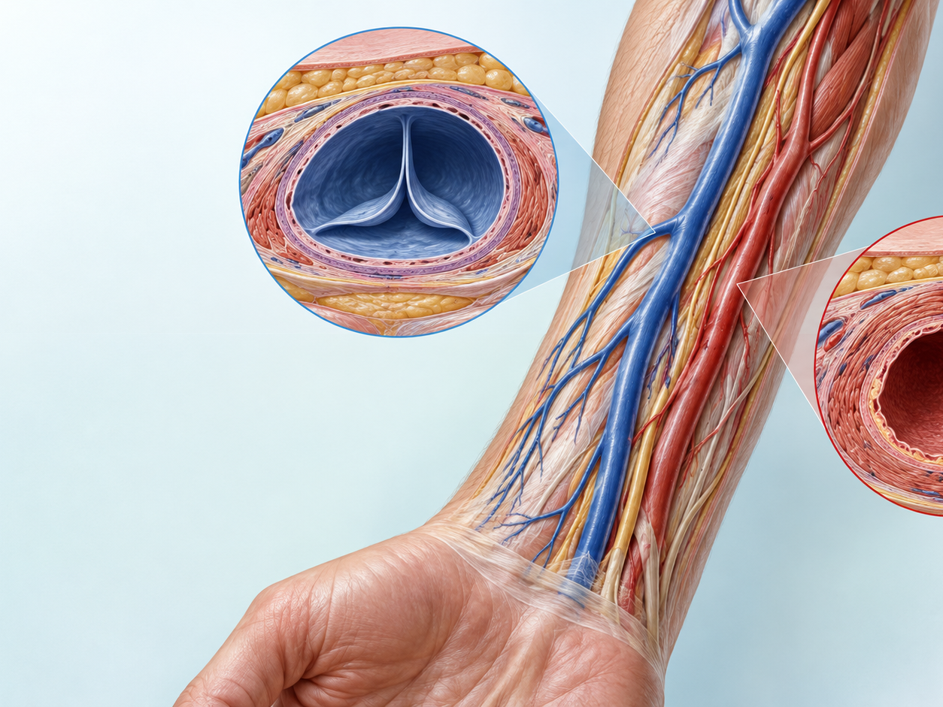
Forearm vascular anatomy
10
MODULE 7
Superficial veins are common peripheral access targets.
Veins have thinner walls, lower pressure, and valves; arteries have thicker muscular walls and pulsatile flow.
The skin, subcutaneous tissue, nerves, and nearby arteries influence site selection and insertion angle.
Confirm anatomy by inspection and palpation before preparing the site.
Educational visual. Verify device-specific technique during supervised practice.
Notes:
HEYGEN INSTRUCTOR SCRIPT
Welcome to this lesson segment on Forearm vascular anatomy. First, Superficial veins are common peripheral access targets. Next, Veins have thinner walls, lower pressure, and valves; arteries have thicker muscular walls and pulsatile flow. Next, The skin, subcutaneous tissue, nerves, and nearby arteries influence site selection and insertion angle. Next, Confirm anatomy by inspection and palpation before preparing the site. Pause here and ask learners to identify the safety check they would complete before proceeding. Reinforce that students must follow current orders, facility policy, their authorized scope, and the supervising registered nurse's direction. Invite learners to replay this segment and record questions for the instructor.
PRODUCTION DIRECTION
Use a professional nursing instructor avatar, calm pace, neutral clinical background, and captions. Pronounce IV as I-V and IVPB as I-V piggyback.
SOURCES
Supplied Basic Intravenous Therapy Certification manual, pages 80-108; BMHI IVT 030 course content. Original BMHI educational anatomy image generated October 23, 2026. Source topics: 30 Hour IV Certification Study Guide, revised March 2013, PDF pages 20-23.
Current legal reference: Florida Administrative Code Rule 64B9-12.005, effective July 20, 2023; Florida Statutes section 464.003 (2026). Instructor must verify current institutional policy and current drug/device guidance before use.

Slide 11
Skin layers and insertion discomfort
11
MODULE 7
Layer
Clinical connection
Epidermis
Provides the outer barrier and must be cleansed without recontamination
Dermis
Contains sensory structures; rapid controlled penetration may reduce prolonged discomfort
Subcutaneous tissue
Depth varies by patient and changes vein palpation and insertion angle
Vessel wall
Trauma to the intima can promote inflammation and thrombosis
Notes:
HEYGEN INSTRUCTOR SCRIPT
Welcome to this lesson segment on Skin layers and insertion discomfort. First, Epidermis: Provides the outer barrier and must be cleansed without recontamination Next, Dermis: Contains sensory structures; rapid controlled penetration may reduce prolonged discomfort Next, Subcutaneous tissue: Depth varies by patient and changes vein palpation and insertion angle Next, Vessel wall: Trauma to the intima can promote inflammation and thrombosis Pause here and ask learners to identify the safety check they would complete before proceeding. Reinforce that students must follow current orders, facility policy, their authorized scope, and the supervising registered nurse's direction. Invite learners to replay this segment and record questions for the instructor.
PRODUCTION DIRECTION
Use a professional nursing instructor avatar, calm pace, neutral clinical background, and captions. Pronounce IV as I-V and IVPB as I-V piggyback.
SOURCES
Supplied Basic Intravenous Therapy Certification manual, pages 80-108; BMHI IVT 030 course content. Source: 30 Hour IV Certification Study Guide, revised March 2013, PDF pages 20-21.
Current legal reference: Florida Administrative Code Rule 64B9-12.005, effective July 20, 2023; Florida Statutes section 464.003 (2026). Instructor must verify current institutional policy and current drug/device guidance before use.

Slide 12
Common upper-extremity veins
12
MODULE 7
Vein or region
Potential advantage
Important caution
Dorsal metacarpal network
Visible, distal starting point
Movement and fragile skin may affect comfort and securement
Cephalic vein
Often accessible along the radial forearm
Near the wrist, protect against motion and nerve or artery injury
Basilic vein
May be large and straight
Can roll and lies near important structures proximally
Median antebrachial region
May provide a forearm option
Anatomy varies; assess depth, direction, and therapy needs
Notes:
HEYGEN INSTRUCTOR SCRIPT
Welcome to this lesson segment on Common upper-extremity veins. First, Dorsal metacarpal network: Visible, distal starting point; Movement and fragile skin may affect comfort and securement Next, Cephalic vein: Often accessible along the radial forearm; Near the wrist, protect against motion and nerve or artery injury Next, Basilic vein: May be large and straight; Can roll and lies near important structures proximally Next, Median antebrachial region: May provide a forearm option; Anatomy varies; assess depth, direction, and therapy needs Pause here and ask learners to identify the safety check they would complete before proceeding. Reinforce that students must follow current orders, facility policy, their authorized scope, and the supervising registered nurse's direction. Invite learners to replay this segment and record questions for the instructor.
PRODUCTION DIRECTION
Use a professional nursing instructor avatar, calm pace, neutral clinical background, and captions. Pronounce IV as I-V and IVPB as I-V piggyback.
SOURCES
Supplied Basic Intravenous Therapy Certification manual, pages 80-108; BMHI IVT 030 course content. Source: 30 Hour IV Certification Study Guide, revised March 2013, PDF pages 22-23.
Current legal reference: Florida Administrative Code Rule 64B9-12.005, effective July 20, 2023; Florida Statutes section 464.003 (2026). Instructor must verify current institutional policy and current drug/device guidance before use.

Slide 13
Hand and wrist veins: advantages and disadvantages
13
MODULE 7
Site
Advantages
Disadvantages
Dorsal metacarpal veins
Visible, distal, often easy to stabilize in adults
Painful movement, vulnerable to dislodgement, fragile skin in older adults
Dorsal venous network
Several branches and easy visual assessment
Branch points, valves, short segments, and hand use can limit dwell
Cephalic near the thumb or wrist
May be prominent and accommodate a suitable catheter
Wrist motion, radial nerve or artery proximity, and discomfort
Digital veins
Possible last-resort option for very small therapy
Small, painful, requires immobilization, limited flow and device size
Notes:
HEYGEN INSTRUCTOR SCRIPT
Welcome to this lesson segment on Hand and wrist veins: advantages and disadvantages. First, Dorsal metacarpal veins: Visible, distal, often easy to stabilize in adults; Painful movement, vulnerable to dislodgement, fragile skin in older adults Next, Dorsal venous network: Several branches and easy visual assessment; Branch points, valves, short segments, and hand use can limit dwell Next, Cephalic near the thumb or wrist: May be prominent and accommodate a suitable catheter; Wrist motion, radial nerve or artery proximity, and discomfort Next, Digital veins: Possible last-resort option for very small therapy; Small, painful, requires immobilization, limited flow and device size Pause here and ask learners to identify the safety check they would complete before proceeding. Reinforce that students must follow current orders, facility policy, their authorized scope, and the supervising registered nurse's direction. Invite learners to replay this segment and record questions for the instructor.
PRODUCTION DIRECTION
Use a professional nursing instructor avatar, calm pace, neutral clinical background, and captions. Pronounce IV as I-V and IVPB as I-V piggyback.
SOURCES
Supplied Basic Intravenous Therapy Certification manual, pages 80-108; BMHI IVT 030 course content. Source: 30 Hour IV Certification Study Guide, revised March 2013, PDF pages 22-23. Device choice follows therapy needs and current policy.
Current legal reference: Florida Administrative Code Rule 64B9-12.005, effective July 20, 2023; Florida Statutes section 464.003 (2026). Instructor must verify current institutional policy and current drug/device guidance before use.

Slide 14
Forearm and antecubital veins: advantages and disadvantages
14
MODULE 7
Site
Advantages
Disadvantages
Cephalic forearm
Often straight, accessible, and away from major flexion
May roll and become deeper proximally
Basilic forearm
Often large with good flow
Can be mobile and lies near arteries and nerves proximally
Median antebrachial vein
May provide a stable forearm segment
Size and course vary and may join deeper structures
Median cubital region
Large and easy to locate; useful in urgent access
Elbow flexion, dislodgement, occlusion, nerve and artery proximity; poor routine long-term choice
Notes:
HEYGEN INSTRUCTOR SCRIPT
Welcome to this lesson segment on Forearm and antecubital veins: advantages and disadvantages. First, Cephalic forearm: Often straight, accessible, and away from major flexion; May roll and become deeper proximally Next, Basilic forearm: Often large with good flow; Can be mobile and lies near arteries and nerves proximally Next, Median antebrachial vein: May provide a stable forearm segment; Size and course vary and may join deeper structures Next, Median cubital region: Large and easy to locate; useful in urgent access; Elbow flexion, dislodgement, occlusion, nerve and artery proximity; poor routine long-term choice Pause here and ask learners to identify the safety check they would complete before proceeding. Reinforce that students must follow current orders, facility policy, their authorized scope, and the supervising registered nurse's direction. Invite learners to replay this segment and record questions for the instructor.
PRODUCTION DIRECTION
Use a professional nursing instructor avatar, calm pace, neutral clinical background, and captions. Pronounce IV as I-V and IVPB as I-V piggyback.
SOURCES
Supplied Basic Intravenous Therapy Certification manual, pages 80-108; BMHI IVT 030 course content. Source: 30 Hour IV Certification Study Guide, revised March 2013, PDF pages 22-23.
Current legal reference: Florida Administrative Code Rule 64B9-12.005, effective July 20, 2023; Florida Statutes section 464.003 (2026). Instructor must verify current institutional policy and current drug/device guidance before use.

Slide 15
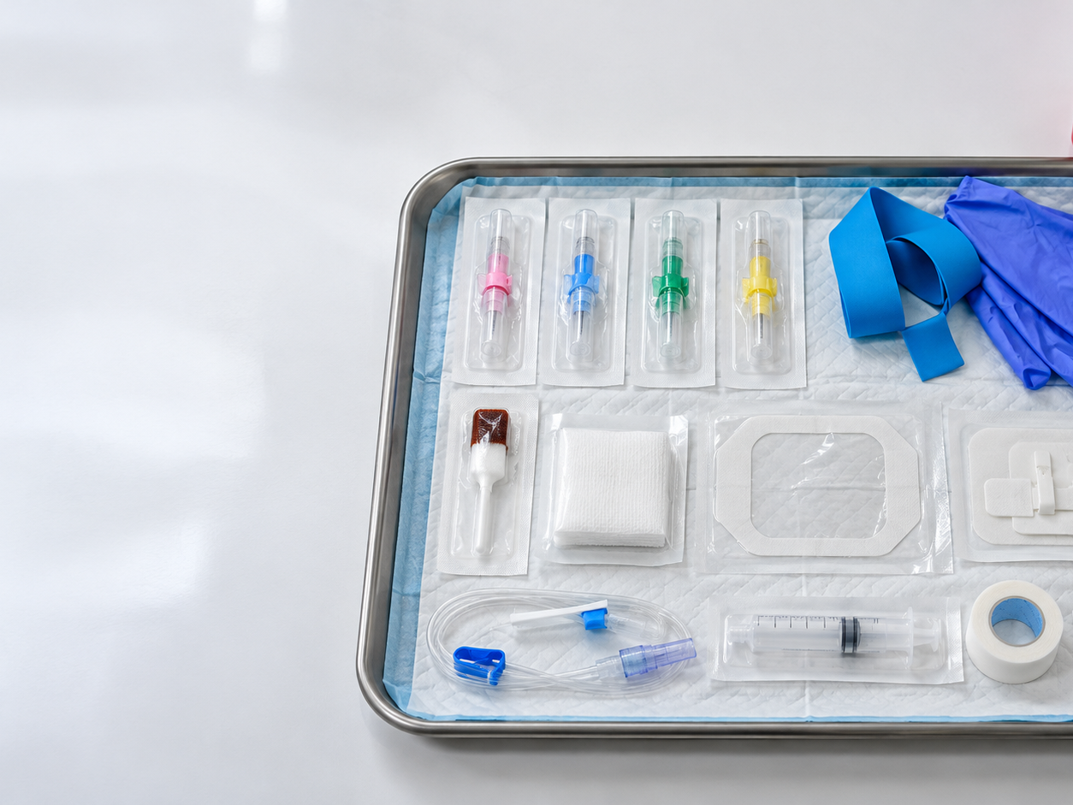
Peripheral IV insertion supplies
15
MODULE 7
Select the catheter and equipment after assessing the patient, therapy, vein, and expected duration.
Open supplies only when ready to maintain asepsis.
Place the sharps container within immediate reach before insertion.
Prepare backup supplies without contaminating the primary setup.
Educational visual. Verify device-specific technique during supervised practice.
Notes:
HEYGEN INSTRUCTOR SCRIPT
Welcome to this lesson segment on Peripheral IV insertion supplies. First, Select the catheter and equipment after assessing the patient, therapy, vein, and expected duration. Next, Open supplies only when ready to maintain asepsis. Next, Place the sharps container within immediate reach before insertion. Next, Prepare backup supplies without contaminating the primary setup. Pause here and ask learners to identify the safety check they would complete before proceeding. Reinforce that students must follow current orders, facility policy, their authorized scope, and the supervising registered nurse's direction. Invite learners to replay this segment and record questions for the instructor.
PRODUCTION DIRECTION
Use a professional nursing instructor avatar, calm pace, neutral clinical background, and captions. Pronounce IV as I-V and IVPB as I-V piggyback.
SOURCES
Supplied Basic Intravenous Therapy Certification manual, pages 80-108; BMHI IVT 030 course content. Original BMHI educational visual generated October 23, 2026. Source topics: 30 Hour IV Certification Study Guide, revised March 2013, PDF pages 24-26.
Current legal reference: Florida Administrative Code Rule 64B9-12.005, effective July 20, 2023; Florida Statutes section 464.003 (2026). Instructor must verify current institutional policy and current drug/device guidance before use.

Slide 16
Peripheral IV supply checklist
16
MODULE 7
Category
Supplies and purpose
Patient and clinician protection
Clean gloves and additional PPE based on exposure risk
Access
Appropriate safety catheter, tourniquet, optional vein-visualization or warming aid per policy
Skin preparation
Facility-approved antiseptic, sterile gauze, and enough drying time
Connection
Primed extension tubing, needleless connector, ordered solution or flush, compatible administration set
Securement
Stabilization device, transparent dressing or indicated alternative, tape and label
Safety and cleanup
Sharps container, waste receptacle, absorbent material, and spill supplies when indicated
Notes:
HEYGEN INSTRUCTOR SCRIPT
Welcome to this lesson segment on Peripheral IV supply checklist. First, Patient and clinician protection: Clean gloves and additional PPE based on exposure risk Next, Access: Appropriate safety catheter, tourniquet, optional vein-visualization or warming aid per policy Next, Skin preparation: Facility-approved antiseptic, sterile gauze, and enough drying time Next, Connection: Primed extension tubing, needleless connector, ordered solution or flush, compatible administration set Next, Securement: Stabilization device, transparent dressing or indicated alternative, tape and label Next, Safety and cleanup: Sharps container, waste receptacle, absorbent material, and spill supplies when indicated Pause here and ask learners to identify the safety check they would complete before proceeding. Reinforce that students must follow current orders, facility policy, their authorized scope, and the supervising registered nurse's direction. Invite learners to replay this segment and record questions for the instructor.
PRODUCTION DIRECTION
Use a professional nursing instructor avatar, calm pace, neutral clinical background, and captions. Pronounce IV as I-V and IVPB as I-V piggyback.
SOURCES
Supplied Basic Intravenous Therapy Certification manual, pages 80-108; BMHI IVT 030 course content. Source: 30 Hour IV Certification Study Guide, revised March 2013, PDF pages 24-26. Use the device instructions and facility supply list.
Current legal reference: Florida Administrative Code Rule 64B9-12.005, effective July 20, 2023; Florida Statutes section 464.003 (2026). Instructor must verify current institutional policy and current drug/device guidance before use.

Slide 17
Extremities and sites that need special caution
17
MODULE 7
Finding or history
Action
Infection, burn, wound, hematoma, or impaired circulation
Avoid the affected site and select a safer location
Dialysis fistula or graft
Do not use the extremity unless a specialist-specific emergency protocol authorizes it
Lymph-node surgery, mastectomy, or lymphedema risk
Follow the current patient-specific restriction and facility policy
Paralysis or reduced sensation
Avoid when possible because injury or complication may go unrecognized
Lower extremity in an adult
Use only when clinically authorized and replace with safer access as directed
Notes:
HEYGEN INSTRUCTOR SCRIPT
Welcome to this lesson segment on Extremities and sites that need special caution. First, Infection, burn, wound, hematoma, or impaired circulation: Avoid the affected site and select a safer location Next, Dialysis fistula or graft: Do not use the extremity unless a specialist-specific emergency protocol authorizes it Next, Lymph-node surgery, mastectomy, or lymphedema risk: Follow the current patient-specific restriction and facility policy Next, Paralysis or reduced sensation: Avoid when possible because injury or complication may go unrecognized Next, Lower extremity in an adult: Use only when clinically authorized and replace with safer access as directed Pause here and ask learners to identify the safety check they would complete before proceeding. Reinforce that students must follow current orders, facility policy, their authorized scope, and the supervising registered nurse's direction. Invite learners to replay this segment and record questions for the instructor.
PRODUCTION DIRECTION
Use a professional nursing instructor avatar, calm pace, neutral clinical background, and captions. Pronounce IV as I-V and IVPB as I-V piggyback.
SOURCES
Supplied Basic Intravenous Therapy Certification manual, pages 80-108; BMHI IVT 030 course content. Source: 30 Hour IV Certification Study Guide, revised March 2013, PDF pages 22-24. Current patient-specific and facility restrictions control.
Current legal reference: Florida Administrative Code Rule 64B9-12.005, effective July 20, 2023; Florida Statutes section 464.003 (2026). Instructor must verify current institutional policy and current drug/device guidance before use.

Slide 18
Primary and secondary administration sets
18
MODULE 7
Equipment
Purpose
Safety check
Macrodrip set
Gravity delivery with a manufacturer-specified drop factor
Read the actual package; never assume 10, 15, or 20 gtt/mL
Microdrip set
Fine gravity control, commonly 60 gtt/mL
Confirm package and patient-specific use
Primary set
Continuous fluid path from main container
Prime, label, trace, and change according to current policy
Secondary set
Intermittent medication through compatible primary line
Verify compatibility, bag height, connection port, pump channel, volume, and rate
Extension or needleless connector
Adds access and supports securement
Prime, disinfect, protect key parts, and assess patency
Notes:
HEYGEN INSTRUCTOR SCRIPT
Welcome to this lesson segment on Primary and secondary administration sets. First, Macrodrip set: Gravity delivery with a manufacturer-specified drop factor; Read the actual package; never assume 10, 15, or 20 gtt/mL Next, Microdrip set: Fine gravity control, commonly 60 gtt/mL; Confirm package and patient-specific use Next, Primary set: Continuous fluid path from main container; Prime, label, trace, and change according to current policy Next, Secondary set: Intermittent medication through compatible primary line; Verify compatibility, bag height, connection port, pump channel, volume, and rate Next, Extension or needleless connector: Adds access and supports securement; Prime, disinfect, protect key parts, and assess patency Pause here and ask learners to identify the safety check they would complete before proceeding. Reinforce that students must follow current orders, facility policy, their authorized scope, and the supervising registered nurse's direction. Invite learners to replay this segment and record questions for the instructor.
PRODUCTION DIRECTION
Use a professional nursing instructor avatar, calm pace, neutral clinical background, and captions. Pronounce IV as I-V and IVPB as I-V piggyback.
SOURCES
Supplied Basic Intravenous Therapy Certification manual, pages 80-108; BMHI IVT 030 course content. Source: 30 Hour IV Certification Study Guide, revised March 2013, PDF pages 28-29. Manufacturer information and current policy control.
Current legal reference: Florida Administrative Code Rule 64B9-12.005, effective July 20, 2023; Florida Statutes section 464.003 (2026). Instructor must verify current institutional policy and current drug/device guidance before use.

Slide 19
Medication delivery methods
19
MODULE 7
Method
Description
Primary safety issue
Continuous infusion
Medication or fluid delivered at a prescribed ongoing rate
Concentration, pump programming, line tracing, cumulative dose
Intermittent or IVPB
Medication delivered at scheduled intervals
Compatibility, secondary setup, residual volume, timing
Direct IV administration
Small volume delivered over a specified time
Scope, dilution, rate, patency, immediate adverse effect
Saline lock
Intermittent access without continuous fluid
Patency assessment, flushing sequence, connector disinfection
Bolus fluid
Rapid prescribed fluid volume
Hemodynamic tolerance and exact volume
Notes:
HEYGEN INSTRUCTOR SCRIPT
Welcome to this lesson segment on Medication delivery methods. First, Continuous infusion: Medication or fluid delivered at a prescribed ongoing rate; Concentration, pump programming, line tracing, cumulative dose Next, Intermittent or IVPB: Medication delivered at scheduled intervals; Compatibility, secondary setup, residual volume, timing Next, Direct IV administration: Small volume delivered over a specified time; Scope, dilution, rate, patency, immediate adverse effect Next, Saline lock: Intermittent access without continuous fluid; Patency assessment, flushing sequence, connector disinfection Next, Bolus fluid: Rapid prescribed fluid volume; Hemodynamic tolerance and exact volume Pause here and ask learners to identify the safety check they would complete before proceeding. Reinforce that students must follow current orders, facility policy, their authorized scope, and the supervising registered nurse's direction. Invite learners to replay this segment and record questions for the instructor.
PRODUCTION DIRECTION
Use a professional nursing instructor avatar, calm pace, neutral clinical background, and captions. Pronounce IV as I-V and IVPB as I-V piggyback.
SOURCES
Supplied Basic Intravenous Therapy Certification manual, pages 80-108; BMHI IVT 030 course content. Source: 30 Hour IV Certification Study Guide, revised March 2013, PDF page 28.
Current legal reference: Florida Administrative Code Rule 64B9-12.005, effective July 20, 2023; Florida Statutes section 464.003 (2026). Instructor must verify current institutional policy and current drug/device guidance before use.

Slide 20
Medication compatibility has several dimensions
20
MODULE 7
Type
Meaning
What the nurse does
Physical
Visible precipitate, haze, color change, gas, or separation
Do not administer; stop and clarify
Chemical
Drug degrades or reacts even without visible change
Use an approved compatibility reference
Therapeutic
Combined drug effects create an unintended clinical result
Review interactions, patient condition, and monitoring
Container or tubing
Drug binds to, leaches from, or is altered by the delivery system
Follow pharmacy and manufacturer instructions
Notes:
HEYGEN INSTRUCTOR SCRIPT
Welcome to this lesson segment on Medication compatibility has several dimensions. First, Physical: Visible precipitate, haze, color change, gas, or separation; Do not administer; stop and clarify Next, Chemical: Drug degrades or reacts even without visible change; Use an approved compatibility reference Next, Therapeutic: Combined drug effects create an unintended clinical result; Review interactions, patient condition, and monitoring Next, Container or tubing: Drug binds to, leaches from, or is altered by the delivery system; Follow pharmacy and manufacturer instructions Pause here and ask learners to identify the safety check they would complete before proceeding. Reinforce that students must follow current orders, facility policy, their authorized scope, and the supervising registered nurse's direction. Invite learners to replay this segment and record questions for the instructor.
PRODUCTION DIRECTION
Use a professional nursing instructor avatar, calm pace, neutral clinical background, and captions. Pronounce IV as I-V and IVPB as I-V piggyback.
SOURCES
Supplied Basic Intravenous Therapy Certification manual, pages 80-108; BMHI IVT 030 course content. Source: 30 Hour IV Certification Study Guide, revised March 2013, PDF pages 31-32.
Current legal reference: Florida Administrative Code Rule 64B9-12.005, effective July 20, 2023; Florida Statutes section 464.003 (2026). Instructor must verify current institutional policy and current drug/device guidance before use.

Slide 21
Medication action and patient response
21
MODULE 7
Concept
Question
Absorption and bioavailability
How does direct IV delivery change onset and risk?
Distribution
Do fluid status, protein binding, perfusion, or body composition change effect?
Metabolism
Does liver function alter clearance or active metabolites?
Excretion
Does kidney function require dose or interval adjustment?
Interaction
Could another drug, food, herb, disease, or test change the response?
Notes:
HEYGEN INSTRUCTOR SCRIPT
Welcome to this lesson segment on Medication action and patient response. First, Absorption and bioavailability: How does direct IV delivery change onset and risk? Next, Distribution: Do fluid status, protein binding, perfusion, or body composition change effect? Next, Metabolism: Does liver function alter clearance or active metabolites? Next, Excretion: Does kidney function require dose or interval adjustment? Next, Interaction: Could another drug, food, herb, disease, or test change the response? Pause here and ask learners to identify the safety check they would complete before proceeding. Reinforce that students must follow current orders, facility policy, their authorized scope, and the supervising registered nurse's direction. Invite learners to replay this segment and record questions for the instructor.
PRODUCTION DIRECTION
Use a professional nursing instructor avatar, calm pace, neutral clinical background, and captions. Pronounce IV as I-V and IVPB as I-V piggyback.
SOURCES
Supplied Basic Intravenous Therapy Certification manual, pages 80-108; BMHI IVT 030 course content. Source: 30 Hour IV Certification Study Guide, revised March 2013, PDF pages 30-32.
Current legal reference: Florida Administrative Code Rule 64B9-12.005, effective July 20, 2023; Florida Statutes section 464.003 (2026). Instructor must verify current institutional policy and current drug/device guidance before use.

Slide 22
Choose the site before the catheter
22
MODULE 7
Start with the prescribed therapy: pH, osmolarity, duration, flow requirement, and vesicant risk affect device choice.
Select a vein that is palpable, resilient, and appropriate for the therapy.
Prefer the smallest suitable gauge and shortest catheter.
Avoid infected, injured, poorly perfused, or policy-restricted extremities and areas of flexion when possible.
Use current orders, facility policy, and authorized scope when applying this information.
Notes:
HEYGEN INSTRUCTOR SCRIPT
Welcome to this lesson segment on Choose the site before the catheter. First, Start with the prescribed therapy: pH, osmolarity, duration, flow requirement, and vesicant risk affect device choice. Next, Select a vein that is palpable, resilient, and appropriate for the therapy. Next, Prefer the smallest suitable gauge and shortest catheter. Next, Avoid infected, injured, poorly perfused, or policy-restricted extremities and areas of flexion when possible. Pause here and ask learners to identify the safety check they would complete before proceeding. Reinforce that students must follow current orders, facility policy, their authorized scope, and the supervising registered nurse's direction. Invite learners to replay this segment and record questions for the instructor.
PRODUCTION DIRECTION
Use a professional nursing instructor avatar, calm pace, neutral clinical background, and captions. Pronounce IV as I-V and IVPB as I-V piggyback.
SOURCES
Supplied Basic Intravenous Therapy Certification manual, pages 80-108; BMHI IVT 030 course content.
Current legal reference: Florida Administrative Code Rule 64B9-12.005, effective July 20, 2023; Florida Statutes section 464.003 (2026). Instructor must verify current institutional policy and current drug/device guidance before use.

Slide 23
Vein-wall anatomy and complication risk
23
MODULE 7
Vein layer
Function
Clinical connection
Tunica intima
Smooth inner lining and venous valves
Trauma, chemical irritation, or contamination can promote phlebitis and thrombosis
Tunica media
Muscle and elastic tissue
Irritation can trigger venospasm, pain, and reduced flow
Tunica adventitia
Outer connective-tissue support
Deep advancement or vessel injury can affect surrounding tissue
Notes:
HEYGEN INSTRUCTOR SCRIPT
Welcome to this lesson segment on Vein-wall anatomy and complication risk. First, Tunica intima: Smooth inner lining and venous valves; Trauma, chemical irritation, or contamination can promote phlebitis and thrombosis Next, Tunica media: Muscle and elastic tissue; Irritation can trigger venospasm, pain, and reduced flow Next, Tunica adventitia: Outer connective-tissue support; Deep advancement or vessel injury can affect surrounding tissue Pause here and ask learners to identify the safety check they would complete before proceeding. Reinforce that students must follow current orders, facility policy, their authorized scope, and the supervising registered nurse's direction. Invite learners to replay this segment and record questions for the instructor.
PRODUCTION DIRECTION
Use a professional nursing instructor avatar, calm pace, neutral clinical background, and captions. Pronounce IV as I-V and IVPB as I-V piggyback.
SOURCES
Supplied Basic Intravenous Therapy Certification manual, pages 80-108; BMHI IVT 030 course content. Additional source: Peripheral Intravenous Initiation Self Learning Module, pages 7-8.
Current legal reference: Florida Administrative Code Rule 64B9-12.005, effective July 20, 2023; Florida Statutes section 464.003 (2026). Instructor must verify current institutional policy and current drug/device guidance before use.

Slide 24
Vein or artery? Stop when the findings do not fit
24
MODULE 7
Assessment cue
Typical vein
Possible artery / safety response
Palpation
Soft, compressible, nonpulsatile
Pulsation or firm recoil: do not cannulate
Location
Often superficial and visible or palpable
Often deeper and protected; confirm anatomy before proceeding
Blood return
Usually darker and lower pressure
Bright or pulsatile return is an emergency cue—stop and escalate
When uncertain
Reassess the site and therapy
Do not rely on color alone; obtain qualified assistance
Notes:
HEYGEN INSTRUCTOR SCRIPT
Welcome to this lesson segment on Vein or artery? Stop when the findings do not fit. First, Palpation: Soft, compressible, nonpulsatile; Pulsation or firm recoil: do not cannulate Next, Location: Often superficial and visible or palpable; Often deeper and protected; confirm anatomy before proceeding Next, Blood return: Usually darker and lower pressure; Bright or pulsatile return is an emergency cue—stop and escalate Next, When uncertain: Reassess the site and therapy; Do not rely on color alone; obtain qualified assistance Pause here and ask learners to identify the safety check they would complete before proceeding. Reinforce that students must follow current orders, facility policy, their authorized scope, and the supervising registered nurse's direction. Invite learners to replay this segment and record questions for the instructor.
PRODUCTION DIRECTION
Use a professional nursing instructor avatar, calm pace, neutral clinical background, and captions. Pronounce IV as I-V and IVPB as I-V piggyback.
SOURCES
Supplied Basic Intravenous Therapy Certification manual, pages 80-108; BMHI IVT 030 course content. Additional source: Phlebotomy Skills and Practicum Review, pages 7-8. Blood color can be altered by oxygenation and clinical conditions; palpation, anatomy, patient assessment, and facility escalation policy take priority.
Current legal reference: Florida Administrative Code Rule 64B9-12.005, effective July 20, 2023; Florida Statutes section 464.003 (2026). Instructor must verify current institutional policy and current drug/device guidance before use.

Slide 25
Vein assessment uses sight and touch
25
MODULE 7
Inspect both appropriate extremities before choosing a site.
Use one or two fingertips rather than the thumb to palpate the vessel.
Press lightly, release, and assess elasticity, rebound filling, direction, depth, and length.
Palpate even when a vein looks easy to access; appearance alone does not confirm suitability.
Use current orders, facility policy, and authorized scope when applying this information.
Notes:
HEYGEN INSTRUCTOR SCRIPT
Welcome to this lesson segment on Vein assessment uses sight and touch. First, Inspect both appropriate extremities before choosing a site. Next, Use one or two fingertips rather than the thumb to palpate the vessel. Next, Press lightly, release, and assess elasticity, rebound filling, direction, depth, and length. Next, Palpate even when a vein looks easy to access; appearance alone does not confirm suitability. Pause here and ask learners to identify the safety check they would complete before proceeding. Reinforce that students must follow current orders, facility policy, their authorized scope, and the supervising registered nurse's direction. Invite learners to replay this segment and record questions for the instructor.
PRODUCTION DIRECTION
Use a professional nursing instructor avatar, calm pace, neutral clinical background, and captions. Pronounce IV as I-V and IVPB as I-V piggyback.
SOURCES
Supplied Basic Intravenous Therapy Certification manual, pages 80-108; BMHI IVT 030 course content. Additional source: Peripheral Intravenous Initiation Self Learning Module, page 18.
Current legal reference: Florida Administrative Code Rule 64B9-12.005, effective July 20, 2023; Florida Statutes section 464.003 (2026). Instructor must verify current institutional policy and current drug/device guidance before use.

Slide 26
Strategies for a poorly filled vein
26
MODULE 7
Lower the arm below heart level before applying the tourniquet when the patient's condition permits.
Ask the patient to gently open and close the hand, then relax it for insertion.
Use light tapping rather than forceful striking, which may cause vasoconstriction.
Apply an approved warm compress according to facility policy and reassess the vein before proceeding.
Use current orders, facility policy, and authorized scope when applying this information.
Notes:
HEYGEN INSTRUCTOR SCRIPT
Welcome to this lesson segment on Strategies for a poorly filled vein. First, Lower the arm below heart level before applying the tourniquet when the patient's condition permits. Next, Ask the patient to gently open and close the hand, then relax it for insertion. Next, Use light tapping rather than forceful striking, which may cause vasoconstriction. Next, Apply an approved warm compress according to facility policy and reassess the vein before proceeding. Pause here and ask learners to identify the safety check they would complete before proceeding. Reinforce that students must follow current orders, facility policy, their authorized scope, and the supervising registered nurse's direction. Invite learners to replay this segment and record questions for the instructor.
PRODUCTION DIRECTION
Use a professional nursing instructor avatar, calm pace, neutral clinical background, and captions. Pronounce IV as I-V and IVPB as I-V piggyback.
SOURCES
Supplied Basic Intravenous Therapy Certification manual, pages 80-108; BMHI IVT 030 course content. Additional source: Peripheral Intravenous Initiation Self Learning Module, pages 19-20. Follow current facility policy for warming devices and exposure time.
Current legal reference: Florida Administrative Code Rule 64B9-12.005, effective July 20, 2023; Florida Statutes section 464.003 (2026). Instructor must verify current institutional policy and current drug/device guidance before use.

Slide 27
Peripheral catheter selection
27
MODULE 7
Clinical need
Selection principle
Routine fluids or intermittent medication
Use the smallest gauge that reliably supports therapy
Rapid volume or blood
A larger bore may be required when clinically appropriate
Fragile or small veins
Choose a smaller gauge and appropriate short catheter
Long duration or irritating therapy
Reassess whether a different vascular-access device is indicated
Notes:
HEYGEN INSTRUCTOR SCRIPT
Welcome to this lesson segment on Peripheral catheter selection. First, Routine fluids or intermittent medication: Use the smallest gauge that reliably supports therapy Next, Rapid volume or blood: A larger bore may be required when clinically appropriate Next, Fragile or small veins: Choose a smaller gauge and appropriate short catheter Next, Long duration or irritating therapy: Reassess whether a different vascular-access device is indicated Pause here and ask learners to identify the safety check they would complete before proceeding. Reinforce that students must follow current orders, facility policy, their authorized scope, and the supervising registered nurse's direction. Invite learners to replay this segment and record questions for the instructor.
PRODUCTION DIRECTION
Use a professional nursing instructor avatar, calm pace, neutral clinical background, and captions. Pronounce IV as I-V and IVPB as I-V piggyback.
SOURCES
Supplied Basic Intravenous Therapy Certification manual, pages 80-108; BMHI IVT 030 course content.
Current legal reference: Florida Administrative Code Rule 64B9-12.005, effective July 20, 2023; Florida Statutes section 464.003 (2026). Instructor must verify current institutional policy and current drug/device guidance before use.

Slide 28
Insertion sequence: prepare and access
28
MODULE 7
Verify the order, identify and teach the patient, perform hand hygiene, and gather supplies.
Position the limb, assess veins, apply the tourniquet, and select the site.
Cleanse with the approved antiseptic using the required friction and allow it to dry completely.
Stabilize the vein, insert bevel up, observe flashback, lower the angle, and advance the catheter—not the needle.
Use current orders, facility policy, and authorized scope when applying this information.
Notes:
HEYGEN INSTRUCTOR SCRIPT
Welcome to this lesson segment on Insertion sequence: prepare and access. First, Verify the order, identify and teach the patient, perform hand hygiene, and gather supplies. Next, Position the limb, assess veins, apply the tourniquet, and select the site. Next, Cleanse with the approved antiseptic using the required friction and allow it to dry completely. Next, Stabilize the vein, insert bevel up, observe flashback, lower the angle, and advance the catheter—not the needle. Pause here and ask learners to identify the safety check they would complete before proceeding. Reinforce that students must follow current orders, facility policy, their authorized scope, and the supervising registered nurse's direction. Invite learners to replay this segment and record questions for the instructor.
PRODUCTION DIRECTION
Use a professional nursing instructor avatar, calm pace, neutral clinical background, and captions. Pronounce IV as I-V and IVPB as I-V piggyback.
SOURCES
Supplied Basic Intravenous Therapy Certification manual, pages 80-108; BMHI IVT 030 course content.
Current legal reference: Florida Administrative Code Rule 64B9-12.005, effective July 20, 2023; Florida Statutes section 464.003 (2026). Instructor must verify current institutional policy and current drug/device guidance before use.

Slide 29
Insertion sequence: connect and secure
29
MODULE 7
Release the tourniquet, apply appropriate pressure, activate the sharps safety device, and discard immediately.
Connect the primed extension without contaminating key parts.
Confirm patency using the approved assessment; never force a flush.
Secure and dress the catheter, label it, start the ordered therapy, teach the patient, and document.
Use current orders, facility policy, and authorized scope when applying this information.
Notes:
HEYGEN INSTRUCTOR SCRIPT
Welcome to this lesson segment on Insertion sequence: connect and secure. First, Release the tourniquet, apply appropriate pressure, activate the sharps safety device, and discard immediately. Next, Connect the primed extension without contaminating key parts. Next, Confirm patency using the approved assessment; never force a flush. Next, Secure and dress the catheter, label it, start the ordered therapy, teach the patient, and document. Pause here and ask learners to identify the safety check they would complete before proceeding. Reinforce that students must follow current orders, facility policy, their authorized scope, and the supervising registered nurse's direction. Invite learners to replay this segment and record questions for the instructor.
PRODUCTION DIRECTION
Use a professional nursing instructor avatar, calm pace, neutral clinical background, and captions. Pronounce IV as I-V and IVPB as I-V piggyback.
SOURCES
Supplied Basic Intravenous Therapy Certification manual, pages 80-108; BMHI IVT 030 course content.
Current legal reference: Florida Administrative Code Rule 64B9-12.005, effective July 20, 2023; Florida Statutes section 464.003 (2026). Instructor must verify current institutional policy and current drug/device guidance before use.

Slide 30
Sharps safety is part of every IV start
30
MODULE 7
Place an approved, closable, puncture-resistant sharps container within easy reach before beginning.
Never bend, break, remove, or recap the introducer needle.
Activate the engineered safety feature immediately after withdrawal and visually confirm activation when the device permits.
Dispose of the sharp at once; never carry it, hand it to another person, or force it into an overfilled container.
If an injury occurs, stop safely and follow the facility exposure-control plan without delay.
Use current orders, facility policy, and authorized scope when applying this information.
Notes:
HEYGEN INSTRUCTOR SCRIPT
Welcome to this lesson segment on Sharps safety is part of every IV start. First, Place an approved, closable, puncture-resistant sharps container within easy reach before beginning. Next, Never bend, break, remove, or recap the introducer needle. Next, Activate the engineered safety feature immediately after withdrawal and visually confirm activation when the device permits. Next, Dispose of the sharp at once; never carry it, hand it to another person, or force it into an overfilled container. Next, If an injury occurs, stop safely and follow the facility exposure-control plan without delay. Pause here and ask learners to identify the safety check they would complete before proceeding. Reinforce that students must follow current orders, facility policy, their authorized scope, and the supervising registered nurse's direction. Invite learners to replay this segment and record questions for the instructor.
PRODUCTION DIRECTION
Use a professional nursing instructor avatar, calm pace, neutral clinical background, and captions. Pronounce IV as I-V and IVPB as I-V piggyback.
SOURCES
Supplied Basic Intravenous Therapy Certification manual, pages 80-108; BMHI IVT 030 course content. Additional sources: Phlebotomy Skills and Practicum Review, pages 5-6 and 12; 30 Hour IV Certification Study Guide, revised March 2013, pages 9-11. Content is adapted to current OSHA requirements, the device instructions for use, and facility policy.
Current legal reference: Florida Administrative Code Rule 64B9-12.005, effective July 20, 2023; Florida Statutes section 464.003 (2026). Instructor must verify current institutional policy and current drug/device guidance before use.

Slide 31
Occupational exposure: immediate response
31
MODULE 7
Exposure
Immediate action
Needlestick or cut
Wash with soap and water; do not scrub aggressively or squeeze the wound
Eye or mucous-membrane splash
Flush promptly with water or the designated eyewash
Nonintact-skin contact
Wash the area promptly and remove contaminated clothing as directed
Every exposure
Report immediately, identify the source process when permitted, and obtain confidential medical evaluation and follow-up
Do not delay reporting while deciding whether the exposure seems serious. Follow the employer's written exposure-control plan and current post-exposure protocol.
Notes:
HEYGEN INSTRUCTOR SCRIPT
Welcome to this lesson segment on Occupational exposure: immediate response. First, Needlestick or cut: Wash with soap and water; do not scrub aggressively or squeeze the wound Next, Eye or mucous-membrane splash: Flush promptly with water or the designated eyewash Next, Nonintact-skin contact: Wash the area promptly and remove contaminated clothing as directed Next, Every exposure: Report immediately, identify the source process when permitted, and obtain confidential medical evaluation and follow-up Next, Do not delay reporting while deciding whether the exposure seems serious. Follow the employer's written exposure-control plan and current post-exposure protocol. Pause here and ask learners to identify the safety check they would complete before proceeding. Reinforce that students must follow current orders, facility policy, their authorized scope, and the supervising registered nurse's direction. Invite learners to replay this segment and record questions for the instructor.
PRODUCTION DIRECTION
Use a professional nursing instructor avatar, calm pace, neutral clinical background, and captions. Pronounce IV as I-V and IVPB as I-V piggyback.
SOURCES
Supplied Basic Intravenous Therapy Certification manual, pages 80-108; BMHI IVT 030 course content. Do not delay reporting while deciding whether the exposure seems serious. Follow the employer's written exposure-control plan and current post-exposure protocol. Additional sources: Phlebotomy Skills and Practicum Review, pages 5-6; 30 Hour IV Certification Study Guide, revised March 2013, pages 9-11. No historical transmission statistics or obsolete cleanup directions were imported.
Current legal reference: Florida Administrative Code Rule 64B9-12.005, effective July 20, 2023; Florida Statutes section 464.003 (2026). Instructor must verify current institutional policy and current drug/device guidance before use.

Slide 32
Unsuccessful insertion: safe next steps
32
MODULE 7
Problem
Likely cause
Safe response
Vein rolls away
Inadequate stabilization
Stop probing; stabilize correctly and use a new catheter/site as required
Hematoma develops
Posterior-wall trauma or excessive angle
Stop, remove, apply pressure, and reassess
Flashback appears but catheter will not advance
Only the needle tip may be in the lumen
Do not reinsert the needle into the catheter; remove and restart according to policy
Repeated unsuccessful attempts
Site, device, or operator factors
Stop at the facility attempt limit and escalate to a more experienced clinician
Notes:
HEYGEN INSTRUCTOR SCRIPT
Welcome to this lesson segment on Unsuccessful insertion: safe next steps. First, Vein rolls away: Inadequate stabilization; Stop probing; stabilize correctly and use a new catheter/site as required Next, Hematoma develops: Posterior-wall trauma or excessive angle; Stop, remove, apply pressure, and reassess Next, Flashback appears but catheter will not advance: Only the needle tip may be in the lumen; Do not reinsert the needle into the catheter; remove and restart according to policy Next, Repeated unsuccessful attempts: Site, device, or operator factors; Stop at the facility attempt limit and escalate to a more experienced clinician Pause here and ask learners to identify the safety check they would complete before proceeding. Reinforce that students must follow current orders, facility policy, their authorized scope, and the supervising registered nurse's direction. Invite learners to replay this segment and record questions for the instructor.
PRODUCTION DIRECTION
Use a professional nursing instructor avatar, calm pace, neutral clinical background, and captions. Pronounce IV as I-V and IVPB as I-V piggyback.
SOURCES
Supplied Basic Intravenous Therapy Certification manual, pages 80-108; BMHI IVT 030 course content. Additional source: Peripheral Intravenous Initiation Self Learning Module, page 27. Attempt limits must follow current BMHI clinical-site policy.
Current legal reference: Florida Administrative Code Rule 64B9-12.005, effective July 20, 2023; Florida Statutes section 464.003 (2026). Instructor must verify current institutional policy and current drug/device guidance before use.

Slide 33
Infusion flow troubleshooting
33
MODULE 7
Observation
Check first
Safety response
Pump occlusion or slowed flow
Trace the line from patient to container for clamps, kinks, or compression
Correct an external cause only after assessing the patient and site
Flow changes with limb position
Catheter tip may contact the vein wall or lie near flexion
Reposition and reassess; do not manipulate a contaminated catheter
Blood backs into tubing
Bag height, empty container, clamp position, or interruption
Protect against air and clot risk; restore flow only under order and policy
Resistance during flushing
Mechanical obstruction, malposition, or complication
Never force the flush; stop use and escalate
Notes:
HEYGEN INSTRUCTOR SCRIPT
Welcome to this lesson segment on Infusion flow troubleshooting. First, Pump occlusion or slowed flow: Trace the line from patient to container for clamps, kinks, or compression; Correct an external cause only after assessing the patient and site Next, Flow changes with limb position: Catheter tip may contact the vein wall or lie near flexion; Reposition and reassess; do not manipulate a contaminated catheter Next, Blood backs into tubing: Bag height, empty container, clamp position, or interruption; Protect against air and clot risk; restore flow only under order and policy Next, Resistance during flushing: Mechanical obstruction, malposition, or complication; Never force the flush; stop use and escalate Pause here and ask learners to identify the safety check they would complete before proceeding. Reinforce that students must follow current orders, facility policy, their authorized scope, and the supervising registered nurse's direction. Invite learners to replay this segment and record questions for the instructor.
PRODUCTION DIRECTION
Use a professional nursing instructor avatar, calm pace, neutral clinical background, and captions. Pronounce IV as I-V and IVPB as I-V piggyback.
SOURCES
Supplied Basic Intravenous Therapy Certification manual, pages 80-108; BMHI IVT 030 course content. Additional source: Peripheral Intravenous Initiation Self Learning Module, pages 28-29. Device-specific actions require current manufacturer instructions and facility policy.
Current legal reference: Florida Administrative Code Rule 64B9-12.005, effective July 20, 2023; Florida Statutes section 464.003 (2026). Instructor must verify current institutional policy and current drug/device guidance before use.

Slide 34
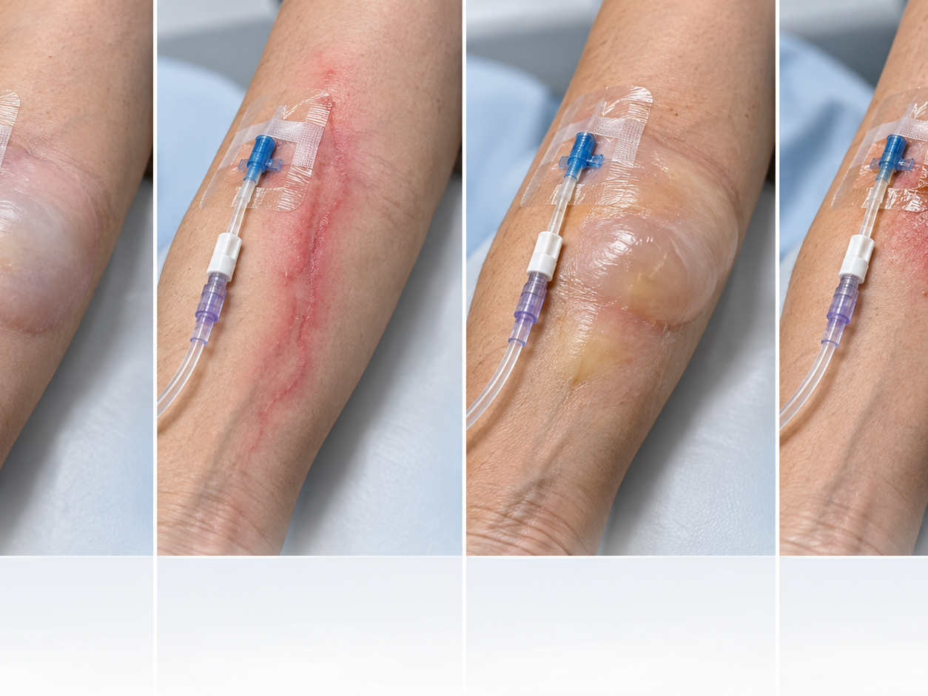
Visual comparison of local IV complications
34
MODULE 7
Infiltration: cool, pale swelling and slowed or stopped flow.
Phlebitis: pain, warmth, redness, swelling, or a palpable venous cord.
Extravasation: burning, tense swelling, blistering, discoloration, or worsening tissue injury after a vesicant or irritant.
Local infection: increasing redness, warmth, tenderness, drainage, or associated fever.
Educational visual. Verify device-specific technique during supervised practice.
Notes:
HEYGEN INSTRUCTOR SCRIPT
Welcome to this lesson segment on Visual comparison of local IV complications. First, Infiltration: cool, pale swelling and slowed or stopped flow. Next, Phlebitis: pain, warmth, redness, swelling, or a palpable venous cord. Next, Extravasation: burning, tense swelling, blistering, discoloration, or worsening tissue injury after a vesicant or irritant. Next, Local infection: increasing redness, warmth, tenderness, drainage, or associated fever. Pause here and ask learners to identify the safety check they would complete before proceeding. Reinforce that students must follow current orders, facility policy, their authorized scope, and the supervising registered nurse's direction. Invite learners to replay this segment and record questions for the instructor.
PRODUCTION DIRECTION
Use a professional nursing instructor avatar, calm pace, neutral clinical background, and captions. Pronounce IV as I-V and IVPB as I-V piggyback.
SOURCES
Supplied Basic Intravenous Therapy Certification manual, pages 80-108; BMHI IVT 030 course content. Original BMHI educational visual generated October 23, 2026. Illustrations are examples only; assess the patient and follow the current facility protocol.
Current legal reference: Florida Administrative Code Rule 64B9-12.005, effective July 20, 2023; Florida Statutes section 464.003 (2026). Instructor must verify current institutional policy and current drug/device guidance before use.

Slide 35

First response to a suspected IV complication
35
MODULE 7
Stop the infusion when the site or patient response becomes unsafe.
Assess the site, limb, vital signs, symptoms, medication or solution, and estimated volume infused.
Do not flush a suspected extravasation. Leave the catheter in place when the agent-specific protocol requires aspiration or antidote delivery.
Notify the appropriate clinician, follow the specific protocol, document the event, and arrange reassessment.
Educational visual. Verify device-specific technique during supervised practice.
Notes:
HEYGEN INSTRUCTOR SCRIPT
Welcome to this lesson segment on First response to a suspected IV complication. First, Stop the infusion when the site or patient response becomes unsafe. Next, Assess the site, limb, vital signs, symptoms, medication or solution, and estimated volume infused. Next, Do not flush a suspected extravasation. Leave the catheter in place when the agent-specific protocol requires aspiration or antidote delivery. Next, Notify the appropriate clinician, follow the specific protocol, document the event, and arrange reassessment. Pause here and ask learners to identify the safety check they would complete before proceeding. Reinforce that students must follow current orders, facility policy, their authorized scope, and the supervising registered nurse's direction. Invite learners to replay this segment and record questions for the instructor.
PRODUCTION DIRECTION
Use a professional nursing instructor avatar, calm pace, neutral clinical background, and captions. Pronounce IV as I-V and IVPB as I-V piggyback.
SOURCES
Supplied Basic Intravenous Therapy Certification manual, pages 80-108; BMHI IVT 030 course content. Original BMHI educational visual generated October 23, 2026. The exact sequence depends on the medication or solution, complication, scope, and facility policy.
Current legal reference: Florida Administrative Code Rule 64B9-12.005, effective July 20, 2023; Florida Statutes section 464.003 (2026). Instructor must verify current institutional policy and current drug/device guidance before use.

Slide 36
Local complication interventions
36
MODULE 7
Complication
Immediate intervention
Follow-up
Infiltration
Stop infusion; disconnect tubing; remove catheter unless the protocol requires temporary retention
Elevate and use a solution-specific compress when directed; restart at another site; reassess tissue and circulation
Phlebitis
Stop infusion and remove the peripheral catheter
Apply the ordered or policy-directed compress; notify as indicated; restart elsewhere; trend the vein and symptoms
Extravasation
Stop infusion; do not flush; disconnect tubing; leave catheter in place for aspiration or antidote when the protocol directs
Notify immediately; identify agent and dose; apply agent-specific antidote and compress; elevate when directed; photograph or measure and arrange follow-up
Local infection
Stop using the site and notify the supervising clinician
Remove or culture as ordered; assess for systemic infection; initiate the prescribed infection or sepsis pathway
Notes:
HEYGEN INSTRUCTOR SCRIPT
Welcome to this lesson segment on Local complication interventions. First, Infiltration: Stop infusion; disconnect tubing; remove catheter unless the protocol requires temporary retention; Elevate and use a solution-specific compress when directed; restart at another site; reassess tissue and circulation Next, Phlebitis: Stop infusion and remove the peripheral catheter; Apply the ordered or policy-directed compress; notify as indicated; restart elsewhere; trend the vein and symptoms Next, Extravasation: Stop infusion; do not flush; disconnect tubing; leave catheter in place for aspiration or antidote when the protocol directs; Notify immediately; identify agent and dose; apply agent-specific antidote and compress; elevate when directed; photograph or measure and arrange follow-up Next, Local infection: Stop using the site and notify the supervising clinician; Remove or culture as ordered; assess for systemic infection; initiate the prescribed infection or sepsis pathway Pause here and ask learners to identify the safety check they would complete before proceeding. Reinforce that students must follow current orders, facility policy, their authorized scope, and the supervising registered nurse's direction. Invite learners to replay this segment and record questions for the instructor.
PRODUCTION DIRECTION
Use a professional nursing instructor avatar, calm pace, neutral clinical background, and captions. Pronounce IV as I-V and IVPB as I-V piggyback.
SOURCES
Supplied Basic Intravenous Therapy Certification manual, pages 80-108; BMHI IVT 030 course content. Use the current medication-specific extravasation reference and facility policy. Compress type and catheter removal timing vary by agent.
Current legal reference: Florida Administrative Code Rule 64B9-12.005, effective July 20, 2023; Florida Statutes section 464.003 (2026). Instructor must verify current institutional policy and current drug/device guidance before use.

Slide 37
Local complication comparison
37
MODULE 7
Finding
Likely concern
Immediate priority
Cool, pale swelling; slowed infusion
Infiltration
Stop infusion and follow infiltration protocol
Pain, warmth, redness, venous cord
Phlebitis
Stop infusion, remove as indicated, assess and report
Burning, blistering, tissue injury with vesicant
Extravasation
Stop; do not flush; follow agent-specific protocol
Drainage, tenderness, fever
Local or bloodstream infection
Stop unsafe use, assess, notify, and follow culture/removal policy
Notes:
HEYGEN INSTRUCTOR SCRIPT
Welcome to this lesson segment on Local complication comparison. First, Cool, pale swelling; slowed infusion: Infiltration; Stop infusion and follow infiltration protocol Next, Pain, warmth, redness, venous cord: Phlebitis; Stop infusion, remove as indicated, assess and report Next, Burning, blistering, tissue injury with vesicant: Extravasation; Stop; do not flush; follow agent-specific protocol Next, Drainage, tenderness, fever: Local or bloodstream infection; Stop unsafe use, assess, notify, and follow culture/removal policy Pause here and ask learners to identify the safety check they would complete before proceeding. Reinforce that students must follow current orders, facility policy, their authorized scope, and the supervising registered nurse's direction. Invite learners to replay this segment and record questions for the instructor.
PRODUCTION DIRECTION
Use a professional nursing instructor avatar, calm pace, neutral clinical background, and captions. Pronounce IV as I-V and IVPB as I-V piggyback.
SOURCES
Supplied Basic Intravenous Therapy Certification manual, pages 80-108; BMHI IVT 030 course content.
Current legal reference: Florida Administrative Code Rule 64B9-12.005, effective July 20, 2023; Florida Statutes section 464.003 (2026). Instructor must verify current institutional policy and current drug/device guidance before use.

Slide 38
Systemic IV complications
38
MODULE 7
Complication
Possible findings
Immediate priority
Fluid overload
Dyspnea, crackles, edema, hypertension, oxygen decline
Slow or stop as authorized, position and support breathing, notify promptly
Speed shock or medication reaction
Flushing, headache, chest tightness, hypotension, rapid change after administration
Stop medication, assess ABCs, activate emergency response
Air embolism
Sudden dyspnea, chest pain, confusion, hypotension
Clamp or protect the system, call emergency response, support ABCs
Catheter-related bloodstream infection
Fever, chills, hypotension, altered status
Stop unsafe use, assess, notify, and follow culture and sepsis pathway
Notes:
HEYGEN INSTRUCTOR SCRIPT
Welcome to this lesson segment on Systemic IV complications. First, Fluid overload: Dyspnea, crackles, edema, hypertension, oxygen decline; Slow or stop as authorized, position and support breathing, notify promptly Next, Speed shock or medication reaction: Flushing, headache, chest tightness, hypotension, rapid change after administration; Stop medication, assess ABCs, activate emergency response Next, Air embolism: Sudden dyspnea, chest pain, confusion, hypotension; Clamp or protect the system, call emergency response, support ABCs Next, Catheter-related bloodstream infection: Fever, chills, hypotension, altered status; Stop unsafe use, assess, notify, and follow culture and sepsis pathway Pause here and ask learners to identify the safety check they would complete before proceeding. Reinforce that students must follow current orders, facility policy, their authorized scope, and the supervising registered nurse's direction. Invite learners to replay this segment and record questions for the instructor.
PRODUCTION DIRECTION
Use a professional nursing instructor avatar, calm pace, neutral clinical background, and captions. Pronounce IV as I-V and IVPB as I-V piggyback.
SOURCES
Supplied Basic Intravenous Therapy Certification manual, pages 80-108; BMHI IVT 030 course content. Source: 30 Hour IV Certification Study Guide, revised March 2013, PDF pages 32-35.
Current legal reference: Florida Administrative Code Rule 64B9-12.005, effective July 20, 2023; Florida Statutes section 464.003 (2026). Instructor must verify current institutional policy and current drug/device guidance before use.

Slide 39
Infiltration severity and response
39
MODULE 7
Assess pain, temperature, color, capillary refill, swelling, skin integrity, sensation, and the estimated area involved.
Stop the infusion and disconnect tubing. Follow the solution-specific policy before removing the catheter because aspiration or an antidote may be required for extravasation.
Elevate or apply a compress only when the specific protocol directs it.
Document findings, estimated severity, solution and volume, actions, notifications, patient response, and follow-up plan.
Use current orders, facility policy, and authorized scope when applying this information.
Notes:
HEYGEN INSTRUCTOR SCRIPT
Welcome to this lesson segment on Infiltration severity and response. First, Assess pain, temperature, color, capillary refill, swelling, skin integrity, sensation, and the estimated area involved. Next, Stop the infusion and disconnect tubing. Follow the solution-specific policy before removing the catheter because aspiration or an antidote may be required for extravasation. Next, Elevate or apply a compress only when the specific protocol directs it. Next, Document findings, estimated severity, solution and volume, actions, notifications, patient response, and follow-up plan. Pause here and ask learners to identify the safety check they would complete before proceeding. Reinforce that students must follow current orders, facility policy, their authorized scope, and the supervising registered nurse's direction. Invite learners to replay this segment and record questions for the instructor.
PRODUCTION DIRECTION
Use a professional nursing instructor avatar, calm pace, neutral clinical background, and captions. Pronounce IV as I-V and IVPB as I-V piggyback.
SOURCES
Supplied Basic Intravenous Therapy Certification manual, pages 80-108; BMHI IVT 030 course content. Source: 30 Hour IV Certification Study Guide, revised March 2013, PDF pages 32-35. Use the facility's current infiltration and extravasation scale.
Current legal reference: Florida Administrative Code Rule 64B9-12.005, effective July 20, 2023; Florida Statutes section 464.003 (2026). Instructor must verify current institutional policy and current drug/device guidance before use.

Slide 40
Phlebitis causes and prevention
40
MODULE 7
Cause
Example
Prevention
Mechanical
Large catheter, flexion, movement, poor securement
Smallest suitable catheter, stable site, effective securement
Chemical
Extreme pH or osmolarity, irritating medication
Correct dilution, rate, access device, and compatibility
Bacterial
Contamination of site, hub, or connection
Hand hygiene, antisepsis, connector disinfection, closed system
Patient-related
Fragile veins, inflammation, hypercoagulability
Individualized site and device plan with frequent assessment
Notes:
HEYGEN INSTRUCTOR SCRIPT
Welcome to this lesson segment on Phlebitis causes and prevention. First, Mechanical: Large catheter, flexion, movement, poor securement; Smallest suitable catheter, stable site, effective securement Next, Chemical: Extreme pH or osmolarity, irritating medication; Correct dilution, rate, access device, and compatibility Next, Bacterial: Contamination of site, hub, or connection; Hand hygiene, antisepsis, connector disinfection, closed system Next, Patient-related: Fragile veins, inflammation, hypercoagulability; Individualized site and device plan with frequent assessment Pause here and ask learners to identify the safety check they would complete before proceeding. Reinforce that students must follow current orders, facility policy, their authorized scope, and the supervising registered nurse's direction. Invite learners to replay this segment and record questions for the instructor.
PRODUCTION DIRECTION
Use a professional nursing instructor avatar, calm pace, neutral clinical background, and captions. Pronounce IV as I-V and IVPB as I-V piggyback.
SOURCES
Supplied Basic Intravenous Therapy Certification manual, pages 80-108; BMHI IVT 030 course content. Source: 30 Hour IV Certification Study Guide, revised March 2013, PDF pages 32-35.
Current legal reference: Florida Administrative Code Rule 64B9-12.005, effective July 20, 2023; Florida Statutes section 464.003 (2026). Instructor must verify current institutional policy and current drug/device guidance before use.

Slide 41
Complete documentation tells the clinical story
41
MODULE 7
Record date and time, site, vein or anatomic location, catheter gauge and length when required, number of attempts, and inserter.
Record skin preparation, dressing, securement, patency assessment, solution, rate, pump, and patient tolerance.
Document teaching, complications, actions, notifications, and response.
Use current orders, facility policy, and authorized scope when applying this information.
Notes:
HEYGEN INSTRUCTOR SCRIPT
Welcome to this lesson segment on Complete documentation tells the clinical story. First, Record date and time, site, vein or anatomic location, catheter gauge and length when required, number of attempts, and inserter. Next, Record skin preparation, dressing, securement, patency assessment, solution, rate, pump, and patient tolerance. Next, Document teaching, complications, actions, notifications, and response. Pause here and ask learners to identify the safety check they would complete before proceeding. Reinforce that students must follow current orders, facility policy, their authorized scope, and the supervising registered nurse's direction. Invite learners to replay this segment and record questions for the instructor.
PRODUCTION DIRECTION
Use a professional nursing instructor avatar, calm pace, neutral clinical background, and captions. Pronounce IV as I-V and IVPB as I-V piggyback.
SOURCES
Supplied Basic Intravenous Therapy Certification manual, pages 80-108; BMHI IVT 030 course content.
Current legal reference: Florida Administrative Code Rule 64B9-12.005, effective July 20, 2023; Florida Statutes section 464.003 (2026). Instructor must verify current institutional policy and current drug/device guidance before use.

Slide 42
Practice and competency check
42
MODULE 7
Palpate and select veins on a task trainer
Perform the complete insertion sequence without contamination
Discontinue the catheter and verify that it remains intact
Complete the matching online lesson and assessment before the in-person laboratory.
Notes:
HEYGEN INSTRUCTOR SCRIPT
Welcome to this lesson segment on practice and competency expectations. First, Palpate and select veins on a task trainer Next, Perform the complete insertion sequence without contamination Next, Discontinue the catheter and verify that it remains intact Pause here and ask learners to identify the safety check they would complete before proceeding. Reinforce that students must follow current orders, facility policy, their authorized scope, and the supervising registered nurse's direction. Invite learners to replay this segment and record questions for the instructor.
PRODUCTION DIRECTION
Use a professional nursing instructor avatar, calm pace, neutral clinical background, and captions. Pronounce IV as I-V and IVPB as I-V piggyback.
SOURCES
Supplied Basic Intravenous Therapy Certification manual, pages 80; BMHI IVT 030 course content. Online preparation precedes live practice.
Current legal reference: Florida Administrative Code Rule 64B9-12.005, effective July 20, 2023; Florida Statutes section 464.003 (2026). Instructor must verify current institutional policy and current drug/device guidance before use.

Slide 43
Key points
43
MODULE 7
Select an appropriate peripheral vein and catheter
Perform hand hygiene, prepare and position the patient, apply the tourniquet, cleanse the site with the approved antiseptic, let it dry, stabilize the vein, observe flashback, thread the catheter, and activate sharps protection.
Cool swelling suggests infiltration. Pain, warmth, redness, or a venous cord suggests phlebitis. Burning or tissue injury with a vesicant suggests extravasation. Stop unsafe therapy and follow the condition-specific protocol.
Review the course lesson, complete the assessment, and bring questions to the live session.
Notes:
HEYGEN INSTRUCTOR SCRIPT
Welcome to this lesson segment on the module key points. First, Select an appropriate peripheral vein and catheter Next, Perform hand hygiene, prepare and position the patient, apply the tourniquet, cleanse the site with the approved antiseptic, let it dry, stabilize the vein, observe flashback, thread the catheter, and activate sharps protection. Next, Cool swelling suggests infiltration. Pain, warmth, redness, or a venous cord suggests phlebitis. Burning or tissue injury with a vesicant suggests extravasation. Stop unsafe therapy and follow the condition-specific protocol. Pause here and ask learners to identify the safety check they would complete before proceeding. Reinforce that students must follow current orders, facility policy, their authorized scope, and the supervising registered nurse's direction. Invite learners to replay this segment and record questions for the instructor.
PRODUCTION DIRECTION
Use a professional nursing instructor avatar, calm pace, neutral clinical background, and captions. Pronounce IV as I-V and IVPB as I-V piggyback.
SOURCES
Supplied Basic Intravenous Therapy Certification manual, pages 80; BMHI IVT 030 course content.
Current legal reference: Florida Administrative Code Rule 64B9-12.005, effective July 20, 2023; Florida Statutes section 464.003 (2026). Instructor must verify current institutional policy and current drug/device guidance before use.

