Slide 1
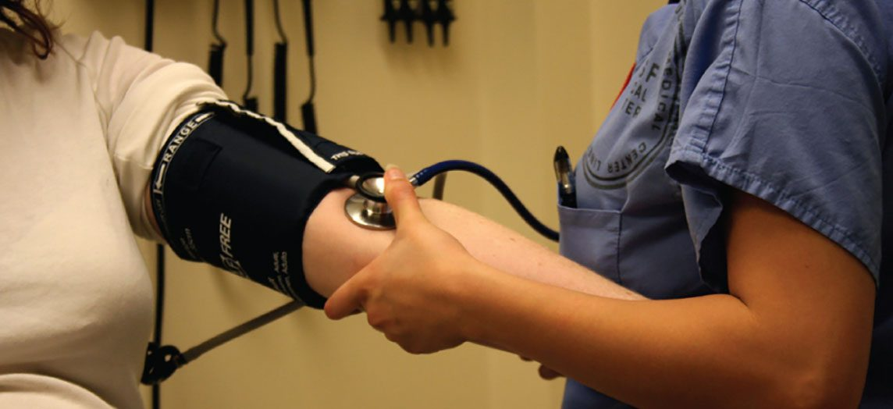
CHAPTER 1
An Introduction to the Human Body
Anatomy, physiology, levels of organization, homeostasis,
and the language of the body.
Anatomy & Physiology · Broward-Miami Health Institute
FACULTY EDITION

Slide 2
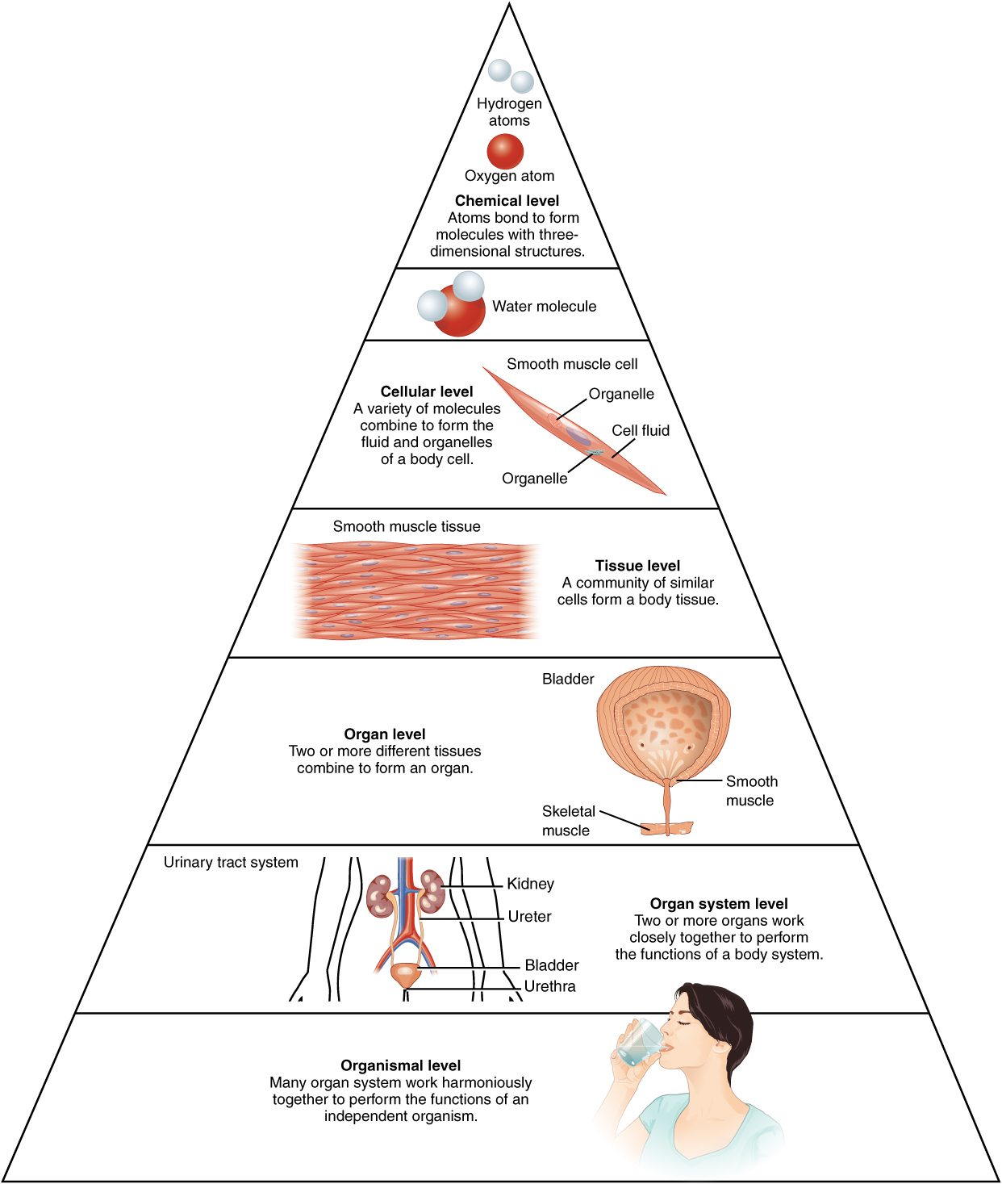
CHAPTER 1
Learning Objectives
After studying this chapter, students will be able to:
1
Distinguish between anatomy and physiology, and identify several branches of each
2
Describe the structure of the body, from simplest to most complex, in terms of the six levels of organization
3
Identify the functional characteristics of human life
4
Identify the four requirements for human survival
5
Define homeostasis and explain its importance to normal human functioning
6
Use appropriate anatomical terminology to identify key body structures, body regions, and directions in the body
The body's levels of organization — the roadmap for this chapter.
PN 104 · Ch 1 — An Introduction to the Human Body
2

Slide 3
1.1
SECTION
Overview of Anatomy and Physiology
The study of the body's structure and how its parts function — and why the two are inseparable.

Slide 4
SECTION 1.1
Anatomy & Physiology in Action
Anatomy = structure; physiology = function
Form and function are always linked
Gross (macroscopic) vs. microscopic anatomy
A blood-pressure reading is physiology at the bedside
Measuring blood pressure — physiology you assess every shift
PN 104 · Ch 1 — An Introduction to the Human Body
4

Slide 5
1.2
SECTION
Structural Organization of the Human Body
From atoms to the whole organism — six levels of increasing complexity, and the eleven organ systems.

Slide 6
SECTION 1.2
The Six Levels of Organization
Chemical → cellular → tissue → organ → system → organism
Each level builds on the one below it
The cell is the smallest unit of life
Complexity rises from atom to whole person
The levels of structural organization in the body
PN 104 · Ch 1 — An Introduction to the Human Body
6

Slide 7
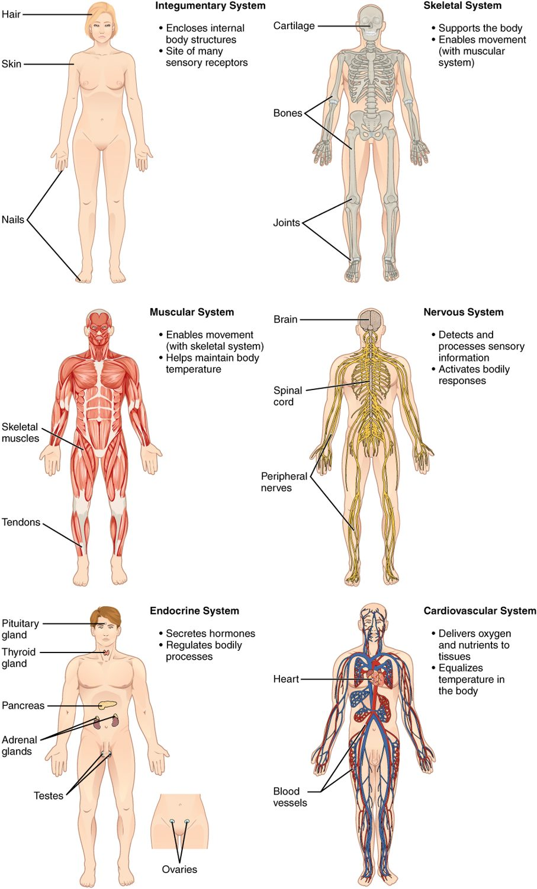
SECTION 1.2
Organ Systems of the Body (I)
Integumentary, skeletal, and muscular systems
Nervous and endocrine — the body's control systems
Cardiovascular system transports blood
Each system has distinct organs and roles
Organ systems and their major organs (part 1)
PN 104 · Ch 1 — An Introduction to the Human Body
7

Slide 8
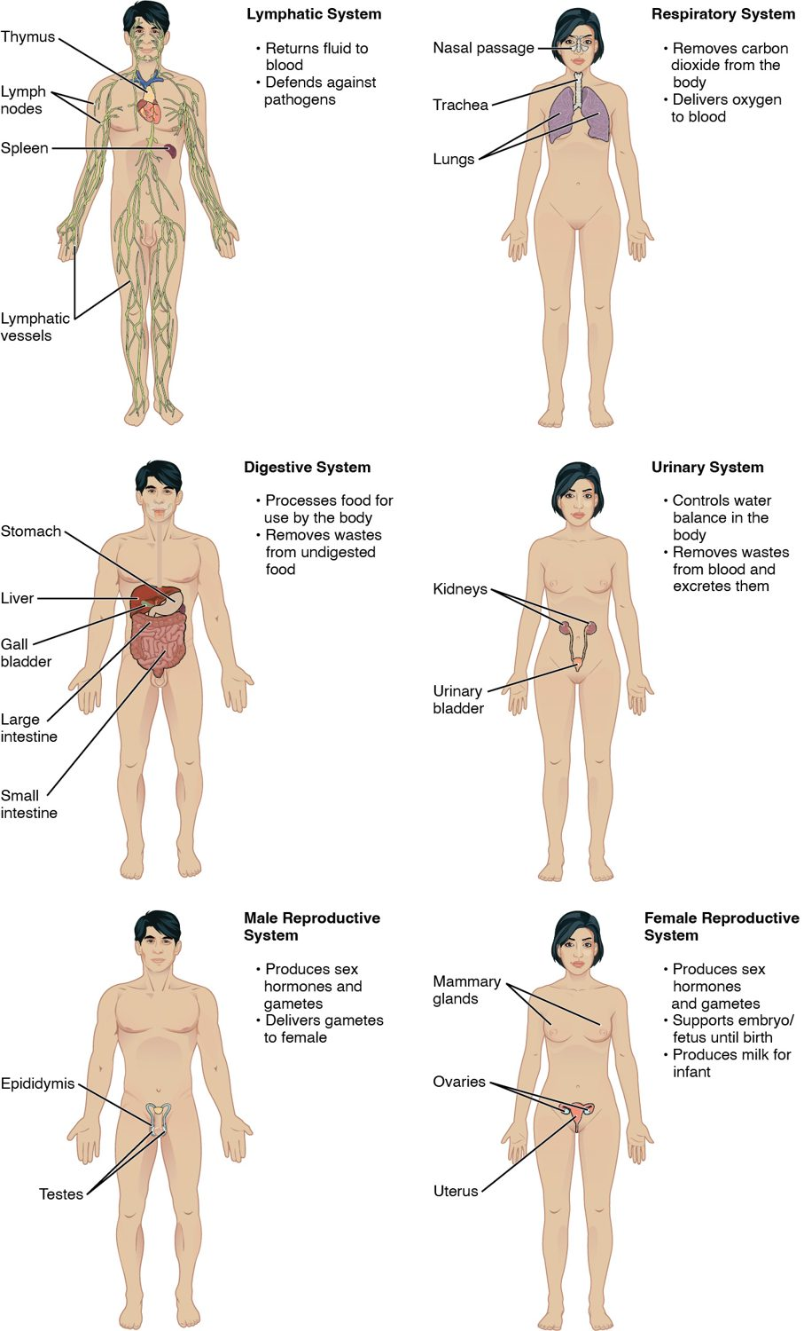
SECTION 1.2
Organ Systems of the Body (II)
Lymphatic/immune and respiratory systems
Digestive and urinary systems
Male and female reproductive systems
All eleven systems work interdependently
Organ systems and their major organs (part 2)
PN 104 · Ch 1 — An Introduction to the Human Body
8

Slide 9
1.3
SECTION
Functions of Human Life
The processes that distinguish the living human body — organization, metabolism, responsiveness, and more.

Slide 10
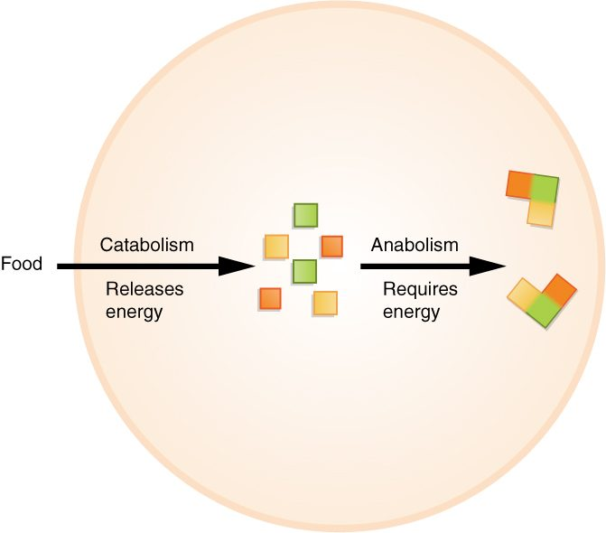
SECTION 1.3
Functions of Human Life
Organization, metabolism, responsiveness
Movement, development, and reproduction
Metabolism = catabolism + anabolism
Catabolism releases energy; anabolism builds
Metabolism: catabolism releases energy, anabolism uses it
PN 104 · Ch 1 — An Introduction to the Human Body
10

Slide 11
1.4
SECTION
Requirements for Human Life
Oxygen, nutrients, water, and narrow ranges of temperature and atmospheric pressure.

Slide 12
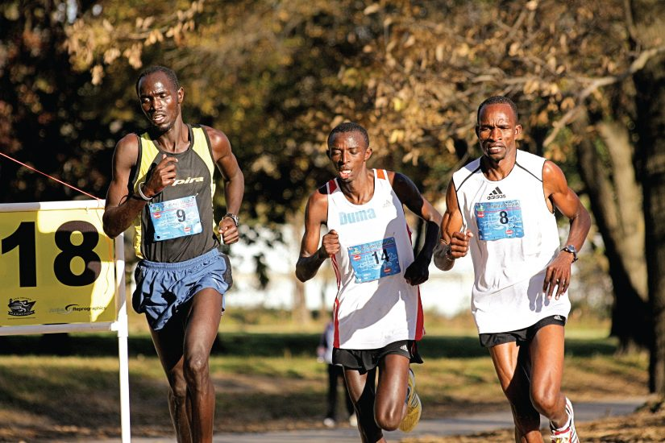
SECTION 1.4
Requirements for Human Survival
Oxygen, nutrients, and water
Narrow ranges of temperature and pressure
Demand rises sharply during activity
Survival depends on meeting all of these
The body's demands climb steeply with activity
PN 104 · Ch 1 — An Introduction to the Human Body
12

Slide 13
1.5
SECTION
Homeostasis
How the body maintains a stable internal environment through feedback.

Slide 14
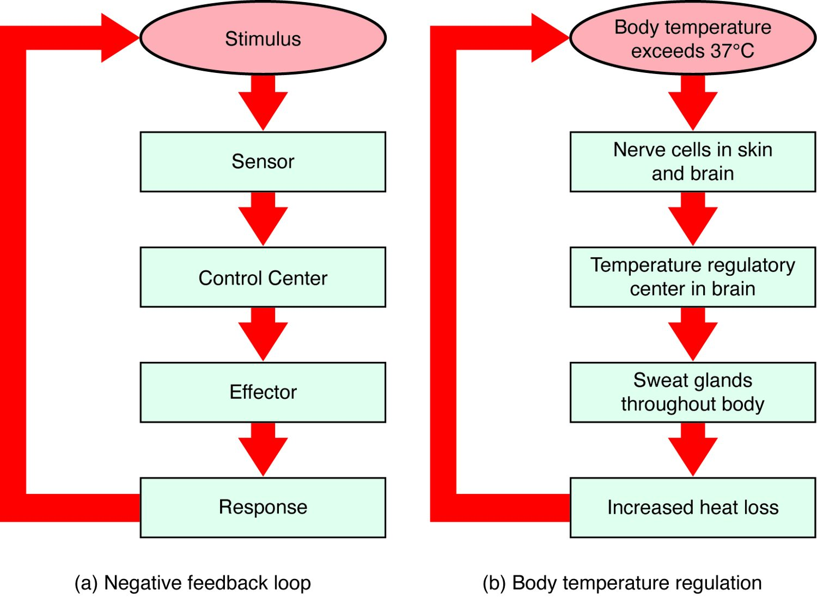
SECTION 1.5
Homeostasis & Negative Feedback
Homeostasis = a stable internal environment
Negative feedback reverses a change
Stimulus → sensor → control center → effector
Example: temperature regulation by sweating
The negative-feedback loop and body-temperature control
PN 104 · Ch 1 — An Introduction to the Human Body
14

Slide 15
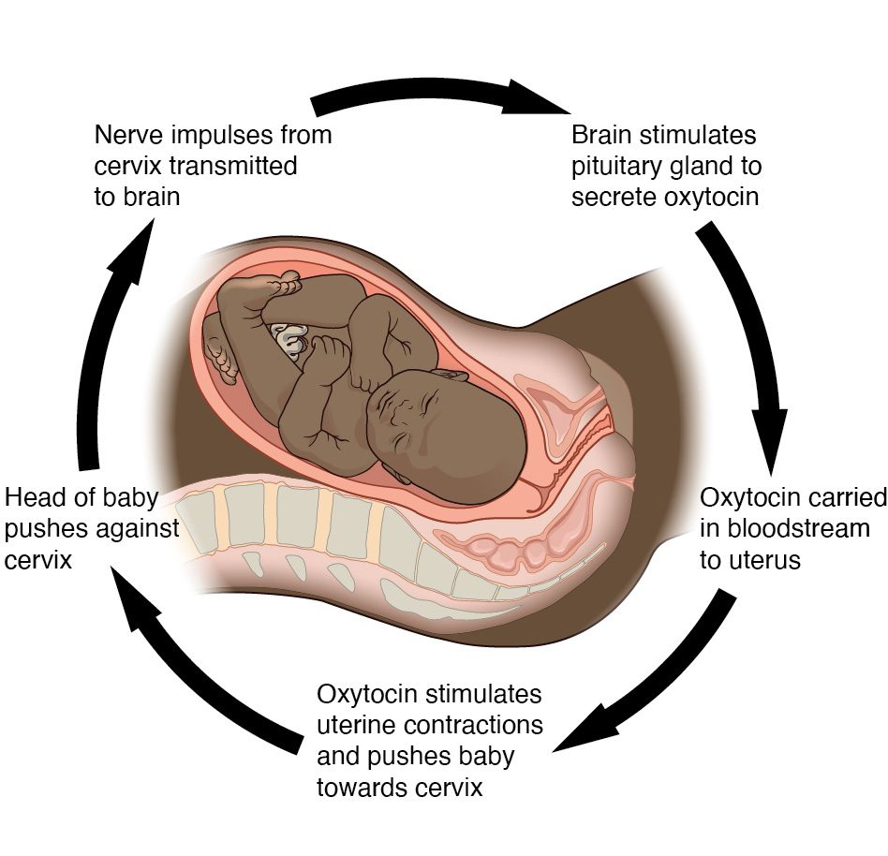
SECTION 1.5
Positive Feedback
Amplifies a change rather than reversing it
Reserved for rapid, self-limiting events
Example: oxytocin during labor and childbirth
Also drives the blood-clotting cascade
Positive feedback: oxytocin intensifies labor contractions
PN 104 · Ch 1 — An Introduction to the Human Body
15

Slide 16
1.6
SECTION
Anatomical Terminology
The standardized language of position, direction, planes, cavities, and regions.

Slide 17
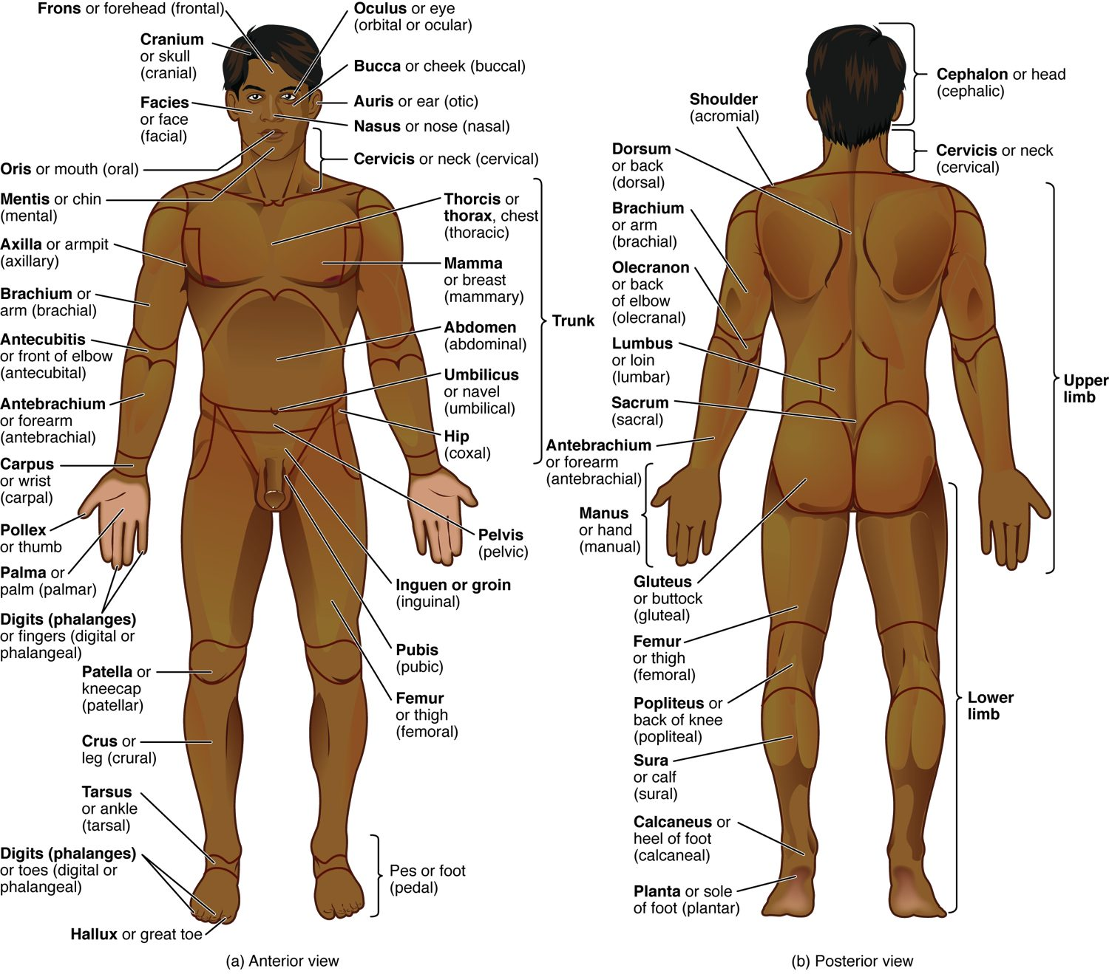
SECTION 1.6
Anatomical Position & Body Regions
Anatomical position is the reference posture
Standing, facing forward, palms forward
Regional terms name specific body areas
A shared language prevents miscommunication
Anatomical position with regional terms (anterior and posterior)
PN 104 · Ch 1 — An Introduction to the Human Body
17

Slide 18
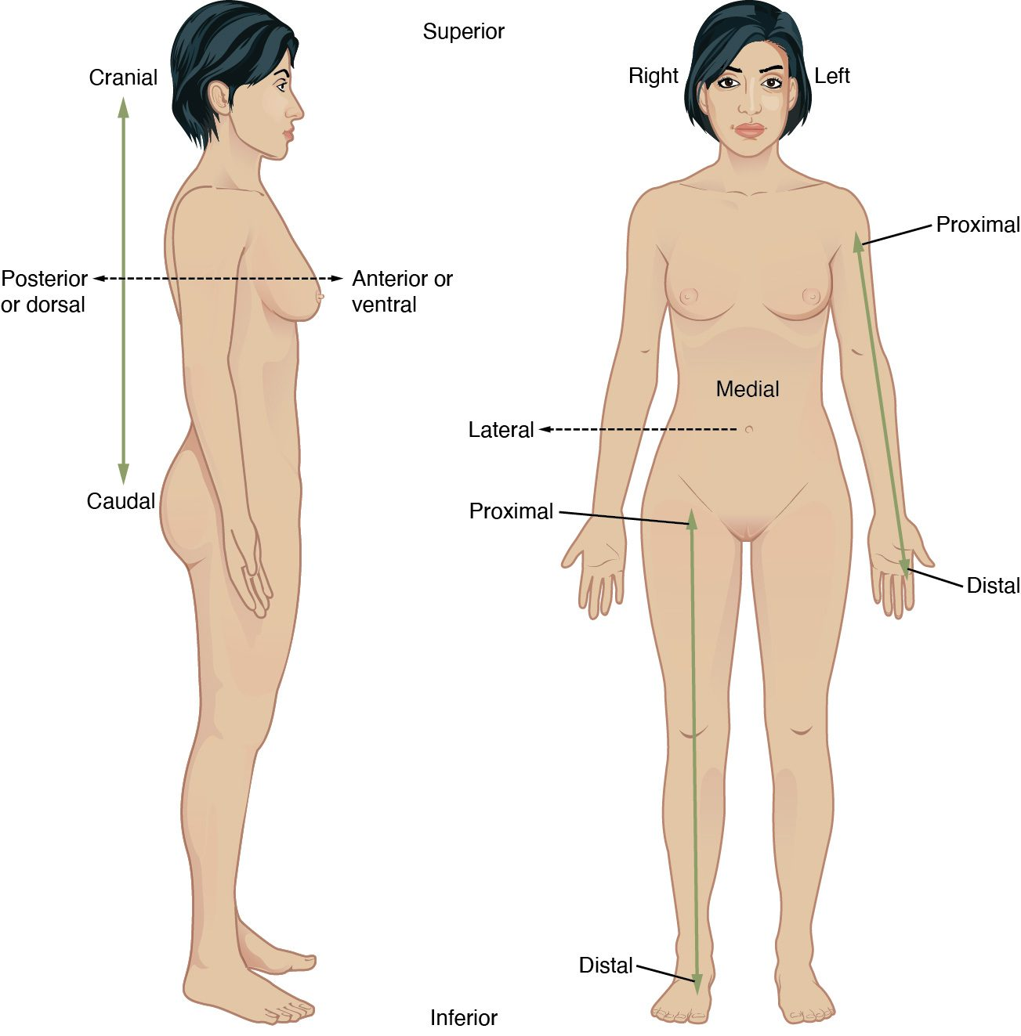
SECTION 1.6
Directional Terms
Superior/inferior, anterior/posterior
Medial/lateral, proximal/distal
Superficial/deep
Always described from anatomical position
Directional terms used to relate body structures
PN 104 · Ch 1 — An Introduction to the Human Body
18

Slide 19
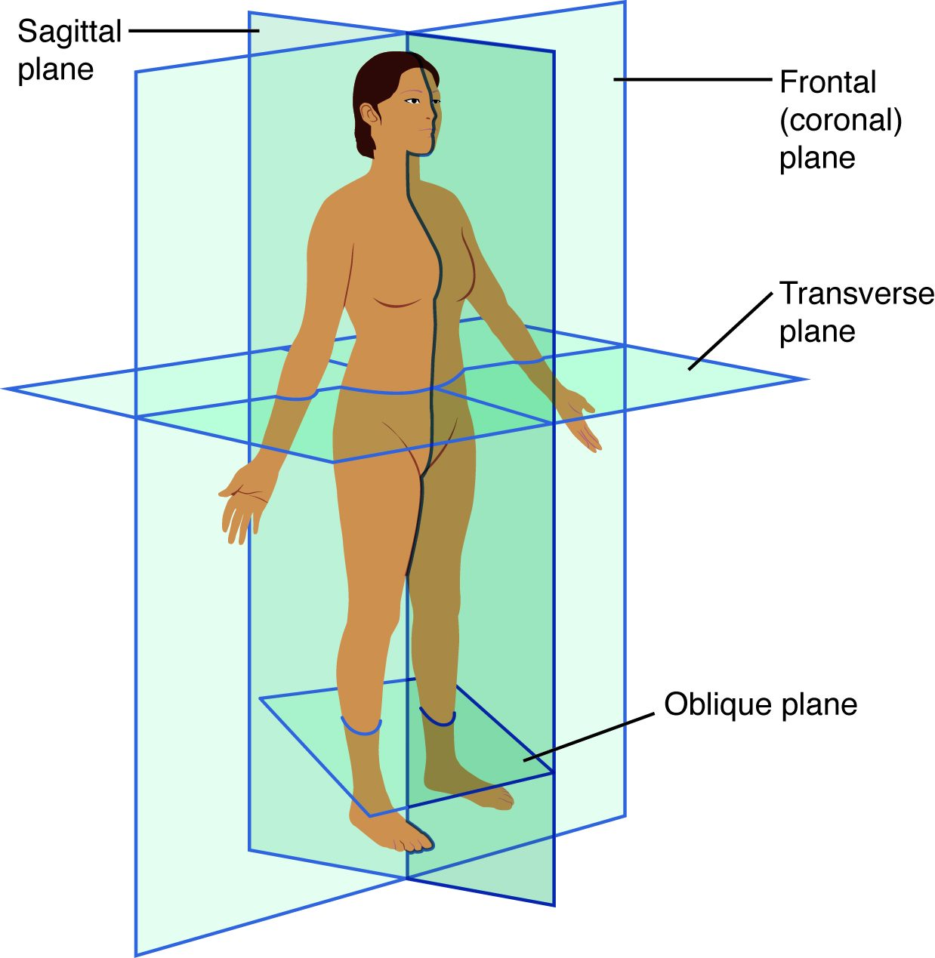
SECTION 1.6
Planes of Section
Sagittal plane divides left and right
Frontal (coronal) divides front and back
Transverse divides superior and inferior
Imaging studies are read in these planes
The sagittal, frontal, and transverse planes
PN 104 · Ch 1 — An Introduction to the Human Body
19

Slide 20
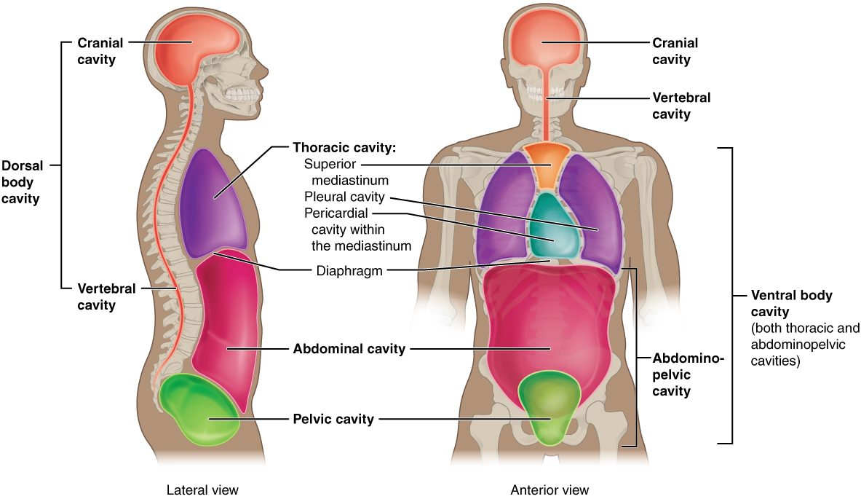
SECTION 1.6
Body Cavities & Membranes
The dorsal and ventral body cavities
Dorsal cavity: cranial and vertebral
Ventral cavity: thoracic and abdominopelvic
The diaphragm separates thorax and abdomen
Cavities protect and organize the organs
PN 104 · Ch 1 — An Introduction to the Human Body
20

Slide 21
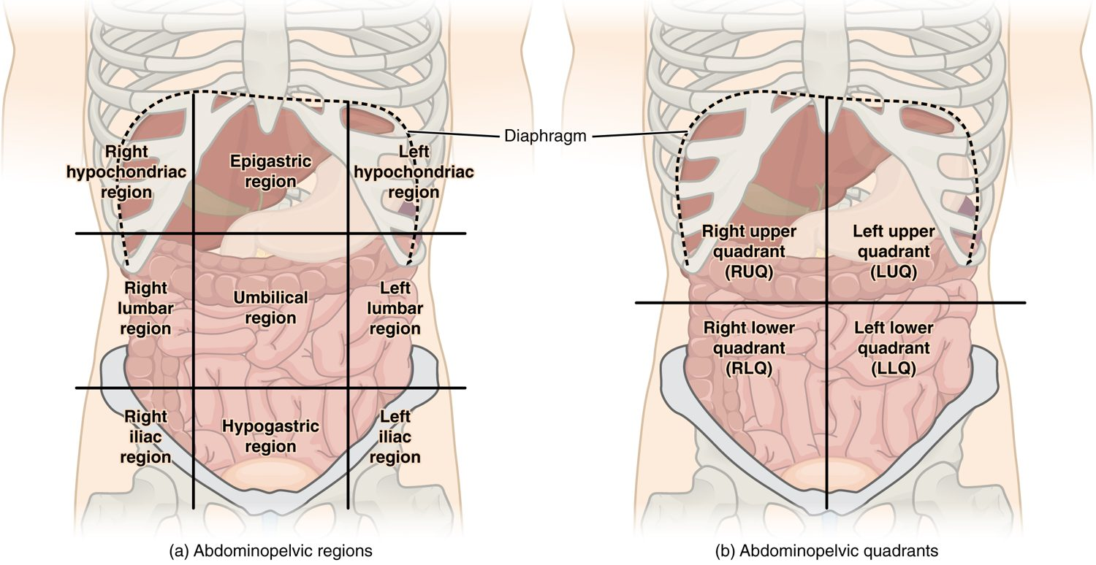
SECTION 1.6
Abdominal Regions & Quadrants
The nine abdominal regions and four quadrants
Four quadrants: RUQ, LUQ, RLQ, LLQ
Nine regions allow finer localization
Used to describe pain and organ location
RLQ pain → think appendicitis
PN 104 · Ch 1 — An Introduction to the Human Body
21

Slide 22
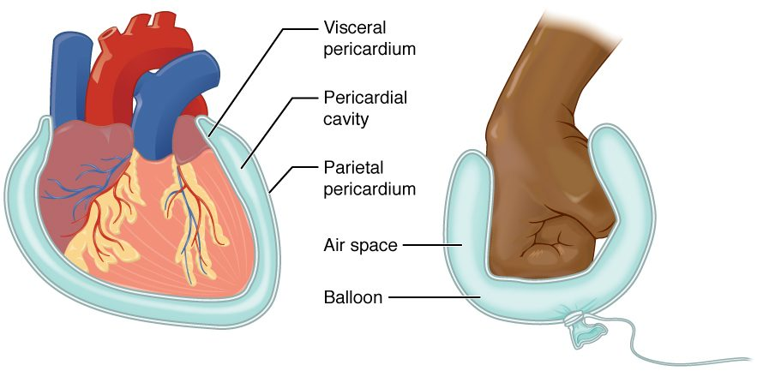
SECTION 1.6
Serous Membranes
Line cavities and cover the organs
Parietal layer lines the wall; visceral covers the organ
Serous fluid reduces friction
Examples: pericardium, pleura, peritoneum
Serous membrane structure (balloon-and-fist analogy)
PN 104 · Ch 1 — An Introduction to the Human Body
22

Slide 23
1.7
SECTION
Medical Imaging
Seeing inside the living body — radiography, CT, MRI, PET, and ultrasound.

Slide 24
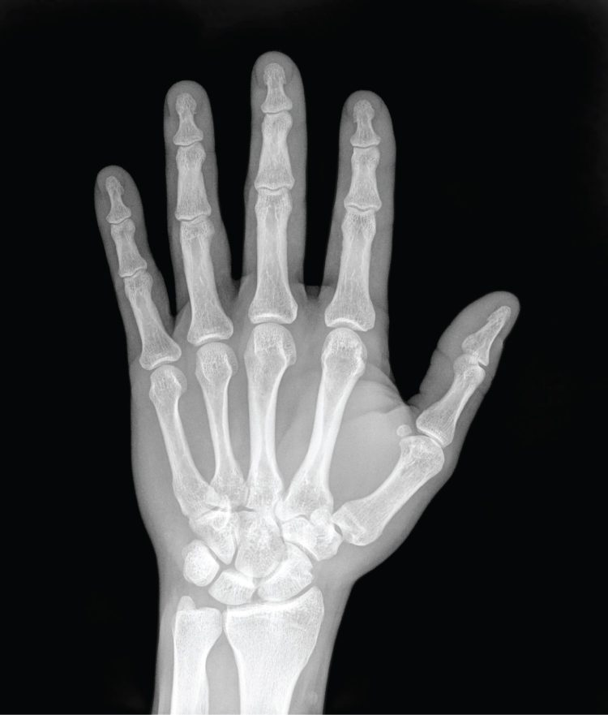
SECTION 1.7
Medical Imaging — Radiography
X-rays show dense structures like bone
Quick, inexpensive, and widely available
Limited soft-tissue detail
First-line for suspected fractures
A plain radiograph (X-ray) of the hand
PN 104 · Ch 1 — An Introduction to the Human Body
24

Slide 25
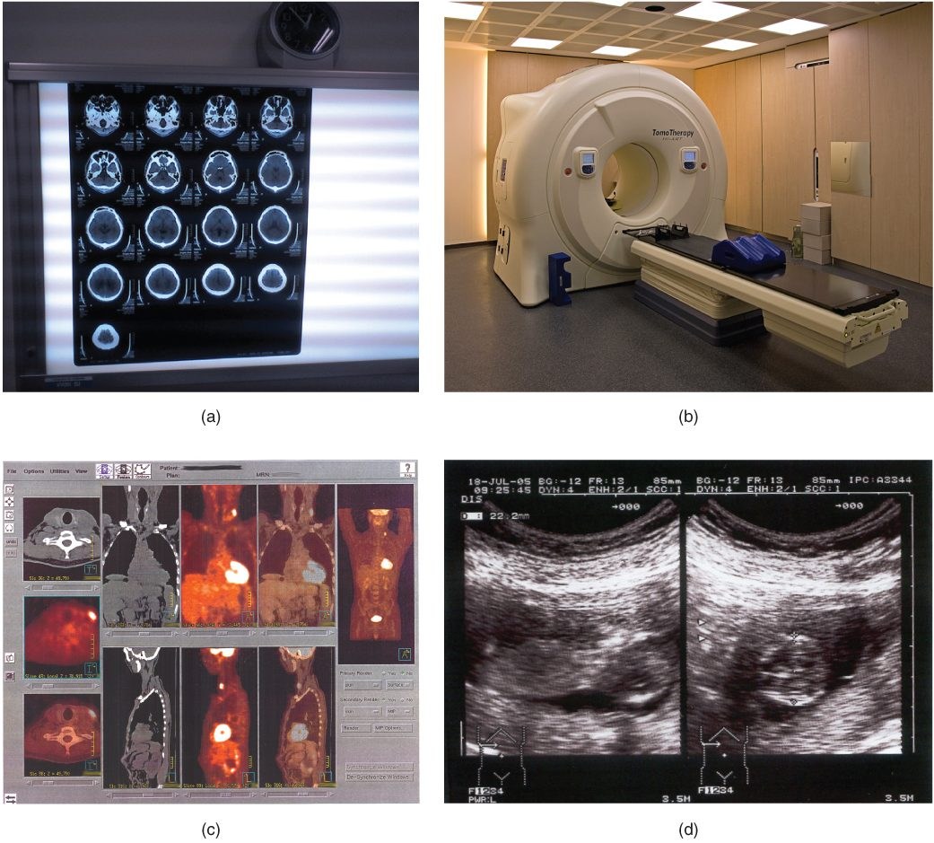
SECTION 1.7
Imaging Modalities Compared
CT: cross-sectional X-ray, excellent for trauma
MRI: magnetic, superb soft-tissue detail
PET: shows metabolic activity
Ultrasound: safe, real-time, no radiation
Common imaging modalities and their uses
PN 104 · Ch 1 — An Introduction to the Human Body
25

Slide 26
CHAPTER 1
Key Takeaways
Anatomy is structure and physiology is function — the two are inseparable.
The body is organized in six levels, from the chemical level to the organism.
Eleven organ systems work together to keep the body alive.
Homeostasis, maintained mainly by negative feedback, keeps internal conditions stable.
Anatomical terminology gives a precise, shared language for safe practice.
PN 104 · Ch 1 — An Introduction to the Human Body
26

Slide 27
CLINICAL CONNECTIONS
Why the Basics Matter in Practical Nursing
Vital Signs
Assessment Language
Temperature, BP, HR, and RR are homeostasis you measure every shift.
Directional terms and quadrants make documentation precise and safe.
Abdominal Assessment
Feedback Loops
Quadrants and regions localize pain to the underlying organs.
Fever, blood-glucose, and BP control all follow feedback mechanisms.
Reading Imaging
Whole-Person Care
Knowing the planes and modalities helps you interpret and explain studies.
Systems are interdependent — one failing system affects the rest.

