Slide 1
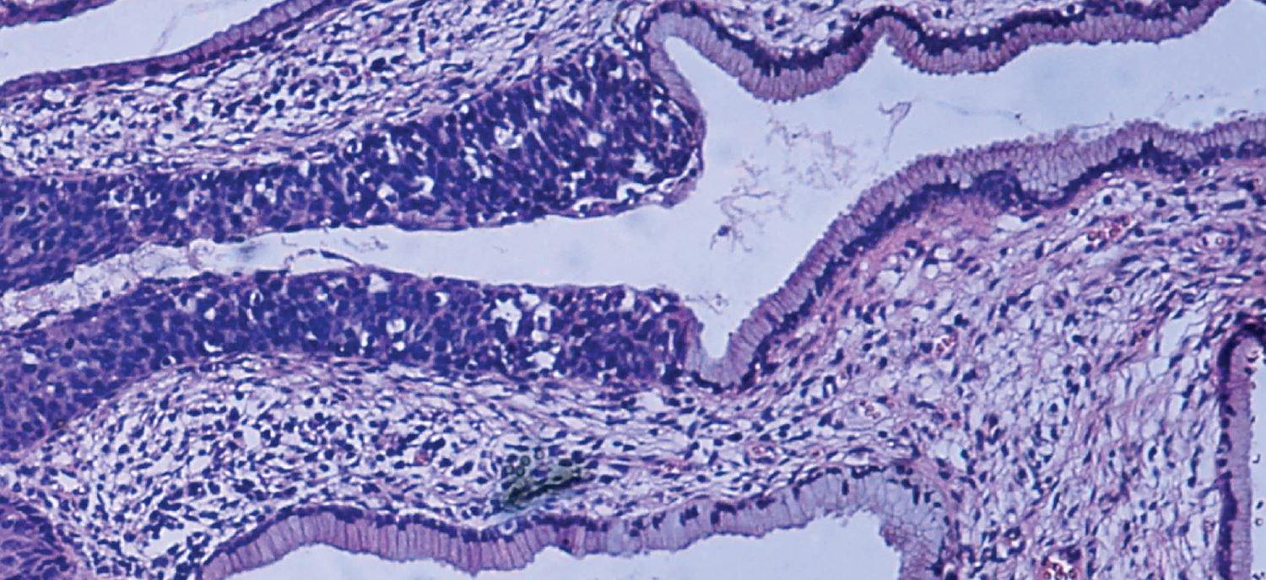
CHAPTER 4
The Tissue Level of Organization
The four primary tissues, their membranes, and how tissues heal.
Anatomy & Physiology · Broward-Miami Health Institute
FACULTY EDITION
Notes:
READ ALOUD SCRIPT
Today we are beginning Chapter 4, the tissue level of organization. In this chapter, we will connect the major structures and processes with their functions and with the observations that matter in practical nursing care. As we move through the slides, focus on how this system supports circulation, perfusion, protection, and patient safety. By the end, you should be able to explain the major concepts in your own words and apply them to a patient-care situation.
[Sources]
- BMHI PN 104 Chapter 4 faculty PowerPoint slide content.

Slide 2
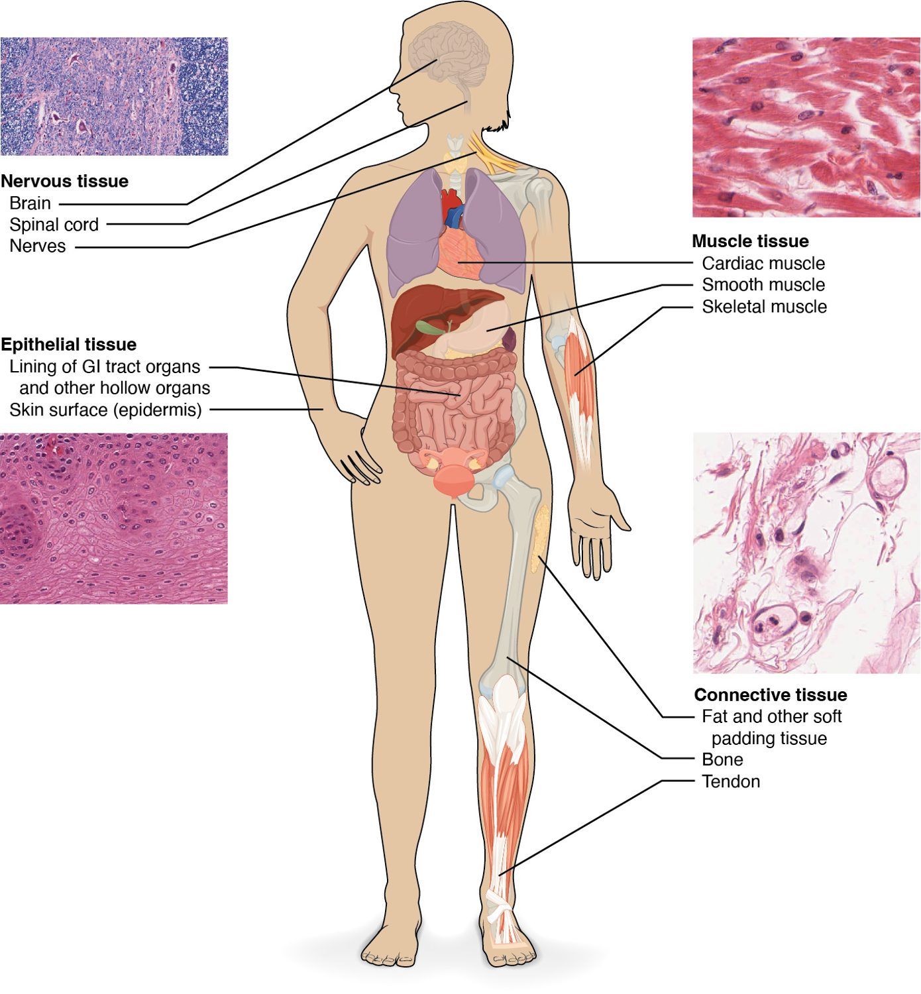
CHAPTER 4
Learning Objectives
After studying this chapter, students will be able to:
1
Identify the main tissue types and discuss their roles in the human body
2
Identify the four types of tissue membranes and the characteristics of each that make them functional
3
Explain the functions of various epithelial tissues and how their forms enable their functions
4
Explain the functions of various connective tissues and how their forms enable their functions
5
Describe the characteristics of muscle tissue and how these enable function
Four primary tissue types build every organ.
PN 104 · Ch 4 — The Tissue Level of Organization
2
Notes:
READ ALOUD SCRIPT
These are our learning objectives for Chapter 4. By the end of the chapter, you should be able to do the following: Identify the main tissue types and discuss their roles in the human body. Identify the four types of tissue membranes and the characteristics of each that make them functional. Explain the functions of various epithelial tissues and how their forms enable their functions. Explain the functions of various connective tissues and how their forms enable their functions. Describe the characteristics of muscle tissue and how these enable function. Do not treat these as isolated facts. Use them as a checklist for what you should be able to identify, explain, and connect to safe practical nursing care.
[Sources]
- BMHI PN 104 Chapter 4 faculty PowerPoint slide content.

Slide 3
4.1
SECTION
Types of Tissues
The four primary tissues and the membranes they form.
Notes:
READ ALOUD SCRIPT
We are now moving into Types of Tissues. The four primary tissues and the membranes they form. As we begin this section, listen for the major structures, their locations, and the functions they perform. Then ask yourself what a change in this area might look like during patient care.
[Sources]
- BMHI PN 104 Chapter 4 faculty PowerPoint slide content.

Slide 4
SECTION 4.1
The Four Tissue Types
Epithelial, connective, muscle, nervous
Tissue = similar cells + their matrix
Tissues combine to form organs
Each type has distinct functions
The four primary tissue types
PN 104 · Ch 4 — The Tissue Level of Organization
4
Notes:
READ ALOUD SCRIPT
Now let's focus on The Four Tissue Types. The four primary tissue types. Epithelial, connective, muscle, nervous. Tissue = similar cells + their matrix. Tissues combine to form organs. Each type has distinct functions. Epithelial tissue protects surfaces and forms glands, so connect disruption with infection risk, fluid loss, impaired secretion, and delayed healing. Take a moment to identify the structure on the image and explain how its form supports its function. This is slide 4 of 24.
[Sources]
- BMHI PN 104 Chapter 4 faculty PowerPoint slide content.

Slide 5
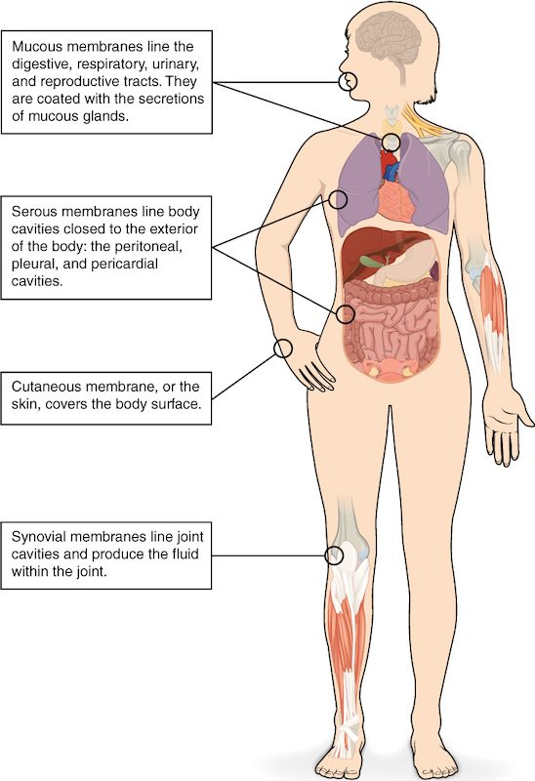
SECTION 4.1
Body Membranes
Membranes line and cover surfaces
Mucous membranes line passages to the outside
Serous membranes line closed cavities
The cutaneous membrane is the skin
The body's epithelial membranes
PN 104 · Ch 4 — The Tissue Level of Organization
5
Notes:
READ ALOUD SCRIPT
Now let's focus on Body Membranes. The body's epithelial membranes. Membranes line and cover surfaces. Mucous membranes line passages to the outside. Serous membranes line closed cavities. The cutaneous membrane is the skin. Epithelial tissue protects surfaces and forms glands, so connect disruption with infection risk, fluid loss, impaired secretion, and delayed healing. Take a moment to identify the structure on the image and explain how its form supports its function. This is slide 5 of 24.
[Sources]
- BMHI PN 104 Chapter 4 faculty PowerPoint slide content.

Slide 6
4.2
SECTION
Epithelial Tissue
Covering and lining tissue — classified by cell shape and layering.
Notes:
READ ALOUD SCRIPT
We are now moving into Epithelial Tissue. Covering and lining tissue — classified by cell shape and layering. As we begin this section, listen for the major structures, their locations, and the functions they perform. Then ask yourself what a change in this area might look like during patient care.
[Sources]
- BMHI PN 104 Chapter 4 faculty PowerPoint slide content.

Slide 7
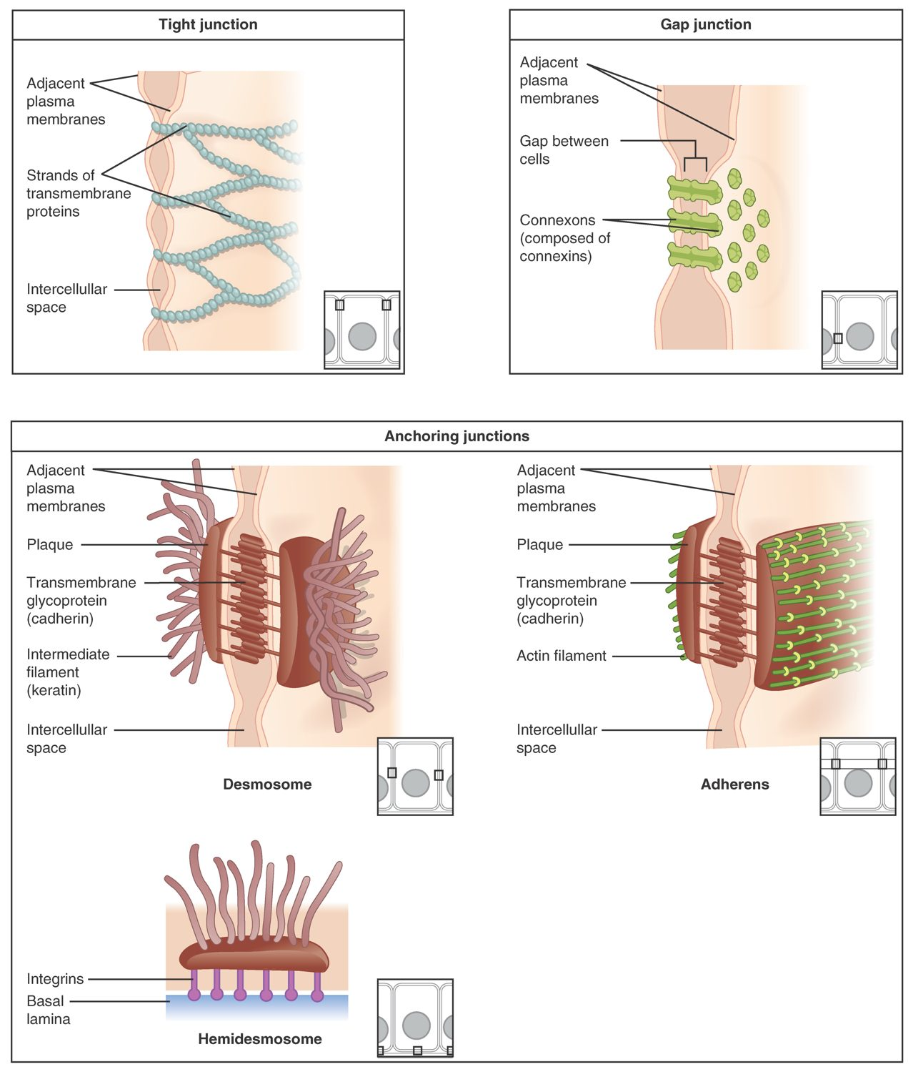
SECTION 4.2
Cell Junctions
Bind epithelial cells together
Tight junctions seal gaps
Desmosomes anchor cells
Gap junctions allow communication
Types of cell junctions
PN 104 · Ch 4 — The Tissue Level of Organization
7
Notes:
READ ALOUD SCRIPT
Now let's focus on Cell Junctions. Types of cell junctions. Bind epithelial cells together. Tight junctions seal gaps. Desmosomes anchor cells. Gap junctions allow communication. Epithelial tissue protects surfaces and forms glands, so connect disruption with infection risk, fluid loss, impaired secretion, and delayed healing. Take a moment to identify the structure on the image and explain how its form supports its function. This is slide 7 of 24.
[Sources]
- BMHI PN 104 Chapter 4 faculty PowerPoint slide content.

Slide 8
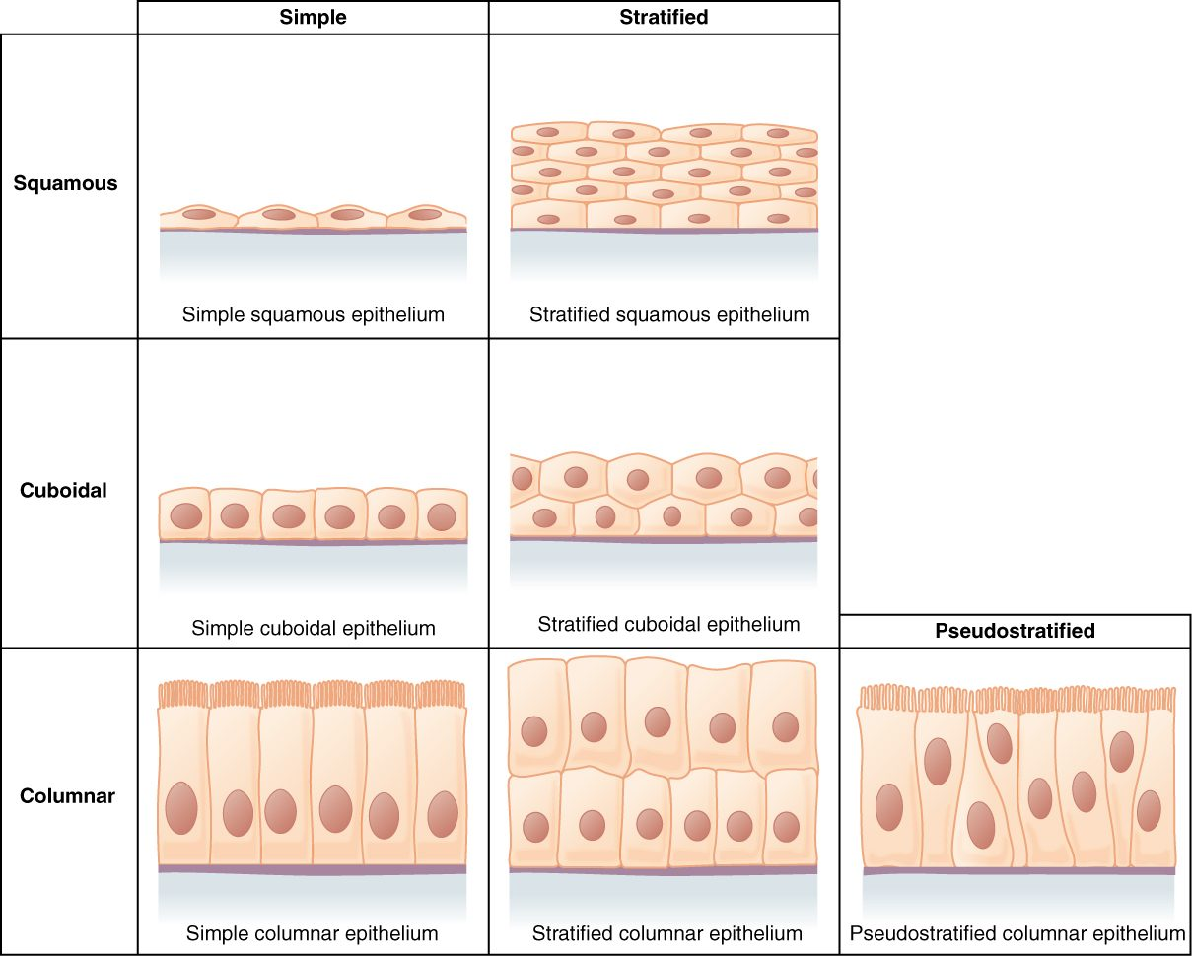
SECTION 4.2
Classifying Epithelium
Named by cell shape and number of layers
Shapes: squamous, cuboidal, columnar
Simple (one layer) vs. stratified (many)
Structure matches function
Classification of epithelial tissues
PN 104 · Ch 4 — The Tissue Level of Organization
8
Notes:
READ ALOUD SCRIPT
Now let's focus on Classifying Epithelium. Named by cell shape and number of layers. Shapes: squamous, cuboidal, columnar. Simple (one layer) vs. stratified (many). Structure matches function. Classification of epithelial tissues. Epithelial tissue protects surfaces and forms glands, so connect disruption with infection risk, fluid loss, impaired secretion, and delayed healing. Take a moment to identify the structure on the image and explain how its form supports its function. This is slide 8 of 24.
[Sources]
- BMHI PN 104 Chapter 4 faculty PowerPoint slide content.

Slide 9
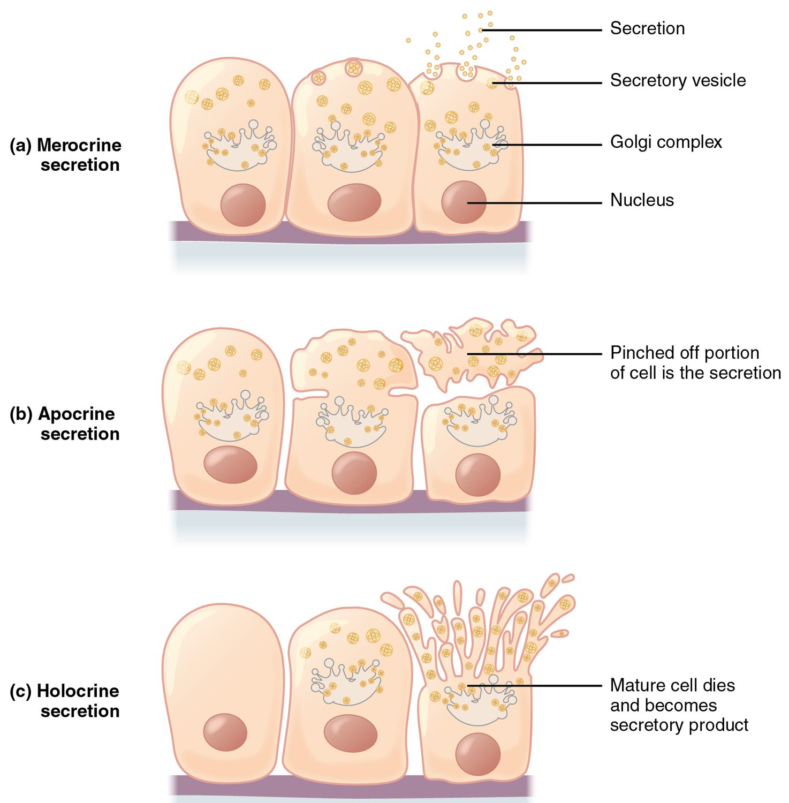
SECTION 4.2
Modes of Glandular Secretion
Exocrine glands secrete onto surfaces
Merocrine: released by exocytosis
Apocrine: part of the cell pinches off
Holocrine: the whole cell ruptures
Merocrine, apocrine, and holocrine secretion
PN 104 · Ch 4 — The Tissue Level of Organization
9
Notes:
READ ALOUD SCRIPT
Now let's focus on Modes of Glandular Secretion. Exocrine glands secrete onto surfaces. Merocrine: released by exocytosis. Apocrine: part of the cell pinches off. Holocrine: the whole cell ruptures. Merocrine, apocrine, and holocrine secretion. At the tissue level, nursing assessment focuses on integrity, color, temperature, moisture, swelling, pain, drainage, sensation, movement, and signs of impaired healing. Take a moment to identify the structure on the image and explain how its form supports its function. This is slide 9 of 24.
[Sources]
- BMHI PN 104 Chapter 4 faculty PowerPoint slide content.

Slide 10
4.3
SECTION
Connective Tissue Supports and Protects
The body's most diverse tissue — binding, supporting, and transporting.
Notes:
READ ALOUD SCRIPT
We are now moving into Connective Tissue Supports and Protects. The body's most diverse tissue — binding, supporting, and transporting. As we begin this section, listen for the major structures, their locations, and the functions they perform. Then ask yourself what a change in this area might look like during patient care.
[Sources]
- BMHI PN 104 Chapter 4 faculty PowerPoint slide content.

Slide 11
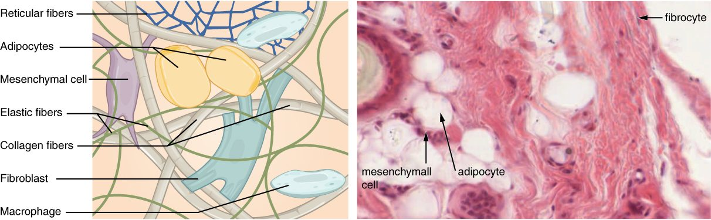
SECTION 4.3
Connective Tissue Overview
Loose connective tissue and its components
Cells scattered in an extracellular matrix
Matrix = ground substance + fibers
Fibroblasts and immune cells reside here
The most abundant, diverse tissue
PN 104 · Ch 4 — The Tissue Level of Organization
11
Notes:
READ ALOUD SCRIPT
Now let's focus on Connective Tissue Overview. Loose connective tissue and its components. Cells scattered in an extracellular matrix. Matrix = ground substance + fibers. Fibroblasts and immune cells reside here. The most abundant, diverse tissue. Connective tissue supports, binds, stores, and transports; injury or disease may appear as poor wound strength, swelling, reduced mobility, or altered cushioning and insulation. Take a moment to identify the structure on the image and explain how its form supports its function. This is slide 11 of 24.
[Sources]
- BMHI PN 104 Chapter 4 faculty PowerPoint slide content.

Slide 12
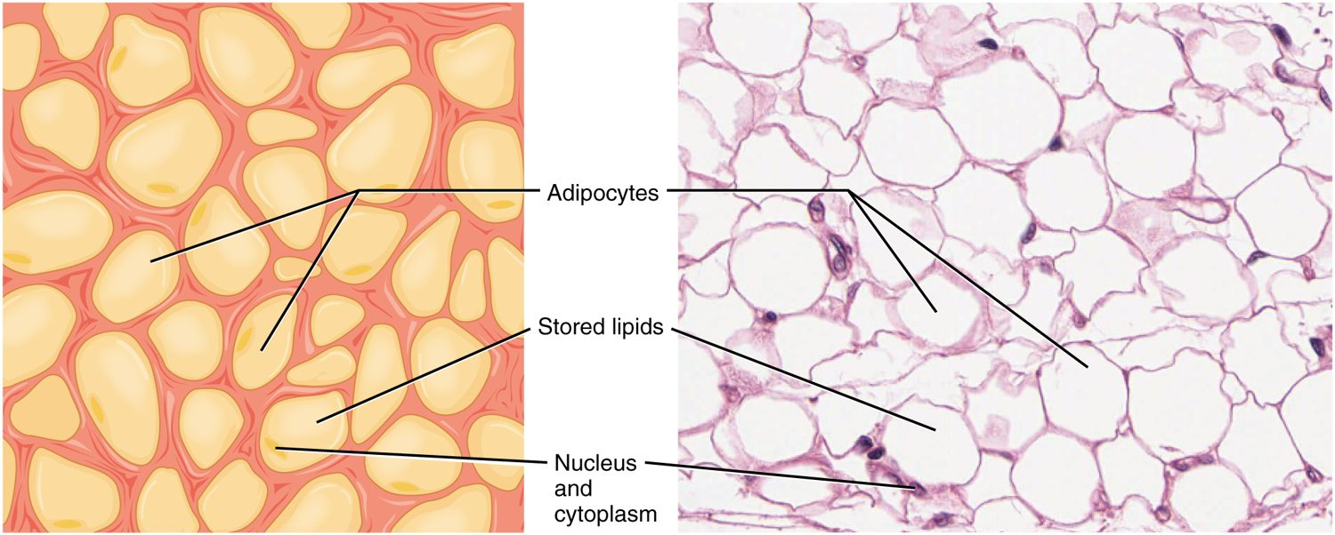
SECTION 4.3
Adipose Tissue
Adipose (fat) tissue
Stores energy as fat
Cushions and insulates organs
Cells are filled with lipid droplets
An active endocrine tissue
PN 104 · Ch 4 — The Tissue Level of Organization
12
Notes:
READ ALOUD SCRIPT
Now let's focus on Adipose Tissue. Adipose (fat) tissue. Stores energy as fat. Cushions and insulates organs. Cells are filled with lipid droplets. An active endocrine tissue. Connective tissue supports, binds, stores, and transports; injury or disease may appear as poor wound strength, swelling, reduced mobility, or altered cushioning and insulation. Take a moment to identify the structure on the image and explain how its form supports its function. This is slide 12 of 24.
[Sources]
- BMHI PN 104 Chapter 4 faculty PowerPoint slide content.

Slide 13
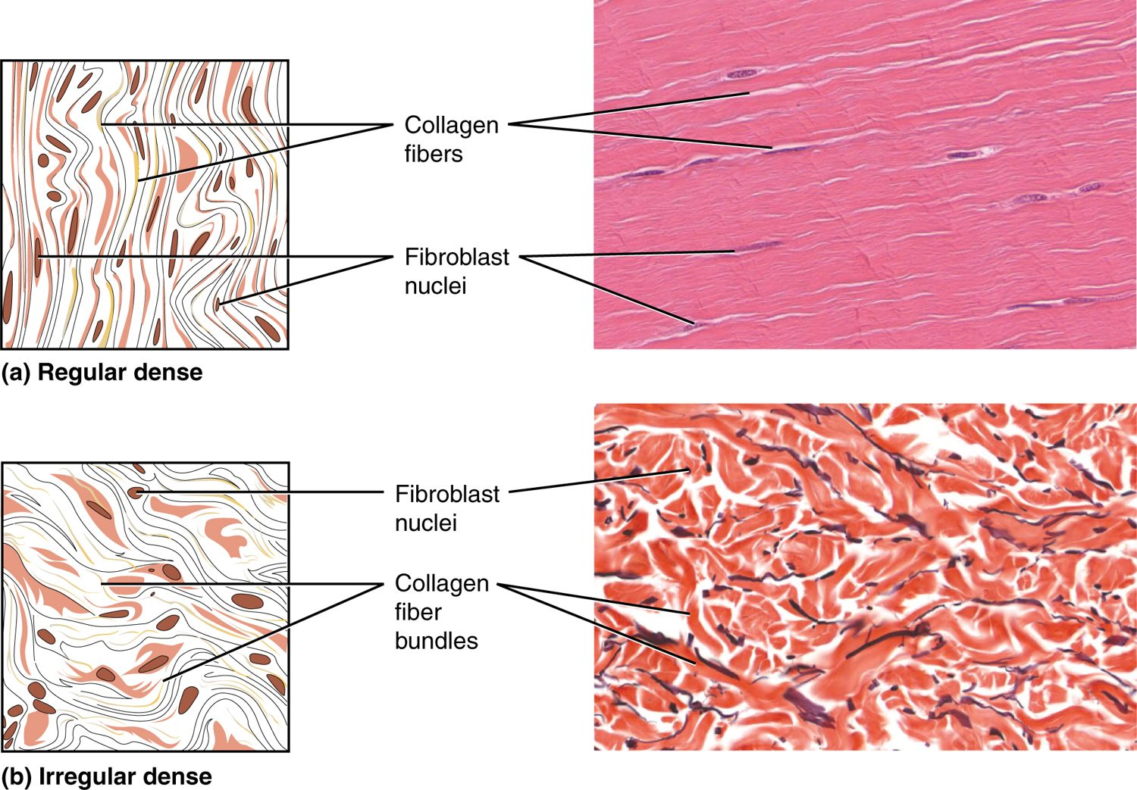
SECTION 4.3
Dense Connective Tissue
Packed with collagen fibers
Dense regular: tendons and ligaments
Dense irregular: dermis and capsules
Provides tensile strength
Dense regular and irregular connective tissue
PN 104 · Ch 4 — The Tissue Level of Organization
13
Notes:
READ ALOUD SCRIPT
Now let's focus on Dense Connective Tissue. Packed with collagen fibers. Dense regular: tendons and ligaments. Dense irregular: dermis and capsules. Provides tensile strength. Dense regular and irregular connective tissue. Connective tissue supports, binds, stores, and transports; injury or disease may appear as poor wound strength, swelling, reduced mobility, or altered cushioning and insulation. Take a moment to identify the structure on the image and explain how its form supports its function. This is slide 13 of 24.
[Sources]
- BMHI PN 104 Chapter 4 faculty PowerPoint slide content.

Slide 14
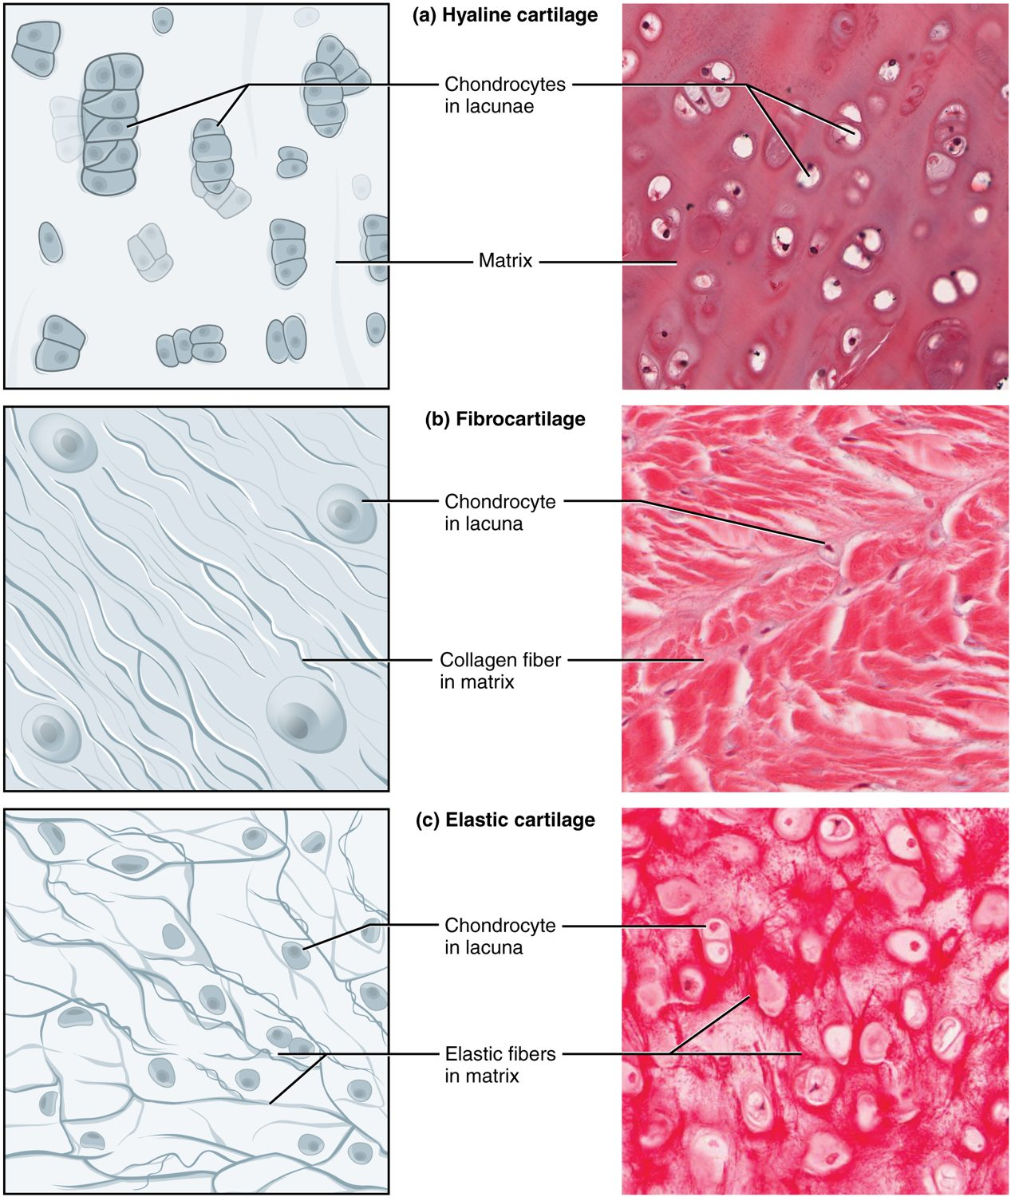
SECTION 4.3
Cartilage
Firm but flexible matrix
Hyaline: joints, nose, trachea
Fibrocartilage: discs and menisci
Elastic: ear and epiglottis
Hyaline, fibrocartilage, and elastic cartilage
PN 104 · Ch 4 — The Tissue Level of Organization
14
Notes:
READ ALOUD SCRIPT
Now let's focus on Cartilage. Hyaline, fibrocartilage, and elastic cartilage. Firm but flexible matrix. Hyaline: joints, nose, trachea. Fibrocartilage: discs and menisci. Elastic: ear and epiglottis. At the tissue level, nursing assessment focuses on integrity, color, temperature, moisture, swelling, pain, drainage, sensation, movement, and signs of impaired healing. Take a moment to identify the structure on the image and explain how its form supports its function. This is slide 14 of 24.
[Sources]
- BMHI PN 104 Chapter 4 faculty PowerPoint slide content.

Slide 15
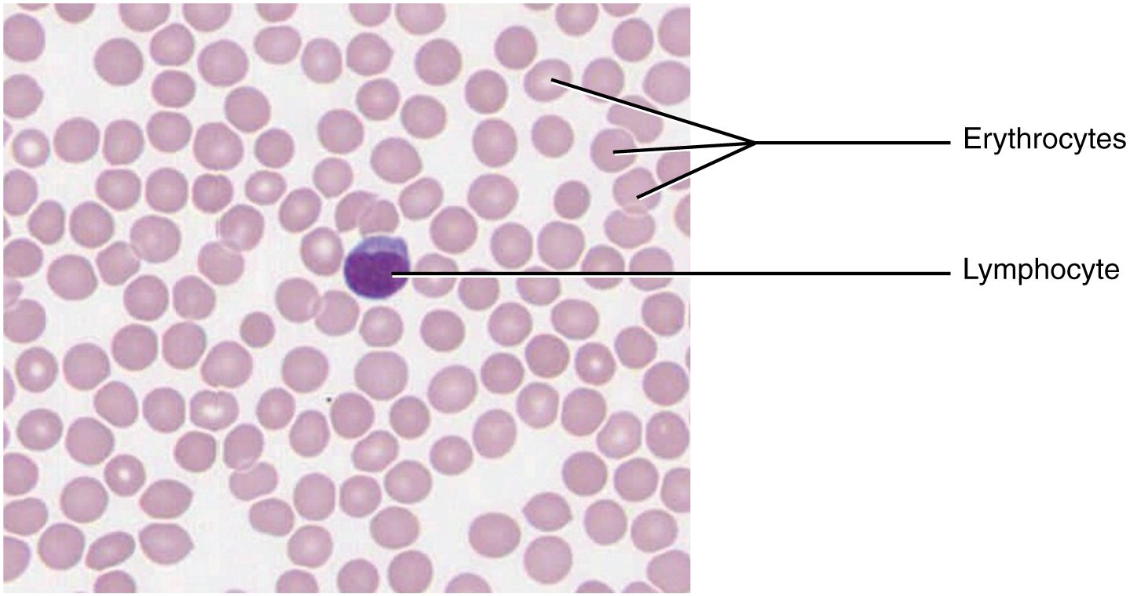
SECTION 4.3
Blood
Blood: erythrocytes and leukocytes
A fluid connective tissue
Plasma is the liquid matrix
Red cells carry oxygen
White cells defend; platelets clot
PN 104 · Ch 4 — The Tissue Level of Organization
15
Notes:
READ ALOUD SCRIPT
Now let's focus on Blood. Blood: erythrocytes and leukocytes. A fluid connective tissue. Plasma is the liquid matrix. Red cells carry oxygen. White cells defend; platelets clot. Connective tissue supports, binds, stores, and transports; injury or disease may appear as poor wound strength, swelling, reduced mobility, or altered cushioning and insulation. Take a moment to identify the structure on the image and explain how its form supports its function. This is slide 15 of 24.
[Sources]
- BMHI PN 104 Chapter 4 faculty PowerPoint slide content.

Slide 16
4.4
SECTION
Muscle Tissue and Motion
The three muscle types that generate movement.
Notes:
READ ALOUD SCRIPT
We are now moving into Muscle Tissue and Motion. The three muscle types that generate movement. As we begin this section, listen for the major structures, their locations, and the functions they perform. Then ask yourself what a change in this area might look like during patient care.
[Sources]
- BMHI PN 104 Chapter 4 faculty PowerPoint slide content.

Slide 17
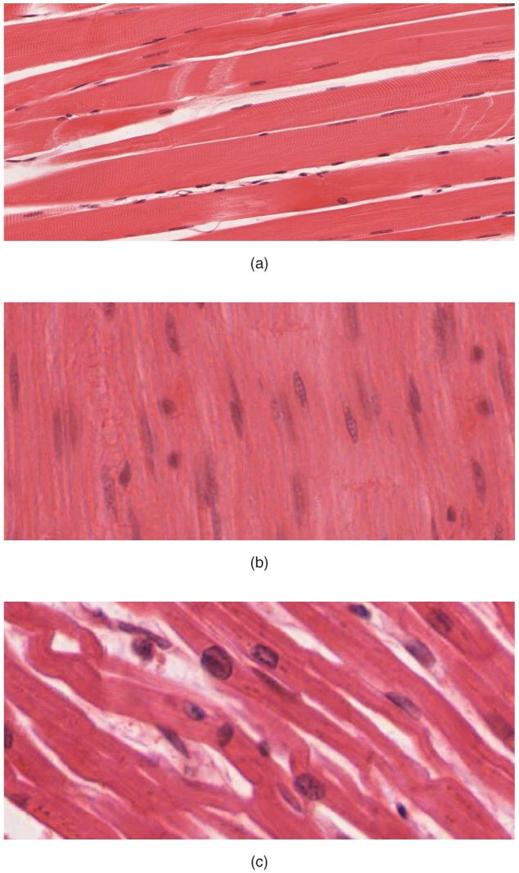
SECTION 4.4
The Three Muscle Tissues
Skeletal: voluntary, striated
Cardiac: involuntary, striated, branched
Smooth: involuntary, non-striated
All convert energy into movement
Skeletal, cardiac, and smooth muscle
PN 104 · Ch 4 — The Tissue Level of Organization
17
Notes:
READ ALOUD SCRIPT
Now let's focus on The Three Muscle Tissues. Skeletal, cardiac, and smooth muscle. Skeletal: voluntary, striated. Cardiac: involuntary, striated, branched. Smooth: involuntary, non-striated. All convert energy into movement. Relate muscle and nervous tissue to movement, sensation, communication, swallowing, breathing, circulation, and changes in functional status. Take a moment to identify the structure on the image and explain how its form supports its function. This is slide 17 of 24.
[Sources]
- BMHI PN 104 Chapter 4 faculty PowerPoint slide content.

Slide 18
4.5
SECTION
Nervous Tissue Mediates Perception and Response
The communication tissue — neurons and their supporting cells.
Notes:
READ ALOUD SCRIPT
We are now moving into Nervous Tissue Mediates Perception and Response. The communication tissue — neurons and their supporting cells. As we begin this section, listen for the major structures, their locations, and the functions they perform. Then ask yourself what a change in this area might look like during patient care.
[Sources]
- BMHI PN 104 Chapter 4 faculty PowerPoint slide content.

Slide 19
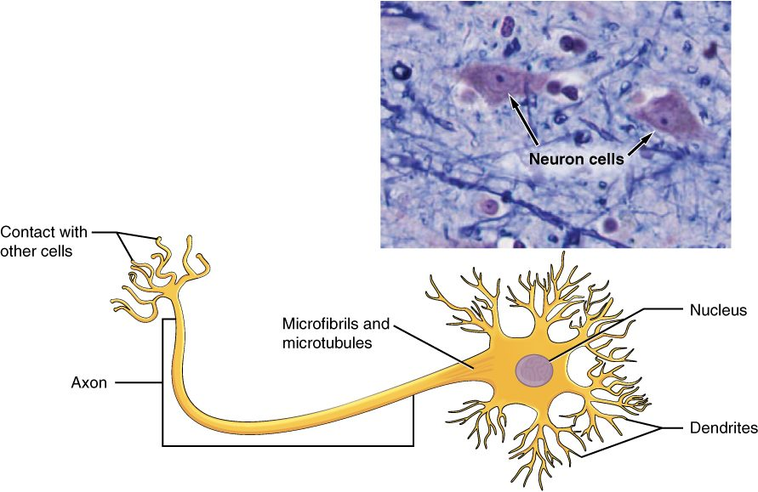
SECTION 4.5
Nervous Tissue
A neuron of nervous tissue
Neurons transmit electrical signals
Cell body, dendrites, and axon
Dendrites receive; axons send
Glial cells support neurons
PN 104 · Ch 4 — The Tissue Level of Organization
19
Notes:
READ ALOUD SCRIPT
Now let's focus on Nervous Tissue. A neuron of nervous tissue. Neurons transmit electrical signals. Cell body, dendrites, and axon. Dendrites receive; axons send. Glial cells support neurons. Relate muscle and nervous tissue to movement, sensation, communication, swallowing, breathing, circulation, and changes in functional status. Take a moment to identify the structure on the image and explain how its form supports its function. This is slide 19 of 24.
[Sources]
- BMHI PN 104 Chapter 4 faculty PowerPoint slide content.

Slide 20
4.6
SECTION
Tissue Injury and Aging
How tissues respond to damage, repair themselves, and change with age.
Notes:
READ ALOUD SCRIPT
We are now moving into Tissue Injury and Aging. How tissues respond to damage, repair themselves, and change with age. As we begin this section, listen for the major structures, their locations, and the functions they perform. Then ask yourself what a change in this area might look like during patient care.
[Sources]
- BMHI PN 104 Chapter 4 faculty PowerPoint slide content.

Slide 21
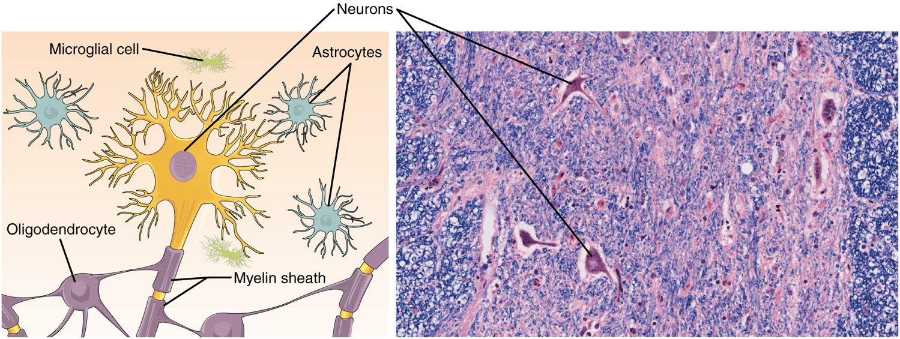
SECTION 4.6
Tissue Injury & Repair
The tissue inflammation and repair process
Inflammation is the first response
A clot forms and immune cells arrive
Granulation tissue rebuilds the area
Healing by regeneration or scarring
PN 104 · Ch 4 — The Tissue Level of Organization
21
Notes:
READ ALOUD SCRIPT
Now let's focus on Tissue Injury & Repair. The tissue inflammation and repair process. Inflammation is the first response. A clot forms and immune cells arrive. Granulation tissue rebuilds the area. Healing by regeneration or scarring. Healing depends on perfusion, oxygenation, nutrition, immune function, pressure relief, and control of moisture and contamination. Take a moment to identify the structure on the image and explain how its form supports its function. This is slide 21 of 24.
[Sources]
- BMHI PN 104 Chapter 4 faculty PowerPoint slide content.

Slide 22
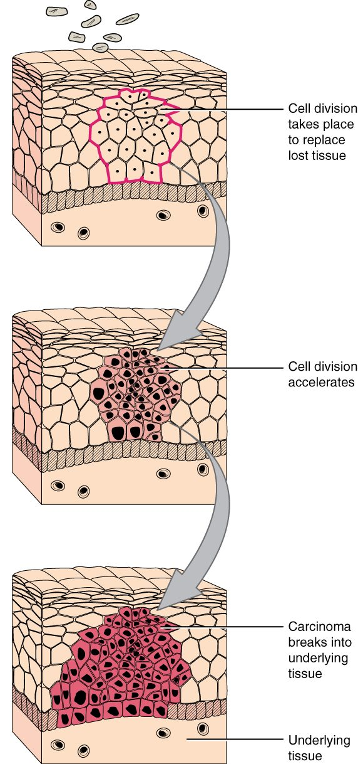
SECTION 4.6
Tissue Aging & Neoplasia
Tissues lose efficiency with age
Repair slows and tissues thin
Uncontrolled division → neoplasia
Malignant tumors invade and spread
Abnormal cell division and tissue change
PN 104 · Ch 4 — The Tissue Level of Organization
22
Notes:
READ ALOUD SCRIPT
Now let's focus on Tissue Aging & Neoplasia. Abnormal cell division and tissue change. Tissues lose efficiency with age. Repair slows and tissues thin. Uncontrolled division → neoplasia. Malignant tumors invade and spread. Healing depends on perfusion, oxygenation, nutrition, immune function, pressure relief, and control of moisture and contamination. Take a moment to identify the structure on the image and explain how its form supports its function. This is slide 22 of 24.
[Sources]
- BMHI PN 104 Chapter 4 faculty PowerPoint slide content.

Slide 23
CHAPTER 4
Key Takeaways
Four primary tissues — epithelial, connective, muscle, and nervous — build every organ.
Epithelium covers and lines, classified by cell shape and layering.
Connective tissue is the most diverse, defined by its extracellular matrix.
Muscle generates movement; nervous tissue enables communication.
Tissues respond to injury through inflammation and repair, and change with age.
PN 104 · Ch 4 — The Tissue Level of Organization
23
Notes:
READ ALOUD SCRIPT
Let us review the major takeaways from Chapter 4. Four primary tissues — epithelial, connective, muscle, and nervous — build every organ. Epithelium covers and lines, classified by cell shape and layering. Connective tissue is the most diverse, defined by its extracellular matrix. Muscle generates movement; nervous tissue enables communication. Tissues respond to injury through inflammation and repair, and change with age. Before moving on, pause and explain each point without reading the slide. If any statement is difficult to explain, mark that topic for review before the quiz.
[Sources]
- BMHI PN 104 Chapter 4 faculty PowerPoint slide content.

Slide 24
CLINICAL CONNECTIONS
Why Tissues Matter in Practical Nursing
Wound Care
Skin Integrity
Inflammation and repair guide every dressing change and healing assessment.
Epithelial membranes are the body's first barrier against infection.
Mobility
Mucous Membranes
The three muscle types underlie movement, heartbeat, and organ function.
Assessing moist linings reveals hydration status and infection.
Cancer Awareness
Aging Patients
Uncontrolled cell division produces tumors that invade and spread.
Slower tissue repair raises the risk of pressure injuries and delayed healing.
Notes:
READ ALOUD SCRIPT
This final slide connects Chapter 4 to practical nursing. Wound Care. Inflammation and repair guide every dressing change and healing assessment. Skin Integrity. Epithelial membranes are the body's first barrier against infection. Mobility. The three muscle types underlie movement, heartbeat, and organ function. Mucous Membranes. Assessing moist linings reveals hydration status and infection. Cancer Awareness. Uncontrolled cell division produces tumors that invade and spread. Aging Patients. Slower tissue repair raises the risk of pressure injuries and delayed healing. Your role is to observe carefully, protect safety, follow orders and precautions, document objectively, and report changes through the appropriate chain of command. Use these examples to connect anatomy with the care you will provide.
[Sources]
- BMHI PN 104 Chapter 4 faculty PowerPoint slide content.

