Slide 1
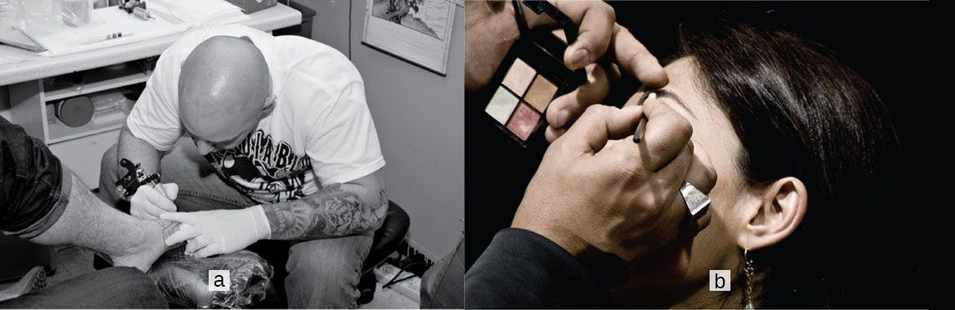
CHAPTER 5
The Integumentary System
The skin, its accessory structures, functions, and disorders.
Anatomy & Physiology · Broward-Miami Health Institute
FACULTY EDITION

Slide 2
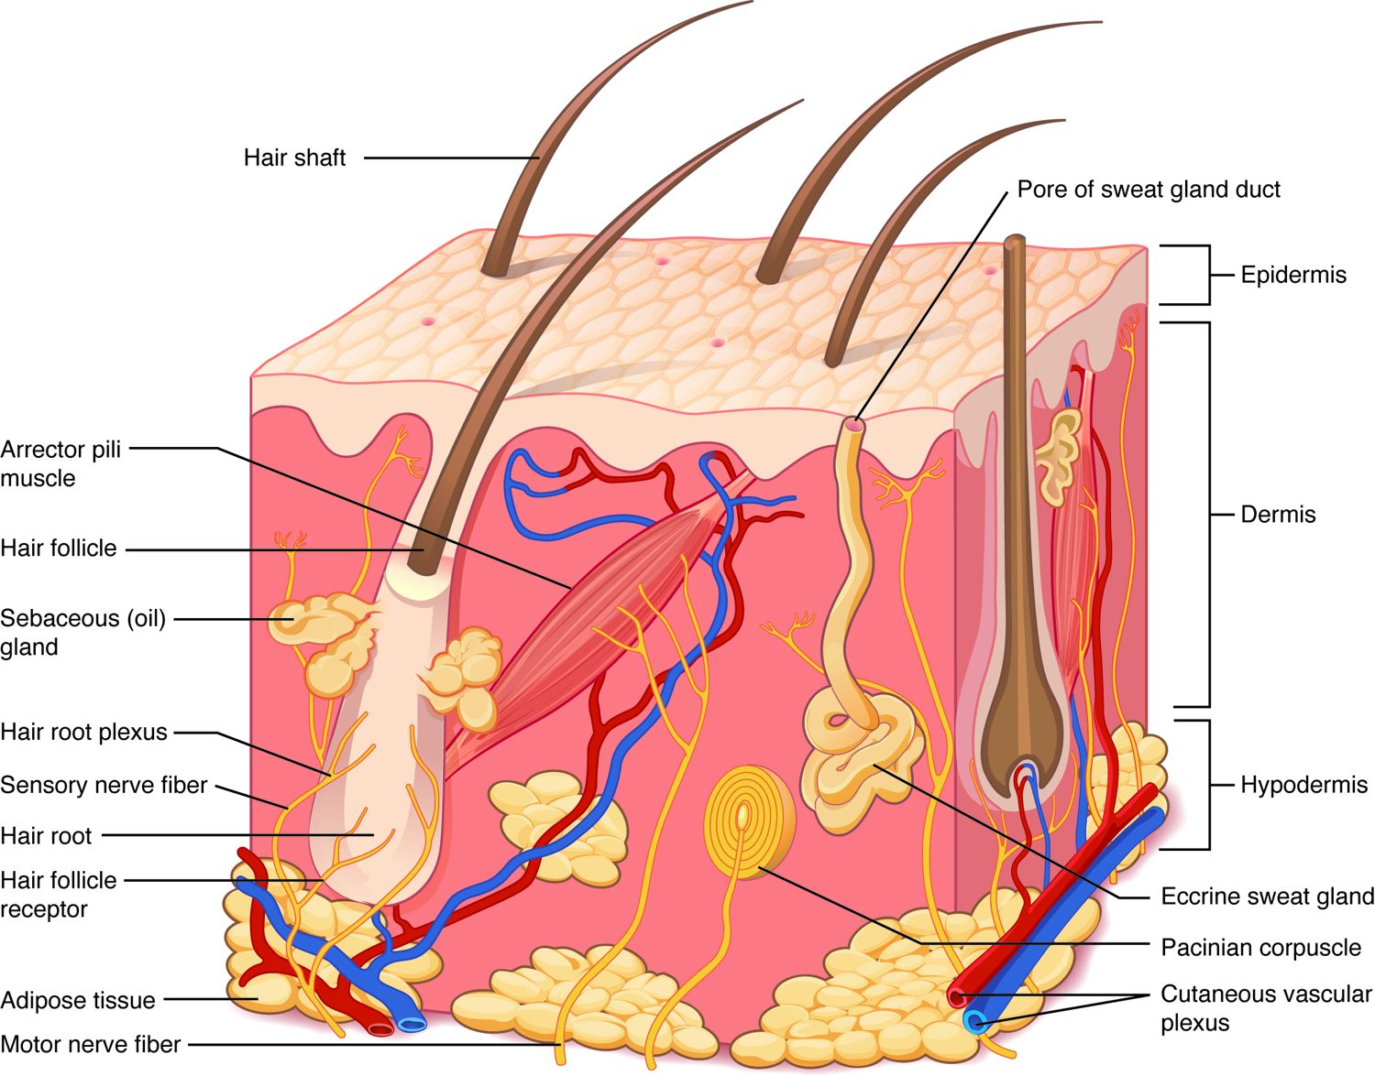
CHAPTER 5
Learning Objectives
After studying this chapter, students will be able to:
1
Describe the integumentary system and the role it plays in homeostasis
2
Describe the layers of the skin and the functions of each layer
3
Describe the accessory structures of the skin and the functions of each
4
Describe the changes that occur in the integumentary system during the aging process
5
Discuss several common diseases, disorders, and injuries that affect the integumentary system
The skin — the body's largest organ.
PN 104 · Ch 5 — The Integumentary System
2

Slide 3
5.1
SECTION
Layers of the Skin
The epidermis, dermis, and hypodermis — the layered structure of the skin.

Slide 4
SECTION 5.1
Structure of the Skin
Three layers: epidermis, dermis, hypodermis
Epidermis is avascular epithelium
Dermis holds vessels, nerves, glands
Hypodermis stores fat and anchors skin
The layers of the skin and underlying tissue
PN 104 · Ch 5 — The Integumentary System
4

Slide 5
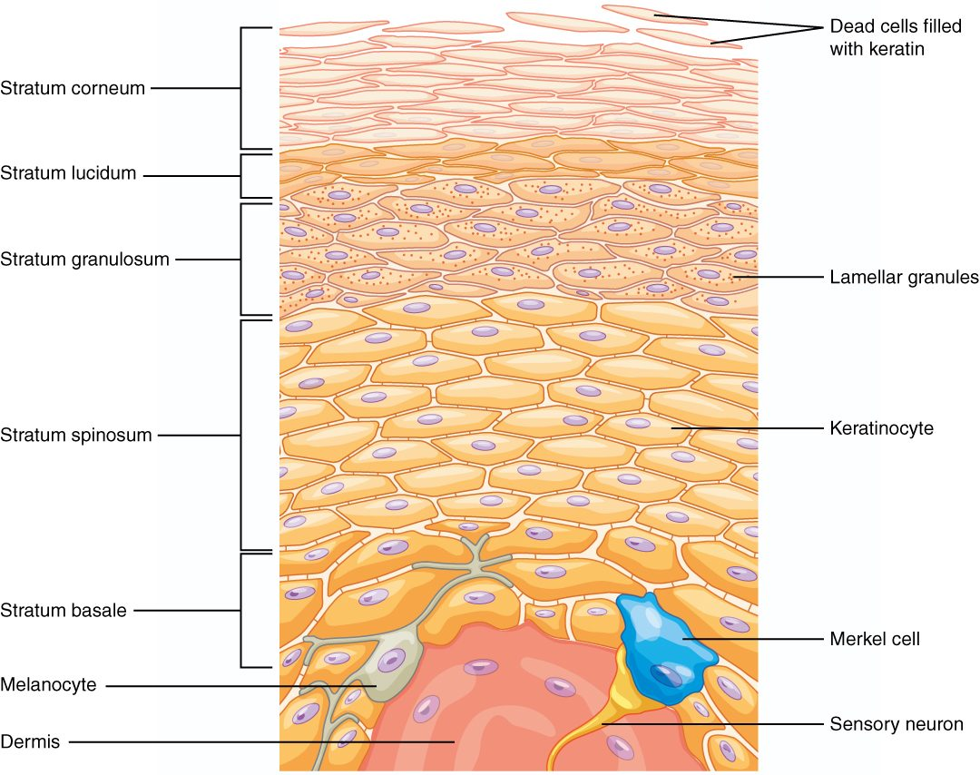
SECTION 5.1
Layers of the Epidermis
Up to five layers in thick skin
Stratum basale up to stratum corneum
Keratinocytes fill with keratin and shed
Melanocytes and immune cells reside here
The strata of the epidermis
PN 104 · Ch 5 — The Integumentary System
5

Slide 6
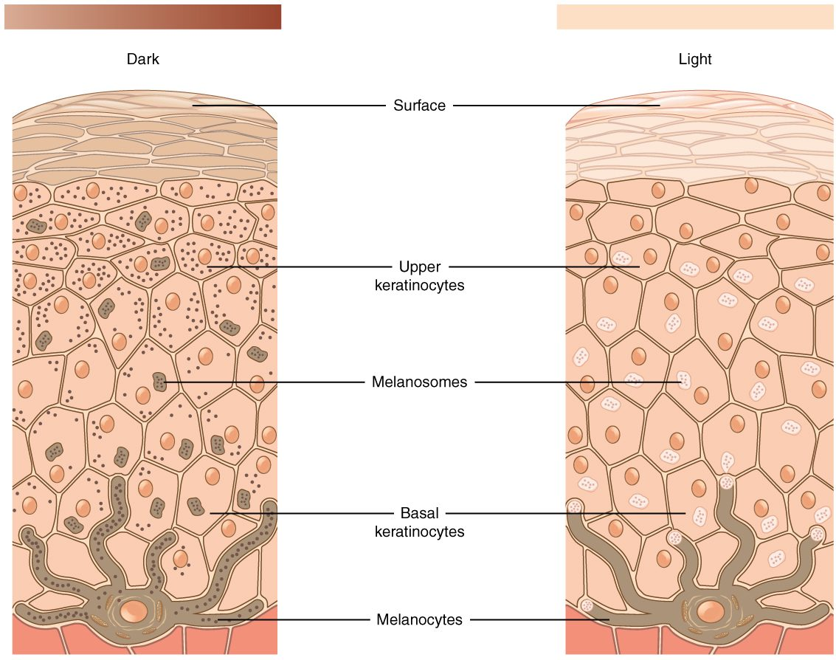
SECTION 5.1
Skin Pigmentation
Melanin determines skin color
Made by melanocytes in the basale
Protects DNA from UV damage
Everyone has similar melanocyte numbers
Melanin production and skin color
PN 104 · Ch 5 — The Integumentary System
6

Slide 7
5.2
SECTION
Accessory Structures of the Skin
Hair, nails, and glands — the structures that arise from the skin.

Slide 8
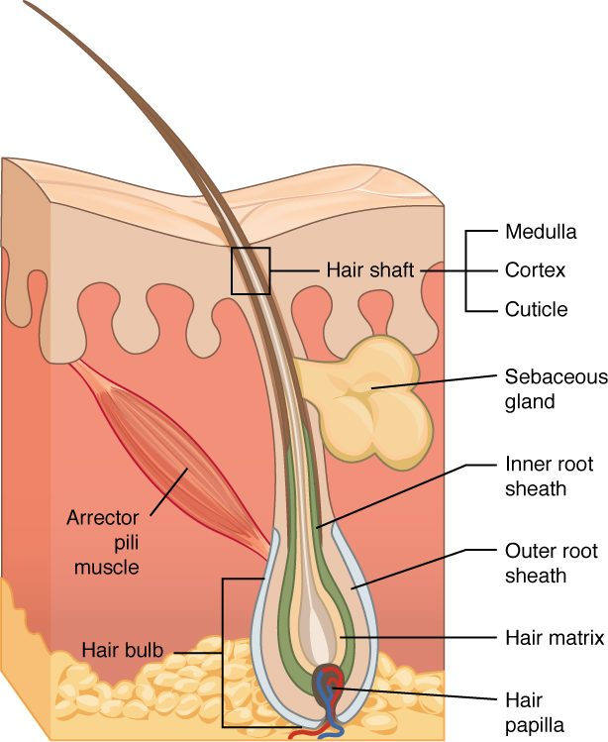
SECTION 5.2
Hair and the Hair Follicle
Hair grows from follicles in the dermis
Shaft is visible; root is embedded
Arrector pili muscle causes goosebumps
Provides protection and sensation
Structure of a hair and its follicle
PN 104 · Ch 5 — The Integumentary System
8

Slide 9
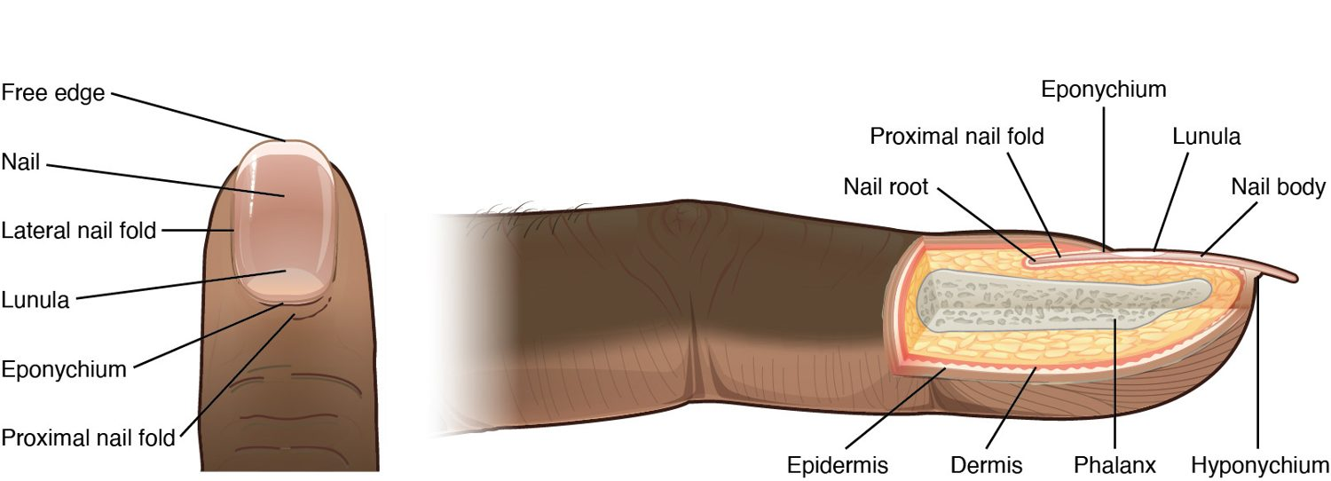
SECTION 5.2
Nails
Structure of a nail
Keratinized plates over the digits
Protect fingertips and toes
Nail bed, lunula, and cuticle
Useful in clinical assessment
PN 104 · Ch 5 — The Integumentary System
9

Slide 10
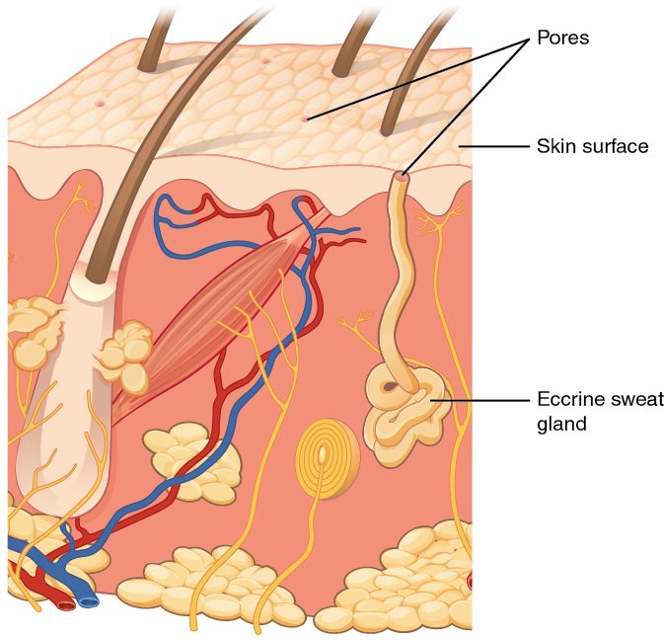
SECTION 5.2
Glands of the Skin
Eccrine sweat glands cool the body
Sweat evaporates to lose heat
Sebaceous glands secrete oily sebum
Sebum lubricates skin and hair
Sweat and sebaceous glands of the skin
PN 104 · Ch 5 — The Integumentary System
10

Slide 11
5.3
SECTION
Functions of the Integumentary System
Protection, sensation, thermoregulation, and vitamin D — what the skin does.

Slide 12
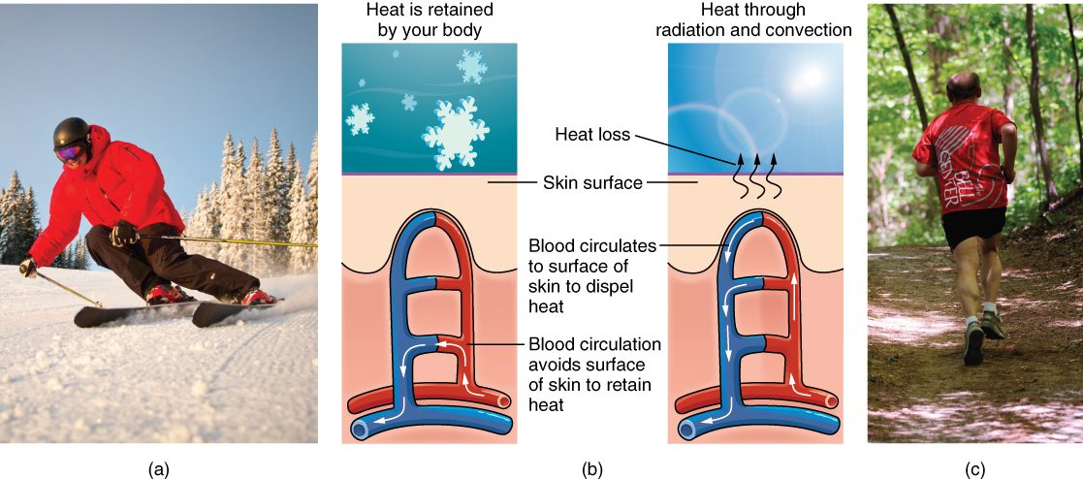
SECTION 5.3
Thermoregulation
The skin's role in thermoregulation
The skin helps control body temperature
Sweating and evaporation cool the body
Vasodilation releases heat
Vasoconstriction conserves heat
PN 104 · Ch 5 — The Integumentary System
12

Slide 13
5.4
SECTION
Diseases, Disorders, and Injuries of the Integumentary System
Burns, skin cancer, acne, and other disorders of the skin.

Slide 14
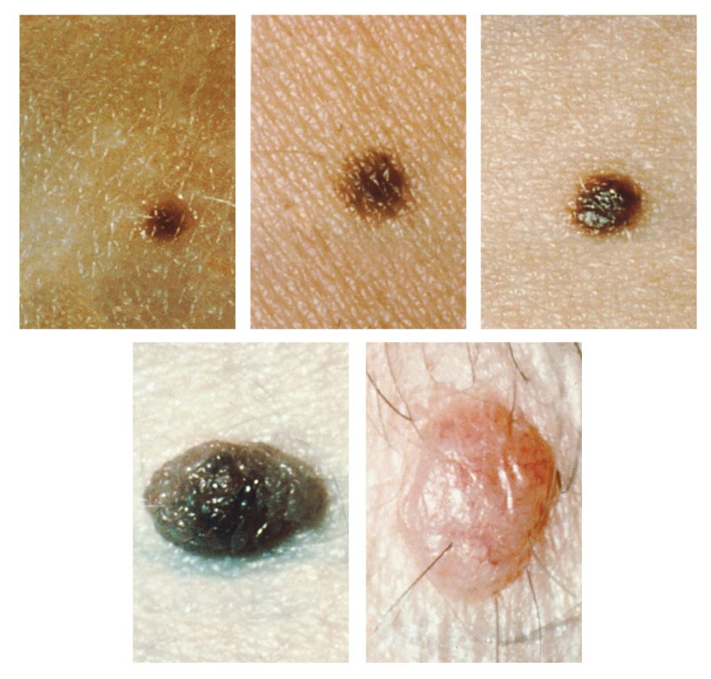
SECTION 5.4
Skin Cancer & the ABCDE Rule
Three main types of skin cancer
Basal cell, squamous cell, melanoma
Melanoma is the most dangerous
Watch moles for ABCDE changes
Moles and the ABCDE signs of melanoma
PN 104 · Ch 5 — The Integumentary System
14

Slide 15
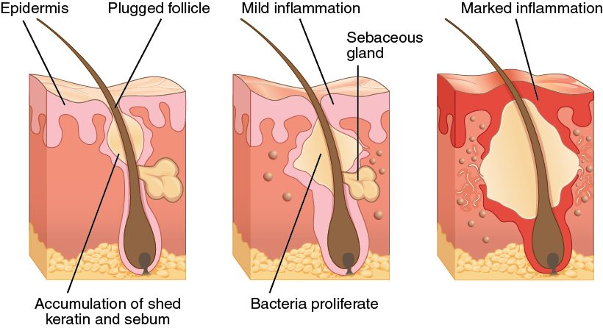
SECTION 5.4
Acne
The development of acne
A follicle becomes plugged with sebum
Bacteria multiply and inflame it
Ranges from comedones to cysts
Common during hormonal changes
PN 104 · Ch 5 — The Integumentary System
15

Slide 16
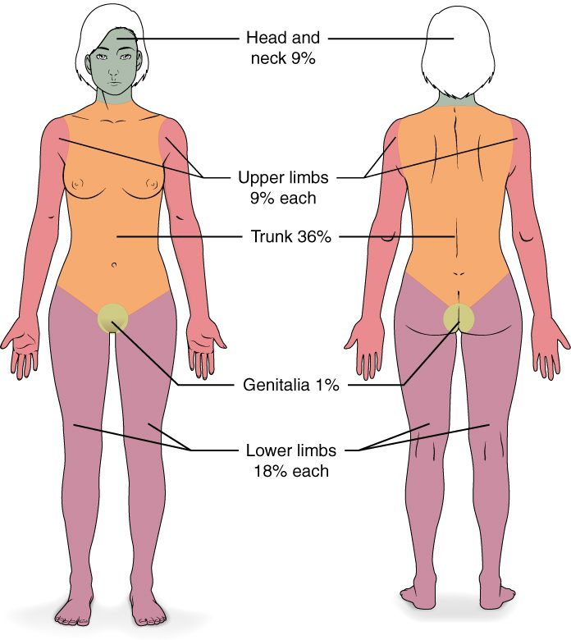
SECTION 5.4
Burns and the Rule of Nines
Classified by depth and extent
Superficial, partial, and full thickness
Rule of nines estimates body area
Guides fluid resuscitation
The rule of nines for estimating burn area
PN 104 · Ch 5 — The Integumentary System
16

Slide 17
CHAPTER 5
Key Takeaways
The skin has three layers — epidermis, dermis, and hypodermis — and is the body's largest organ.
Keratinocytes and melanin give the epidermis its protection and color.
Hair, nails, and glands are accessory structures that arise from the skin.
The skin protects, senses, makes vitamin D, and regulates temperature.
Burns, skin cancers, and infections are common, clinically important disorders.
PN 104 · Ch 5 — The Integumentary System
17

Slide 18
CLINICAL CONNECTIONS
Why the Skin Matters in Practical Nursing
Skin Assessment
Pressure Injuries
Color, temperature, turgor, and lesions reveal a patient's overall status.
Prolonged pressure breaks down skin — prevention is vital in immobile patients.
Burn Care
Infection Barrier
Depth and the rule of nines guide fluid resuscitation and treatment.
Intact skin is the body's first defense against pathogens.
Skin Cancer
Thermoregulation
Teach the ABCDE rule and the importance of sun protection.
Sweating and skin blood flow help control body temperature.

