Slide 1
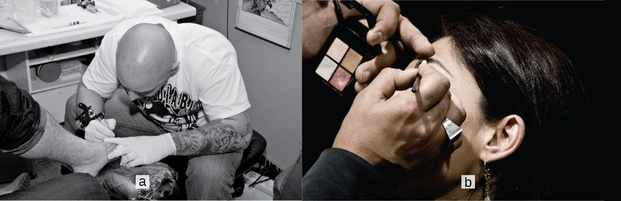
CHAPTER 5
The Integumentary System
The skin, its accessory structures, functions, and disorders.
Anatomy & Physiology · Broward-Miami Health Institute
FACULTY EDITION
Notes:
READ ALOUD SCRIPT
Today we are beginning Chapter 5, the integumentary system. In this chapter, we will connect the major structures and processes with their functions and with the observations that matter in practical nursing care. As we move through the slides, focus on how this system supports circulation, perfusion, protection, and patient safety. By the end, you should be able to explain the major concepts in your own words and apply them to a patient-care situation.
[Sources]
- BMHI PN 104 Chapter 5 faculty PowerPoint slide content.

Slide 2
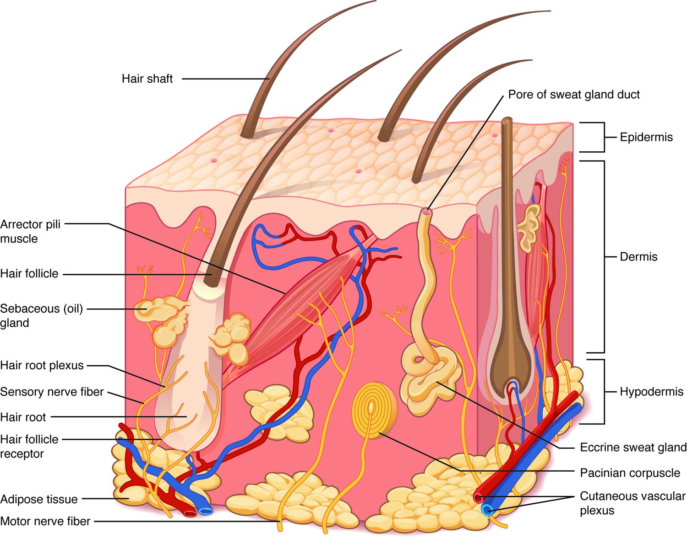
CHAPTER 5
Learning Objectives
After studying this chapter, students will be able to:
1
Describe the integumentary system and the role it plays in homeostasis
2
Describe the layers of the skin and the functions of each layer
3
Describe the accessory structures of the skin and the functions of each
4
Describe the changes that occur in the integumentary system during the aging process
5
Discuss several common diseases, disorders, and injuries that affect the integumentary system
The skin — the body's largest organ.
PN 104 · Ch 5 — The Integumentary System
2
Notes:
READ ALOUD SCRIPT
These are our learning objectives for Chapter 5. By the end of the chapter, you should be able to do the following: Describe the integumentary system and the role it plays in homeostasis. Describe the layers of the skin and the functions of each layer. Describe the accessory structures of the skin and the functions of each. Describe the changes that occur in the integumentary system during the aging process. Discuss several common diseases, disorders, and injuries that affect the integumentary system. Do not treat these as isolated facts. Use them as a checklist for what you should be able to identify, explain, and connect to safe practical nursing care.
[Sources]
- BMHI PN 104 Chapter 5 faculty PowerPoint slide content.

Slide 3
5.1
SECTION
Layers of the Skin
The epidermis, dermis, and hypodermis — the layered structure of the skin.
Notes:
READ ALOUD SCRIPT
We are now moving into Layers of the Skin. The epidermis, dermis, and hypodermis — the layered structure of the skin. As we begin this section, listen for the major structures, their locations, and the functions they perform. Then ask yourself what a change in this area might look like during patient care.
[Sources]
- BMHI PN 104 Chapter 5 faculty PowerPoint slide content.

Slide 4
SECTION 5.1
Structure of the Skin
Three layers: epidermis, dermis, hypodermis
Epidermis is avascular epithelium
Dermis holds vessels, nerves, glands
Hypodermis stores fat and anchors skin
The layers of the skin and underlying tissue
PN 104 · Ch 5 — The Integumentary System
4
Notes:
READ ALOUD SCRIPT
Now let's focus on Structure of the Skin. Three layers: epidermis, dermis, hypodermis. Epidermis is avascular epithelium. Dermis holds vessels, nerves, glands. Hypodermis stores fat and anchors skin. The layers of the skin and underlying tissue. Describe skin findings by exact layer or location when known, and document color, temperature, moisture, integrity, tenderness, swelling, and drainage objectively. Take a moment to identify the structure on the image and explain how its form supports its function. This is slide 4 of 18.
[Sources]
- BMHI PN 104 Chapter 5 faculty PowerPoint slide content.

Slide 5
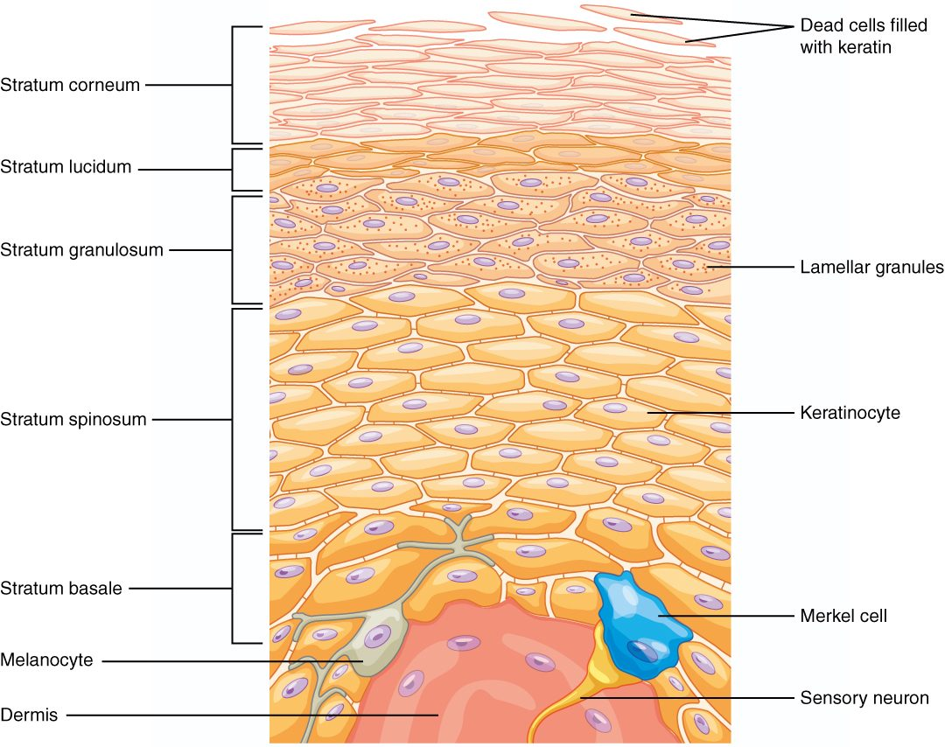
SECTION 5.1
Layers of the Epidermis
Up to five layers in thick skin
Stratum basale up to stratum corneum
Keratinocytes fill with keratin and shed
Melanocytes and immune cells reside here
The strata of the epidermis
PN 104 · Ch 5 — The Integumentary System
5
Notes:
READ ALOUD SCRIPT
Now let's focus on Layers of the Epidermis. Up to five layers in thick skin. Stratum basale up to stratum corneum. Keratinocytes fill with keratin and shed. Melanocytes and immune cells reside here. The strata of the epidermis. Describe skin findings by exact layer or location when known, and document color, temperature, moisture, integrity, tenderness, swelling, and drainage objectively. Take a moment to identify the structure on the image and explain how its form supports its function. This is slide 5 of 18.
[Sources]
- BMHI PN 104 Chapter 5 faculty PowerPoint slide content.

Slide 6
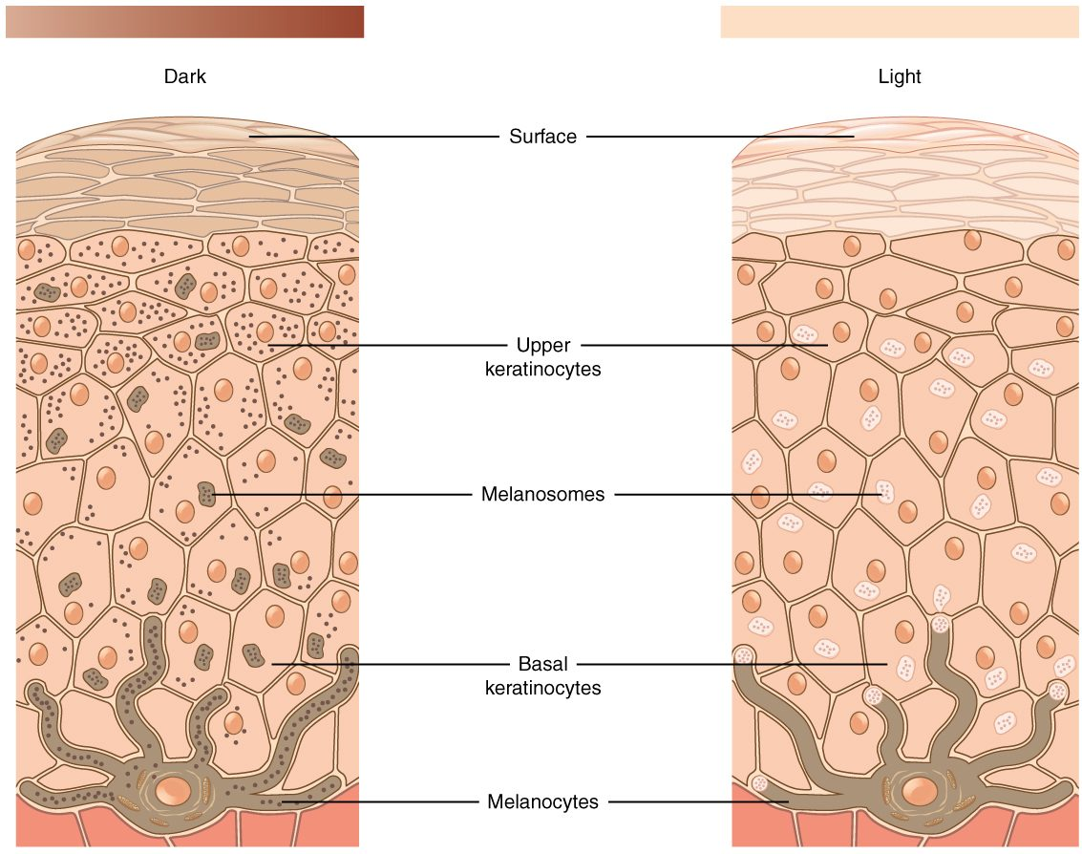
SECTION 5.1
Skin Pigmentation
Melanin determines skin color
Made by melanocytes in the basale
Protects DNA from UV damage
Everyone has similar melanocyte numbers
Melanin production and skin color
PN 104 · Ch 5 — The Integumentary System
6
Notes:
READ ALOUD SCRIPT
Now let's focus on Skin Pigmentation. Melanin determines skin color. Made by melanocytes in the basale. Protects DNA from UV damage. Everyone has similar melanocyte numbers. Melanin production and skin color. Skin assessment is a routine nursing responsibility because the integumentary system provides protection, sensation, temperature regulation, vitamin D support, and visible clues about overall health. Take a moment to identify the structure on the image and explain how its form supports its function. This is slide 6 of 18.
[Sources]
- BMHI PN 104 Chapter 5 faculty PowerPoint slide content.

Slide 7
5.2
SECTION
Accessory Structures of the Skin
Hair, nails, and glands — the structures that arise from the skin.
Notes:
READ ALOUD SCRIPT
We are now moving into Accessory Structures of the Skin. Hair, nails, and glands — the structures that arise from the skin. As we begin this section, listen for the major structures, their locations, and the functions they perform. Then ask yourself what a change in this area might look like during patient care.
[Sources]
- BMHI PN 104 Chapter 5 faculty PowerPoint slide content.

Slide 8
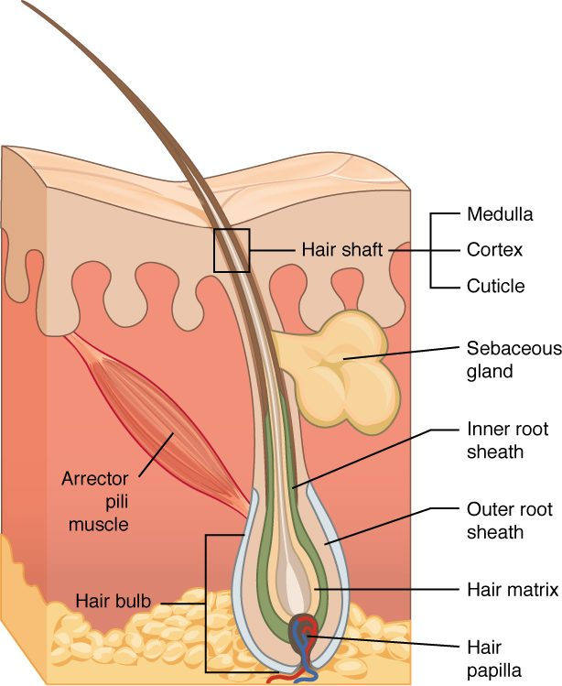
SECTION 5.2
Hair and the Hair Follicle
Hair grows from follicles in the dermis
Shaft is visible; root is embedded
Arrector pili muscle causes goosebumps
Provides protection and sensation
Structure of a hair and its follicle
PN 104 · Ch 5 — The Integumentary System
8
Notes:
READ ALOUD SCRIPT
Now let's focus on Hair and the Hair Follicle. Structure of a hair and its follicle. Hair grows from follicles in the dermis. Shaft is visible; root is embedded. Arrector pili muscle causes goosebumps. Provides protection and sensation. Describe skin findings by exact layer or location when known, and document color, temperature, moisture, integrity, tenderness, swelling, and drainage objectively. Take a moment to identify the structure on the image and explain how its form supports its function. This is slide 8 of 18.
[Sources]
- BMHI PN 104 Chapter 5 faculty PowerPoint slide content.

Slide 9
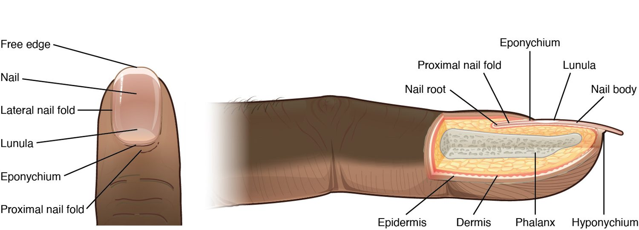
SECTION 5.2
Nails
Structure of a nail
Keratinized plates over the digits
Protect fingertips and toes
Nail bed, lunula, and cuticle
Useful in clinical assessment
PN 104 · Ch 5 — The Integumentary System
9
Notes:
READ ALOUD SCRIPT
Now let's focus on Nails. Structure of a nail. Keratinized plates over the digits. Protect fingertips and toes. Nail bed, lunula, and cuticle. Useful in clinical assessment. Hair, nails, and glands can reveal changes in circulation, nutrition, hygiene, endocrine function, infection, and self-care ability. Take a moment to identify the structure on the image and explain how its form supports its function. This is slide 9 of 18.
[Sources]
- BMHI PN 104 Chapter 5 faculty PowerPoint slide content.

Slide 10
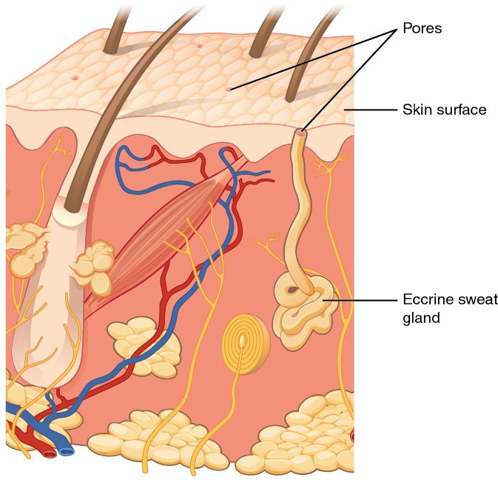
SECTION 5.2
Glands of the Skin
Eccrine sweat glands cool the body
Sweat evaporates to lose heat
Sebaceous glands secrete oily sebum
Sebum lubricates skin and hair
Sweat and sebaceous glands of the skin
PN 104 · Ch 5 — The Integumentary System
10
Notes:
READ ALOUD SCRIPT
Now let's focus on Glands of the Skin. Eccrine sweat glands cool the body. Sweat evaporates to lose heat. Sebaceous glands secrete oily sebum. Sebum lubricates skin and hair. Sweat and sebaceous glands of the skin. Skin supports temperature control through sweating and blood-vessel changes, so monitor hydration, environment, medications, and vulnerable patients closely. Take a moment to identify the structure on the image and explain how its form supports its function. This is slide 10 of 18.
[Sources]
- BMHI PN 104 Chapter 5 faculty PowerPoint slide content.

Slide 11
5.3
SECTION
Functions of the Integumentary System
Protection, sensation, thermoregulation, and vitamin D — what the skin does.
Notes:
READ ALOUD SCRIPT
We are now moving into Functions of the Integumentary System. Protection, sensation, thermoregulation, and vitamin D — what the skin does. As we begin this section, listen for the major structures, their locations, and the functions they perform. Then ask yourself what a change in this area might look like during patient care.
[Sources]
- BMHI PN 104 Chapter 5 faculty PowerPoint slide content.

Slide 12
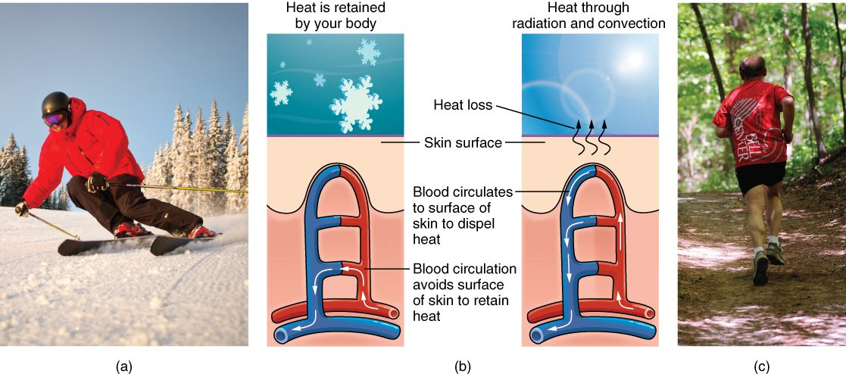
SECTION 5.3
Thermoregulation
The skin's role in thermoregulation
The skin helps control body temperature
Sweating and evaporation cool the body
Vasodilation releases heat
Vasoconstriction conserves heat
PN 104 · Ch 5 — The Integumentary System
12
Notes:
READ ALOUD SCRIPT
Now let's focus on Thermoregulation. The skin's role in thermoregulation. The skin helps control body temperature. Sweating and evaporation cool the body. Vasodilation releases heat. Vasoconstriction conserves heat. Skin supports temperature control through sweating and blood-vessel changes, so monitor hydration, environment, medications, and vulnerable patients closely. Take a moment to identify the structure on the image and explain how its form supports its function. This is slide 12 of 18.
[Sources]
- BMHI PN 104 Chapter 5 faculty PowerPoint slide content.

Slide 13
5.4
SECTION
Diseases, Disorders, and Injuries of the Integumentary System
Burns, skin cancer, acne, and other disorders of the skin.
Notes:
READ ALOUD SCRIPT
We are now moving into Diseases, Disorders, and Injuries of the Integumentary System. Burns, skin cancer, acne, and other disorders of the skin. As we begin this section, listen for the major structures, their locations, and the functions they perform. Then ask yourself what a change in this area might look like during patient care.
[Sources]
- BMHI PN 104 Chapter 5 faculty PowerPoint slide content.

Slide 14
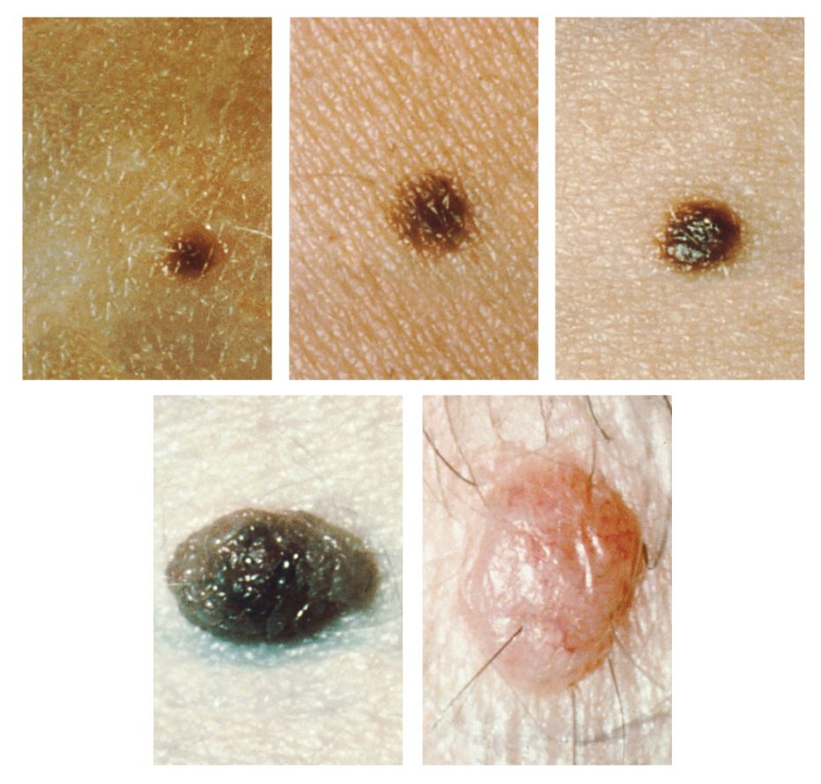
SECTION 5.4
Skin Cancer & the ABCDE Rule
Three main types of skin cancer
Basal cell, squamous cell, melanoma
Melanoma is the most dangerous
Watch moles for ABCDE changes
Moles and the ABCDE signs of melanoma
PN 104 · Ch 5 — The Integumentary System
14
Notes:
READ ALOUD SCRIPT
Now let's focus on Skin Cancer & the ABCDE Rule. Three main types of skin cancer. Basal cell, squamous cell, melanoma. Melanoma is the most dangerous. Watch moles for ABCDE changes. Moles and the ABCDE signs of melanoma. Skin assessment is a routine nursing responsibility because the integumentary system provides protection, sensation, temperature regulation, vitamin D support, and visible clues about overall health. Take a moment to identify the structure on the image and explain how its form supports its function. This is slide 14 of 18.
[Sources]
- BMHI PN 104 Chapter 5 faculty PowerPoint slide content.

Slide 15
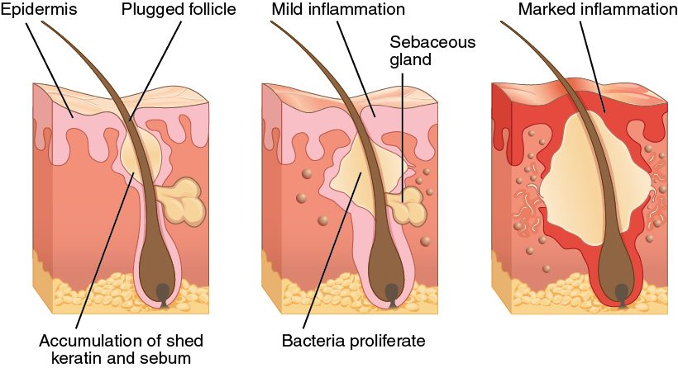
SECTION 5.4
Acne
The development of acne
A follicle becomes plugged with sebum
Bacteria multiply and inflame it
Ranges from comedones to cysts
Common during hormonal changes
PN 104 · Ch 5 — The Integumentary System
15
Notes:
READ ALOUD SCRIPT
Now let's focus on Acne. The development of acne. A follicle becomes plugged with sebum. Bacteria multiply and inflame it. Ranges from comedones to cysts. Common during hormonal changes. Skin assessment is a routine nursing responsibility because the integumentary system provides protection, sensation, temperature regulation, vitamin D support, and visible clues about overall health. Take a moment to identify the structure on the image and explain how its form supports its function. This is slide 15 of 18.
[Sources]
- BMHI PN 104 Chapter 5 faculty PowerPoint slide content.

Slide 16
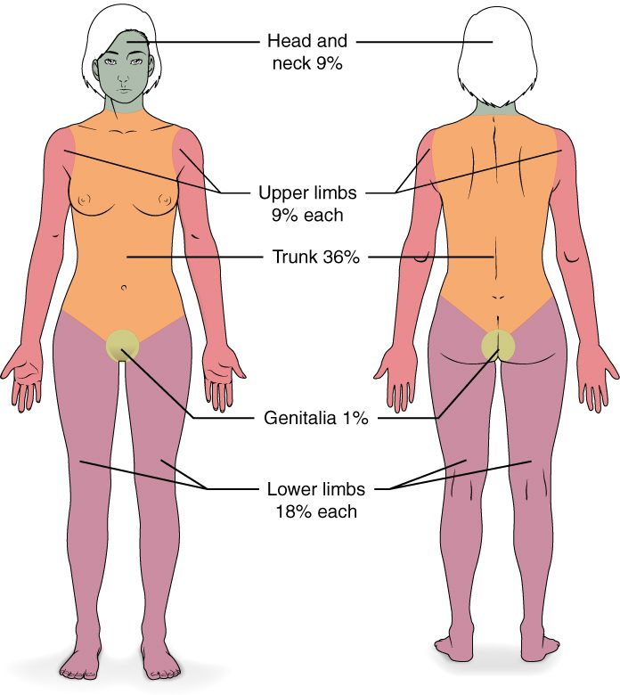
SECTION 5.4
Burns and the Rule of Nines
Classified by depth and extent
Superficial, partial, and full thickness
Rule of nines estimates body area
Guides fluid resuscitation
The rule of nines for estimating burn area
PN 104 · Ch 5 — The Integumentary System
16
Notes:
READ ALOUD SCRIPT
Now let's focus on Burns and the Rule of Nines. The rule of nines for estimating burn area. Classified by depth and extent. Superficial, partial, and full thickness. Rule of nines estimates body area. Guides fluid resuscitation. Burn priorities include scene safety, airway and breathing, circulation, pain, temperature control, infection prevention, fluid balance, and rapid escalation according to severity. Take a moment to identify the structure on the image and explain how its form supports its function. This is slide 16 of 18.
[Sources]
- BMHI PN 104 Chapter 5 faculty PowerPoint slide content.

Slide 17
CHAPTER 5
Key Takeaways
The skin has three layers — epidermis, dermis, and hypodermis — and is the body's largest organ.
Keratinocytes and melanin give the epidermis its protection and color.
Hair, nails, and glands are accessory structures that arise from the skin.
The skin protects, senses, makes vitamin D, and regulates temperature.
Burns, skin cancers, and infections are common, clinically important disorders.
PN 104 · Ch 5 — The Integumentary System
17
Notes:
READ ALOUD SCRIPT
Let us review the major takeaways from Chapter 5. The skin has three layers — epidermis, dermis, and hypodermis — and is the body's largest organ. Keratinocytes and melanin give the epidermis its protection and color. Hair, nails, and glands are accessory structures that arise from the skin. The skin protects, senses, makes vitamin D, and regulates temperature. Burns, skin cancers, and infections are common, clinically important disorders. Before moving on, pause and explain each point without reading the slide. If any statement is difficult to explain, mark that topic for review before the quiz.
[Sources]
- BMHI PN 104 Chapter 5 faculty PowerPoint slide content.

Slide 18
CLINICAL CONNECTIONS
Why the Skin Matters in Practical Nursing
Skin Assessment
Pressure Injuries
Color, temperature, turgor, and lesions reveal a patient's overall status.
Prolonged pressure breaks down skin — prevention is vital in immobile patients.
Burn Care
Infection Barrier
Depth and the rule of nines guide fluid resuscitation and treatment.
Intact skin is the body's first defense against pathogens.
Skin Cancer
Thermoregulation
Teach the ABCDE rule and the importance of sun protection.
Sweating and skin blood flow help control body temperature.
Notes:
READ ALOUD SCRIPT
This final slide connects Chapter 5 to practical nursing. Skin Assessment. Color, temperature, turgor, and lesions reveal a patient's overall status. Pressure Injuries. Prolonged pressure breaks down skin — prevention is vital in immobile patients. Burn Care. Depth and the rule of nines guide fluid resuscitation and treatment. Infection Barrier. Intact skin is the body's first defense against pathogens. Skin Cancer. Teach the ABCDE rule and the importance of sun protection. Thermoregulation. Sweating and skin blood flow help control body temperature. Your role is to observe carefully, protect safety, follow orders and precautions, document objectively, and report changes through the appropriate chain of command. Use these examples to connect anatomy with the care you will provide.
[Sources]
- BMHI PN 104 Chapter 5 faculty PowerPoint slide content.

