Slide 1
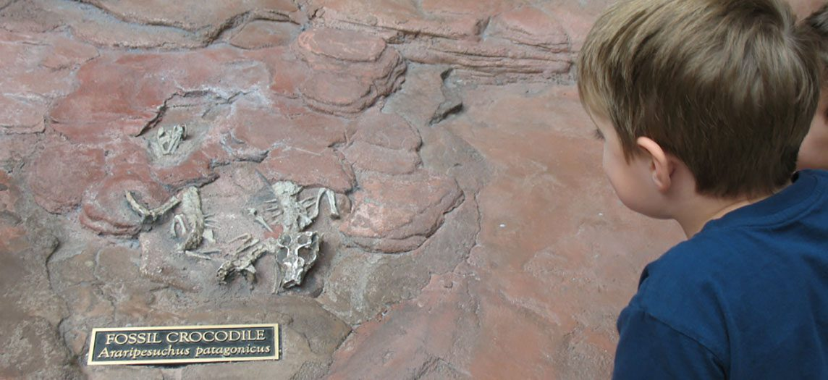
CHAPTER 6
Bone Tissue and the Skeletal System
Bone structure, formation, fractures, and calcium balance.
Anatomy & Physiology · Broward-Miami Health Institute
FACULTY EDITION

Slide 2
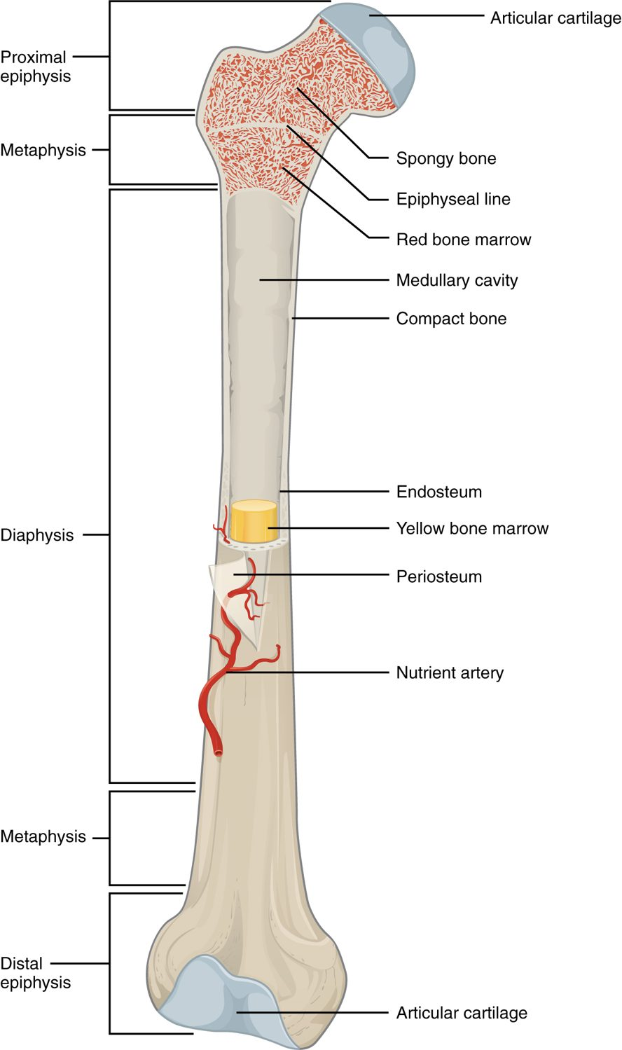
CHAPTER 6
Learning Objectives
After studying this chapter, students will be able to:
1
List and describe the functions of bones
2
Describe the classes of bones
3
Discuss the process of bone formation and development
4
Explain how bone repairs itself after a fracture
5
Discuss the effect of exercise, nutrition, and hormones on bone tissue
6
Describe how an imbalance of calcium can affect bone tissue Bones make good fossils
The anatomy of a long bone.
PN 104 · Ch 6 — Bone Tissue and the Skeletal System
2

Slide 3
6.2
SECTION
Bone Classification
The five shapes of bones and how shape relates to function.

Slide 4
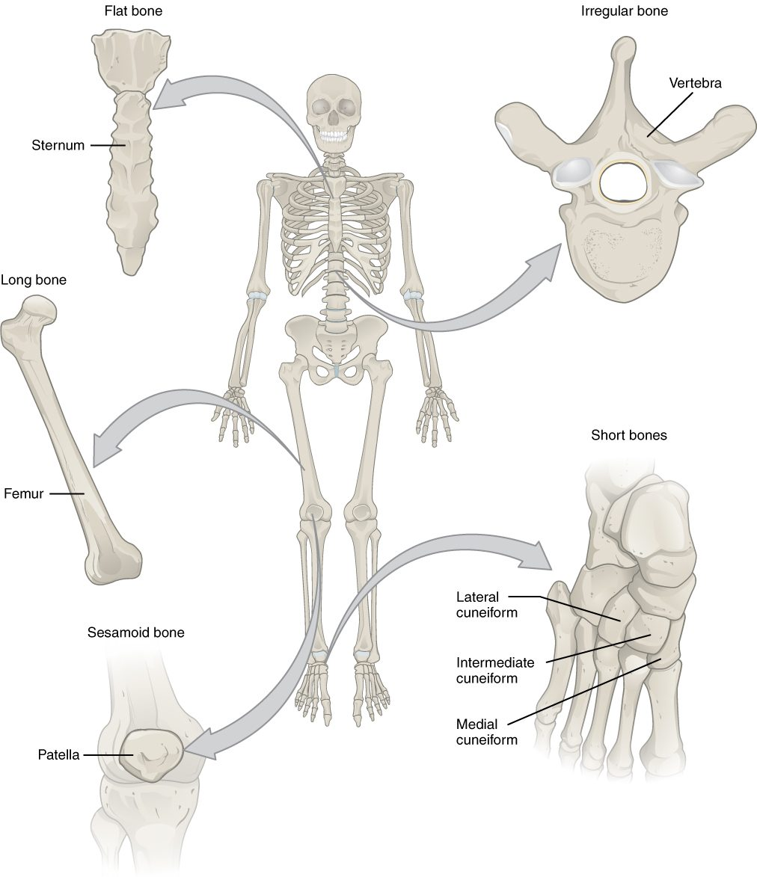
SECTION 6.2
Classification of Bones
Long bones (limbs) act as levers
Short bones (wrist, ankle) add stability
Flat bones (skull, ribs) protect
Irregular and sesamoid bones
The classification of bones by shape
PN 104 · Ch 6 — Bone Tissue and the Skeletal System
4

Slide 5
6.3
SECTION
Bone Structure
The gross and microscopic structure of bone tissue.

Slide 6
SECTION 6.3
Anatomy of a Long Bone
Diaphysis (shaft) and epiphyses (ends)
Medullary cavity holds marrow
Periosteum covers the outer surface
Articular cartilage cushions the joints
The structure of a long bone
PN 104 · Ch 6 — Bone Tissue and the Skeletal System
6

Slide 7
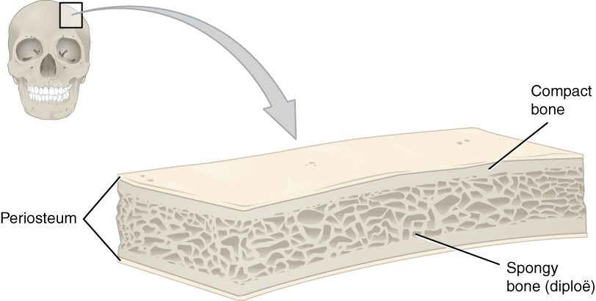
SECTION 6.3
Compact and Spongy Bone
Compact and spongy bone
Compact bone is dense and solid
Forms the strong outer layer
Spongy bone is porous (trabeculae)
Trabeculae resist stress, hold marrow
PN 104 · Ch 6 — Bone Tissue and the Skeletal System
7

Slide 8
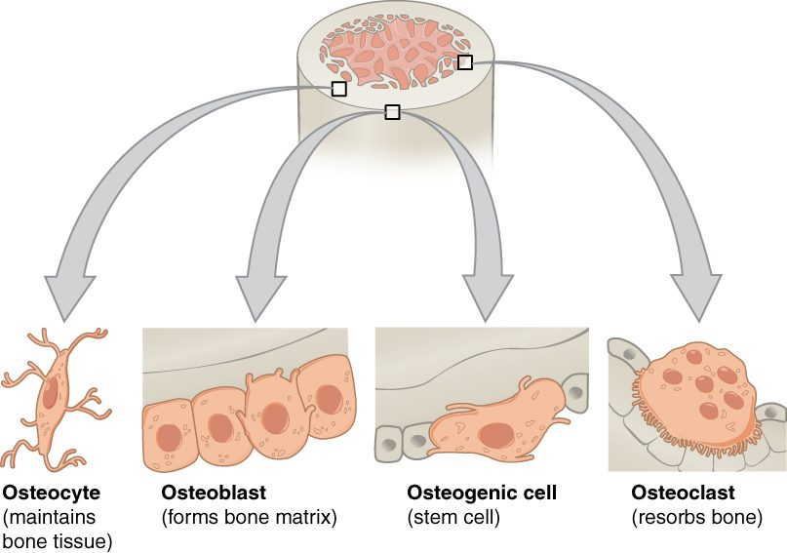
SECTION 6.3
The Four Bone Cells
Osteogenic cells are bone stem cells
Osteoblasts build new bone
Osteocytes maintain bone tissue
Osteoclasts resorb (break down) bone
The cells of bone tissue
PN 104 · Ch 6 — Bone Tissue and the Skeletal System
8

Slide 9
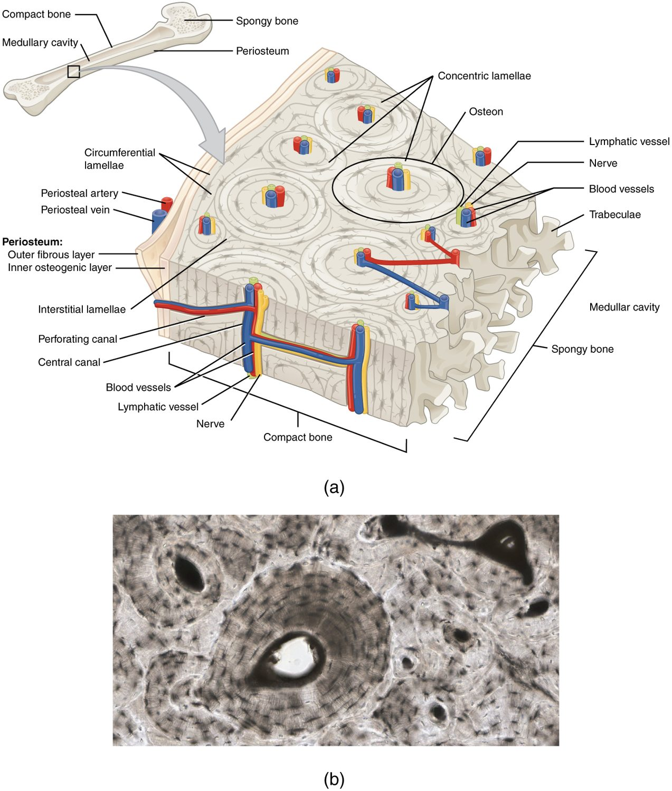
SECTION 6.3
Microscopic Bone — The Osteon
Compact bone is built of osteons
Central canal carries vessels and nerves
Concentric lamellae surround the canal
Osteocytes sit in lacunae
The osteon (Haversian system)
PN 104 · Ch 6 — Bone Tissue and the Skeletal System
9

Slide 10
6.4
SECTION
Bone Formation and Development
How bones form before birth and grow throughout childhood.

Slide 11
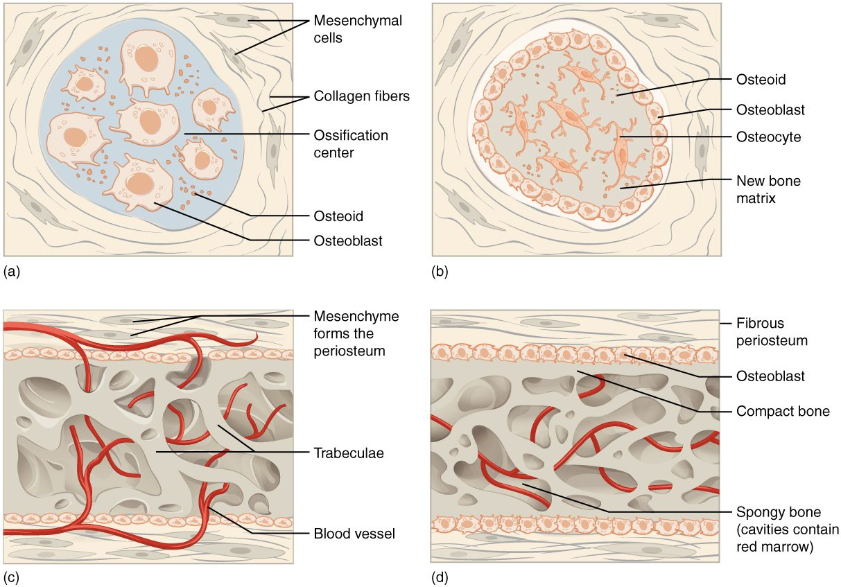
SECTION 6.4
Bone Formation (Ossification)
Intramembranous forms flat bones
Endochondral replaces cartilage
Most bones form from a cartilage model
Begins before birth
Intramembranous and endochondral ossification
PN 104 · Ch 6 — Bone Tissue and the Skeletal System
11

Slide 12
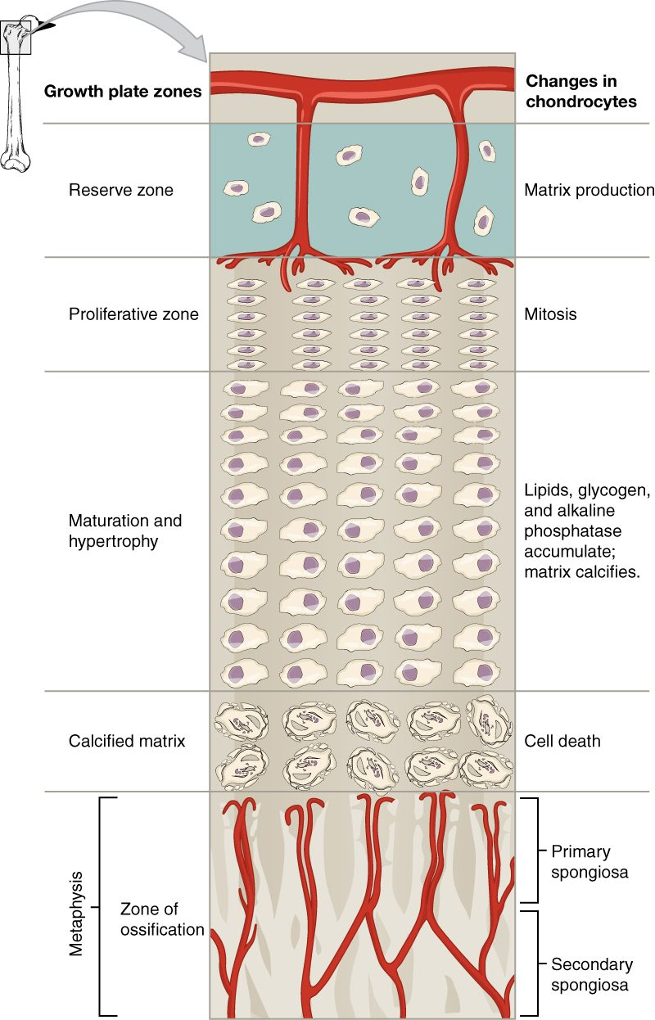
SECTION 6.4
The Epiphyseal (Growth) Plate
A plate of hyaline cartilage
Lengthens long bones in childhood
Cartilage grows, then turns to bone
Closes after puberty
Zones of the epiphyseal plate
PN 104 · Ch 6 — Bone Tissue and the Skeletal System
12

Slide 13
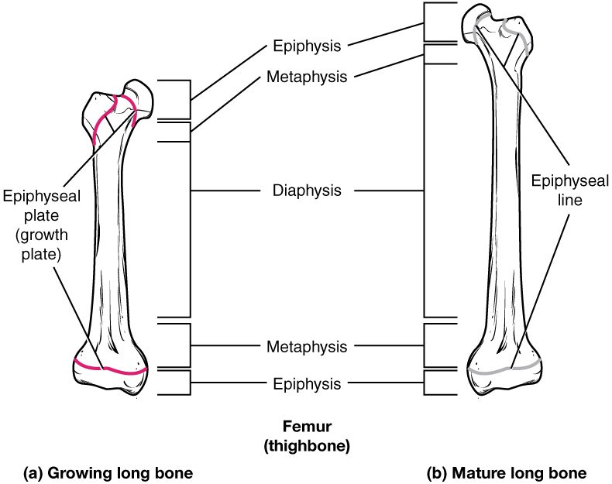
SECTION 6.4
Growing vs. Mature Bone
Active growth plate in children
Epiphyseal line in adults
Marks where growth occurred
Plate injuries can affect growth
Growing and mature long bone
PN 104 · Ch 6 — Bone Tissue and the Skeletal System
13

Slide 14
6.5
SECTION
Fractures: Bone Repair
Types of fractures and how bone repairs itself.

Slide 15
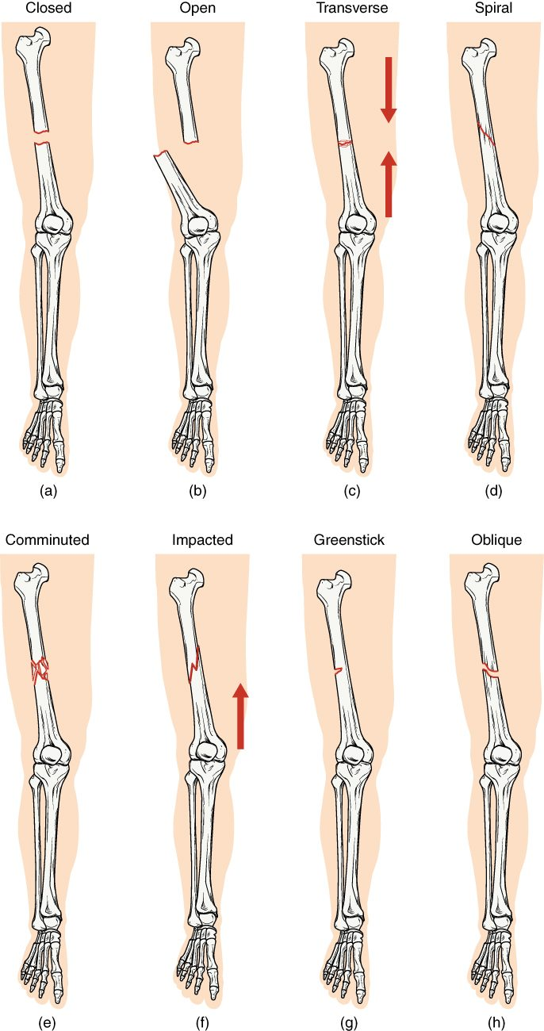
SECTION 6.5
Types of Fractures
Closed (simple) vs. open (compound)
Transverse, oblique, spiral, comminuted
Greenstick (incomplete) in children
Impacted ends driven together
Common types of bone fractures
PN 104 · Ch 6 — Bone Tissue and the Skeletal System
15

Slide 16
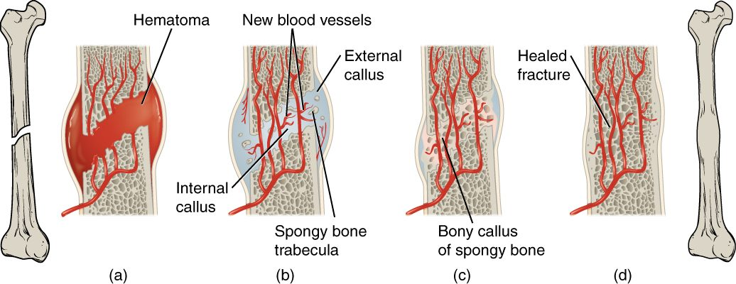
SECTION 6.5
Fracture Repair
The stages of fracture repair
A hematoma forms at the break
A soft (fibrocartilage) callus bridges it
A bony callus replaces it
Remodeling restores the bone
PN 104 · Ch 6 — Bone Tissue and the Skeletal System
16

Slide 17
6.6
SECTION
Exercise, Nutrition, Hormones, and Bone Tissue
How exercise, nutrition, and hormones keep bone strong.

Slide 18
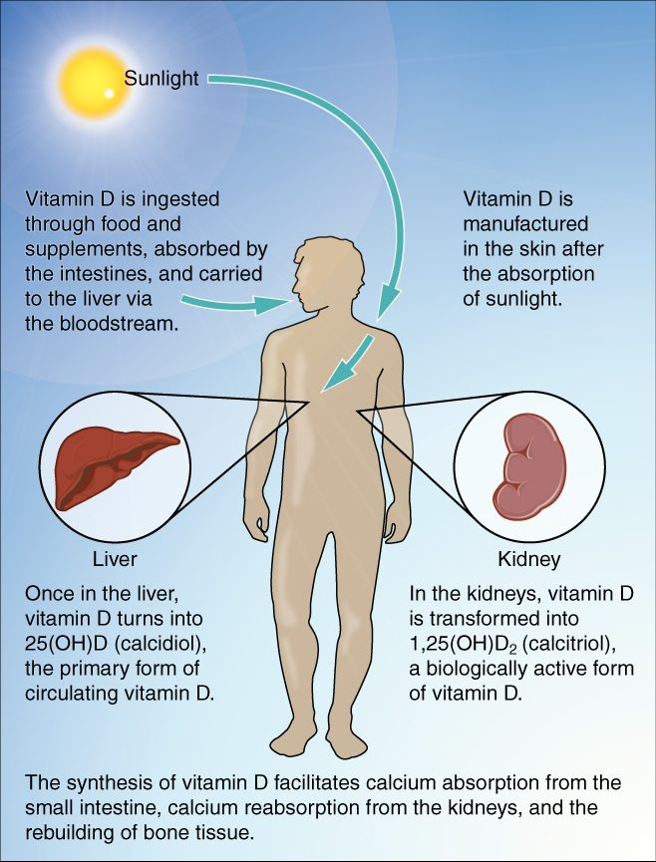
SECTION 6.6
Vitamin D & Calcium Absorption
Sunlight starts vitamin D synthesis
Liver and kidneys activate it
Vitamin D drives calcium absorption
Essential for strong bones
Vitamin D synthesis and calcium absorption
PN 104 · Ch 6 — Bone Tissue and the Skeletal System
18

Slide 19
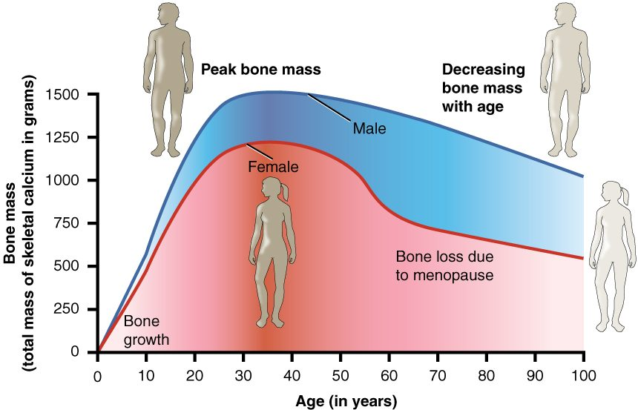
SECTION 6.6
Bone Mass Over the Lifespan
Bone mass across the lifespan
Bone mass peaks in young adulthood
Declines with age, faster after menopause
Low bone mass leads to osteoporosis
Exercise and calcium slow the loss
PN 104 · Ch 6 — Bone Tissue and the Skeletal System
19

Slide 20
6.7
SECTION
Calcium Homeostasis: Interactions of the Skeletal System and Other Organ Systems
How the skeleton helps keep blood calcium in a safe range.

Slide 21
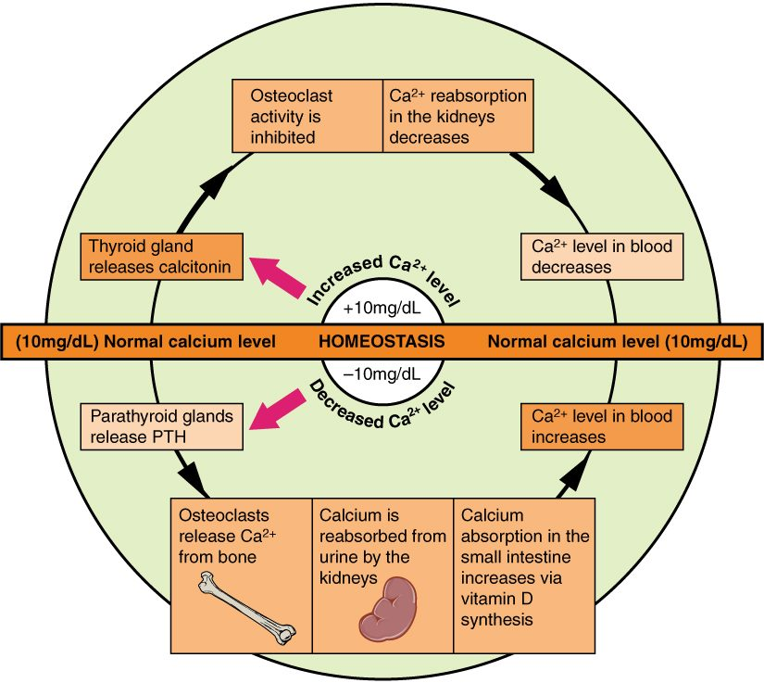
SECTION 6.7
Calcium Homeostasis
Blood calcium is tightly controlled
PTH raises calcium (bone, kidney, gut)
Calcitonin lowers calcium
Bone is the body's calcium reservoir
Hormonal control of blood calcium
PN 104 · Ch 6 — Bone Tissue and the Skeletal System
21

Slide 22
CHAPTER 6
Key Takeaways
The skeleton supports, protects, moves the body, stores minerals, and makes blood cells.
Bones are classified by shape, with structure suited to function.
Bone is living tissue, built of osteons and continuously remodeled by bone cells.
Bones form by ossification and lengthen at the epiphyseal plate until adulthood.
Bone health depends on exercise, nutrition, hormones, and calcium balance.
PN 104 · Ch 6 — Bone Tissue and the Skeletal System
22

Slide 23
CLINICAL CONNECTIONS
Why Bone Matters in Practical Nursing
Fracture Care
Osteoporosis
Knowing fracture types and healing stages guides immobilization and recovery.
Bone loss with age raises fracture risk — central to fall prevention.
Calcium & Vitamin D
Blood Cell Formation
Essential nutrients for bone and for nerve and muscle function.
Red marrow makes the blood cells you monitor in lab work.
Growth Plates
Mobility
Pediatric growth-plate injuries require special attention.
Bone strength underpins safe movement and weight-bearing.

