Slide 1
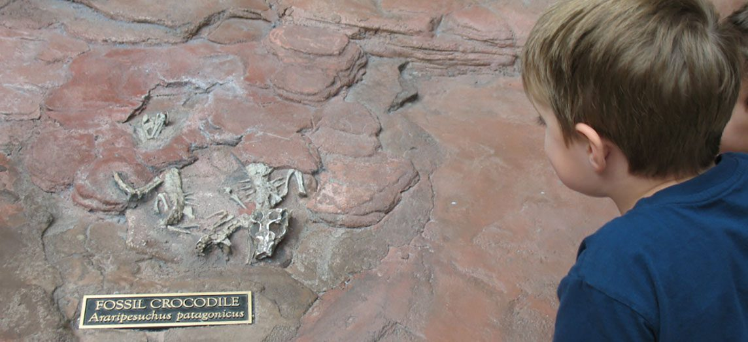
CHAPTER 6
Bone Tissue and the Skeletal System
Bone structure, formation, fractures, and calcium balance.
Anatomy & Physiology · Broward-Miami Health Institute
FACULTY EDITION
Notes:
READ ALOUD SCRIPT
Today we are beginning Chapter 6, bone tissue and the skeletal system. In this chapter, we will connect the names and locations of skeletal structures with their functions and with the observations that matter in practical nursing care. As we move through the slides, focus on how structure supports protection, movement, stability, mineral balance, and patient safety. By the end, you should be able to explain the major concepts in your own words and apply them to a patient-care situation.
[Sources]
- BMHI PN 104 Chapter 6 faculty PowerPoint slide content.

Slide 2
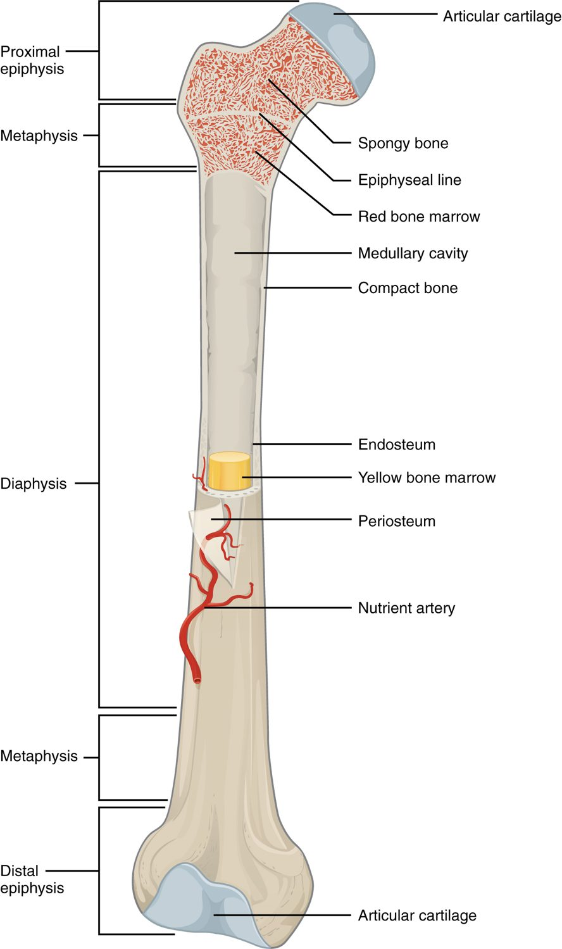
CHAPTER 6
Learning Objectives
After studying this chapter, students will be able to:
1
List and describe the functions of bones
2
Describe the classes of bones
3
Discuss the process of bone formation and development
4
Explain how bone repairs itself after a fracture
5
Discuss the effect of exercise, nutrition, and hormones on bone tissue
6
Describe how an imbalance of calcium can affect bone tissue Bones make good fossils
The anatomy of a long bone.
PN 104 · Ch 6 — Bone Tissue and the Skeletal System
2
Notes:
READ ALOUD SCRIPT
These are our learning objectives for Chapter 6. By the end of the chapter, you should be able to do the following: List and describe the functions of bones. Describe the classes of bones. Discuss the process of bone formation and development. Explain how bone repairs itself after a fracture. Discuss the effect of exercise, nutrition, and hormones on bone tissue. Describe how an imbalance of calcium can affect bone tissue Bones make good fossils. Do not treat these as isolated facts. Use them as a checklist for what you should be able to identify, explain, and connect to safe practical nursing care.
[Sources]
- BMHI PN 104 Chapter 6 faculty PowerPoint slide content.

Slide 3
6.2
SECTION
Bone Classification
The five shapes of bones and how shape relates to function.
Notes:
READ ALOUD SCRIPT
We are now moving into Bone Classification. The five shapes of bones and how shape relates to function. As we begin this section, listen for the major structures, their locations, and the functions they perform. Then ask yourself what a change in this area might look like during patient care.
[Sources]
- BMHI PN 104 Chapter 6 faculty PowerPoint slide content.

Slide 4
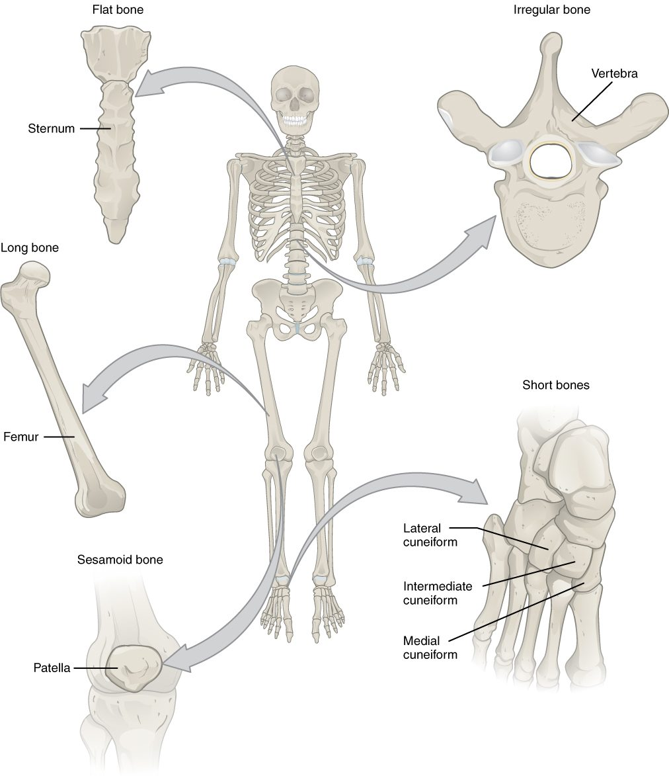
SECTION 6.2
Classification of Bones
Long bones (limbs) act as levers
Short bones (wrist, ankle) add stability
Flat bones (skull, ribs) protect
Irregular and sesamoid bones
The classification of bones by shape
PN 104 · Ch 6 — Bone Tissue and the Skeletal System
4
Notes:
READ ALOUD SCRIPT
Now let's focus on Classification of Bones. The classification of bones by shape. Long bones (limbs) act as levers. Short bones (wrist, ankle) add stability. Flat bones (skull, ribs) protect. Irregular and sesamoid bones. Connect this anatomy with safe mobility, fall prevention, nutrition, and recognition of changes that may signal injury or bone loss. Take a moment to identify the structure on the image and explain how its form supports its function. This is slide 4 of 23.
[Sources]
- BMHI PN 104 Chapter 6 faculty PowerPoint slide content.

Slide 5
6.3
SECTION
Bone Structure
The gross and microscopic structure of bone tissue.
Notes:
READ ALOUD SCRIPT
We are now moving into Bone Structure. The gross and microscopic structure of bone tissue. As we begin this section, listen for the major structures, their locations, and the functions they perform. Then ask yourself what a change in this area might look like during patient care.
[Sources]
- BMHI PN 104 Chapter 6 faculty PowerPoint slide content.

Slide 6
SECTION 6.3
Anatomy of a Long Bone
Diaphysis (shaft) and epiphyses (ends)
Medullary cavity holds marrow
Periosteum covers the outer surface
Articular cartilage cushions the joints
The structure of a long bone
PN 104 · Ch 6 — Bone Tissue and the Skeletal System
6
Notes:
READ ALOUD SCRIPT
Now let's focus on Anatomy of a Long Bone. The structure of a long bone. Diaphysis (shaft) and epiphyses (ends). Medullary cavity holds marrow. Periosteum covers the outer surface. Articular cartilage cushions the joints. Connect this anatomy with safe mobility, fall prevention, nutrition, and recognition of changes that may signal injury or bone loss. Take a moment to identify the structure on the image and explain how its form supports its function. This is slide 6 of 23.
[Sources]
- BMHI PN 104 Chapter 6 faculty PowerPoint slide content.

Slide 7
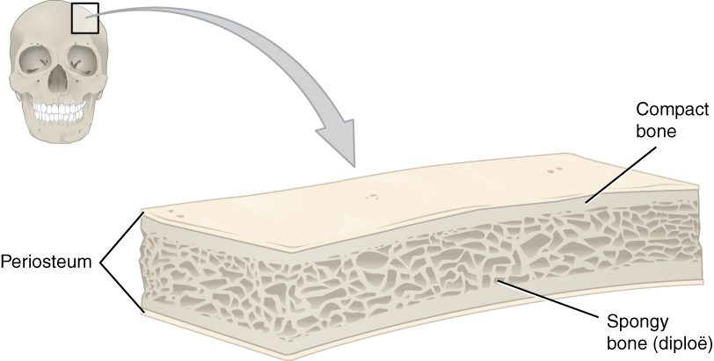
SECTION 6.3
Compact and Spongy Bone
Compact and spongy bone
Compact bone is dense and solid
Forms the strong outer layer
Spongy bone is porous (trabeculae)
Trabeculae resist stress, hold marrow
PN 104 · Ch 6 — Bone Tissue and the Skeletal System
7
Notes:
READ ALOUD SCRIPT
Now let's focus on Compact and Spongy Bone. Compact and spongy bone. Compact bone is dense and solid. Forms the strong outer layer. Spongy bone is porous (trabeculae). Trabeculae resist stress, hold marrow. Connect this anatomy with safe mobility, fall prevention, nutrition, and recognition of changes that may signal injury or bone loss. Take a moment to identify the structure on the image and explain how its form supports its function. This is slide 7 of 23.
[Sources]
- BMHI PN 104 Chapter 6 faculty PowerPoint slide content.

Slide 8
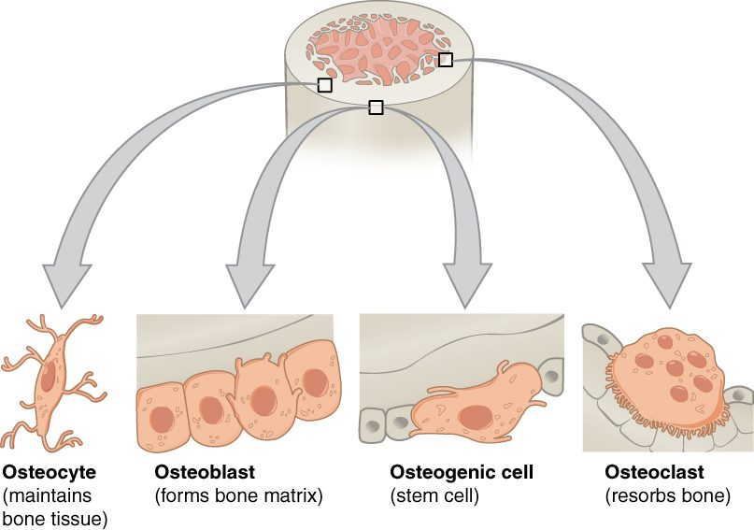
SECTION 6.3
The Four Bone Cells
Osteogenic cells are bone stem cells
Osteoblasts build new bone
Osteocytes maintain bone tissue
Osteoclasts resorb (break down) bone
The cells of bone tissue
PN 104 · Ch 6 — Bone Tissue and the Skeletal System
8
Notes:
READ ALOUD SCRIPT
Now let's focus on The Four Bone Cells. Osteogenic cells are bone stem cells. Osteoblasts build new bone. Osteocytes maintain bone tissue. Osteoclasts resorb (break down) bone. The cells of bone tissue. The key distinction is that osteoblasts build bone while osteoclasts break bone down; healthy remodeling requires both processes. Take a moment to identify the structure on the image and explain how its form supports its function. This is slide 8 of 23.
[Sources]
- BMHI PN 104 Chapter 6 faculty PowerPoint slide content.

Slide 9
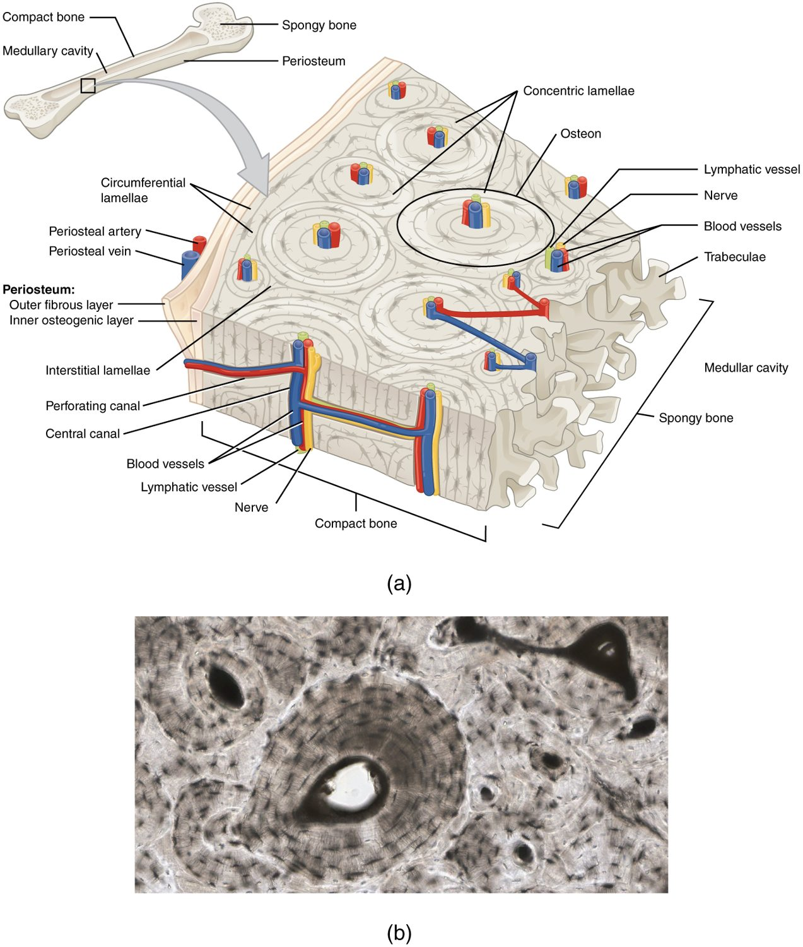
SECTION 6.3
Microscopic Bone — The Osteon
Compact bone is built of osteons
Central canal carries vessels and nerves
Concentric lamellae surround the canal
Osteocytes sit in lacunae
The osteon (Haversian system)
PN 104 · Ch 6 — Bone Tissue and the Skeletal System
9
Notes:
READ ALOUD SCRIPT
Now let's focus on Microscopic Bone — The Osteon. The osteon (Haversian system). Compact bone is built of osteons. Central canal carries vessels and nerves. Concentric lamellae surround the canal. Osteocytes sit in lacunae. Connect this anatomy with safe mobility, fall prevention, nutrition, and recognition of changes that may signal injury or bone loss. Take a moment to identify the structure on the image and explain how its form supports its function. This is slide 9 of 23.
[Sources]
- BMHI PN 104 Chapter 6 faculty PowerPoint slide content.

Slide 10
6.4
SECTION
Bone Formation and Development
How bones form before birth and grow throughout childhood.
Notes:
READ ALOUD SCRIPT
We are now moving into Bone Formation and Development. How bones form before birth and grow throughout childhood. As we begin this section, listen for the major structures, their locations, and the functions they perform. Then ask yourself what a change in this area might look like during patient care.
[Sources]
- BMHI PN 104 Chapter 6 faculty PowerPoint slide content.

Slide 11
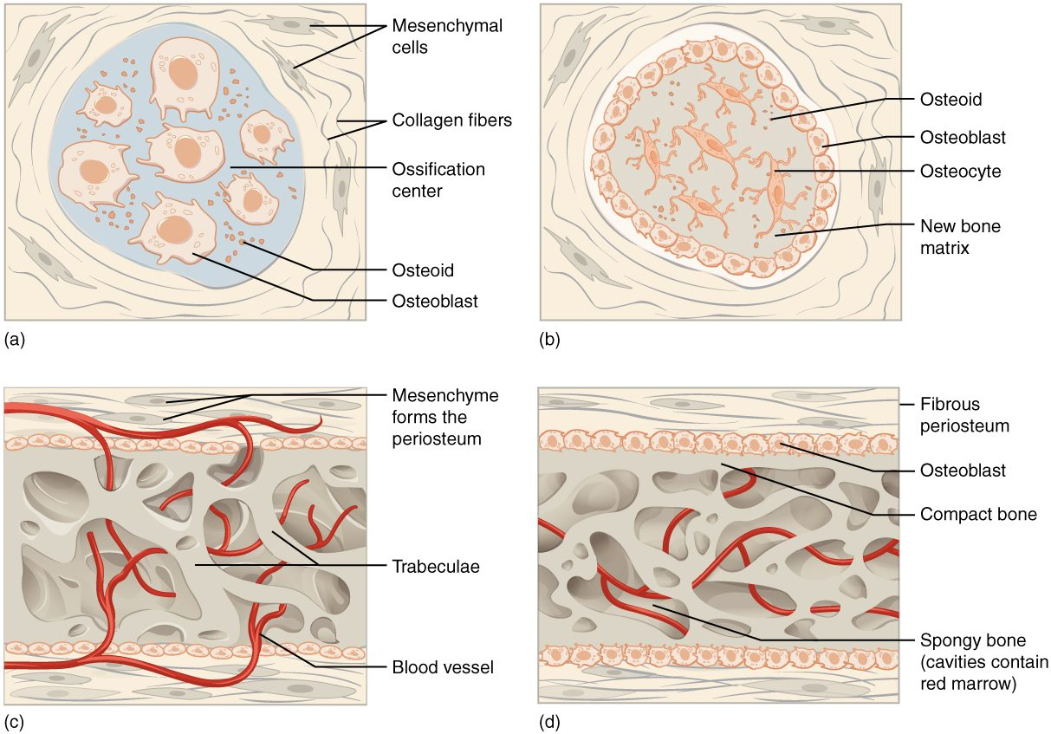
SECTION 6.4
Bone Formation (Ossification)
Intramembranous forms flat bones
Endochondral replaces cartilage
Most bones form from a cartilage model
Begins before birth
Intramembranous and endochondral ossification
PN 104 · Ch 6 — Bone Tissue and the Skeletal System
11
Notes:
READ ALOUD SCRIPT
Now let's focus on Bone Formation (Ossification). Intramembranous forms flat bones. Endochondral replaces cartilage. Most bones form from a cartilage model. Begins before birth. Intramembranous and endochondral ossification. Connect this anatomy with safe mobility, fall prevention, nutrition, and recognition of changes that may signal injury or bone loss. Take a moment to identify the structure on the image and explain how its form supports its function. This is slide 11 of 23.
[Sources]
- BMHI PN 104 Chapter 6 faculty PowerPoint slide content.

Slide 12
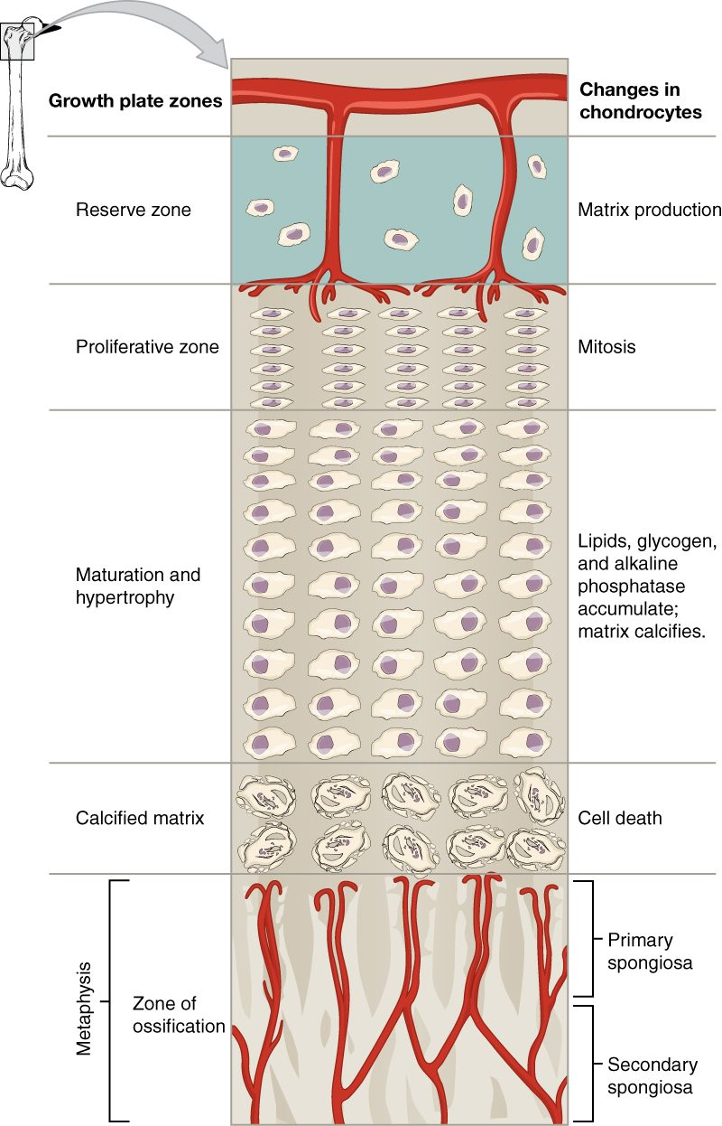
SECTION 6.4
The Epiphyseal (Growth) Plate
A plate of hyaline cartilage
Lengthens long bones in childhood
Cartilage grows, then turns to bone
Closes after puberty
Zones of the epiphyseal plate
PN 104 · Ch 6 — Bone Tissue and the Skeletal System
12
Notes:
READ ALOUD SCRIPT
Now let's focus on The Epiphyseal (Growth) Plate. Zones of the epiphyseal plate. A plate of hyaline cartilage. Lengthens long bones in childhood. Cartilage grows, then turns to bone. Closes after puberty. Connect this anatomy with safe mobility, fall prevention, nutrition, and recognition of changes that may signal injury or bone loss. Take a moment to identify the structure on the image and explain how its form supports its function. This is slide 12 of 23.
[Sources]
- BMHI PN 104 Chapter 6 faculty PowerPoint slide content.

Slide 13
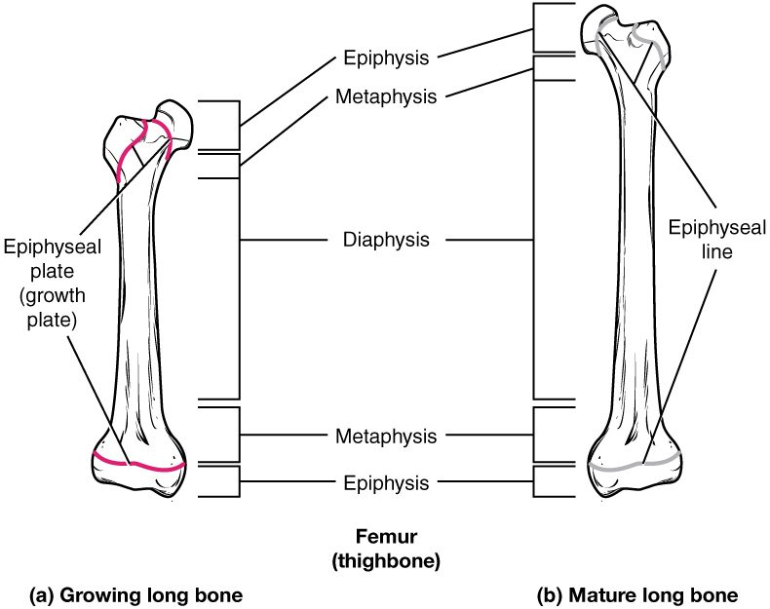
SECTION 6.4
Growing vs. Mature Bone
Active growth plate in children
Epiphyseal line in adults
Marks where growth occurred
Plate injuries can affect growth
Growing and mature long bone
PN 104 · Ch 6 — Bone Tissue and the Skeletal System
13
Notes:
READ ALOUD SCRIPT
Now let's focus on Growing vs. Mature Bone. Active growth plate in children. Epiphyseal line in adults. Marks where growth occurred. Plate injuries can affect growth. Growing and mature long bone. Growth-plate injuries in children require careful follow-up because they can change future bone growth. Take a moment to identify the structure on the image and explain how its form supports its function. This is slide 13 of 23.
[Sources]
- BMHI PN 104 Chapter 6 faculty PowerPoint slide content.

Slide 14
6.5
SECTION
Fractures: Bone Repair
Types of fractures and how bone repairs itself.
Notes:
READ ALOUD SCRIPT
We are now moving into Fractures: Bone Repair. Types of fractures and how bone repairs itself. As we begin this section, listen for the major structures, their locations, and the functions they perform. Then ask yourself what a change in this area might look like during patient care.
[Sources]
- BMHI PN 104 Chapter 6 faculty PowerPoint slide content.

Slide 15
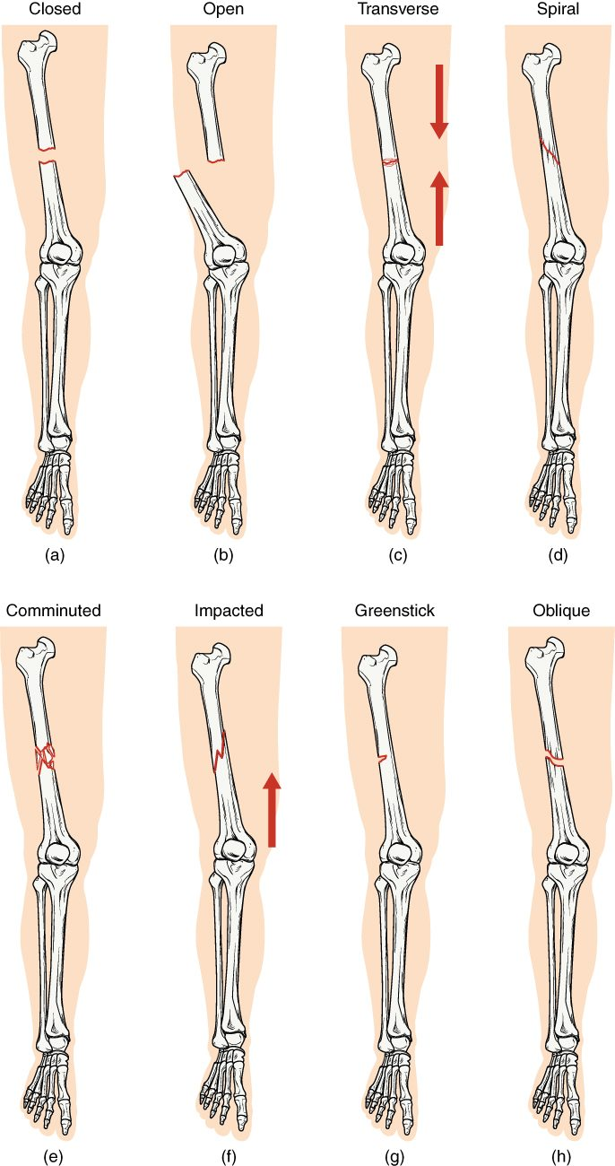
SECTION 6.5
Types of Fractures
Closed (simple) vs. open (compound)
Transverse, oblique, spiral, comminuted
Greenstick (incomplete) in children
Impacted ends driven together
Common types of bone fractures
PN 104 · Ch 6 — Bone Tissue and the Skeletal System
15
Notes:
READ ALOUD SCRIPT
Now let's focus on Types of Fractures. Common types of bone fractures. Closed (simple) vs. open (compound). Transverse, oblique, spiral, comminuted. Greenstick (incomplete) in children. Impacted ends driven together. In practice, observe alignment, circulation, sensation, movement, swelling, pain, and skin condition, and report sudden changes promptly. Take a moment to identify the structure on the image and explain how its form supports its function. This is slide 15 of 23.
[Sources]
- BMHI PN 104 Chapter 6 faculty PowerPoint slide content.

Slide 16
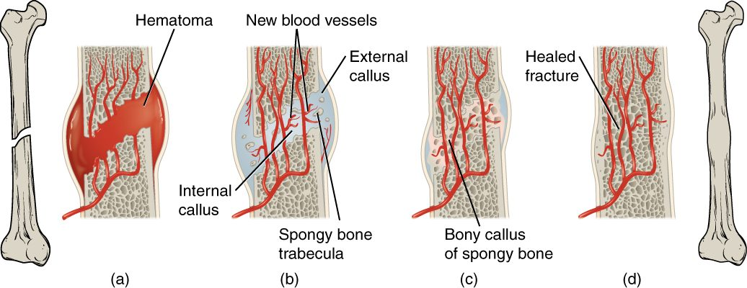
SECTION 6.5
Fracture Repair
The stages of fracture repair
A hematoma forms at the break
A soft (fibrocartilage) callus bridges it
A bony callus replaces it
Remodeling restores the bone
PN 104 · Ch 6 — Bone Tissue and the Skeletal System
16
Notes:
READ ALOUD SCRIPT
Now let's focus on Fracture Repair. The stages of fracture repair. A hematoma forms at the break. A soft (fibrocartilage) callus bridges it. A bony callus replaces it. Remodeling restores the bone. In practice, observe alignment, circulation, sensation, movement, swelling, pain, and skin condition, and report sudden changes promptly. Take a moment to identify the structure on the image and explain how its form supports its function. This is slide 16 of 23.
[Sources]
- BMHI PN 104 Chapter 6 faculty PowerPoint slide content.

Slide 17
6.6
SECTION
Exercise, Nutrition, Hormones, and Bone Tissue
How exercise, nutrition, and hormones keep bone strong.
Notes:
READ ALOUD SCRIPT
We are now moving into Exercise, Nutrition, Hormones, and Bone Tissue. How exercise, nutrition, and hormones keep bone strong. As we begin this section, listen for the major structures, their locations, and the functions they perform. Then ask yourself what a change in this area might look like during patient care.
[Sources]
- BMHI PN 104 Chapter 6 faculty PowerPoint slide content.

Slide 18
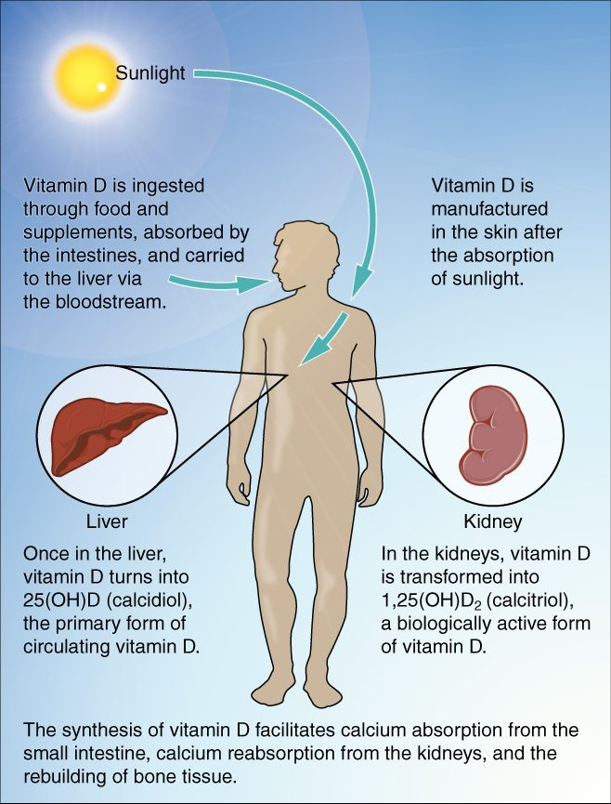
SECTION 6.6
Vitamin D & Calcium Absorption
Sunlight starts vitamin D synthesis
Liver and kidneys activate it
Vitamin D drives calcium absorption
Essential for strong bones
Vitamin D synthesis and calcium absorption
PN 104 · Ch 6 — Bone Tissue and the Skeletal System
18
Notes:
READ ALOUD SCRIPT
Now let's focus on Vitamin D & Calcium Absorption. Vitamin D synthesis and calcium absorption. Sunlight starts vitamin D synthesis. Liver and kidneys activate it. Vitamin D drives calcium absorption. Essential for strong bones. Remember that calcium also supports nerve transmission, muscle contraction, and cardiac function, so imbalance can affect more than bone. Take a moment to identify the structure on the image and explain how its form supports its function. This is slide 18 of 23.
[Sources]
- BMHI PN 104 Chapter 6 faculty PowerPoint slide content.

Slide 19
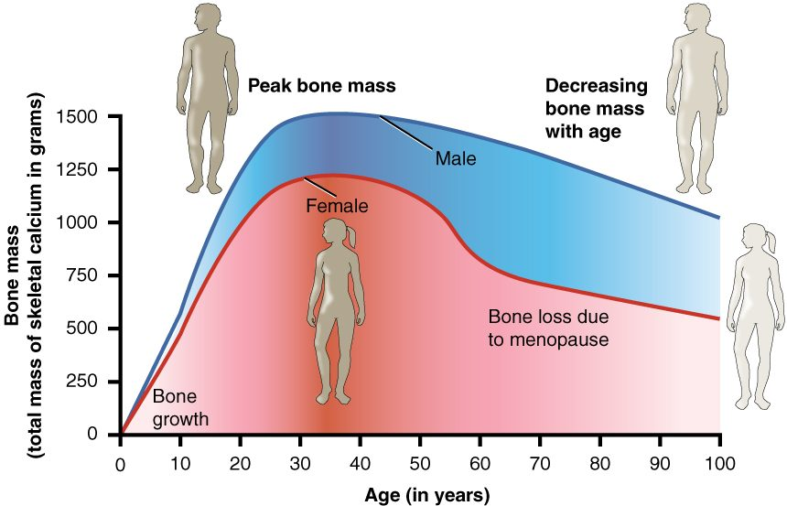
SECTION 6.6
Bone Mass Over the Lifespan
Bone mass across the lifespan
Bone mass peaks in young adulthood
Declines with age, faster after menopause
Low bone mass leads to osteoporosis
Exercise and calcium slow the loss
PN 104 · Ch 6 — Bone Tissue and the Skeletal System
19
Notes:
READ ALOUD SCRIPT
Now let's focus on Bone Mass Over the Lifespan. Bone mass across the lifespan. Bone mass peaks in young adulthood. Declines with age, faster after menopause. Low bone mass leads to osteoporosis. Exercise and calcium slow the loss. Remember that calcium also supports nerve transmission, muscle contraction, and cardiac function, so imbalance can affect more than bone. Take a moment to identify the structure on the image and explain how its form supports its function. This is slide 19 of 23.
[Sources]
- BMHI PN 104 Chapter 6 faculty PowerPoint slide content.

Slide 20
6.7
SECTION
Calcium Homeostasis: Interactions of the Skeletal System and Other Organ Systems
How the skeleton helps keep blood calcium in a safe range.
Notes:
READ ALOUD SCRIPT
We are now moving into Calcium Homeostasis: Interactions of the Skeletal System and Other Organ Systems. How the skeleton helps keep blood calcium in a safe range. As we begin this section, listen for the major structures, their locations, and the functions they perform. Then ask yourself what a change in this area might look like during patient care.
[Sources]
- BMHI PN 104 Chapter 6 faculty PowerPoint slide content.

Slide 21
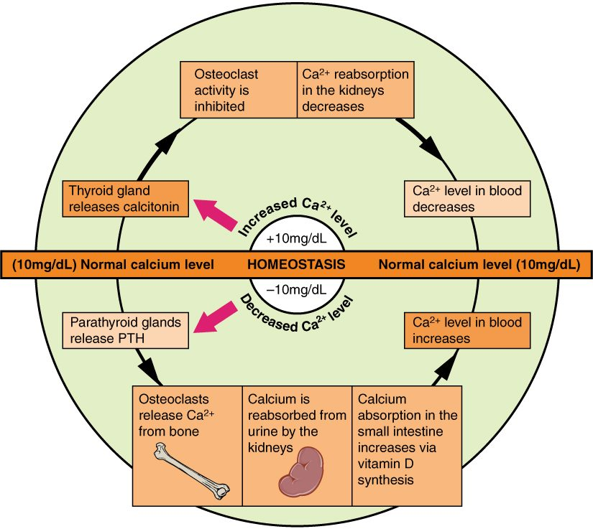
SECTION 6.7
Calcium Homeostasis
Blood calcium is tightly controlled
PTH raises calcium (bone, kidney, gut)
Calcitonin lowers calcium
Bone is the body's calcium reservoir
Hormonal control of blood calcium
PN 104 · Ch 6 — Bone Tissue and the Skeletal System
21
Notes:
READ ALOUD SCRIPT
Now let's focus on Calcium Homeostasis. Blood calcium is tightly controlled. PTH raises calcium (bone, kidney, gut). Calcitonin lowers calcium. Bone is the body's calcium reservoir. Hormonal control of blood calcium. Remember that calcium also supports nerve transmission, muscle contraction, and cardiac function, so imbalance can affect more than bone. Take a moment to identify the structure on the image and explain how its form supports its function. This is slide 21 of 23.
[Sources]
- BMHI PN 104 Chapter 6 faculty PowerPoint slide content.

Slide 22
CHAPTER 6
Key Takeaways
The skeleton supports, protects, moves the body, stores minerals, and makes blood cells.
Bones are classified by shape, with structure suited to function.
Bone is living tissue, built of osteons and continuously remodeled by bone cells.
Bones form by ossification and lengthen at the epiphyseal plate until adulthood.
Bone health depends on exercise, nutrition, hormones, and calcium balance.
PN 104 · Ch 6 — Bone Tissue and the Skeletal System
22
Notes:
READ ALOUD SCRIPT
Let us review the major takeaways from Chapter 6. The skeleton supports, protects, moves the body, stores minerals, and makes blood cells. Bones are classified by shape, with structure suited to function. Bone is living tissue, built of osteons and continuously remodeled by bone cells. Bones form by ossification and lengthen at the epiphyseal plate until adulthood. Bone health depends on exercise, nutrition, hormones, and calcium balance. Before moving on, pause and explain each point without reading the slide. If any statement is difficult to explain, mark that topic for review before the quiz.
[Sources]
- BMHI PN 104 Chapter 6 faculty PowerPoint slide content.

Slide 23
CLINICAL CONNECTIONS
Why Bone Matters in Practical Nursing
Fracture Care
Osteoporosis
Knowing fracture types and healing stages guides immobilization and recovery.
Bone loss with age raises fracture risk — central to fall prevention.
Calcium & Vitamin D
Blood Cell Formation
Essential nutrients for bone and for nerve and muscle function.
Red marrow makes the blood cells you monitor in lab work.
Growth Plates
Mobility
Pediatric growth-plate injuries require special attention.
Bone strength underpins safe movement and weight-bearing.
Notes:
READ ALOUD SCRIPT
This final slide connects Chapter 6 to practical nursing. Fracture Care. Knowing fracture types and healing stages guides immobilization and recovery. Osteoporosis. Bone loss with age raises fracture risk — central to fall prevention. Calcium & Vitamin D. Essential nutrients for bone and for nerve and muscle function. Blood Cell Formation. Red marrow makes the blood cells you monitor in lab work. Growth Plates. Pediatric growth-plate injuries require special attention. Mobility. Bone strength underpins safe movement and weight-bearing. Your role is to observe carefully, protect safety, follow orders and precautions, document objectively, and report changes through the appropriate chain of command. Use these examples to connect anatomy with the care you will provide.
[Sources]
- BMHI PN 104 Chapter 6 faculty PowerPoint slide content.

