Slide 1
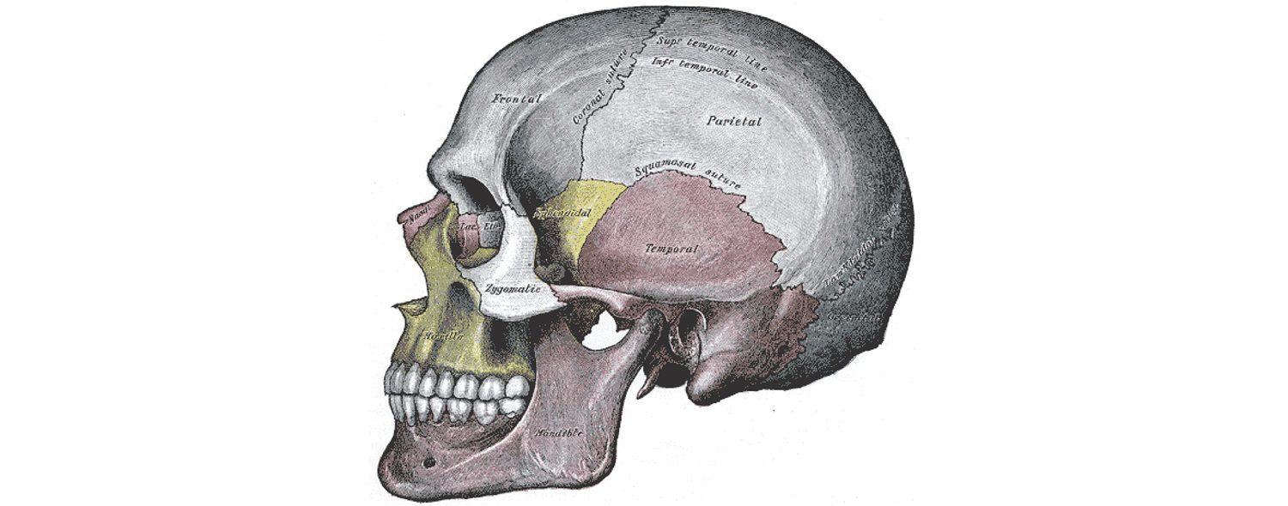
CHAPTER 7
The Axial Skeleton
The skull, vertebral column, and thoracic cage.
Anatomy & Physiology · Broward-Miami Health Institute
FACULTY EDITION
Notes:
READ ALOUD SCRIPT
Today we are beginning Chapter 7, the axial skeleton. In this chapter, we will connect the names and locations of skeletal structures with their functions and with the observations that matter in practical nursing care. As we move through the slides, focus on how structure supports protection, movement, stability, mineral balance, and patient safety. By the end, you should be able to explain the major concepts in your own words and apply them to a patient-care situation.
[Sources]
- BMHI PN 104 Chapter 7 faculty PowerPoint slide content.

Slide 2
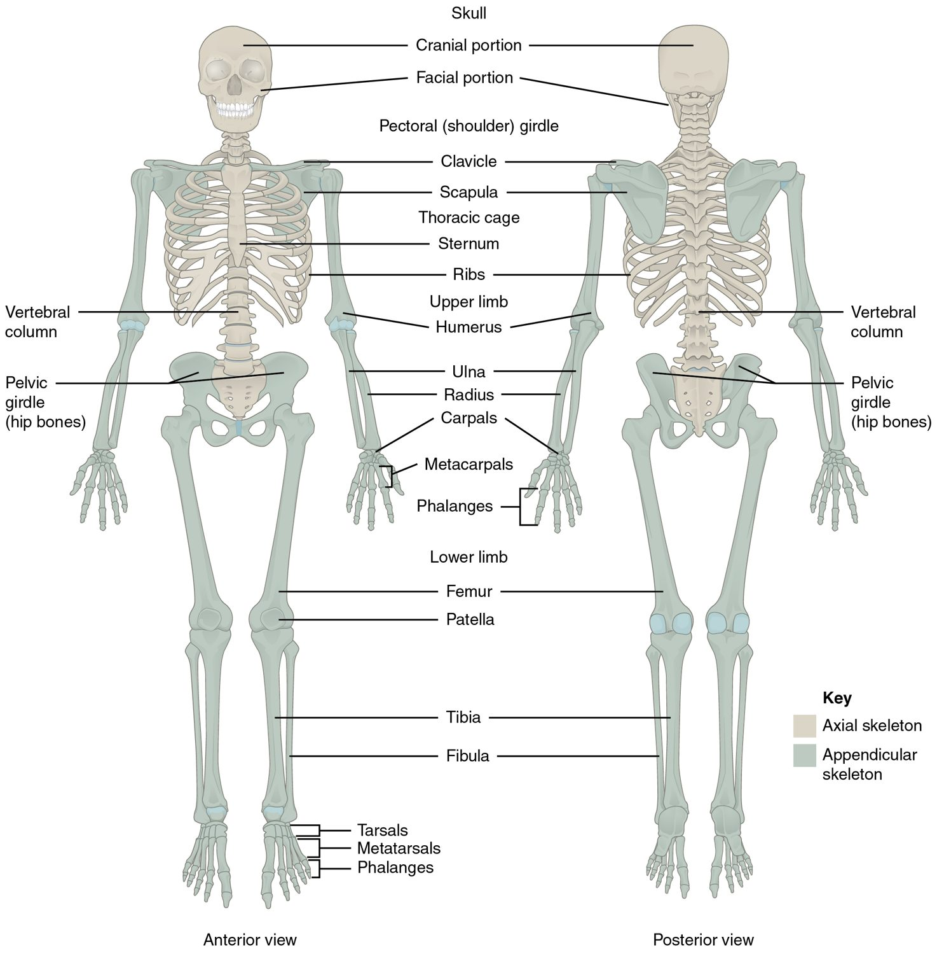
CHAPTER 7
Learning Objectives
After studying this chapter, students will be able to:
1
Describe the functions of the skeletal system and define its two major subdivisions
2
Identify the bones and bony structures of the skull, the cranial suture lines, the cranial fossae, and the openings in the skull
3
Discuss the vertebral column and regional variations in its bony components and curvatures
4
Describe the components of the thoracic cage
5
Discuss the embryonic development of the axial skeleton The skeletal system forms the rigid internal framework of the body
The axial skeleton forms the body's central axis.
PN 104 · Ch 7 — The Axial Skeleton
2
Notes:
READ ALOUD SCRIPT
These are our learning objectives for Chapter 7. By the end of the chapter, you should be able to do the following: Describe the functions of the skeletal system and define its two major subdivisions. Identify the bones and bony structures of the skull, the cranial suture lines, the cranial fossae, and the openings in the skull. Discuss the vertebral column and regional variations in its bony components and curvatures. Describe the components of the thoracic cage. Discuss the embryonic development of the axial skeleton The skeletal system forms the rigid internal framework of the body. Do not treat these as isolated facts. Use them as a checklist for what you should be able to identify, explain, and connect to safe practical nursing care.
[Sources]
- BMHI PN 104 Chapter 7 faculty PowerPoint slide content.

Slide 3
7.1
SECTION
Divisions of the Skeletal System
Dividing the skeleton into the axial core and the appendicular limbs.
Notes:
READ ALOUD SCRIPT
We are now moving into Divisions of the Skeletal System. Dividing the skeleton into the axial core and the appendicular limbs. As we begin this section, listen for the major structures, their locations, and the functions they perform. Then ask yourself what a change in this area might look like during patient care.
[Sources]
- BMHI PN 104 Chapter 7 faculty PowerPoint slide content.

Slide 4
SECTION 7.1
Axial vs. Appendicular Skeleton
206 bones in two divisions
Axial: skull, vertebrae, thoracic cage
Appendicular: limbs and girdles
The axial forms the central axis
The axial and appendicular skeleton
PN 104 · Ch 7 — The Axial Skeleton
4
Notes:
READ ALOUD SCRIPT
Now let's focus on Axial vs. Appendicular Skeleton. bones in two divisions. Axial: skull, vertebrae, thoracic cage. Appendicular: limbs and girdles. The axial forms the central axis. The axial and appendicular skeleton. Protect spinal alignment during movement and transfers, and report new weakness, numbness, severe pain, or loss of bowel or bladder control immediately. Take a moment to identify the structure on the image and explain how its form supports its function. This is slide 4 of 22.
[Sources]
- BMHI PN 104 Chapter 7 faculty PowerPoint slide content.

Slide 5
7.2
SECTION
The Skull
The cranial and facial bones that protect the brain and shape the face.
Notes:
READ ALOUD SCRIPT
We are now moving into The Skull. The cranial and facial bones that protect the brain and shape the face. As we begin this section, listen for the major structures, their locations, and the functions they perform. Then ask yourself what a change in this area might look like during patient care.
[Sources]
- BMHI PN 104 Chapter 7 faculty PowerPoint slide content.

Slide 6
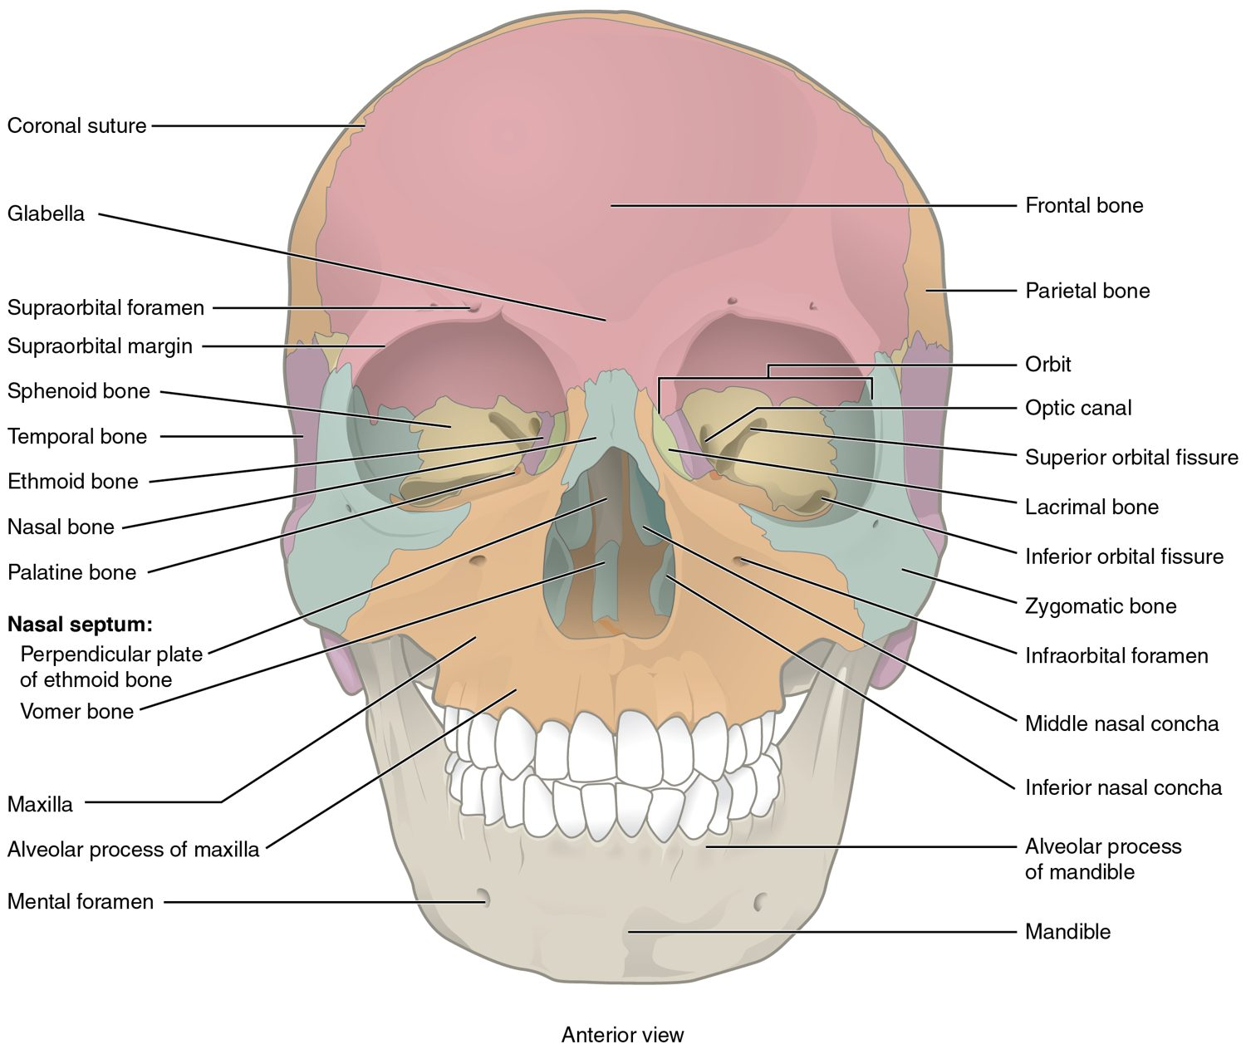
SECTION 7.2
The Skull — Anterior View
22 bones: cranial and facial
Cranial bones enclose the brain
Facial bones shape the face
Joined by immovable sutures
Anterior view of the skull
PN 104 · Ch 7 — The Axial Skeleton
6
Notes:
READ ALOUD SCRIPT
Now let's focus on The Skull — Anterior View. bones: cranial and facial. Cranial bones enclose the brain. Facial bones shape the face. Joined by immovable sutures. Anterior view of the skull. Use these landmarks when observing facial symmetry, trauma, airway concerns, pain, drainage, or changes in neurologic status. Take a moment to identify the structure on the image and explain how its form supports its function. This is slide 6 of 22.
[Sources]
- BMHI PN 104 Chapter 7 faculty PowerPoint slide content.

Slide 7
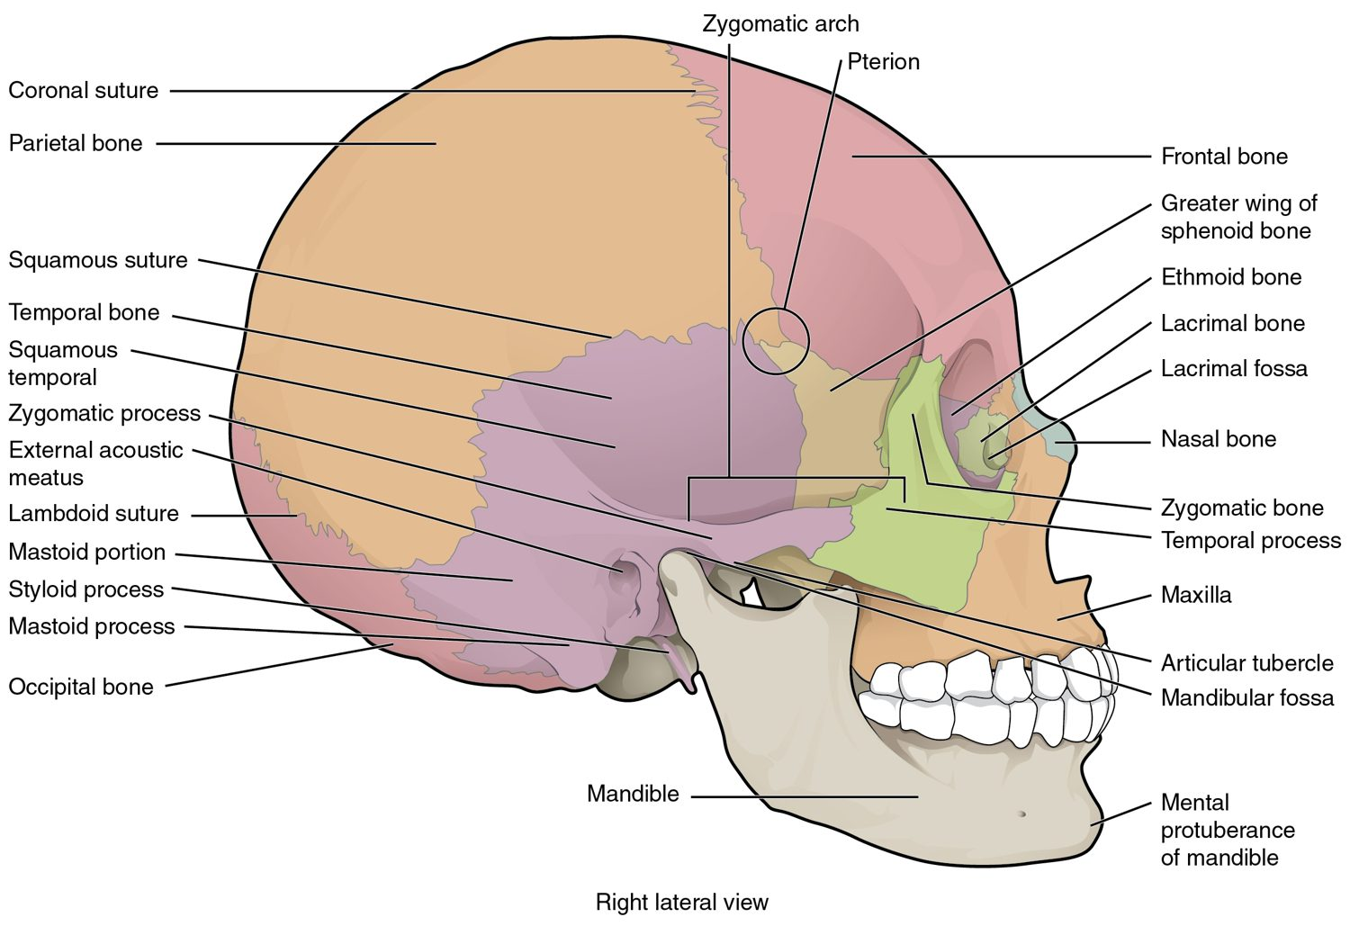
SECTION 7.2
The Skull — Lateral View
Frontal, parietal, temporal, occipital
Sphenoid and ethmoid lie deep within
Cranial bones meet at sutures
Cranial fossae cradle the brain
Lateral view of the skull
PN 104 · Ch 7 — The Axial Skeleton
7
Notes:
READ ALOUD SCRIPT
Now let's focus on The Skull — Lateral View. Frontal, parietal, temporal, occipital. Sphenoid and ethmoid lie deep within. Cranial bones meet at sutures. Cranial fossae cradle the brain. Lateral view of the skull. Use these landmarks when observing facial symmetry, trauma, airway concerns, pain, drainage, or changes in neurologic status. Take a moment to identify the structure on the image and explain how its form supports its function. This is slide 7 of 22.
[Sources]
- BMHI PN 104 Chapter 7 faculty PowerPoint slide content.

Slide 8
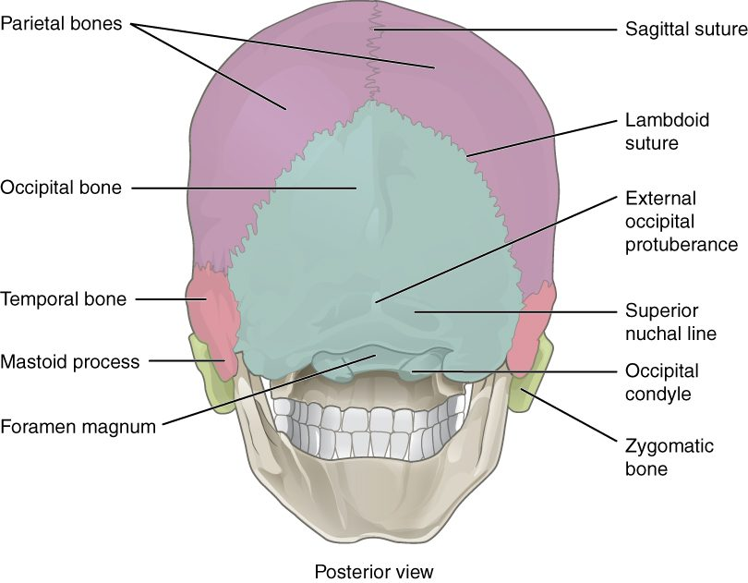
SECTION 7.2
Sutures of the Skull
Sutures are immovable fibrous joints
Coronal, sagittal, and lambdoid
Lock the cranial bones together
Foramen magnum at the base
Posterior skull and cranial sutures
PN 104 · Ch 7 — The Axial Skeleton
8
Notes:
READ ALOUD SCRIPT
Now let's focus on Sutures of the Skull. Sutures are immovable fibrous joints. Coronal, sagittal, and lambdoid. Lock the cranial bones together. Foramen magnum at the base. Posterior skull and cranial sutures. Use these landmarks when observing facial symmetry, trauma, airway concerns, pain, drainage, or changes in neurologic status. Take a moment to identify the structure on the image and explain how its form supports its function. This is slide 8 of 22.
[Sources]
- BMHI PN 104 Chapter 7 faculty PowerPoint slide content.

Slide 9
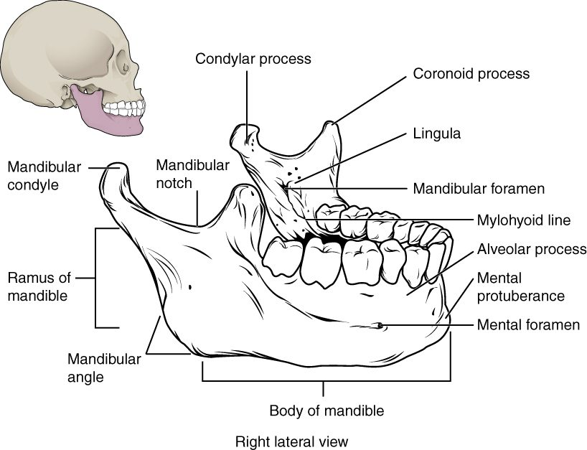
SECTION 7.2
The Mandible
The only movable skull bone
Forms the lower jaw
Holds the lower teeth
Articulates at the TMJ
The mandible (lower jaw)
PN 104 · Ch 7 — The Axial Skeleton
9
Notes:
READ ALOUD SCRIPT
Now let's focus on The Mandible. The only movable skull bone. Forms the lower jaw. Holds the lower teeth. Articulates at the TMJ. The mandible (lower jaw). Use these landmarks when observing facial symmetry, trauma, airway concerns, pain, drainage, or changes in neurologic status. Take a moment to identify the structure on the image and explain how its form supports its function. This is slide 9 of 22.
[Sources]
- BMHI PN 104 Chapter 7 faculty PowerPoint slide content.

Slide 10
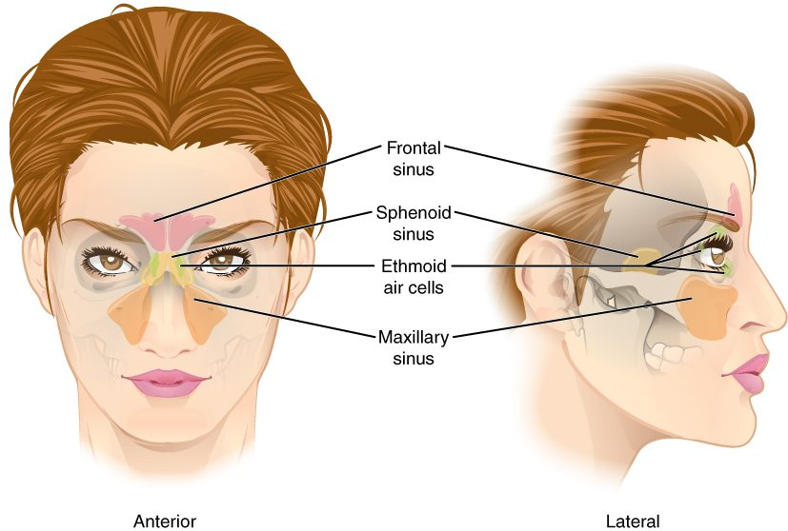
SECTION 7.2
The Paranasal Sinuses
Air-filled spaces in skull bones
Frontal, ethmoid, sphenoid, maxillary
Lighten the skull and warm air
Drain into the nasal cavity
The paranasal sinuses
PN 104 · Ch 7 — The Axial Skeleton
10
Notes:
READ ALOUD SCRIPT
Now let's focus on The Paranasal Sinuses. Air-filled spaces in skull bones. Frontal, ethmoid, sphenoid, maxillary. Lighten the skull and warm air. Drain into the nasal cavity. The paranasal sinuses. Use these landmarks when observing facial symmetry, trauma, airway concerns, pain, drainage, or changes in neurologic status. Take a moment to identify the structure on the image and explain how its form supports its function. This is slide 10 of 22.
[Sources]
- BMHI PN 104 Chapter 7 faculty PowerPoint slide content.

Slide 11
7.3
SECTION
The Vertebral Column
Support, protection of the spinal cord, and flexibility of the spine.
Notes:
READ ALOUD SCRIPT
We are now moving into The Vertebral Column. Support, protection of the spinal cord, and flexibility of the spine. As we begin this section, listen for the major structures, their locations, and the functions they perform. Then ask yourself what a change in this area might look like during patient care.
[Sources]
- BMHI PN 104 Chapter 7 faculty PowerPoint slide content.

Slide 12
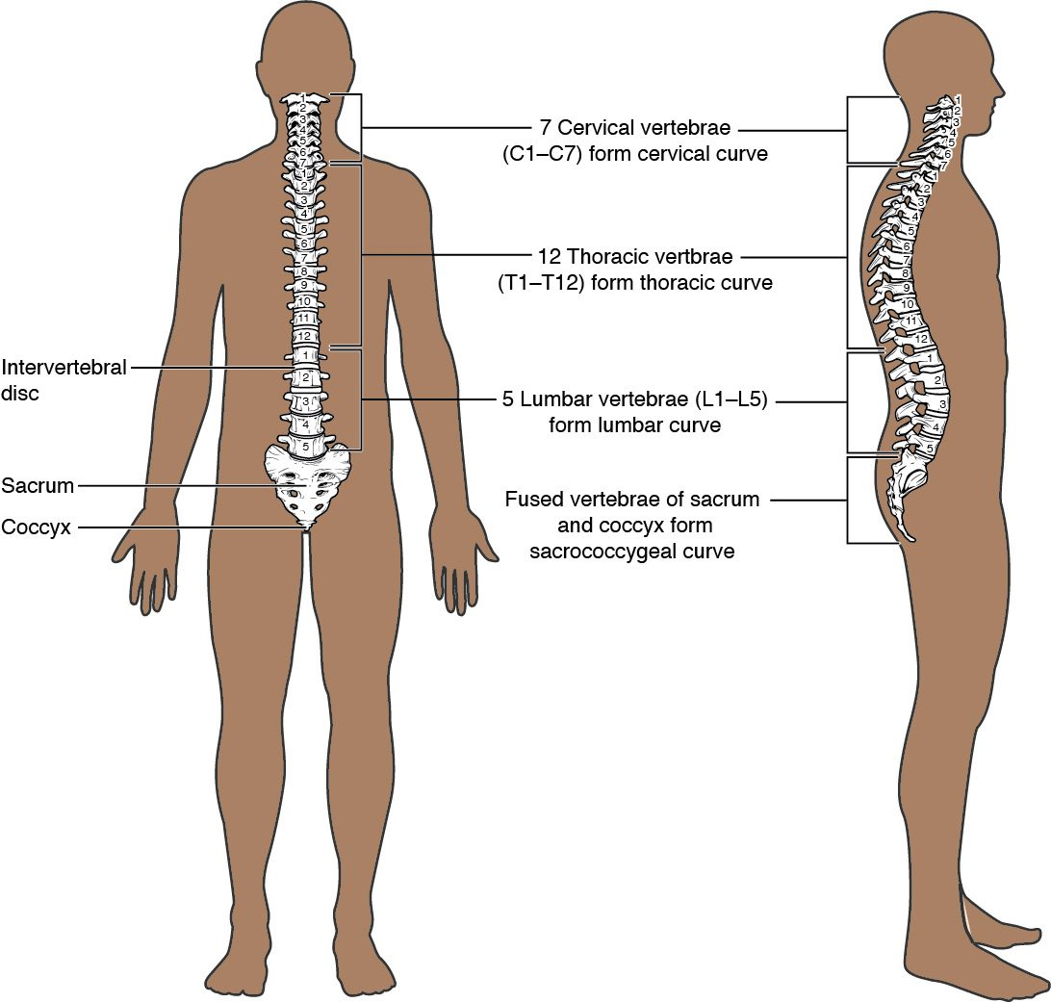
SECTION 7.3
The Vertebral Column
26 bones in five regions
Cervical, thoracic, lumbar, sacrum, coccyx
Four curvatures balance the body
Protects the spinal cord
The vertebral column and its curvatures
PN 104 · Ch 7 — The Axial Skeleton
12
Notes:
READ ALOUD SCRIPT
Now let's focus on The Vertebral Column. bones in five regions. Cervical, thoracic, lumbar, sacrum, coccyx. Four curvatures balance the body. Protects the spinal cord. The vertebral column and its curvatures. Protect spinal alignment during movement and transfers, and report new weakness, numbness, severe pain, or loss of bowel or bladder control immediately. Take a moment to identify the structure on the image and explain how its form supports its function. This is slide 12 of 22.
[Sources]
- BMHI PN 104 Chapter 7 faculty PowerPoint slide content.

Slide 13
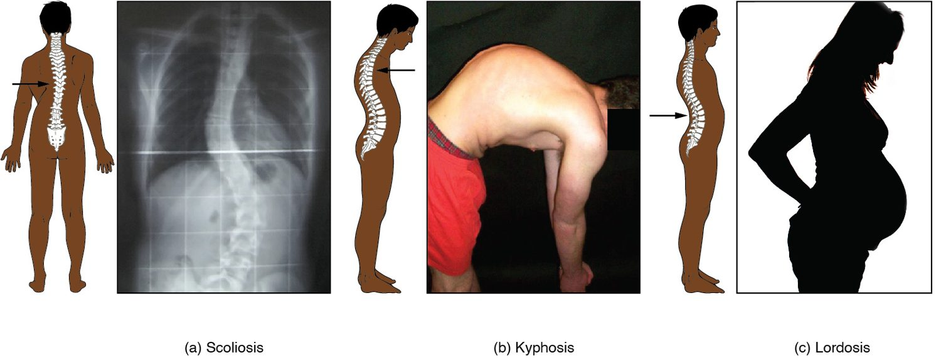
SECTION 7.3
Abnormal Spinal Curvatures
Scoliosis, kyphosis, and lordosis
Scoliosis: a sideways curvature
Kyphosis: exaggerated thoracic curve
Lordosis: exaggerated lumbar curve
Affect posture and breathing
PN 104 · Ch 7 — The Axial Skeleton
13
Notes:
READ ALOUD SCRIPT
Now let's focus on Abnormal Spinal Curvatures. Scoliosis, kyphosis, and lordosis. Scoliosis: a sideways curvature. Kyphosis: exaggerated thoracic curve. Lordosis: exaggerated lumbar curve. Affect posture and breathing. Protect spinal alignment during movement and transfers, and report new weakness, numbness, severe pain, or loss of bowel or bladder control immediately. Take a moment to identify the structure on the image and explain how its form supports its function. This is slide 13 of 22.
[Sources]
- BMHI PN 104 Chapter 7 faculty PowerPoint slide content.

Slide 14
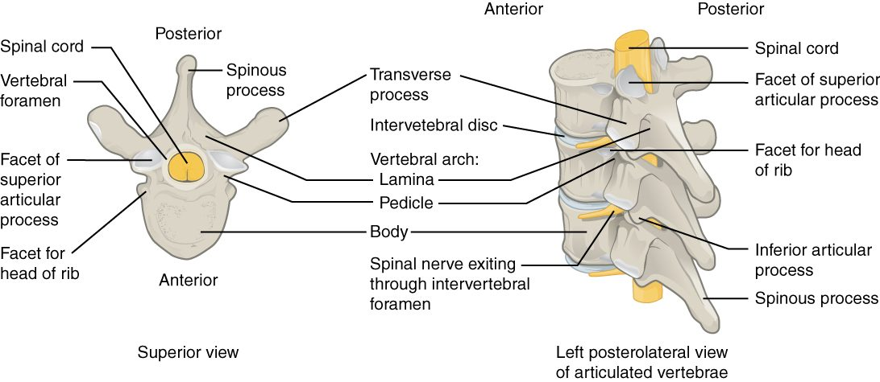
SECTION 7.3
A Typical Vertebra
The structure of a typical vertebra
Body bears weight in front
Vertebral arch surrounds the cord
Spinous and transverse processes
Stacked foramina form the canal
PN 104 · Ch 7 — The Axial Skeleton
14
Notes:
READ ALOUD SCRIPT
Now let's focus on A Typical Vertebra. The structure of a typical vertebra. Body bears weight in front. Vertebral arch surrounds the cord. Spinous and transverse processes. Stacked foramina form the canal. Protect spinal alignment during movement and transfers, and report new weakness, numbness, severe pain, or loss of bowel or bladder control immediately. Take a moment to identify the structure on the image and explain how its form supports its function. This is slide 14 of 22.
[Sources]
- BMHI PN 104 Chapter 7 faculty PowerPoint slide content.

Slide 15
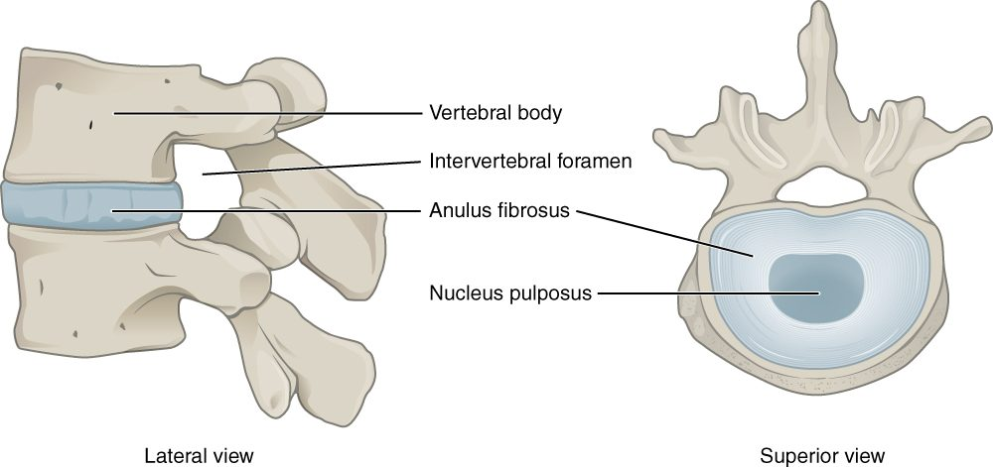
SECTION 7.3
Intervertebral Discs
An intervertebral disc
Cushions between vertebral bodies
Tough outer ring (annulus fibrosus)
Gel-like center (nucleus pulposus)
Absorb shock and allow movement
PN 104 · Ch 7 — The Axial Skeleton
15
Notes:
READ ALOUD SCRIPT
Now let's focus on Intervertebral Discs. An intervertebral disc. Cushions between vertebral bodies. Tough outer ring (annulus fibrosus). Gel-like center (nucleus pulposus). Absorb shock and allow movement. Protect spinal alignment during movement and transfers, and report new weakness, numbness, severe pain, or loss of bowel or bladder control immediately. Take a moment to identify the structure on the image and explain how its form supports its function. This is slide 15 of 22.
[Sources]
- BMHI PN 104 Chapter 7 faculty PowerPoint slide content.

Slide 16
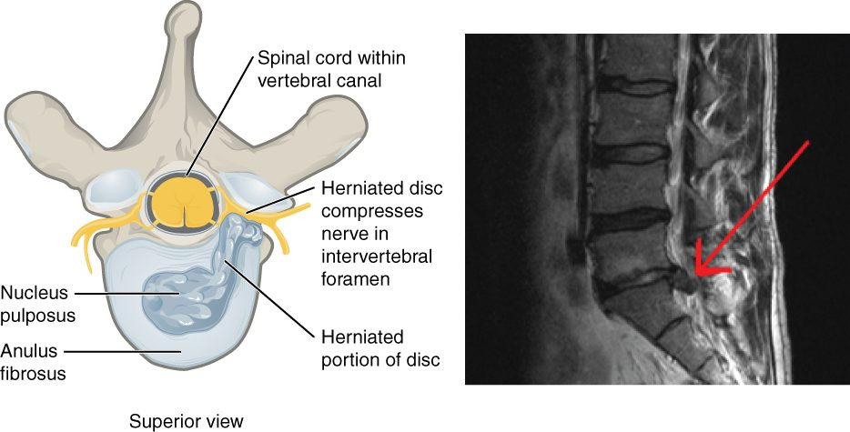
SECTION 7.3
Herniated Disc
A herniated intervertebral disc
Nucleus pushes through the annulus
Can compress spinal nerves
Causes pain, numbness, weakness
Common in the lumbar spine
PN 104 · Ch 7 — The Axial Skeleton
16
Notes:
READ ALOUD SCRIPT
Now let's focus on Herniated Disc. A herniated intervertebral disc. Nucleus pushes through the annulus. Can compress spinal nerves. Causes pain, numbness, weakness. Common in the lumbar spine. Protect spinal alignment during movement and transfers, and report new weakness, numbness, severe pain, or loss of bowel or bladder control immediately. Take a moment to identify the structure on the image and explain how its form supports its function. This is slide 16 of 22.
[Sources]
- BMHI PN 104 Chapter 7 faculty PowerPoint slide content.

Slide 17
7.4
SECTION
The Thoracic Cage
The sternum and ribs that protect the heart and lungs and aid breathing.
Notes:
READ ALOUD SCRIPT
We are now moving into The Thoracic Cage. The sternum and ribs that protect the heart and lungs and aid breathing. As we begin this section, listen for the major structures, their locations, and the functions they perform. Then ask yourself what a change in this area might look like during patient care.
[Sources]
- BMHI PN 104 Chapter 7 faculty PowerPoint slide content.

Slide 18
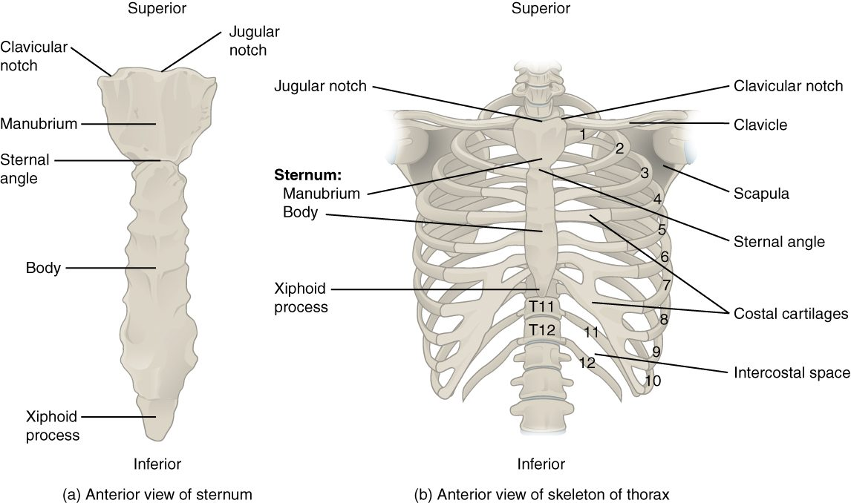
SECTION 7.4
The Thoracic Cage
The thoracic cage (sternum and ribs)
Sternum plus 12 pairs of ribs
True, false, and floating ribs
Protects the heart and lungs
Moves to enable breathing
PN 104 · Ch 7 — The Axial Skeleton
18
Notes:
READ ALOUD SCRIPT
Now let's focus on The Thoracic Cage. The thoracic cage (sternum and ribs). Sternum plus 12 pairs of ribs. True, false, and floating ribs. Protects the heart and lungs. Moves to enable breathing. Relate these landmarks to breathing assessment, trauma observation, positioning, and correct chest-compression placement. Take a moment to identify the structure on the image and explain how its form supports its function. This is slide 18 of 22.
[Sources]
- BMHI PN 104 Chapter 7 faculty PowerPoint slide content.

Slide 19
7.5
SECTION
Embryonic Development of the Axial Skeleton
How the skull and spine form before birth and in infancy.
Notes:
READ ALOUD SCRIPT
We are now moving into Embryonic Development of the Axial Skeleton. How the skull and spine form before birth and in infancy. As we begin this section, listen for the major structures, their locations, and the functions they perform. Then ask yourself what a change in this area might look like during patient care.
[Sources]
- BMHI PN 104 Chapter 7 faculty PowerPoint slide content.

Slide 20
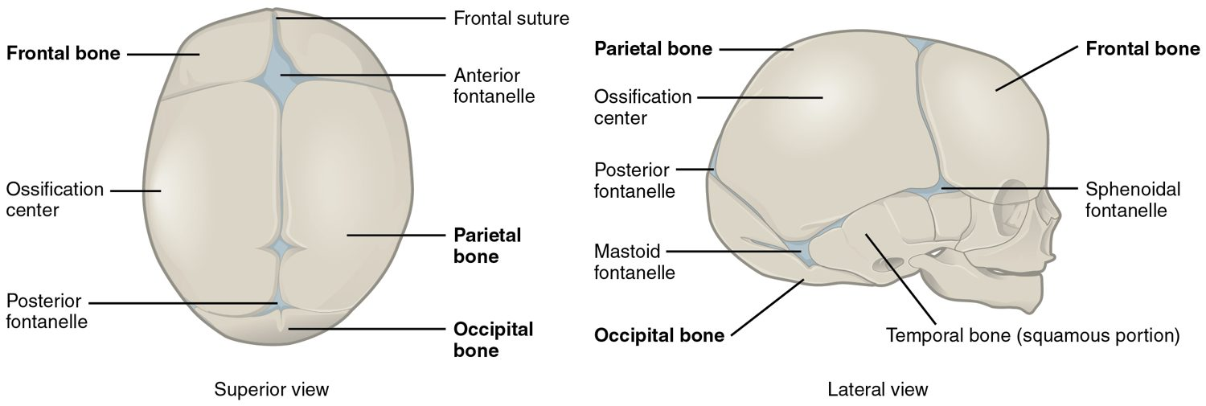
SECTION 7.5
Fontanelles & Skull Development
Fontanelles of the newborn skull
Infant skull bones are not yet fused
Fontanelles ("soft spots") remain
Allow birth passage and brain growth
Close over the first two years
PN 104 · Ch 7 — The Axial Skeleton
20
Notes:
READ ALOUD SCRIPT
Now let's focus on Fontanelles & Skull Development. Fontanelles of the newborn skull. Infant skull bones are not yet fused. Fontanelles ("soft spots") remain. Allow birth passage and brain growth. Close over the first two years. During infant assessment, observe fontanelles without pressing firmly and report marked bulging or sinking with the complete clinical picture. Take a moment to identify the structure on the image and explain how its form supports its function. This is slide 20 of 22.
[Sources]
- BMHI PN 104 Chapter 7 faculty PowerPoint slide content.

Slide 21
CHAPTER 7
Key Takeaways
The skeleton divides into the axial (central axis) and appendicular (limbs) divisions.
The skull's 22 bones protect the brain and form the face, joined by immovable sutures.
The vertebral column supports the body, protects the spinal cord, and has four curvatures.
The thoracic cage protects the heart and lungs and assists with breathing.
The infant skull has fontanelles that allow birth and brain growth.
PN 104 · Ch 7 — The Axial Skeleton
21
Notes:
READ ALOUD SCRIPT
Let us review the major takeaways from Chapter 7. The skeleton divides into the axial (central axis) and appendicular (limbs) divisions. The skull's 22 bones protect the brain and form the face, joined by immovable sutures. The vertebral column supports the body, protects the spinal cord, and has four curvatures. The thoracic cage protects the heart and lungs and assists with breathing. The infant skull has fontanelles that allow birth and brain growth. Before moving on, pause and explain each point without reading the slide. If any statement is difficult to explain, mark that topic for review before the quiz.
[Sources]
- BMHI PN 104 Chapter 7 faculty PowerPoint slide content.

Slide 22
CLINICAL CONNECTIONS
Why the Axial Skeleton Matters in Practical Nursing
Spine Injuries
Back Pain
Vertebrae protect the spinal cord — spinal precautions prevent paralysis.
Herniated discs and abnormal curvatures are common sources of pain.
Sinusitis
Infant Assessment
The paranasal sinuses drain into the nose and can become infected.
Fontanelles reveal hydration status and intracranial pressure.
Osteoporosis
CPR Landmarks
Thoracic kyphosis often reflects vertebral bone loss in older adults.
The sternum and ribs guide hand placement for chest compressions.
Notes:
READ ALOUD SCRIPT
This final slide connects Chapter 7 to practical nursing. Spine Injuries. Vertebrae protect the spinal cord — spinal precautions prevent paralysis. Back Pain. Herniated discs and abnormal curvatures are common sources of pain. Sinusitis. The paranasal sinuses drain into the nose and can become infected. Infant Assessment. Fontanelles reveal hydration status and intracranial pressure. Osteoporosis. Thoracic kyphosis often reflects vertebral bone loss in older adults. CPR Landmarks. The sternum and ribs guide hand placement for chest compressions. Your role is to observe carefully, protect safety, follow orders and precautions, document objectively, and report changes through the appropriate chain of command. Use these examples to connect anatomy with the care you will provide.
[Sources]
- BMHI PN 104 Chapter 7 faculty PowerPoint slide content.

