Slide 1
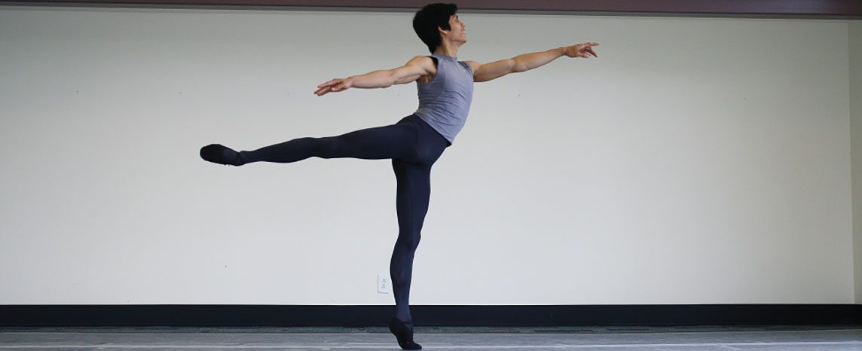
CHAPTER 8
The Appendicular Skeleton
The limbs and the girdles that attach them to the body.
Anatomy & Physiology · Broward-Miami Health Institute
FACULTY EDITION

Slide 2
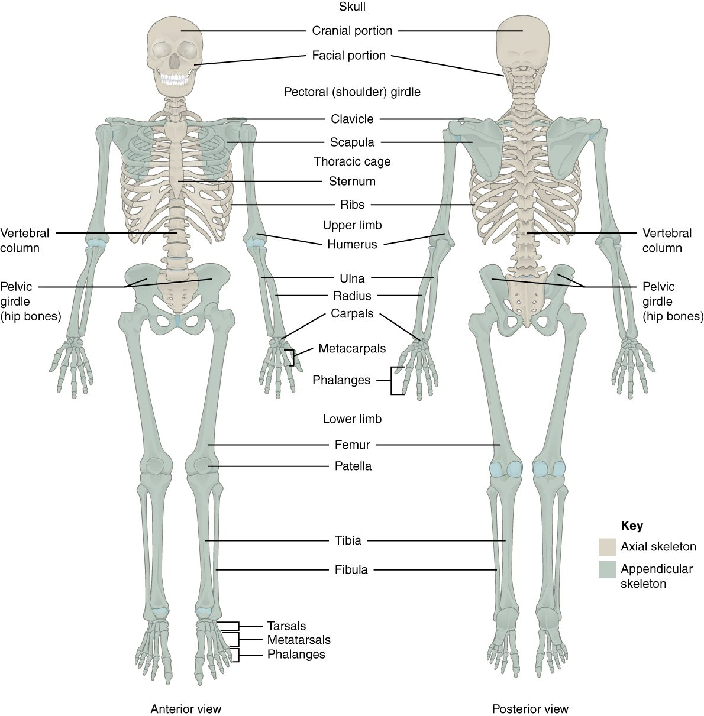
CHAPTER 8
Learning Objectives
After studying this chapter, students will be able to:
1
Discuss the bones of the pectoral and pelvic girdles, and describe how these unite the limbs with the axial skeleton
2
Describe the bones of the upper limb, including the bones of the arm, forearm, wrist, and hand
3
Identify the features of the pelvis and explain how these differ between the adult male and female pelvis
4
Describe the bones of the lower limb, including the bones of the thigh, leg, ankle, and foot
5
Describe the embryonic formation and growth of the limb bones Your skeleton provides the internal supporting structure of the body
The appendicular skeleton — the limbs and their girdles.
PN 104 · Ch 8 — The Appendicular Skeleton
2

Slide 3
8.1
SECTION
The Pectoral Girdle
The clavicle and scapula that anchor the arm to the body.

Slide 4
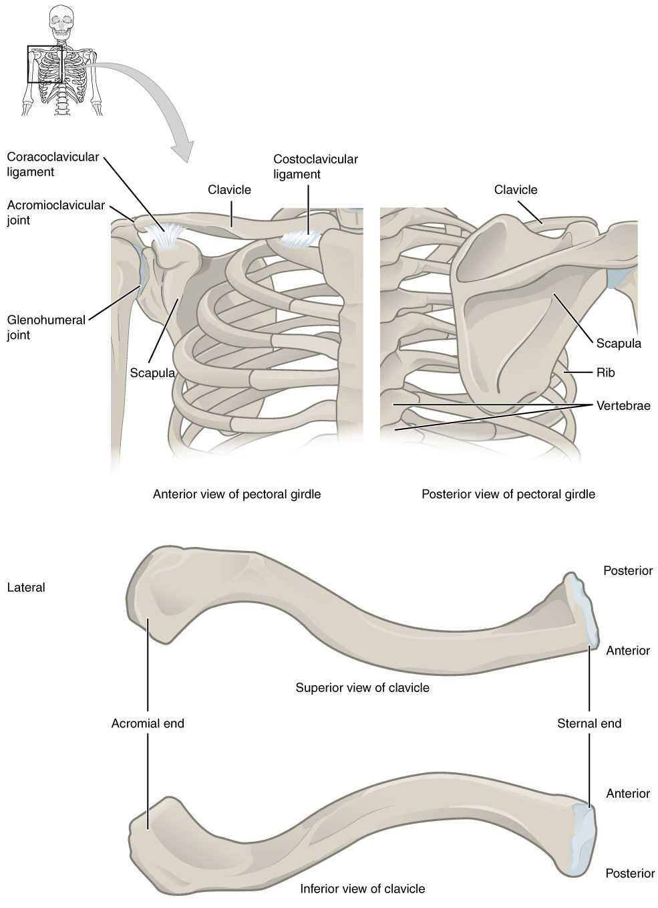
SECTION 8.1
The Pectoral Girdle
Clavicle and scapula on each side
Attaches the arm to the axial skeleton
Highly mobile but less stable
The clavicle is commonly fractured
The pectoral girdle (clavicle and scapula)
PN 104 · Ch 8 — The Appendicular Skeleton
4

Slide 5
8.2
SECTION
Bones of the Upper Limb
The humerus, radius, ulna, and the bones of the wrist and hand.

Slide 6
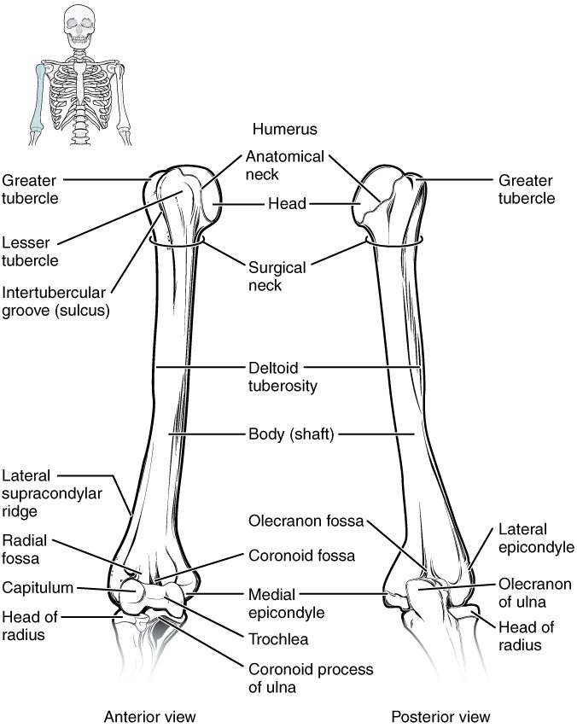
SECTION 8.2
The Humerus
The single bone of the arm
Head fits the scapula's glenoid cavity
Articulates with radius and ulna
Many muscle attachment sites
The humerus (arm bone)
PN 104 · Ch 8 — The Appendicular Skeleton
6

Slide 7
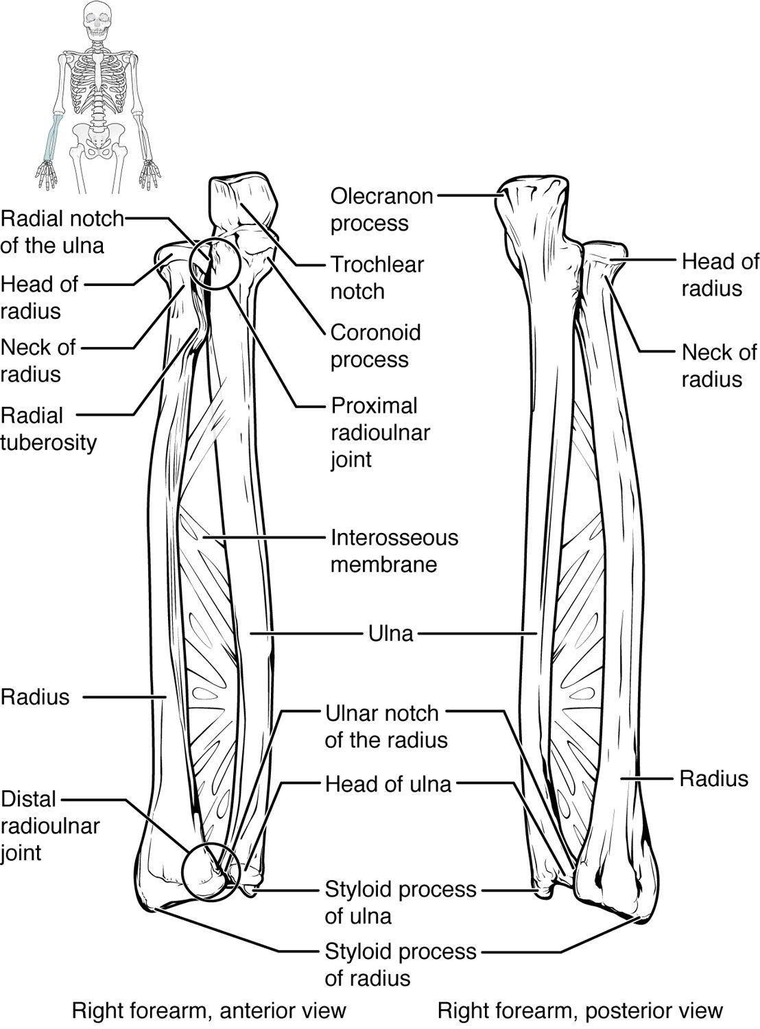
SECTION 8.2
The Radius and Ulna
The two bones of the forearm
Ulna is medial (little-finger side)
Radius is lateral (thumb side)
They cross during pronation
The radius and ulna (forearm)
PN 104 · Ch 8 — The Appendicular Skeleton
7

Slide 8
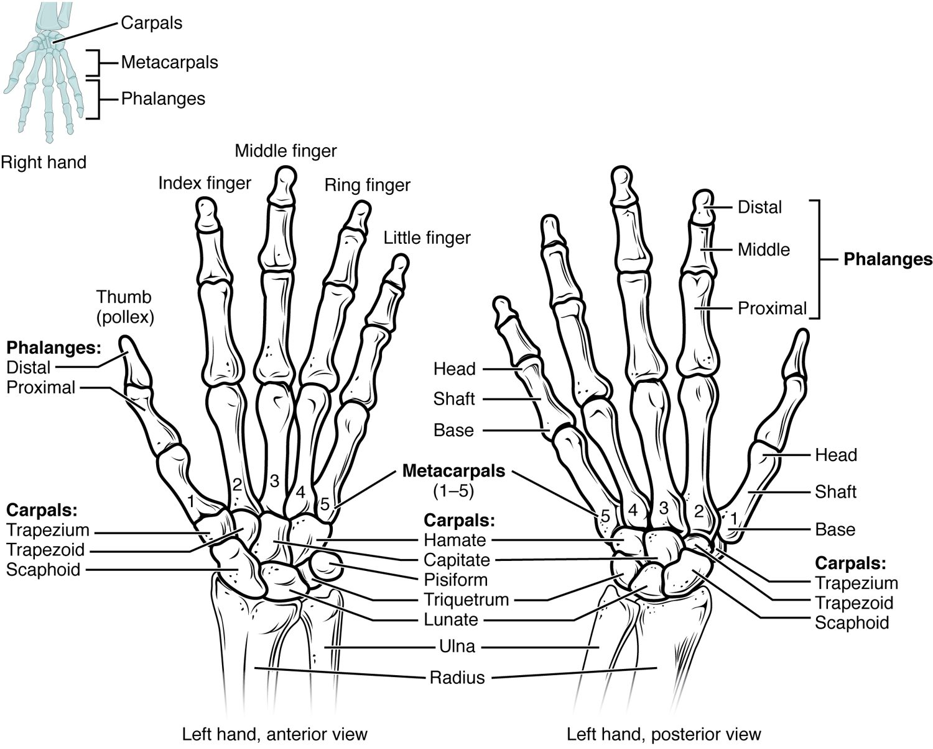
SECTION 8.2
Bones of the Hand
8 carpals form the wrist
5 metacarpals form the palm
14 phalanges form the fingers
Built for fine, precise movement
The bones of the wrist and hand
PN 104 · Ch 8 — The Appendicular Skeleton
8

Slide 9
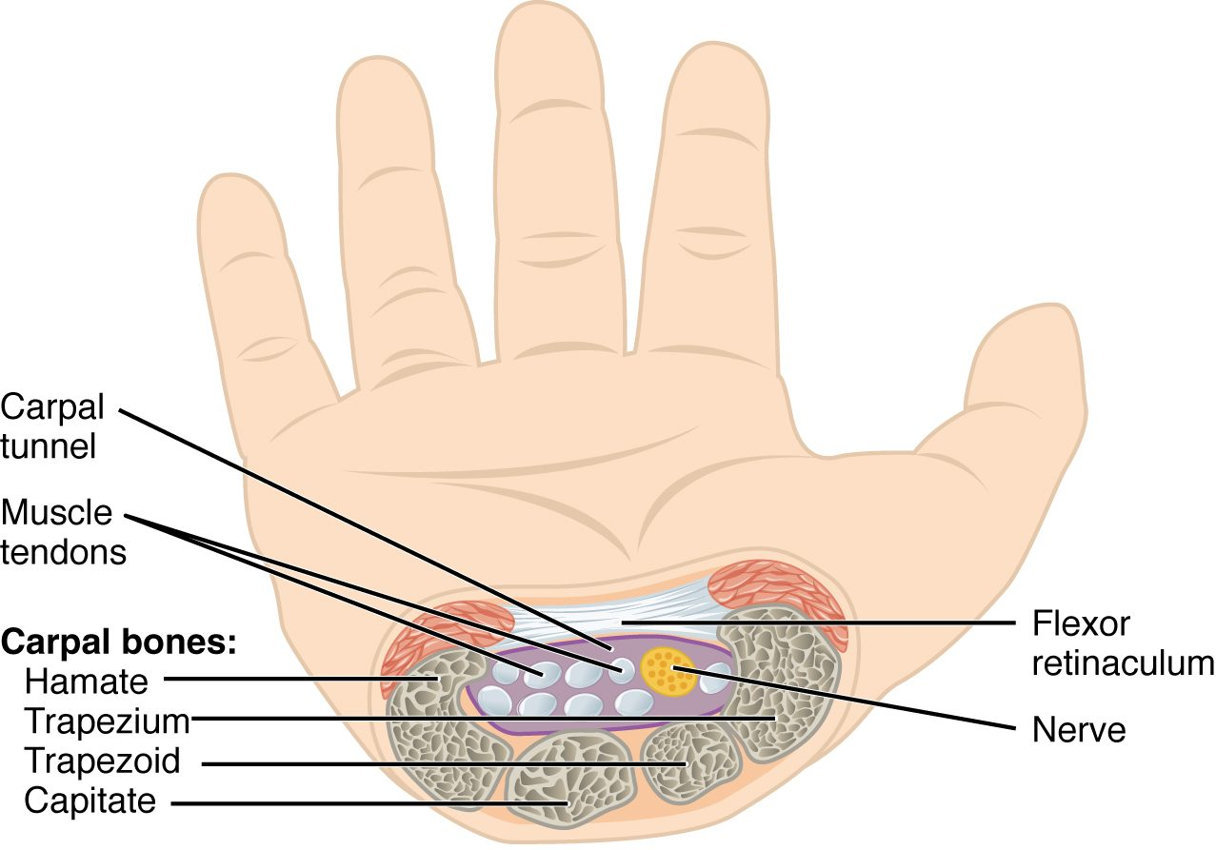
SECTION 8.2
The Carpal Tunnel
A passage at the front of the wrist
Formed by carpals + flexor retinaculum
Carries the median nerve and tendons
Compression causes carpal tunnel syndrome
The carpal tunnel and median nerve
PN 104 · Ch 8 — The Appendicular Skeleton
9

Slide 10
8.3
SECTION
The Pelvic Girdle and Pelvis
The hip bones, the sacrum, and the pelvis they form.

Slide 11
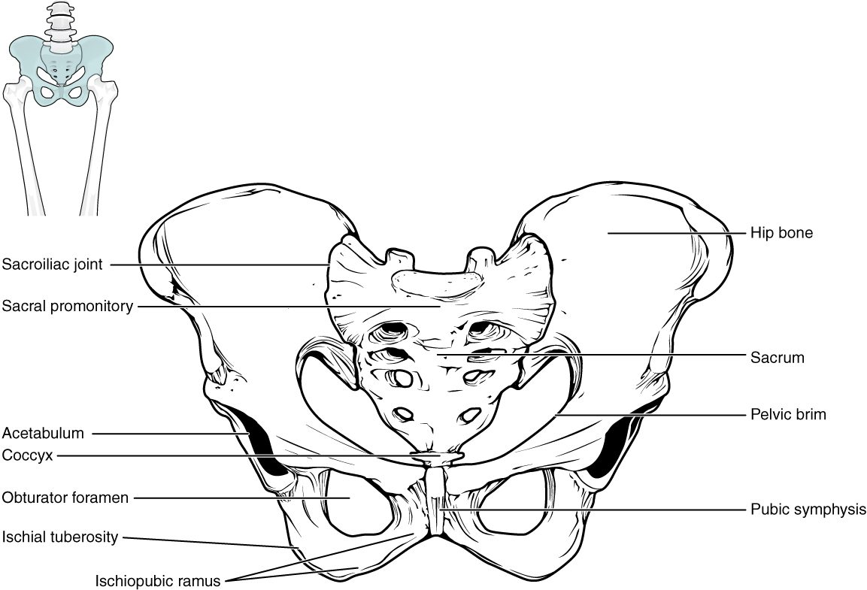
SECTION 8.3
The Pelvis
Two hip bones + sacrum + coccyx
Bears the body's weight
Protects the pelvic organs
A stable, weight-bearing girdle
The pelvis
PN 104 · Ch 8 — The Appendicular Skeleton
11

Slide 12
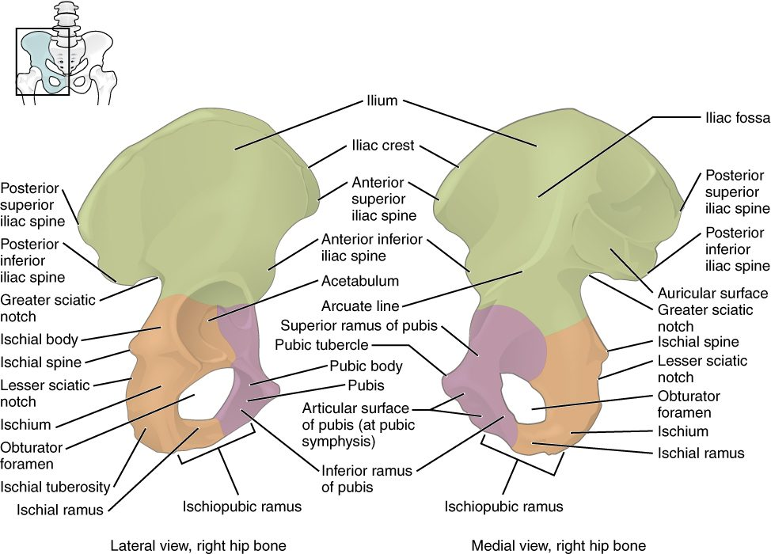
SECTION 8.3
The Hip Bone
Three fused bones: ilium, ischium, pubis
Meet at the acetabulum (hip socket)
Ilium is the broad flaring blade
Many muscle attachments
The hip bone (os coxae)
PN 104 · Ch 8 — The Appendicular Skeleton
12

Slide 13
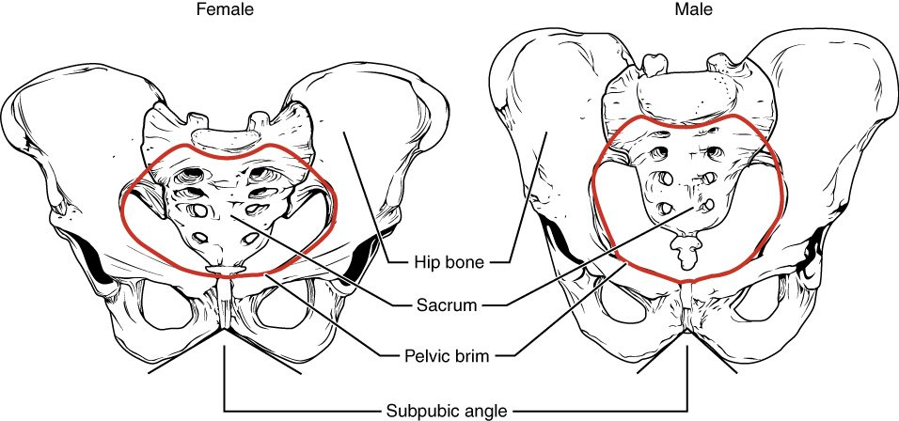
SECTION 8.3
Male vs. Female Pelvis
Differences between the male and female pelvis
Female pelvis is wider and shallower
Larger outlet for childbirth
Male pelvis is narrower and heavier
Sex differences aid identification
PN 104 · Ch 8 — The Appendicular Skeleton
13

Slide 14
8.4
SECTION
Bones of the Lower Limb
The femur, tibia, fibula, and the bones of the foot.

Slide 15
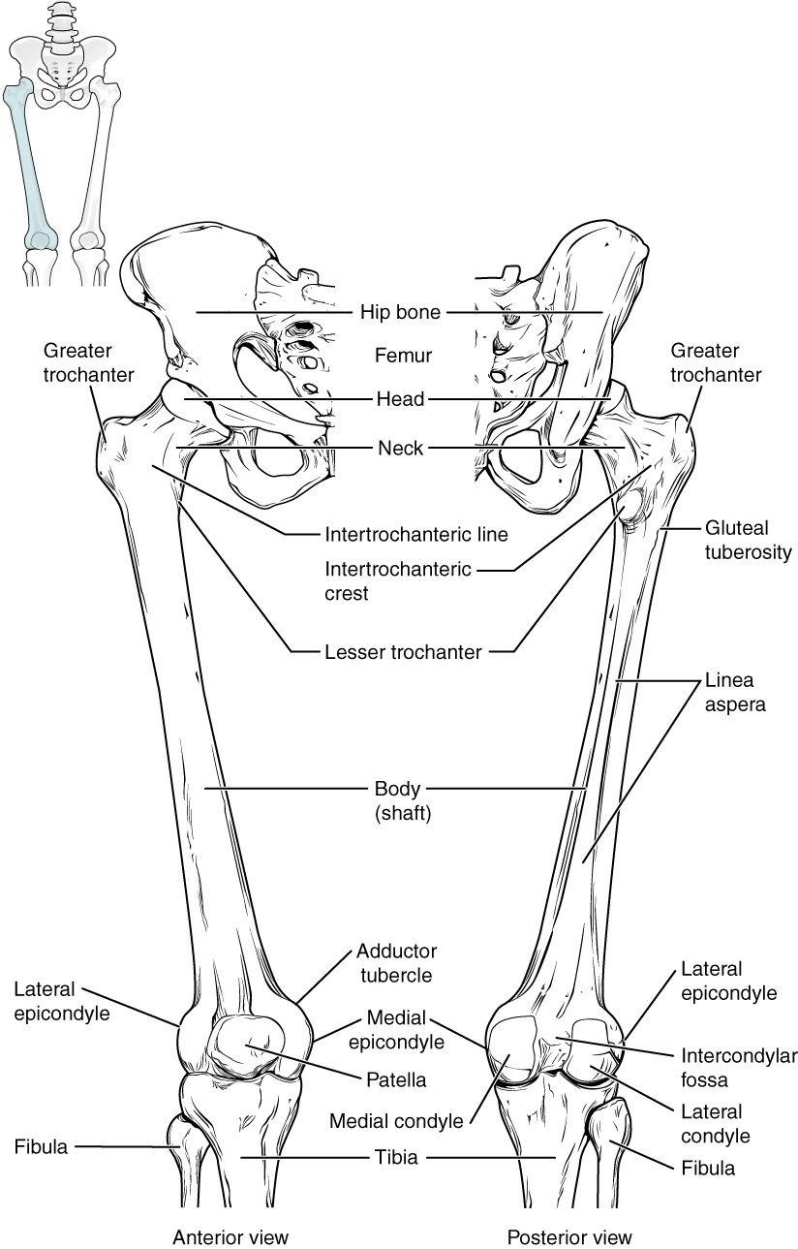
SECTION 8.4
The Femur
The thigh bone — longest, strongest bone
Head fits into the acetabulum
Meets the tibia at the knee
Bears great mechanical loads
The femur (thigh bone)
PN 104 · Ch 8 — The Appendicular Skeleton
15

Slide 16
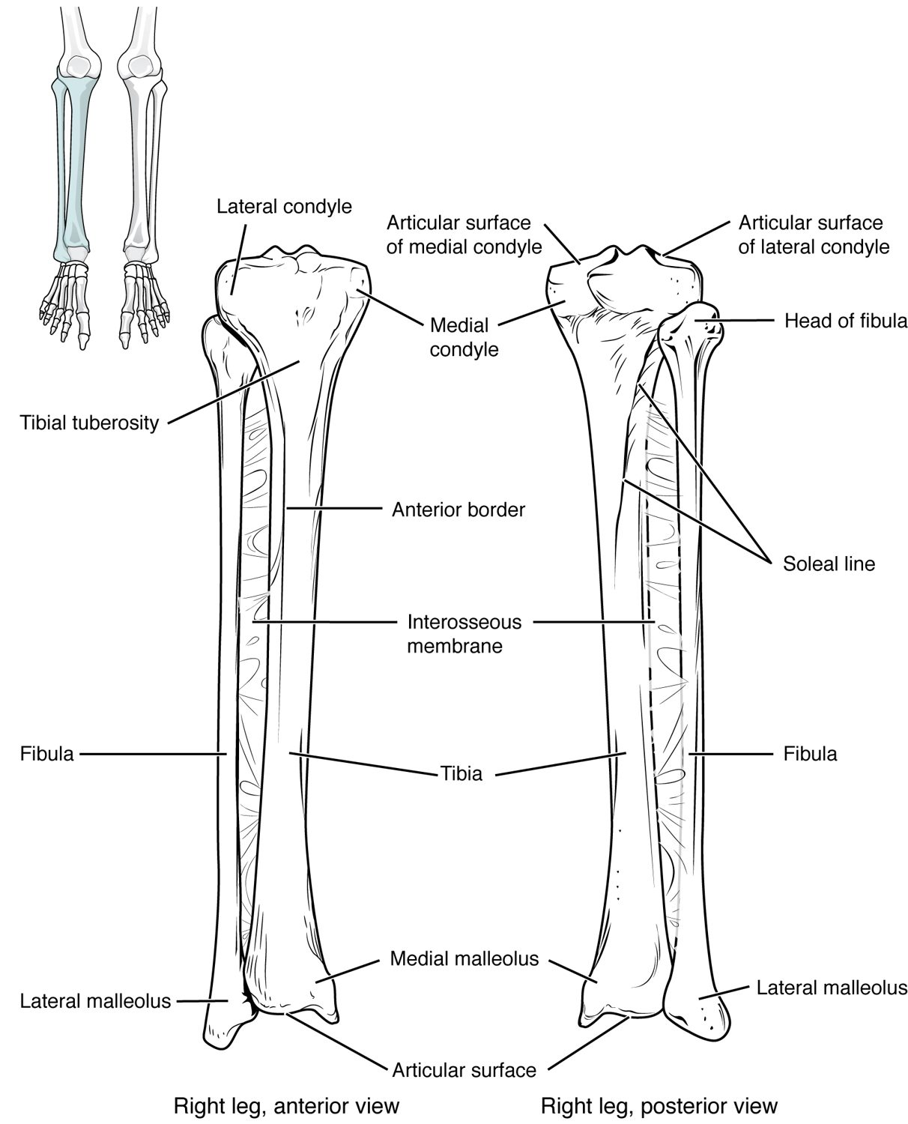
SECTION 8.4
The Tibia and Fibula
The two bones of the lower leg
Tibia (shinbone) bears the weight
Fibula stabilizes the ankle
They form the malleoli of the ankle
The tibia and fibula (lower leg)
PN 104 · Ch 8 — The Appendicular Skeleton
16

Slide 17
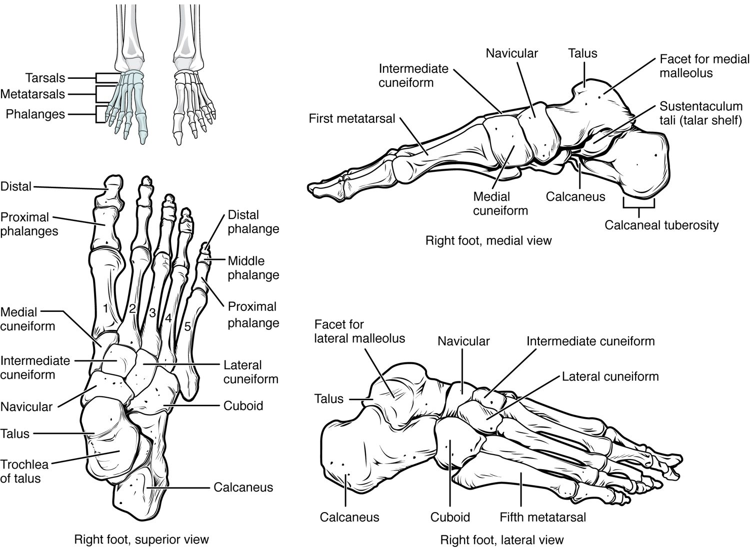
SECTION 8.4
Bones of the Foot
7 tarsals form the ankle and heel
5 metatarsals form the sole
14 phalanges form the toes
Arches support and absorb shock
The bones of the foot
PN 104 · Ch 8 — The Appendicular Skeleton
17

Slide 18
8.5
SECTION
Development of the Appendicular Skeleton
How the limbs form before birth, and common congenital differences.

Slide 19
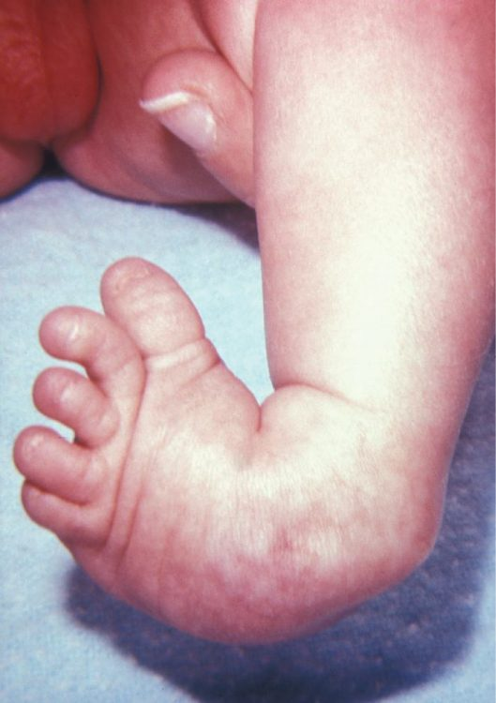
SECTION 8.5
Limb Development & Clubfoot
Limbs form early in the embryo
Bones develop from limb buds
Clubfoot is a common congenital condition
Early treatment improves outcomes
Clubfoot, a congenital foot condition
PN 104 · Ch 8 — The Appendicular Skeleton
19

Slide 20
CHAPTER 8
Key Takeaways
The appendicular skeleton is the limbs plus the girdles that attach them.
The mobile pectoral girdle anchors the arm; humerus, radius, ulna, and hand bones complete the upper limb.
The stable pelvic girdle bears weight and differs between the sexes.
The femur, tibia, fibula, and foot bones support the body and enable walking.
The limbs form early in development; congenital conditions like clubfoot are treatable.
PN 104 · Ch 8 — The Appendicular Skeleton
20

Slide 21
CLINICAL CONNECTIONS
Why the Appendicular Skeleton Matters in Practical Nursing
Fracture Sites
Carpal Tunnel
The clavicle, wrist, and hip are common fracture locations.
Median-nerve compression at the wrist causes numbness and weakness.
Hip Fractures
Obstetrics
Femoral-neck fractures are a major risk in older adults.
The female pelvis shape is central to childbirth.
Mobility
Pediatrics
Limb bones support transfers, ambulation, and weight-bearing.
Congenital limb conditions like clubfoot need early intervention.

