Slide 1
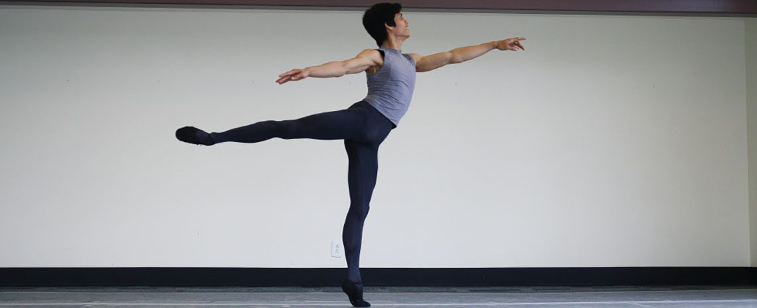
CHAPTER 8
The Appendicular Skeleton
The limbs and the girdles that attach them to the body.
Anatomy & Physiology · Broward-Miami Health Institute
FACULTY EDITION
Notes:
READ ALOUD SCRIPT
Today we are beginning Chapter 8, the appendicular skeleton. In this chapter, we will connect the names and locations of skeletal structures with their functions and with the observations that matter in practical nursing care. As we move through the slides, focus on how structure supports protection, movement, stability, mineral balance, and patient safety. By the end, you should be able to explain the major concepts in your own words and apply them to a patient-care situation.
[Sources]
- BMHI PN 104 Chapter 8 faculty PowerPoint slide content.

Slide 2
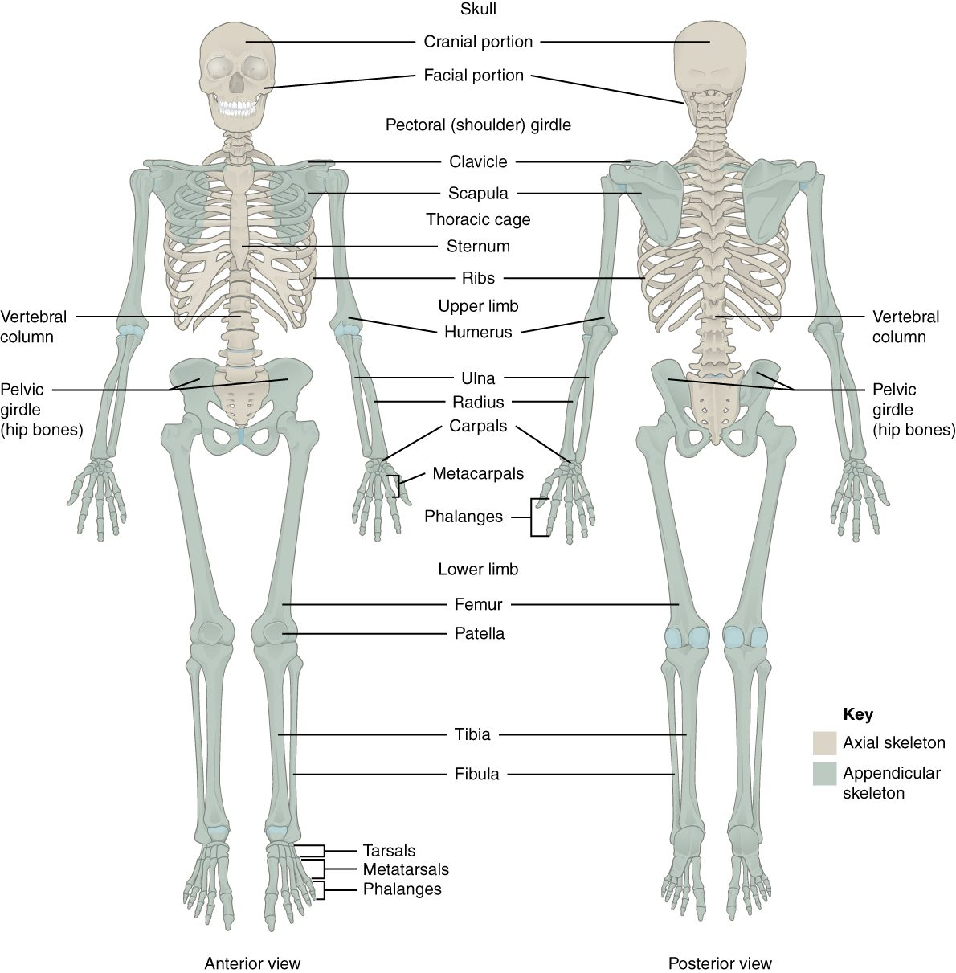
CHAPTER 8
Learning Objectives
After studying this chapter, students will be able to:
1
Discuss the bones of the pectoral and pelvic girdles, and describe how these unite the limbs with the axial skeleton
2
Describe the bones of the upper limb, including the bones of the arm, forearm, wrist, and hand
3
Identify the features of the pelvis and explain how these differ between the adult male and female pelvis
4
Describe the bones of the lower limb, including the bones of the thigh, leg, ankle, and foot
5
Describe the embryonic formation and growth of the limb bones Your skeleton provides the internal supporting structure of the body
The appendicular skeleton — the limbs and their girdles.
PN 104 · Ch 8 — The Appendicular Skeleton
2
Notes:
READ ALOUD SCRIPT
These are our learning objectives for Chapter 8. By the end of the chapter, you should be able to do the following: Discuss the bones of the pectoral and pelvic girdles, and describe how these unite the limbs with the axial skeleton. Describe the bones of the upper limb, including the bones of the arm, forearm, wrist, and hand. Identify the features of the pelvis and explain how these differ between the adult male and female pelvis. Describe the bones of the lower limb, including the bones of the thigh, leg, ankle, and foot. Describe the embryonic formation and growth of the limb bones Your skeleton provides the internal supporting structure of the body. Do not treat these as isolated facts. Use them as a checklist for what you should be able to identify, explain, and connect to safe practical nursing care.
[Sources]
- BMHI PN 104 Chapter 8 faculty PowerPoint slide content.

Slide 3
8.1
SECTION
The Pectoral Girdle
The clavicle and scapula that anchor the arm to the body.
Notes:
READ ALOUD SCRIPT
We are now moving into The Pectoral Girdle. The clavicle and scapula that anchor the arm to the body. As we begin this section, listen for the major structures, their locations, and the functions they perform. Then ask yourself what a change in this area might look like during patient care.
[Sources]
- BMHI PN 104 Chapter 8 faculty PowerPoint slide content.

Slide 4
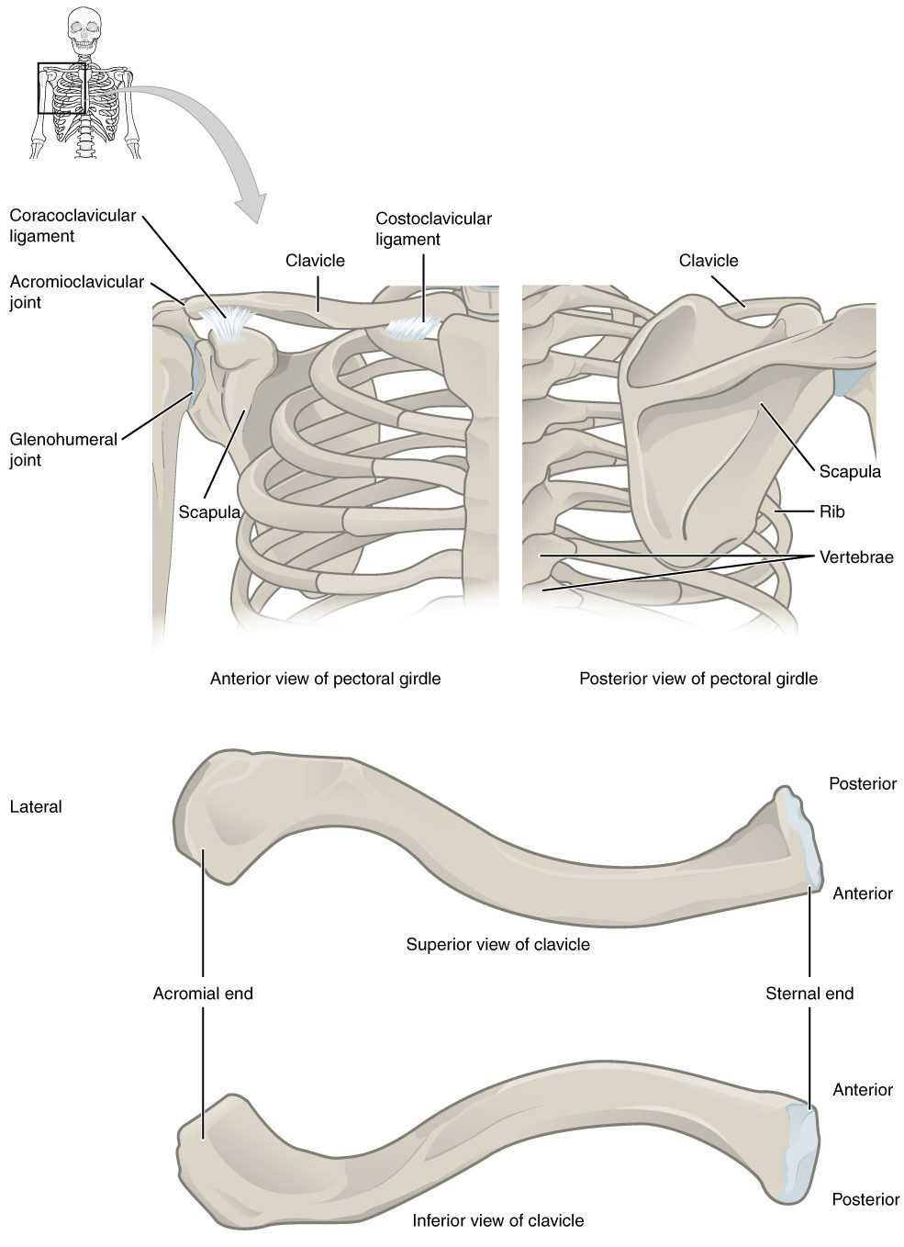
SECTION 8.1
The Pectoral Girdle
Clavicle and scapula on each side
Attaches the arm to the axial skeleton
Highly mobile but less stable
The clavicle is commonly fractured
The pectoral girdle (clavicle and scapula)
PN 104 · Ch 8 — The Appendicular Skeleton
4
Notes:
READ ALOUD SCRIPT
Now let's focus on The Pectoral Girdle. The pectoral girdle (clavicle and scapula). Clavicle and scapula on each side. Attaches the arm to the axial skeleton. Highly mobile but less stable. The clavicle is commonly fractured. Connect these bones with safe transfers, ambulation, weight-bearing orders, range of motion, and neurovascular assessment. Take a moment to identify the structure on the image and explain how its form supports its function. This is slide 4 of 21.
[Sources]
- BMHI PN 104 Chapter 8 faculty PowerPoint slide content.

Slide 5
8.2
SECTION
Bones of the Upper Limb
The humerus, radius, ulna, and the bones of the wrist and hand.
Notes:
READ ALOUD SCRIPT
We are now moving into Bones of the Upper Limb. The humerus, radius, ulna, and the bones of the wrist and hand. As we begin this section, listen for the major structures, their locations, and the functions they perform. Then ask yourself what a change in this area might look like during patient care.
[Sources]
- BMHI PN 104 Chapter 8 faculty PowerPoint slide content.

Slide 6
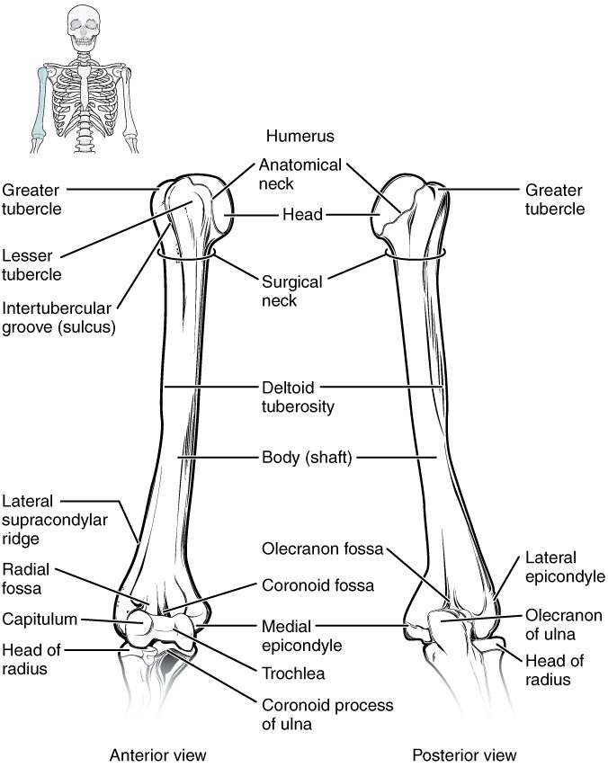
SECTION 8.2
The Humerus
The single bone of the arm
Head fits the scapula's glenoid cavity
Articulates with radius and ulna
Many muscle attachment sites
The humerus (arm bone)
PN 104 · Ch 8 — The Appendicular Skeleton
6
Notes:
READ ALOUD SCRIPT
Now let's focus on The Humerus. The humerus (arm bone). The single bone of the arm. Head fits the scapula's glenoid cavity. Articulates with radius and ulna. Many muscle attachment sites. Connect these bones with safe transfers, ambulation, weight-bearing orders, range of motion, and neurovascular assessment. Take a moment to identify the structure on the image and explain how its form supports its function. This is slide 6 of 21.
[Sources]
- BMHI PN 104 Chapter 8 faculty PowerPoint slide content.

Slide 7
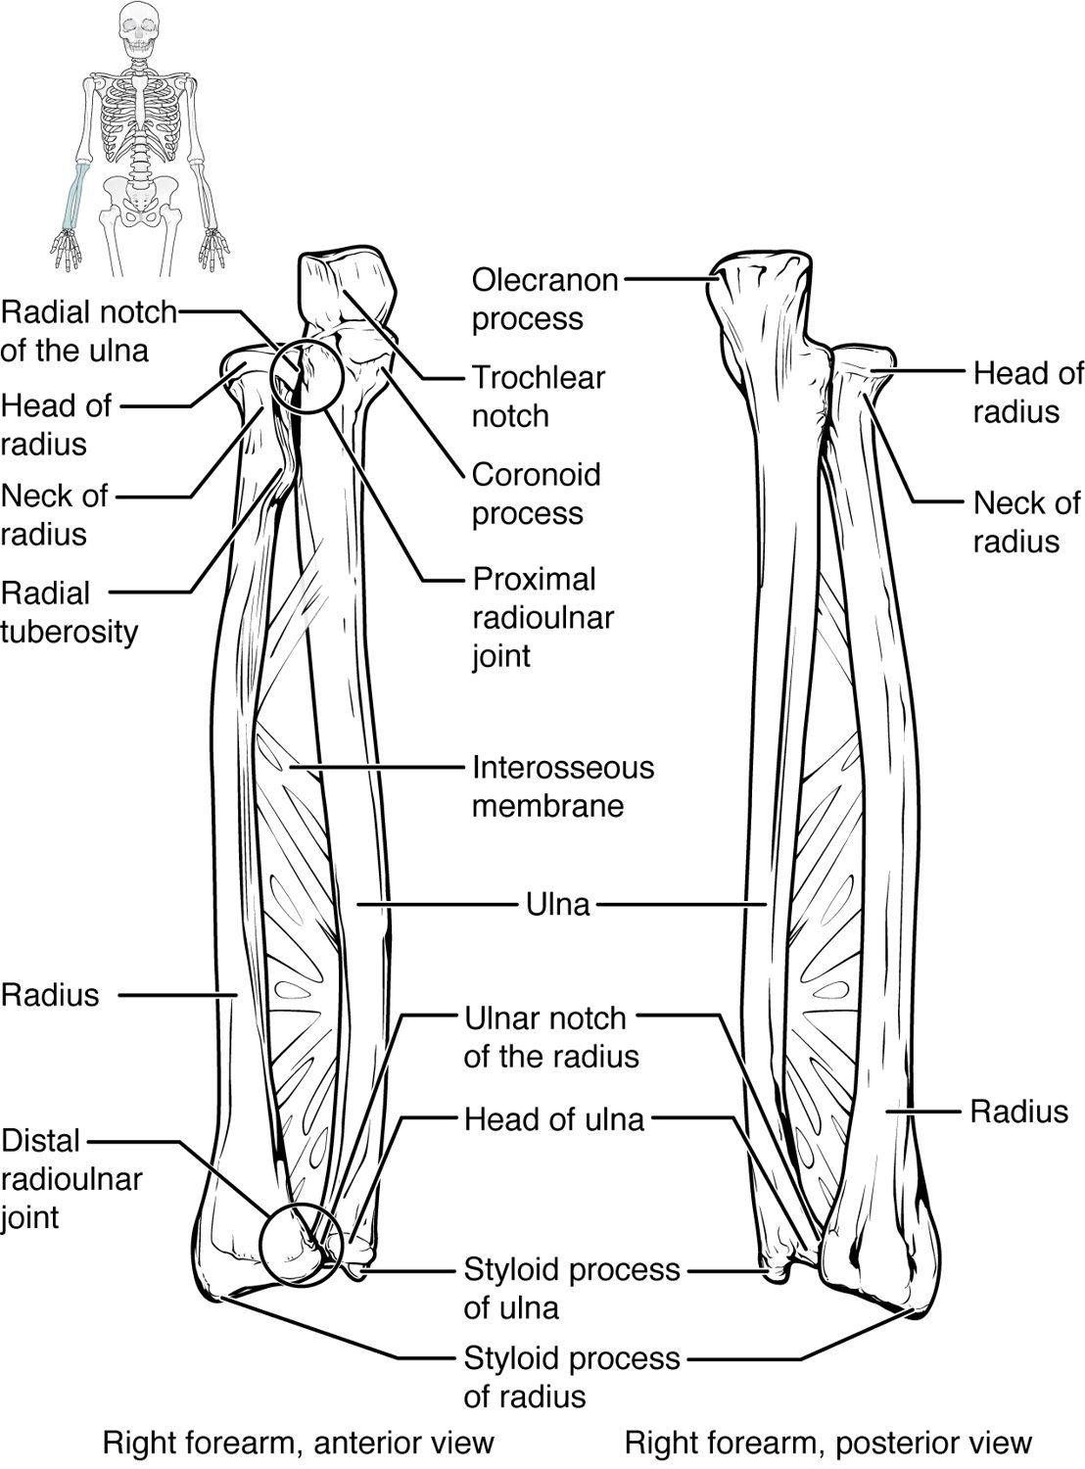
SECTION 8.2
The Radius and Ulna
The two bones of the forearm
Ulna is medial (little-finger side)
Radius is lateral (thumb side)
They cross during pronation
The radius and ulna (forearm)
PN 104 · Ch 8 — The Appendicular Skeleton
7
Notes:
READ ALOUD SCRIPT
Now let's focus on The Radius and Ulna. The radius and ulna (forearm). The two bones of the forearm. Ulna is medial (little-finger side). Radius is lateral (thumb side). They cross during pronation. Connect these bones with safe transfers, ambulation, weight-bearing orders, range of motion, and neurovascular assessment. Take a moment to identify the structure on the image and explain how its form supports its function. This is slide 7 of 21.
[Sources]
- BMHI PN 104 Chapter 8 faculty PowerPoint slide content.

Slide 8
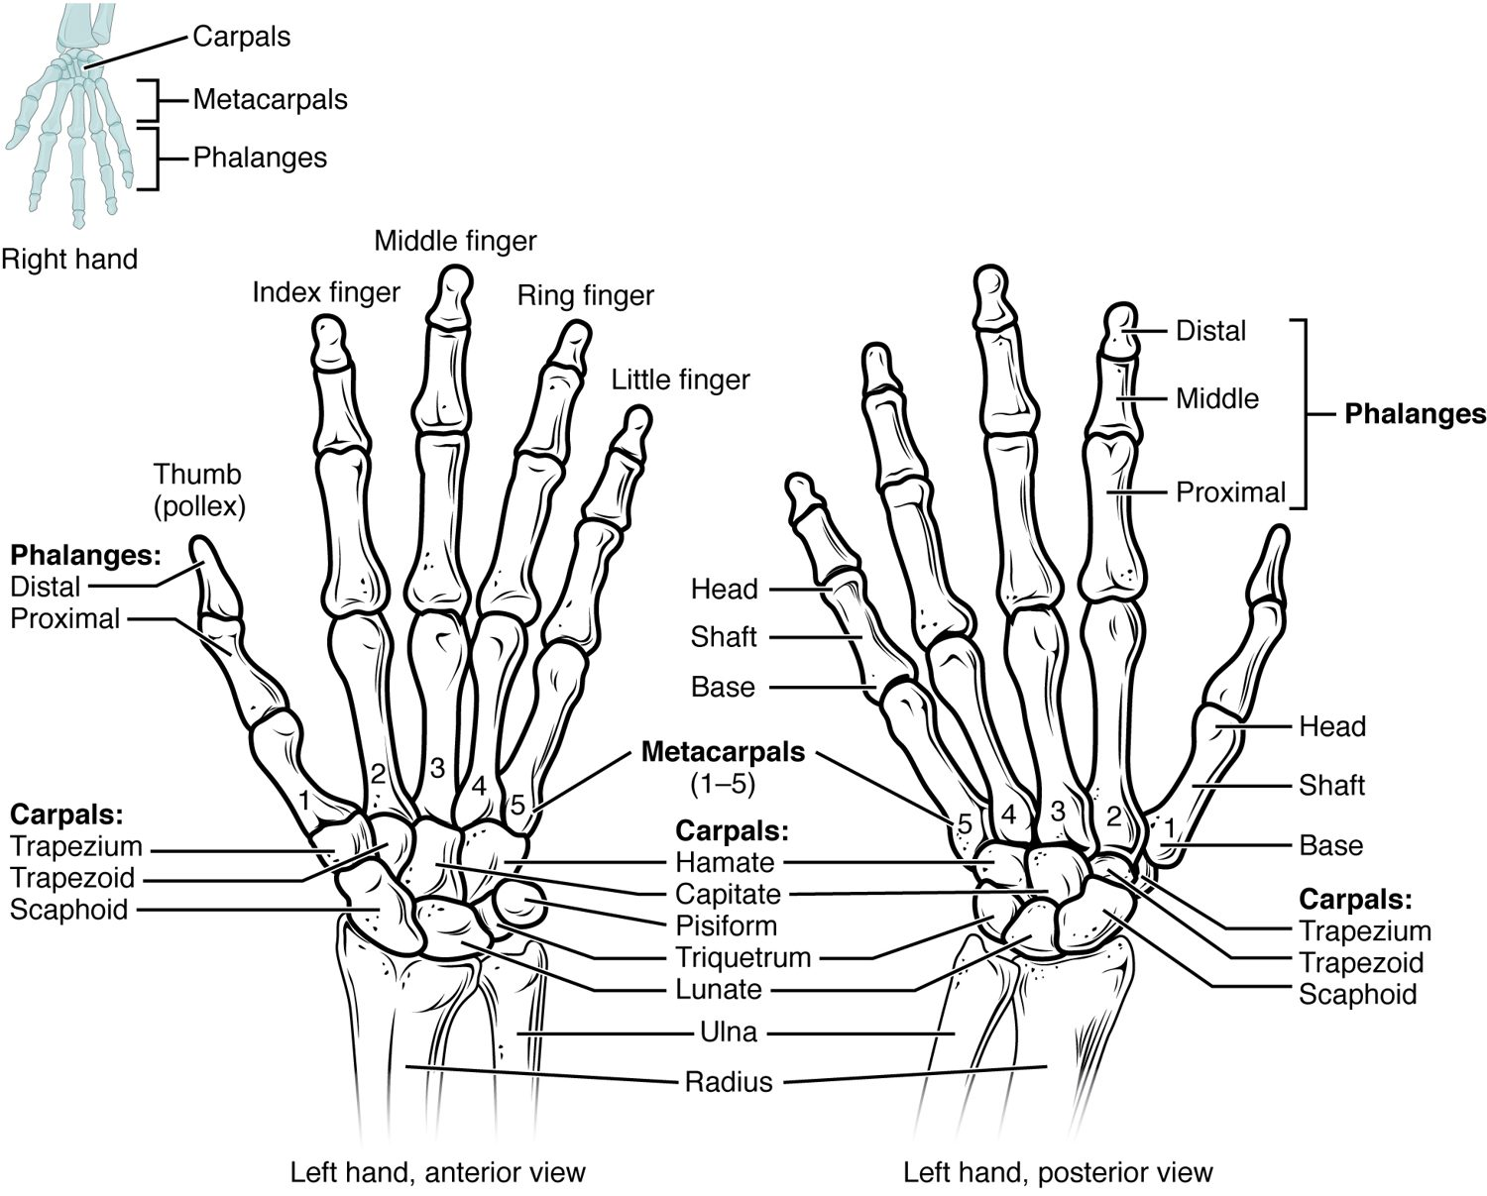
SECTION 8.2
Bones of the Hand
8 carpals form the wrist
5 metacarpals form the palm
14 phalanges form the fingers
Built for fine, precise movement
The bones of the wrist and hand
PN 104 · Ch 8 — The Appendicular Skeleton
8
Notes:
READ ALOUD SCRIPT
Now let's focus on Bones of the Hand. carpals form the wrist. metacarpals form the palm. phalanges form the fingers. Built for fine, precise movement. The bones of the wrist and hand. Median-nerve compression can cause numbness, tingling, weakness, and reduced hand function, especially on the thumb side of the hand. Take a moment to identify the structure on the image and explain how its form supports its function. This is slide 8 of 21.
[Sources]
- BMHI PN 104 Chapter 8 faculty PowerPoint slide content.

Slide 9
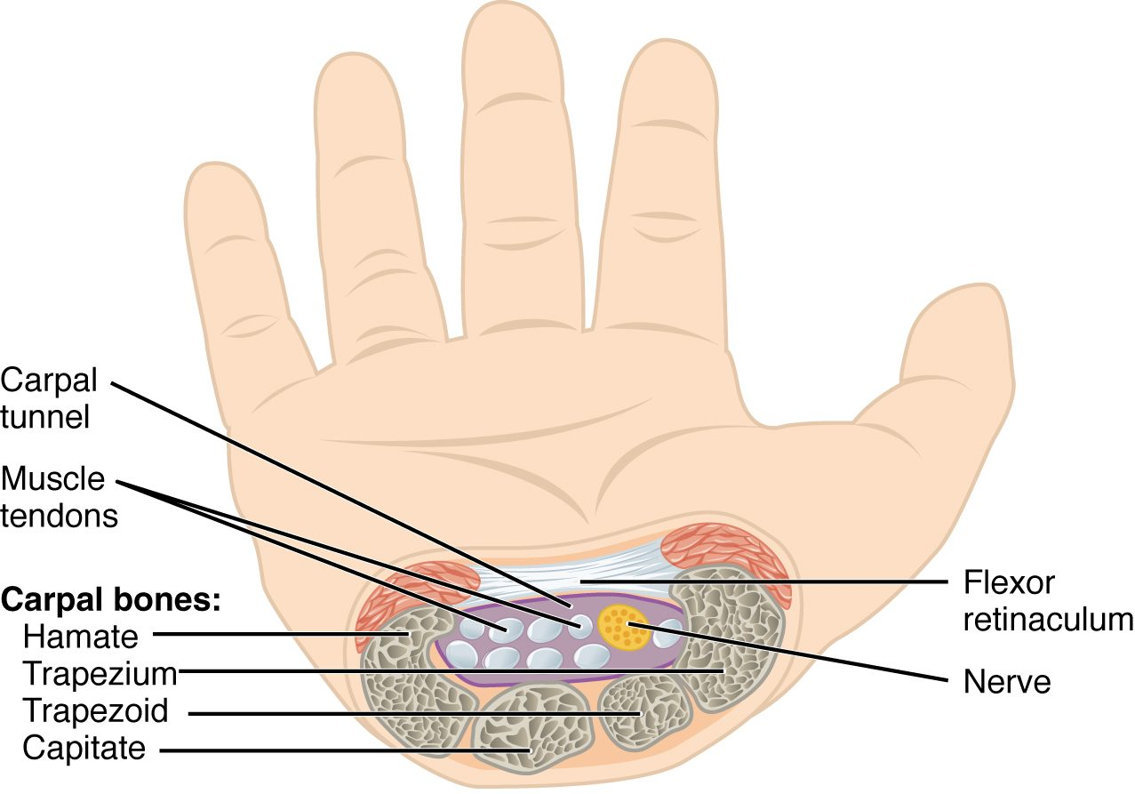
SECTION 8.2
The Carpal Tunnel
A passage at the front of the wrist
Formed by carpals + flexor retinaculum
Carries the median nerve and tendons
Compression causes carpal tunnel syndrome
The carpal tunnel and median nerve
PN 104 · Ch 8 — The Appendicular Skeleton
9
Notes:
READ ALOUD SCRIPT
Now let's focus on The Carpal Tunnel. A passage at the front of the wrist. Formed by carpals + flexor retinaculum. Carries the median nerve and tendons. Compression causes carpal tunnel syndrome. The carpal tunnel and median nerve. Median-nerve compression can cause numbness, tingling, weakness, and reduced hand function, especially on the thumb side of the hand. Take a moment to identify the structure on the image and explain how its form supports its function. This is slide 9 of 21.
[Sources]
- BMHI PN 104 Chapter 8 faculty PowerPoint slide content.

Slide 10
8.3
SECTION
The Pelvic Girdle and Pelvis
The hip bones, the sacrum, and the pelvis they form.
Notes:
READ ALOUD SCRIPT
We are now moving into The Pelvic Girdle and Pelvis. The hip bones, the sacrum, and the pelvis they form. As we begin this section, listen for the major structures, their locations, and the functions they perform. Then ask yourself what a change in this area might look like during patient care.
[Sources]
- BMHI PN 104 Chapter 8 faculty PowerPoint slide content.

Slide 11
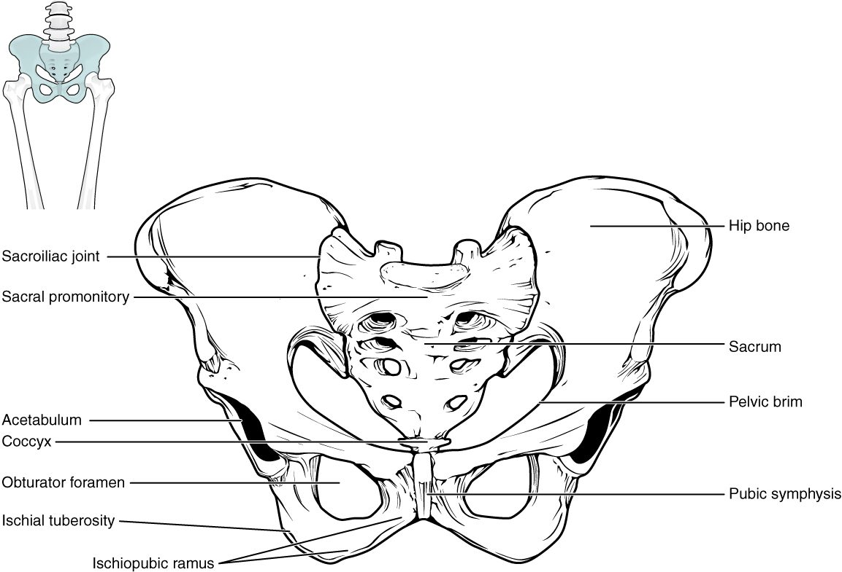
SECTION 8.3
The Pelvis
Two hip bones + sacrum + coccyx
Bears the body's weight
Protects the pelvic organs
A stable, weight-bearing girdle
The pelvis
PN 104 · Ch 8 — The Appendicular Skeleton
11
Notes:
READ ALOUD SCRIPT
Now let's focus on The Pelvis. Two hip bones + sacrum + coccyx. Bears the body's weight. Protects the pelvic organs. A stable, weight-bearing girdle. The pelvis. Hip and pelvic injuries can cause major pain, blood loss, and loss of mobility, especially in older adults, so avoid unnecessary movement and report findings promptly. Take a moment to identify the structure on the image and explain how its form supports its function. This is slide 11 of 21.
[Sources]
- BMHI PN 104 Chapter 8 faculty PowerPoint slide content.

Slide 12
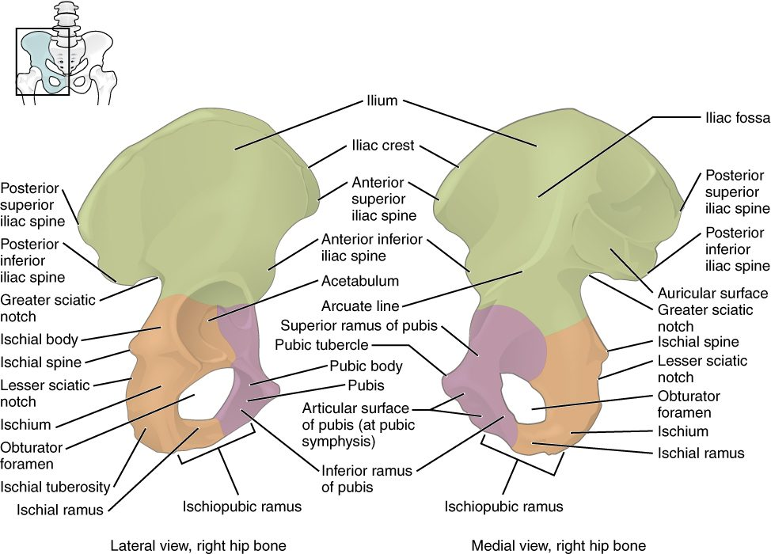
SECTION 8.3
The Hip Bone
Three fused bones: ilium, ischium, pubis
Meet at the acetabulum (hip socket)
Ilium is the broad flaring blade
Many muscle attachments
The hip bone (os coxae)
PN 104 · Ch 8 — The Appendicular Skeleton
12
Notes:
READ ALOUD SCRIPT
Now let's focus on The Hip Bone. Three fused bones: ilium, ischium, pubis. Meet at the acetabulum (hip socket). Ilium is the broad flaring blade. Many muscle attachments. The hip bone (os coxae). Hip and pelvic injuries can cause major pain, blood loss, and loss of mobility, especially in older adults, so avoid unnecessary movement and report findings promptly. Take a moment to identify the structure on the image and explain how its form supports its function. This is slide 12 of 21.
[Sources]
- BMHI PN 104 Chapter 8 faculty PowerPoint slide content.

Slide 13
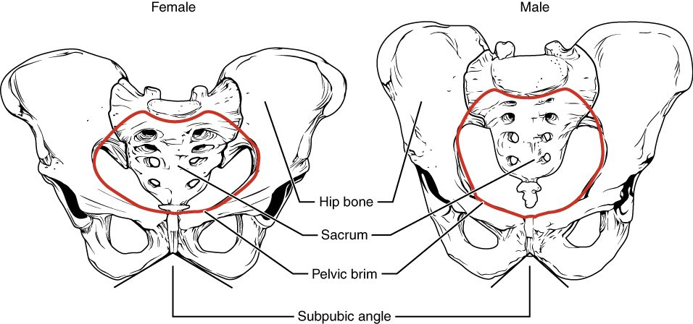
SECTION 8.3
Male vs. Female Pelvis
Differences between the male and female pelvis
Female pelvis is wider and shallower
Larger outlet for childbirth
Male pelvis is narrower and heavier
Sex differences aid identification
PN 104 · Ch 8 — The Appendicular Skeleton
13
Notes:
READ ALOUD SCRIPT
Now let's focus on Male vs. Female Pelvis. Differences between the male and female pelvis. Female pelvis is wider and shallower. Larger outlet for childbirth. Male pelvis is narrower and heavier. Sex differences aid identification. Hip and pelvic injuries can cause major pain, blood loss, and loss of mobility, especially in older adults, so avoid unnecessary movement and report findings promptly. Take a moment to identify the structure on the image and explain how its form supports its function. This is slide 13 of 21.
[Sources]
- BMHI PN 104 Chapter 8 faculty PowerPoint slide content.

Slide 14
8.4
SECTION
Bones of the Lower Limb
The femur, tibia, fibula, and the bones of the foot.
Notes:
READ ALOUD SCRIPT
We are now moving into Bones of the Lower Limb. The femur, tibia, fibula, and the bones of the foot. As we begin this section, listen for the major structures, their locations, and the functions they perform. Then ask yourself what a change in this area might look like during patient care.
[Sources]
- BMHI PN 104 Chapter 8 faculty PowerPoint slide content.

Slide 15
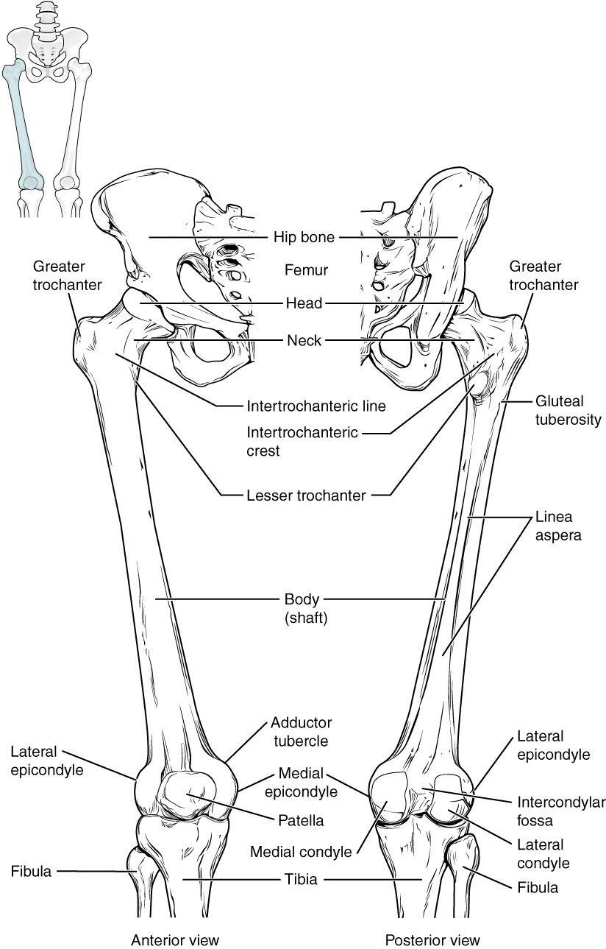
SECTION 8.4
The Femur
The thigh bone — longest, strongest bone
Head fits into the acetabulum
Meets the tibia at the knee
Bears great mechanical loads
The femur (thigh bone)
PN 104 · Ch 8 — The Appendicular Skeleton
15
Notes:
READ ALOUD SCRIPT
Now let's focus on The Femur. The femur (thigh bone). The thigh bone — longest, strongest bone. Head fits into the acetabulum. Meets the tibia at the knee. Bears great mechanical loads. Hip and pelvic injuries can cause major pain, blood loss, and loss of mobility, especially in older adults, so avoid unnecessary movement and report findings promptly. Take a moment to identify the structure on the image and explain how its form supports its function. This is slide 15 of 21.
[Sources]
- BMHI PN 104 Chapter 8 faculty PowerPoint slide content.

Slide 16
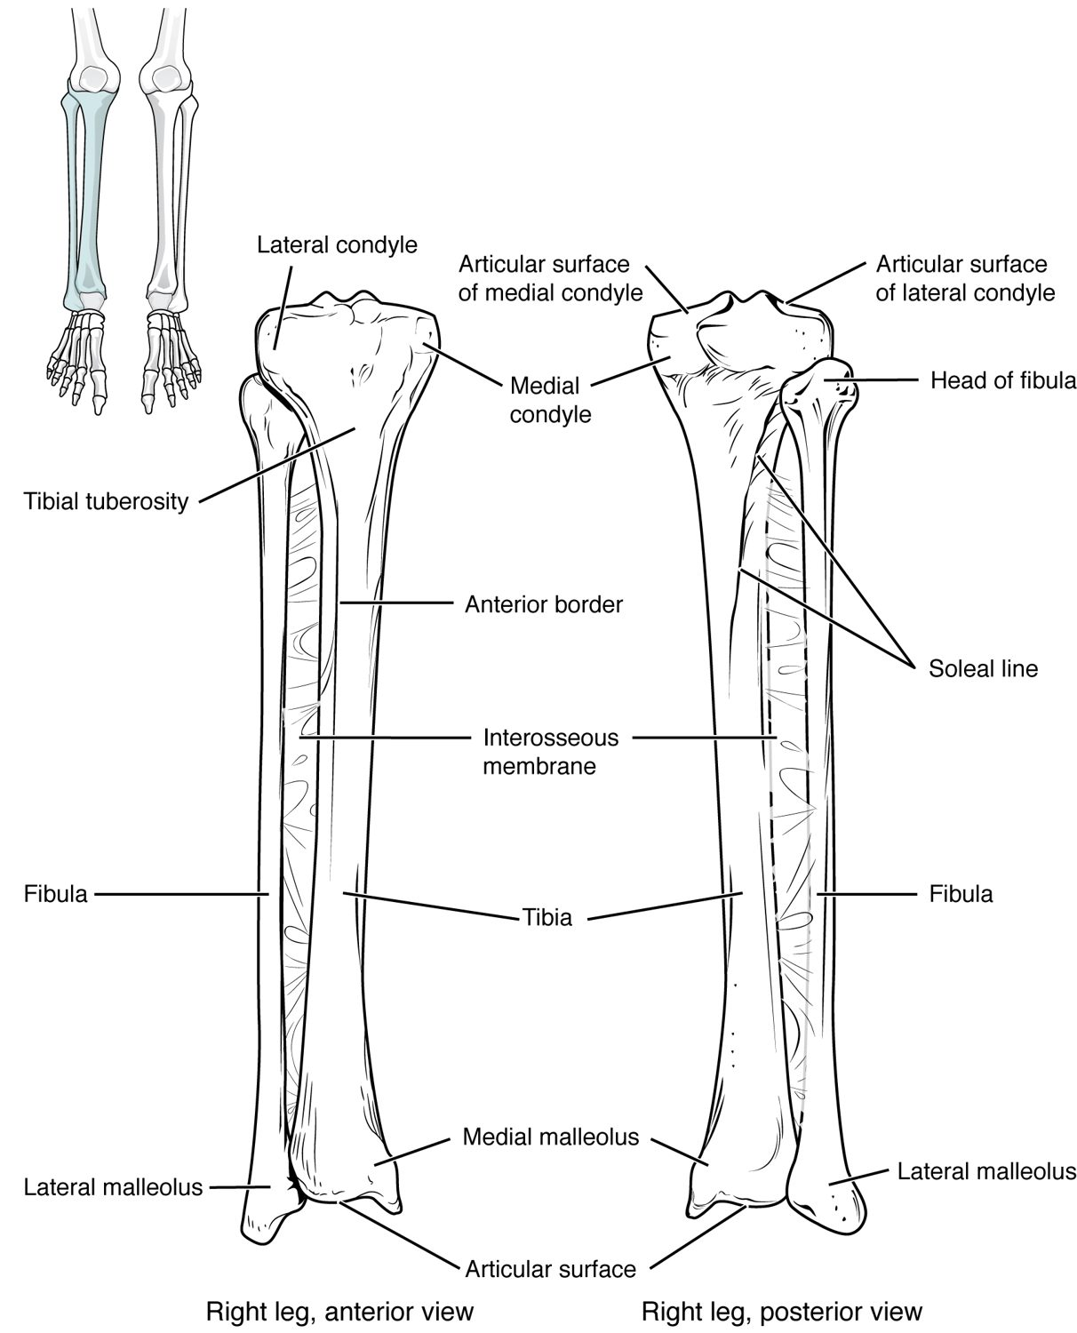
SECTION 8.4
The Tibia and Fibula
The two bones of the lower leg
Tibia (shinbone) bears the weight
Fibula stabilizes the ankle
They form the malleoli of the ankle
The tibia and fibula (lower leg)
PN 104 · Ch 8 — The Appendicular Skeleton
16
Notes:
READ ALOUD SCRIPT
Now let's focus on The Tibia and Fibula. The tibia and fibula (lower leg). The two bones of the lower leg. Tibia (shinbone) bears the weight. Fibula stabilizes the ankle. They form the malleoli of the ankle. After lower-limb injury or immobilization, compare color, temperature, pulses, capillary refill, sensation, movement, pain, and swelling on both sides. Take a moment to identify the structure on the image and explain how its form supports its function. This is slide 16 of 21.
[Sources]
- BMHI PN 104 Chapter 8 faculty PowerPoint slide content.

Slide 17
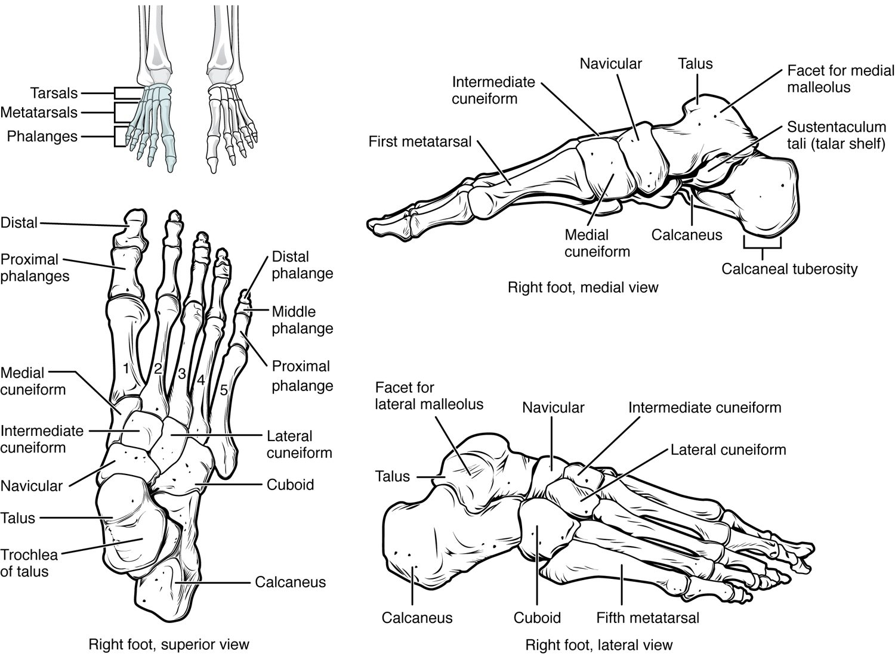
SECTION 8.4
Bones of the Foot
7 tarsals form the ankle and heel
5 metatarsals form the sole
14 phalanges form the toes
Arches support and absorb shock
The bones of the foot
PN 104 · Ch 8 — The Appendicular Skeleton
17
Notes:
READ ALOUD SCRIPT
Now let's focus on Bones of the Foot. tarsals form the ankle and heel. metatarsals form the sole. phalanges form the toes. Arches support and absorb shock. The bones of the foot. After lower-limb injury or immobilization, compare color, temperature, pulses, capillary refill, sensation, movement, pain, and swelling on both sides. Take a moment to identify the structure on the image and explain how its form supports its function. This is slide 17 of 21.
[Sources]
- BMHI PN 104 Chapter 8 faculty PowerPoint slide content.

Slide 18
8.5
SECTION
Development of the Appendicular Skeleton
How the limbs form before birth, and common congenital differences.
Notes:
READ ALOUD SCRIPT
We are now moving into Development of the Appendicular Skeleton. How the limbs form before birth, and common congenital differences. As we begin this section, listen for the major structures, their locations, and the functions they perform. Then ask yourself what a change in this area might look like during patient care.
[Sources]
- BMHI PN 104 Chapter 8 faculty PowerPoint slide content.

Slide 19
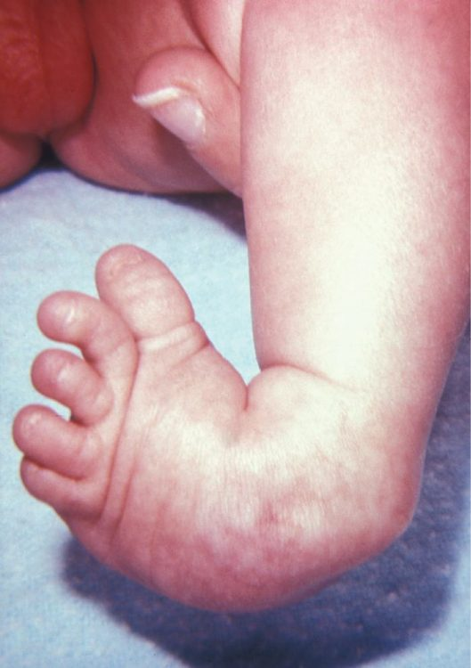
SECTION 8.5
Limb Development & Clubfoot
Limbs form early in the embryo
Bones develop from limb buds
Clubfoot is a common congenital condition
Early treatment improves outcomes
Clubfoot, a congenital foot condition
PN 104 · Ch 8 — The Appendicular Skeleton
19
Notes:
READ ALOUD SCRIPT
Now let's focus on Limb Development & Clubfoot. Clubfoot, a congenital foot condition. Limbs form early in the embryo. Bones develop from limb buds. Clubfoot is a common congenital condition. Early treatment improves outcomes. After lower-limb injury or immobilization, compare color, temperature, pulses, capillary refill, sensation, movement, pain, and swelling on both sides. Take a moment to identify the structure on the image and explain how its form supports its function. This is slide 19 of 21.
[Sources]
- BMHI PN 104 Chapter 8 faculty PowerPoint slide content.

Slide 20
CHAPTER 8
Key Takeaways
The appendicular skeleton is the limbs plus the girdles that attach them.
The mobile pectoral girdle anchors the arm; humerus, radius, ulna, and hand bones complete the upper limb.
The stable pelvic girdle bears weight and differs between the sexes.
The femur, tibia, fibula, and foot bones support the body and enable walking.
The limbs form early in development; congenital conditions like clubfoot are treatable.
PN 104 · Ch 8 — The Appendicular Skeleton
20
Notes:
READ ALOUD SCRIPT
Let us review the major takeaways from Chapter 8. The appendicular skeleton is the limbs plus the girdles that attach them. The mobile pectoral girdle anchors the arm; humerus, radius, ulna, and hand bones complete the upper limb. The stable pelvic girdle bears weight and differs between the sexes. The femur, tibia, fibula, and foot bones support the body and enable walking. The limbs form early in development; congenital conditions like clubfoot are treatable. Before moving on, pause and explain each point without reading the slide. If any statement is difficult to explain, mark that topic for review before the quiz.
[Sources]
- BMHI PN 104 Chapter 8 faculty PowerPoint slide content.

Slide 21
CLINICAL CONNECTIONS
Why the Appendicular Skeleton Matters in Practical Nursing
Fracture Sites
Carpal Tunnel
The clavicle, wrist, and hip are common fracture locations.
Median-nerve compression at the wrist causes numbness and weakness.
Hip Fractures
Obstetrics
Femoral-neck fractures are a major risk in older adults.
The female pelvis shape is central to childbirth.
Mobility
Pediatrics
Limb bones support transfers, ambulation, and weight-bearing.
Congenital limb conditions like clubfoot need early intervention.
Notes:
READ ALOUD SCRIPT
This final slide connects Chapter 8 to practical nursing. Fracture Sites. The clavicle, wrist, and hip are common fracture locations. Carpal Tunnel. Median-nerve compression at the wrist causes numbness and weakness. Hip Fractures. Femoral-neck fractures are a major risk in older adults. Obstetrics. The female pelvis shape is central to childbirth. Mobility. Limb bones support transfers, ambulation, and weight-bearing. Pediatrics. Congenital limb conditions like clubfoot need early intervention. Your role is to observe carefully, protect safety, follow orders and precautions, document objectively, and report changes through the appropriate chain of command. Use these examples to connect anatomy with the care you will provide.
[Sources]
- BMHI PN 104 Chapter 8 faculty PowerPoint slide content.

