Slide 1
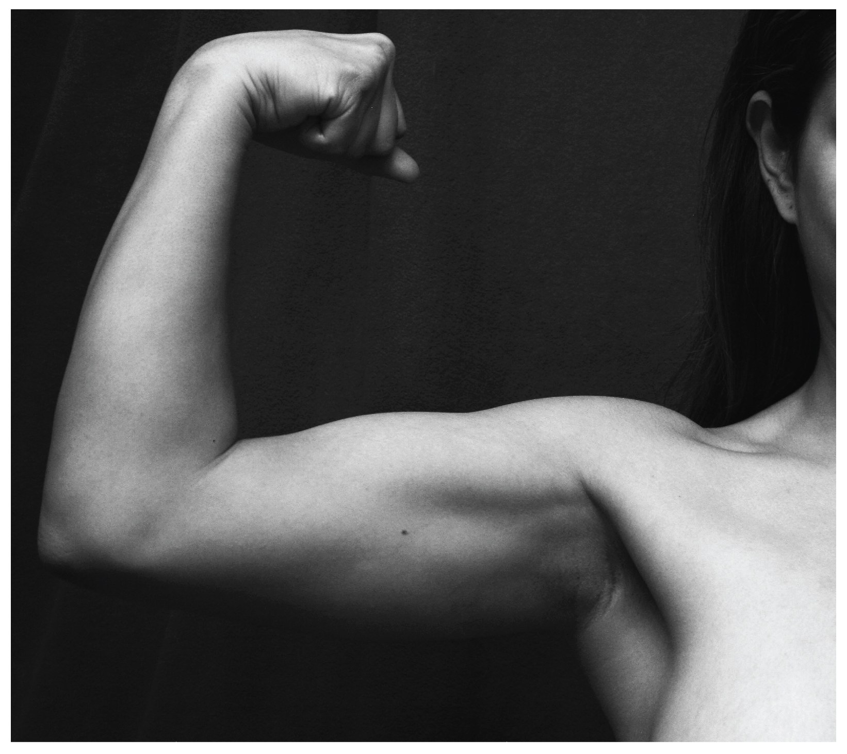
CHAPTER 11
The Muscular System
Gross anatomy of skeletal muscle — interactions, naming, and the
axial and appendicular muscles of the body.
Anatomy & Physiology · Broward-Miami Health Institute
FACULTY EDITION

Slide 2
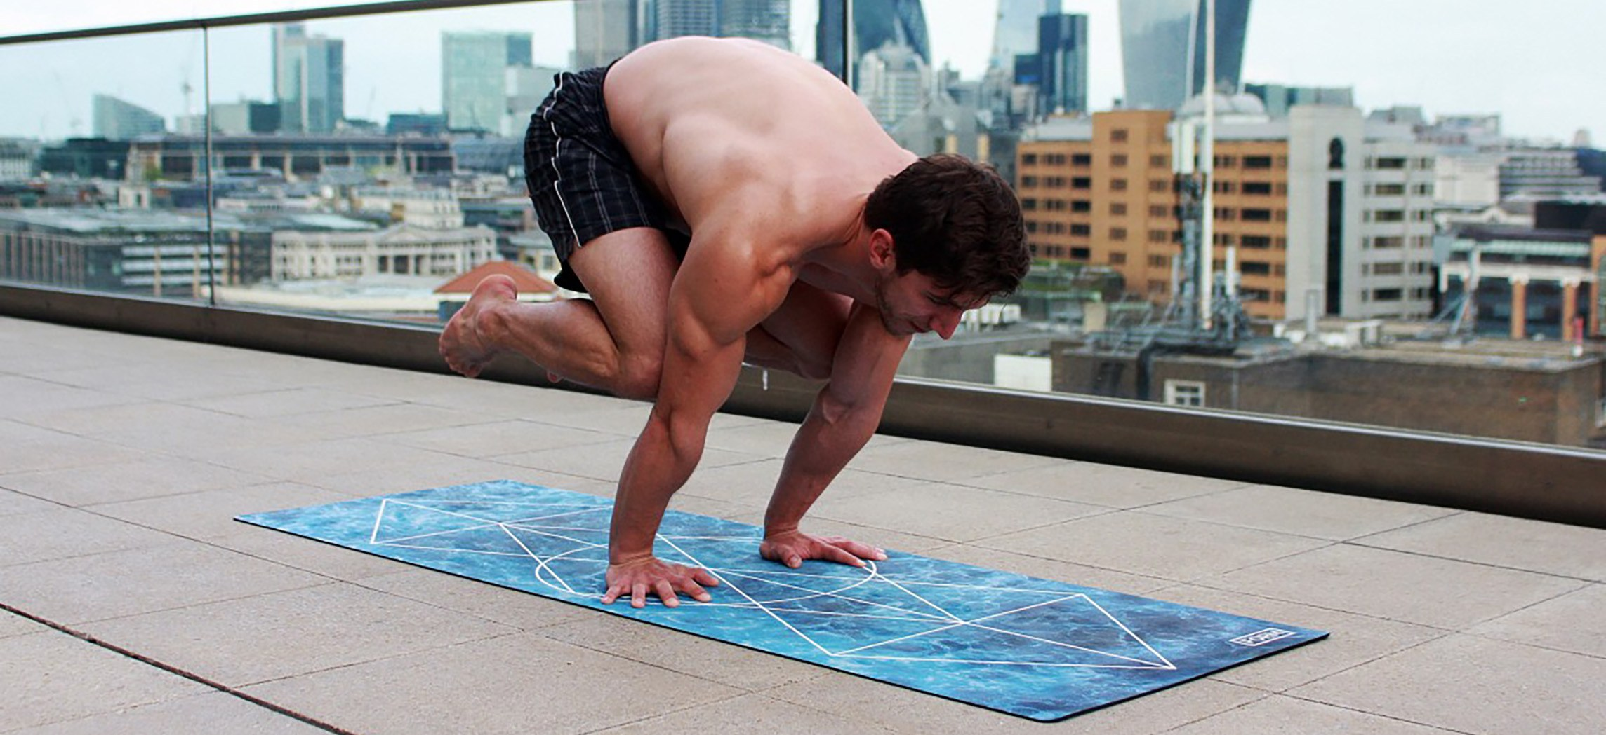
CHAPTER 11
Learning Objectives
After studying this chapter, students will be able to:
1
Describe the actions and roles of agonists and antagonists
2
Explain the structure of muscle fascicles and their role in generating force
3
Explain the criteria used to name skeletal muscles
4
Identify the major skeletal muscles and their actions on the body
Movement is the product of muscle, bone, and nervous control working together.
5
Identify the origins and insertions of muscles and the prime movers
PN 104 · Ch 11 — The Muscular System
2

Slide 3
11.1
SECTION
Interactions of Skeletal Muscles, Fascicle Arrangement & Lever Systems
How muscles work in groups, how fascicle geometry shapes force, and how bones act as levers.

Slide 4
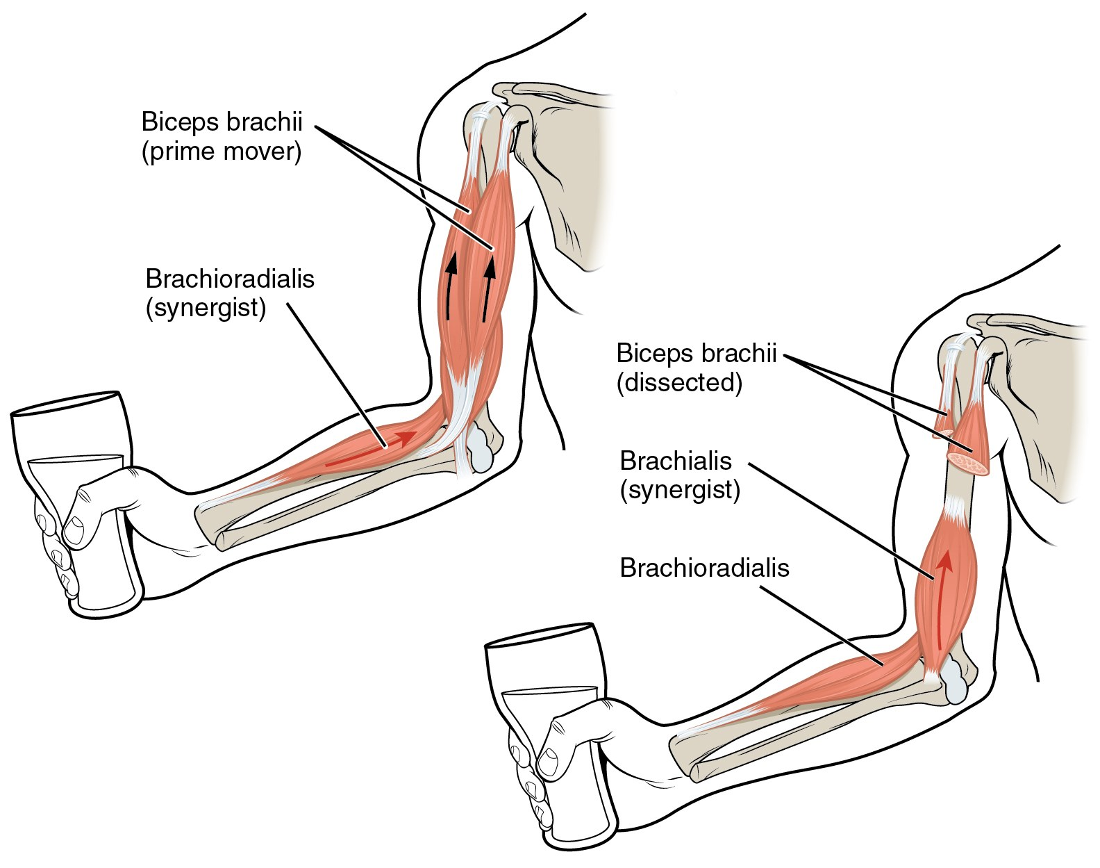
SECTION 11.1
Agonists, Antagonists & Synergists
Prime mover (agonist) produces the main movement
Antagonist opposes and controls the motion
Synergists assist; fixators stabilize the origin
Example: biceps flexes, triceps extends the elbow
Biceps brachii acting as a prime mover with synergists
PN 104 · Ch 11 — The Muscular System
4

Slide 5
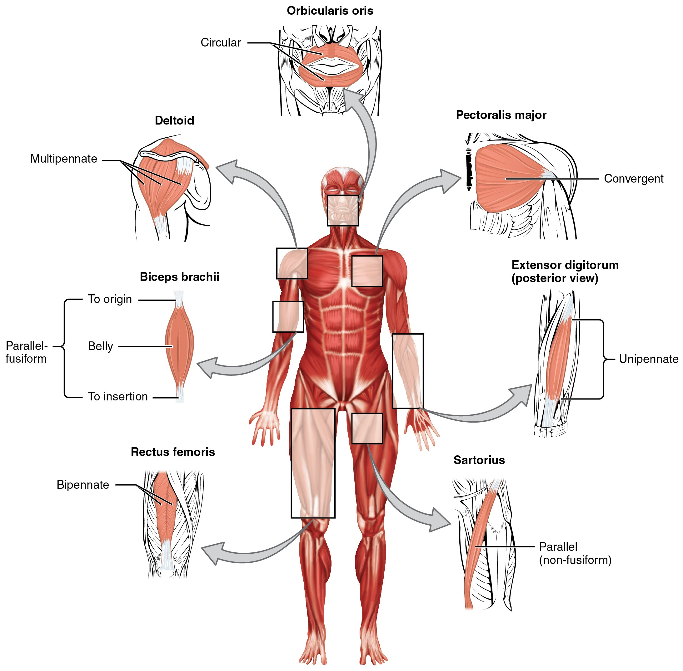
SECTION 11.1
Fascicle Arrangement & Muscle Shapes
Fascicle pattern sets the force–range trade-off
Parallel, fusiform, convergent, circular, pennate
Pennate muscles pack more fibers → greater force
Circular muscles (sphincters) close body openings
Patterns of fascicle organization seen throughout the body
PN 104 · Ch 11 — The Muscular System
5

Slide 6
SECTION 11.1
Lever Systems & Muscle Action
Bones are levers; joints are fulcrums; muscle is effort
First-, second-, and third-class levers occur in the body
Most body levers are third-class (favor speed/range)
Leverage lets a small effort move a larger load
Muscle generates movement by pulling on bony levers
PN 104 · Ch 11 — The Muscular System
6

Slide 7
11.2
SECTION
Naming Skeletal Muscles
Muscle names are descriptive codes — decode them to predict location and action.

Slide 8
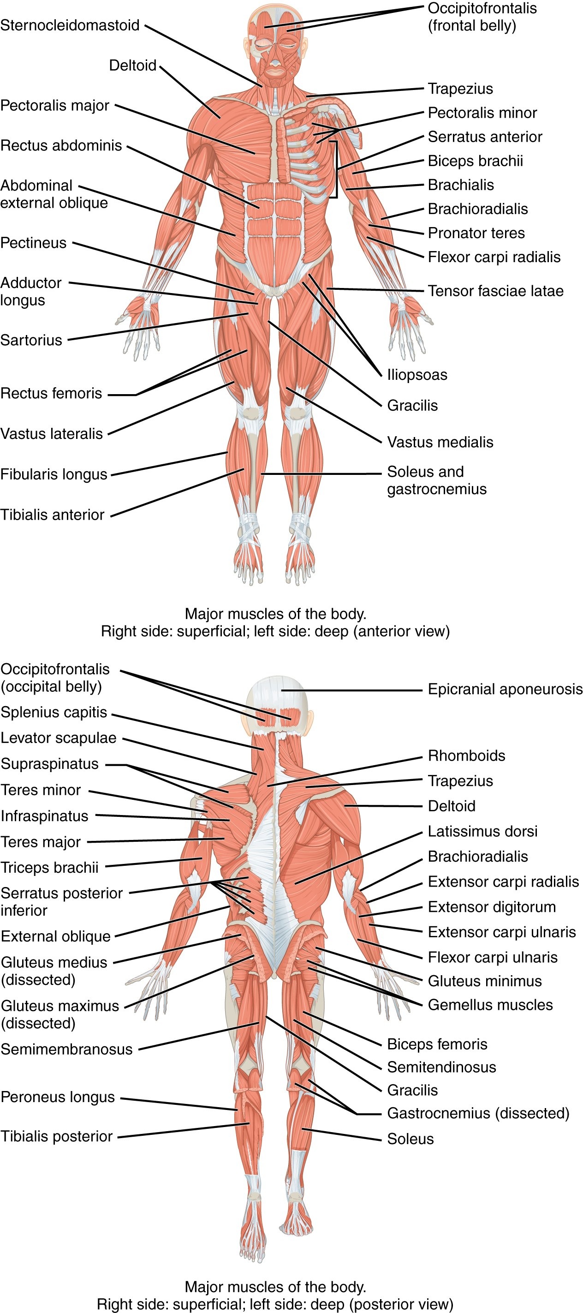
SECTION 11.2
How Skeletal Muscles Are Named
Named by location, shape, size, and fiber direction
Also by number of origins and by origin/insertion
Named by action: flexor, extensor, adductor
Decoding the name predicts what the muscle does
Major skeletal muscles, anterior and posterior views
PN 104 · Ch 11 — The Muscular System
8

Slide 9
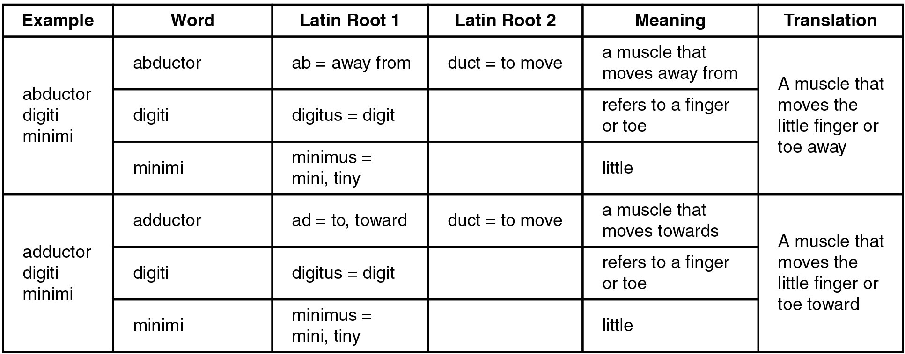
SECTION 11.2
Naming Criteria — Worked Examples
Break each name into root + meaning
"Abductor digiti minimi" → moves the little finger
Build a personal glossary of recurring roots
Use the name to predict location and action
Reference: word roots used in muscle names
PN 104 · Ch 11 — The Muscular System
9

Slide 10
11.3
SECTION
Axial Muscles of the Head, Neck & Back
Facial expression, mastication, eye and tongue movement, neck support, and spinal posture.

Slide 11
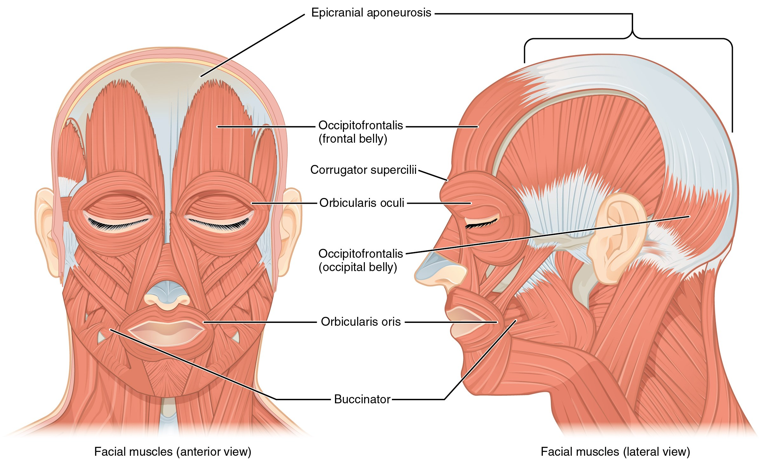
SECTION 11.3
Muscles of Facial Expression
Facial muscles, anterior and lateral views
Insert into skin, not bone → move soft tissue
All innervated by the facial nerve (CN VII)
Orbicularis oris/oculi, zygomaticus, buccinator
Clinical: CN VII palsy causes facial drooping
PN 104 · Ch 11 — The Muscular System
11

Slide 12
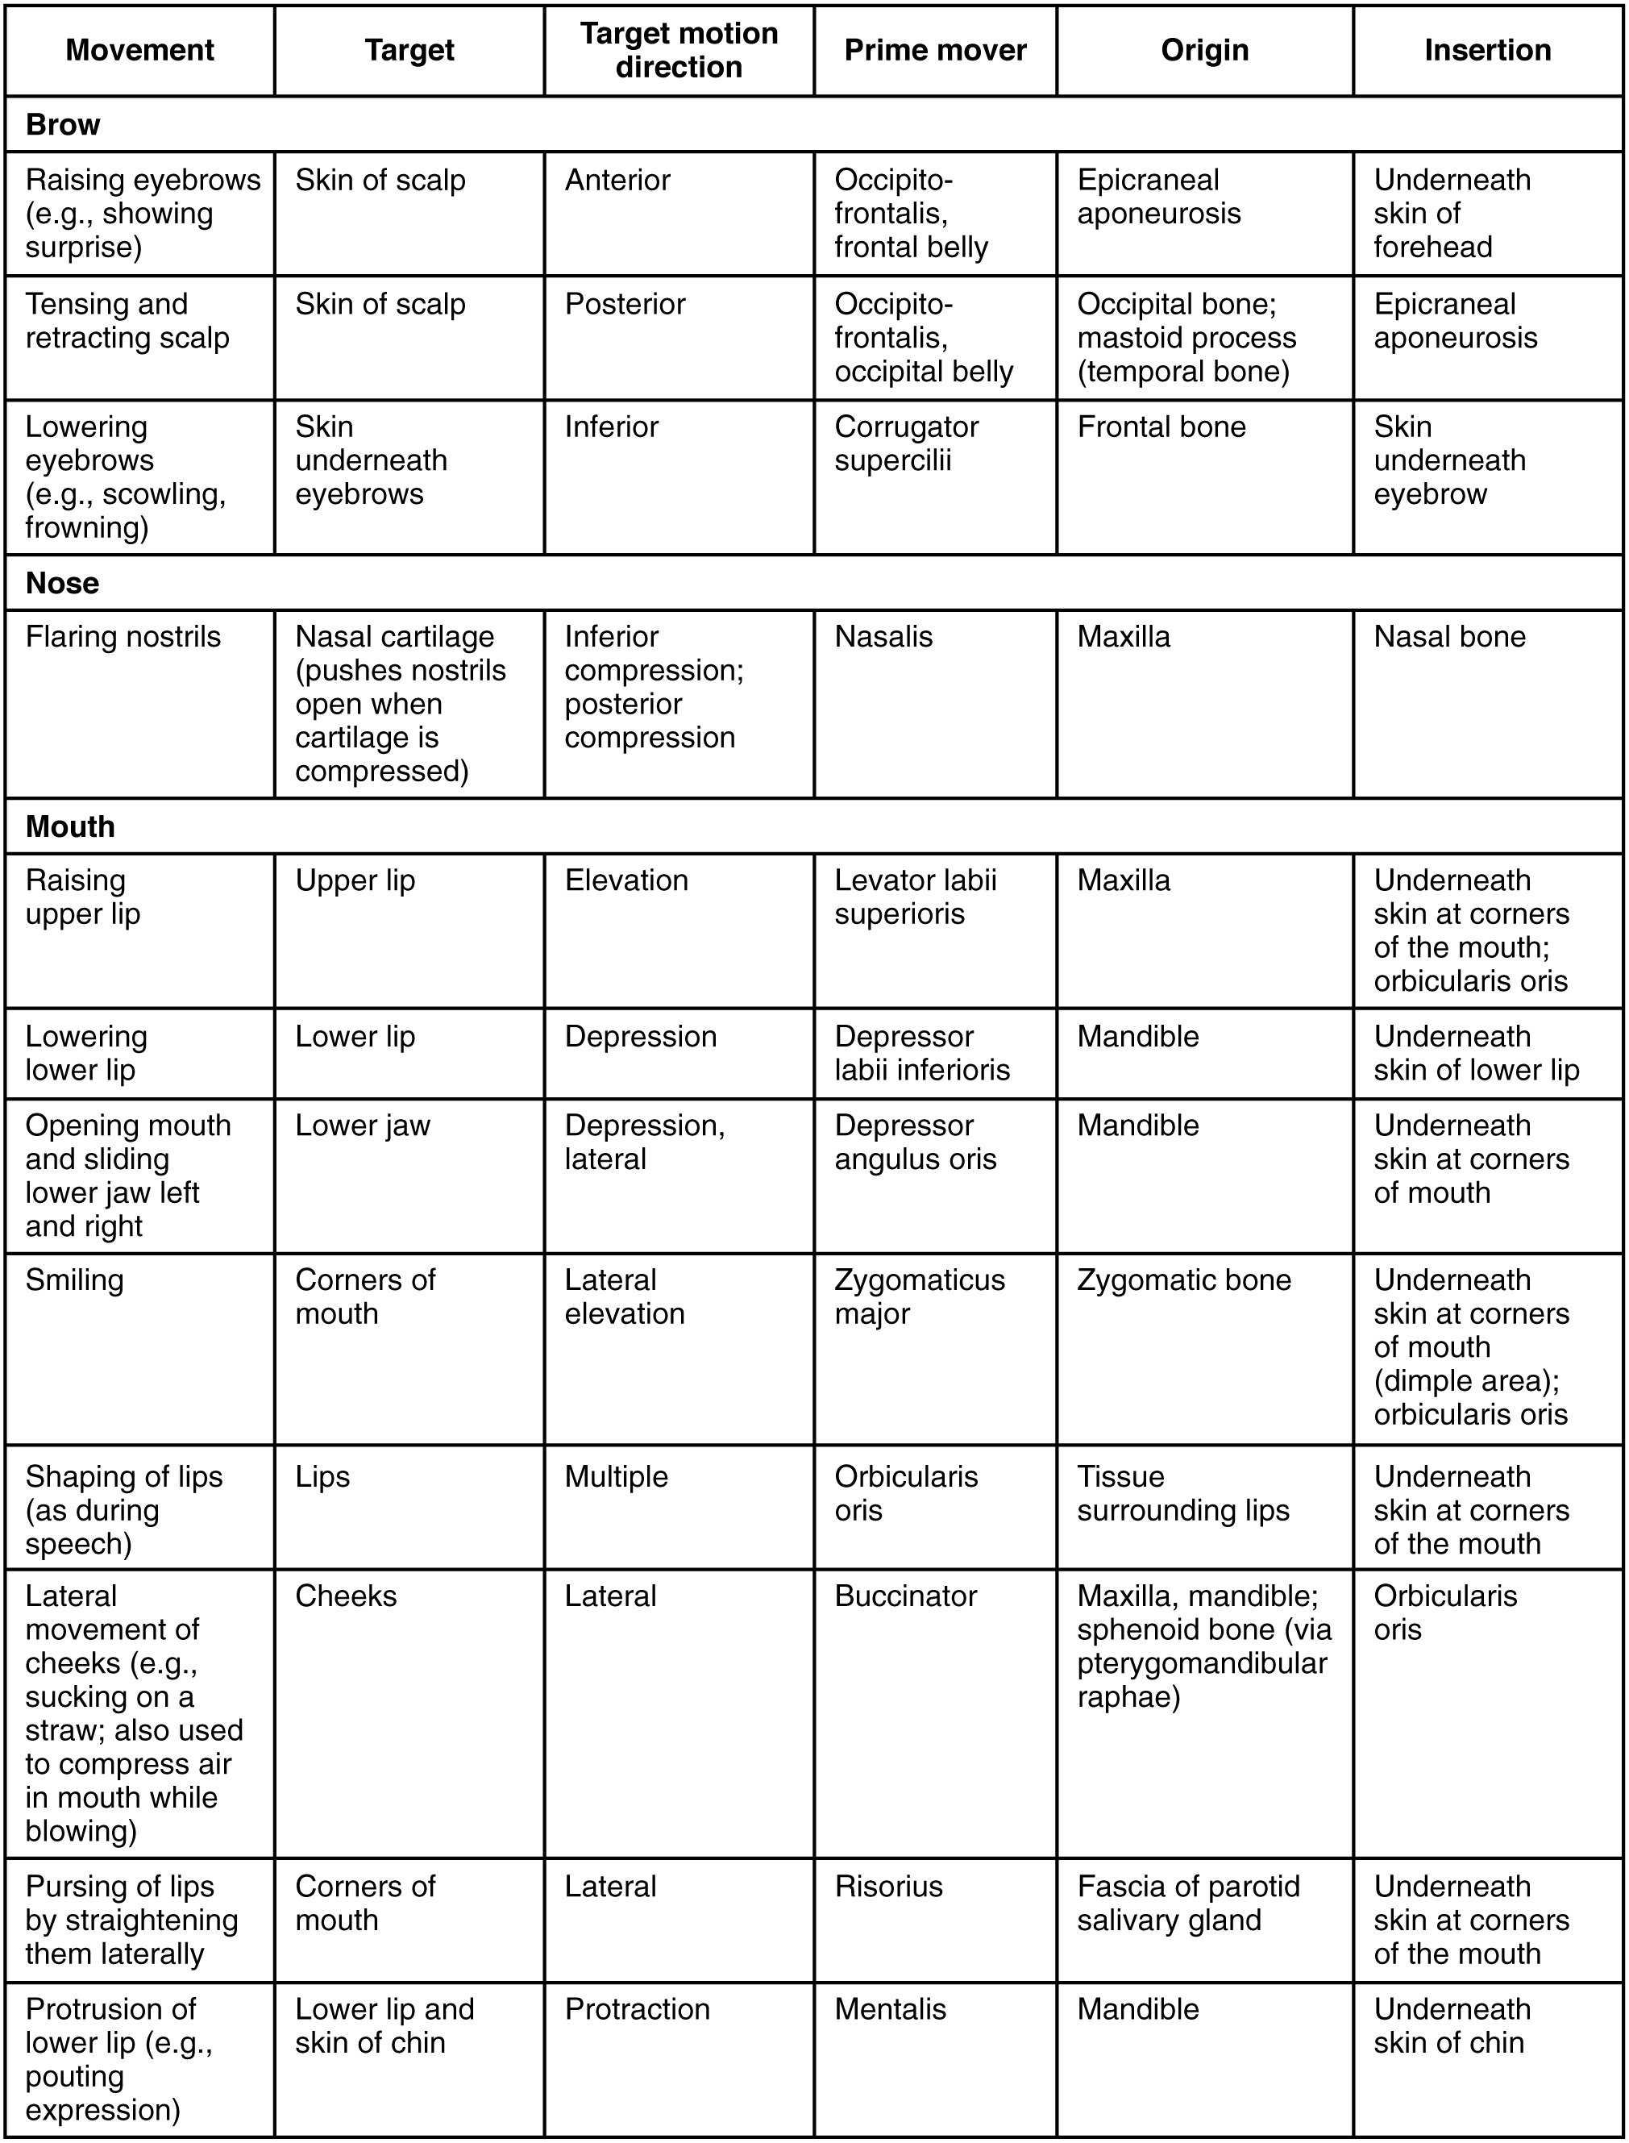
SECTION 11.3
Facial Expression — Reference Table
Group muscles by region: eye, mouth, nose, scalp
Note the shared CN VII innervation
Focus on action verbs: elevate, compress, purse
Pair with the diagram on the previous slide
Muscles of facial expression: action, origin, insertion
PN 104 · Ch 11 — The Muscular System
12

Slide 13
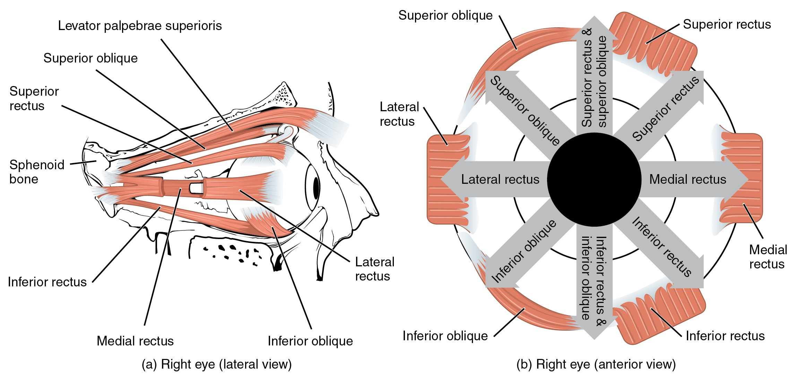
SECTION 11.3
Muscles of the Eye & Mastication
Extraocular muscles and the muscles of mastication
Six extraocular muscles move the eyeball
Mastication: masseter, temporalis, pterygoids
Chewing muscles served by trigeminal nerve (CN V)
Clinical: check jaw strength and symmetry
PN 104 · Ch 11 — The Muscular System
13

Slide 14
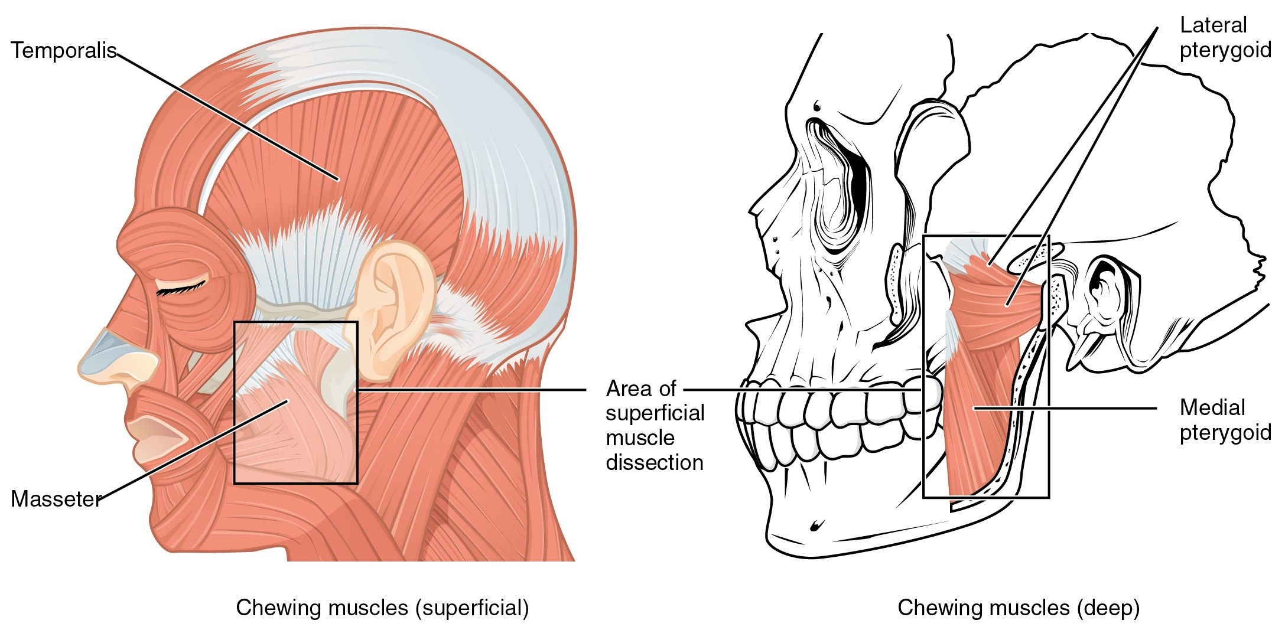
SECTION 11.3
Muscles That Move the Tongue
Muscles of mastication and the tongue
Intrinsic muscles change the tongue's shape
Extrinsic muscles (-glossus) move its position
Innervated by the hypoglossal nerve (CN XII)
Essential for speech, chewing, and swallowing
PN 104 · Ch 11 — The Muscular System
14

Slide 15
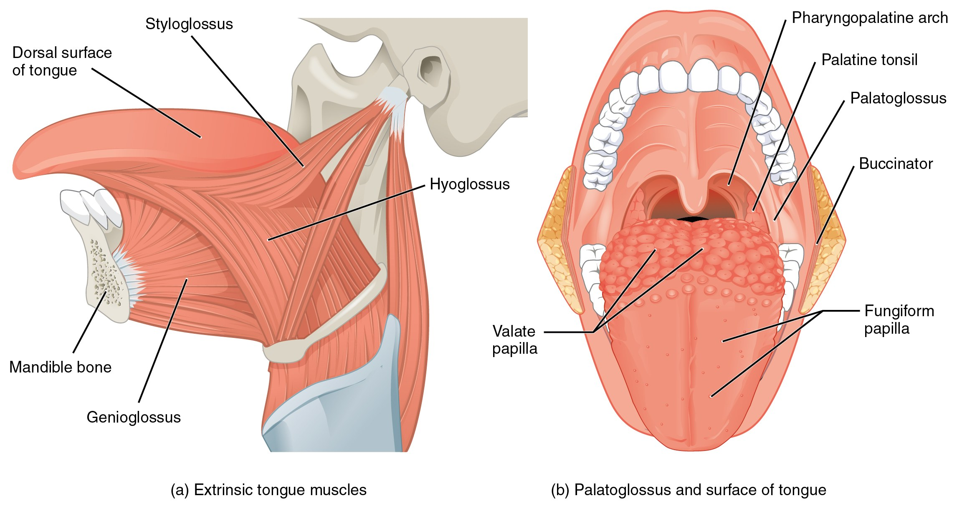
SECTION 11.3
Tongue & Pharyngeal Muscles
Tongue muscles and associated pharyngeal structures
Coordinate the oral phase of swallowing
Move the food bolus toward the pharynx
Work with suprahyoid muscles to elevate the larynx
Dysfunction → dysphagia and aspiration risk
PN 104 · Ch 11 — The Muscular System
15

Slide 16
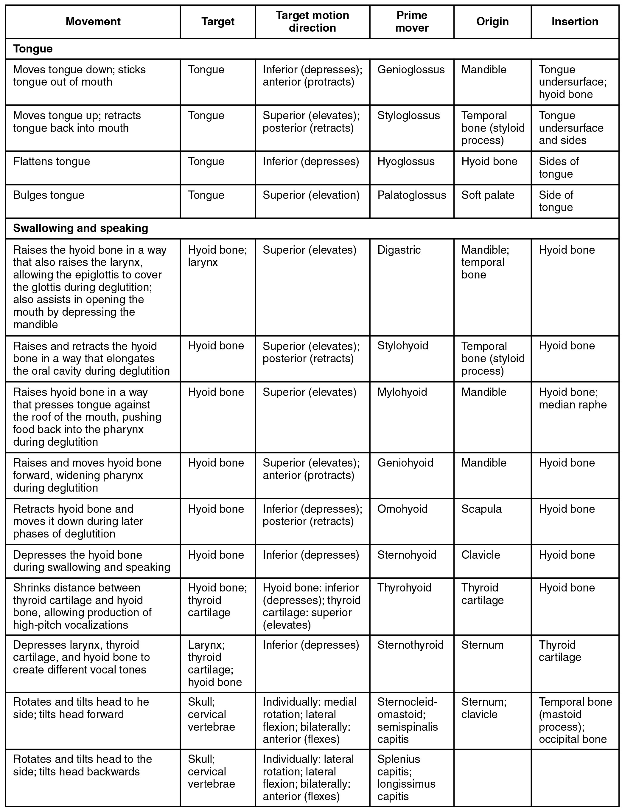
SECTION 11.3
Head & Neck — Reference Table
Consolidates head and neck muscle actions
Cross-reference each muscle's cranial-nerve supply
Identify the prime mover for each motion
Use for targeted review before exams
Muscles of the head and neck: summary table
PN 104 · Ch 11 — The Muscular System
16

Slide 17
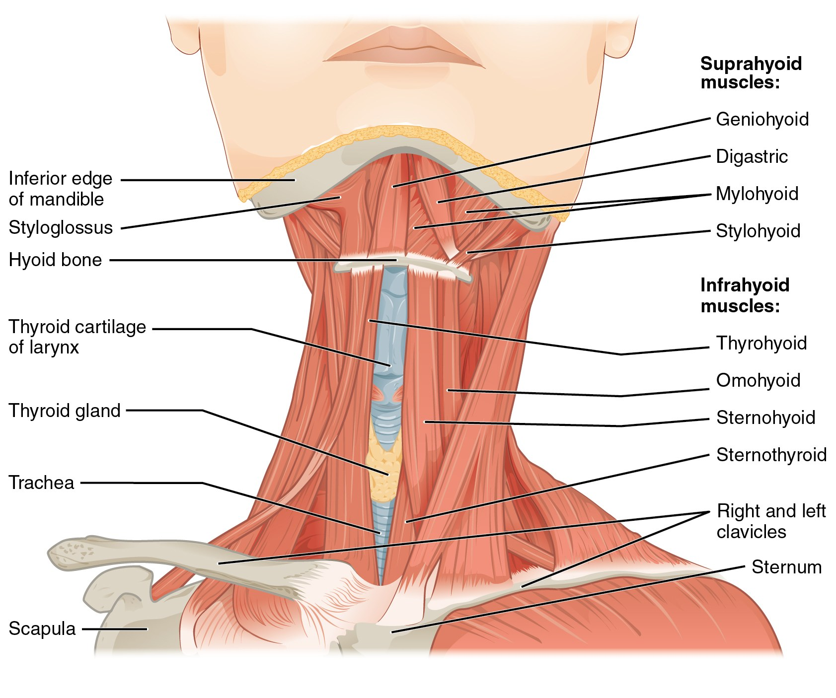
SECTION 11.3
Anterior Neck — Hyoid Muscles
Suprahyoid muscles elevate the hyoid and larynx
Infrahyoid (strap) muscles depress them
Stabilize the hyoid for speech and swallowing
Landmarks for airway and thyroid assessment
Suprahyoid and infrahyoid muscles of the neck
PN 104 · Ch 11 — The Muscular System
17

Slide 18
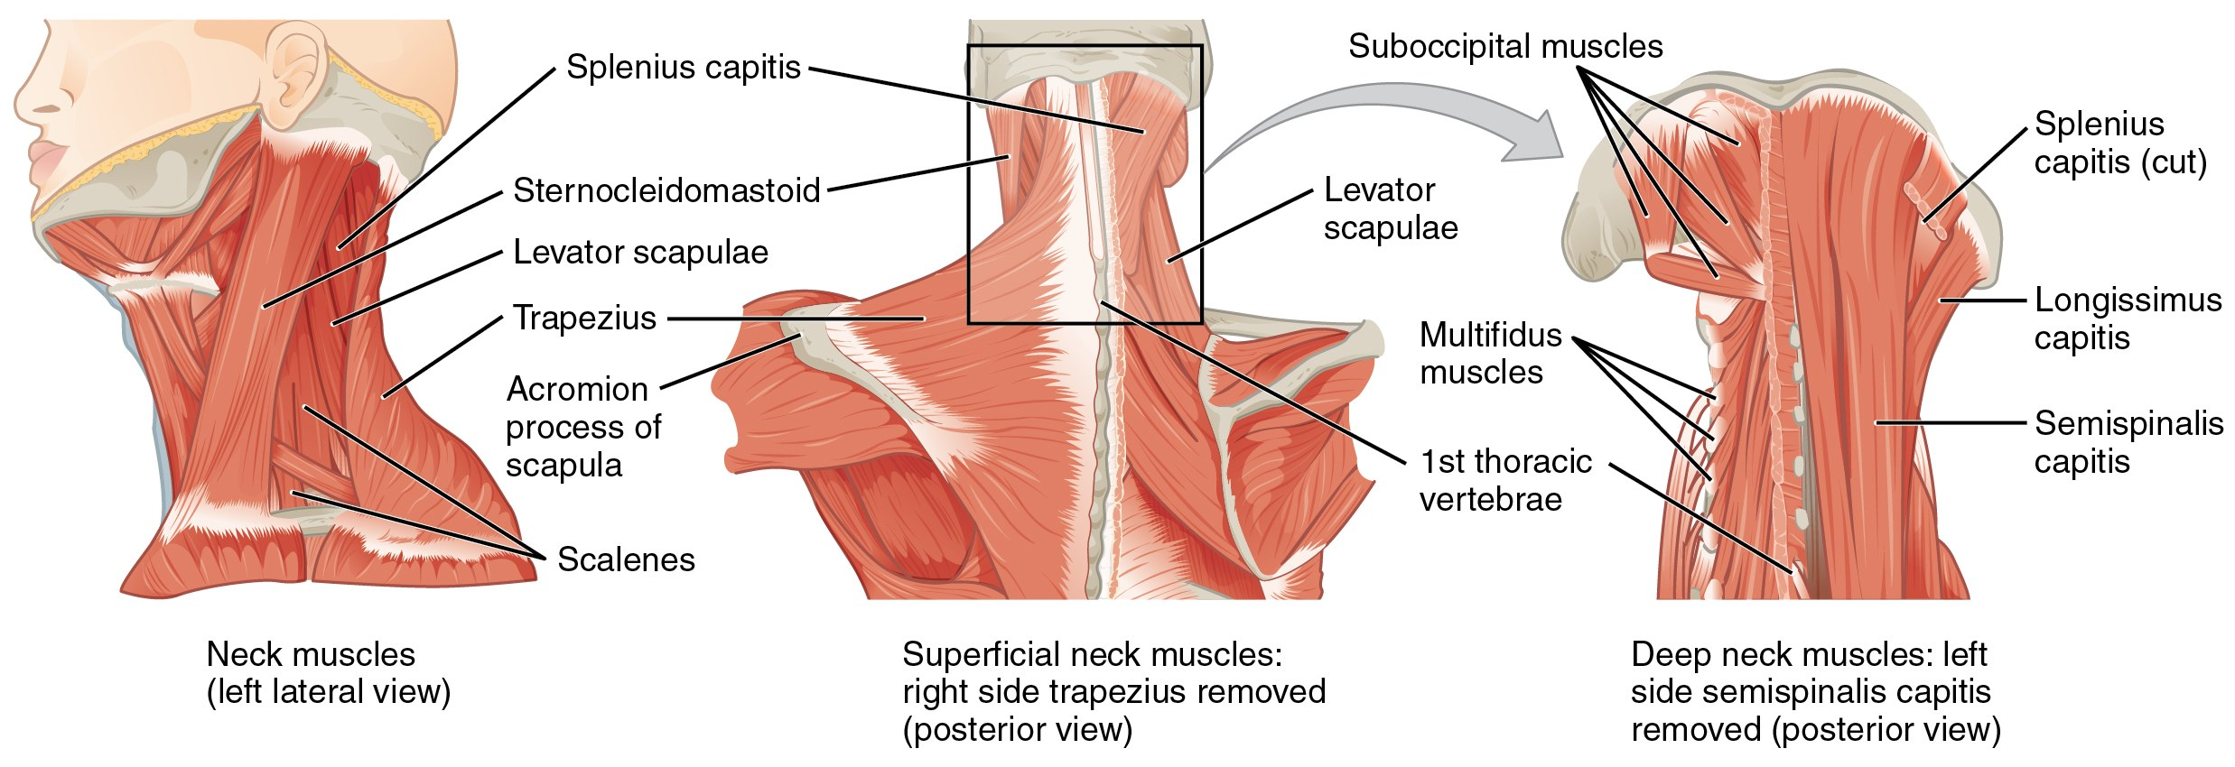
SECTION 11.3
Muscles of the Neck & Back
Sternocleidomastoid flexes and rotates the head
Trapezius and scalenes support posture
Deep muscles stabilize the cervical spine
Scalenes act as accessory respiratory muscles
Posterior and lateral muscles of the neck and back
PN 104 · Ch 11 — The Muscular System
18

Slide 19
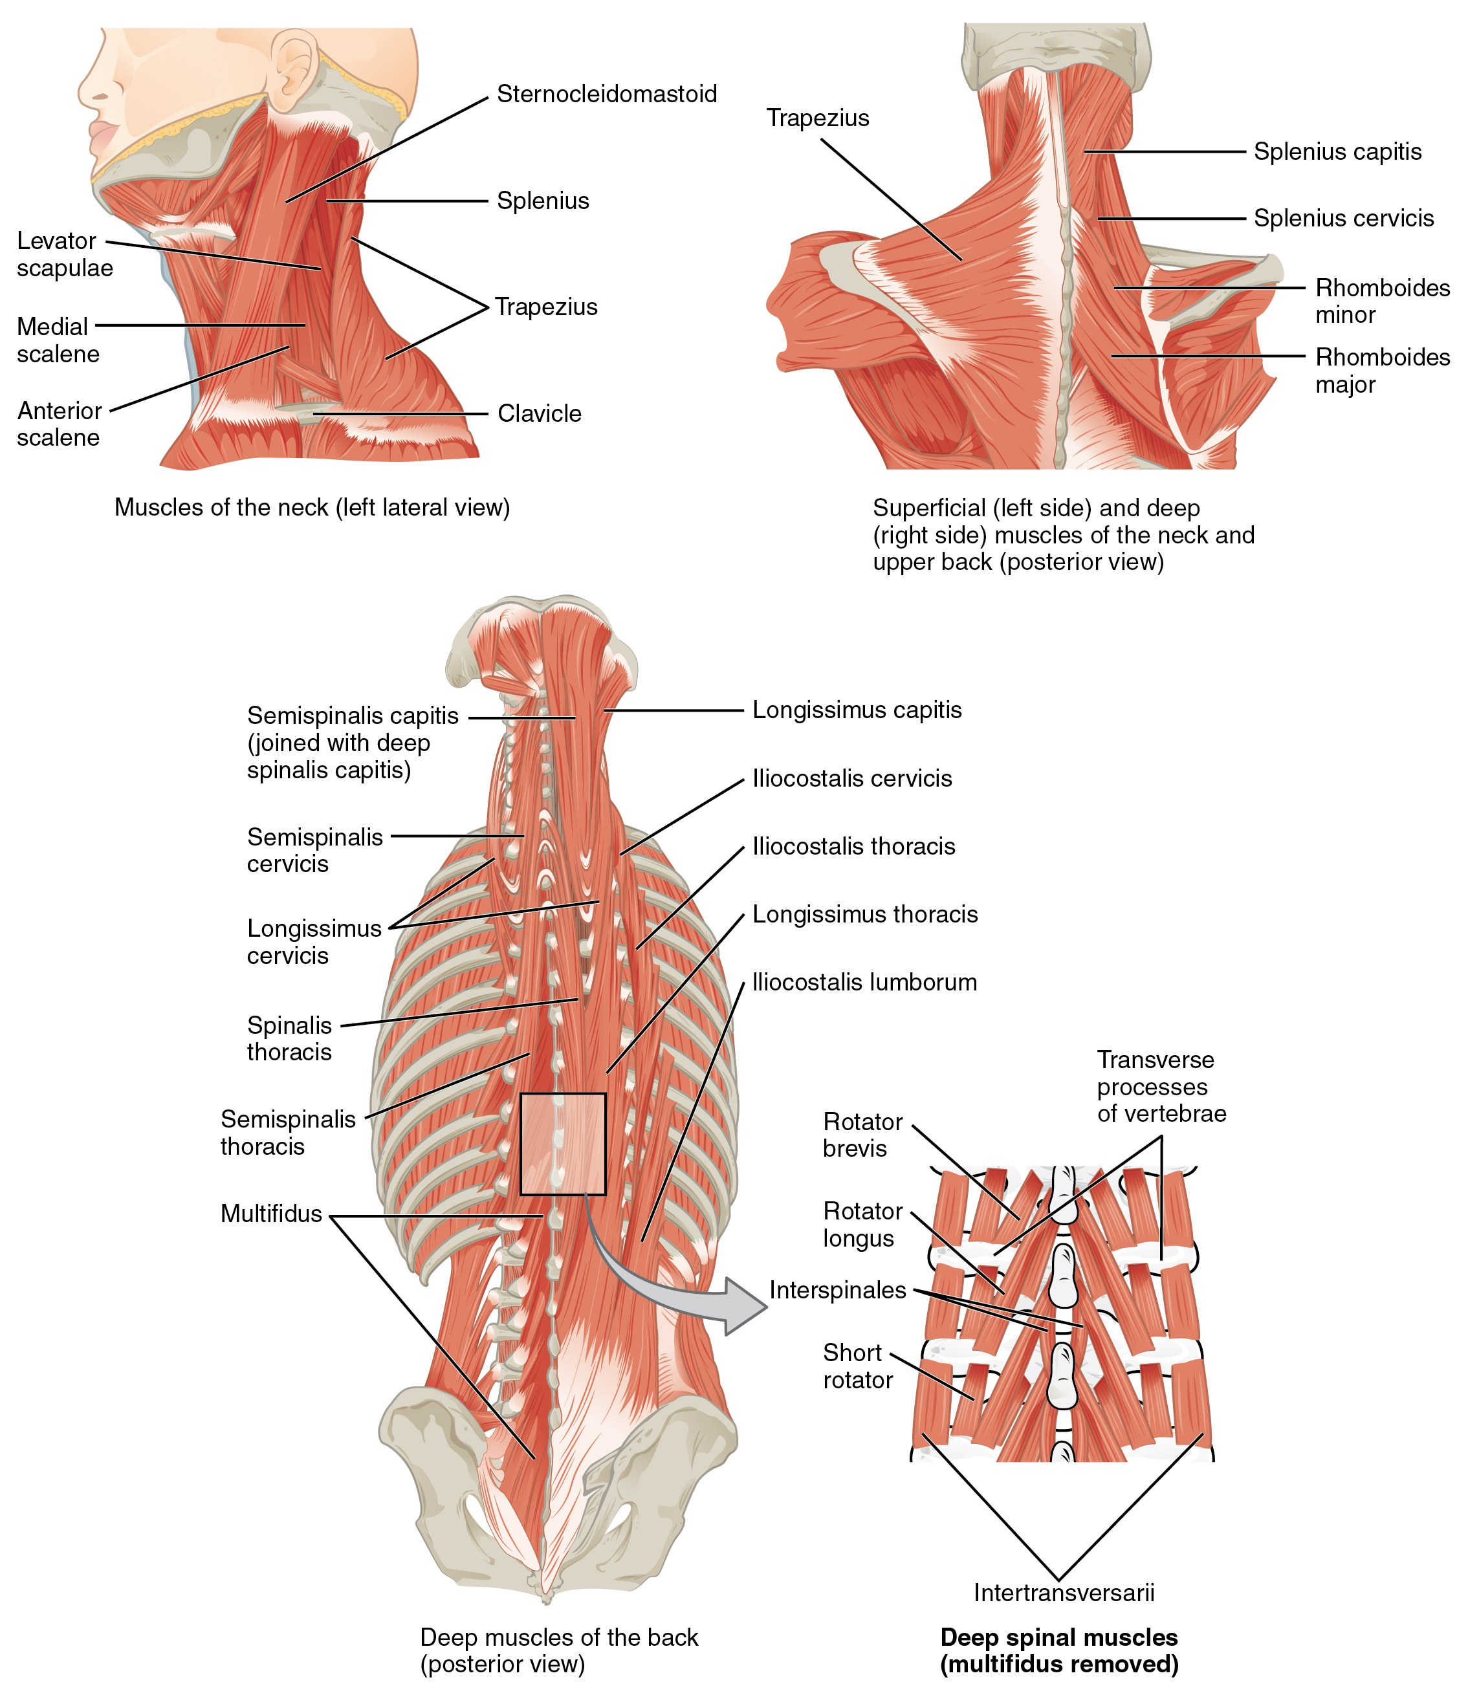
SECTION 11.3
Deep Back — Erector Spinae
Erector spinae = iliocostalis, longissimus, spinalis
Extend and stabilize the vertebral column
Maintain upright posture against gravity
Common source of mechanical low-back strain
Erector spinae group and the deep back muscles
PN 104 · Ch 11 — The Muscular System
19

Slide 20
11.4
SECTION
Axial Muscles of the Abdominal Wall & Thorax
The core, the diaphragm and intercostals of breathing, and the pelvic floor.

Slide 21
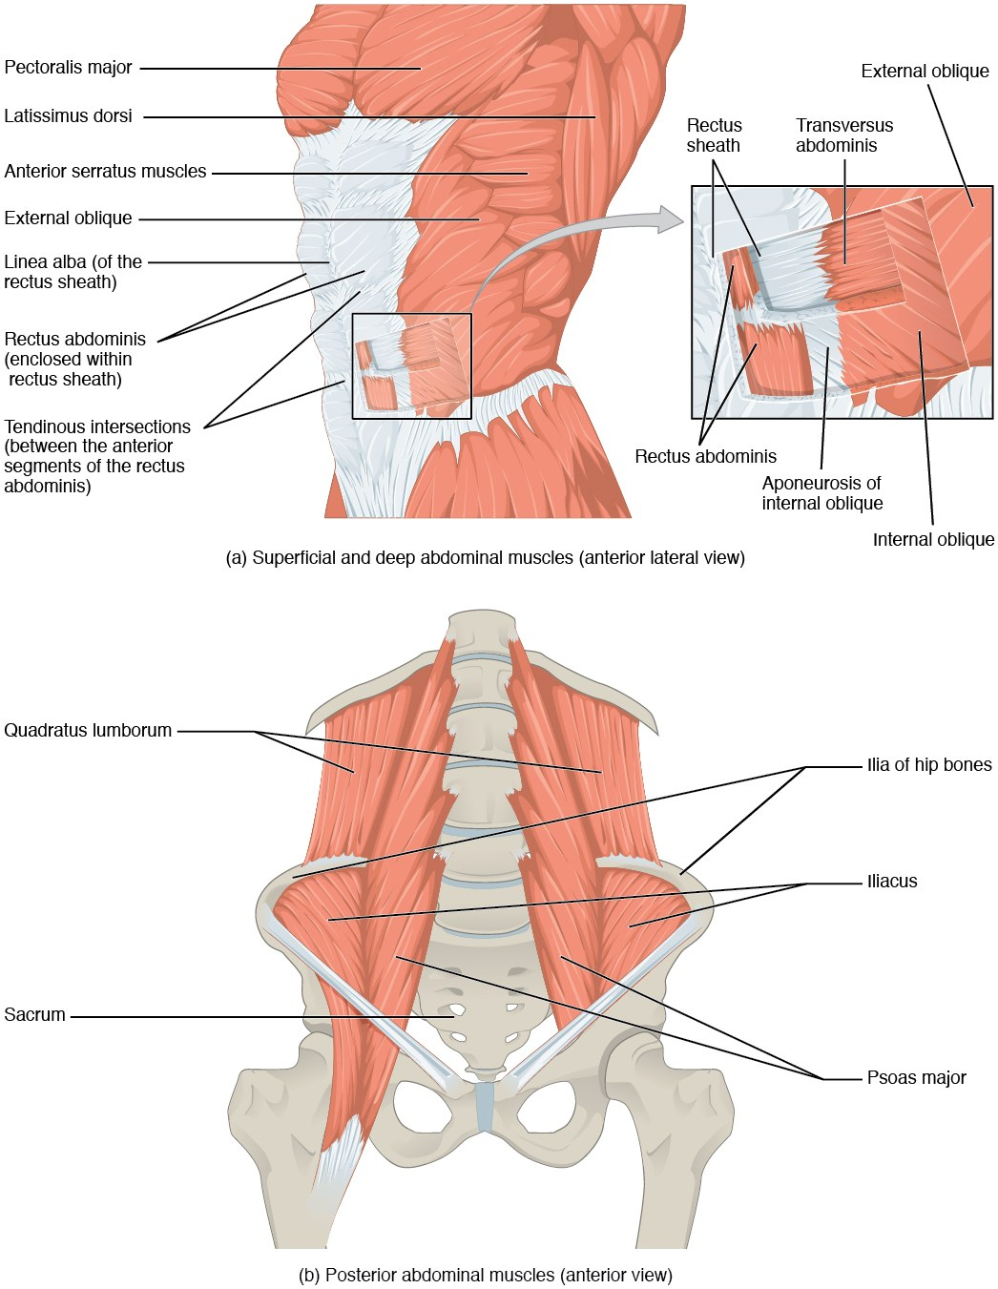
SECTION 11.4
Muscles of the Abdominal Wall
Rectus abdominis flexes the trunk
External/internal obliques bend and rotate
Transversus abdominis compresses the abdomen
Support posture, breathing, and core stability
Layered muscles of the anterior abdominal wall
PN 104 · Ch 11 — The Muscular System
21

Slide 22
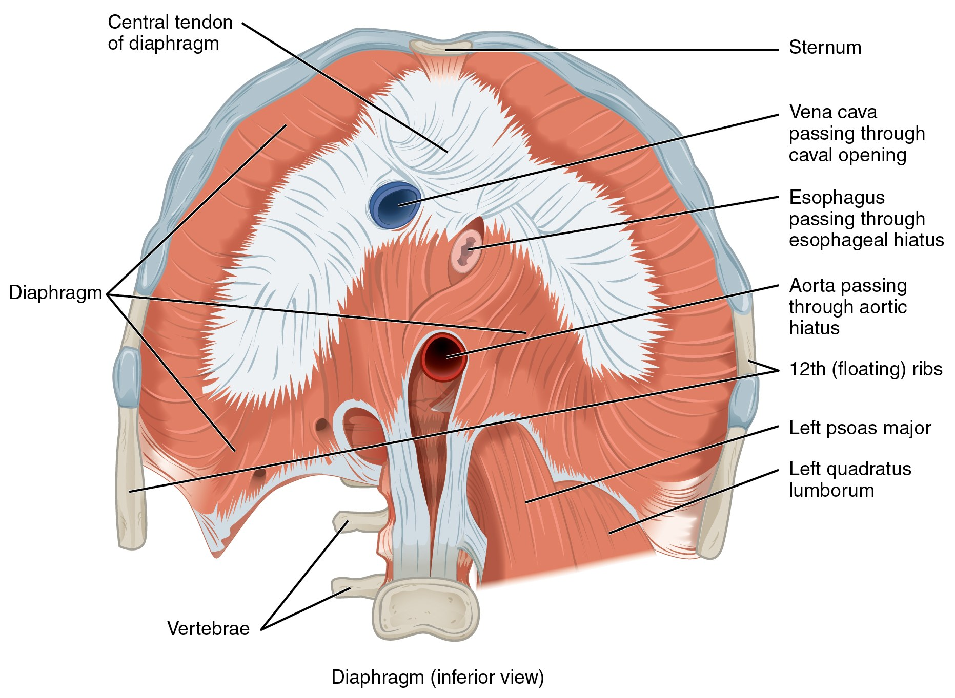
SECTION 11.4
The Diaphragm
Primary muscle of inspiration
Contracts and flattens → thoracic volume rises
Innervated by the phrenic nerve (C3–C5)
"C3, 4, 5 keep the diaphragm alive"
The diaphragm, inferior view
PN 104 · Ch 11 — The Muscular System
22

Slide 23
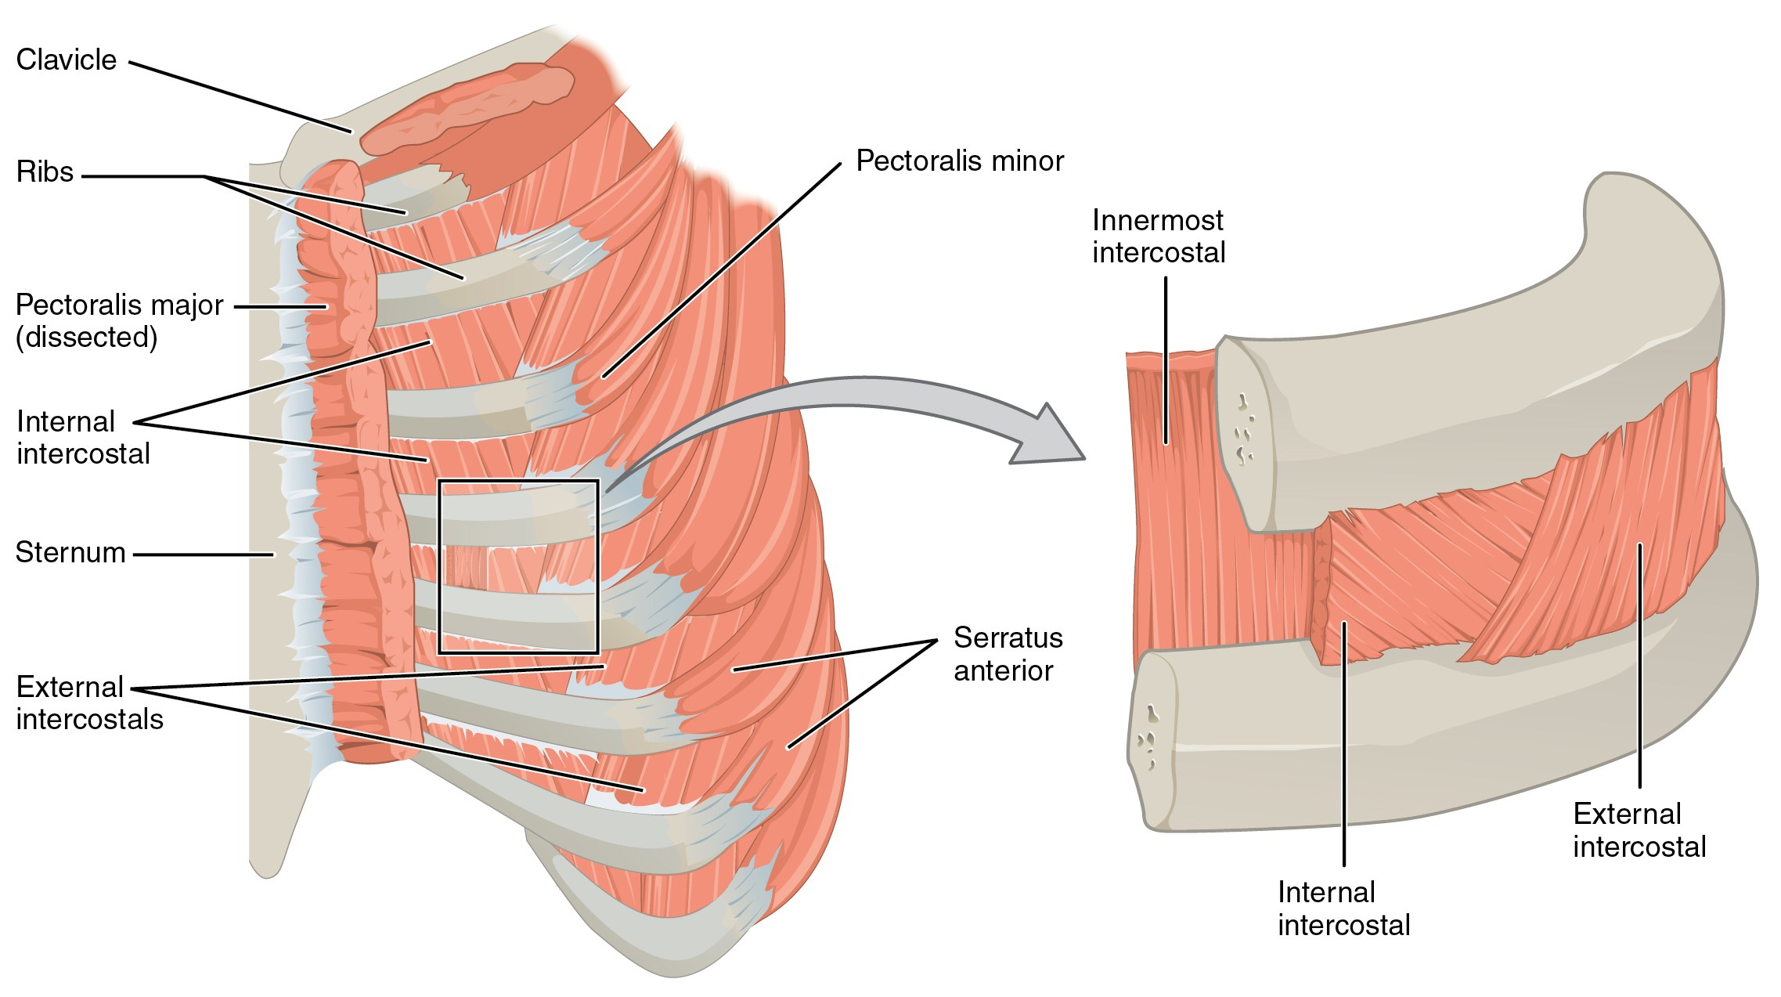
SECTION 11.4
Thoracic Muscles & Intercostals
External intercostals elevate ribs (inspiration)
Internal intercostals depress ribs (forced expiration)
Accessory muscles assist in respiratory distress
Retractions signal increased work of breathing
Intercostal muscles of the thoracic wall
PN 104 · Ch 11 — The Muscular System
23

Slide 24
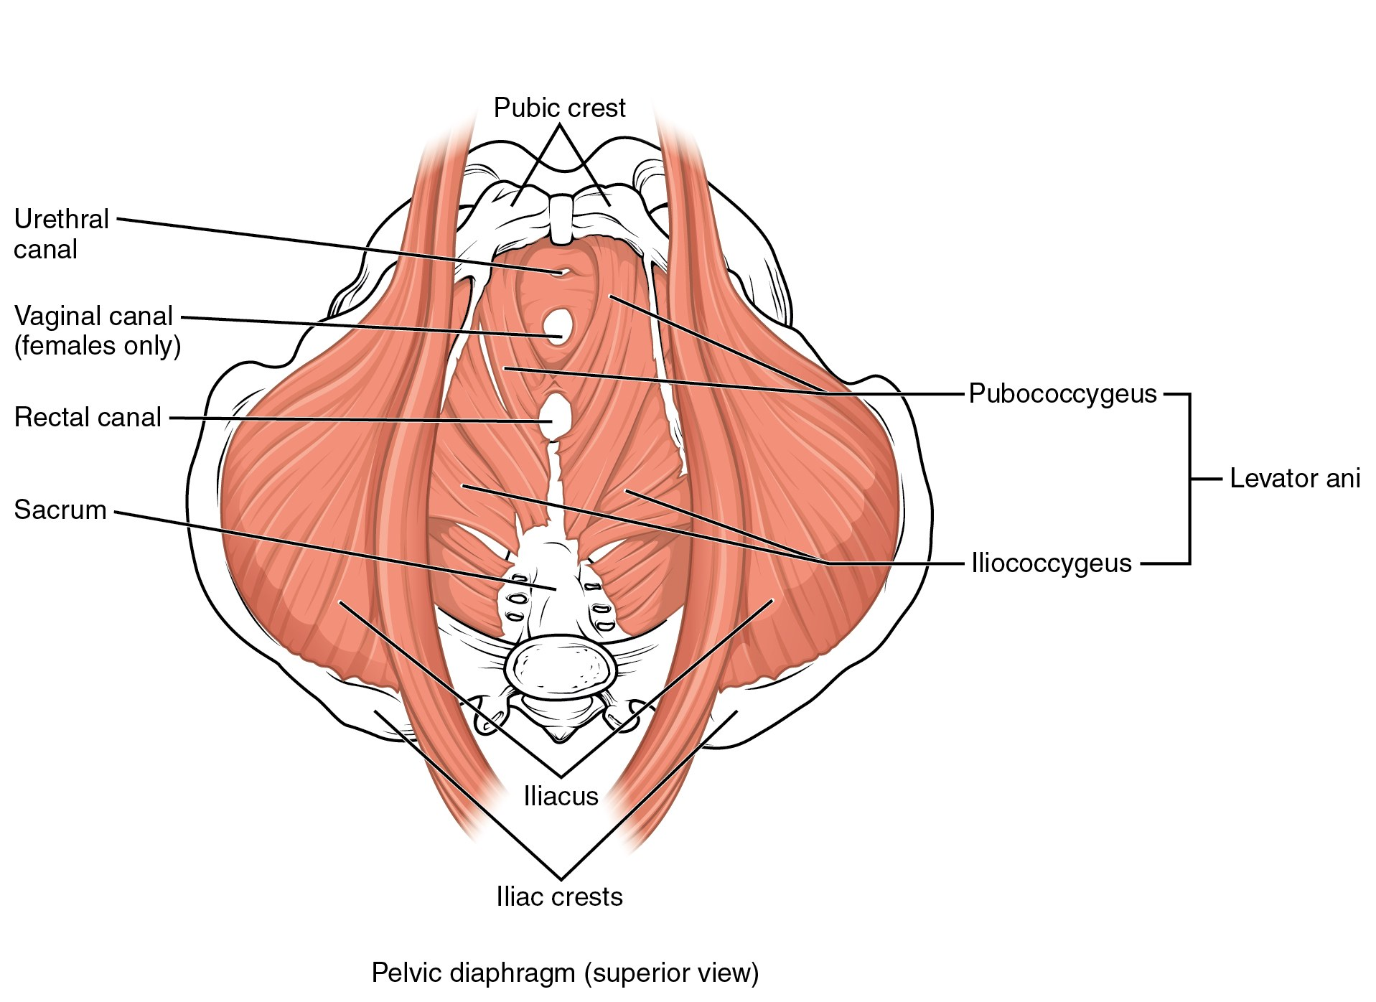
SECTION 11.4
Pelvic Floor & Perineum
Levator ani forms the pelvic diaphragm
Supports the bladder, rectum, and pelvic organs
Maintains continence of urine and stool
Weakness → prolapse and incontinence
Muscles of the pelvic floor (perineum)
PN 104 · Ch 11 — The Muscular System
24

Slide 25
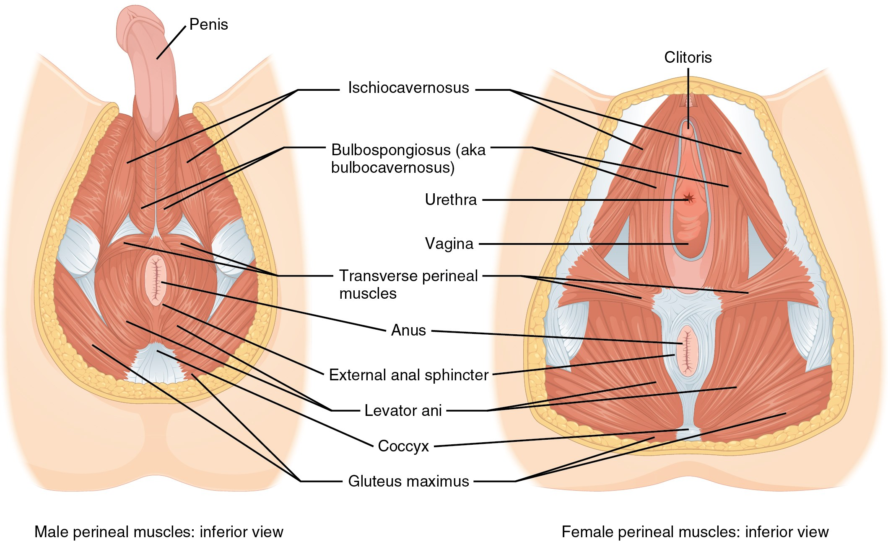
SECTION 11.4
The Pelvic Diaphragm
Pelvic diaphragm, male and female
Levator ani + coccygeus = pelvic diaphragm
Sex differences in the openings it transmits
Resists downward intra-abdominal pressure
Key to bowel, bladder, and sexual function
PN 104 · Ch 11 — The Muscular System
25

Slide 26
11.5
SECTION
Muscles of the Pectoral Girdle & Upper Limbs
Positioning the scapula, moving the humerus and forearm, and the muscles of the hand.

Slide 27
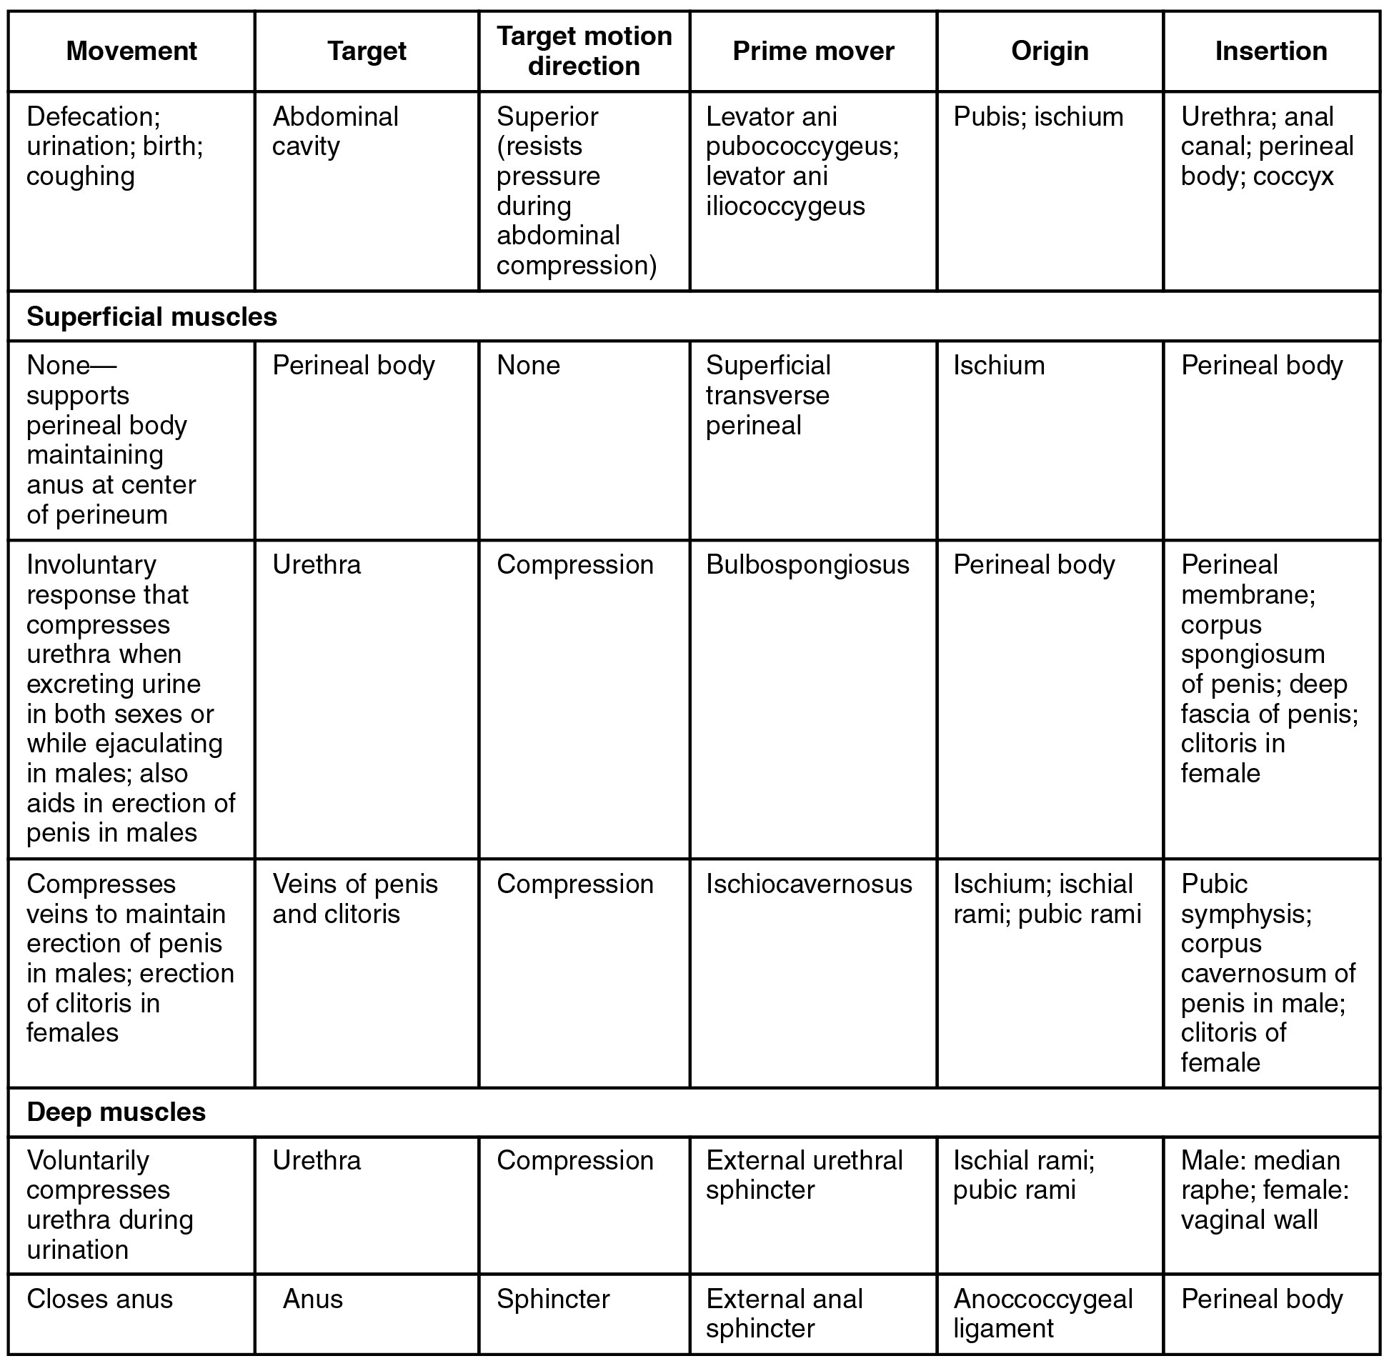
SECTION 11.5
Pectoral Girdle — Reference Table
Anchors the upper limb to the axial skeleton
These muscles position the scapula and clavicle
A stable scapula enables efficient arm movement
Sets up the humerus muscles that follow
Muscles that position the pectoral girdle
PN 104 · Ch 11 — The Muscular System
27

Slide 28
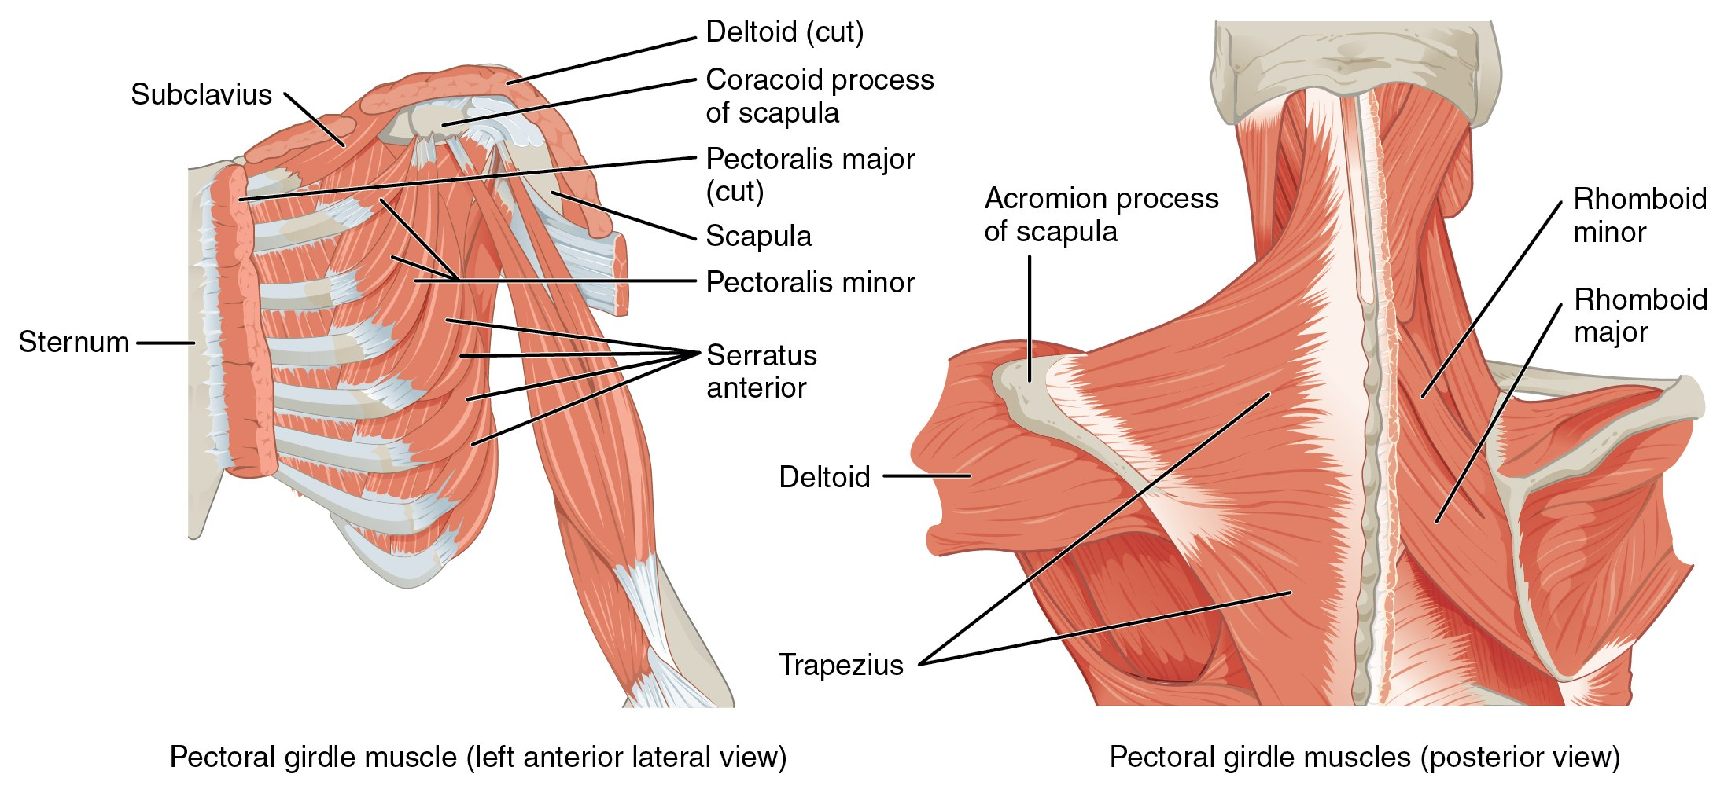
SECTION 11.5
Positioning the Pectoral Girdle
Anterior and posterior muscles of the pectoral girdle
Trapezius and serratus anterior move the scapula
Rhomboids retract; pectoralis minor depresses
Stabilize the shoulder for lifting and reaching
Serratus anterior weakness → "winged scapula"
PN 104 · Ch 11 — The Muscular System
28

Slide 29
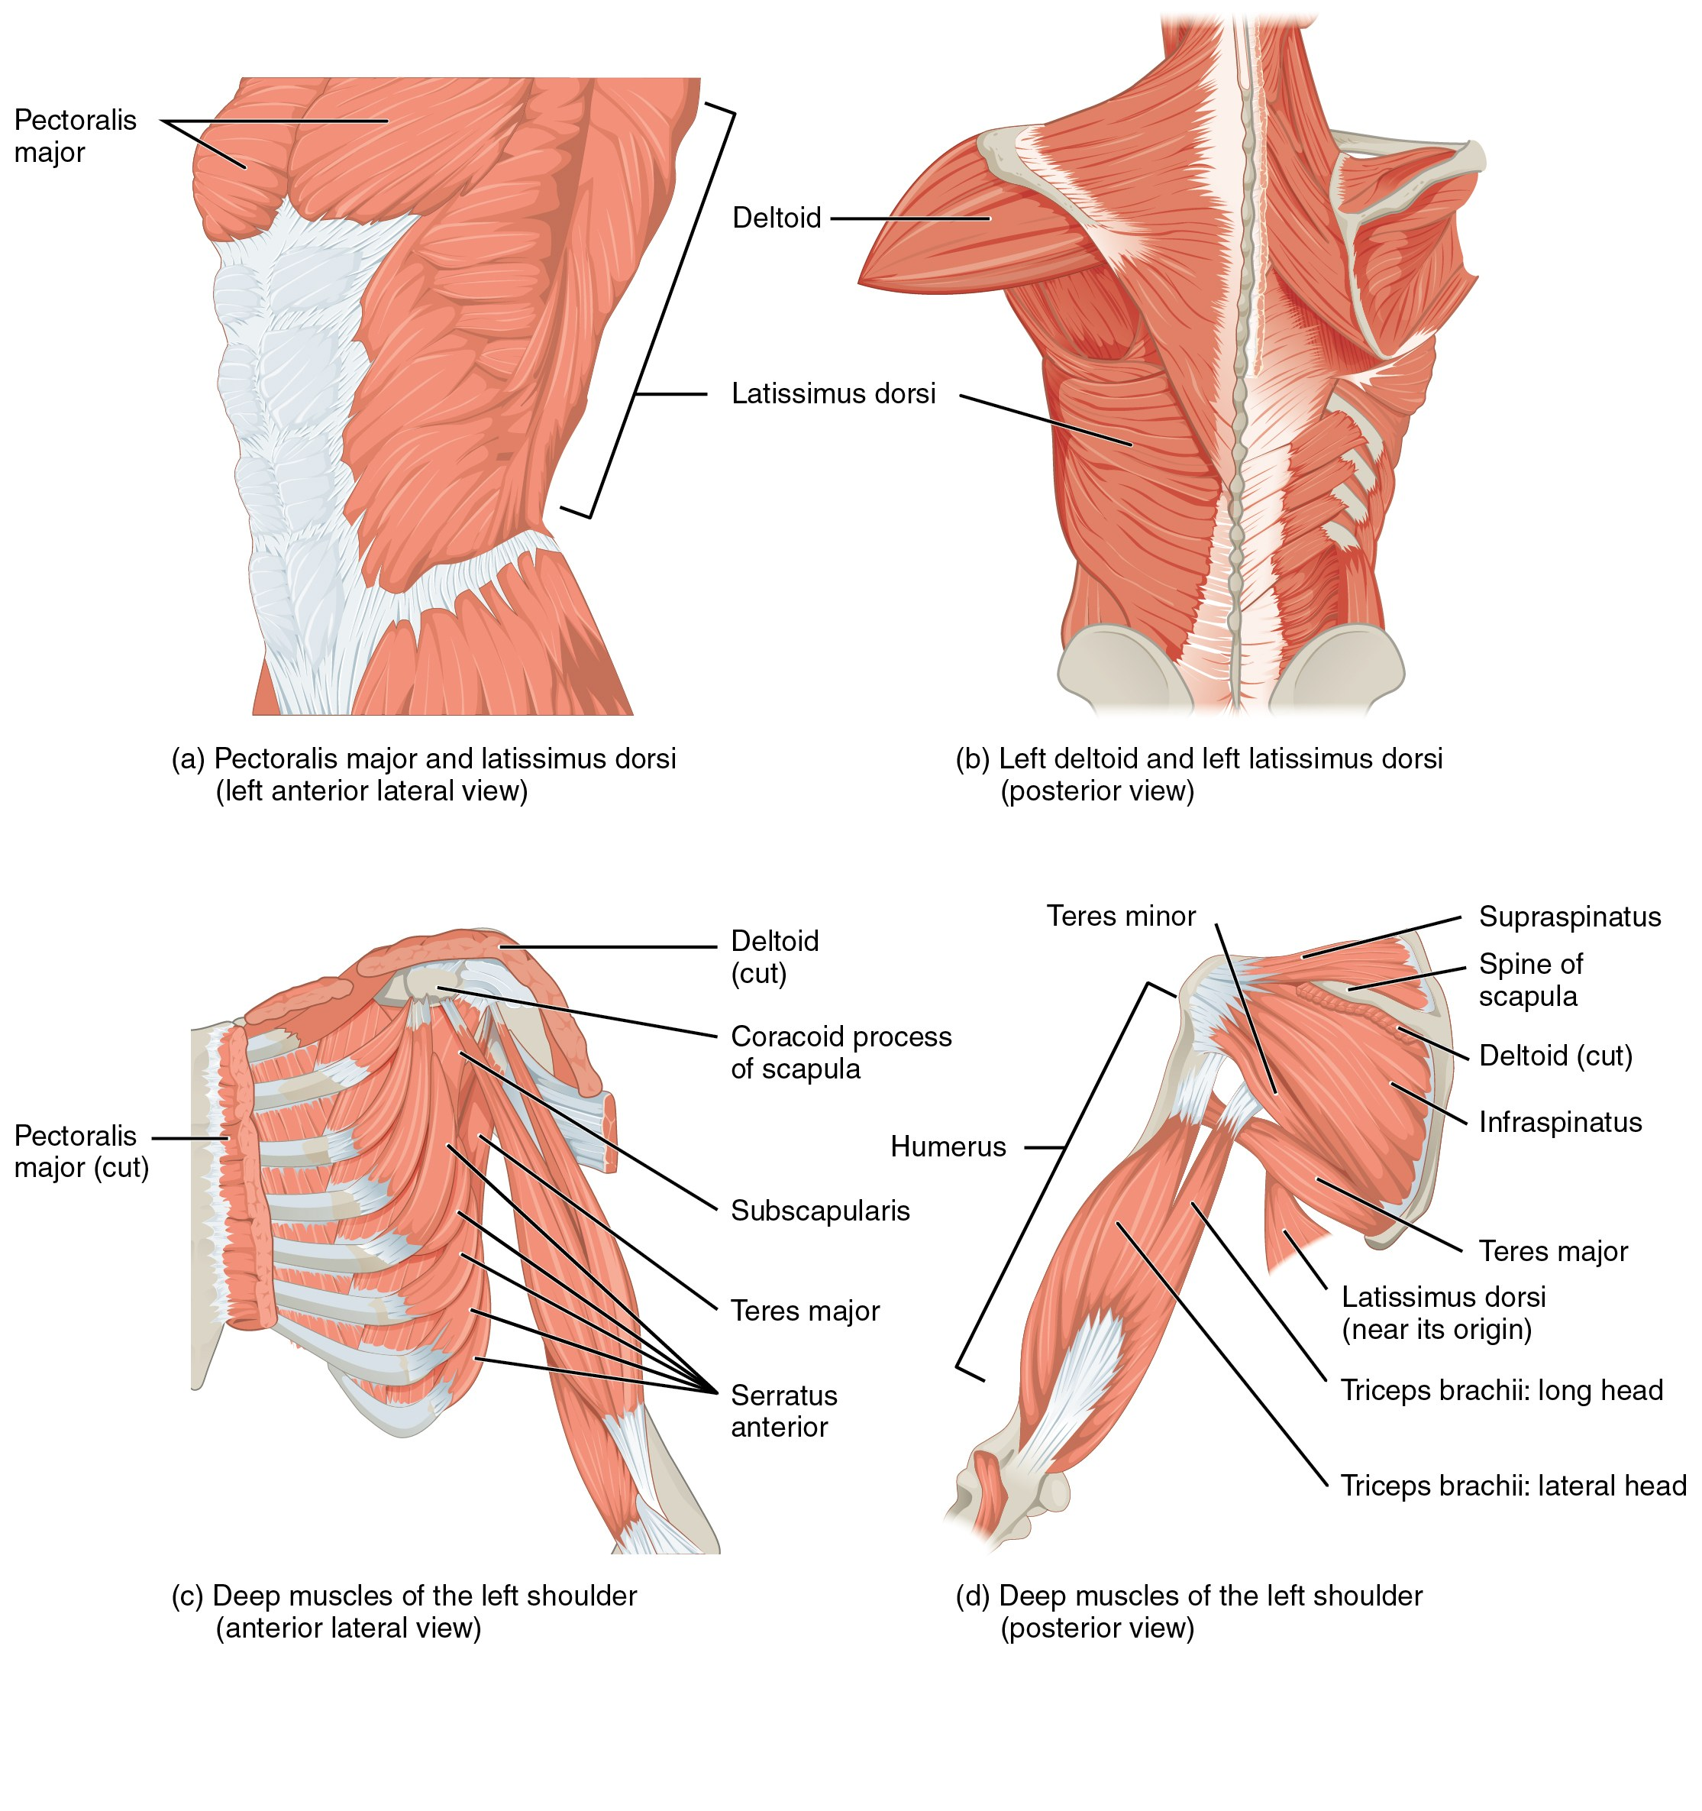
SECTION 11.5
Muscles That Move the Humerus
Deltoid abducts; pectoralis major adducts/flexes
Latissimus dorsi extends and medially rotates
Rotator cuff (SITS) stabilizes the joint
Most mobile — and least stable — joint in the body
Muscles that move the humerus, including the rotator cuff
PN 104 · Ch 11 — The Muscular System
29

Slide 30
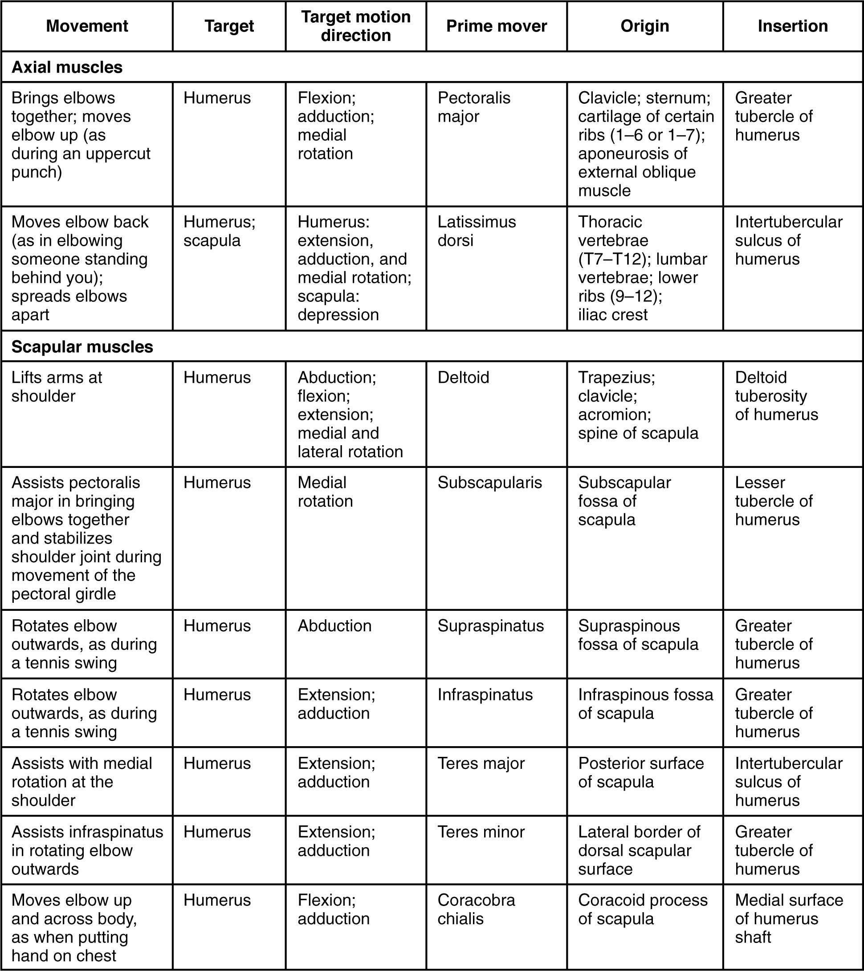
SECTION 11.5
Humerus Muscles — Reference Table
Sort movers by action: flex, extend, abduct
Separate rotator cuff from the prime movers
Link origin/insertion to the motion produced
Use for skills lab and exam review
Muscles that move the humerus: summary table
PN 104 · Ch 11 — The Muscular System
30

Slide 31
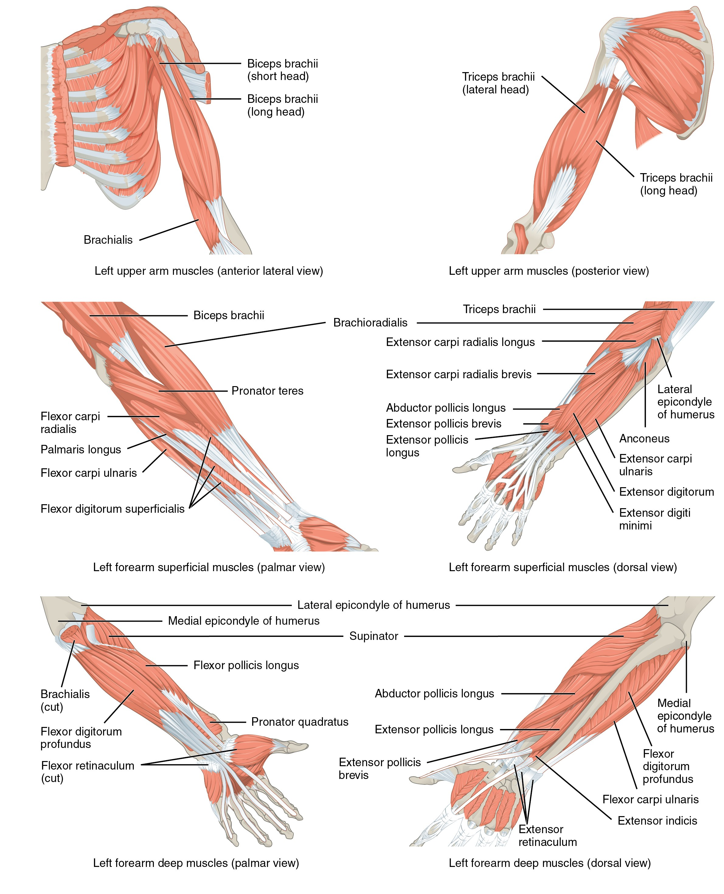
SECTION 11.5
Muscles That Move the Forearm
Biceps brachii and brachialis flex the elbow
Triceps brachii extends the elbow
Supinator and pronators rotate the forearm
Anterior vs. posterior compartments group them
Muscles of the arm that move the forearm
PN 104 · Ch 11 — The Muscular System
31

Slide 32
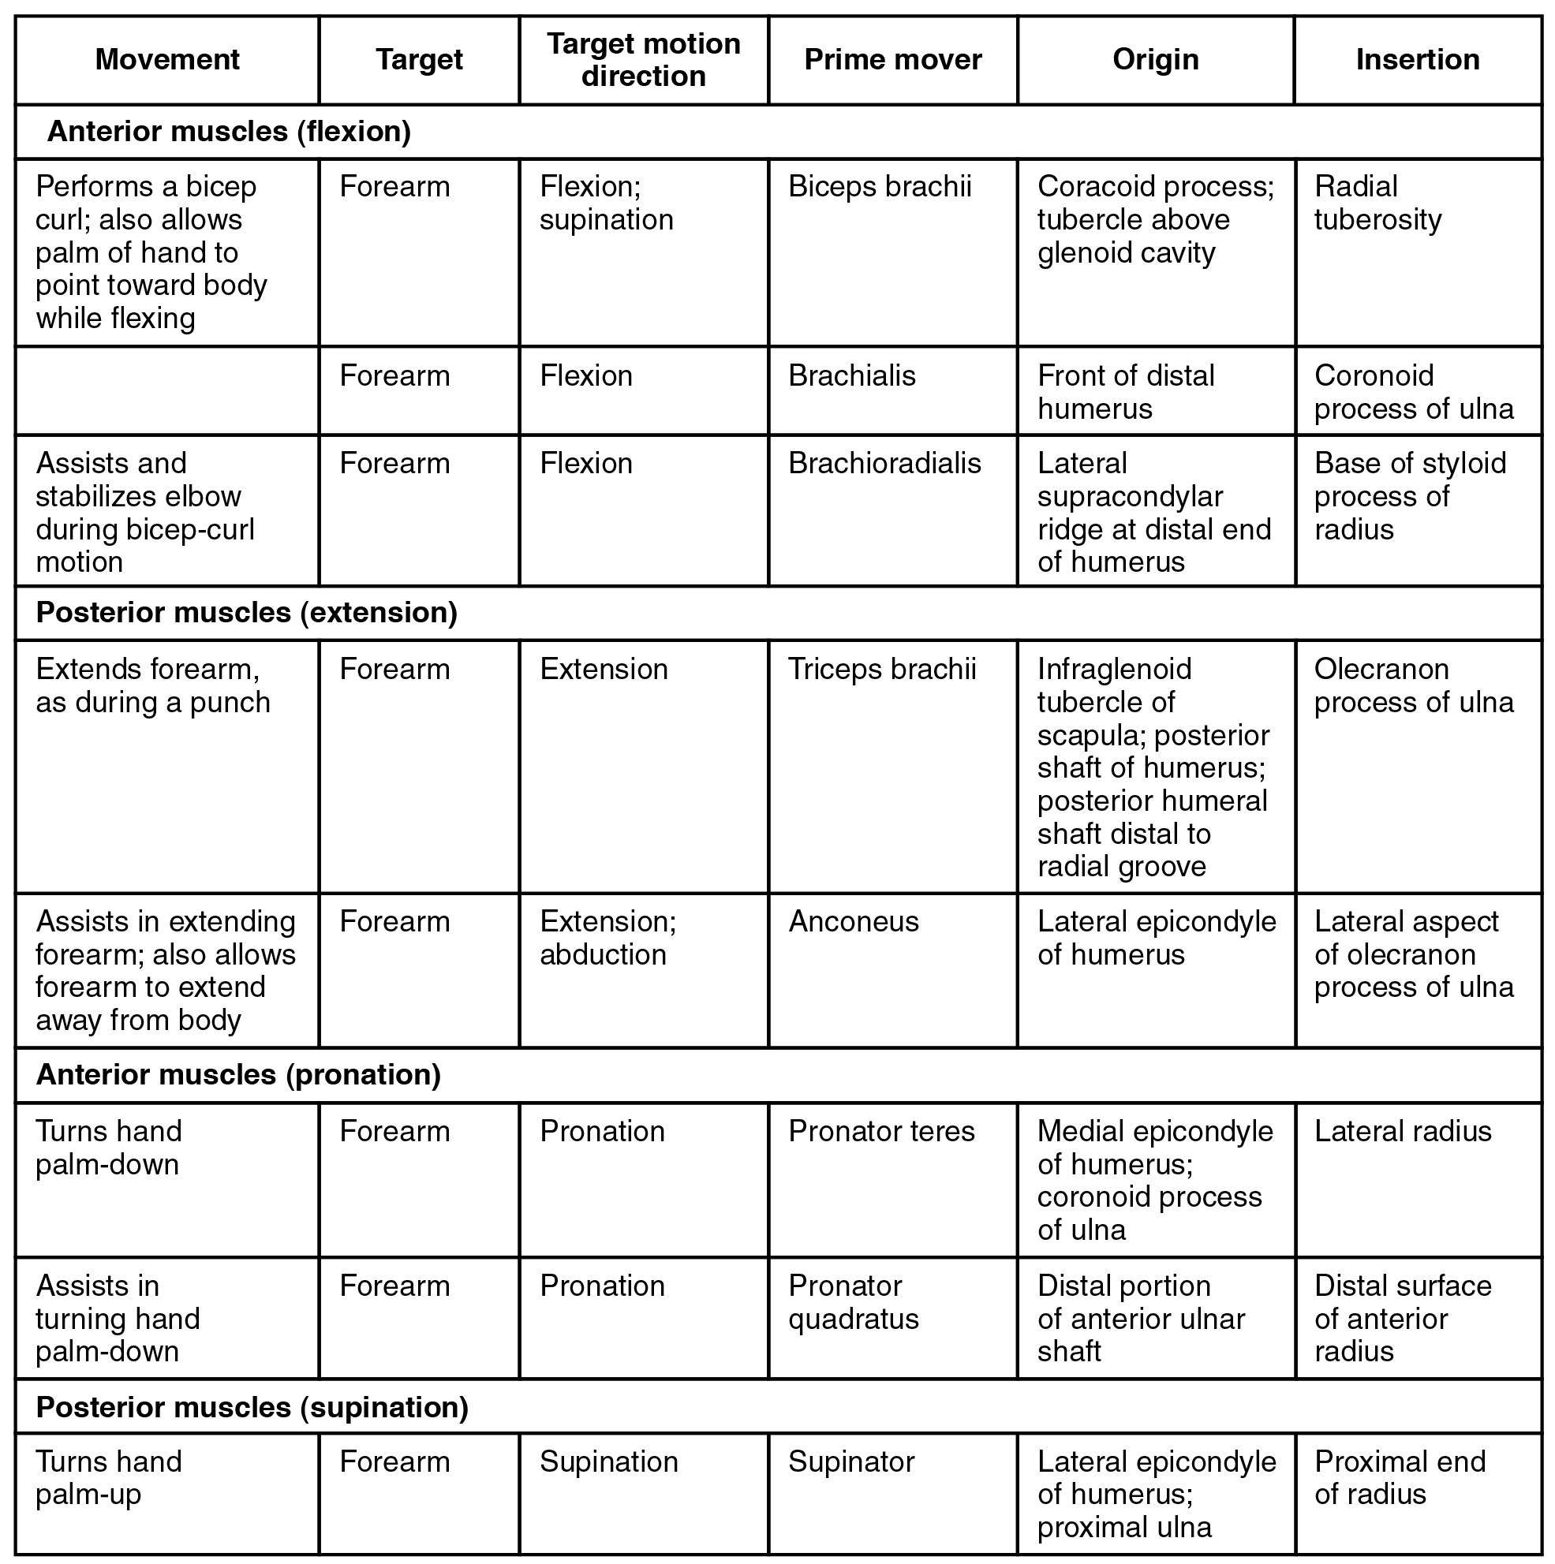
SECTION 11.5
Forearm — Muscles of the Wrist (Table)
Anterior compartment flexes wrist and fingers
Posterior compartment extends wrist and fingers
Long tendons cross from forearm into the hand
Median, ulnar, and radial nerve supply
Muscles that move the forearm: reference table
PN 104 · Ch 11 — The Muscular System
32

Slide 33
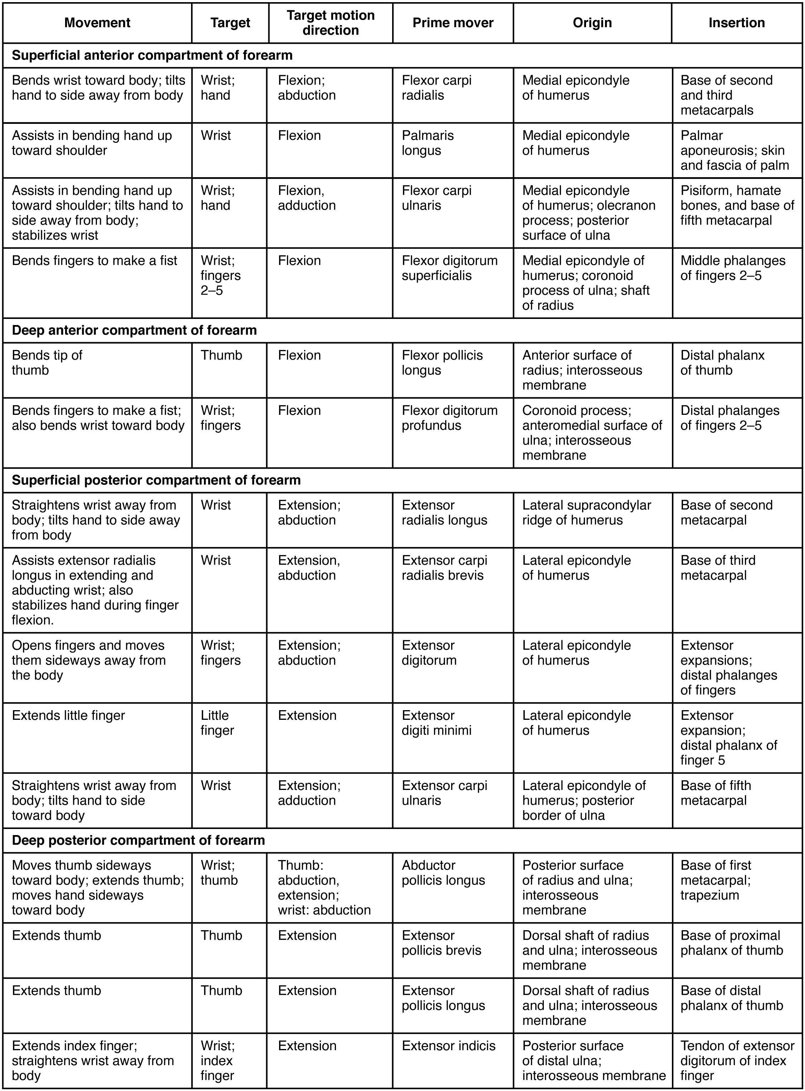
SECTION 11.5
Wrist & Hand — Reference Table
Extrinsic muscles power gross grip
Retinacula stabilize the long tendons
Carpal tunnel transmits the median nerve + tendons
Clinical: carpal tunnel syndrome
Muscles of the wrist and hand: reference table
PN 104 · Ch 11 — The Muscular System
33

Slide 34
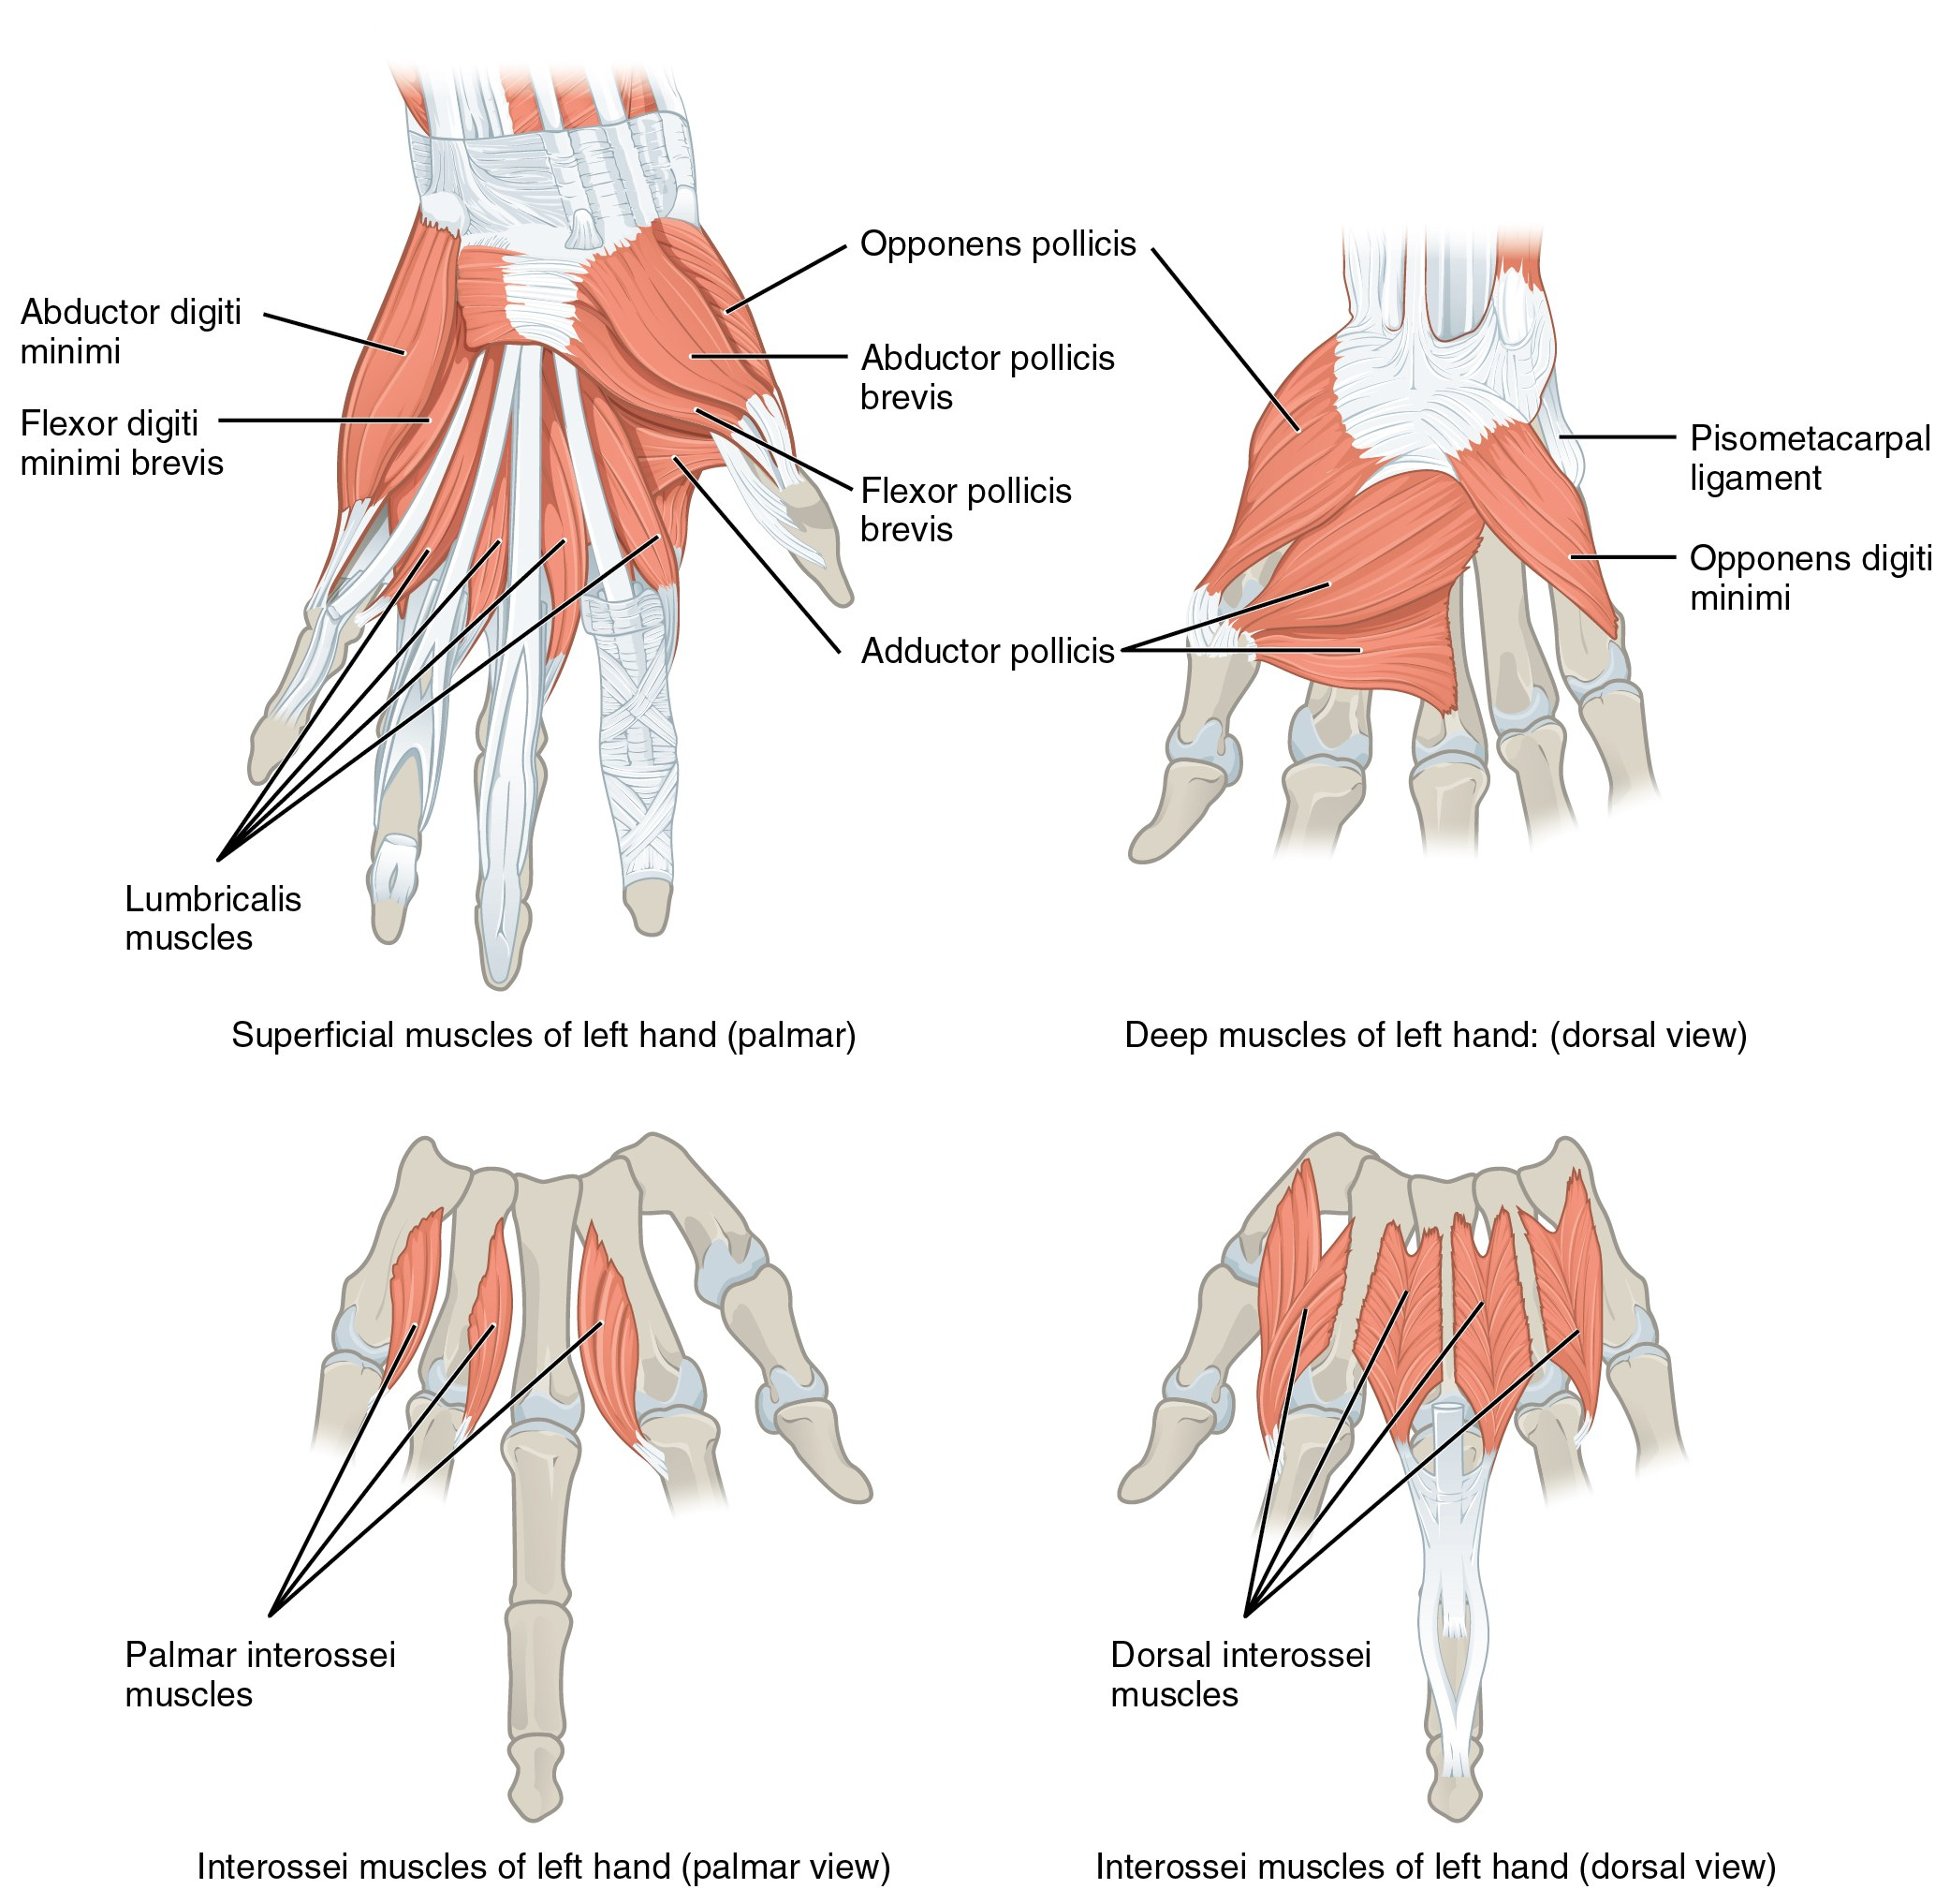
SECTION 11.5
Intrinsic Muscles of the Hand
Thenar, hypothenar, and midpalmar groups
Provide fine, precise finger movements
Thumb opposition enables a functional grasp
Nerve injury impairs dexterity and grip
Intrinsic muscles of the hand
PN 104 · Ch 11 — The Muscular System
34

Slide 35
11.6
SECTION
Appendicular Muscles of the Pelvic Girdle & Lower Limbs
The hip, thigh, leg, and foot muscles that power standing, walking, and balance.

Slide 36
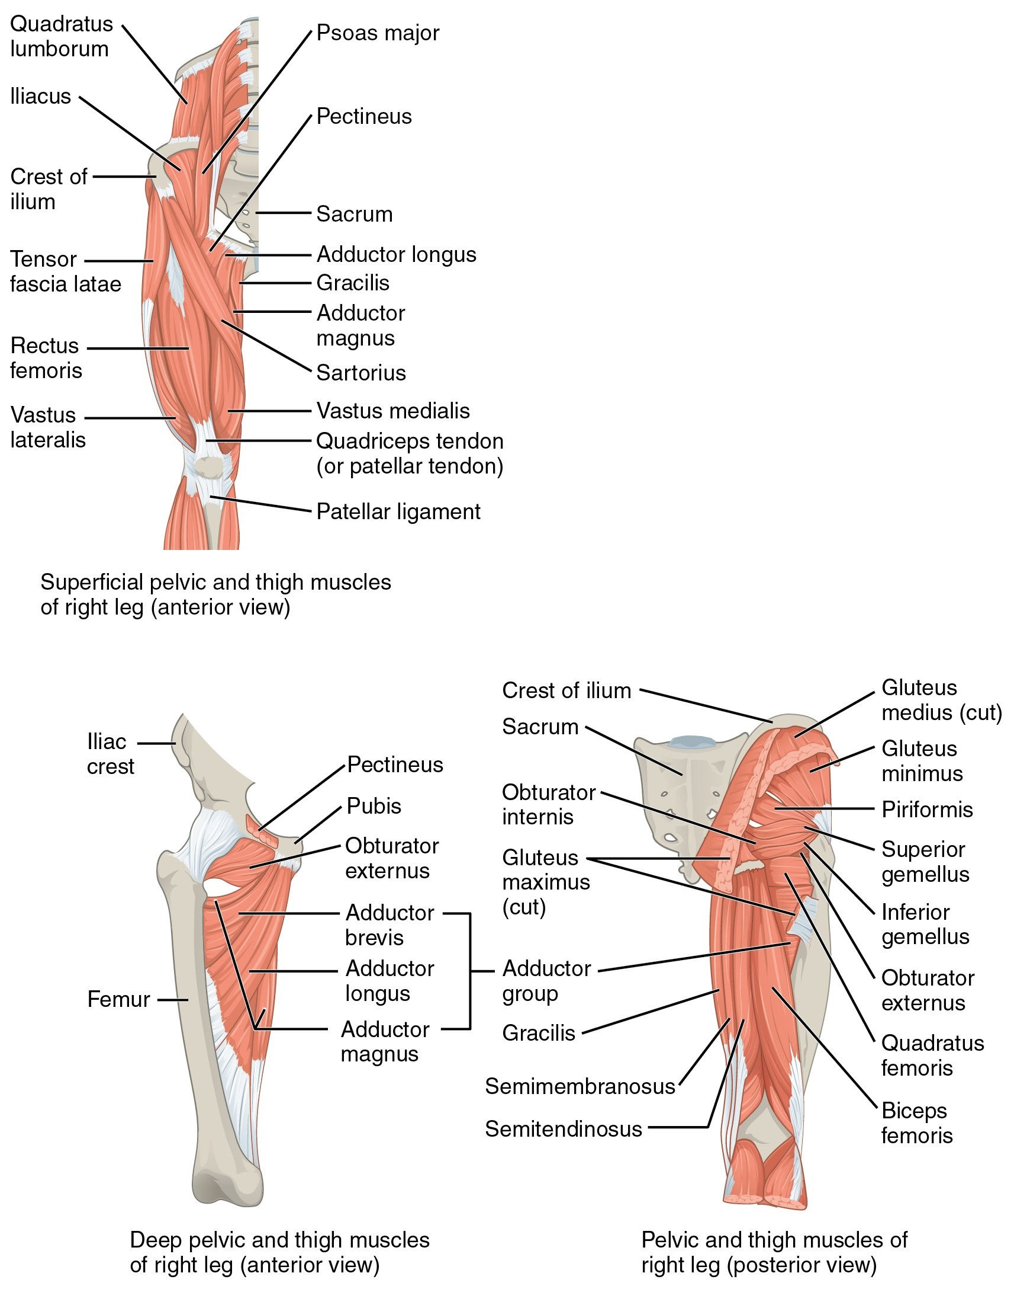
SECTION 11.6
Muscles of the Gluteal Region & Thigh
Gluteus maximus extends the hip
Gluteus medius/minimus abduct and stabilize
Iliopsoas is the main hip flexor
Gait and balance depend on these muscles
Muscles of the gluteal region acting on the femur
PN 104 · Ch 11 — The Muscular System
36

Slide 37
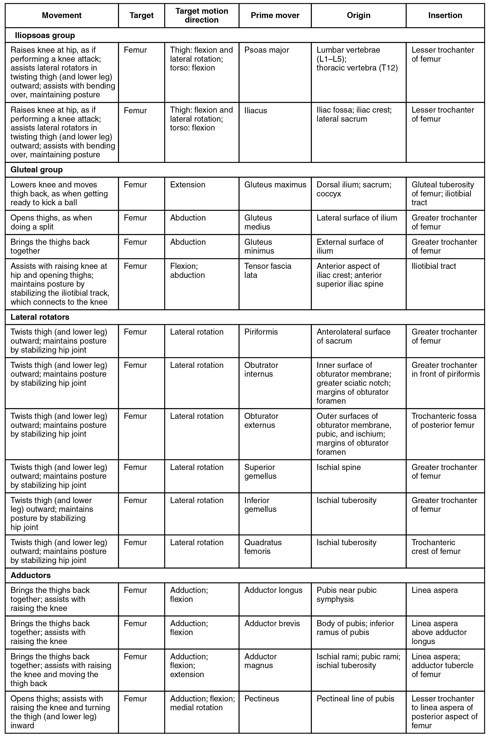
SECTION 11.6
Gluteal Region — Reference Table
Separate flexors, extensors, abductors, rotators
Note the pelvic stabilizers used in gait
Connect to fall risk and mobility
Reference for clinical skills
Muscles of the gluteal region: summary table
PN 104 · Ch 11 — The Muscular System
37

Slide 38
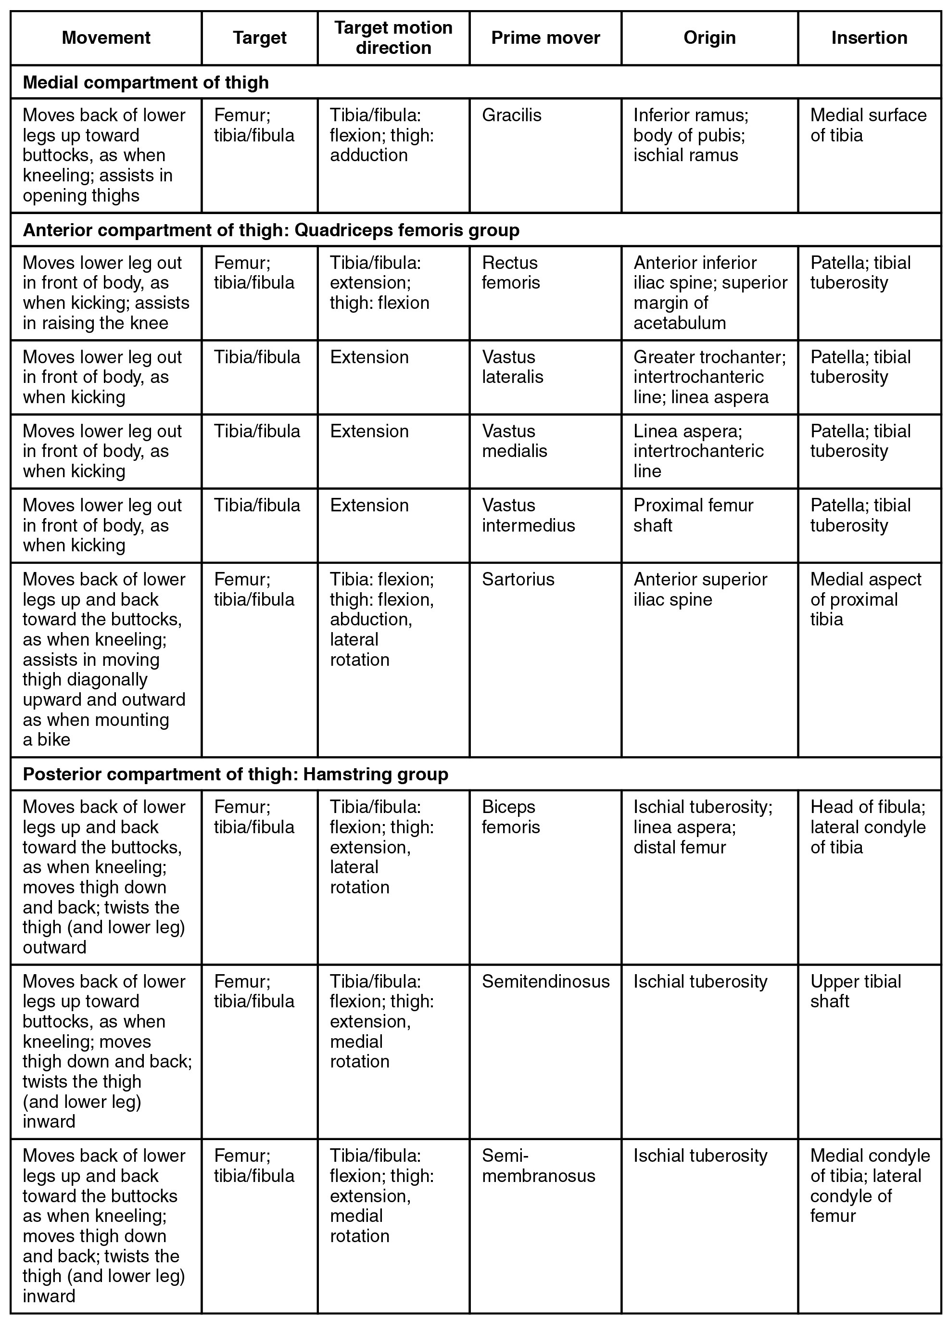
SECTION 11.6
Muscles of the Thigh — Reference Table
Quadriceps extend the knee
Hamstrings flex the knee and extend the hip
Adductors pull the thigh medially
Powerful muscles for transfers and walking
Muscles of the thigh: reference table
PN 104 · Ch 11 — The Muscular System
38

Slide 39
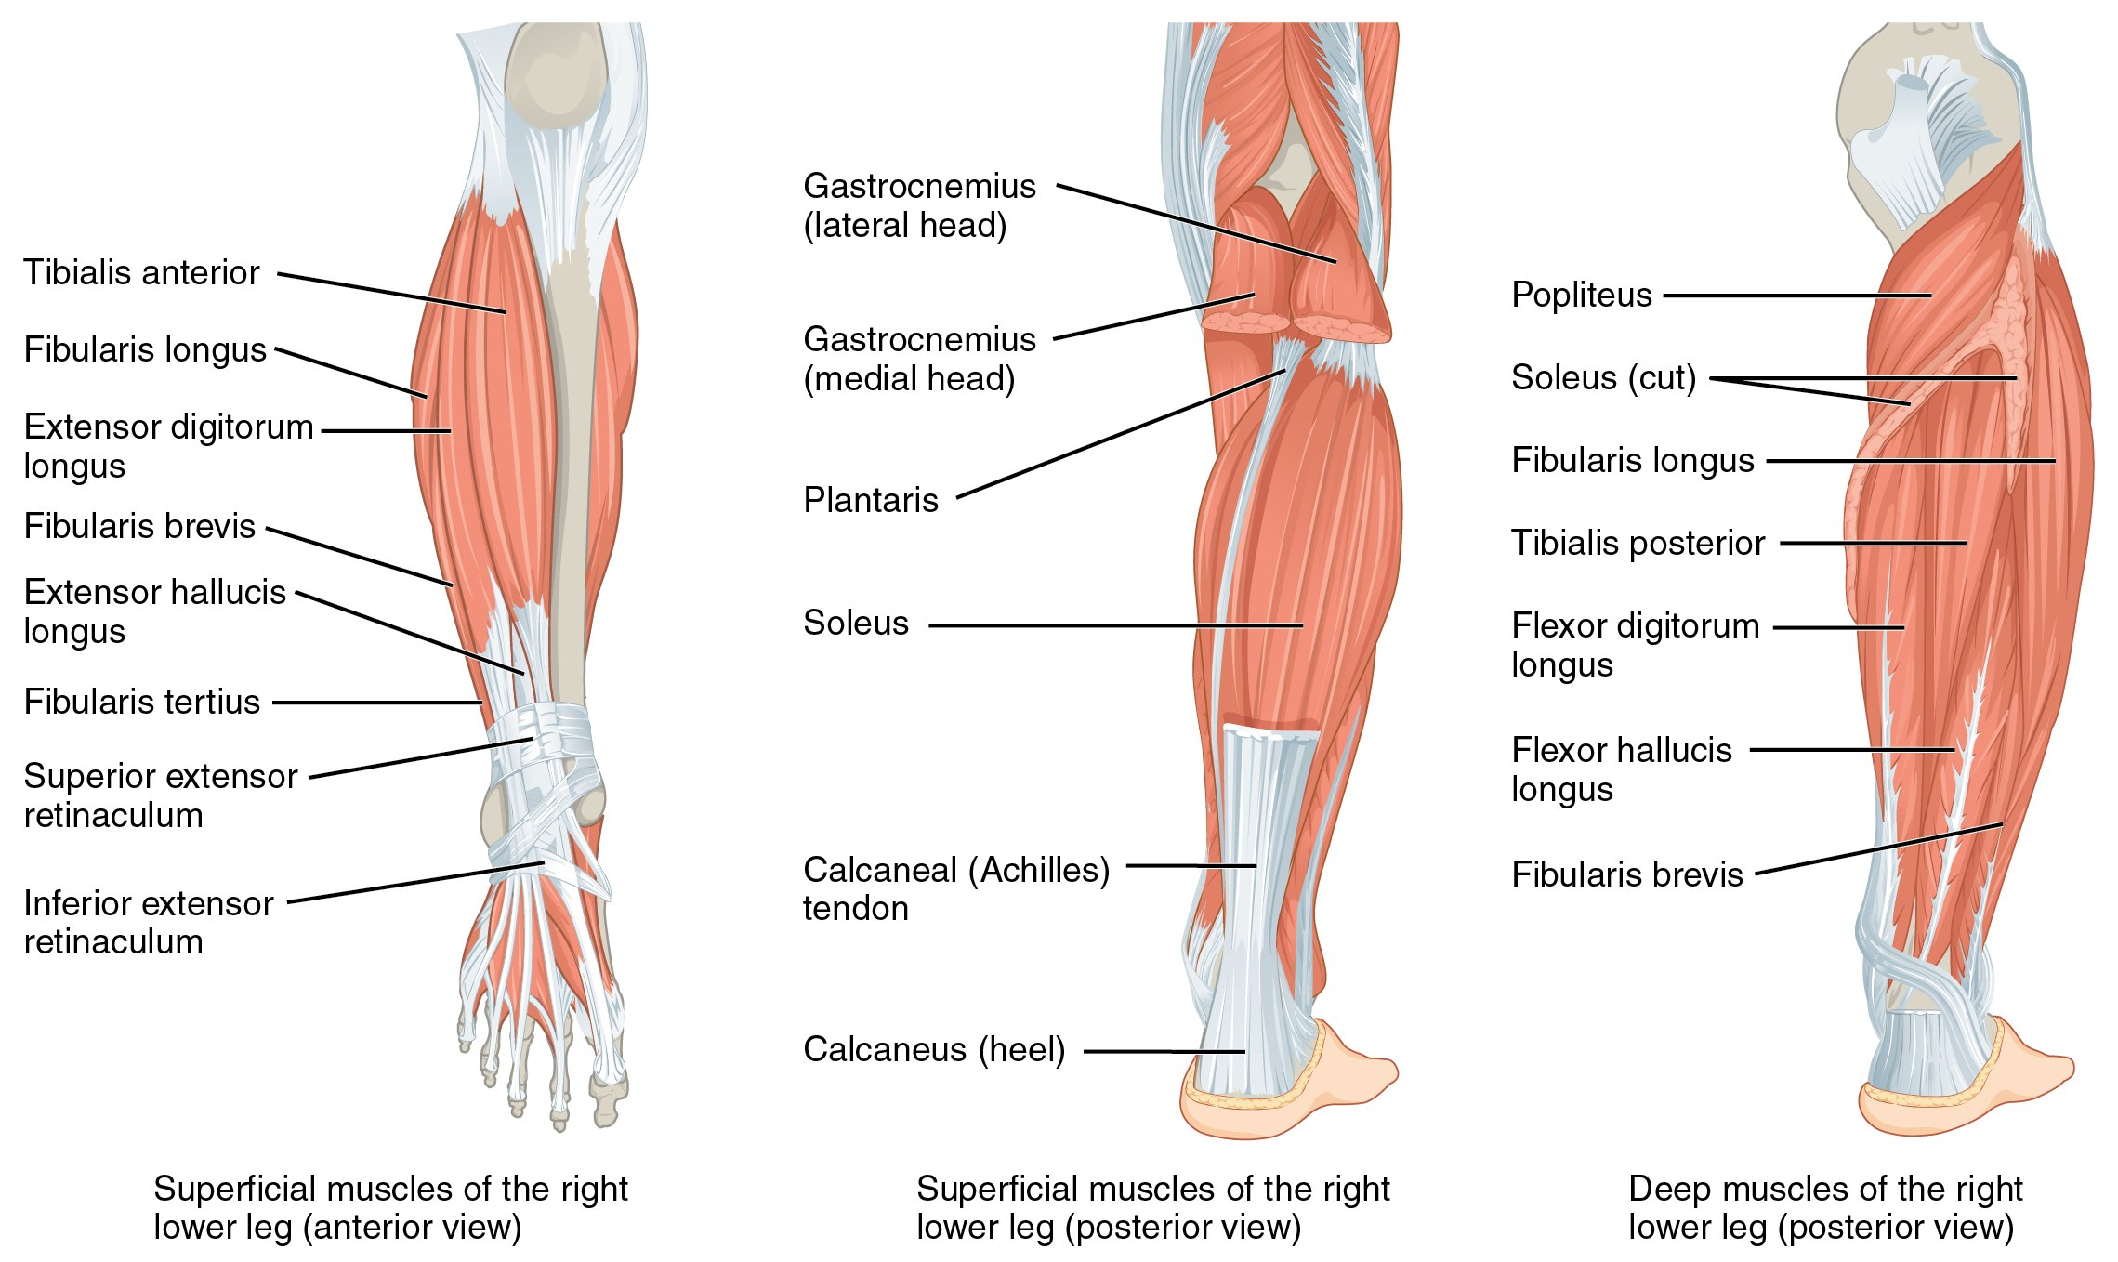
SECTION 11.6
Muscles That Move the Foot
Muscles of the leg that move the foot
Anterior leg dorsiflexes (tibialis anterior)
Posterior leg plantarflexes (gastrocnemius, soleus)
Calf muscles form the Achilles tendon
Deep fibular nerve injury → "foot drop"
PN 104 · Ch 11 — The Muscular System
39

Slide 40
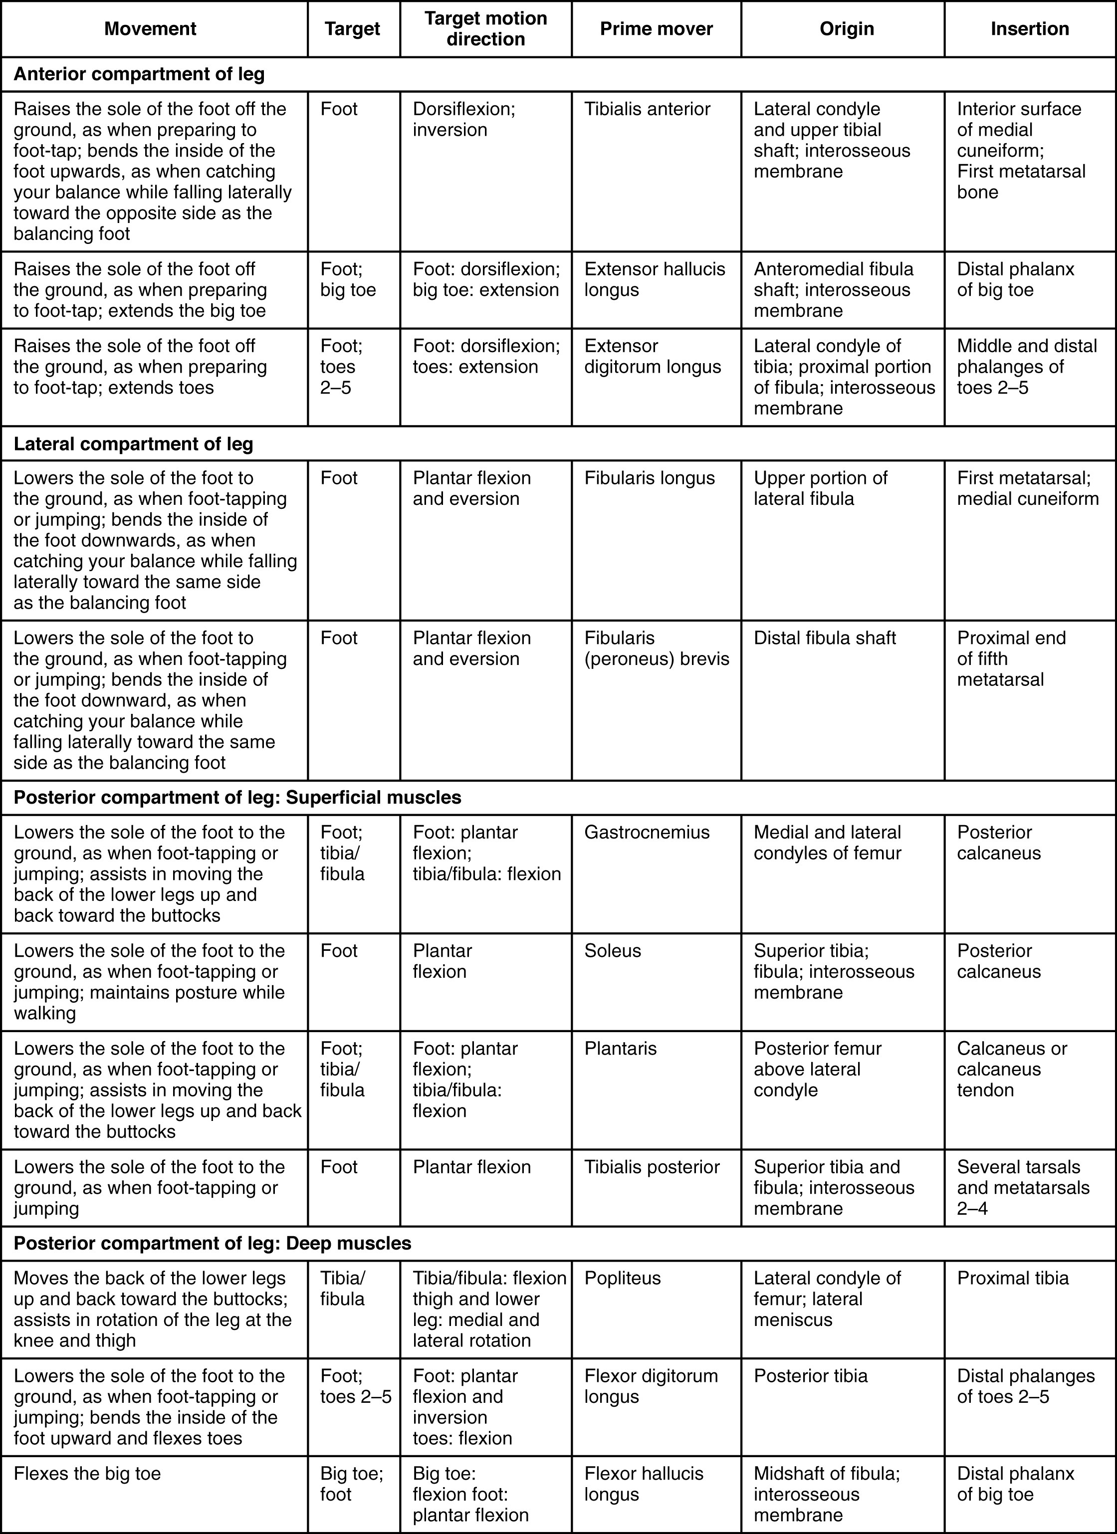
SECTION 11.6
Leg Muscles — Reference Table
Group by compartment: anterior, lateral, posterior
Match each muscle to its foot movement
Note tendons crossing the ankle
Compartment syndrome awareness
Muscles of the leg: reference table
PN 104 · Ch 11 — The Muscular System
40

Slide 41
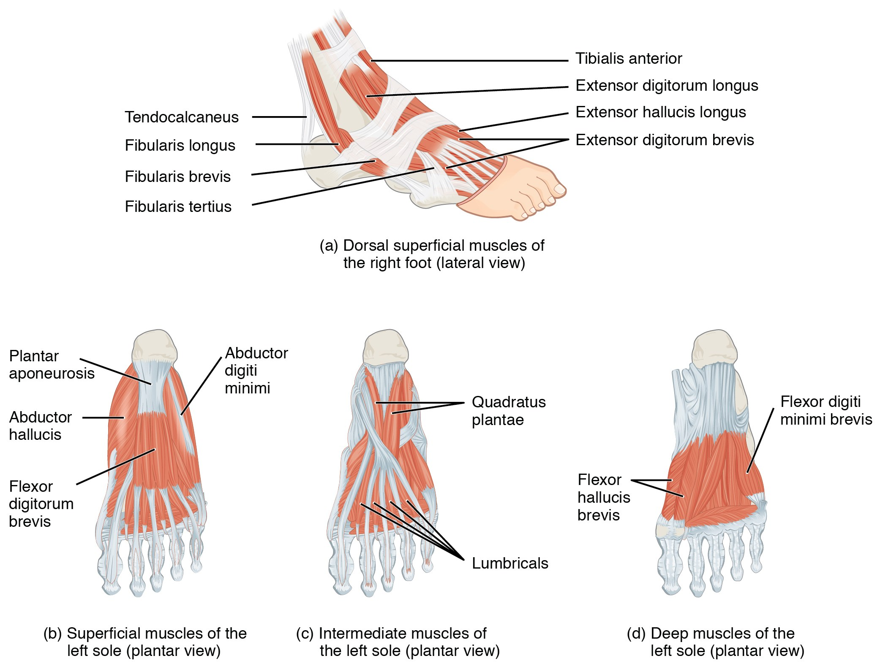
SECTION 11.6
Intrinsic Muscles of the Foot
Support the arches of the foot
Provide balance and fine foot control
Layered plantar muscles cushion body weight
Arch support matters in diabetic foot care
Intrinsic muscles of the foot
PN 104 · Ch 11 — The Muscular System
41

Slide 42
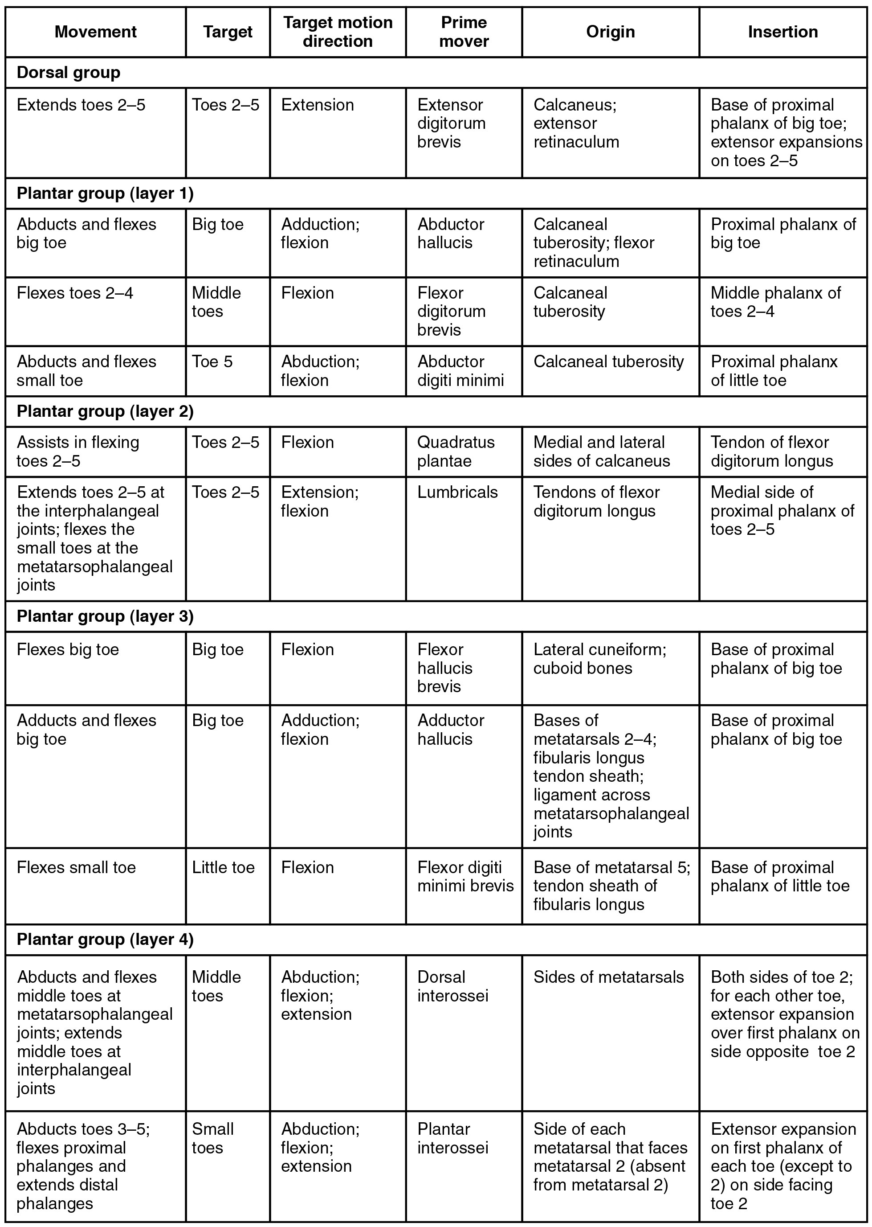
SECTION 11.6
Foot Muscles — Reference Table
Plantar muscles arranged in four layers
Work with intrinsic and extrinsic tendons
Maintain the arches and move the toes
Reference for foot assessment
Muscles of the foot: reference table
PN 104 · Ch 11 — The Muscular System
42

Slide 43
CHAPTER 11
Key Takeaways
Muscles act in coordinated groups — agonist, antagonist, synergist, and fixator.
Fascicle arrangement sets the trade-off between force and range of motion.
Muscle names encode location, shape, size, direction, action, and attachments.
Axial muscles support the head, neck, trunk, breathing, and continence.
Appendicular muscles move the limbs and underlie gait, grasp, and balance.
PN 104 · Ch 11 — The Muscular System
43

Slide 44
CLINICAL CONNECTIONS
Why the Muscular System Matters in Practical Nursing
Breathing
Mobility & Transfers
Diaphragm (C3–C5), intercostals, and accessory muscles drive ventilation — watch for retractions.
Gluteals, quadriceps, and hamstrings power standing and walking — central to fall risk and safe lifting.
Swallowing
Continence
Tongue, suprahyoid, and pharyngeal muscles protect the airway — basis for aspiration precautions.
The pelvic floor (levator ani) supports organs and controls elimination — weakness causes incontinence.
Cranial Nerves
Body Mechanics
Link muscle groups to CN V (chewing), VII (face), XII (tongue), and XI (SCM/trapezius).
Erector spinae and core muscles protect the back — reinforce lifting technique with every patient.

