Slide 1
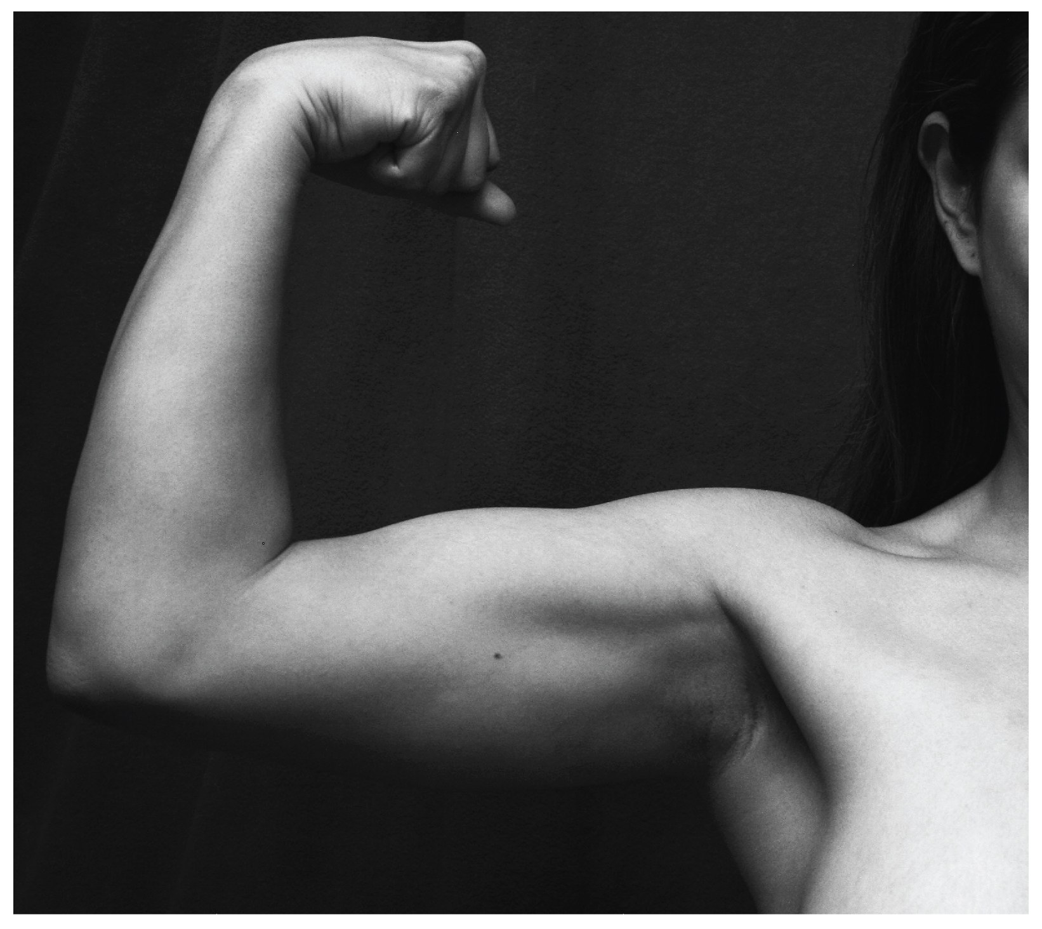
CHAPTER 11
The Muscular System
Gross anatomy of skeletal muscle — interactions, naming, and the
axial and appendicular muscles of the body.
Anatomy & Physiology · Broward-Miami Health Institute
FACULTY EDITION

Slide 2
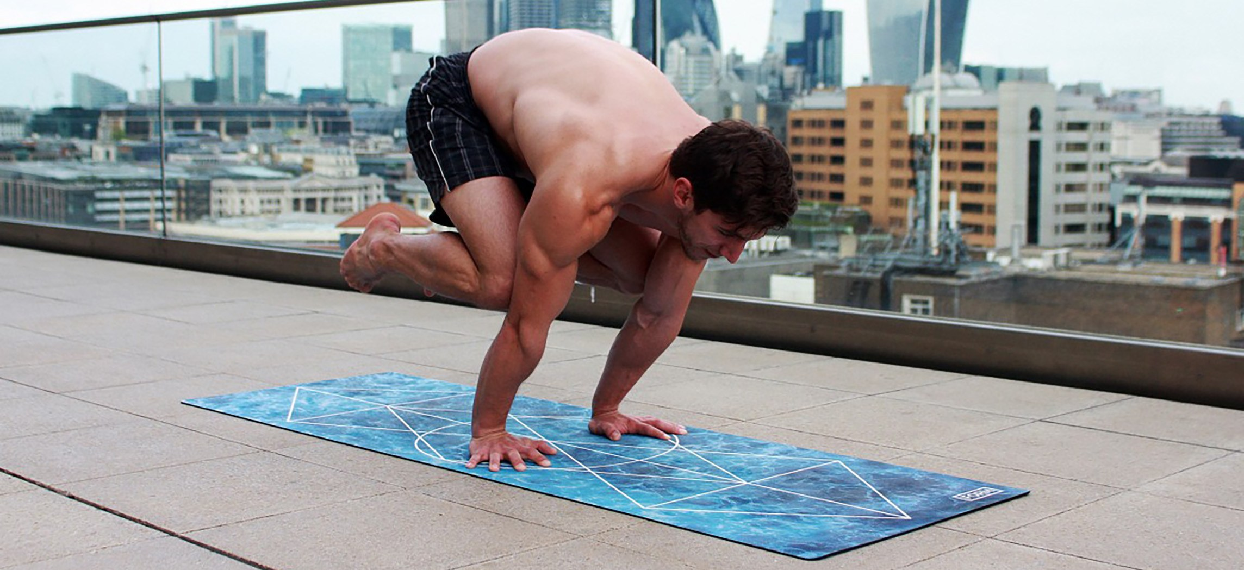
CHAPTER 11
Learning Objectives
After studying this chapter, students will be able to:
1
Describe the actions and roles of agonists and antagonists
2
Explain the structure of muscle fascicles and their role in generating force
3
Explain the criteria used to name skeletal muscles
4
Identify the major skeletal muscles and their actions on the body
Movement is the product of muscle, bone, and nervous control working together.
5
Identify the origins and insertions of muscles and the prime movers
PN 104 · Ch 11 — The Muscular System
2
Notes:
Frame the chapter: muscles are organs of movement, posture, and protection. Preview the two big organizing ideas — how muscles interact to produce coordinated movement, and how the body's named muscles are grouped into axial (head, neck, trunk) and appendicular (limb) regions. Connect to practical nursing throughout: mobility, breathing, swallowing, and continence all depend on this content.

Slide 3
11.1
SECTION
Interactions of Skeletal Muscles, Fascicle Arrangement & Lever Systems
How muscles work in groups, how fascicle geometry shapes force, and how bones act as levers.

Slide 4
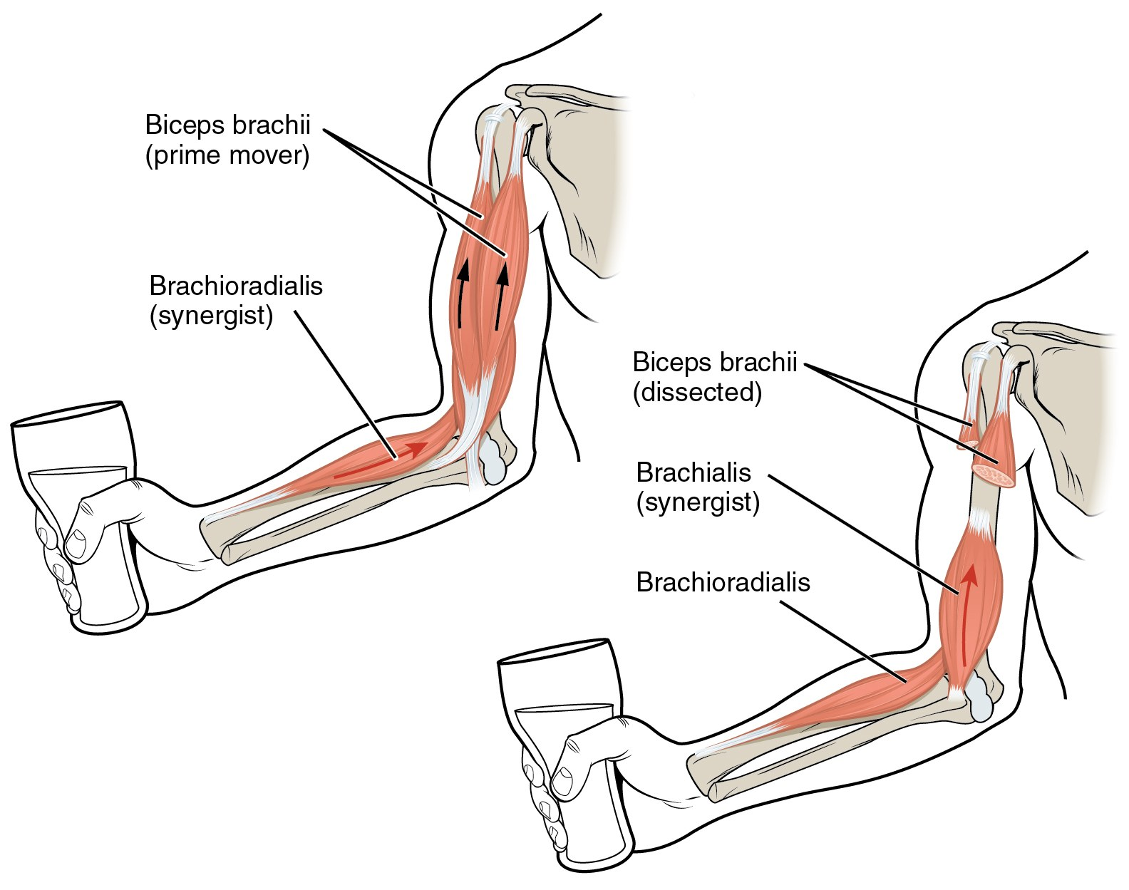
SECTION 11.1
Agonists, Antagonists & Synergists
Prime mover (agonist) produces the main movement
Antagonist opposes and controls the motion
Synergists assist; fixators stabilize the origin
Example: biceps flexes, triceps extends the elbow
Biceps brachii acting as a prime mover with synergists
PN 104 · Ch 11 — The Muscular System
4
Notes:
Stress that muscles work in functional groups, never alone. The agonist shortens to create movement while the antagonist lengthens under control to smooth and brake the motion. Synergists add force or neutralize unwanted movement; fixators hold the origin steady. Tie to patient mobility — weakness or spasticity in one group disrupts the whole pairing.

Slide 5
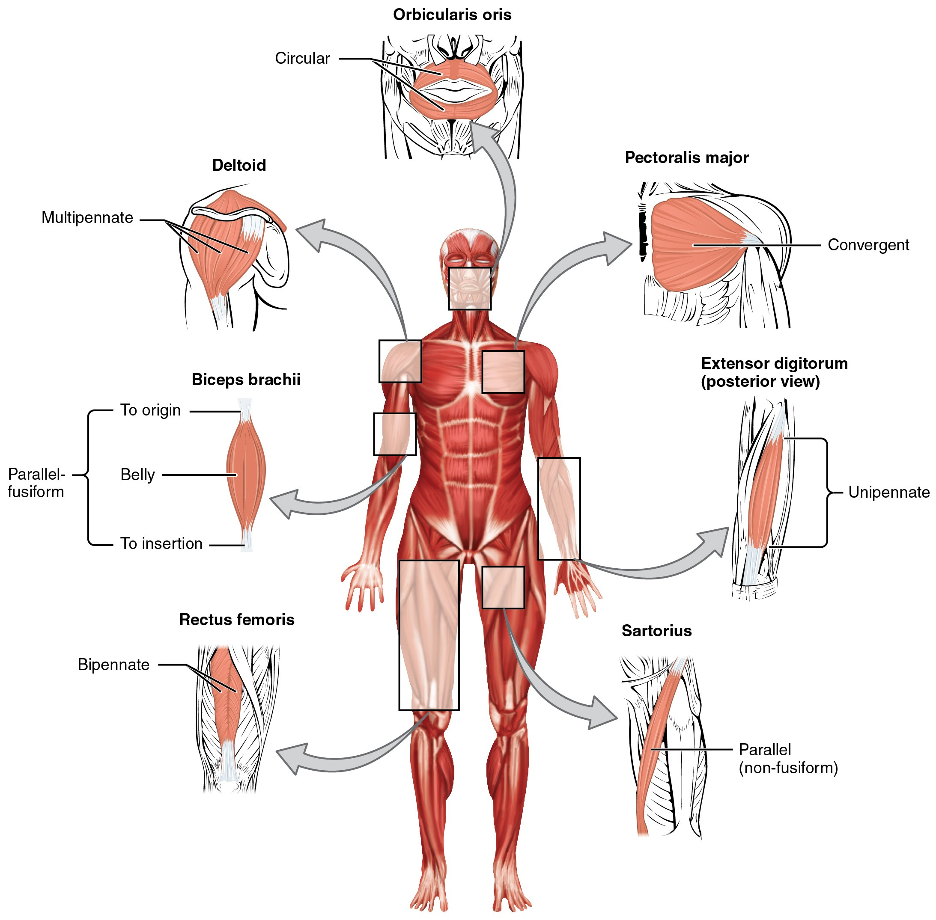
SECTION 11.1
Fascicle Arrangement & Muscle Shapes
Fascicle pattern sets the force–range trade-off
Parallel, fusiform, convergent, circular, pennate
Pennate muscles pack more fibers → greater force
Circular muscles (sphincters) close body openings
Patterns of fascicle organization seen throughout the body
PN 104 · Ch 11 — The Muscular System
5
Notes:
The geometry of fascicles is a trade-off: parallel and fusiform muscles give greater range and speed; pennate arrangements pack more fibers per area for greater force but shorter range. Circular sphincters control openings (orbicularis oris, anal sphincter). Convergent muscles such as pectoralis major allow a versatile pull from several directions.

Slide 6
SECTION 11.1
Lever Systems & Muscle Action
Bones are levers; joints are fulcrums; muscle is effort
First-, second-, and third-class levers occur in the body
Most body levers are third-class (favor speed/range)
Leverage lets a small effort move a larger load
Muscle generates movement by pulling on bony levers
PN 104 · Ch 11 — The Muscular System
6
Notes:
Connect levers to everyday patient movement. A lever is a rigid bar (bone) moving around a fulcrum (joint); muscle supplies the effort against a load. Third-class levers — most common, e.g., the biceps at the elbow — favor speed and range of motion over mechanical advantage. This is why we cue patients to use large, mechanically efficient muscle groups during transfers.

Slide 7
11.2
SECTION
Naming Skeletal Muscles
Muscle names are descriptive codes — decode them to predict location and action.

Slide 8
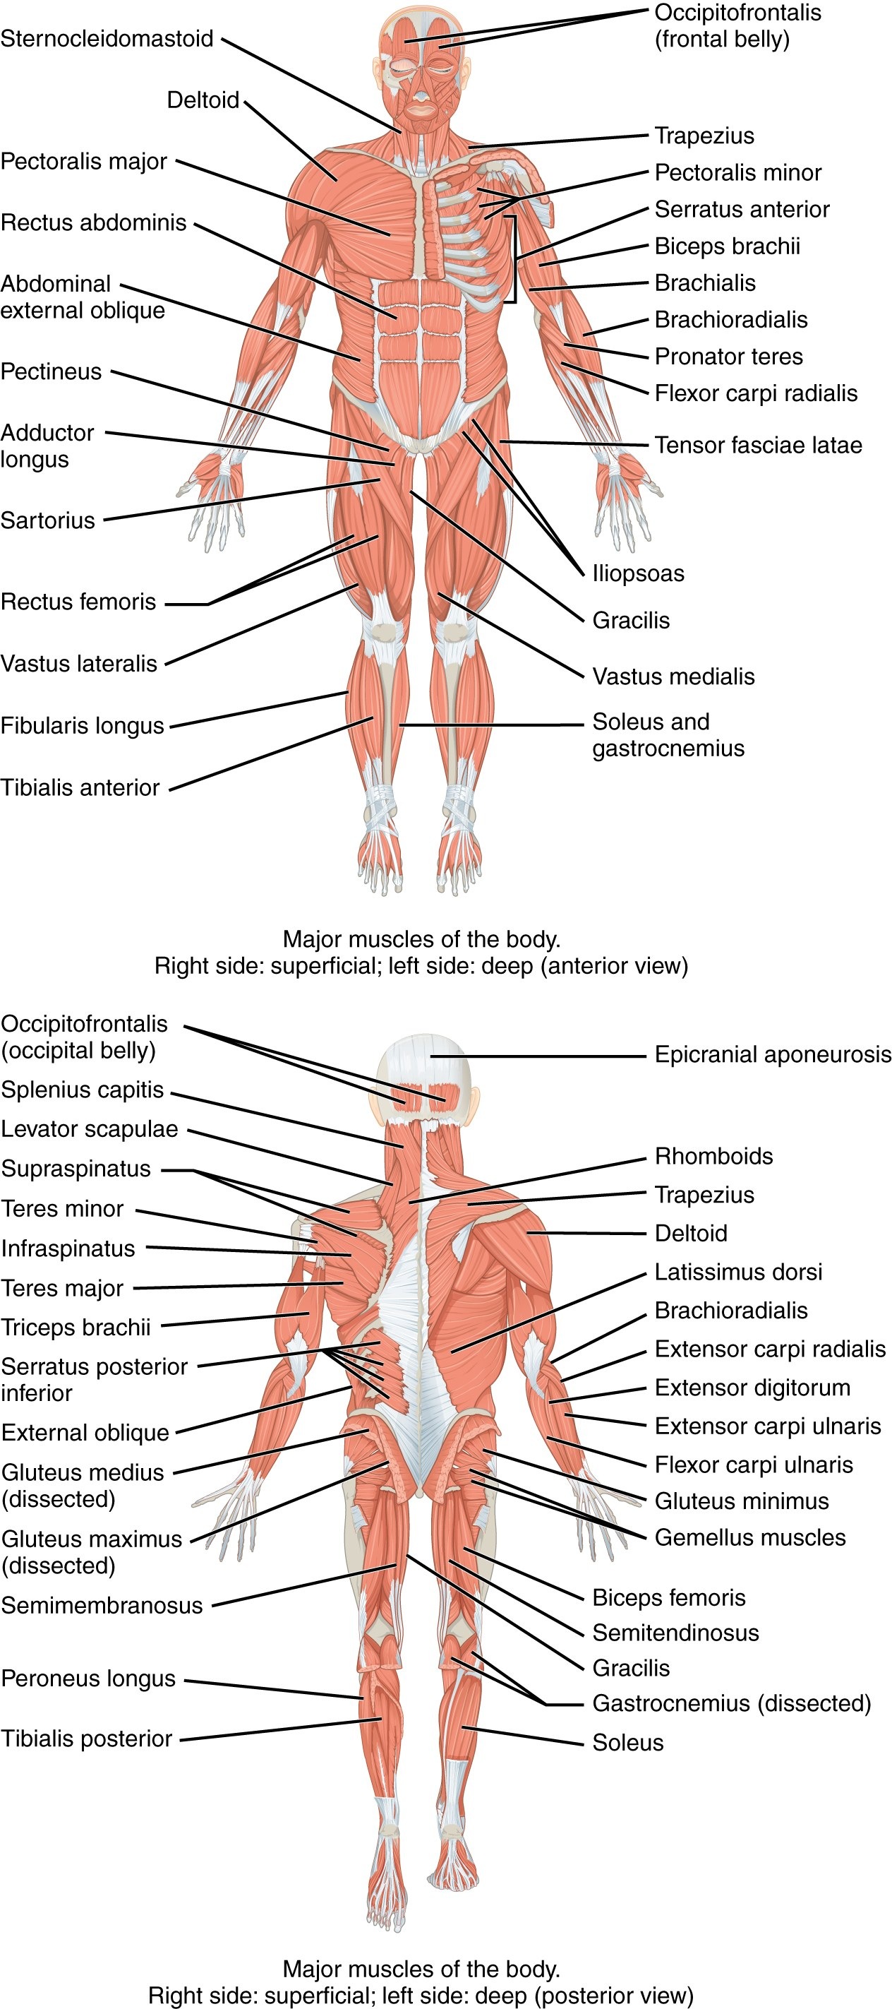
SECTION 11.2
How Skeletal Muscles Are Named
Named by location, shape, size, and fiber direction
Also by number of origins and by origin/insertion
Named by action: flexor, extensor, adductor
Decoding the name predicts what the muscle does
Major skeletal muscles, anterior and posterior views
PN 104 · Ch 11 — The Muscular System
8
Notes:
Teach naming as a decoding skill rather than rote memorization. Each criterion is a clue: size (maximus/minimus), shape (deltoid, trapezius), direction (rectus, transversus, oblique), location (tibialis anterior), action (flexor, extensor), and attachments (sternocleidomastoid). Once students recognize the roots, hundreds of muscle names become predictable.

Slide 9
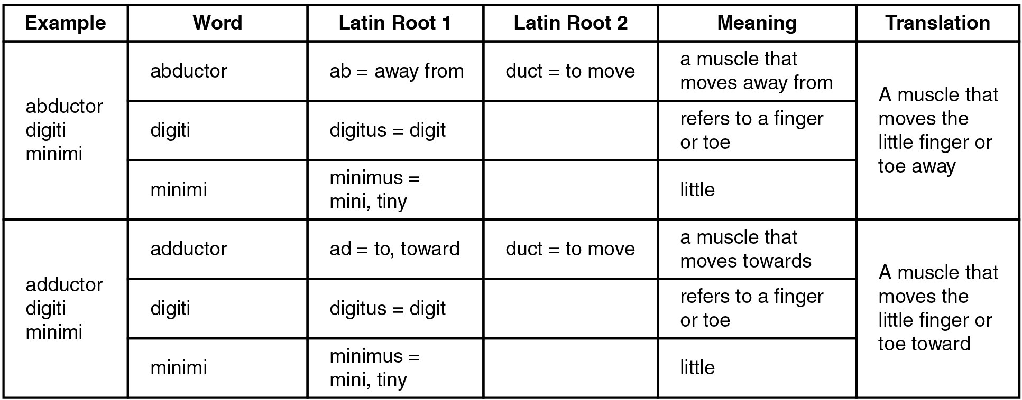
SECTION 11.2
Naming Criteria — Worked Examples
Break each name into root + meaning
"Abductor digiti minimi" → moves the little finger
Build a personal glossary of recurring roots
Use the name to predict location and action
Reference: word roots used in muscle names
PN 104 · Ch 11 — The Muscular System
9
Notes:
Work through two or three examples live. Have students translate a name aloud before you reveal the answer. This table is handout-worthy — encourage students to keep it nearby while learning the regional muscles in 11.3 through 11.6.

Slide 10
11.3
SECTION
Axial Muscles of the Head, Neck & Back
Facial expression, mastication, eye and tongue movement, neck support, and spinal posture.

Slide 11
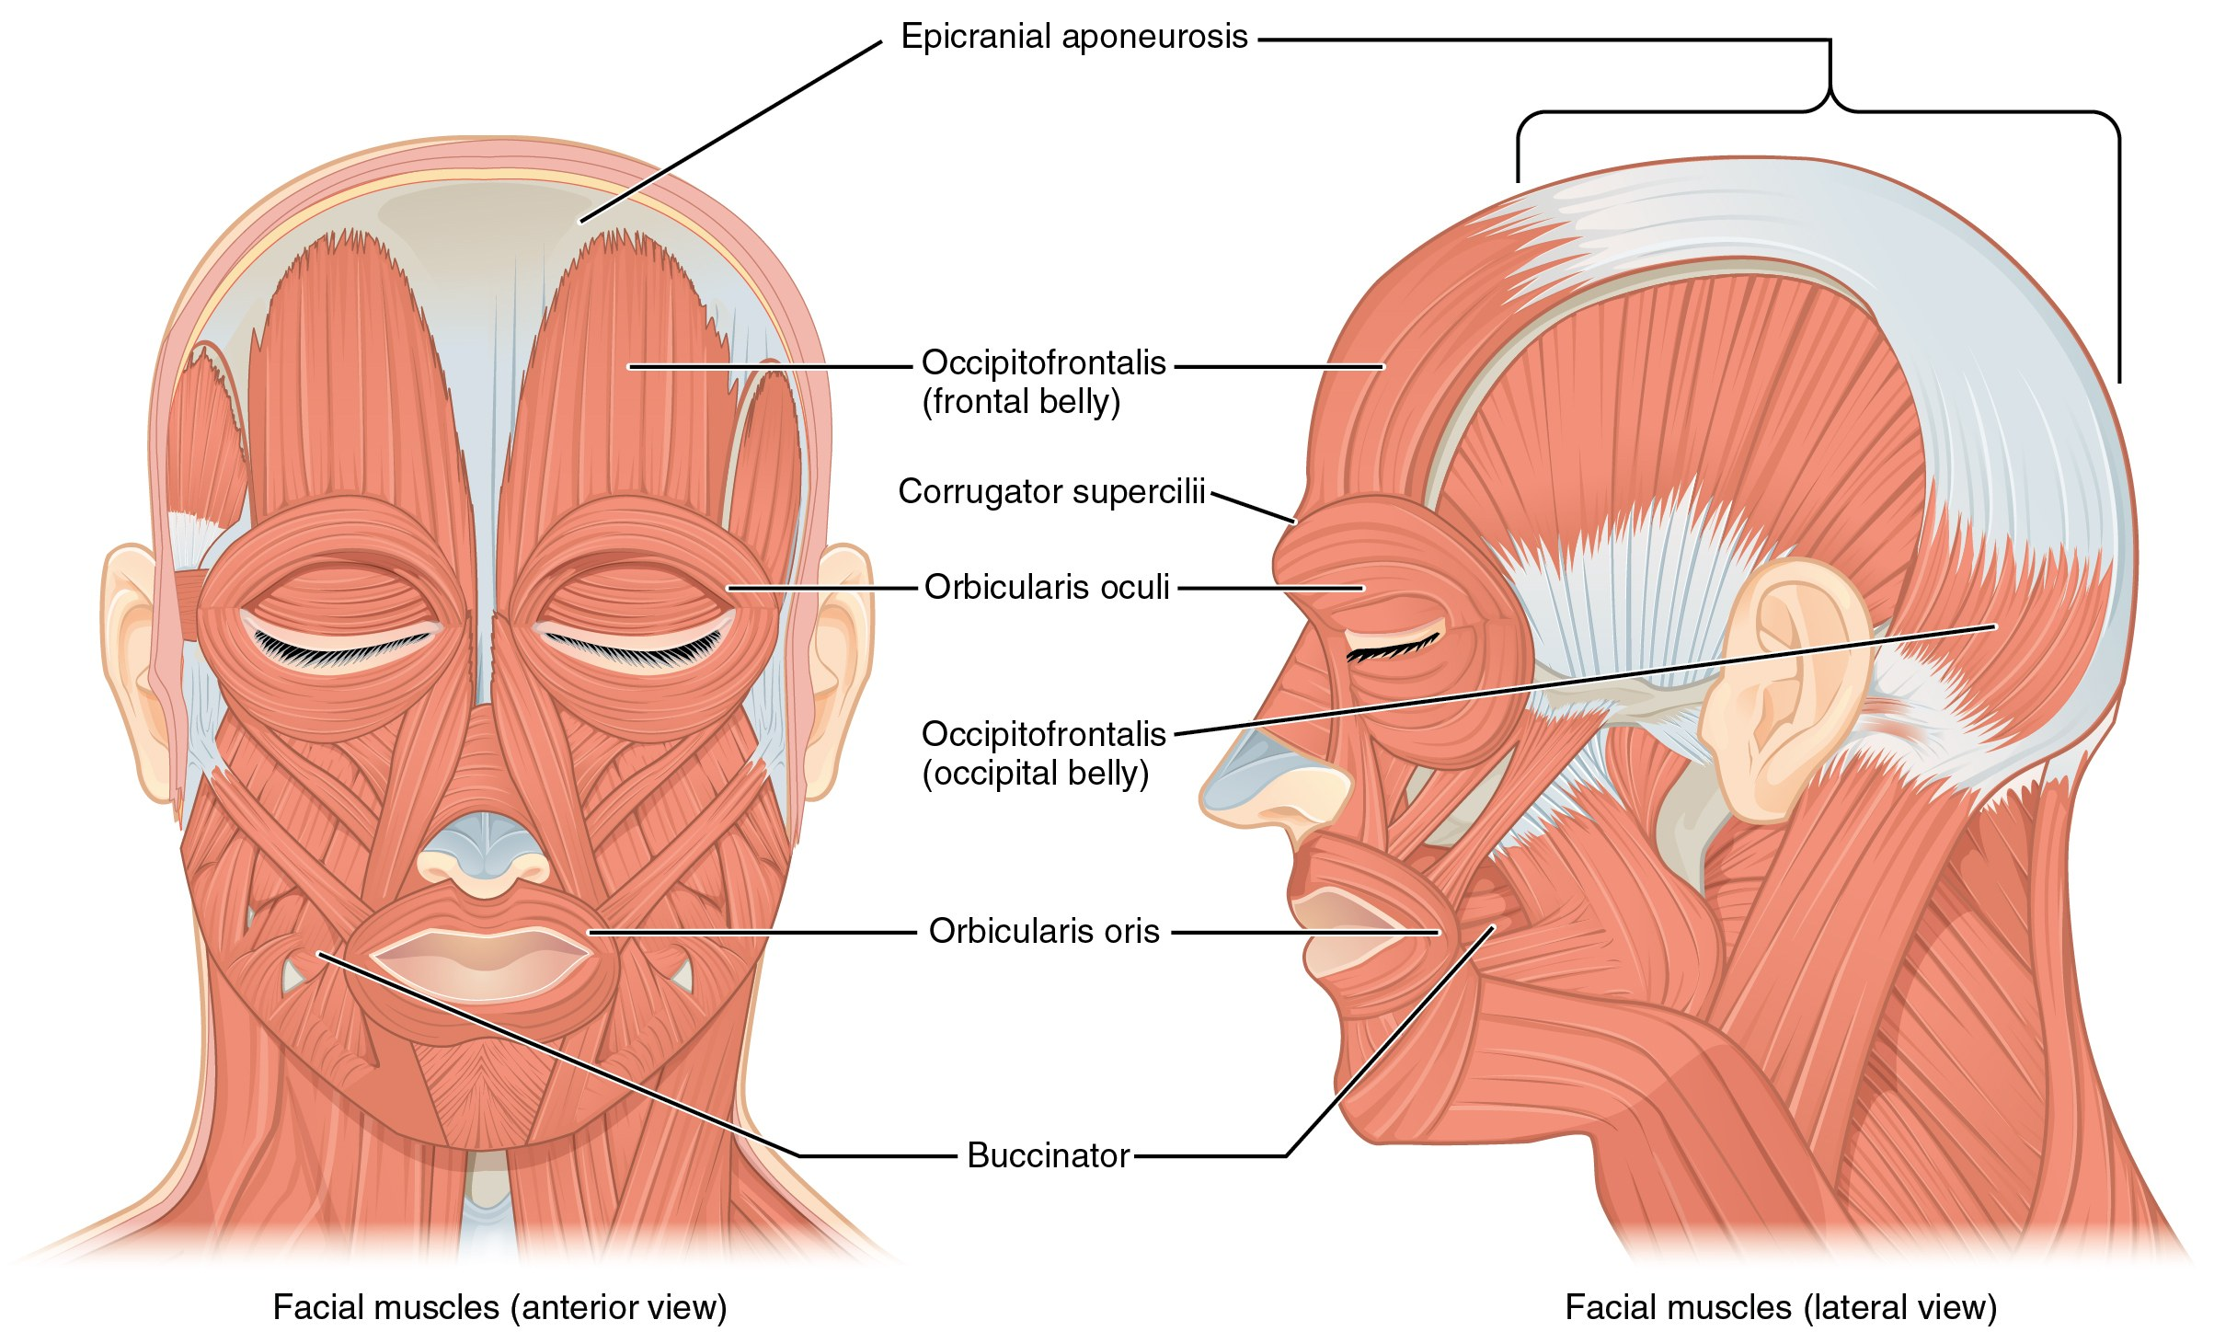
SECTION 11.3
Muscles of Facial Expression
Facial muscles, anterior and lateral views
Insert into skin, not bone → move soft tissue
All innervated by the facial nerve (CN VII)
Orbicularis oris/oculi, zygomaticus, buccinator
Clinical: CN VII palsy causes facial drooping
PN 104 · Ch 11 — The Muscular System
11
Notes:
Facial expression muscles are unique: they insert into skin and other muscles, so contraction moves the face rather than a joint. All are supplied by CN VII. Connect to assessment — asymmetry, an inability to close one eye, or a drooping mouth signals facial-nerve involvement (Bell's palsy, stroke).

Slide 12
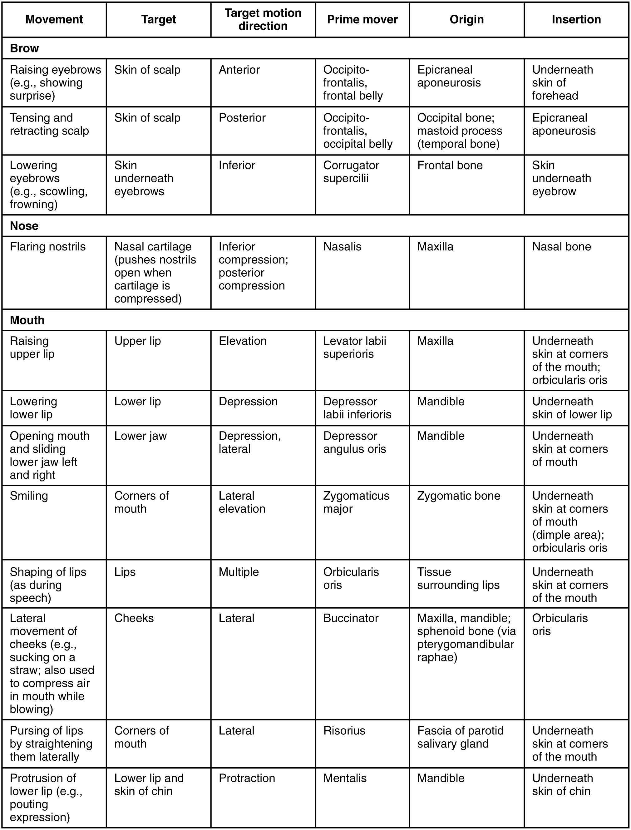
SECTION 11.3
Facial Expression — Reference Table
Group muscles by region: eye, mouth, nose, scalp
Note the shared CN VII innervation
Focus on action verbs: elevate, compress, purse
Pair with the diagram on the previous slide
Muscles of facial expression: action, origin, insertion
PN 104 · Ch 11 — The Muscular System
12
Notes:
Use as a study reference. Encourage students to learn muscles in functional clusters (smiling, frowning, eye closure) rather than alphabetically, and reinforce that they all share one cranial nerve.

Slide 13
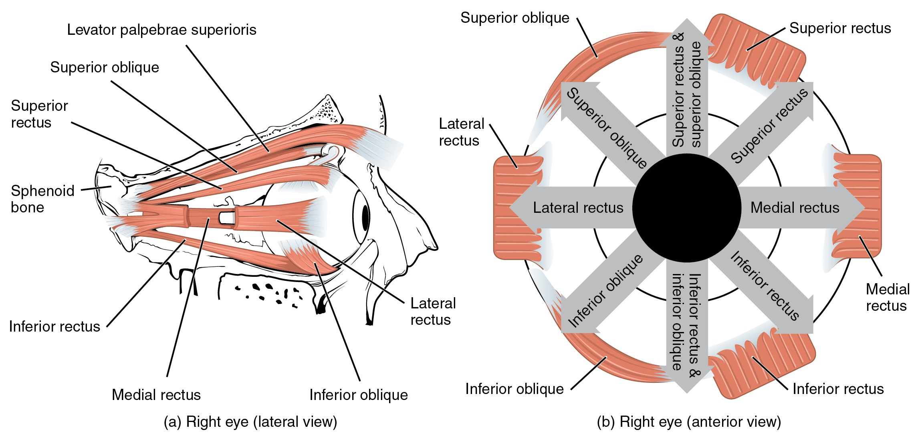
SECTION 11.3
Muscles of the Eye & Mastication
Extraocular muscles and the muscles of mastication
Six extraocular muscles move the eyeball
Mastication: masseter, temporalis, pterygoids
Chewing muscles served by trigeminal nerve (CN V)
Clinical: check jaw strength and symmetry
PN 104 · Ch 11 — The Muscular System
13
Notes:
Two systems here. Extraocular muscles (CN III, IV, VI) move the eye in conjugate gaze; disconjugate movement suggests a cranial-nerve palsy. The muscles of mastication (CN V3) close and grind the jaw — masseter and temporalis are easily palpated when a patient clenches.

Slide 14
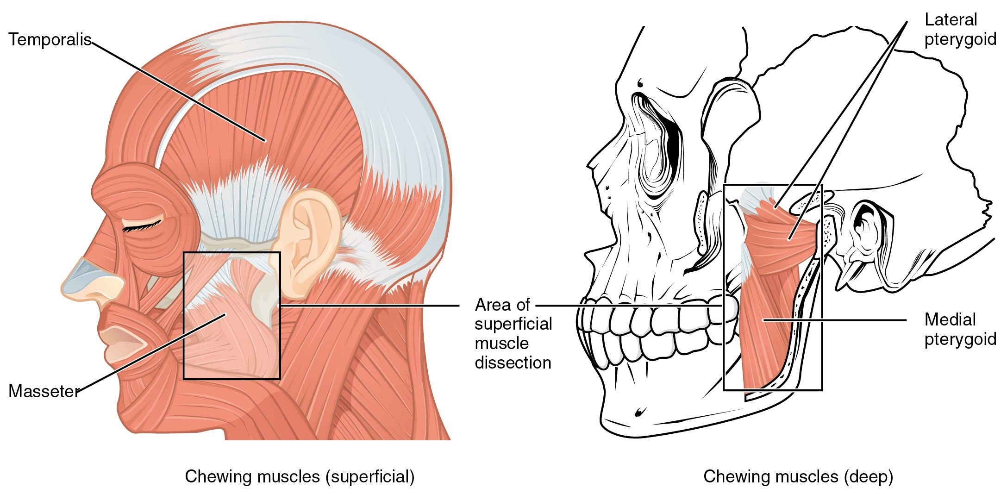
SECTION 11.3
Muscles That Move the Tongue
Muscles of mastication and the tongue
Intrinsic muscles change the tongue's shape
Extrinsic muscles (-glossus) move its position
Innervated by the hypoglossal nerve (CN XII)
Essential for speech, chewing, and swallowing
PN 104 · Ch 11 — The Muscular System
14
Notes:
Tongue movement underlies safe swallowing and clear speech — directly relevant to aspiration risk. Extrinsic muscles share the '-glossus' suffix (genioglossus, styloglossus, hyoglossus). CN XII palsy makes the tongue deviate toward the weak side on protrusion.

Slide 15
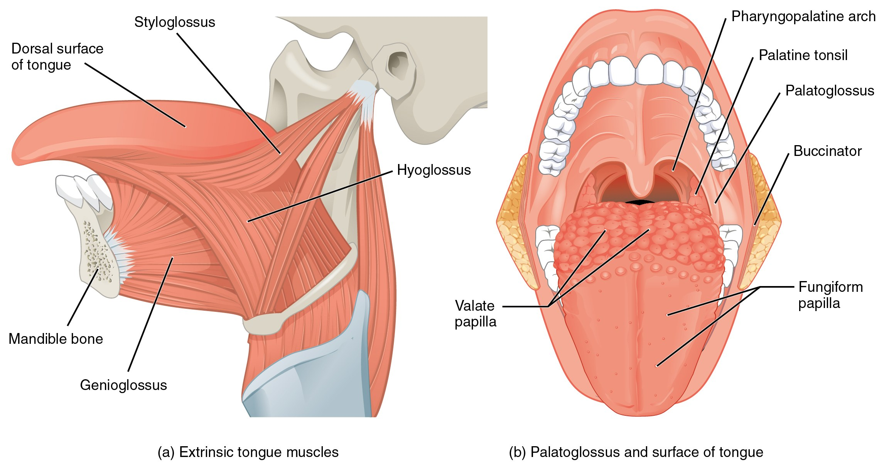
SECTION 11.3
Tongue & Pharyngeal Muscles
Tongue muscles and associated pharyngeal structures
Coordinate the oral phase of swallowing
Move the food bolus toward the pharynx
Work with suprahyoid muscles to elevate the larynx
Dysfunction → dysphagia and aspiration risk
PN 104 · Ch 11 — The Muscular System
15
Notes:
Reinforce the swallowing connection. The tongue propels the bolus while pharyngeal and suprahyoid muscles elevate the larynx and protect the airway. This is the anatomical basis for aspiration precautions and swallow assessments in geriatric and post-stroke care.

Slide 16
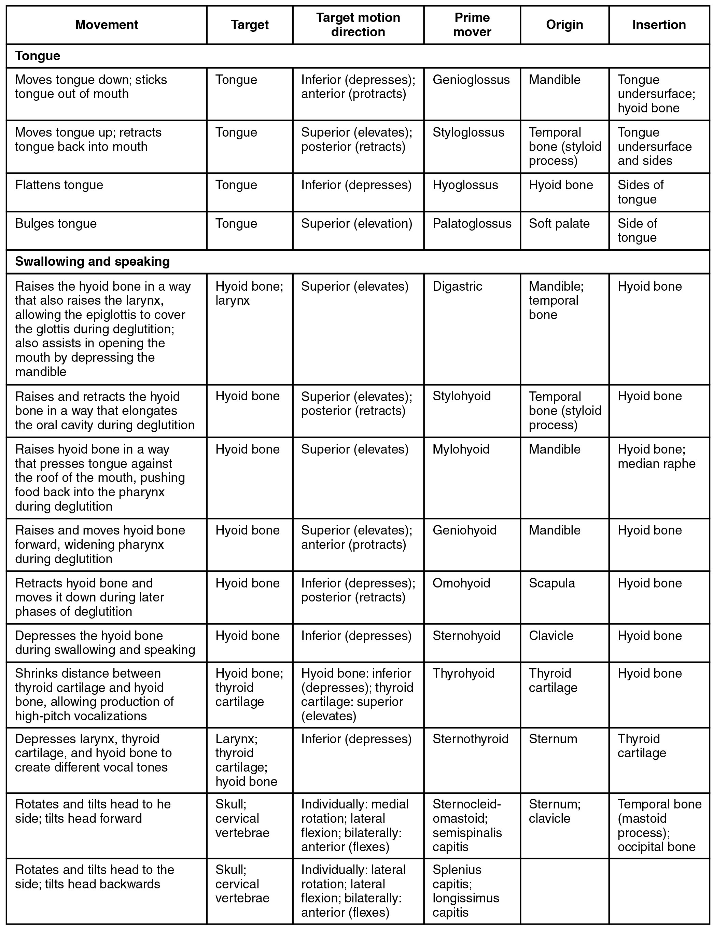
SECTION 11.3
Head & Neck — Reference Table
Consolidates head and neck muscle actions
Cross-reference each muscle's cranial-nerve supply
Identify the prime mover for each motion
Use for targeted review before exams
Muscles of the head and neck: summary table
PN 104 · Ch 11 — The Muscular System
16
Notes:
A consolidation slide — keep it brief in lecture and point students to it for self-study. Emphasize linking each muscle group to its cranial nerve.

Slide 17
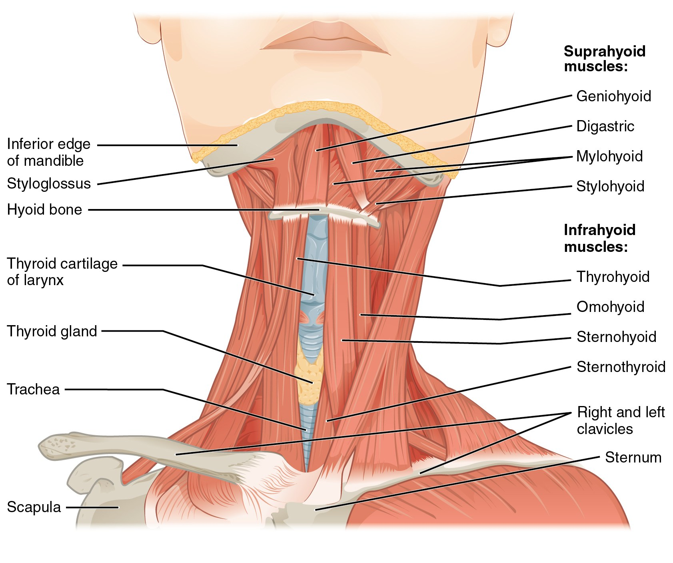
SECTION 11.3
Anterior Neck — Hyoid Muscles
Suprahyoid muscles elevate the hyoid and larynx
Infrahyoid (strap) muscles depress them
Stabilize the hyoid for speech and swallowing
Landmarks for airway and thyroid assessment
Suprahyoid and infrahyoid muscles of the neck
PN 104 · Ch 11 — The Muscular System
17
Notes:
The hyoid is the anchor for swallowing mechanics. Suprahyoids raise the larynx during the pharyngeal phase; infrahyoids return it. These strap muscles also frame the thyroid and trachea — useful surface landmarks for airway and neck assessment.

Slide 18
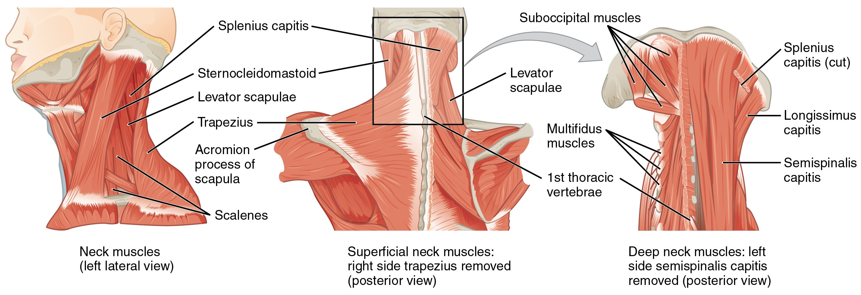
SECTION 11.3
Muscles of the Neck & Back
Sternocleidomastoid flexes and rotates the head
Trapezius and scalenes support posture
Deep muscles stabilize the cervical spine
Scalenes act as accessory respiratory muscles
Posterior and lateral muscles of the neck and back
PN 104 · Ch 11 — The Muscular System
18
Notes:
SCM and trapezius are CN XI (accessory) test muscles — shrug and head-turn against resistance. The scalenes are accessory muscles of respiration, recruited in respiratory distress. Tie the deep neck muscles to posture-related pain.

Slide 19
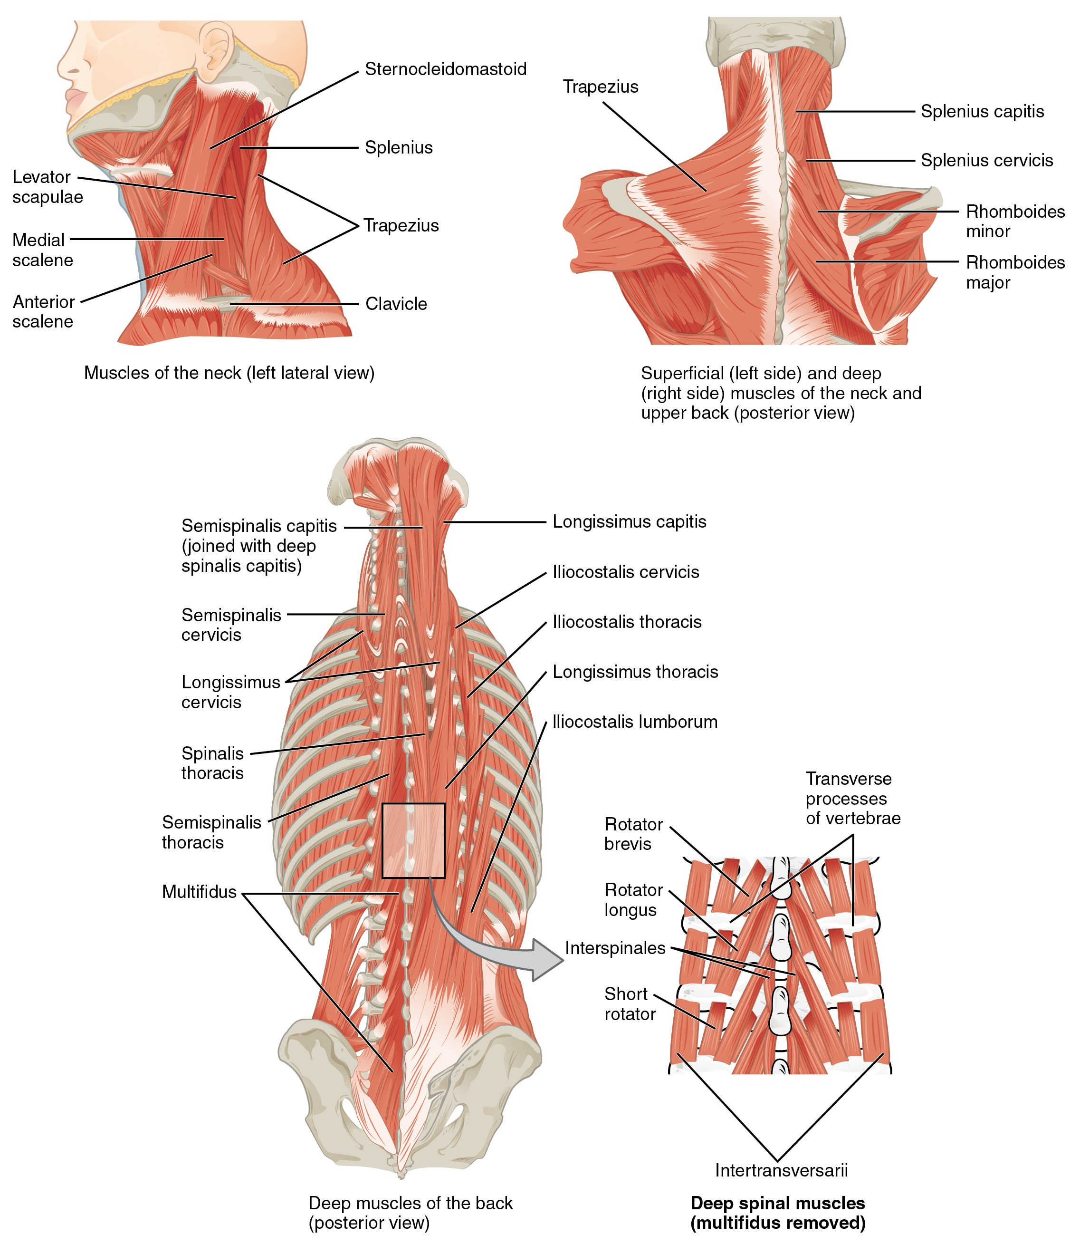
SECTION 11.3
Deep Back — Erector Spinae
Erector spinae = iliocostalis, longissimus, spinalis
Extend and stabilize the vertebral column
Maintain upright posture against gravity
Common source of mechanical low-back strain
Erector spinae group and the deep back muscles
PN 104 · Ch 11 — The Muscular System
19
Notes:
The erector spinae run the length of the spine in three columns and are the primary extensors and postural stabilizers of the trunk. Most mechanical low-back pain involves strain here — reinforce body-mechanics teaching (lift with the legs, keep the load close).

Slide 20
11.4
SECTION
Axial Muscles of the Abdominal Wall & Thorax
The core, the diaphragm and intercostals of breathing, and the pelvic floor.

Slide 21
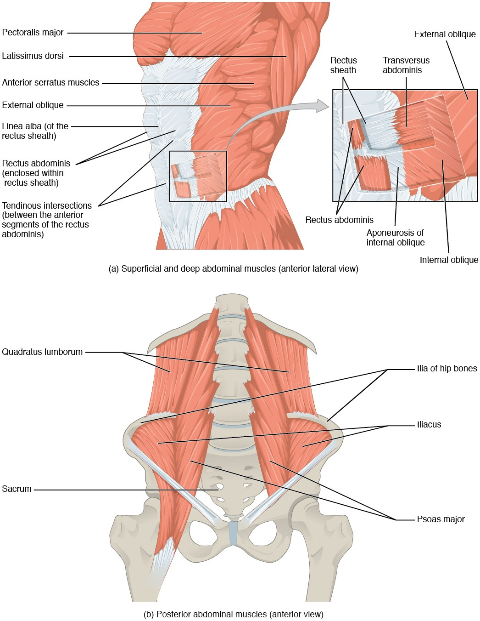
SECTION 11.4
Muscles of the Abdominal Wall
Rectus abdominis flexes the trunk
External/internal obliques bend and rotate
Transversus abdominis compresses the abdomen
Support posture, breathing, and core stability
Layered muscles of the anterior abdominal wall
PN 104 · Ch 11 — The Muscular System
21
Notes:
The abdominal wall is layered for strength and supports core stability plus forced expiration, coughing, defecation, and childbirth via increased intra-abdominal pressure. The crisscross orientation of the obliques and transversus resists herniation. Connect to post-op coughing and splinting teaching.

Slide 22
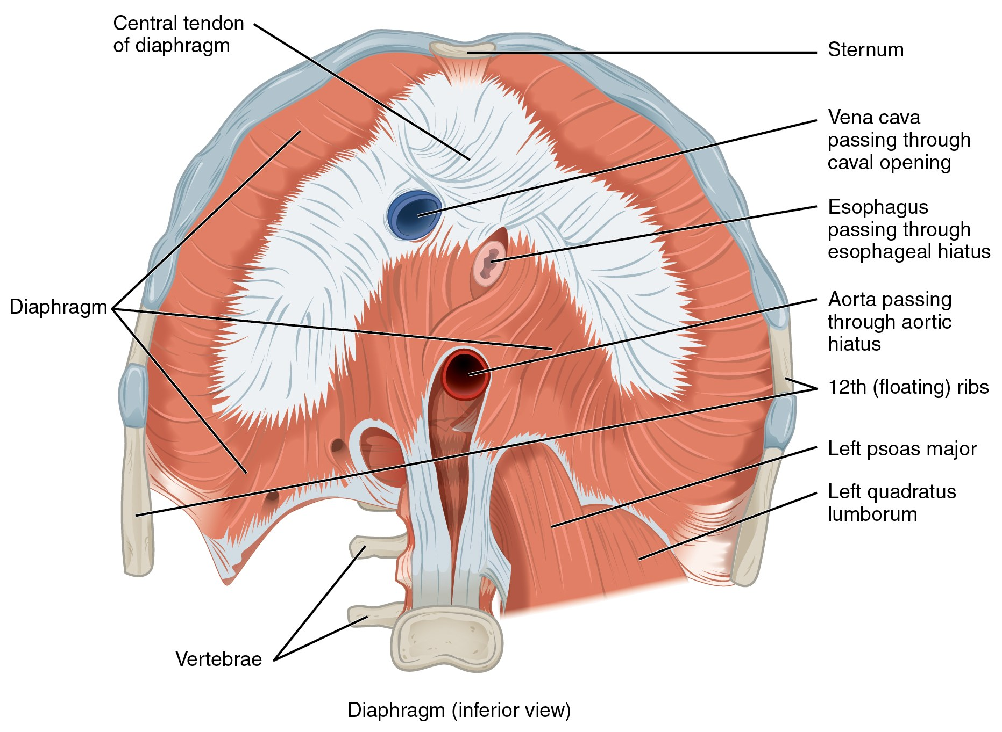
SECTION 11.4
The Diaphragm
Primary muscle of inspiration
Contracts and flattens → thoracic volume rises
Innervated by the phrenic nerve (C3–C5)
"C3, 4, 5 keep the diaphragm alive"
The diaphragm, inferior view
PN 104 · Ch 11 — The Muscular System
22
Notes:
The diaphragm is THE key respiratory muscle. On contraction it descends, enlarging the thorax and drawing air in; relaxation drives passive expiration. Phrenic nerve roots C3–C5 are clinically vital — high cervical injury can stop spontaneous breathing. Point out the openings for the aorta, esophagus, and inferior vena cava.

Slide 23
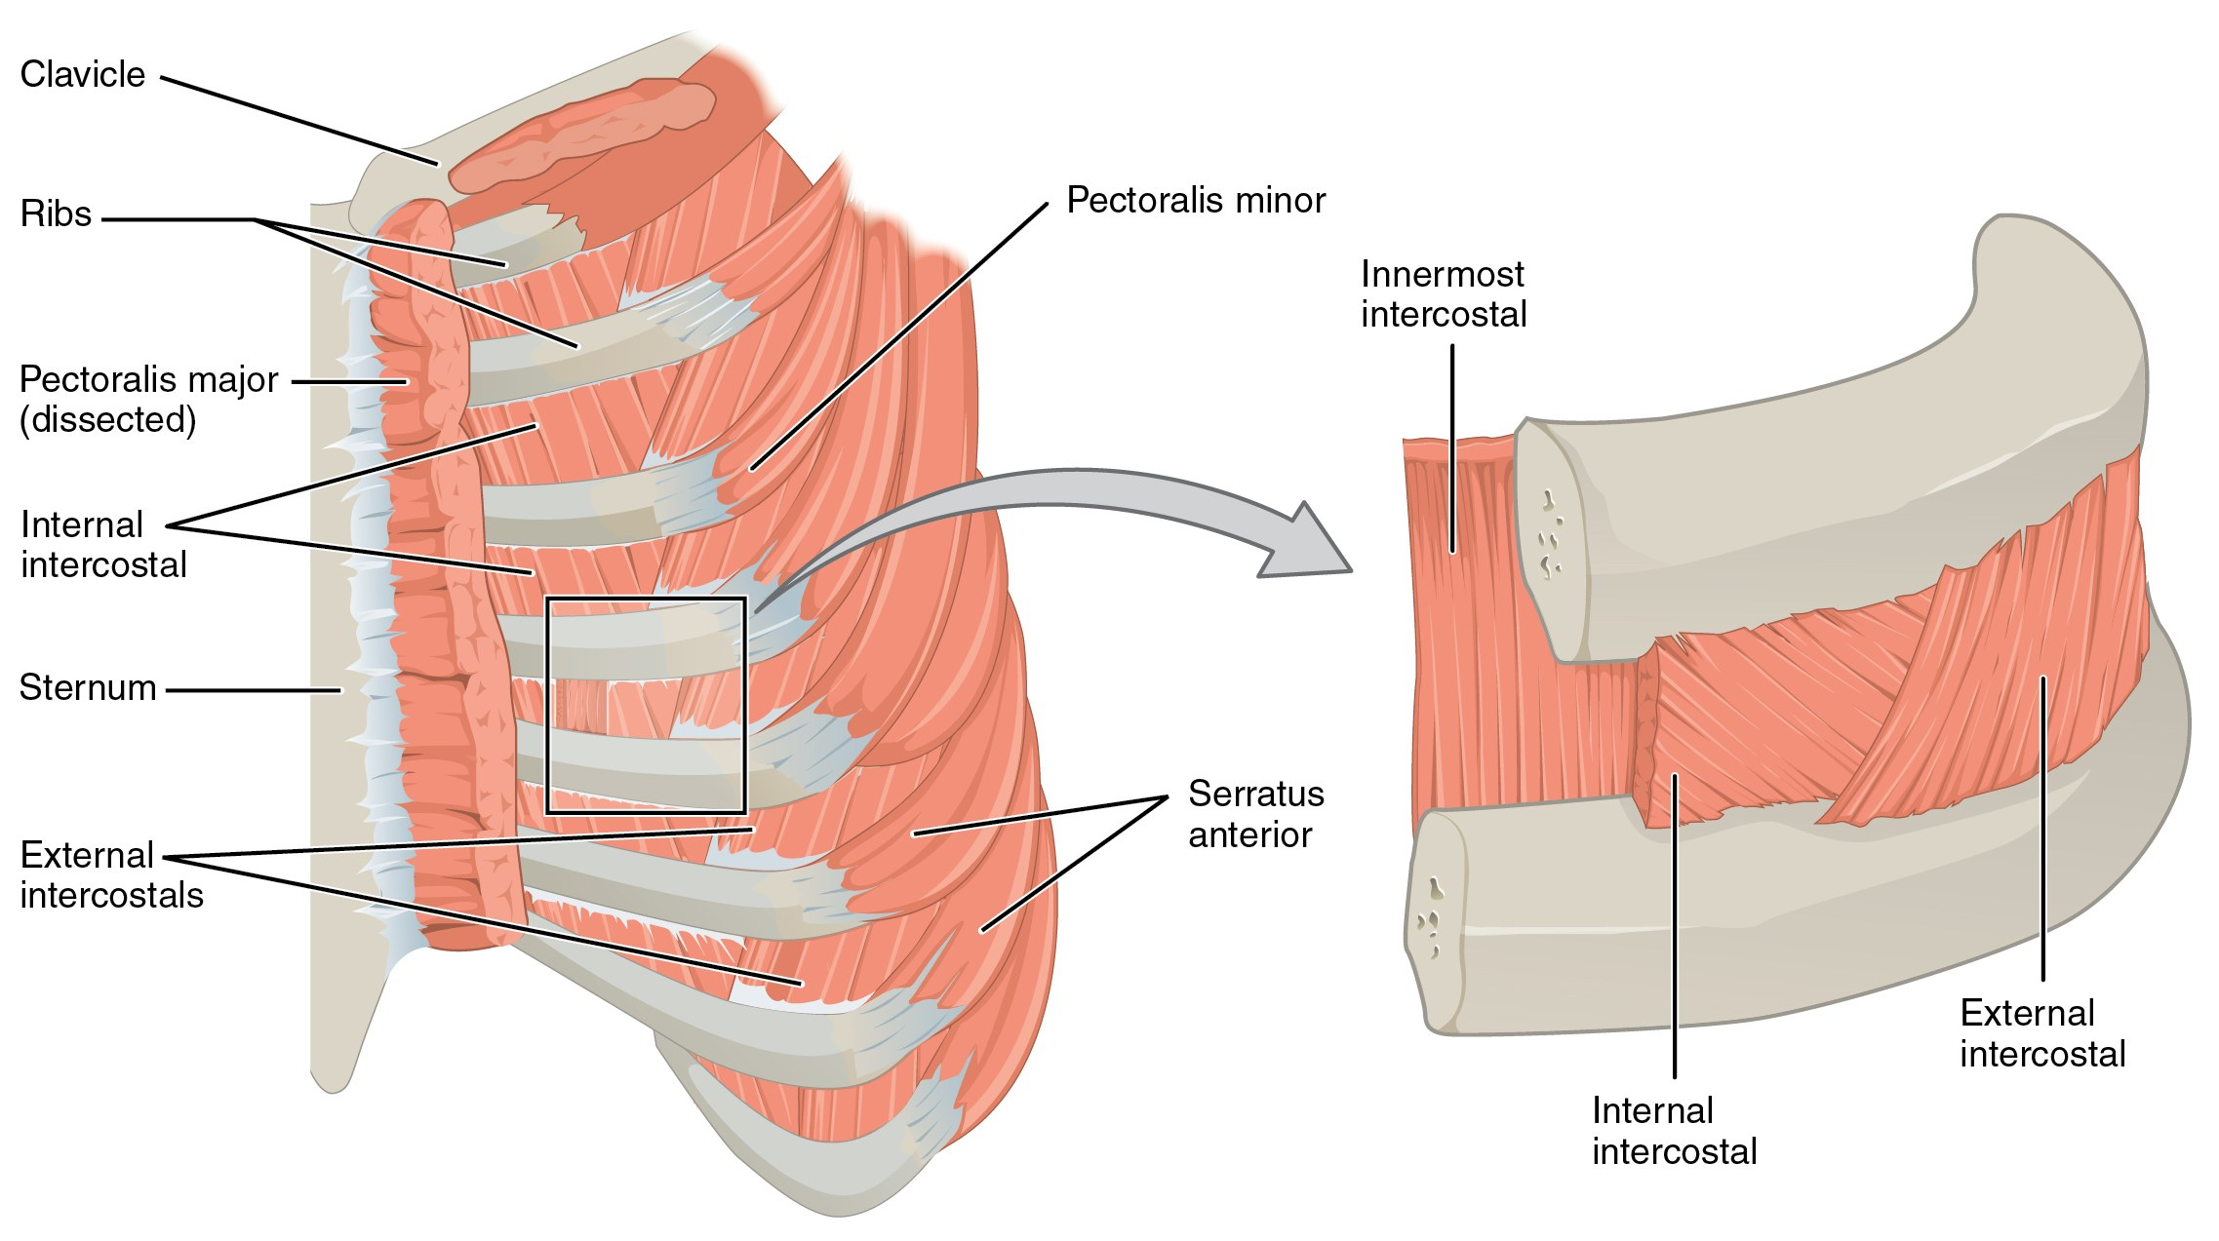
SECTION 11.4
Thoracic Muscles & Intercostals
External intercostals elevate ribs (inspiration)
Internal intercostals depress ribs (forced expiration)
Accessory muscles assist in respiratory distress
Retractions signal increased work of breathing
Intercostal muscles of the thoracic wall
PN 104 · Ch 11 — The Muscular System
23
Notes:
Intercostals fine-tune the rib cage during breathing: external elevate ribs to expand the chest, internal aid forced expiration. When patients labor to breathe, accessory muscles are recruited and you may see intercostal retractions — an important assessment finding.

Slide 24
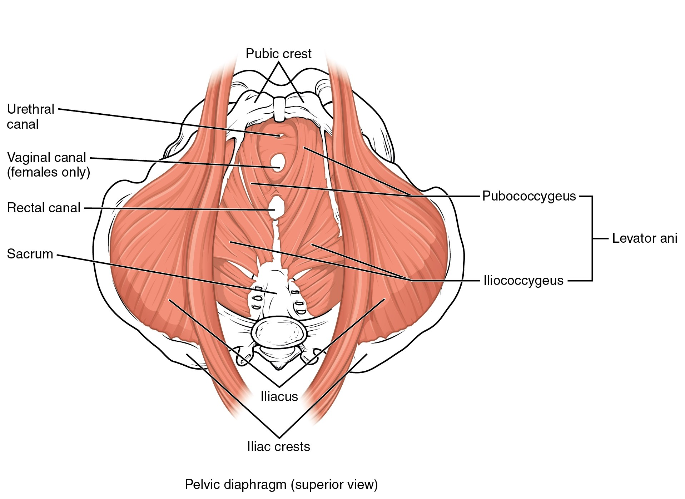
SECTION 11.4
Pelvic Floor & Perineum
Levator ani forms the pelvic diaphragm
Supports the bladder, rectum, and pelvic organs
Maintains continence of urine and stool
Weakness → prolapse and incontinence
Muscles of the pelvic floor (perineum)
PN 104 · Ch 11 — The Muscular System
24
Notes:
The pelvic floor is a muscular hammock supporting the pelvic organs and maintaining continence. Childbirth, aging, and chronic straining weaken it, leading to prolapse and incontinence. This grounds pelvic-floor (Kegel) teaching and post-partum and geriatric care.

Slide 25
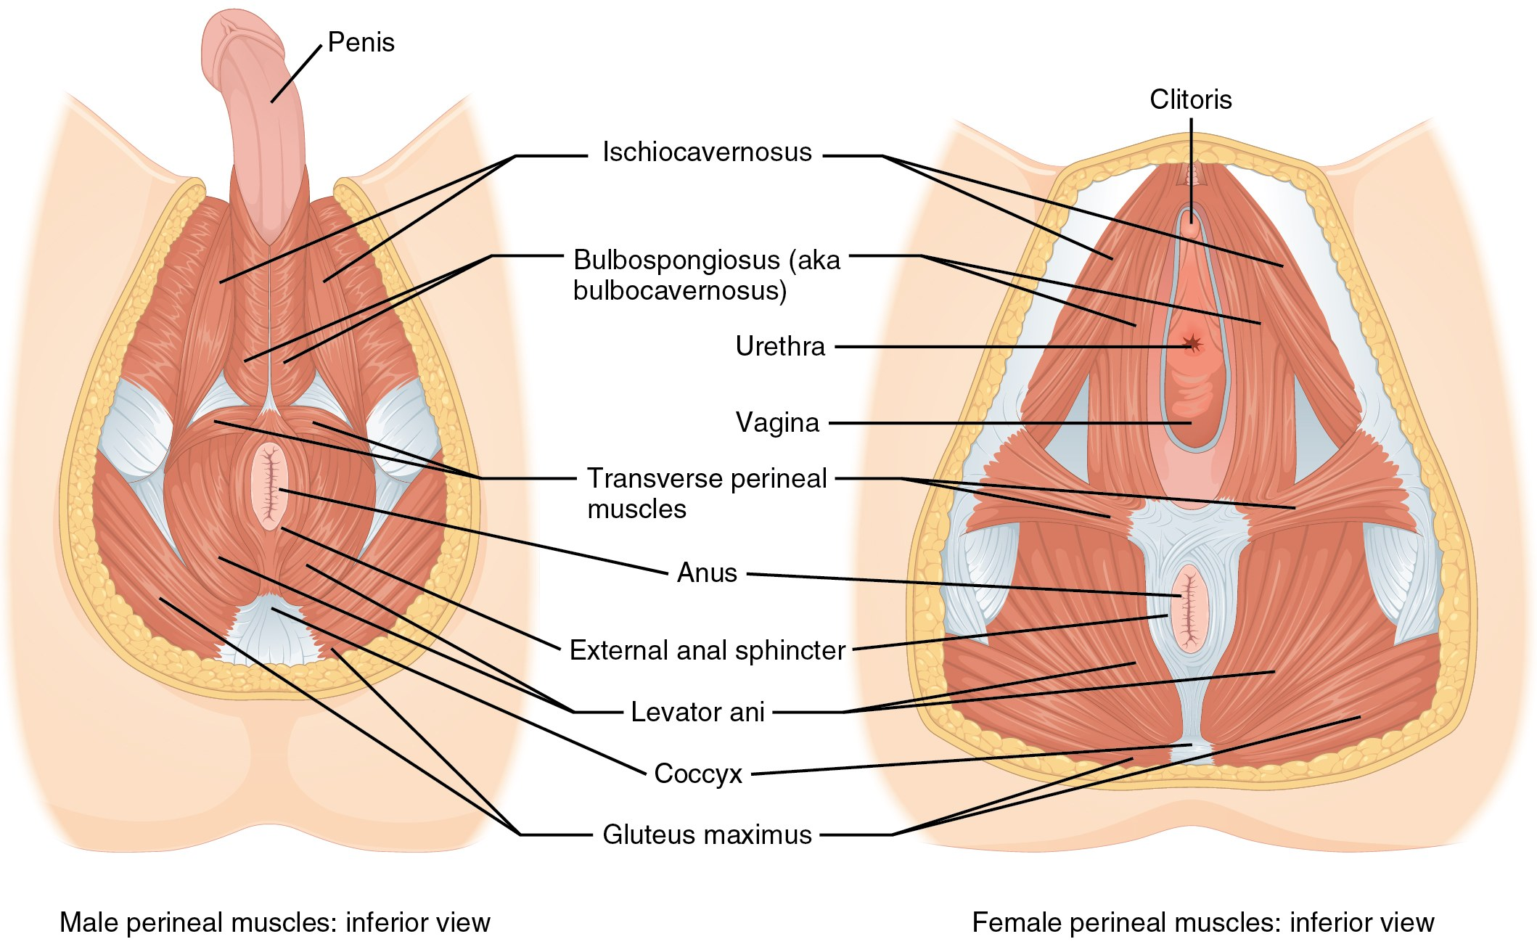
SECTION 11.4
The Pelvic Diaphragm
Pelvic diaphragm, male and female
Levator ani + coccygeus = pelvic diaphragm
Sex differences in the openings it transmits
Resists downward intra-abdominal pressure
Key to bowel, bladder, and sexual function
PN 104 · Ch 11 — The Muscular System
25
Notes:
Compare the male and female pelvic floors — the female floor has the additional vaginal opening, a factor in obstetric injury. The pelvic diaphragm counteracts intra-abdominal pressure spikes (coughing, lifting). Reinforce its role across continence, organ support, and sexual function.

Slide 26
11.5
SECTION
Muscles of the Pectoral Girdle & Upper Limbs
Positioning the scapula, moving the humerus and forearm, and the muscles of the hand.

Slide 27
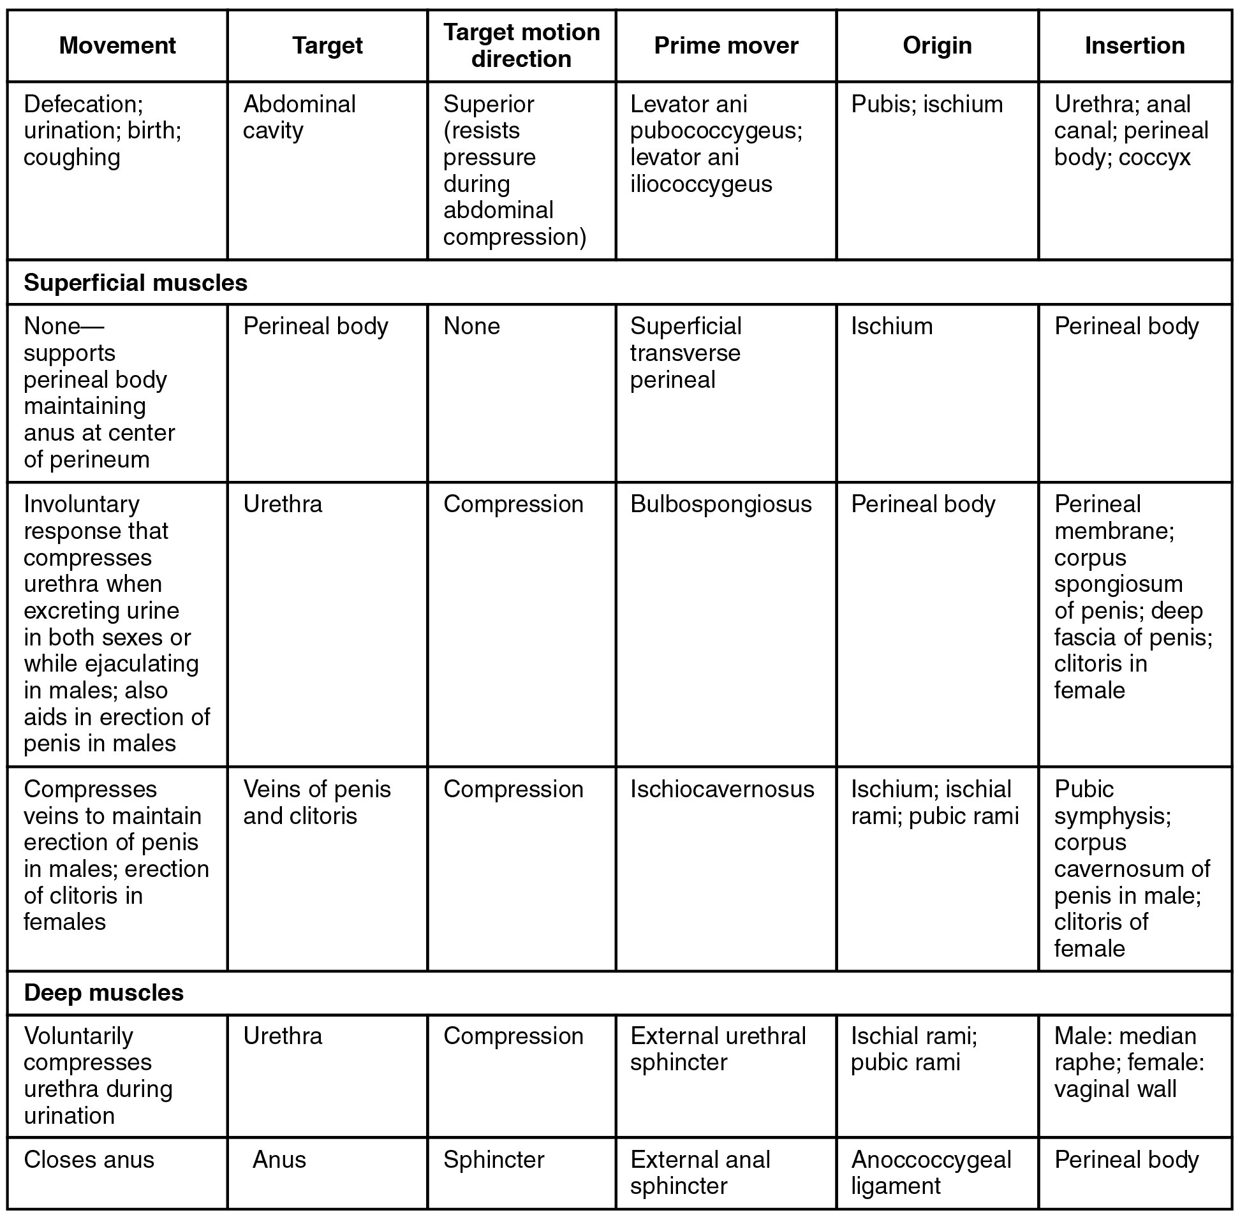
SECTION 11.5
Pectoral Girdle — Reference Table
Anchors the upper limb to the axial skeleton
These muscles position the scapula and clavicle
A stable scapula enables efficient arm movement
Sets up the humerus muscles that follow
Muscles that position the pectoral girdle
PN 104 · Ch 11 — The Muscular System
27
Notes:
Use as orientation to the upper limb. The pectoral girdle is mobile, so its muscles must first stabilize the scapula before the arm can move powerfully. Scapular dyskinesis underlies many shoulder complaints.

Slide 28
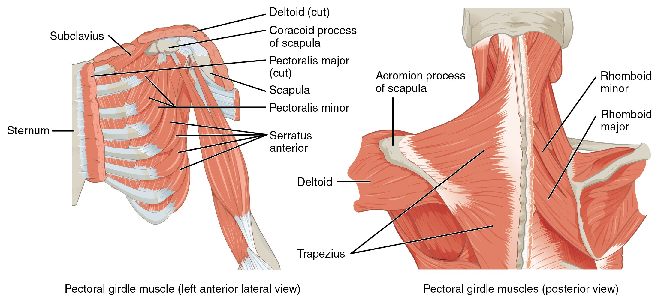
SECTION 11.5
Positioning the Pectoral Girdle
Anterior and posterior muscles of the pectoral girdle
Trapezius and serratus anterior move the scapula
Rhomboids retract; pectoralis minor depresses
Stabilize the shoulder for lifting and reaching
Serratus anterior weakness → "winged scapula"
PN 104 · Ch 11 — The Muscular System
28
Notes:
These muscles glide the scapula across the rib cage. Serratus anterior protracts and holds the scapula flat; its weakness (long thoracic nerve injury) causes a winged scapula. Trapezius and rhomboids retract and elevate. Stable scapular positioning is essential before loading the shoulder.

Slide 29
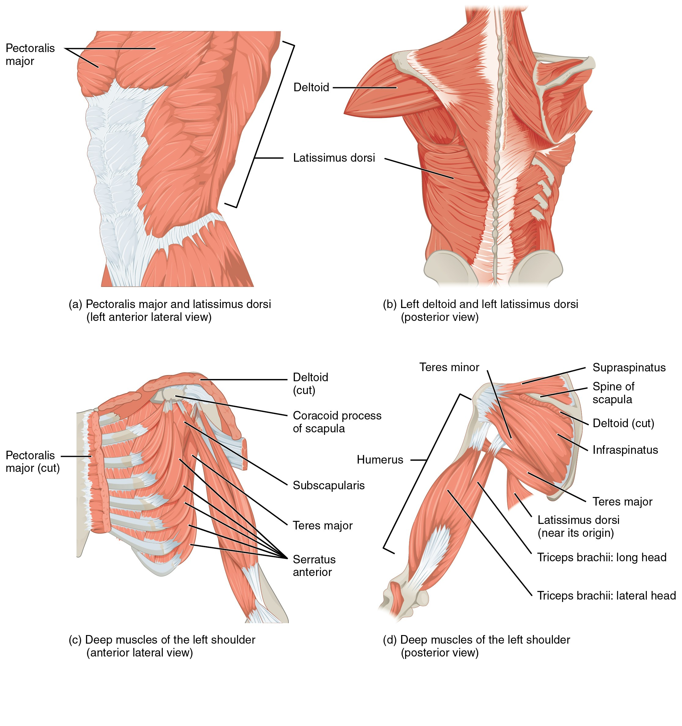
SECTION 11.5
Muscles That Move the Humerus
Deltoid abducts; pectoralis major adducts/flexes
Latissimus dorsi extends and medially rotates
Rotator cuff (SITS) stabilizes the joint
Most mobile — and least stable — joint in the body
Muscles that move the humerus, including the rotator cuff
PN 104 · Ch 11 — The Muscular System
29
Notes:
The shoulder trades stability for mobility. Large prime movers (deltoid, pectoralis major, latissimus dorsi) generate power, while the four rotator cuff muscles — Supraspinatus, Infraspinatus, Teres minor, Subscapularis (SITS) — hold the humeral head in the shallow glenoid. Rotator cuff tears are very common.

Slide 30
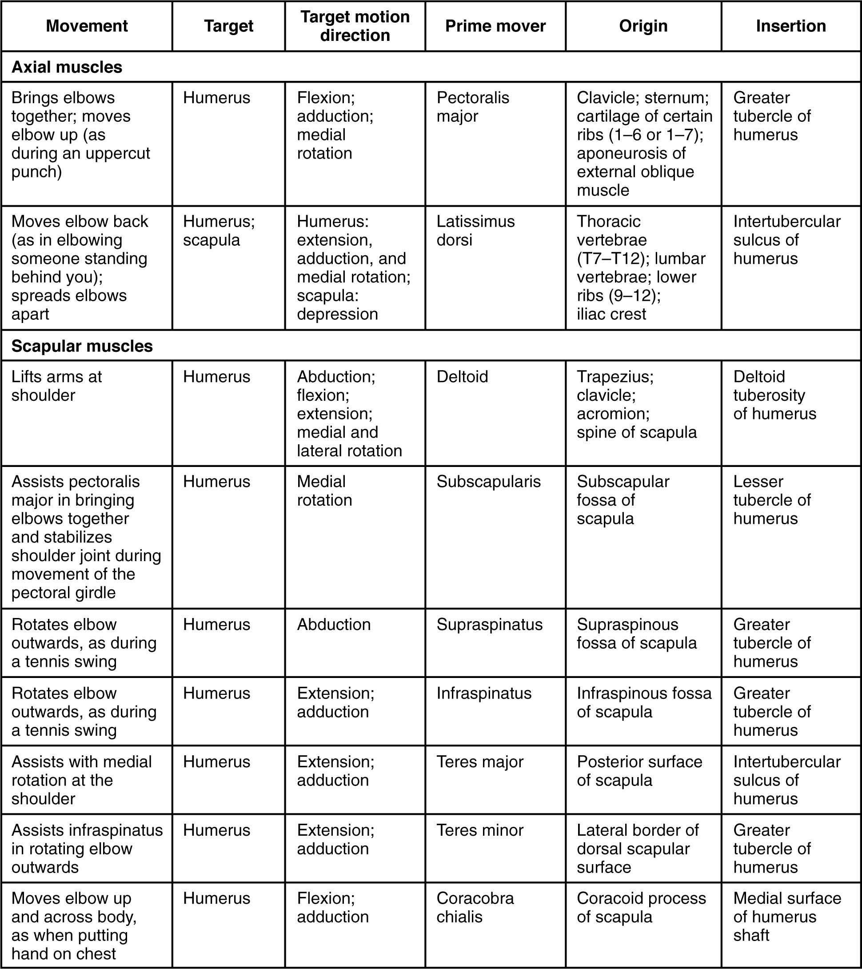
SECTION 11.5
Humerus Muscles — Reference Table
Sort movers by action: flex, extend, abduct
Separate rotator cuff from the prime movers
Link origin/insertion to the motion produced
Use for skills lab and exam review
Muscles that move the humerus: summary table
PN 104 · Ch 11 — The Muscular System
30
Notes:
A reference consolidation. Encourage grouping by action and separating stabilizers (the cuff) from prime movers. Tie to range-of-motion assessment.

Slide 31
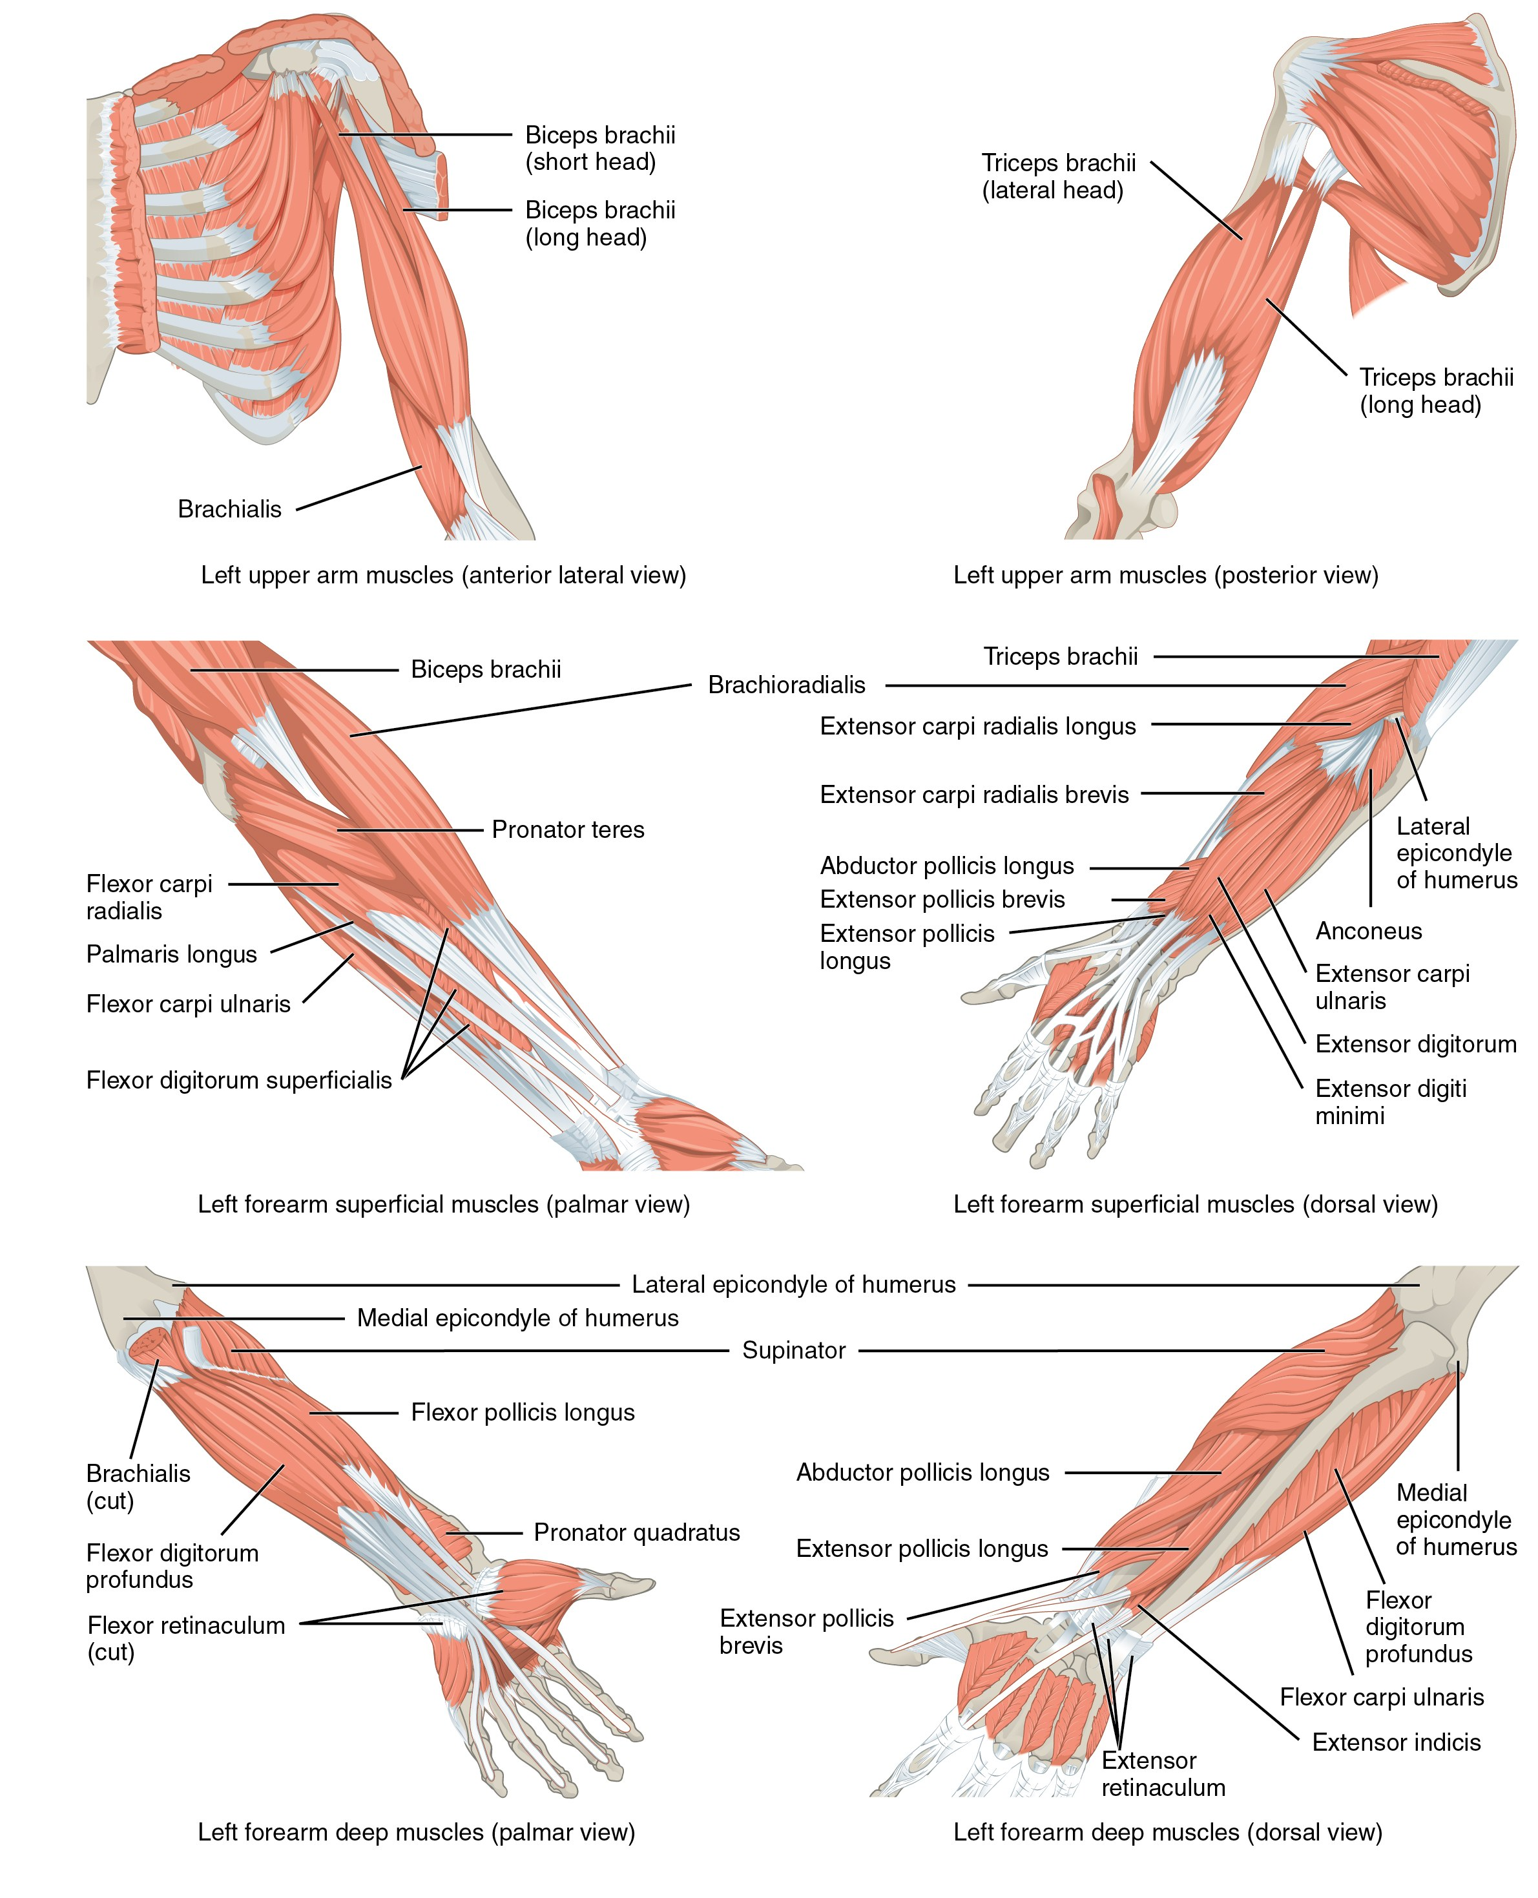
SECTION 11.5
Muscles That Move the Forearm
Biceps brachii and brachialis flex the elbow
Triceps brachii extends the elbow
Supinator and pronators rotate the forearm
Anterior vs. posterior compartments group them
Muscles of the arm that move the forearm
PN 104 · Ch 11 — The Muscular System
31
Notes:
Elbow flexion (biceps, brachialis, brachioradialis) versus extension (triceps) is a clean agonist/antagonist pair that reinforces 11.1. Pronation and supination rotate the radius over the ulna. Note the anterior (flexor) and posterior (extensor) compartments — relevant to compartment syndrome.

Slide 32
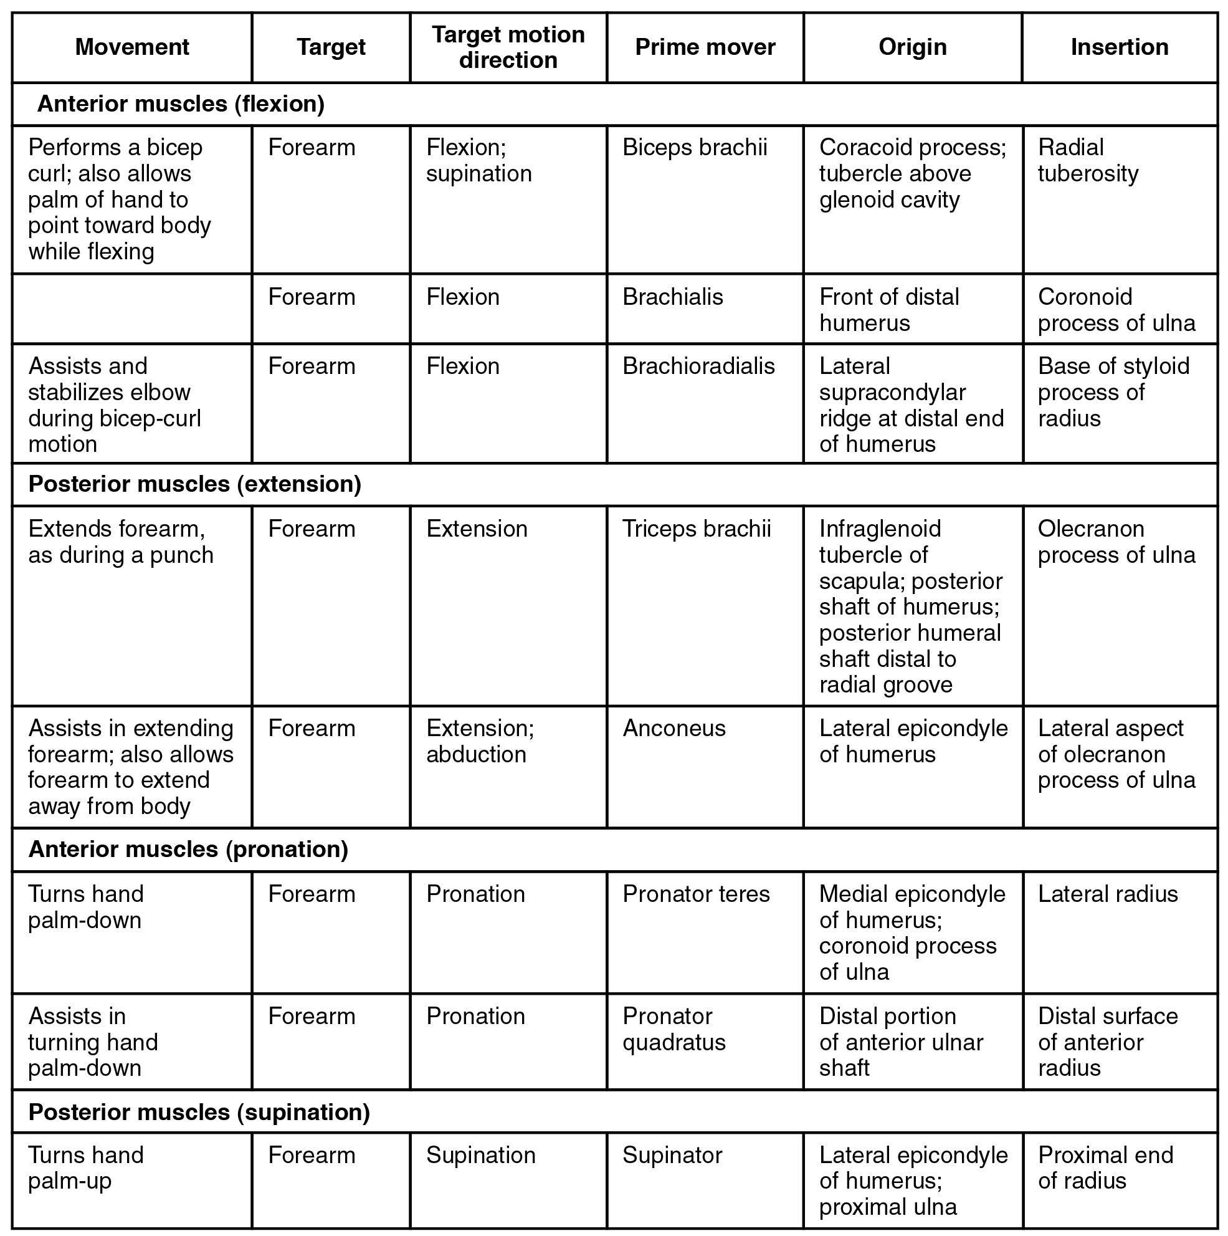
SECTION 11.5
Forearm — Muscles of the Wrist (Table)
Anterior compartment flexes wrist and fingers
Posterior compartment extends wrist and fingers
Long tendons cross from forearm into the hand
Median, ulnar, and radial nerve supply
Muscles that move the forearm: reference table
PN 104 · Ch 11 — The Muscular System
32
Notes:
Reference table for the forearm. Emphasize the compartment concept and that most fine hand control comes from forearm muscles acting through long tendons. Nerve supply matters when assessing injuries.

Slide 33
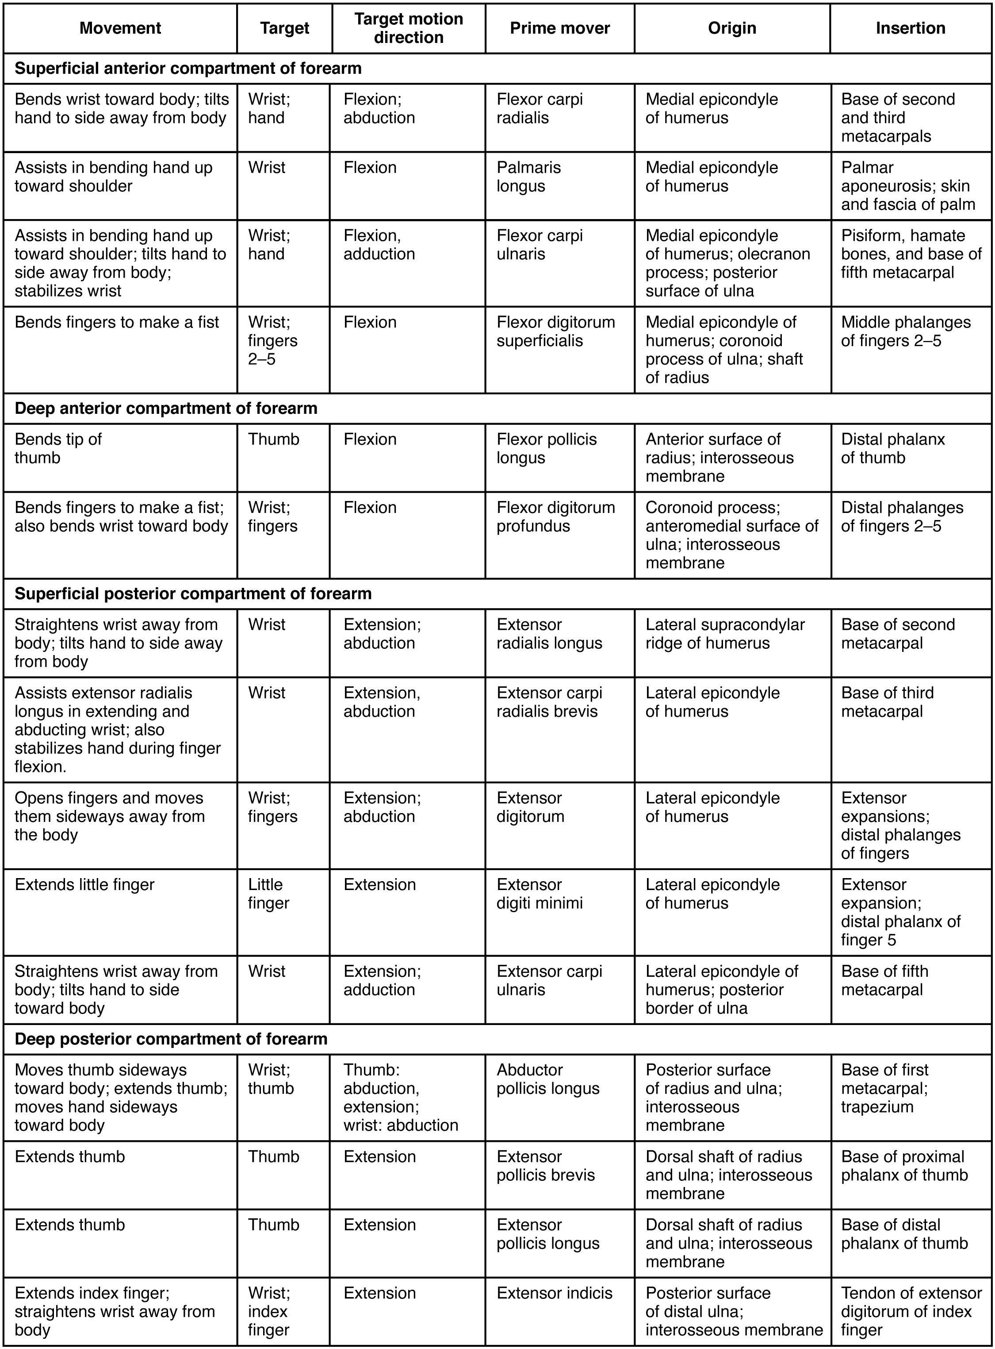
SECTION 11.5
Wrist & Hand — Reference Table
Extrinsic muscles power gross grip
Retinacula stabilize the long tendons
Carpal tunnel transmits the median nerve + tendons
Clinical: carpal tunnel syndrome
Muscles of the wrist and hand: reference table
PN 104 · Ch 11 — The Muscular System
33
Notes:
Continue the forearm-to-hand story. The flexor retinaculum forms the carpal tunnel; median-nerve compression there causes carpal tunnel syndrome (numbness, thenar weakness) — a common clinical correlate.

Slide 34
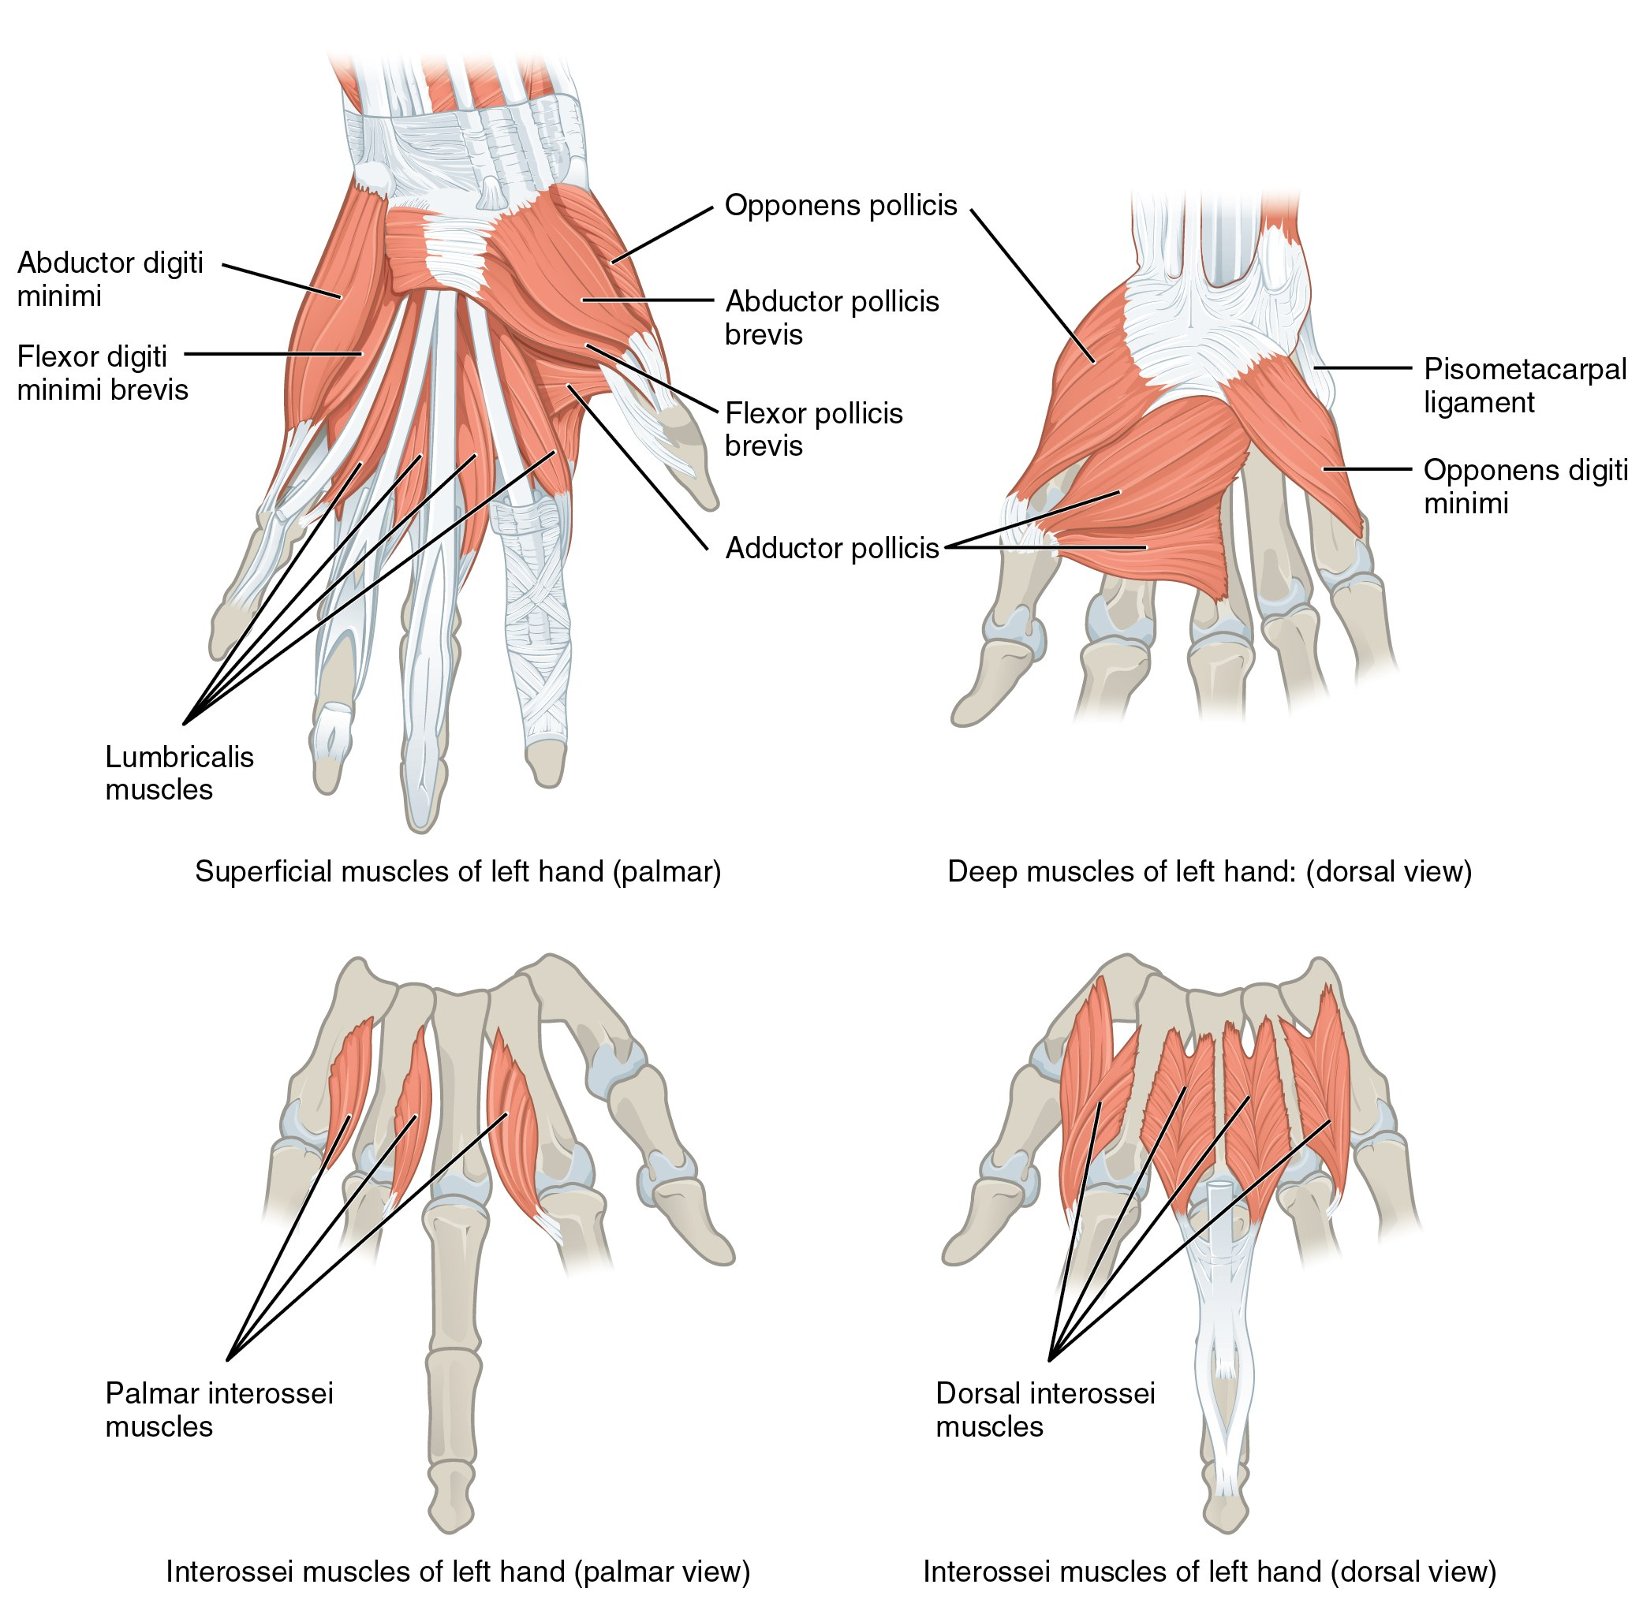
SECTION 11.5
Intrinsic Muscles of the Hand
Thenar, hypothenar, and midpalmar groups
Provide fine, precise finger movements
Thumb opposition enables a functional grasp
Nerve injury impairs dexterity and grip
Intrinsic muscles of the hand
PN 104 · Ch 11 — The Muscular System
34
Notes:
Intrinsic hand muscles give precision — opposition of the thumb is the hallmark of human grasp. Thenar muscles (median nerve) oppose the thumb; interossei and lumbricals (mostly ulnar) abduct and adduct the fingers. Nerve injury produces characteristic deformities such as ape hand or claw hand.

Slide 35
11.6
SECTION
Appendicular Muscles of the Pelvic Girdle & Lower Limbs
The hip, thigh, leg, and foot muscles that power standing, walking, and balance.

Slide 36
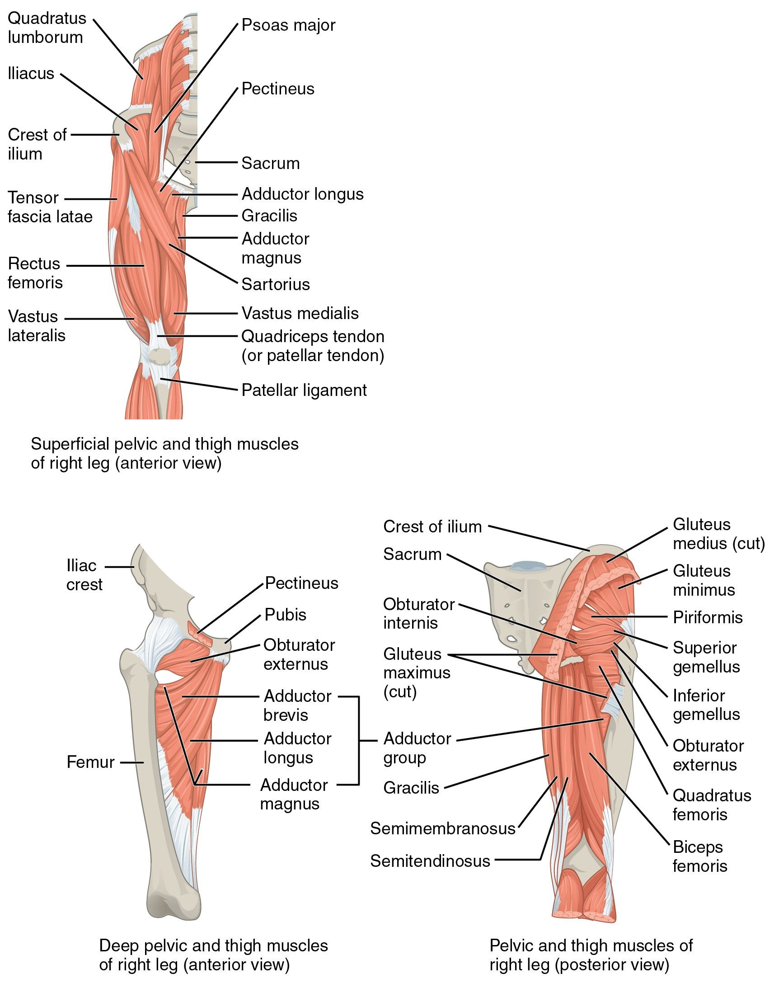
SECTION 11.6
Muscles of the Gluteal Region & Thigh
Gluteus maximus extends the hip
Gluteus medius/minimus abduct and stabilize
Iliopsoas is the main hip flexor
Gait and balance depend on these muscles
Muscles of the gluteal region acting on the femur
PN 104 · Ch 11 — The Muscular System
36
Notes:
Hip muscles drive standing, walking, and stair-climbing. Gluteus maximus is the powerful hip extensor; medius and minimus stabilize the pelvis during single-leg stance (a positive Trendelenburg sign indicates weakness). Iliopsoas flexes the hip. Gluteus medius is the classic IM injection site (ventrogluteal).

Slide 37
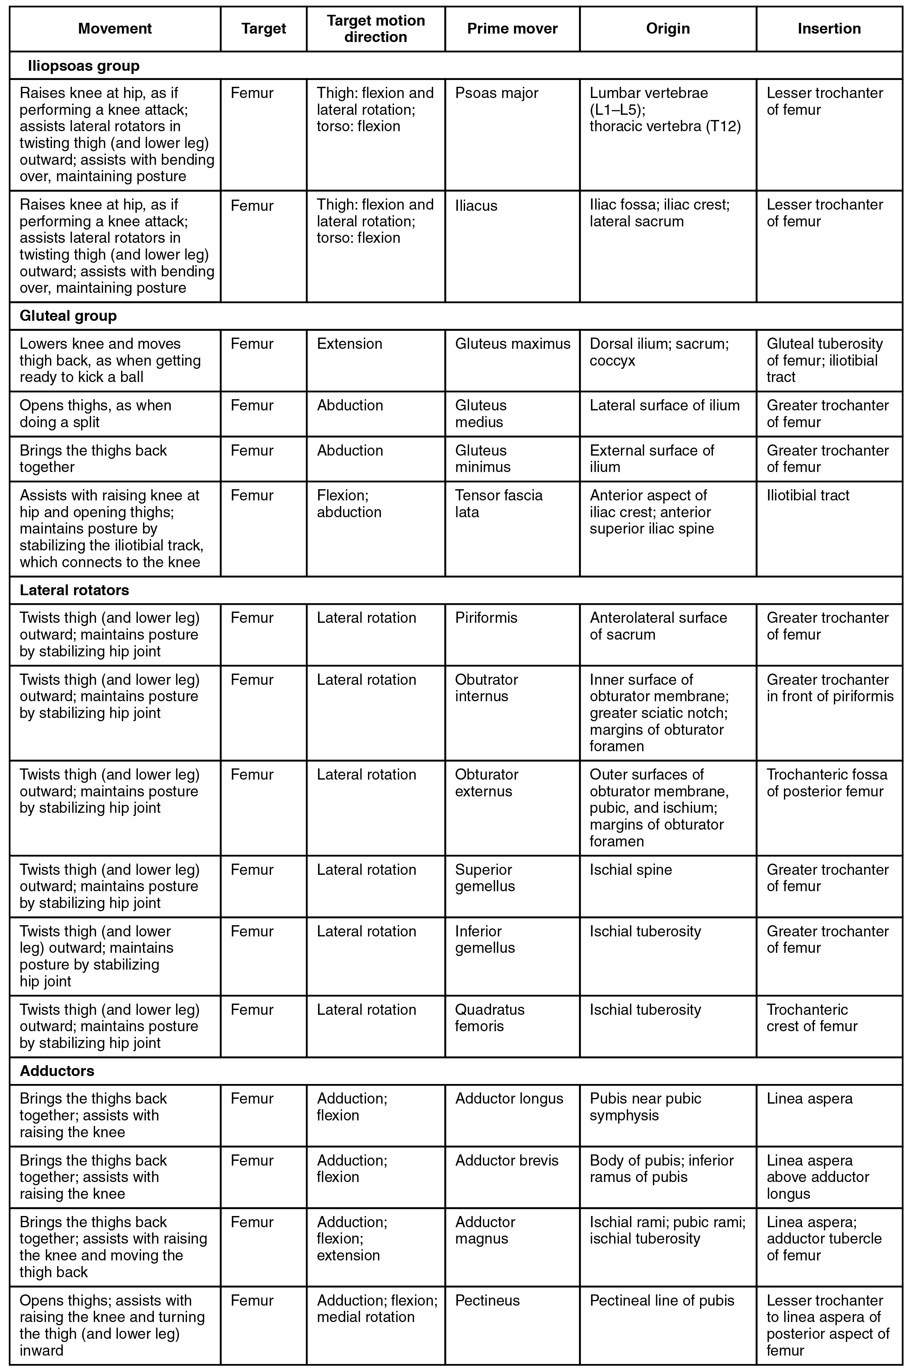
SECTION 11.6
Gluteal Region — Reference Table
Separate flexors, extensors, abductors, rotators
Note the pelvic stabilizers used in gait
Connect to fall risk and mobility
Reference for clinical skills
Muscles of the gluteal region: summary table
PN 104 · Ch 11 — The Muscular System
37
Notes:
Reference consolidation. Highlight the pelvic stabilizers and their role in balance and fall prevention in older adults.

Slide 38
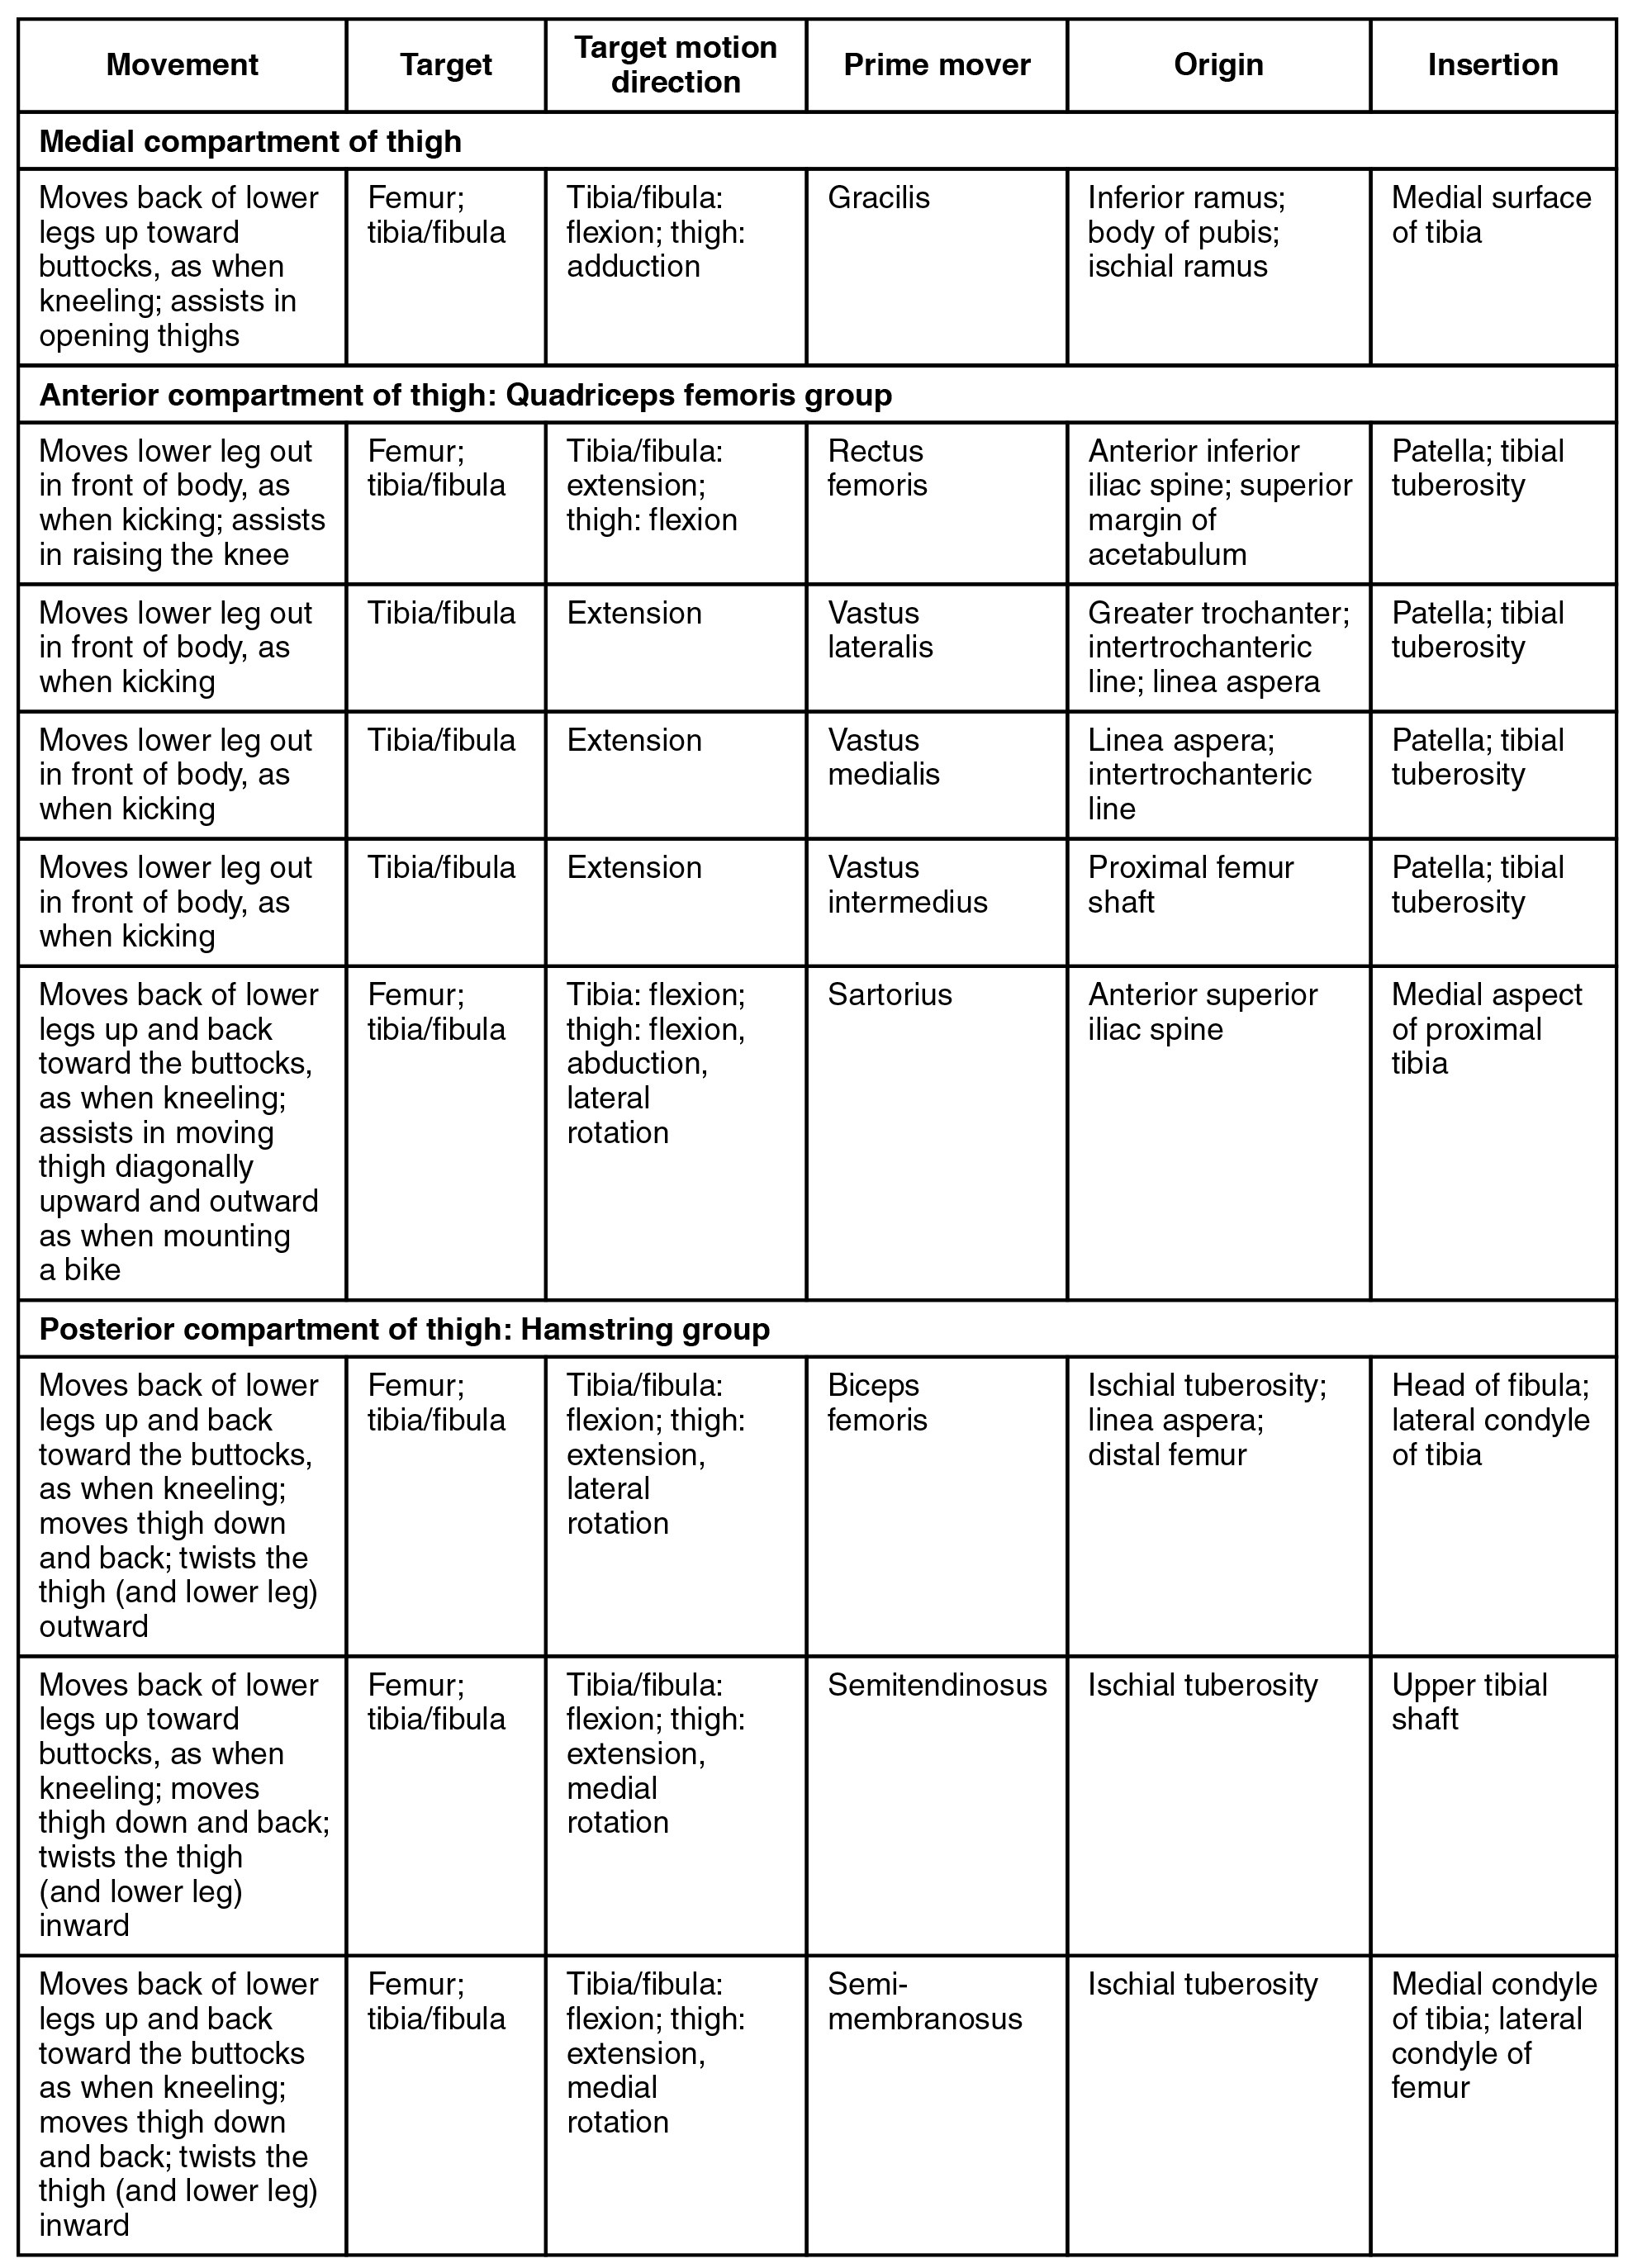
SECTION 11.6
Muscles of the Thigh — Reference Table
Quadriceps extend the knee
Hamstrings flex the knee and extend the hip
Adductors pull the thigh medially
Powerful muscles for transfers and walking
Muscles of the thigh: reference table
PN 104 · Ch 11 — The Muscular System
38
Notes:
Quadriceps (anterior) extend the knee and are crucial for sit-to-stand and stair climbing; hamstrings (posterior) flex the knee. Adductors stabilize the medial thigh. These big muscles are what patients use in transfers — strength here predicts mobility.

Slide 39
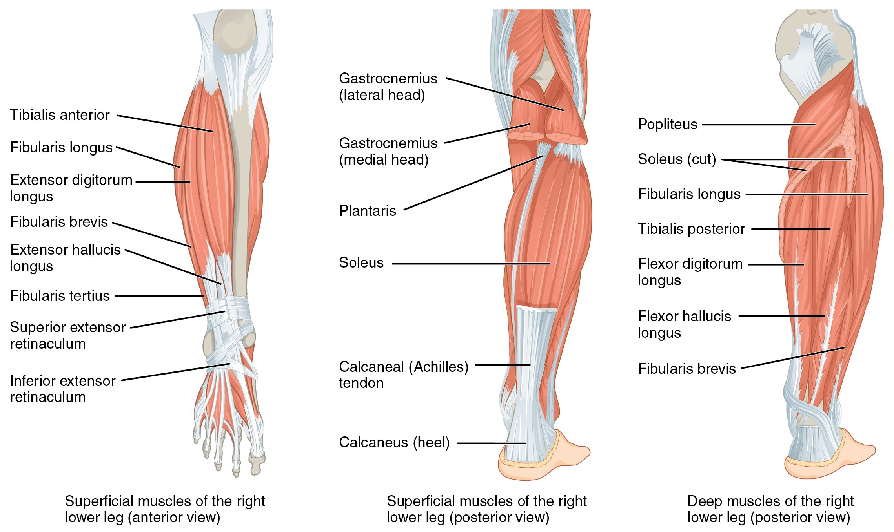
SECTION 11.6
Muscles That Move the Foot
Muscles of the leg that move the foot
Anterior leg dorsiflexes (tibialis anterior)
Posterior leg plantarflexes (gastrocnemius, soleus)
Calf muscles form the Achilles tendon
Deep fibular nerve injury → "foot drop"
PN 104 · Ch 11 — The Muscular System
39
Notes:
Dorsiflexion (tibialis anterior) clears the foot during the swing phase; weakness causes foot drop and a steppage gait. Plantarflexors (gastrocnemius and soleus via the Achilles tendon) propel walking and push-off. The calf muscle pump also aids venous return — relevant to DVT prevention.

Slide 40
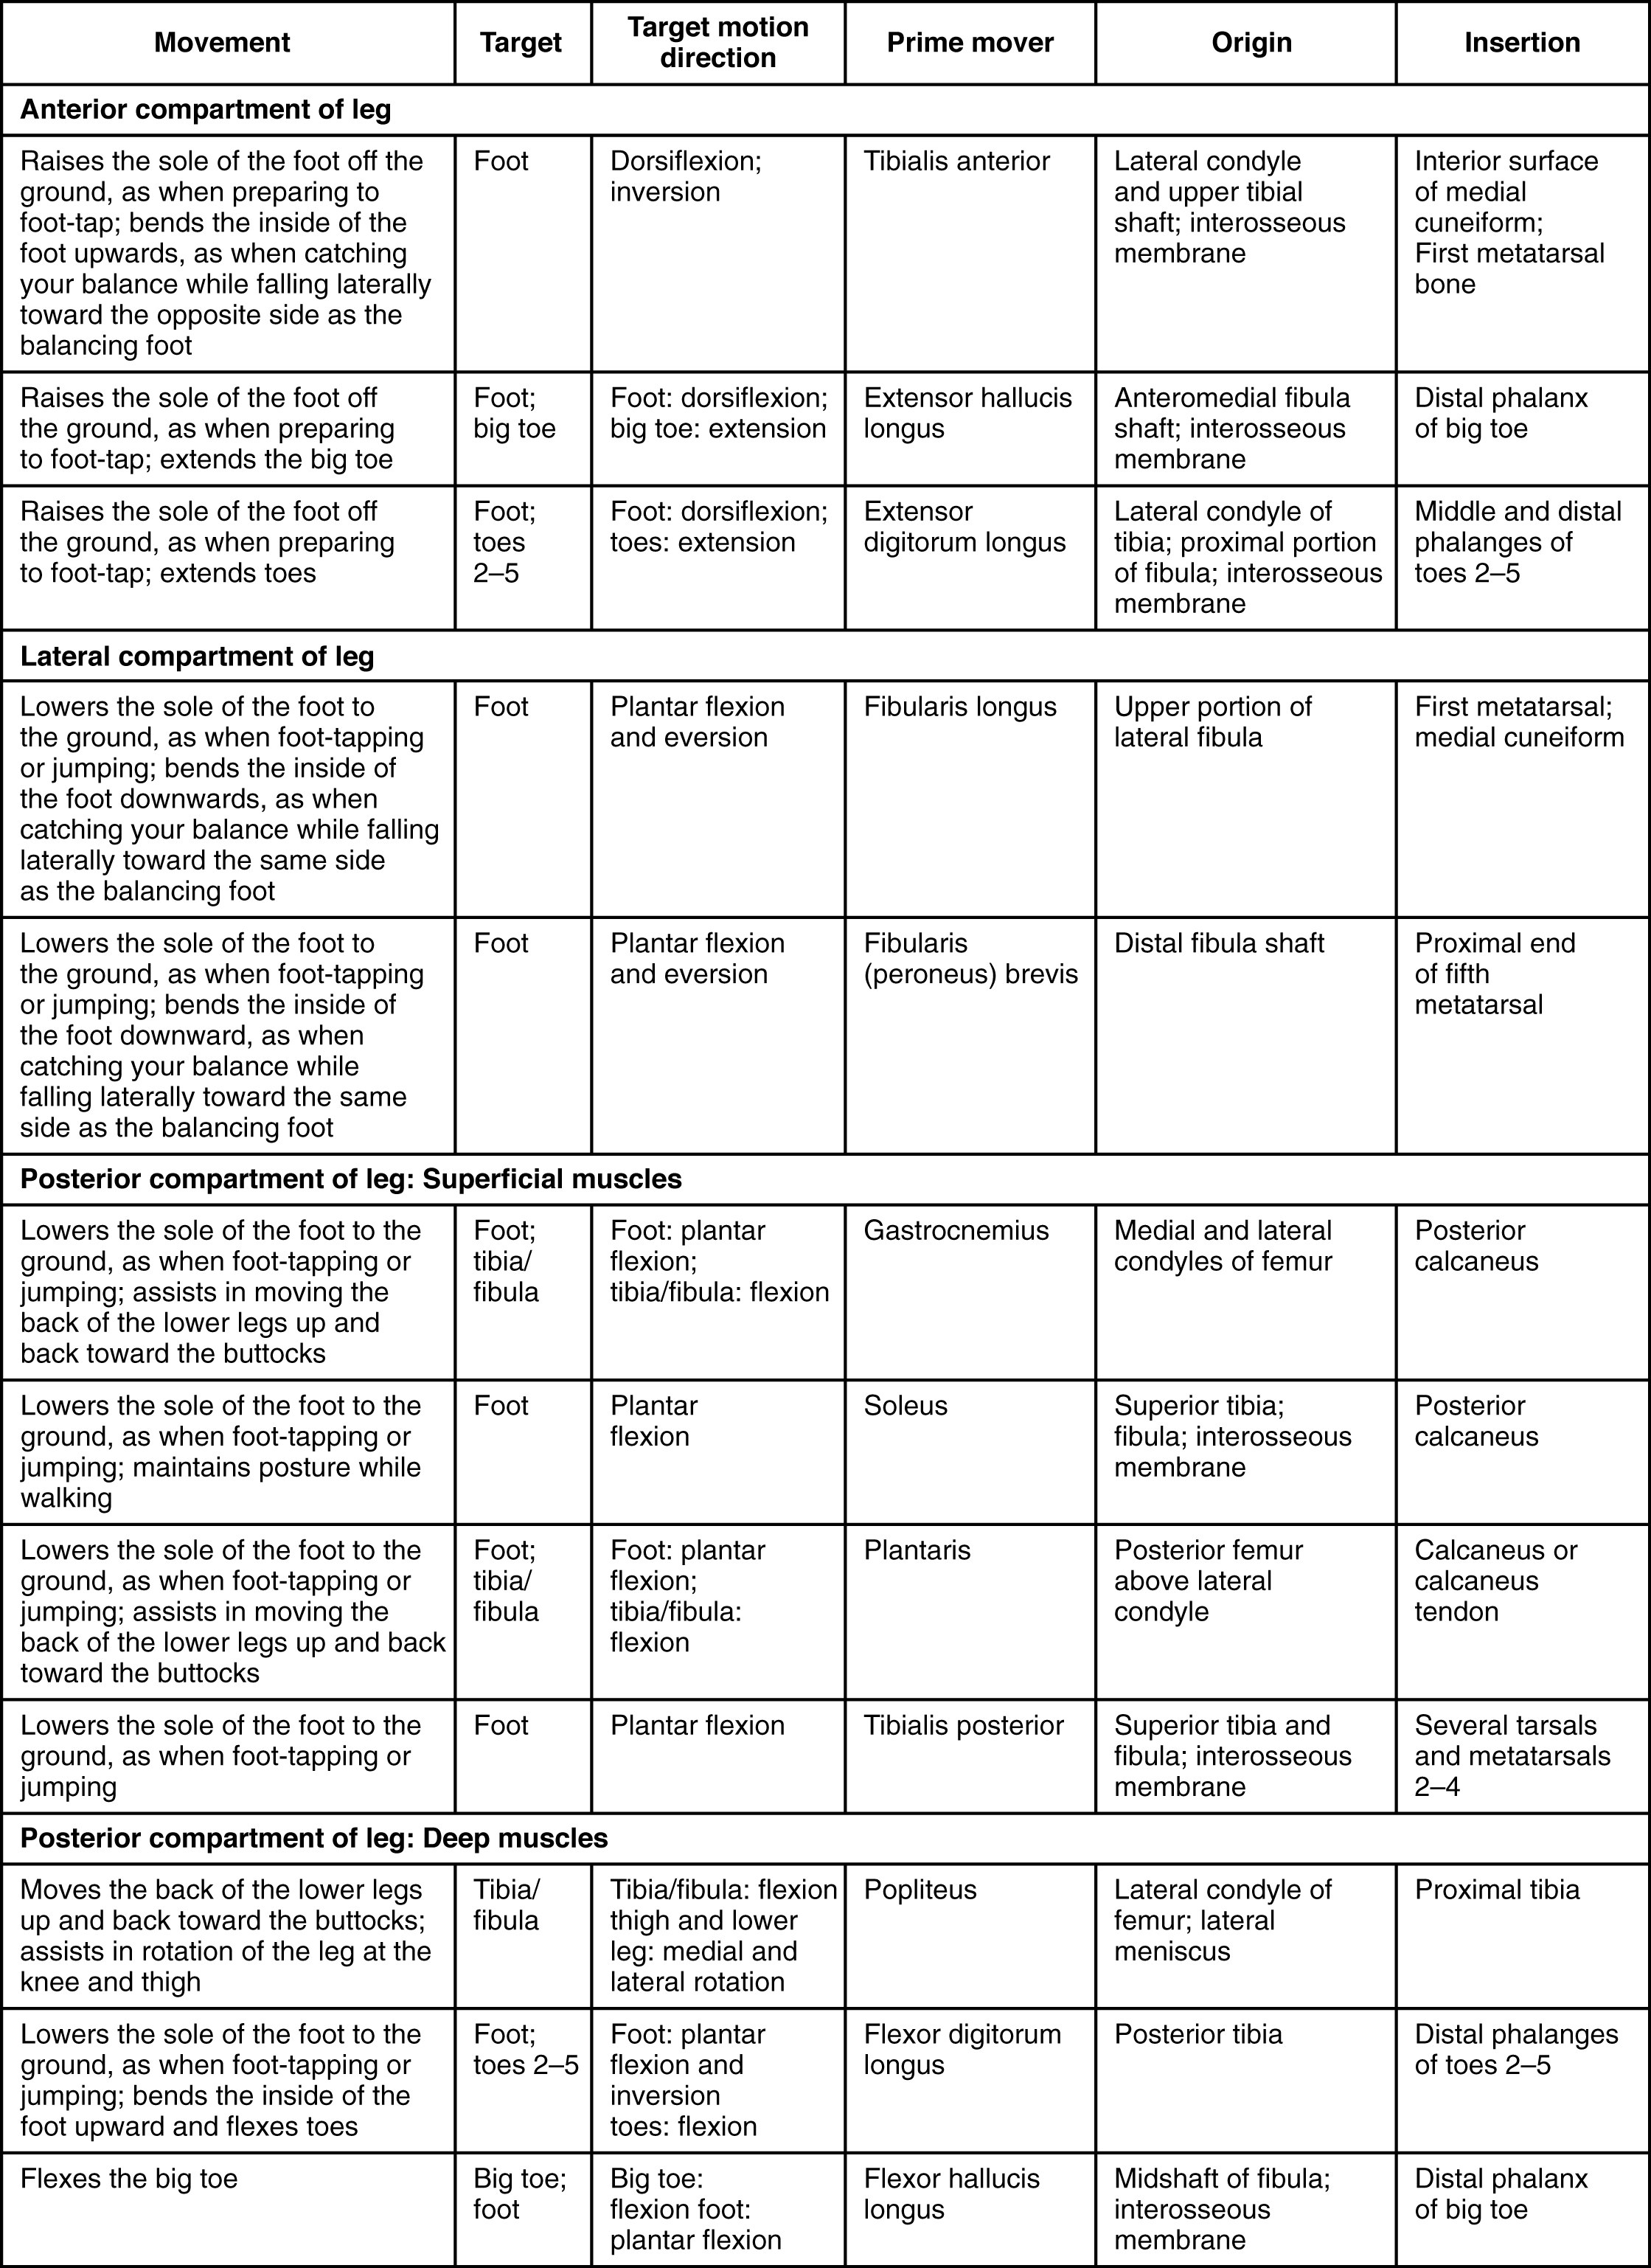
SECTION 11.6
Leg Muscles — Reference Table
Group by compartment: anterior, lateral, posterior
Match each muscle to its foot movement
Note tendons crossing the ankle
Compartment syndrome awareness
Muscles of the leg: reference table
PN 104 · Ch 11 — The Muscular System
40
Notes:
Reference table. Reinforce the compartment model and that lower-leg compartment syndrome is a surgical emergency (the five P's). Tie the tendons to ankle movement.

Slide 41
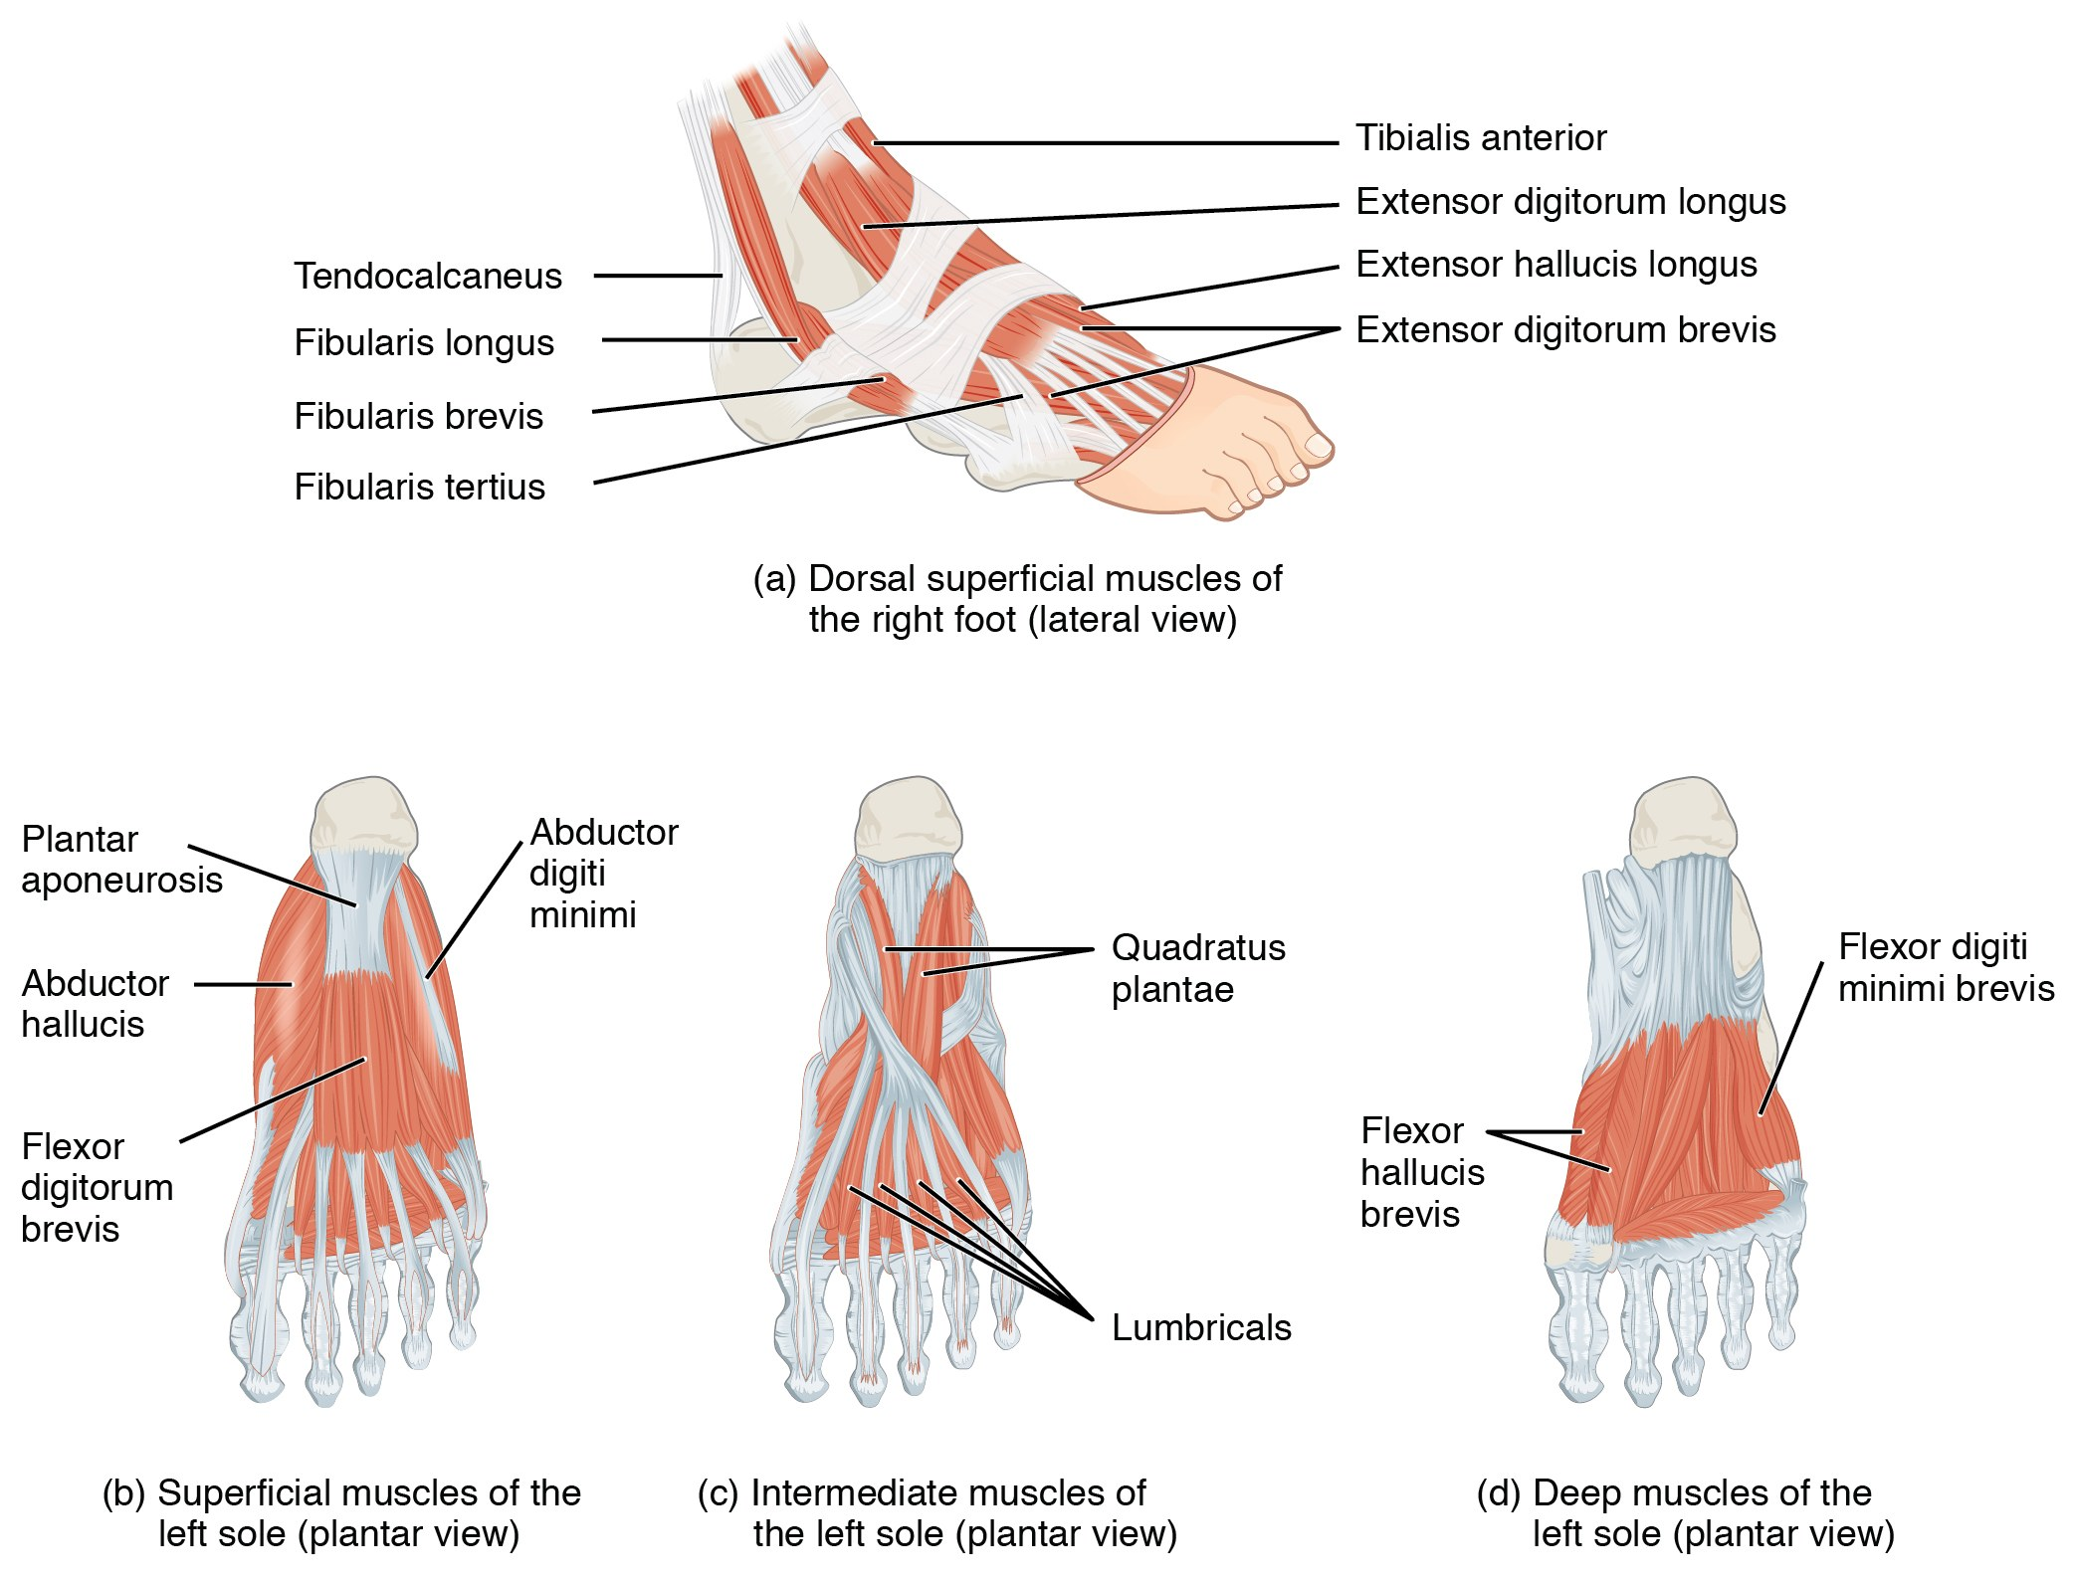
SECTION 11.6
Intrinsic Muscles of the Foot
Support the arches of the foot
Provide balance and fine foot control
Layered plantar muscles cushion body weight
Arch support matters in diabetic foot care
Intrinsic muscles of the foot
PN 104 · Ch 11 — The Muscular System
41
Notes:
Intrinsic foot muscles maintain the arches and adjust to uneven ground for balance. Their support of the longitudinal arch is relevant in diabetic and geriatric foot care, where structural breakdown leads to ulcers and instability.

Slide 42
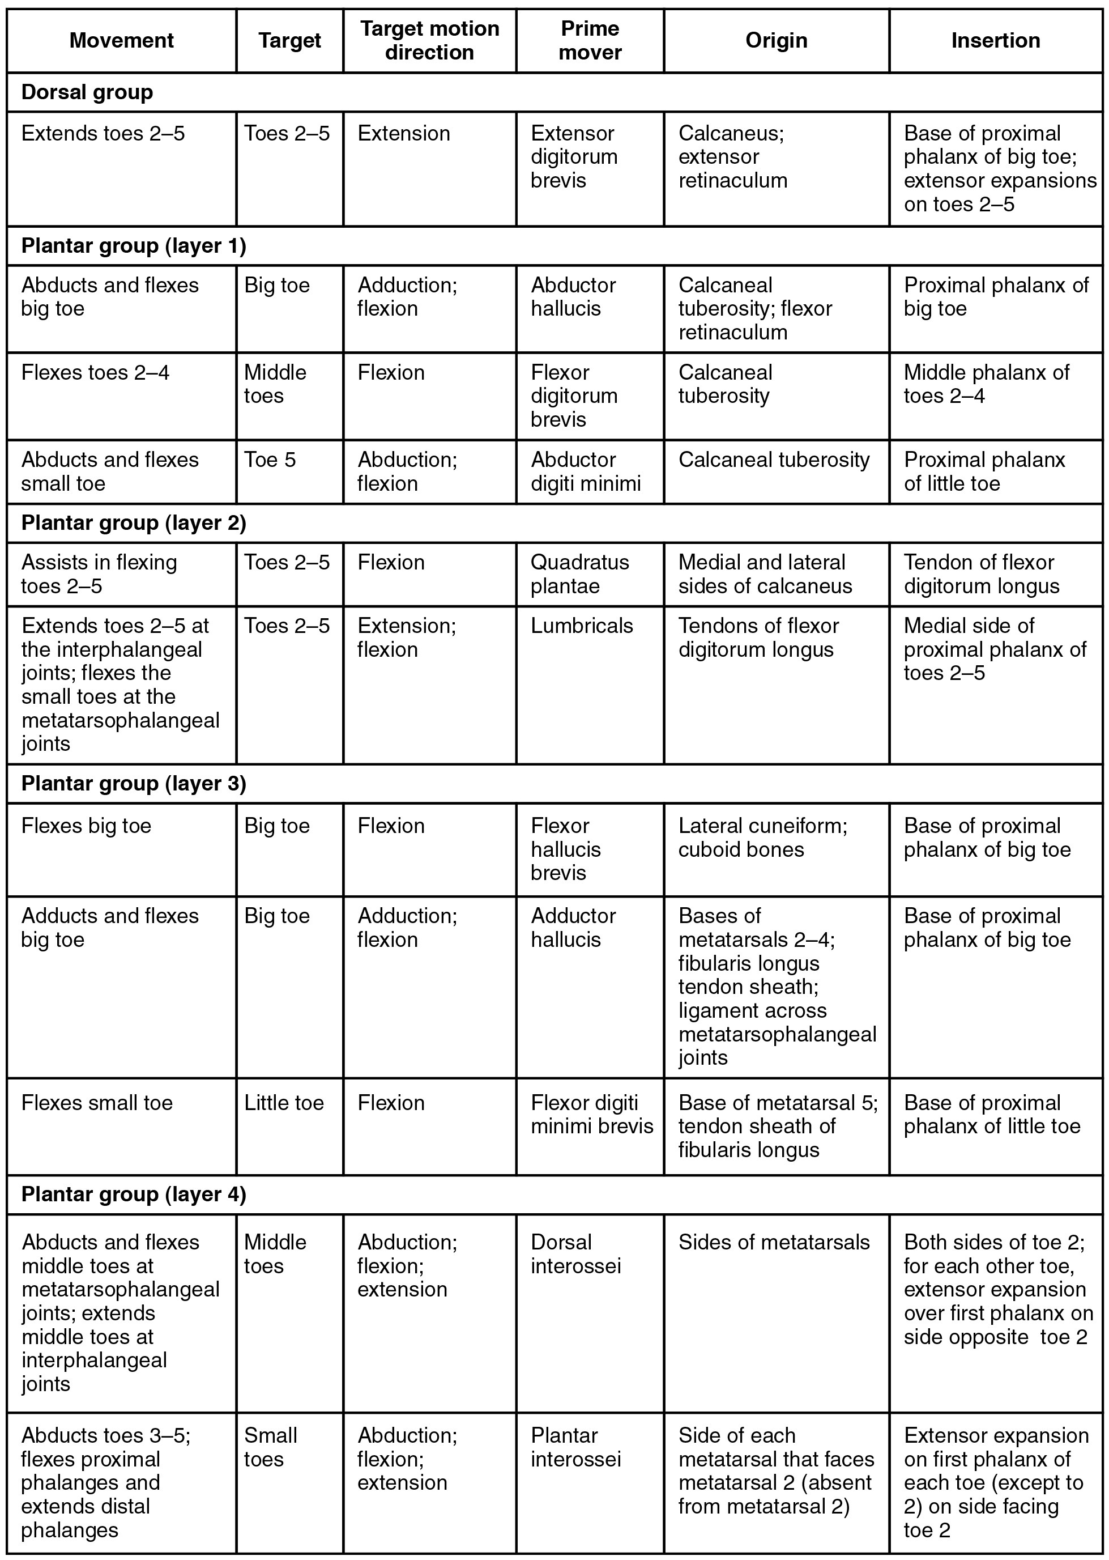
SECTION 11.6
Foot Muscles — Reference Table
Plantar muscles arranged in four layers
Work with intrinsic and extrinsic tendons
Maintain the arches and move the toes
Reference for foot assessment
Muscles of the foot: reference table
PN 104 · Ch 11 — The Muscular System
42
Notes:
Final reference table. Keep brief and point students to it for foot-anatomy review. Connect to skin and foot-integrity assessment.

Slide 43
CHAPTER 11
Key Takeaways
Muscles act in coordinated groups — agonist, antagonist, synergist, and fixator.
Fascicle arrangement sets the trade-off between force and range of motion.
Muscle names encode location, shape, size, direction, action, and attachments.
Axial muscles support the head, neck, trunk, breathing, and continence.
Appendicular muscles move the limbs and underlie gait, grasp, and balance.
PN 104 · Ch 11 — The Muscular System
43
Notes:
Recap the chapter's arc: from how muscles interact, to how they are named, to a regional tour of the body's axial and appendicular muscles. Remind students that every muscle group connects to a patient-care priority — mobility, breathing, swallowing, or continence.

Slide 44
CLINICAL CONNECTIONS
Why the Muscular System Matters in Practical Nursing
Breathing
Mobility & Transfers
Diaphragm (C3–C5), intercostals, and accessory muscles drive ventilation — watch for retractions.
Gluteals, quadriceps, and hamstrings power standing and walking — central to fall risk and safe lifting.
Swallowing
Continence
Tongue, suprahyoid, and pharyngeal muscles protect the airway — basis for aspiration precautions.
The pelvic floor (levator ani) supports organs and controls elimination — weakness causes incontinence.
Cranial Nerves
Body Mechanics
Link muscle groups to CN V (chewing), VII (face), XII (tongue), and XI (SCM/trapezius).
Erector spinae and core muscles protect the back — reinforce lifting technique with every patient.
Notes:
Close by anchoring the anatomy to bedside priorities. Ask students to name a muscle group involved in each scenario: a patient in respiratory distress, a transfer, a swallow evaluation, and incontinence care. This is the bridge from A&P (PN 104) into Fundamentals of Nursing (PN 105).

