Slide 1
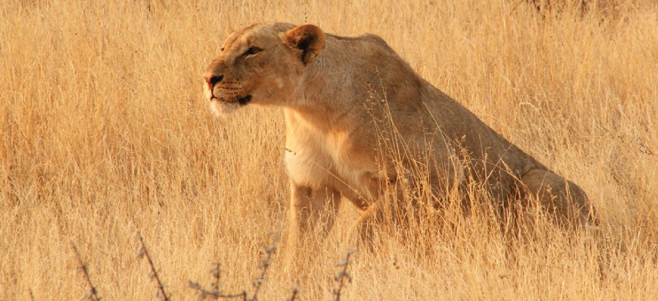
CHAPTER 15
The Autonomic Nervous System
Involuntary control of the body's organs and internal balance.
Anatomy & Physiology · Broward-Miami Health Institute
FACULTY EDITION
Notes:
READ ALOUD SCRIPT
Today we are beginning Chapter 15, the autonomic nervous system. In this chapter, we will connect the names and locations of skeletal structures with their functions and with the observations that matter in practical nursing care. As we move through the slides, focus on how structure supports protection, movement, stability, mineral balance, and patient safety. By the end, you should be able to explain the major concepts in your own words and apply them to a patient-care situation.
[Sources]
- BMHI PN 104 Chapter 15 faculty PowerPoint slide content.

Slide 2
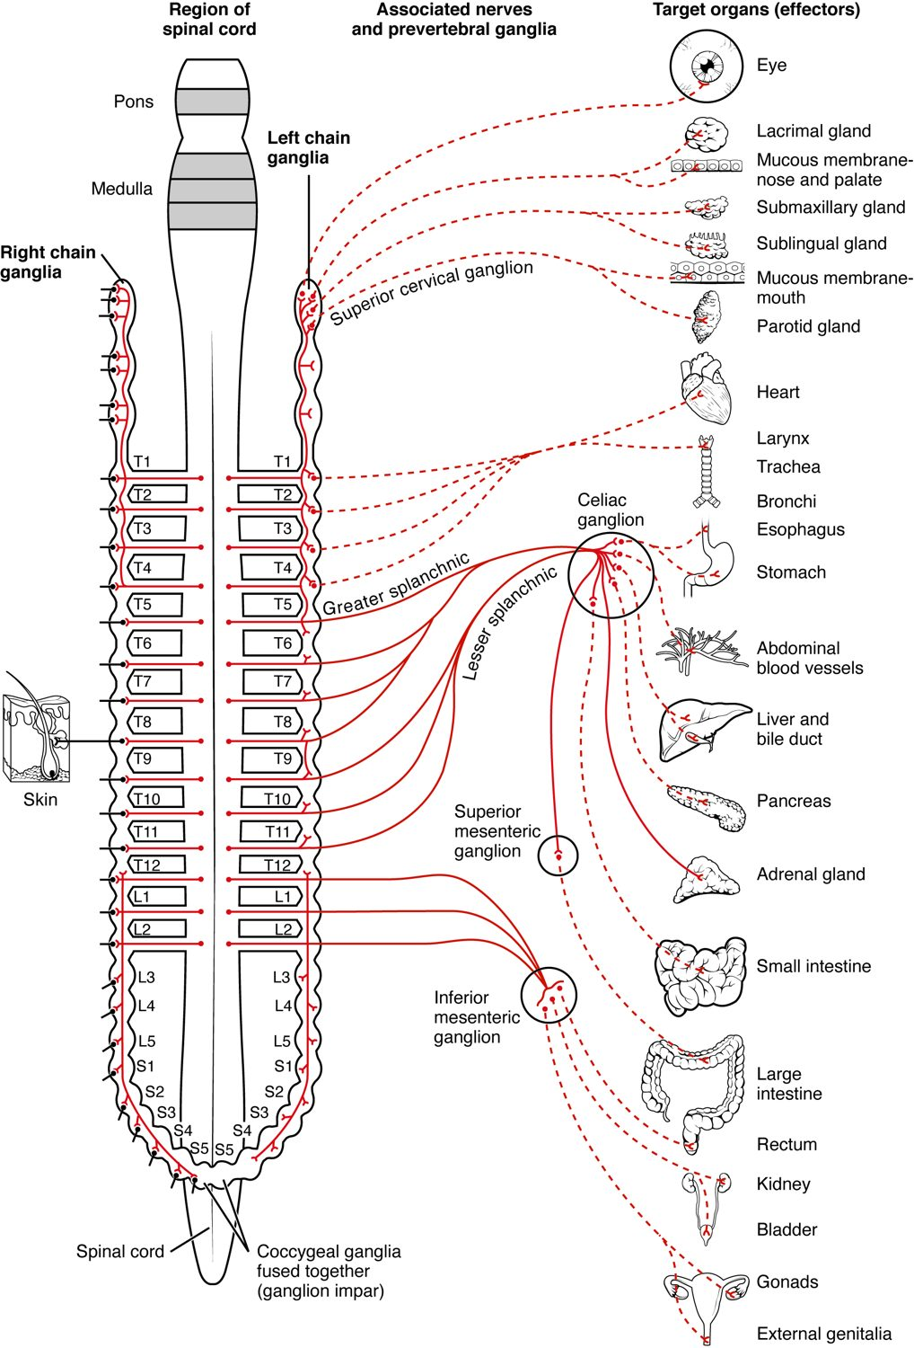
CHAPTER 15
Learning Objectives
After studying this chapter, students will be able to:
1
Describe the components of the autonomic nervous system
2
Differentiate between the structures of the sympathetic and parasympathetic divisions in the autonomic nervous system
3
Name the components of a visceral reflex specific to the autonomic division to which it belongs
4
Predict the response of a target effector to autonomic input on the basis of the released signaling molecule
The autonomic nervous system: involuntary control.
PN 104 · Ch 15 — The Autonomic Nervous System
2
Notes:
READ ALOUD SCRIPT
These are our learning objectives for Chapter 15. By the end of the chapter, you should be able to do the following: Describe the components of the autonomic nervous system. Differentiate between the structures of the sympathetic and parasympathetic divisions in the autonomic nervous system. Name the components of a visceral reflex specific to the autonomic division to which it belongs. Predict the response of a target effector to autonomic input on the basis of the released signaling molecule. The autonomic nervous system: involuntary control. Do not treat these as isolated facts. Use them as a checklist for what you should be able to identify, explain, and connect to safe practical nursing care.
[Sources]
- BMHI PN 104 Chapter 15 faculty PowerPoint slide content.

Slide 3
15.1
SECTION
Divisions of the Autonomic Nervous System
The sympathetic and parasympathetic divisions of the autonomic system.
Notes:
READ ALOUD SCRIPT
We are now moving into Divisions of the Autonomic Nervous System. The sympathetic and parasympathetic divisions of the autonomic system. As we begin this section, listen for the major structures, their locations, and the functions they perform. Then ask yourself what a change in this area might look like during patient care.
[Sources]
- BMHI PN 104 Chapter 15 faculty PowerPoint slide content.

Slide 4
SECTION 15.1
The Sympathetic Division
The "fight-or-flight" system
Prepares the body for action
Raises heart rate and breathing
Arises from the thoracolumbar cord
The sympathetic division
PN 104 · Ch 15 — The Autonomic Nervous System
4
Notes:
READ ALOUD SCRIPT
Now let's focus on The Sympathetic Division. The sympathetic division. The "fight-or-flight" system. Prepares the body for action. Raises heart rate and breathing. Arises from the thoracolumbar cord. Connect sympathetic activation with increased heart rate, dilated airways and pupils, reduced digestive activity, and the body's response to stress or danger. Take a moment to identify the structure on the image and explain how its form supports its function. This is slide 4 of 16.
[Sources]
- BMHI PN 104 Chapter 15 faculty PowerPoint slide content.

Slide 5
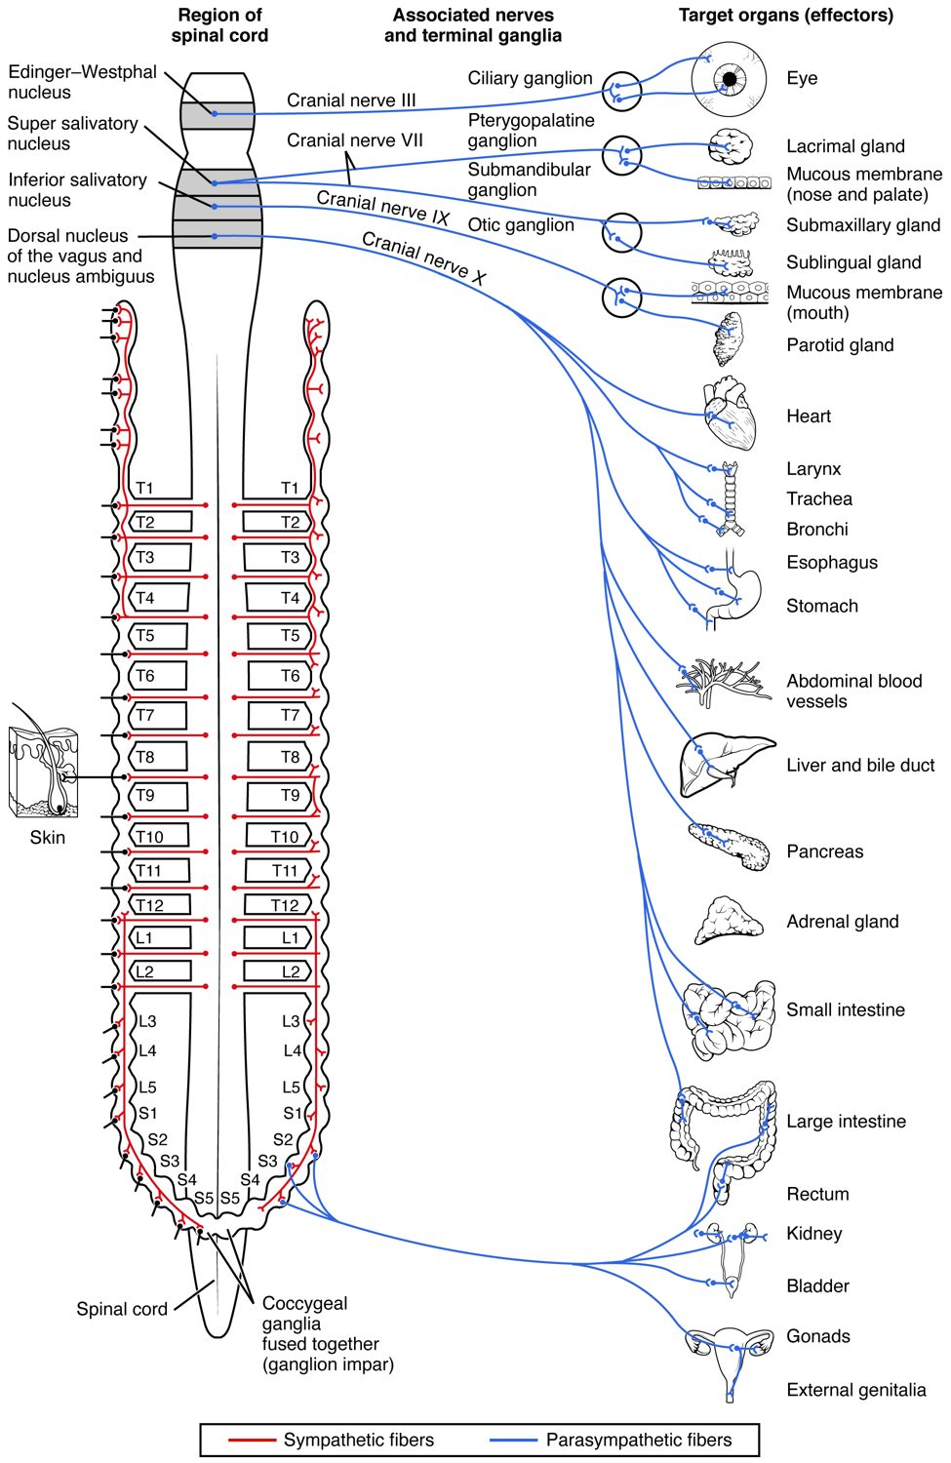
SECTION 15.1
The Parasympathetic Division
The "rest-and-digest" system
Conserves energy at rest
Slows the heart, aids digestion
Arises from cranial and sacral regions
The parasympathetic division
PN 104 · Ch 15 — The Autonomic Nervous System
5
Notes:
READ ALOUD SCRIPT
Now let's focus on The Parasympathetic Division. The parasympathetic division. The "rest-and-digest" system. Conserves energy at rest. Slows the heart, aids digestion. Arises from cranial and sacral regions. Connect sympathetic activation with increased heart rate, dilated airways and pupils, reduced digestive activity, and the body's response to stress or danger. Take a moment to identify the structure on the image and explain how its form supports its function. This is slide 5 of 16.
[Sources]
- BMHI PN 104 Chapter 15 faculty PowerPoint slide content.

Slide 6
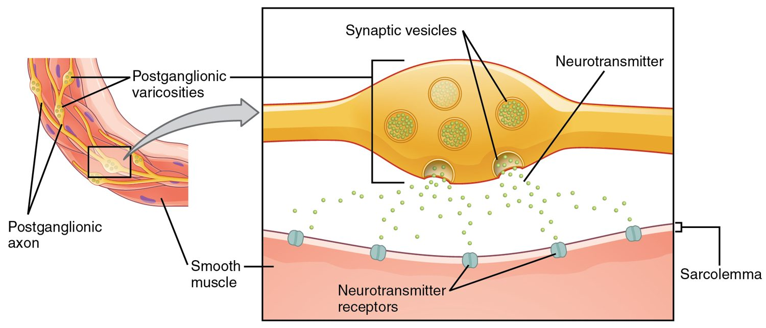
SECTION 15.1
Autonomic Neurotransmitters
Neurotransmitters of the autonomic system
A two-neuron pathway to the target
Acetylcholine and norepinephrine
Receptor type determines the effect
The basis of many drug actions
PN 104 · Ch 15 — The Autonomic Nervous System
6
Notes:
READ ALOUD SCRIPT
Now let's focus on Autonomic Neurotransmitters. Neurotransmitters of the autonomic system. A two-neuron pathway to the target. Acetylcholine and norepinephrine. Receptor type determines the effect. The basis of many drug actions. Medication effects and adverse reactions often depend on the receptor being stimulated or blocked, so monitor vital signs, breathing, alertness, and safety. Take a moment to identify the structure on the image and explain how its form supports its function. This is slide 6 of 16.
[Sources]
- BMHI PN 104 Chapter 15 faculty PowerPoint slide content.

Slide 7
15.2
SECTION
Autonomic Reflexes and Homeostasis
How autonomic reflexes keep internal conditions stable.
Notes:
READ ALOUD SCRIPT
We are now moving into Autonomic Reflexes and Homeostasis. How autonomic reflexes keep internal conditions stable. As we begin this section, listen for the major structures, their locations, and the functions they perform. Then ask yourself what a change in this area might look like during patient care.
[Sources]
- BMHI PN 104 Chapter 15 faculty PowerPoint slide content.

Slide 8
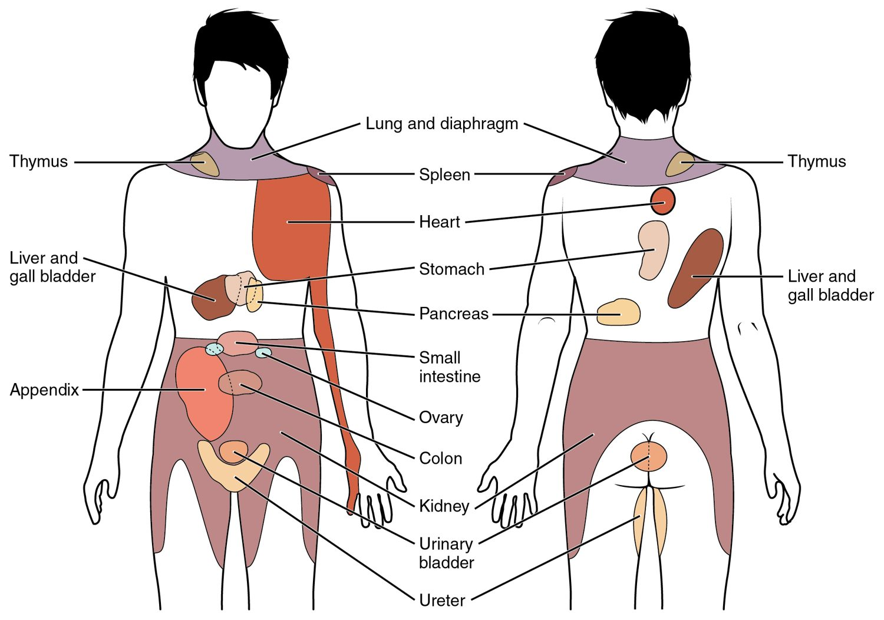
SECTION 15.2
Dual Innervation
Most organs get both divisions
The two usually oppose each other
Balance fine-tunes organ activity
Maintains homeostasis
Sympathetic and parasympathetic effects on organs
PN 104 · Ch 15 — The Autonomic Nervous System
8
Notes:
READ ALOUD SCRIPT
Now let's focus on Dual Innervation. Most organs get both divisions. The two usually oppose each other. Balance fine-tunes organ activity. Maintains homeostasis. Sympathetic and parasympathetic effects on organs. Connect sympathetic activation with increased heart rate, dilated airways and pupils, reduced digestive activity, and the body's response to stress or danger. Take a moment to identify the structure on the image and explain how its form supports its function. This is slide 8 of 16.
[Sources]
- BMHI PN 104 Chapter 15 faculty PowerPoint slide content.

Slide 9
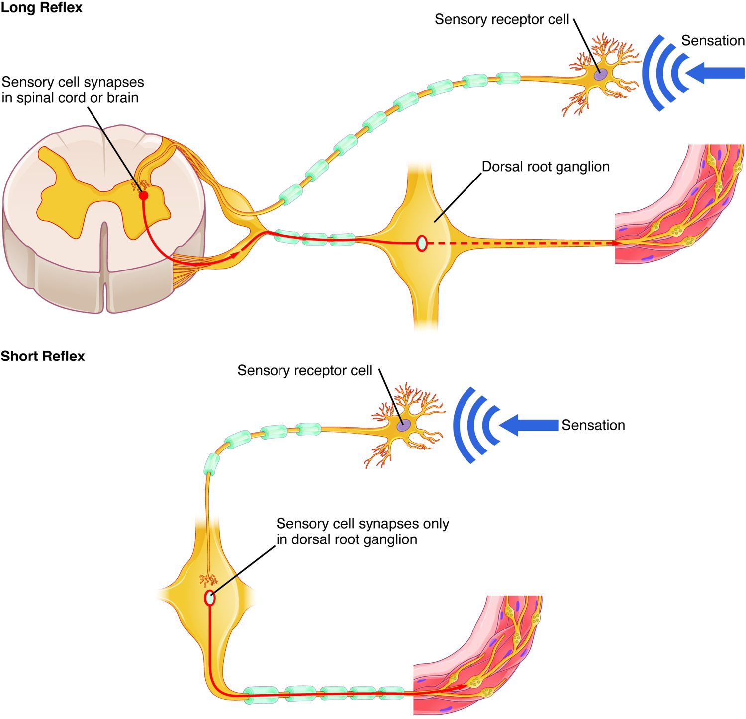
SECTION 15.2
Autonomic Reflexes
Automatic responses to stimuli
Sensory input → CNS → autonomic output
Control heart rate, BP, digestion
Operate without awareness
Long and short autonomic reflexes
PN 104 · Ch 15 — The Autonomic Nervous System
9
Notes:
READ ALOUD SCRIPT
Now let's focus on Autonomic Reflexes. Automatic responses to stimuli. Sensory input → CNS → autonomic output. Control heart rate, BP, digestion. Operate without awareness. Long and short autonomic reflexes. Autonomic changes can appear in heart rate, blood pressure, breathing, pupils, digestion, sweating, and bladder function, making careful assessment and reporting essential. Take a moment to identify the structure on the image and explain how its form supports its function. This is slide 9 of 16.
[Sources]
- BMHI PN 104 Chapter 15 faculty PowerPoint slide content.

Slide 10
15.3
SECTION
Central Control
How the brain oversees the autonomic nervous system.
Notes:
READ ALOUD SCRIPT
We are now moving into Central Control. How the brain oversees the autonomic nervous system. As we begin this section, listen for the major structures, their locations, and the functions they perform. Then ask yourself what a change in this area might look like during patient care.
[Sources]
- BMHI PN 104 Chapter 15 faculty PowerPoint slide content.

Slide 11
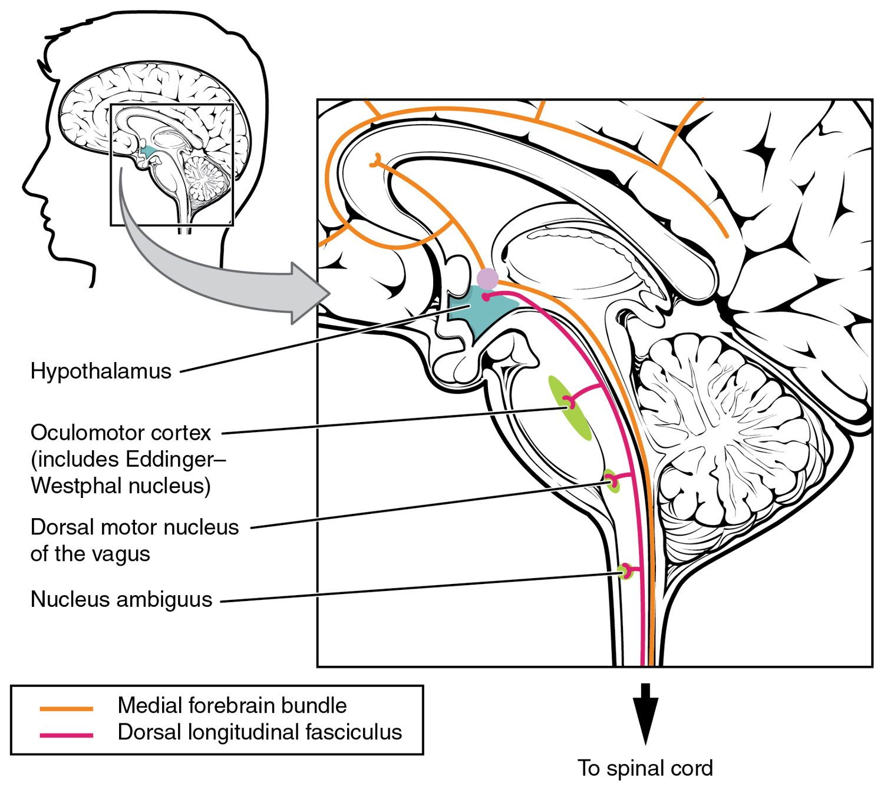
SECTION 15.3
Central Control
The hypothalamus is the main controller
Integrates autonomic and endocrine output
Brainstem centers run vital reflexes
Linked to emotion and stress
Central control of the autonomic system
PN 104 · Ch 15 — The Autonomic Nervous System
11
Notes:
READ ALOUD SCRIPT
Now let's focus on Central Control. The hypothalamus is the main controller. Integrates autonomic and endocrine output. Brainstem centers run vital reflexes. Linked to emotion and stress. Central control of the autonomic system. Autonomic changes can appear in heart rate, blood pressure, breathing, pupils, digestion, sweating, and bladder function, making careful assessment and reporting essential. Take a moment to identify the structure on the image and explain how its form supports its function. This is slide 11 of 16.
[Sources]
- BMHI PN 104 Chapter 15 faculty PowerPoint slide content.

Slide 12
15.4
SECTION
Drugs that Affect the Autonomic System
How drugs act on the autonomic system to treat disease.
Notes:
READ ALOUD SCRIPT
We are now moving into Drugs that Affect the Autonomic System. How drugs act on the autonomic system to treat disease. As we begin this section, listen for the major structures, their locations, and the functions they perform. Then ask yourself what a change in this area might look like during patient care.
[Sources]
- BMHI PN 104 Chapter 15 faculty PowerPoint slide content.

Slide 13
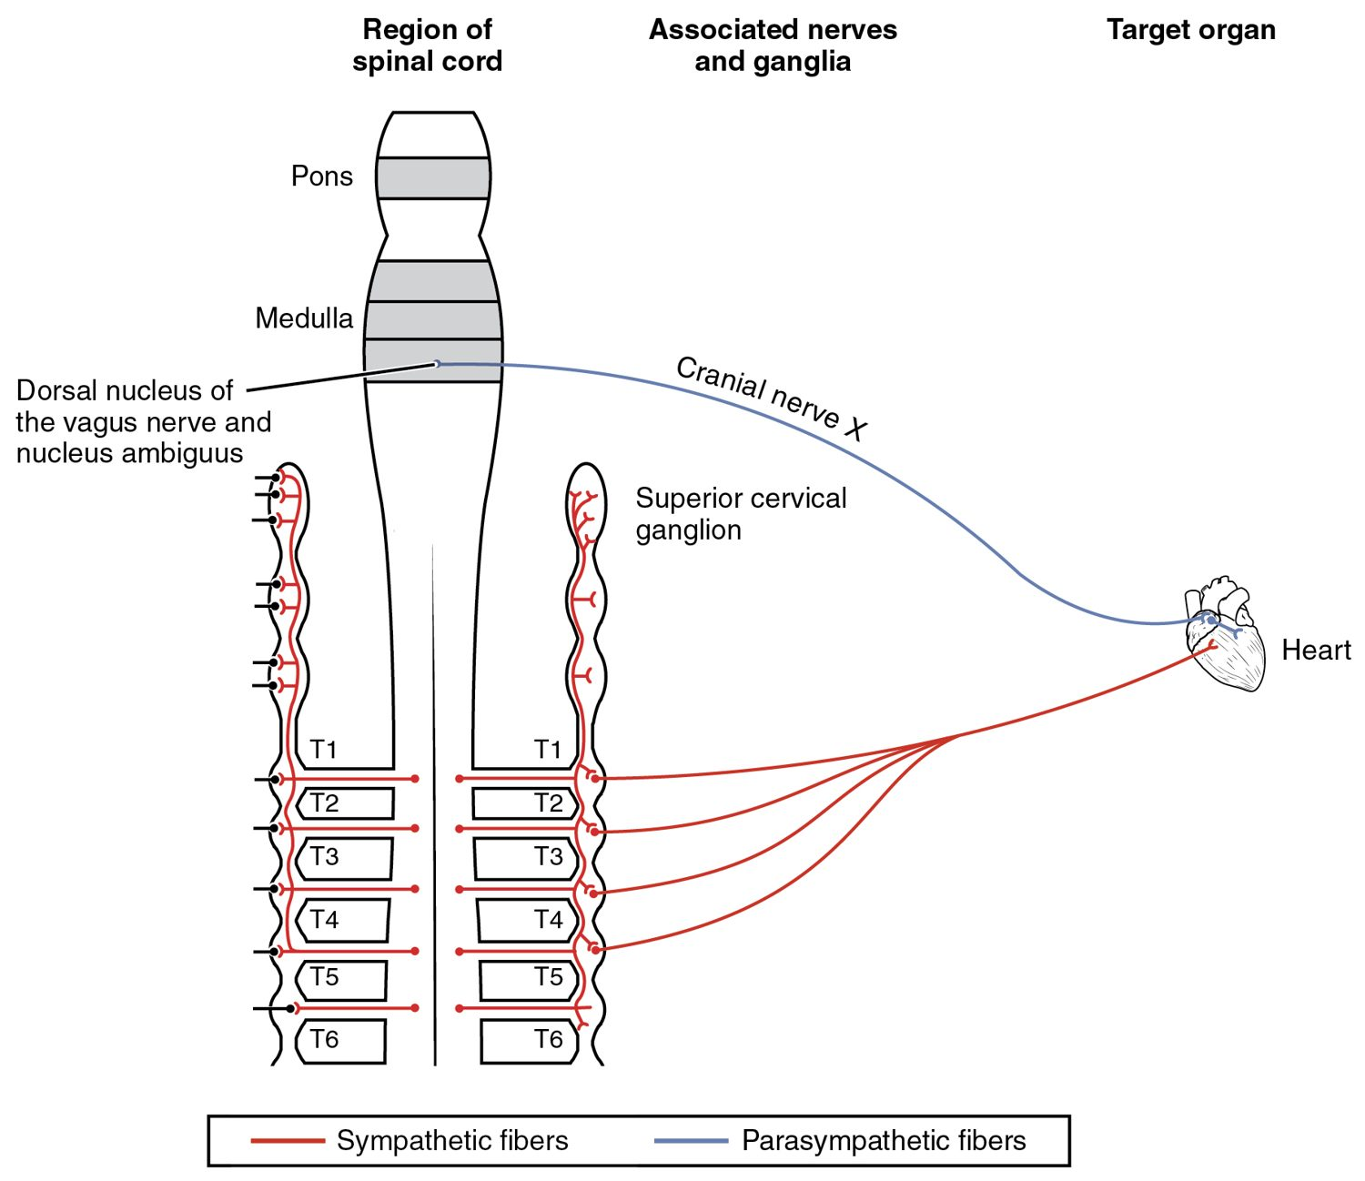
SECTION 15.4
Autonomic Drug Targets
Drugs mimic or block autonomic signals
Affect the heart, vessels, lungs, eyes
Beta-blockers slow the heart
Many common medications act here
Autonomic control of the heart — a drug target
PN 104 · Ch 15 — The Autonomic Nervous System
13
Notes:
READ ALOUD SCRIPT
Now let's focus on Autonomic Drug Targets. Drugs mimic or block autonomic signals. Affect the heart, vessels, lungs, eyes. Beta-blockers slow the heart. Many common medications act here. Autonomic control of the heart — a drug target. Autonomic changes can appear in heart rate, blood pressure, breathing, pupils, digestion, sweating, and bladder function, making careful assessment and reporting essential. Take a moment to identify the structure on the image and explain how its form supports its function. This is slide 13 of 16.
[Sources]
- BMHI PN 104 Chapter 15 faculty PowerPoint slide content.

Slide 14
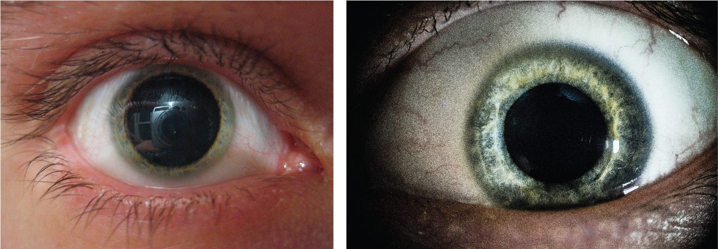
SECTION 15.4
Drug Effects on the Pupil
Autonomic drug effects on the pupil
Autonomic drugs change pupil size
Sympathetic action dilates (mydriasis)
Parasympathetic action constricts (miosis)
Used in eye exams and diagnosis
PN 104 · Ch 15 — The Autonomic Nervous System
14
Notes:
READ ALOUD SCRIPT
Now let's focus on Drug Effects on the Pupil. Autonomic drug effects on the pupil. Autonomic drugs change pupil size. Sympathetic action dilates (mydriasis). Parasympathetic action constricts (miosis). Used in eye exams and diagnosis. Connect sympathetic activation with increased heart rate, dilated airways and pupils, reduced digestive activity, and the body's response to stress or danger. Take a moment to identify the structure on the image and explain how its form supports its function. This is slide 14 of 16.
[Sources]
- BMHI PN 104 Chapter 15 faculty PowerPoint slide content.

Slide 15
CHAPTER 15
Key Takeaways
The autonomic nervous system controls involuntary functions of organs, glands, and vessels.
The sympathetic division drives "fight-or-flight"; the parasympathetic handles "rest-and-digest."
A two-neuron pathway uses acetylcholine and norepinephrine, with receptor type setting the effect.
Most organs receive both divisions, whose balance maintains homeostasis.
The hypothalamus and brainstem control the system, a major target for drugs.
PN 104 · Ch 15 — The Autonomic Nervous System
15
Notes:
READ ALOUD SCRIPT
Let us review the major takeaways from Chapter 15. The autonomic nervous system controls involuntary functions of organs, glands, and vessels. The sympathetic division drives "fight-or-flight"; the parasympathetic handles "rest-and-digest.". A two-neuron pathway uses acetylcholine and norepinephrine, with receptor type setting the effect. Most organs receive both divisions, whose balance maintains homeostasis. The hypothalamus and brainstem control the system, a major target for drugs. Before moving on, pause and explain each point without reading the slide. If any statement is difficult to explain, mark that topic for review before the quiz.
[Sources]
- BMHI PN 104 Chapter 15 faculty PowerPoint slide content.

Slide 16
CLINICAL CONNECTIONS
Why the Autonomic System Matters in Practical Nursing
Blood Pressure
Beta-Blockers
Autonomic reflexes regulate BP and are altered by many drugs.
Block sympathetic signals to slow the heart and lower BP.
Fight-or-Flight
Pupil Assessment
The stress response explains symptoms of anxiety and shock.
Pupil size and reactivity reveal autonomic and brain function.
Bladder & Bowel
Atropine
Autonomic control underlies continence and digestion.
Blocks parasympathetic effects to speed the heart and dry secretions.
Notes:
READ ALOUD SCRIPT
This final slide connects Chapter 15 to practical nursing. Blood Pressure. Autonomic reflexes regulate BP and are altered by many drugs. Beta-Blockers. Block sympathetic signals to slow the heart and lower BP. Fight-or-Flight. The stress response explains symptoms of anxiety and shock. Pupil Assessment. Pupil size and reactivity reveal autonomic and brain function. Bladder & Bowel. Autonomic control underlies continence and digestion. Atropine. Blocks parasympathetic effects to speed the heart and dry secretions. Your role is to observe carefully, protect safety, follow orders and precautions, document objectively, and report changes through the appropriate chain of command. Use these examples to connect anatomy with the care you will provide.
[Sources]
- BMHI PN 104 Chapter 15 faculty PowerPoint slide content.

