Slide 1

CHAPTER 17
The Endocrine System
Chemical control of the body through hormones.
Anatomy & Physiology · Broward-Miami Health Institute
FACULTY EDITION
Notes:
READ ALOUD SCRIPT
Today we are beginning Chapter 17, the endocrine system. In this chapter, we will connect the names and locations of skeletal structures with their functions and with the observations that matter in practical nursing care. As we move through the slides, focus on how structure supports protection, movement, stability, mineral balance, and patient safety. By the end, you should be able to explain the major concepts in your own words and apply them to a patient-care situation.
[Sources]
- BMHI PN 104 Chapter 17 faculty PowerPoint slide content.

Slide 2
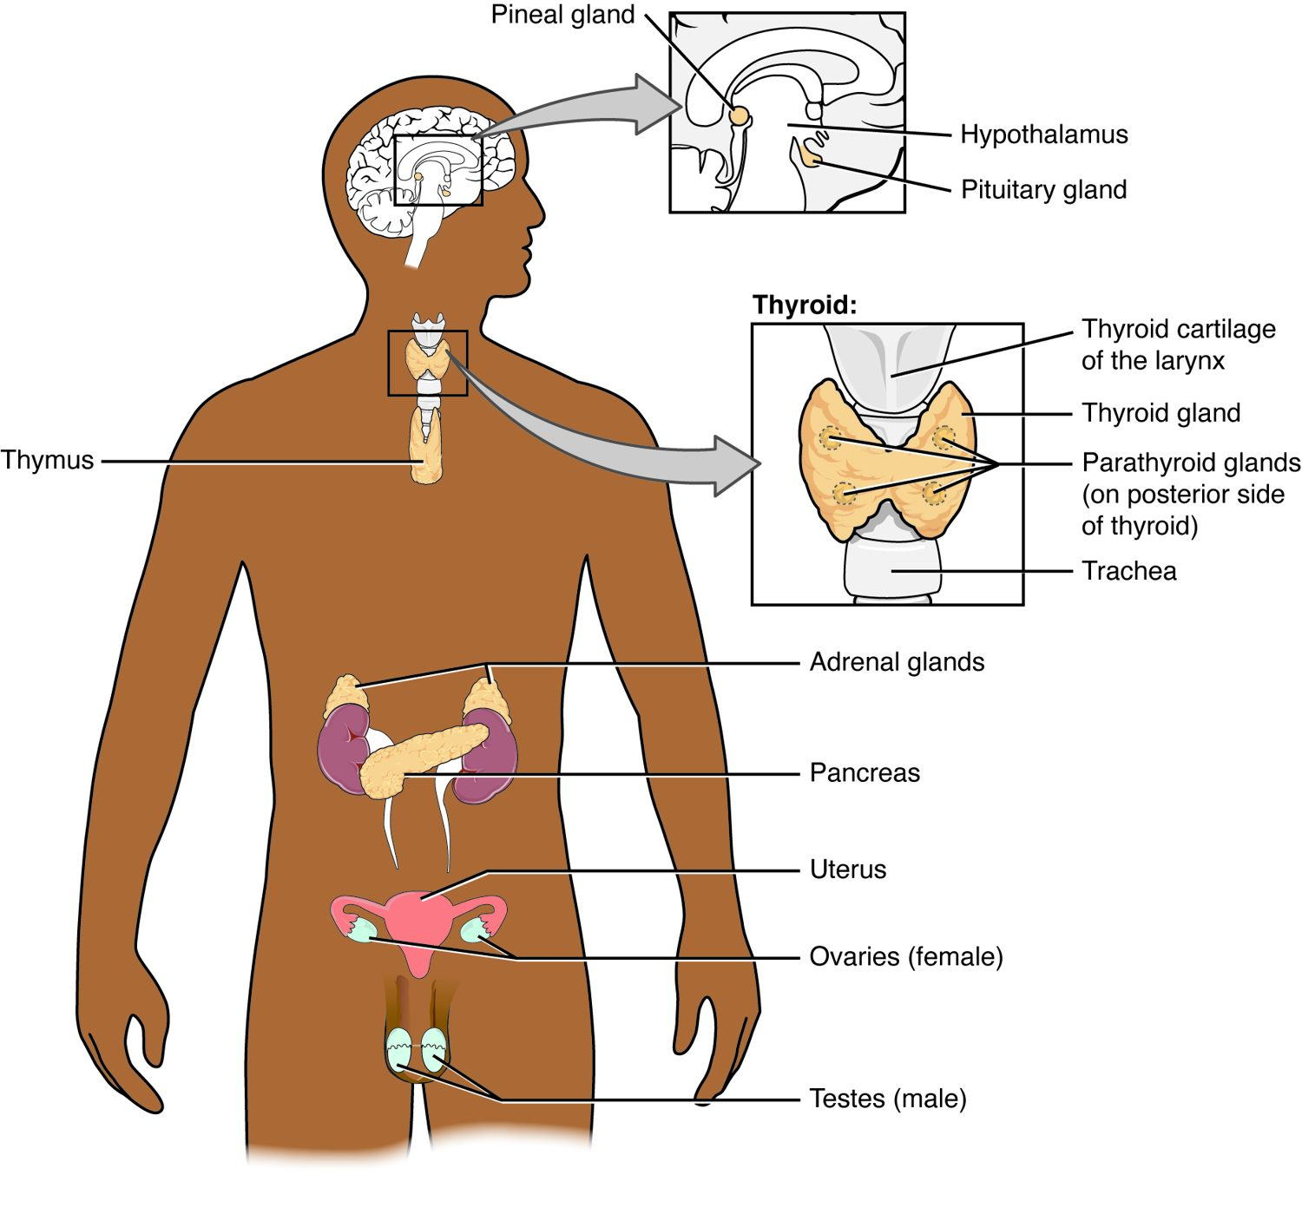
CHAPTER 17
Learning Objectives
After studying this chapter, students will be able to:
1
Identify the contributions of the endocrine system to homeostasis
2
Discuss the chemical composition of hormones and the mechanisms of hormone action
3
Discuss the hormonal regulation of the reproductive system
4
Explain the role of the pancreatic endocrine cells in the regulation of blood glucose
5
Identify the hormones released by the heart, kidneys, and other organs with secondary endocrine functions
6
Discuss several common diseases associated with endocrine system dysfunction
The major endocrine glands of the body.
PN 104 · Ch 17 — The Endocrine System
2
Notes:
READ ALOUD SCRIPT
These are our learning objectives for Chapter 17. By the end of the chapter, you should be able to do the following: Identify the contributions of the endocrine system to homeostasis. Discuss the chemical composition of hormones and the mechanisms of hormone action. Discuss the hormonal regulation of the reproductive system. Explain the role of the pancreatic endocrine cells in the regulation of blood glucose. Identify the hormones released by the heart, kidneys, and other organs with secondary endocrine functions. Do not treat these as isolated facts. Use them as a checklist for what you should be able to identify, explain, and connect to safe practical nursing care.
[Sources]
- BMHI PN 104 Chapter 17 faculty PowerPoint slide content.

Slide 3
17.1
SECTION
An Overview of the Endocrine System
The endocrine system — chemical control through hormones.
Notes:
READ ALOUD SCRIPT
We are now moving into An Overview of the Endocrine System. The endocrine system — chemical control through hormones. As we begin this section, listen for the major structures, their locations, and the functions they perform. Then ask yourself what a change in this area might look like during patient care.
[Sources]
- BMHI PN 104 Chapter 17 faculty PowerPoint slide content.

Slide 4
SECTION 17.1
The Endocrine Glands
Glands secrete hormones into the blood
Hormones travel to distant targets
Control slow, widespread processes
Work alongside the nervous system
The major endocrine glands
PN 104 · Ch 17 — The Endocrine System
4
Notes:
READ ALOUD SCRIPT
Now let's focus on The Endocrine Glands. Glands secrete hormones into the blood. Hormones travel to distant targets. Control slow, widespread processes. Work alongside the nervous system. The major endocrine glands. Endocrine disorders often develop gradually, so compare current findings with the patient's baseline and recognize patterns across multiple body systems. Take a moment to identify the structure on the image and explain how its form supports its function. This is slide 4 of 23.
[Sources]
- BMHI PN 104 Chapter 17 faculty PowerPoint slide content.

Slide 5
17.2
SECTION
Hormones
What hormones are and how they act on target cells.
Notes:
READ ALOUD SCRIPT
We are now moving into Hormones. What hormones are and how they act on target cells. As we begin this section, listen for the major structures, their locations, and the functions they perform. Then ask yourself what a change in this area might look like during patient care.
[Sources]
- BMHI PN 104 Chapter 17 faculty PowerPoint slide content.

Slide 6
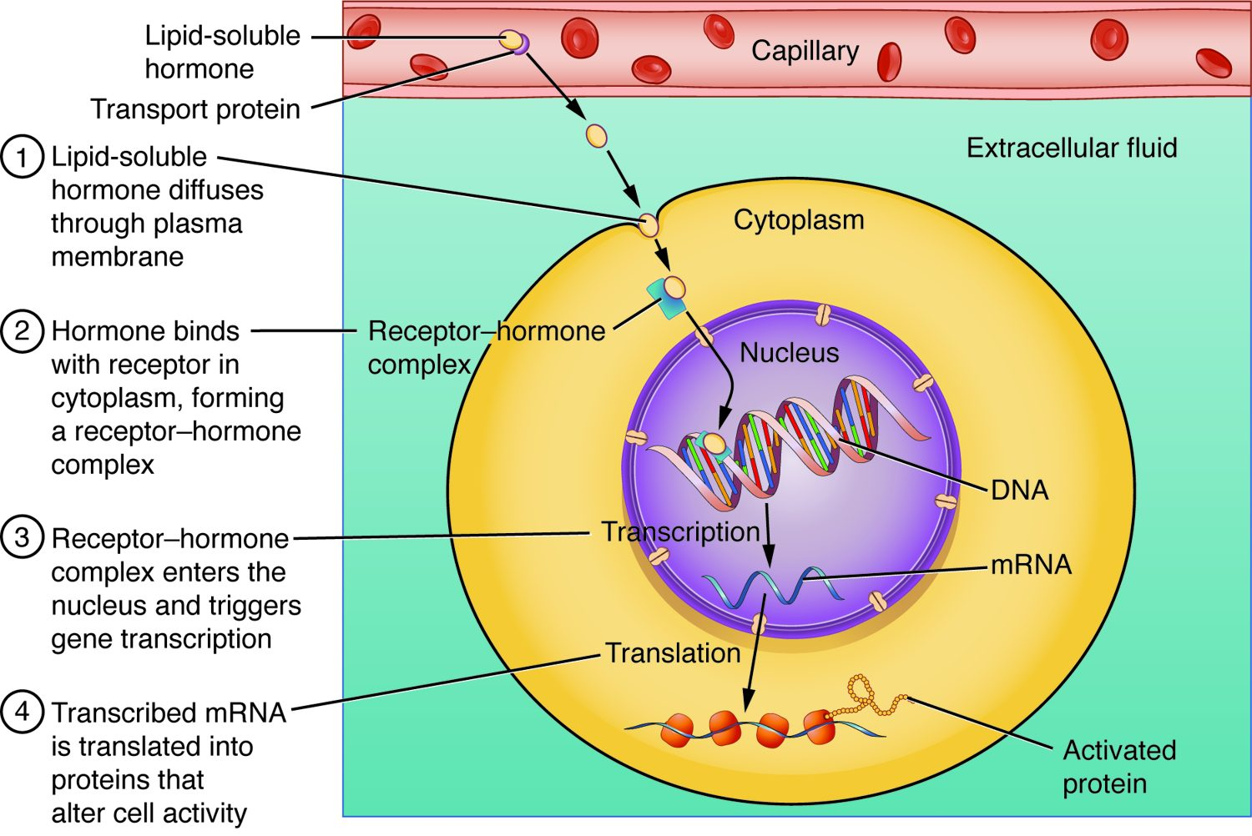
SECTION 17.2
Steroid Hormone Action
Lipid-soluble hormones enter the cell
They pass through the membrane
Bind receptors inside
Switch genes on or off
How a lipid-soluble (steroid) hormone acts
PN 104 · Ch 17 — The Endocrine System
6
Notes:
READ ALOUD SCRIPT
Now let's focus on Steroid Hormone Action. Lipid-soluble hormones enter the cell. They pass through the membrane. Bind receptors inside. Switch genes on or off. How a lipid-soluble (steroid) hormone acts. Endocrine disorders often develop gradually, so compare current findings with the patient's baseline and recognize patterns across multiple body systems. Take a moment to identify the structure on the image and explain how its form supports its function. This is slide 6 of 23.
[Sources]
- BMHI PN 104 Chapter 17 faculty PowerPoint slide content.

Slide 7
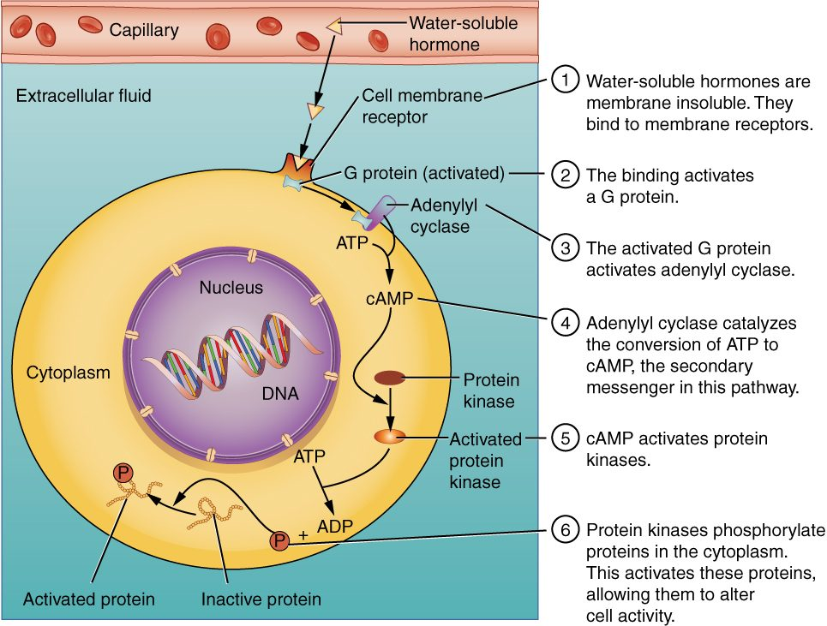
SECTION 17.2
Water-Soluble Hormone Action
Water-soluble hormones can't enter the cell
They bind receptors on the surface
Trigger a second messenger (cAMP)
Produce rapid responses
How a water-soluble hormone acts
PN 104 · Ch 17 — The Endocrine System
7
Notes:
READ ALOUD SCRIPT
Now let's focus on Water-Soluble Hormone Action. Water-soluble hormones can't enter the cell. They bind receptors on the surface. Trigger a second messenger (cAMP). Produce rapid responses. How a water-soluble hormone acts. Endocrine disorders often develop gradually, so compare current findings with the patient's baseline and recognize patterns across multiple body systems. Take a moment to identify the structure on the image and explain how its form supports its function. This is slide 7 of 23.
[Sources]
- BMHI PN 104 Chapter 17 faculty PowerPoint slide content.

Slide 8
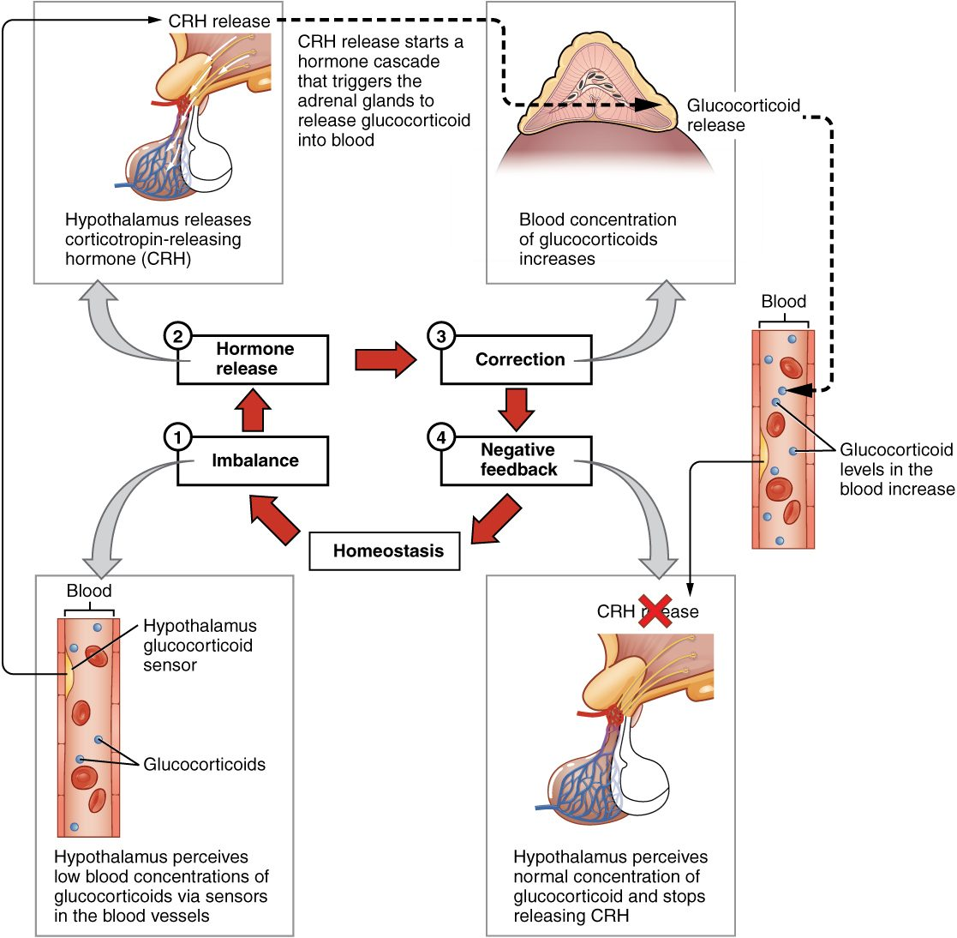
SECTION 17.2
Negative Feedback
Most hormones are feedback-controlled
A change triggers a correcting response
The response shuts off the signal
Keeps levels in a stable range
Negative feedback control of hormones
PN 104 · Ch 17 — The Endocrine System
8
Notes:
READ ALOUD SCRIPT
Now let's focus on Negative Feedback. Most hormones are feedback-controlled. A change triggers a correcting response. The response shuts off the signal. Keeps levels in a stable range. Negative feedback control of hormones. Endocrine disorders often develop gradually, so compare current findings with the patient's baseline and recognize patterns across multiple body systems. Take a moment to identify the structure on the image and explain how its form supports its function. This is slide 8 of 23.
[Sources]
- BMHI PN 104 Chapter 17 faculty PowerPoint slide content.

Slide 9
17.3
SECTION
The Pituitary Gland and Hypothalamus
The pituitary and hypothalamus — the hormonal command center.
Notes:
READ ALOUD SCRIPT
We are now moving into The Pituitary Gland and Hypothalamus. The pituitary and hypothalamus — the hormonal command center. As we begin this section, listen for the major structures, their locations, and the functions they perform. Then ask yourself what a change in this area might look like during patient care.
[Sources]
- BMHI PN 104 Chapter 17 faculty PowerPoint slide content.

Slide 10
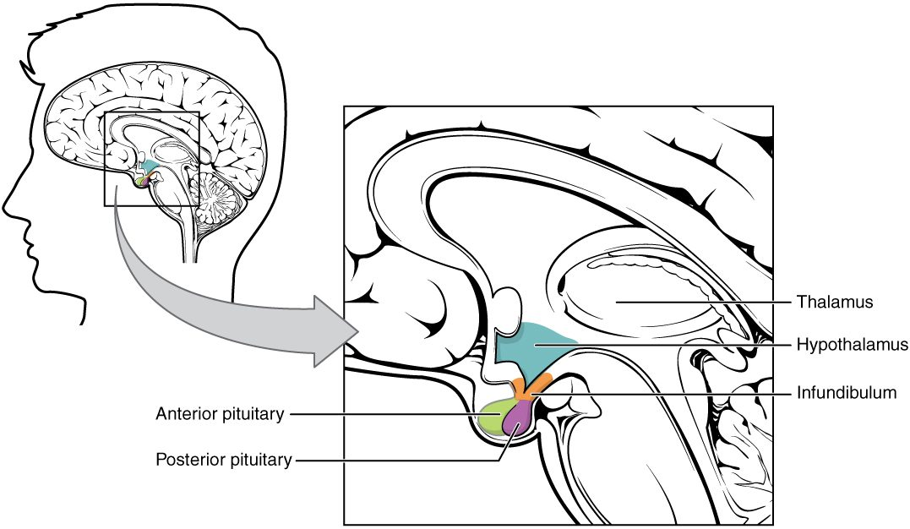
SECTION 17.3
The Pituitary Gland
The pituitary gland and hypothalamus
Sits beneath the hypothalamus
Has anterior and posterior lobes
Controlled by the hypothalamus
Often called the "master gland"
PN 104 · Ch 17 — The Endocrine System
10
Notes:
READ ALOUD SCRIPT
Now let's focus on The Pituitary Gland. The pituitary gland and hypothalamus. Sits beneath the hypothalamus. Has anterior and posterior lobes. Controlled by the hypothalamus. Often called the "master gland". The hypothalamus and pituitary coordinate many other endocrine glands, which is why one disorder may produce findings in several body systems. Take a moment to identify the structure on the image and explain how its form supports its function. This is slide 10 of 23.
[Sources]
- BMHI PN 104 Chapter 17 faculty PowerPoint slide content.

Slide 11
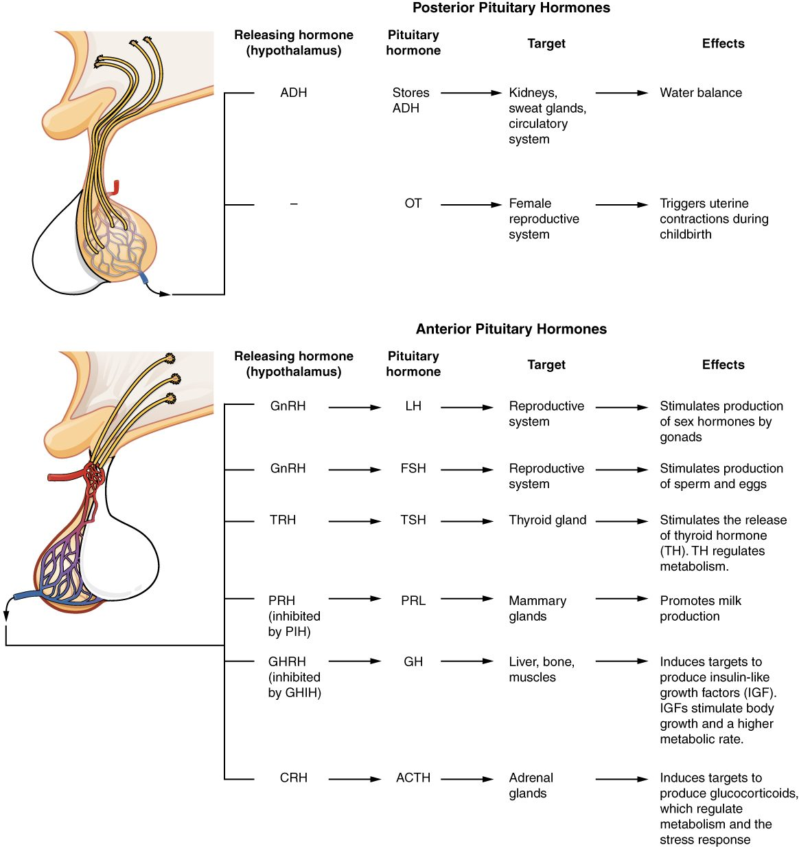
SECTION 17.3
Pituitary Hormones
Anterior lobe makes tropic hormones
Control the thyroid, adrenals, and gonads
Plus growth hormone and prolactin
Posterior releases ADH and oxytocin
Pituitary hormones and their targets
PN 104 · Ch 17 — The Endocrine System
11
Notes:
READ ALOUD SCRIPT
Now let's focus on Pituitary Hormones. Pituitary hormones and their targets. Anterior lobe makes tropic hormones. Control the thyroid, adrenals, and gonads. Plus growth hormone and prolactin. Posterior releases ADH and oxytocin. Thyroid imbalance may affect energy, temperature tolerance, heart rate, weight, bowel function, skin, and mental status. Take a moment to identify the structure on the image and explain how its form supports its function. This is slide 11 of 23.
[Sources]
- BMHI PN 104 Chapter 17 faculty PowerPoint slide content.

Slide 12
17.4
SECTION
The Thyroid Gland
The thyroid gland and its role in metabolism.
Notes:
READ ALOUD SCRIPT
We are now moving into The Thyroid Gland. The thyroid gland and its role in metabolism. As we begin this section, listen for the major structures, their locations, and the functions they perform. Then ask yourself what a change in this area might look like during patient care.
[Sources]
- BMHI PN 104 Chapter 17 faculty PowerPoint slide content.

Slide 13
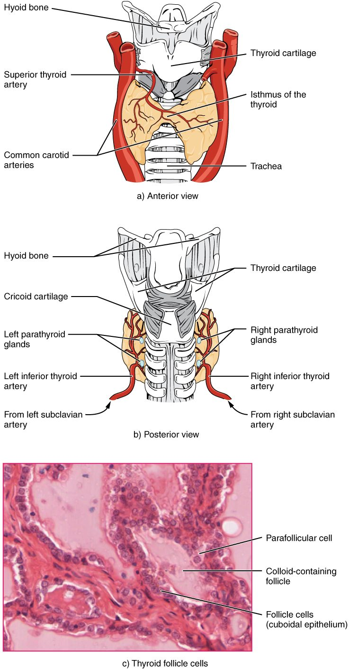
SECTION 17.4
The Thyroid Gland
Located in the front of the neck
Wraps around the trachea
Makes thyroid hormone (T3, T4)
Requires iodine
The thyroid gland
PN 104 · Ch 17 — The Endocrine System
13
Notes:
READ ALOUD SCRIPT
Now let's focus on The Thyroid Gland. The thyroid gland. Located in the front of the neck. Wraps around the trachea. Makes thyroid hormone (T3, T4). Requires iodine. Thyroid imbalance may affect energy, temperature tolerance, heart rate, weight, bowel function, skin, and mental status. Take a moment to identify the structure on the image and explain how its form supports its function. This is slide 13 of 23.
[Sources]
- BMHI PN 104 Chapter 17 faculty PowerPoint slide content.

Slide 14
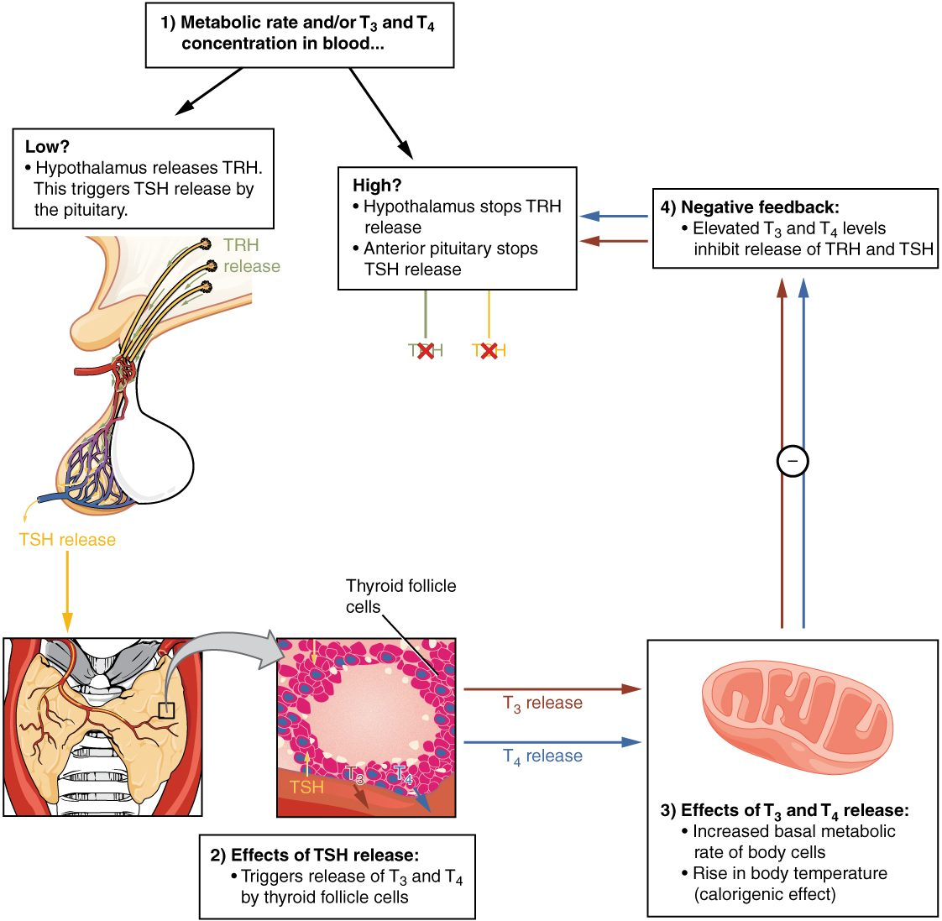
SECTION 17.4
Thyroid Function & Feedback
TSH from the pituitary drives it
T3 and T4 raise metabolic rate
Feedback keeps levels balanced
Imbalance causes disease
Control of thyroid hormone
PN 104 · Ch 17 — The Endocrine System
14
Notes:
READ ALOUD SCRIPT
Now let's focus on Thyroid Function & Feedback. TSH from the pituitary drives it. T3 and T4 raise metabolic rate. Feedback keeps levels balanced. Imbalance causes disease. Control of thyroid hormone. Thyroid imbalance may affect energy, temperature tolerance, heart rate, weight, bowel function, skin, and mental status. Take a moment to identify the structure on the image and explain how its form supports its function. This is slide 14 of 23.
[Sources]
- BMHI PN 104 Chapter 17 faculty PowerPoint slide content.

Slide 15
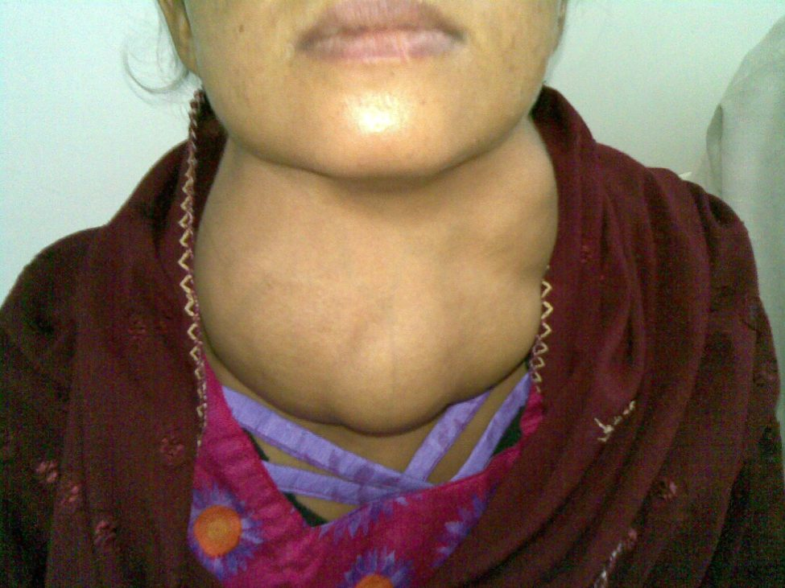
SECTION 17.4
Goiter
An enlarged thyroid gland
Often from iodine deficiency
Can occur with over- or underactivity
A visible neck swelling
Goiter (enlarged thyroid)
PN 104 · Ch 17 — The Endocrine System
15
Notes:
READ ALOUD SCRIPT
Now let's focus on Goiter. An enlarged thyroid gland. Often from iodine deficiency. Can occur with over- or underactivity. A visible neck swelling. Goiter (enlarged thyroid). Thyroid imbalance may affect energy, temperature tolerance, heart rate, weight, bowel function, skin, and mental status. Take a moment to identify the structure on the image and explain how its form supports its function. This is slide 15 of 23.
[Sources]
- BMHI PN 104 Chapter 17 faculty PowerPoint slide content.

Slide 16
17.5
SECTION
The Parathyroid Glands
The parathyroid glands and calcium balance.
Notes:
READ ALOUD SCRIPT
We are now moving into The Parathyroid Glands. The parathyroid glands and calcium balance. As we begin this section, listen for the major structures, their locations, and the functions they perform. Then ask yourself what a change in this area might look like during patient care.
[Sources]
- BMHI PN 104 Chapter 17 faculty PowerPoint slide content.

Slide 17
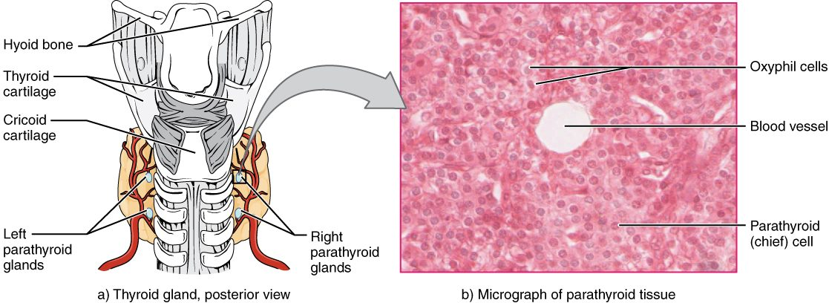
SECTION 17.5
The Parathyroid Glands
The parathyroid glands
Four small glands behind the thyroid
Make parathyroid hormone (PTH)
Tiny but essential
Regulate blood calcium
PN 104 · Ch 17 — The Endocrine System
17
Notes:
READ ALOUD SCRIPT
Now let's focus on The Parathyroid Glands. The parathyroid glands. Four small glands behind the thyroid. Make parathyroid hormone (PTH). Tiny but essential. Regulate blood calcium. Thyroid imbalance may affect energy, temperature tolerance, heart rate, weight, bowel function, skin, and mental status. Take a moment to identify the structure on the image and explain how its form supports its function. This is slide 17 of 23.
[Sources]
- BMHI PN 104 Chapter 17 faculty PowerPoint slide content.

Slide 18
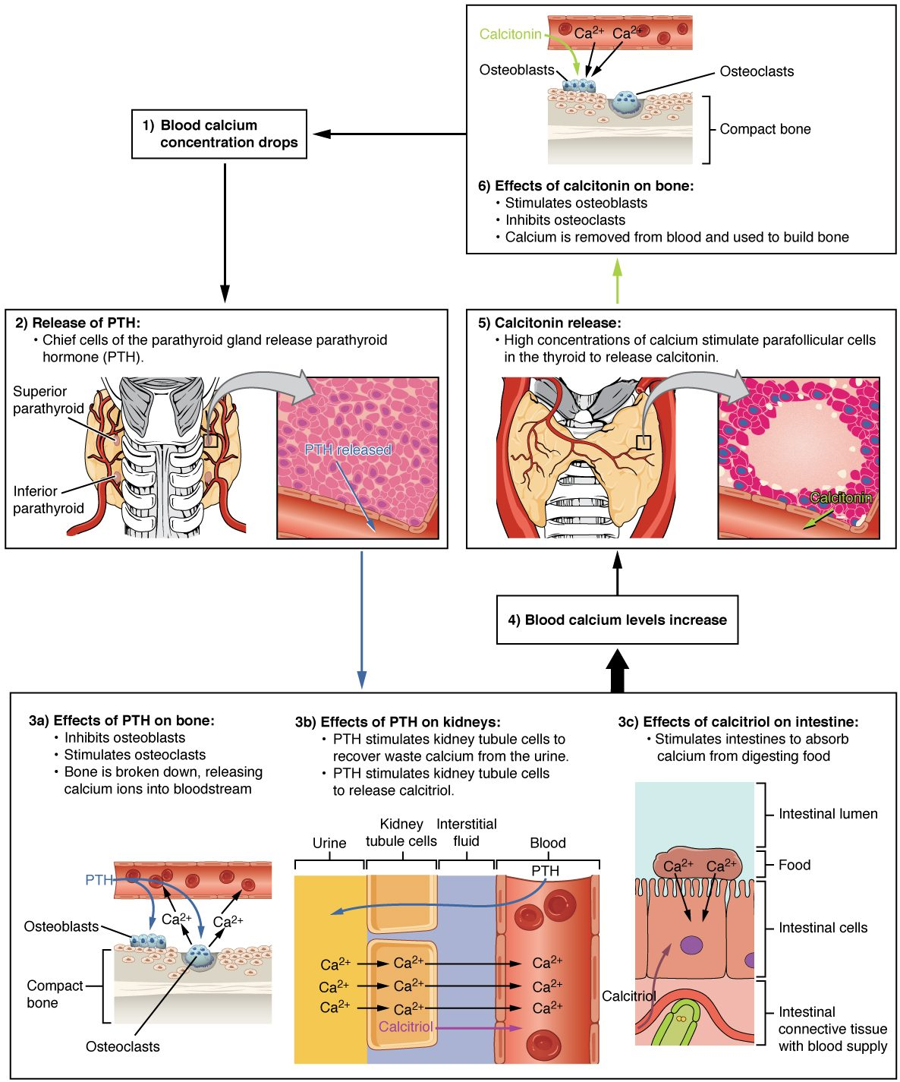
SECTION 17.5
Calcium Regulation
PTH raises blood calcium
Acts on bone, kidney, and intestine
Calcitonin lowers calcium
Balance is tightly controlled
Hormonal control of blood calcium
PN 104 · Ch 17 — The Endocrine System
18
Notes:
READ ALOUD SCRIPT
Now let's focus on Calcium Regulation. Hormonal control of blood calcium. PTH raises blood calcium. Acts on bone, kidney, and intestine. Calcitonin lowers calcium. Balance is tightly controlled. Endocrine disorders often develop gradually, so compare current findings with the patient's baseline and recognize patterns across multiple body systems. Take a moment to identify the structure on the image and explain how its form supports its function. This is slide 18 of 23.
[Sources]
- BMHI PN 104 Chapter 17 faculty PowerPoint slide content.

Slide 19
17.9
SECTION
The Endocrine Pancreas
The pancreas and the control of blood sugar.
Notes:
READ ALOUD SCRIPT
We are now moving into The Endocrine Pancreas. The pancreas and the control of blood sugar. As we begin this section, listen for the major structures, their locations, and the functions they perform. Then ask yourself what a change in this area might look like during patient care.
[Sources]
- BMHI PN 104 Chapter 17 faculty PowerPoint slide content.

Slide 20
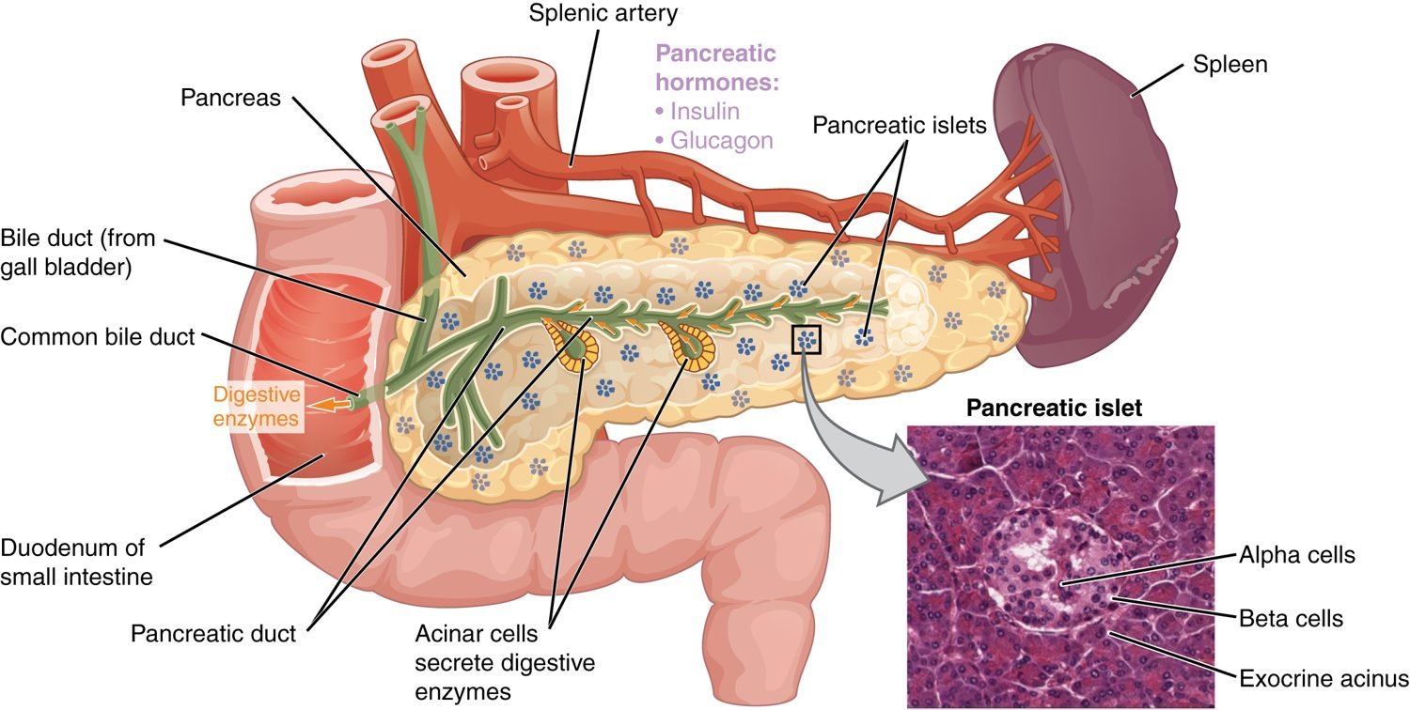
SECTION 17.9
The Endocrine Pancreas
The endocrine pancreas and its islets
Islets scattered in the pancreas
Alpha cells make glucagon
Beta cells make insulin
Both regulate blood glucose
PN 104 · Ch 17 — The Endocrine System
20
Notes:
READ ALOUD SCRIPT
Now let's focus on The Endocrine Pancreas. The endocrine pancreas and its islets. Islets scattered in the pancreas. Alpha cells make glucagon. Beta cells make insulin. Both regulate blood glucose. Monitor for signs of hypo- or hyperglycemia, verify glucose results, follow medication and meal timing, and report significant changes promptly. Take a moment to identify the structure on the image and explain how its form supports its function. This is slide 20 of 23.
[Sources]
- BMHI PN 104 Chapter 17 faculty PowerPoint slide content.

Slide 21
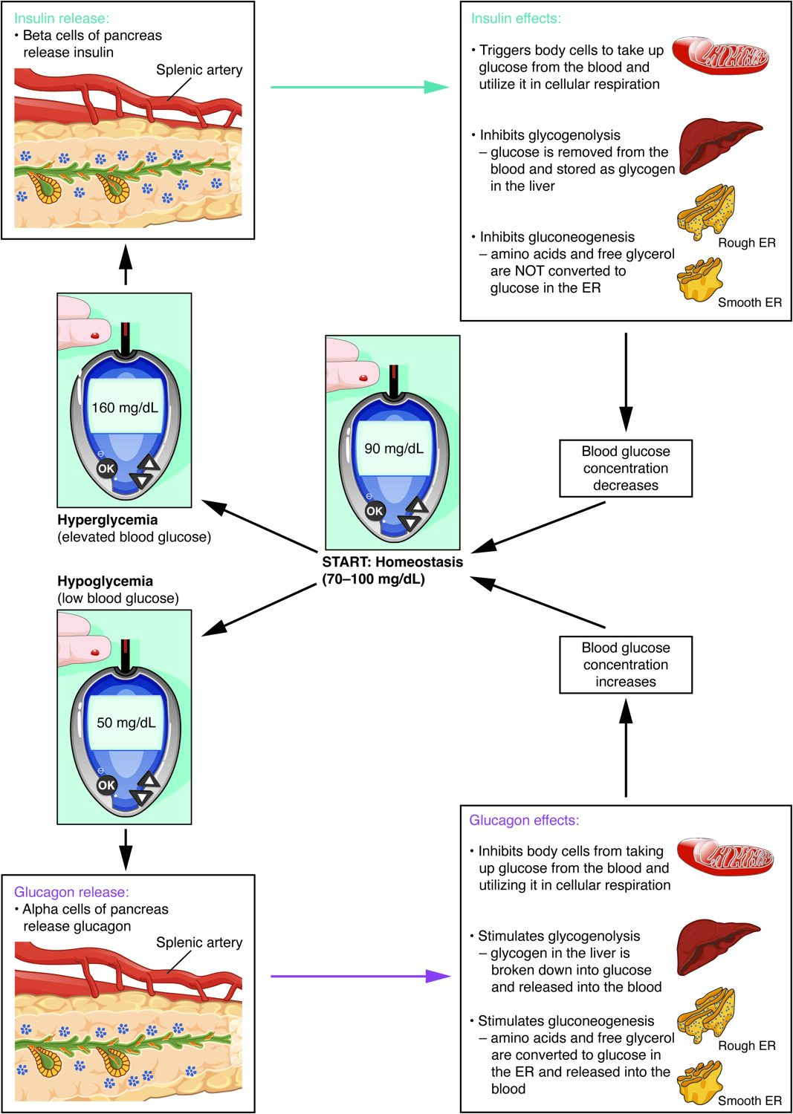
SECTION 17.9
Blood Glucose Regulation
Insulin lowers blood glucose
Glucagon raises it
The two oppose to keep balance
Failure causes diabetes
Insulin, glucagon, and blood glucose
PN 104 · Ch 17 — The Endocrine System
21
Notes:
READ ALOUD SCRIPT
Now let's focus on Blood Glucose Regulation. Insulin, glucagon, and blood glucose. Insulin lowers blood glucose. Glucagon raises it. The two oppose to keep balance. Failure causes diabetes. Monitor for signs of hypo- or hyperglycemia, verify glucose results, follow medication and meal timing, and report significant changes promptly. Take a moment to identify the structure on the image and explain how its form supports its function. This is slide 21 of 23.
[Sources]
- BMHI PN 104 Chapter 17 faculty PowerPoint slide content.

Slide 22
CHAPTER 17
Key Takeaways
The endocrine system uses hormones in the blood to control slow, widespread body processes.
Lipid-soluble hormones act on genes inside the cell; water-soluble ones use surface receptors.
Negative feedback keeps most hormone levels in a stable range.
The pituitary and hypothalamus direct the thyroid, adrenal glands, and gonads.
The thyroid, parathyroids, and pancreas control metabolism, calcium, and blood sugar.
PN 104 · Ch 17 — The Endocrine System
22
Notes:
READ ALOUD SCRIPT
Let us review the major takeaways from Chapter 17. The endocrine system uses hormones in the blood to control slow, widespread body processes. Lipid-soluble hormones act on genes inside the cell; water-soluble ones use surface receptors. Negative feedback keeps most hormone levels in a stable range. The pituitary and hypothalamus direct the thyroid, adrenal glands, and gonads. The thyroid, parathyroids, and pancreas control metabolism, calcium, and blood sugar. Before moving on, pause and explain each point without reading the slide. If any statement is difficult to explain, mark that topic for review before the quiz.
[Sources]
- BMHI PN 104 Chapter 17 faculty PowerPoint slide content.

Slide 23
CLINICAL CONNECTIONS
Why the Endocrine System Matters in Practical Nursing
Diabetes Mellitus
Thyroid Disorders
Insulin problems disrupt blood sugar — a major focus of nursing care.
Hypo- and hyperthyroidism are common and very treatable.
Hormone Feedback
Calcium Balance
Many endocrine diseases stem from broken feedback loops.
Parathyroid problems disturb calcium and nerve/muscle function.
The Stress Response
Growth & Development
Cortisol and the HPA axis shape illness and recovery.
Pituitary hormones affect growth across the lifespan.
Notes:
READ ALOUD SCRIPT
This final slide connects Chapter 17 to practical nursing. Diabetes Mellitus. Insulin problems disrupt blood sugar — a major focus of nursing care. Thyroid Disorders. Hypo- and hyperthyroidism are common and very treatable. Hormone Feedback. Many endocrine diseases stem from broken feedback loops. Calcium Balance. Parathyroid problems disturb calcium and nerve/muscle function. The Stress Response. Cortisol and the HPA axis shape illness and recovery. Growth & Development. Pituitary hormones affect growth across the lifespan. Your role is to observe carefully, protect safety, follow orders and precautions, document objectively, and report changes through the appropriate chain of command. Use these examples to connect anatomy with the care you will provide.
[Sources]
- BMHI PN 104 Chapter 17 faculty PowerPoint slide content.

