Slide 1
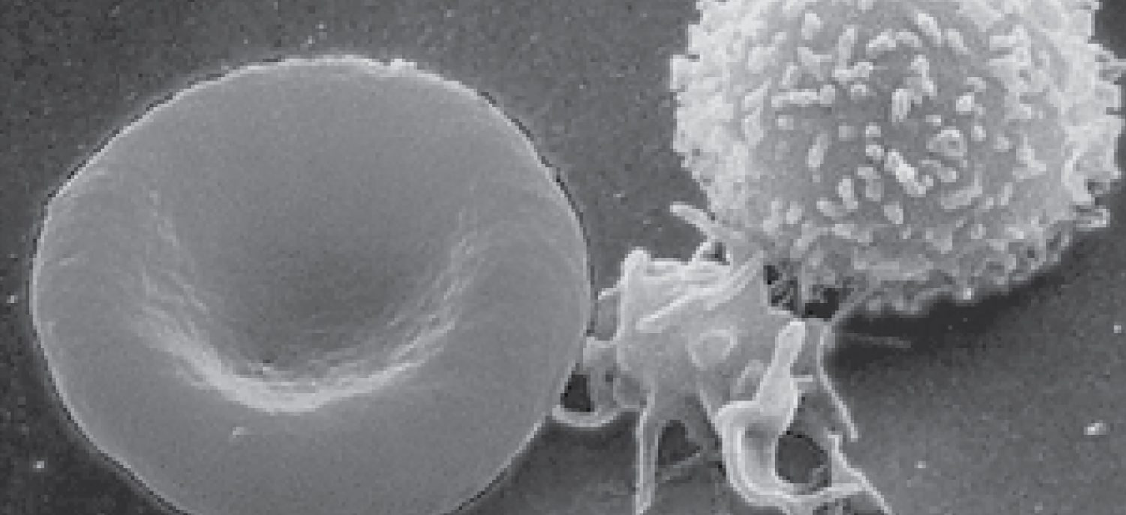
CHAPTER 18
The Cardiovascular System: Blood
Plasma, blood cells, clotting, and blood types.
Anatomy & Physiology · Broward-Miami Health Institute
FACULTY EDITION

Slide 2
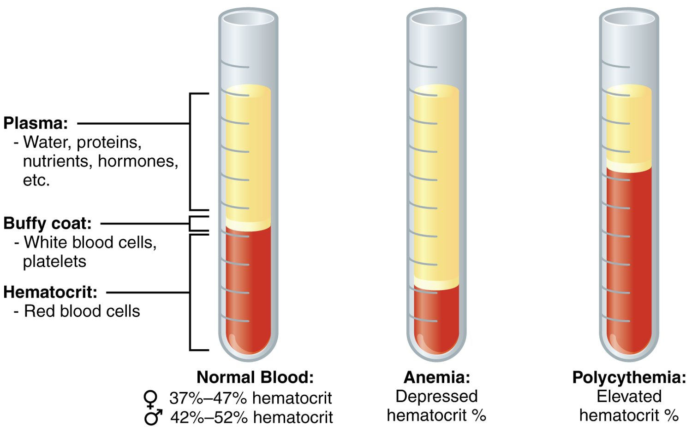
CHAPTER 18
Learning Objectives
After studying this chapter, students will be able to:
1
Identify the primary functions of blood, its fluid and cellular components, and its physical characteristics
2
Identify the most important proteins and other solutes present in blood plasma
3
Describe the formation of the formed element components of blood
4
Discuss the structure and function of red blood cells and hemoglobin
5
Classify and characterize white blood cells
6
Describe the structure of platelets and explain the process of hemostasis
Blood: plasma and formed elements.
PN 104 · Ch 18 — The Cardiovascular System: Blood
2

Slide 3
18.1
SECTION
An Overview of Blood
What blood is made of and what it does.

Slide 4
SECTION 18.1
Composition of Blood
Blood: plasma and formed elements
Plasma is the liquid portion (~55%)
Formed elements are cells (~45%)
Buffy coat = white cells and platelets
Hematocrit = percent red cells
PN 104 · Ch 18 — The Cardiovascular System: Blood
4

Slide 5
18.2
SECTION
Production of the Formed Elements
How blood cells are produced in red bone marrow.

Slide 6
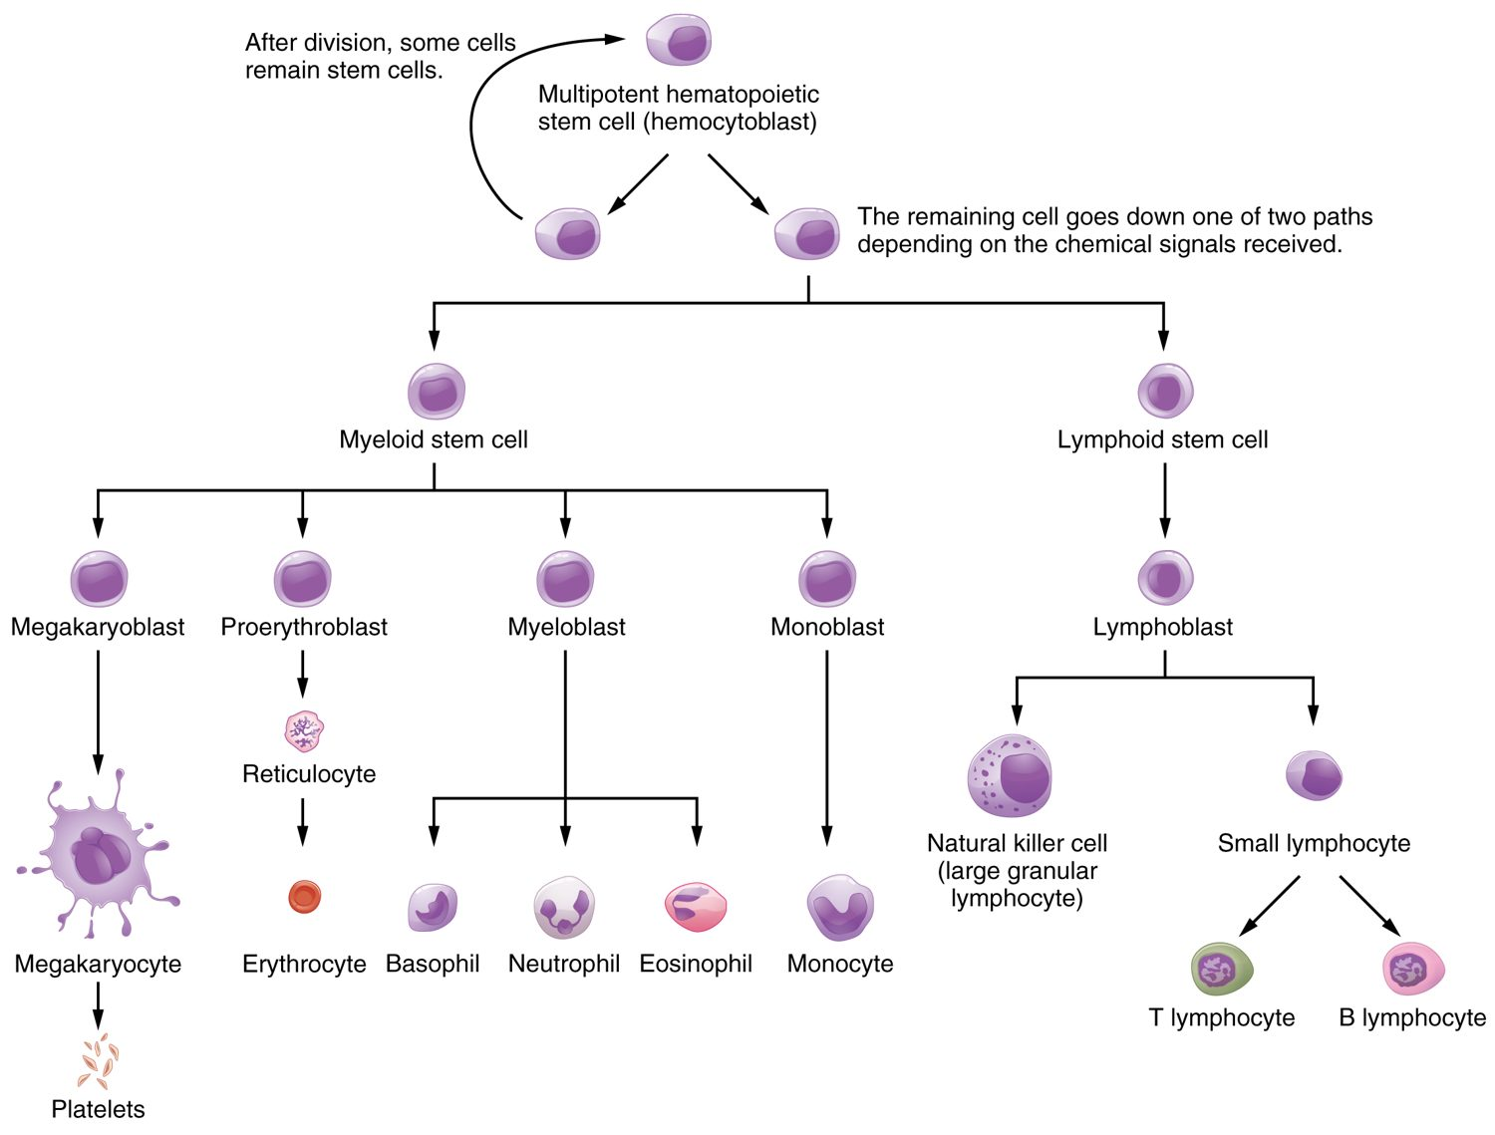
SECTION 18.2
Hematopoiesis
All blood cells form in red marrow
Start from one stem cell
Myeloid line → most cell types
Lymphoid line → lymphocytes
Hematopoiesis: the formation of blood cells
PN 104 · Ch 18 — The Cardiovascular System: Blood
6

Slide 7
18.3
SECTION
Erythrocytes
Red blood cells and oxygen transport.

Slide 8
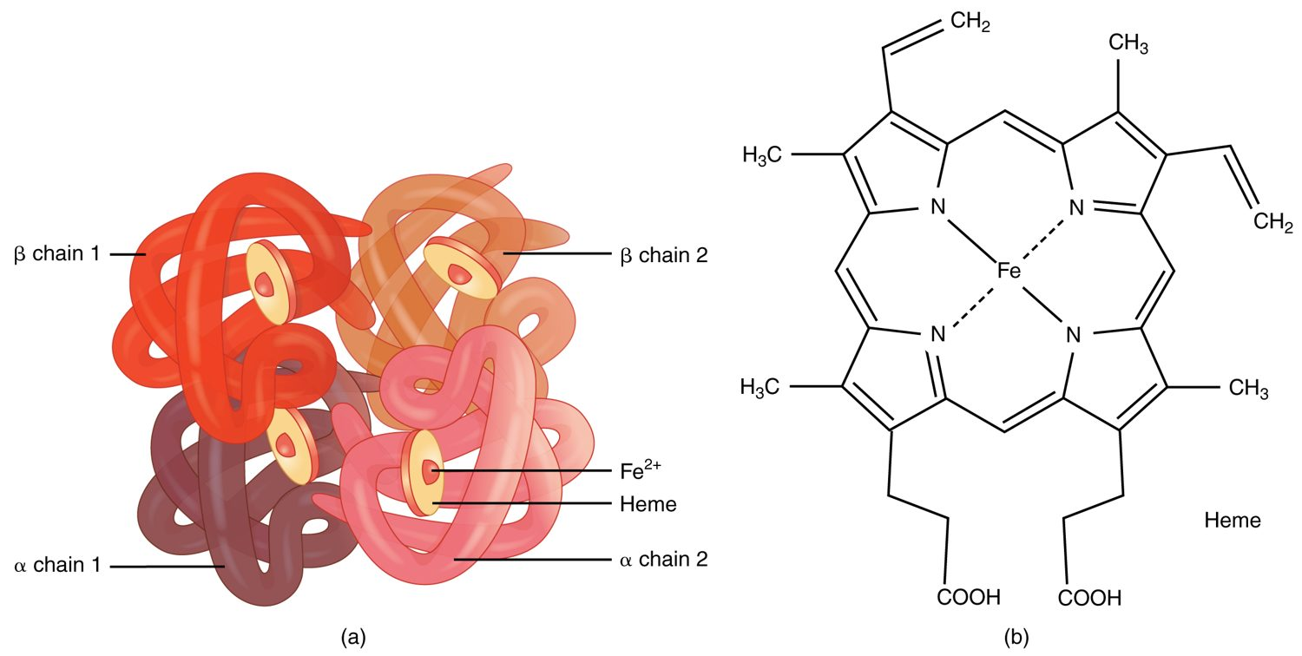
SECTION 18.3
Hemoglobin
The structure of hemoglobin
The oxygen-carrying protein in red cells
Four globin chains
Each holds an iron-rich heme group
Iron binds the oxygen
PN 104 · Ch 18 — The Cardiovascular System: Blood
8

Slide 9
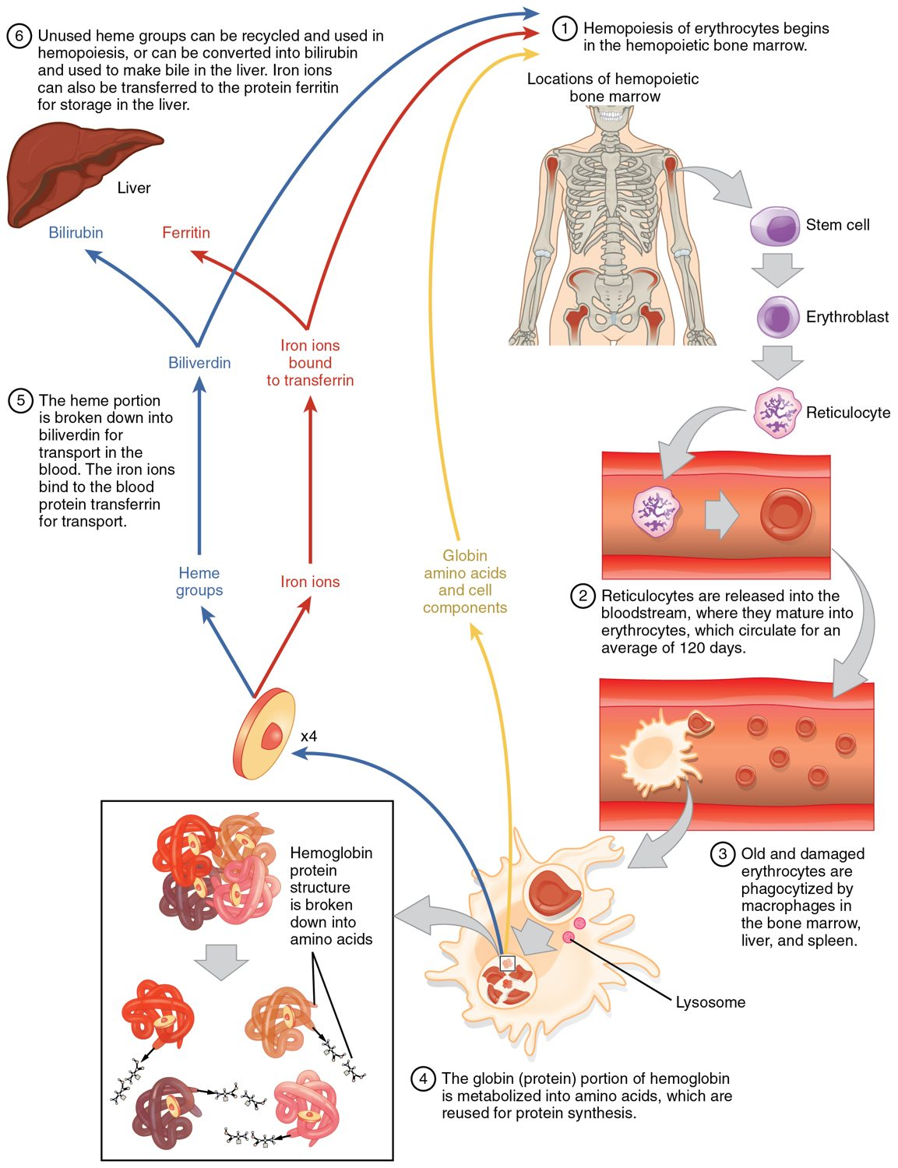
SECTION 18.3
Red Blood Cell Life Cycle
Red cells live about 120 days
Old cells broken down in spleen and liver
Iron is recycled
Heme becomes bilirubin
The life cycle of a red blood cell
PN 104 · Ch 18 — The Cardiovascular System: Blood
9

Slide 10
18.4
SECTION
Leukocytes and Platelets
White blood cells and platelets — defense and clotting.

Slide 11
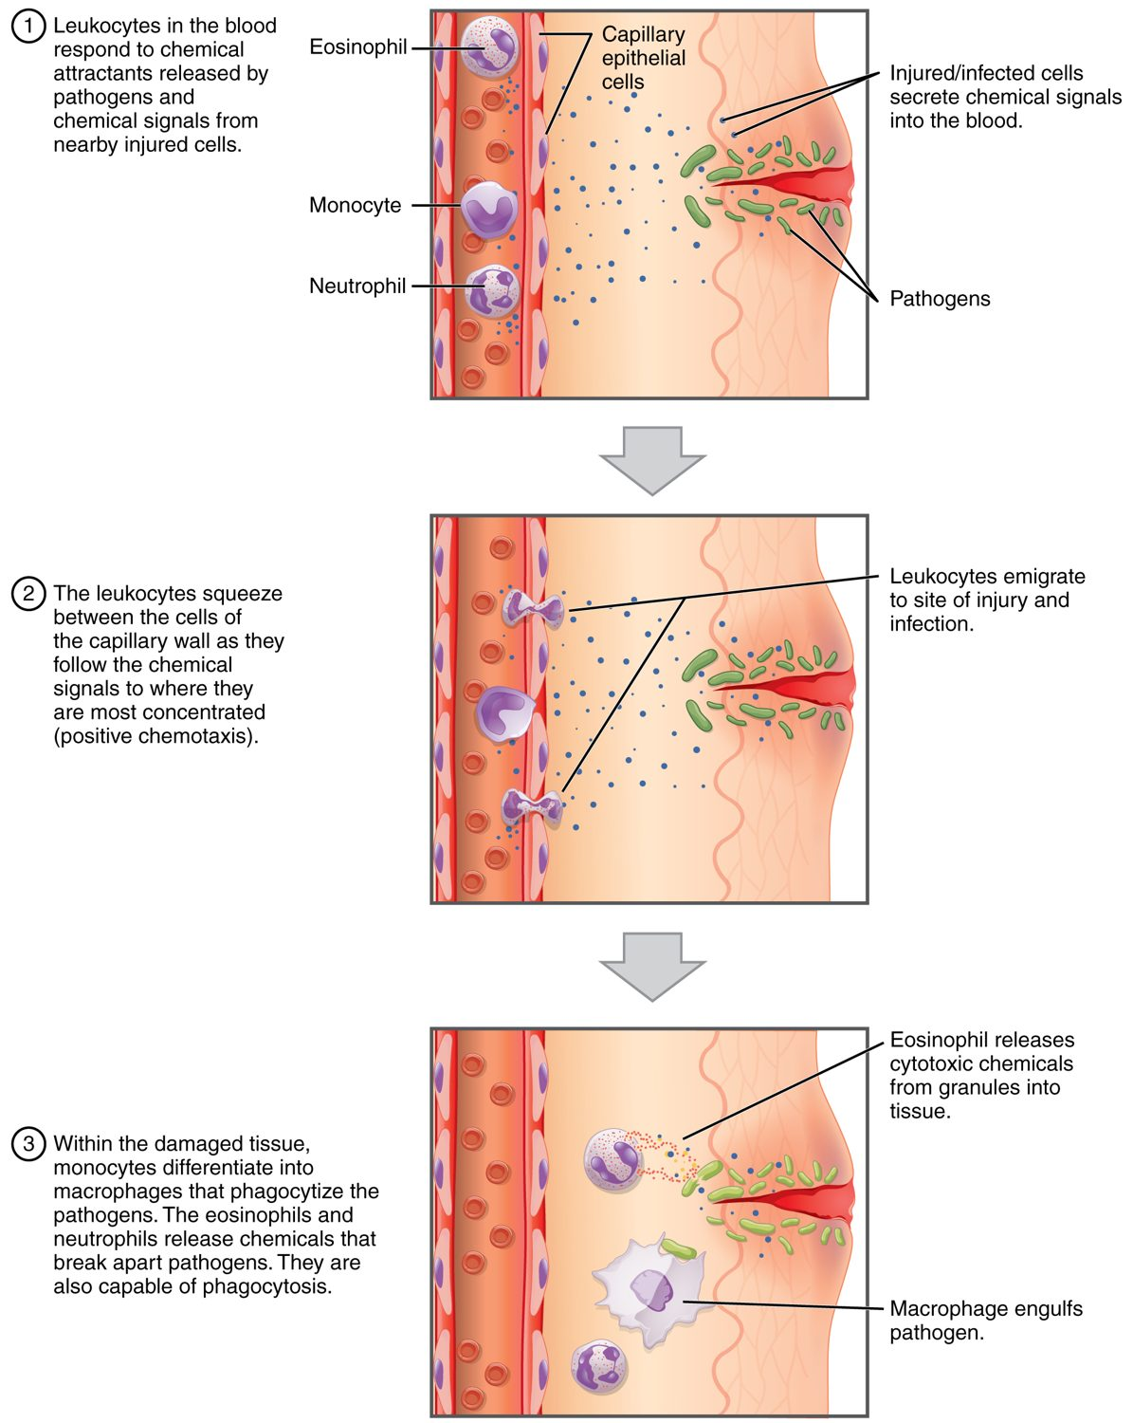
SECTION 18.4
How Leukocytes Fight Infection
White cells defend against infection
Leave vessels by diapedesis
Move toward chemical signals
Engulf pathogens (phagocytosis)
How leukocytes fight infection
PN 104 · Ch 18 — The Cardiovascular System: Blood
11

Slide 12
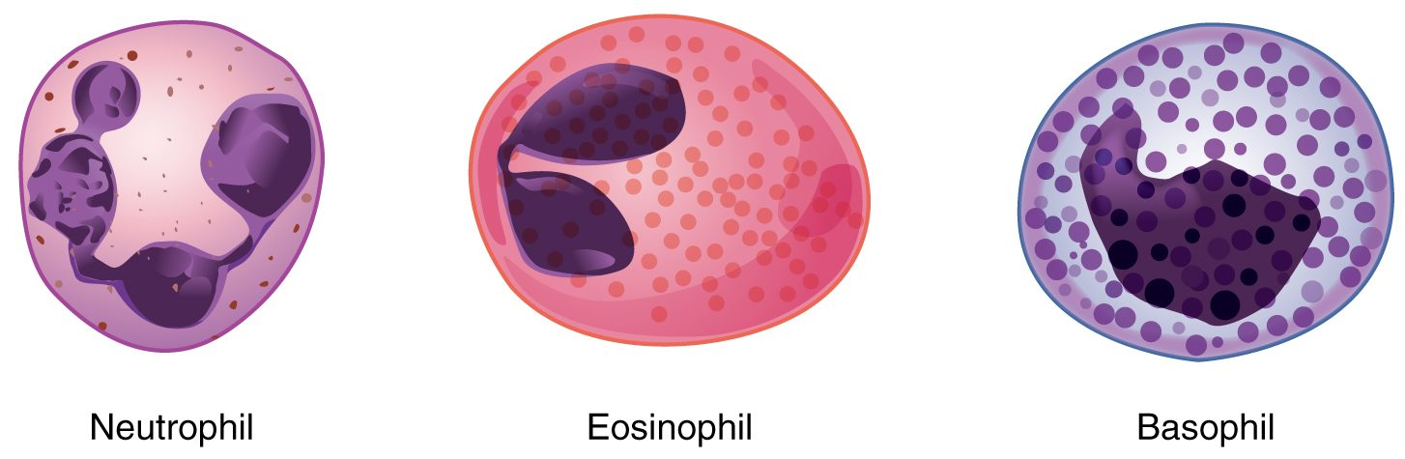
SECTION 18.4
Types of White Blood Cells
The granular leukocytes
Five types of leukocytes
Granulocytes: neutrophil, eosinophil, basophil
Agranulocytes: lymphocyte, monocyte
Each has a specific role
PN 104 · Ch 18 — The Cardiovascular System: Blood
12

Slide 13
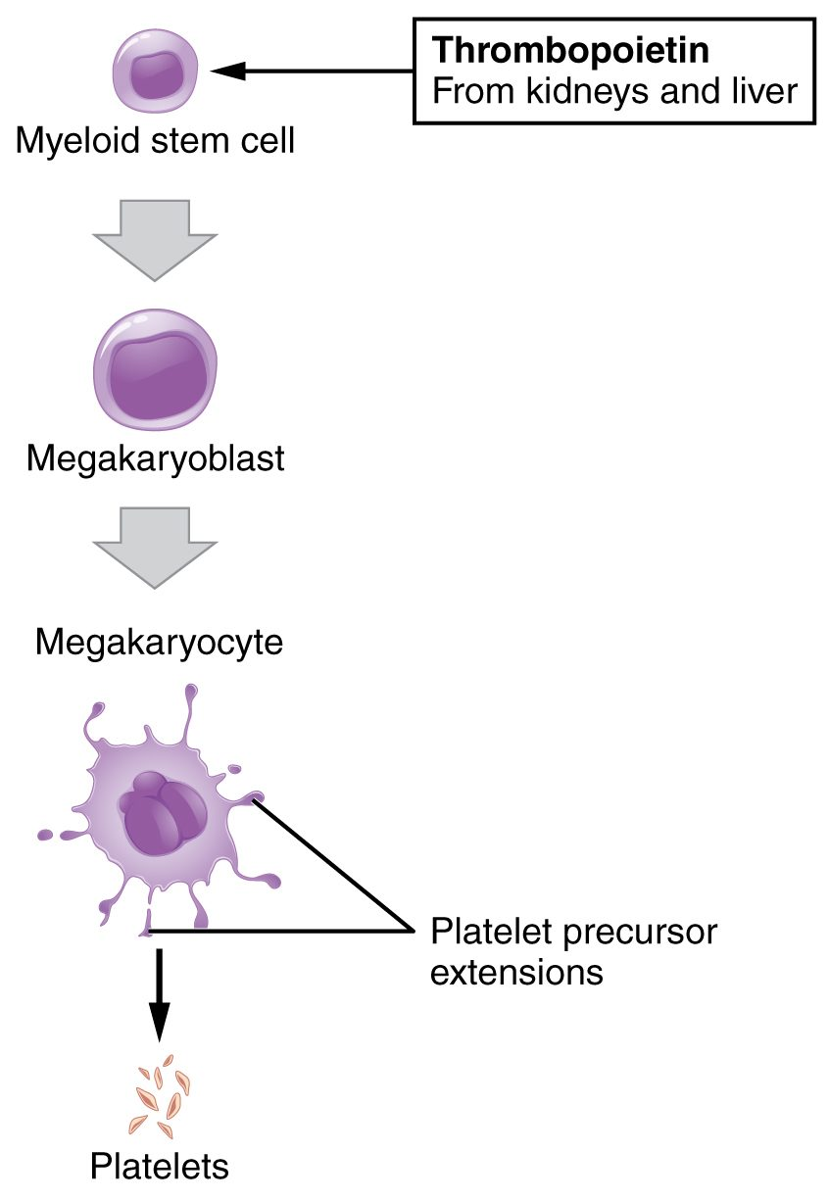
SECTION 18.4
Platelet Formation
Platelets are cell fragments
Shed from megakaryocytes
Driven by thrombopoietin
Essential for clotting
The formation of platelets
PN 104 · Ch 18 — The Cardiovascular System: Blood
13

Slide 14
18.5
SECTION
Hemostasis
Hemostasis — how the body stops bleeding.

Slide 15
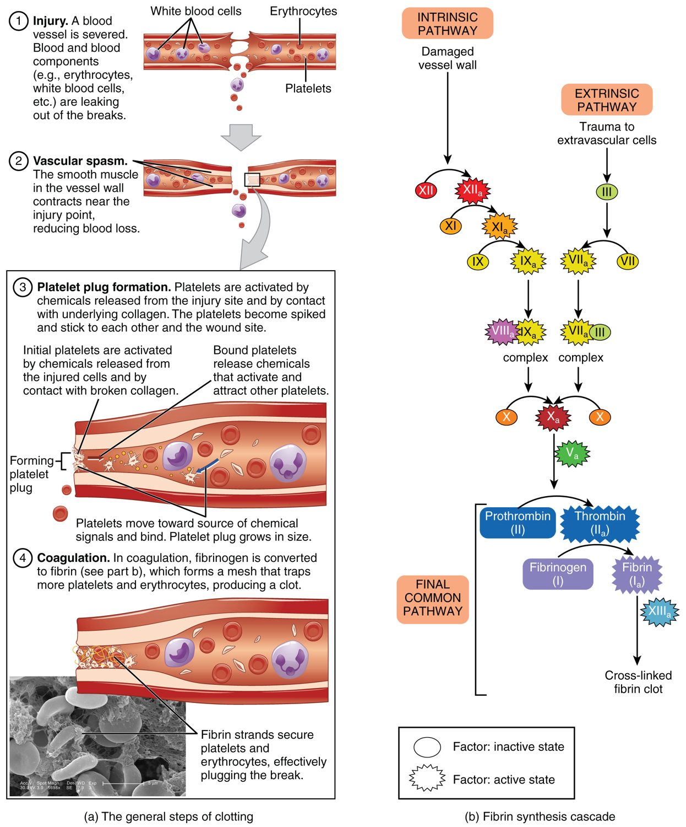
SECTION 18.5
Hemostasis
Stops bleeding in three steps
Vascular spasm narrows the vessel
A platelet plug forms
Coagulation makes a fibrin clot
The steps of hemostasis
PN 104 · Ch 18 — The Cardiovascular System: Blood
15

Slide 16
18.6
SECTION
Blood Typing
Blood typing and transfusion compatibility.

Slide 17
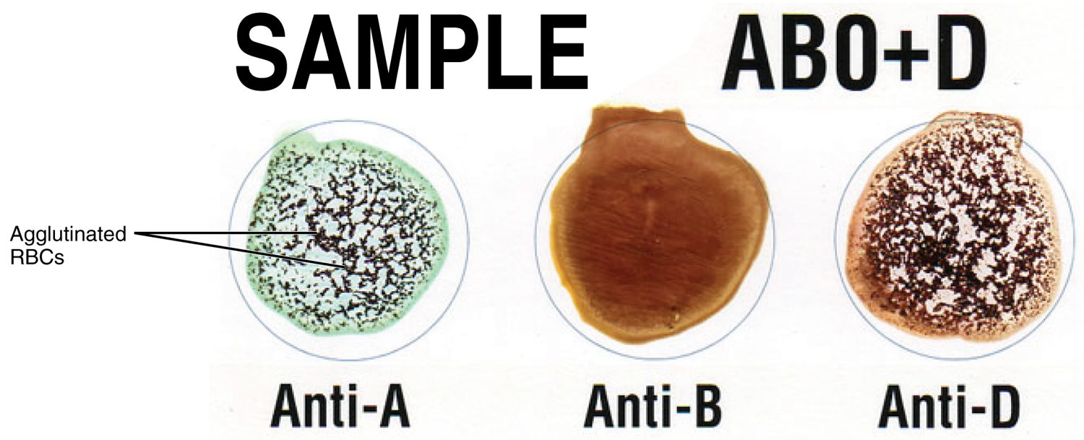
SECTION 18.6
Blood Typing
Blood typing by agglutination
Type set by red-cell surface antigens
ABO system: A, B, AB, O
Rh system: positive or negative
Tested by agglutination
PN 104 · Ch 18 — The Cardiovascular System: Blood
17

Slide 18
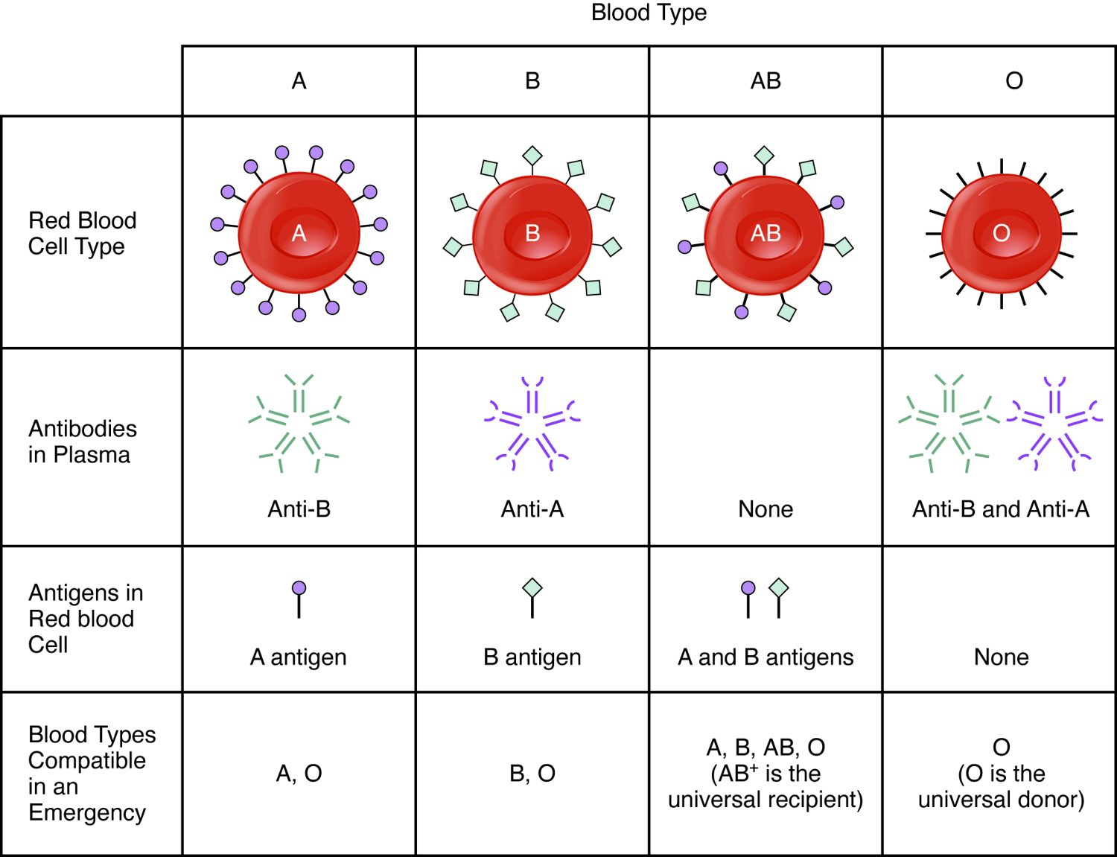
SECTION 18.6
Transfusion Compatibility
Plasma holds antibodies to missing antigens
The wrong type causes agglutination
Type O-negative is universal donor
Type AB-positive is universal recipient
ABO blood type compatibility
PN 104 · Ch 18 — The Cardiovascular System: Blood
18

Slide 19
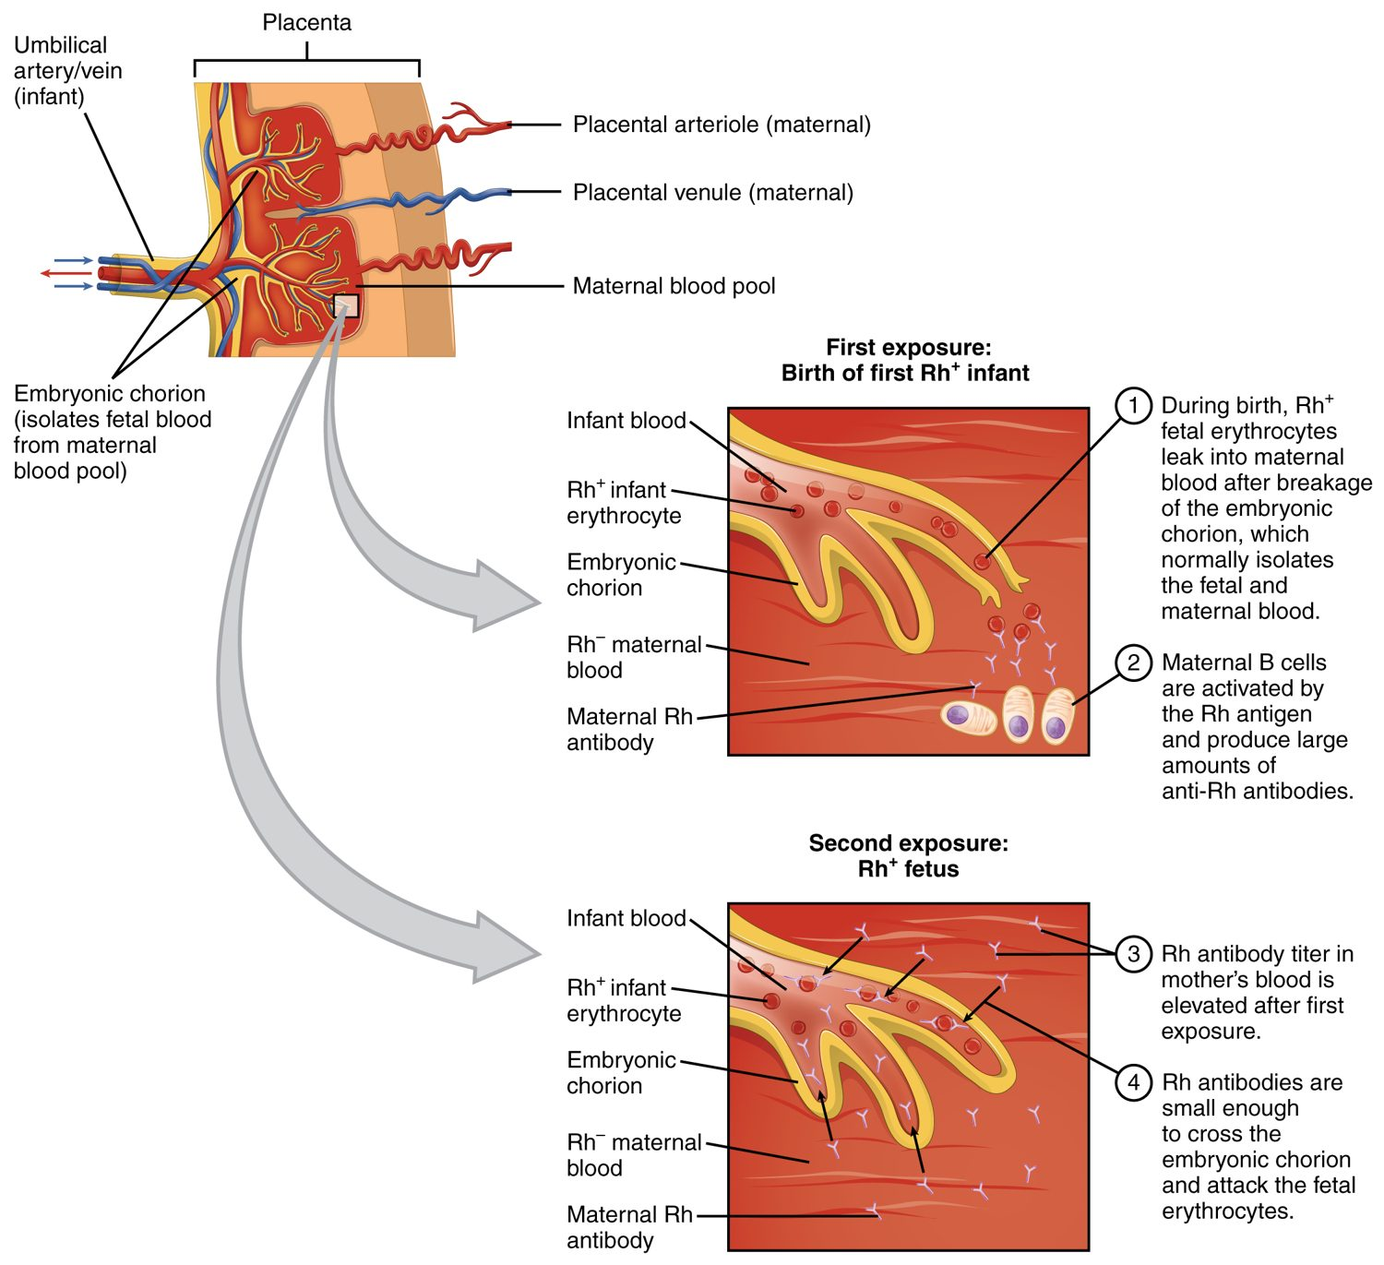
SECTION 18.6
Rh Incompatibility
Rh-negative mother, Rh-positive baby
First exposure sensitizes the mother
Antibodies threaten a later baby
Prevented with Rh immune globulin
Rh incompatibility in pregnancy
PN 104 · Ch 18 — The Cardiovascular System: Blood
19

Slide 20
CHAPTER 18
Key Takeaways
Blood is plasma plus formed elements — red cells, white cells, and platelets.
All blood cells form in red bone marrow from a single stem cell.
Red cells carry oxygen on hemoglobin and are recycled after about 120 days.
White cells defend against infection; platelets and clotting factors stop bleeding.
Blood type (ABO and Rh) must be matched before transfusion.
PN 104 · Ch 18 — The Cardiovascular System: Blood
20

Slide 21
CLINICAL CONNECTIONS
Why Blood Matters in Practical Nursing
Anemia
Complete Blood Count
Too few red cells or too little hemoglobin reduces oxygen delivery.
The CBC is one of the most common diagnostic tests.
Transfusion Safety
Clotting Disorders
Matching ABO and Rh type prevents dangerous reactions.
Too little clotting bleeds; too much causes thrombosis.
Anticoagulants
Infection
Drugs like heparin and warfarin act on the clotting cascade.
A rising white cell count is an early sign of infection.

