Slide 1
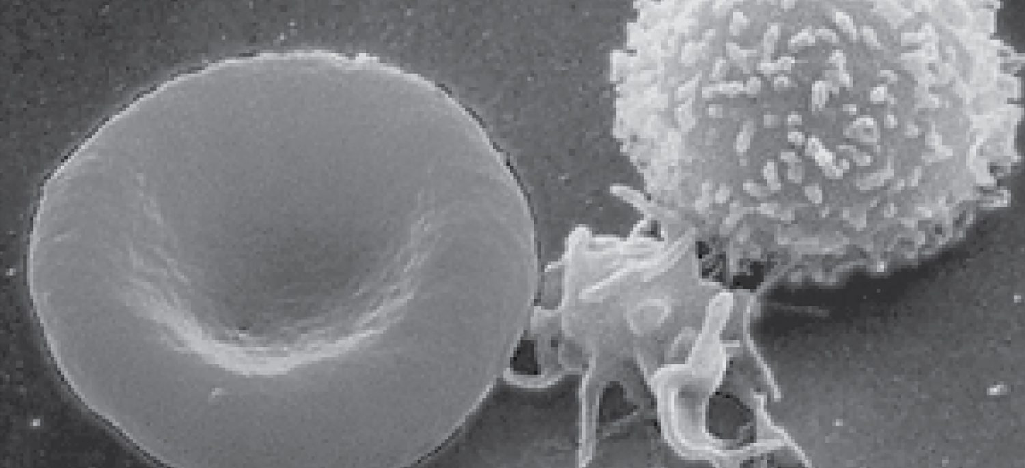
CHAPTER 18
The Cardiovascular System: Blood
Plasma, blood cells, clotting, and blood types.
Anatomy & Physiology · Broward-Miami Health Institute
FACULTY EDITION
Notes:
READ ALOUD SCRIPT
Today we are beginning Chapter 18, blood. In this chapter, we will connect the names and locations of skeletal structures with their functions and with the observations that matter in practical nursing care. As we move through the slides, focus on how structure supports protection, movement, stability, mineral balance, and patient safety. By the end, you should be able to explain the major concepts in your own words and apply them to a patient-care situation.
[Sources]
- BMHI PN 104 Chapter 18 faculty PowerPoint slide content.

Slide 2
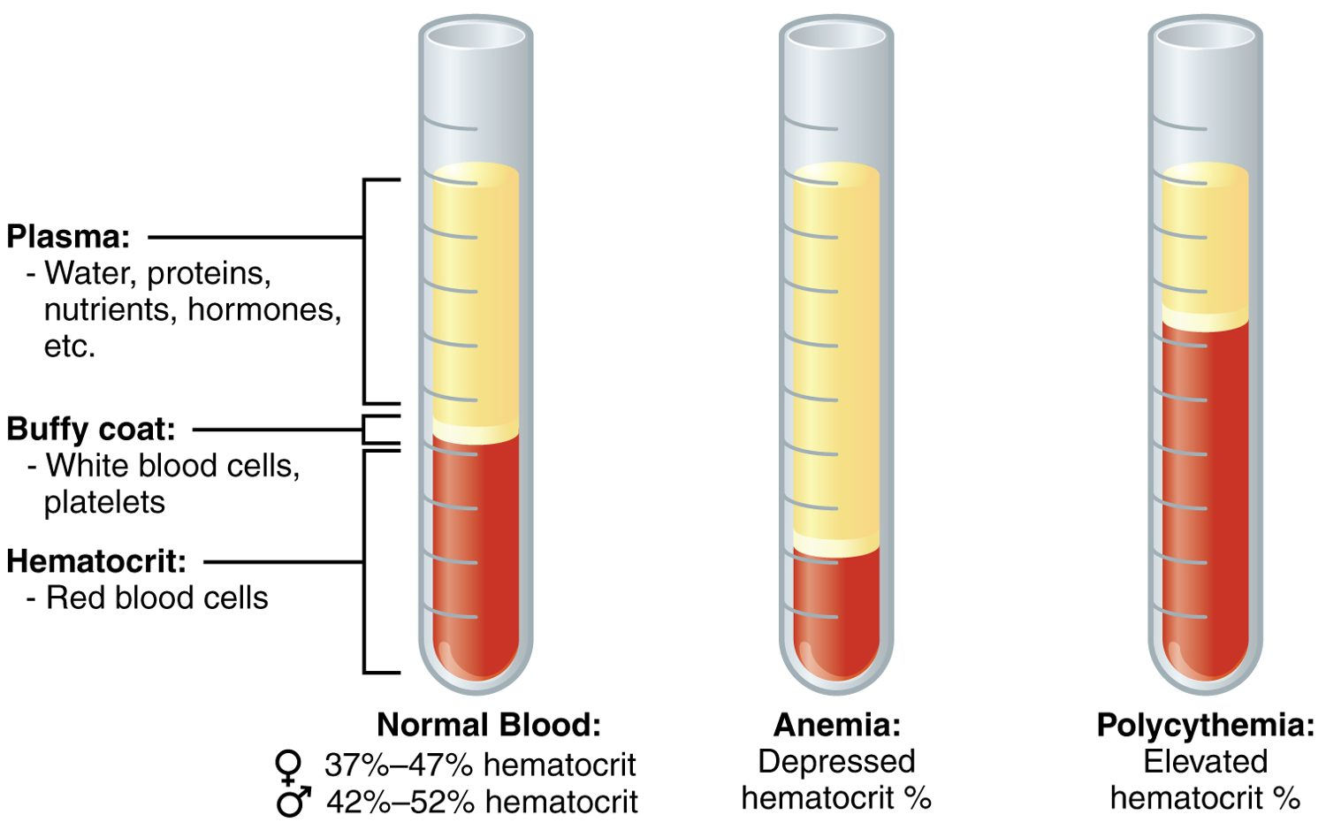
CHAPTER 18
Learning Objectives
After studying this chapter, students will be able to:
1
Identify the primary functions of blood, its fluid and cellular components, and its physical characteristics
2
Identify the most important proteins and other solutes present in blood plasma
3
Describe the formation of the formed element components of blood
4
Discuss the structure and function of red blood cells and hemoglobin
5
Classify and characterize white blood cells
6
Describe the structure of platelets and explain the process of hemostasis
Blood: plasma and formed elements.
PN 104 · Ch 18 — The Cardiovascular System: Blood
2
Notes:
READ ALOUD SCRIPT
These are our learning objectives for Chapter 18. By the end of the chapter, you should be able to do the following: Identify the primary functions of blood, its fluid and cellular components, and its physical characteristics. Identify the most important proteins and other solutes present in blood plasma. Describe the formation of the formed element components of blood. Discuss the structure and function of red blood cells and hemoglobin. Classify and characterize white blood cells. Do not treat these as isolated facts. Use them as a checklist for what you should be able to identify, explain, and connect to safe practical nursing care.
[Sources]
- BMHI PN 104 Chapter 18 faculty PowerPoint slide content.

Slide 3
18.1
SECTION
An Overview of Blood
What blood is made of and what it does.
Notes:
READ ALOUD SCRIPT
We are now moving into An Overview of Blood. What blood is made of and what it does. As we begin this section, listen for the major structures, their locations, and the functions they perform. Then ask yourself what a change in this area might look like during patient care.
[Sources]
- BMHI PN 104 Chapter 18 faculty PowerPoint slide content.

Slide 4
SECTION 18.1
Composition of Blood
Blood: plasma and formed elements
Plasma is the liquid portion (~55%)
Formed elements are cells (~45%)
Buffy coat = white cells and platelets
Hematocrit = percent red cells
PN 104 · Ch 18 — The Cardiovascular System: Blood
4
Notes:
READ ALOUD SCRIPT
Now let's focus on Composition of Blood. Blood: plasma and formed elements. Plasma is the liquid portion (~55%). Formed elements are cells (~45%). Buffy coat = white cells and platelets. Hematocrit = percent red cells. Observe for bleeding, bruising, petechiae, blood in urine or stool, and medication-related bleeding risk, and report concerning findings promptly. Take a moment to identify the structure on the image and explain how its form supports its function. This is slide 4 of 21.
[Sources]
- BMHI PN 104 Chapter 18 faculty PowerPoint slide content.

Slide 5
18.2
SECTION
Production of the Formed Elements
How blood cells are produced in red bone marrow.
Notes:
READ ALOUD SCRIPT
We are now moving into Production of the Formed Elements. How blood cells are produced in red bone marrow. As we begin this section, listen for the major structures, their locations, and the functions they perform. Then ask yourself what a change in this area might look like during patient care.
[Sources]
- BMHI PN 104 Chapter 18 faculty PowerPoint slide content.

Slide 6
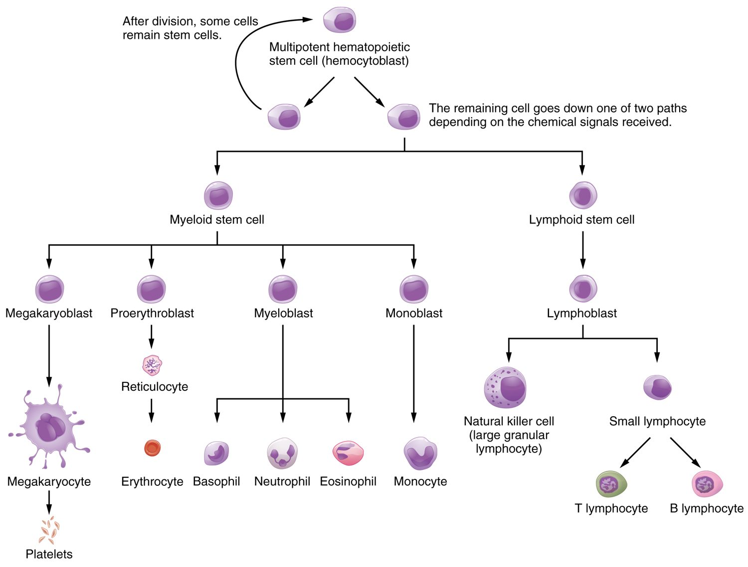
SECTION 18.2
Hematopoiesis
All blood cells form in red marrow
Start from one stem cell
Myeloid line → most cell types
Lymphoid line → lymphocytes
Hematopoiesis: the formation of blood cells
PN 104 · Ch 18 — The Cardiovascular System: Blood
6
Notes:
READ ALOUD SCRIPT
Now let's focus on Hematopoiesis. All blood cells form in red marrow. Start from one stem cell. Myeloid line → most cell types. Lymphoid line → lymphocytes. Hematopoiesis: the formation of blood cells. Blood assessment connects directly with oxygen delivery, infection defense, bleeding risk, circulation, laboratory monitoring, and transfusion safety. Take a moment to identify the structure on the image and explain how its form supports its function. This is slide 6 of 21.
[Sources]
- BMHI PN 104 Chapter 18 faculty PowerPoint slide content.

Slide 7
18.3
SECTION
Erythrocytes
Red blood cells and oxygen transport.
Notes:
READ ALOUD SCRIPT
We are now moving into Erythrocytes. Red blood cells and oxygen transport. As we begin this section, listen for the major structures, their locations, and the functions they perform. Then ask yourself what a change in this area might look like during patient care.
[Sources]
- BMHI PN 104 Chapter 18 faculty PowerPoint slide content.

Slide 8
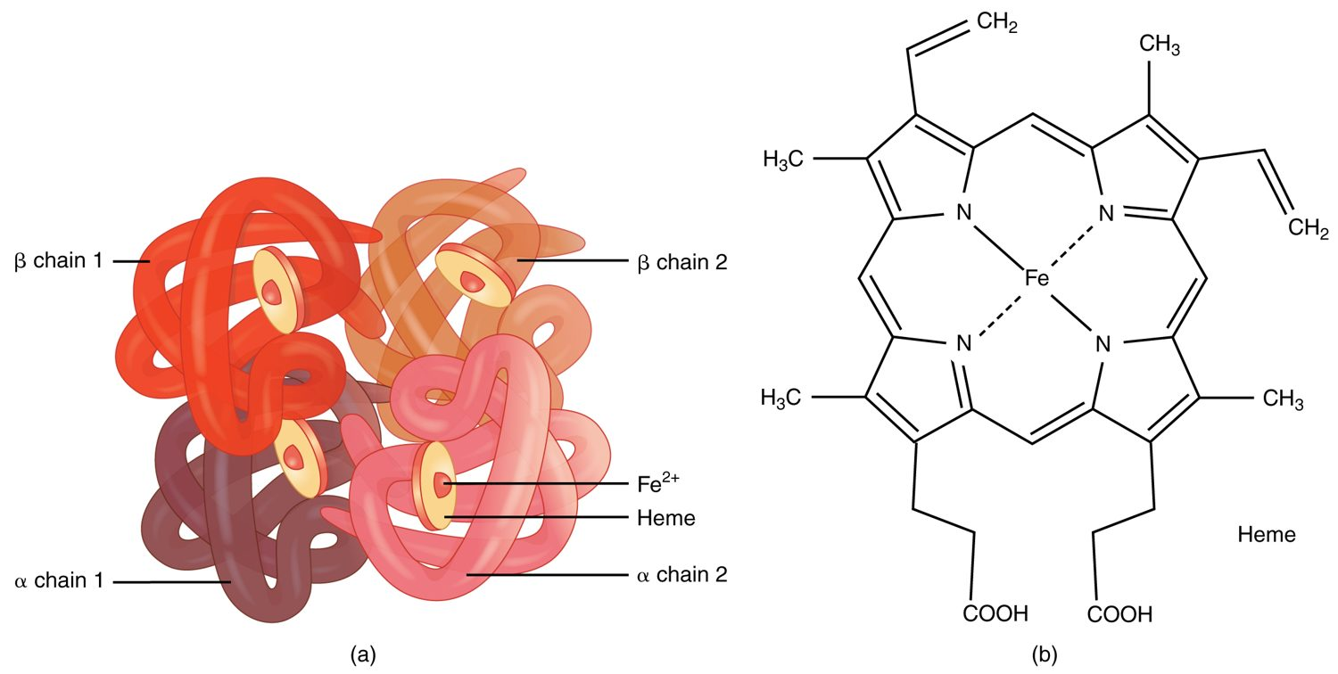
SECTION 18.3
Hemoglobin
The structure of hemoglobin
The oxygen-carrying protein in red cells
Four globin chains
Each holds an iron-rich heme group
Iron binds the oxygen
PN 104 · Ch 18 — The Cardiovascular System: Blood
8
Notes:
READ ALOUD SCRIPT
Now let's focus on Hemoglobin. The structure of hemoglobin. The oxygen-carrying protein in red cells. Four globin chains. Each holds an iron-rich heme group. Iron binds the oxygen. Relate red-cell function to oxygenation, fatigue, pallor, shortness of breath, heart rate, and laboratory values such as hemoglobin and hematocrit. Take a moment to identify the structure on the image and explain how its form supports its function. This is slide 8 of 21.
[Sources]
- BMHI PN 104 Chapter 18 faculty PowerPoint slide content.

Slide 9
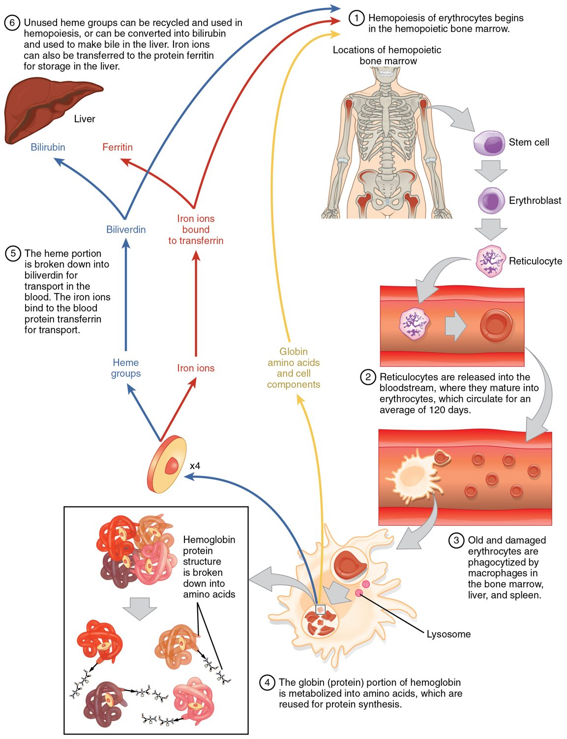
SECTION 18.3
Red Blood Cell Life Cycle
Red cells live about 120 days
Old cells broken down in spleen and liver
Iron is recycled
Heme becomes bilirubin
The life cycle of a red blood cell
PN 104 · Ch 18 — The Cardiovascular System: Blood
9
Notes:
READ ALOUD SCRIPT
Now let's focus on Red Blood Cell Life Cycle. The life cycle of a red blood cell. Red cells live about 120 days. Old cells broken down in spleen and liver. Iron is recycled. Heme becomes bilirubin. Relate red-cell function to oxygenation, fatigue, pallor, shortness of breath, heart rate, and laboratory values such as hemoglobin and hematocrit. Take a moment to identify the structure on the image and explain how its form supports its function. This is slide 9 of 21.
[Sources]
- BMHI PN 104 Chapter 18 faculty PowerPoint slide content.

Slide 10
18.4
SECTION
Leukocytes and Platelets
White blood cells and platelets — defense and clotting.
Notes:
READ ALOUD SCRIPT
We are now moving into Leukocytes and Platelets. White blood cells and platelets — defense and clotting. As we begin this section, listen for the major structures, their locations, and the functions they perform. Then ask yourself what a change in this area might look like during patient care.
[Sources]
- BMHI PN 104 Chapter 18 faculty PowerPoint slide content.

Slide 11
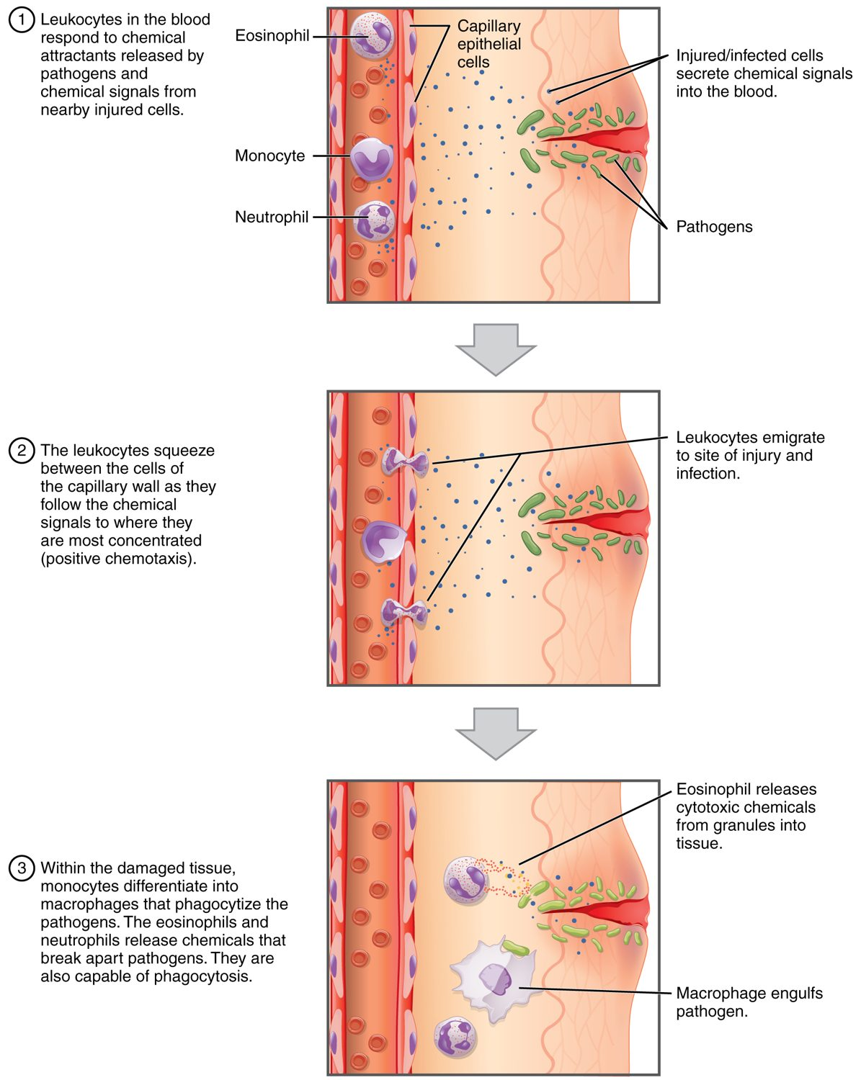
SECTION 18.4
How Leukocytes Fight Infection
White cells defend against infection
Leave vessels by diapedesis
Move toward chemical signals
Engulf pathogens (phagocytosis)
How leukocytes fight infection
PN 104 · Ch 18 — The Cardiovascular System: Blood
11
Notes:
READ ALOUD SCRIPT
Now let's focus on How Leukocytes Fight Infection. How leukocytes fight infection. White cells defend against infection. Leave vessels by diapedesis. Move toward chemical signals. Engulf pathogens (phagocytosis). White-cell changes can signal infection, inflammation, immune dysfunction, or marrow problems; interpret the count with symptoms and precautions. Take a moment to identify the structure on the image and explain how its form supports its function. This is slide 11 of 21.
[Sources]
- BMHI PN 104 Chapter 18 faculty PowerPoint slide content.

Slide 12
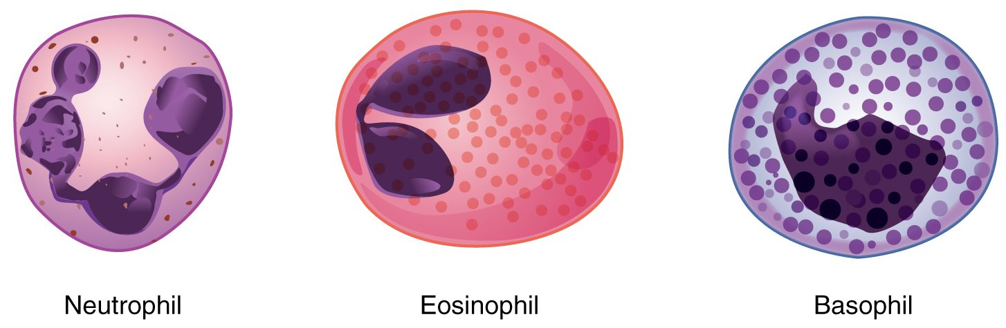
SECTION 18.4
Types of White Blood Cells
The granular leukocytes
Five types of leukocytes
Granulocytes: neutrophil, eosinophil, basophil
Agranulocytes: lymphocyte, monocyte
Each has a specific role
PN 104 · Ch 18 — The Cardiovascular System: Blood
12
Notes:
READ ALOUD SCRIPT
Now let's focus on Types of White Blood Cells. The granular leukocytes. Five types of leukocytes. Granulocytes: neutrophil, eosinophil, basophil. Agranulocytes: lymphocyte, monocyte. Each has a specific role. White-cell changes can signal infection, inflammation, immune dysfunction, or marrow problems; interpret the count with symptoms and precautions. Take a moment to identify the structure on the image and explain how its form supports its function. This is slide 12 of 21.
[Sources]
- BMHI PN 104 Chapter 18 faculty PowerPoint slide content.

Slide 13
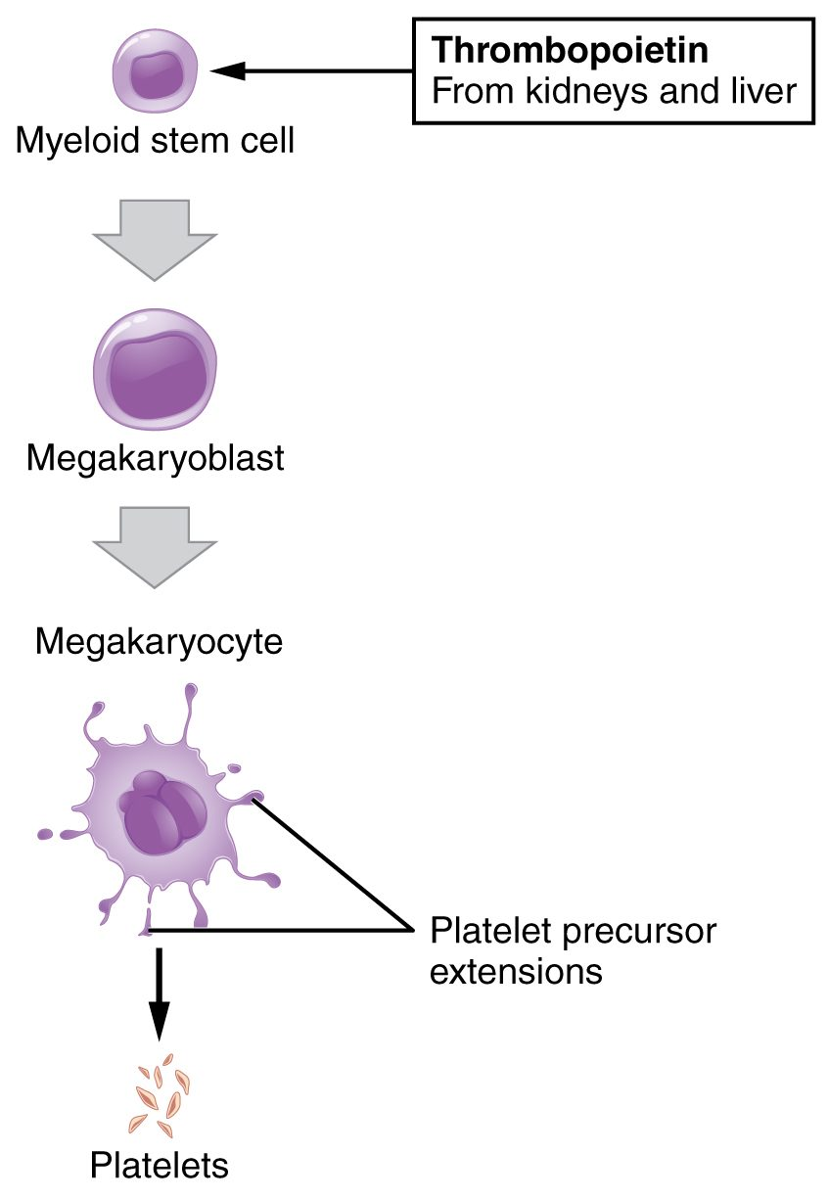
SECTION 18.4
Platelet Formation
Platelets are cell fragments
Shed from megakaryocytes
Driven by thrombopoietin
Essential for clotting
The formation of platelets
PN 104 · Ch 18 — The Cardiovascular System: Blood
13
Notes:
READ ALOUD SCRIPT
Now let's focus on Platelet Formation. The formation of platelets. Platelets are cell fragments. Shed from megakaryocytes. Driven by thrombopoietin. Essential for clotting. Observe for bleeding, bruising, petechiae, blood in urine or stool, and medication-related bleeding risk, and report concerning findings promptly. Take a moment to identify the structure on the image and explain how its form supports its function. This is slide 13 of 21.
[Sources]
- BMHI PN 104 Chapter 18 faculty PowerPoint slide content.

Slide 14
18.5
SECTION
Hemostasis
Hemostasis — how the body stops bleeding.
Notes:
READ ALOUD SCRIPT
We are now moving into Hemostasis. Hemostasis — how the body stops bleeding. As we begin this section, listen for the major structures, their locations, and the functions they perform. Then ask yourself what a change in this area might look like during patient care.
[Sources]
- BMHI PN 104 Chapter 18 faculty PowerPoint slide content.

Slide 15
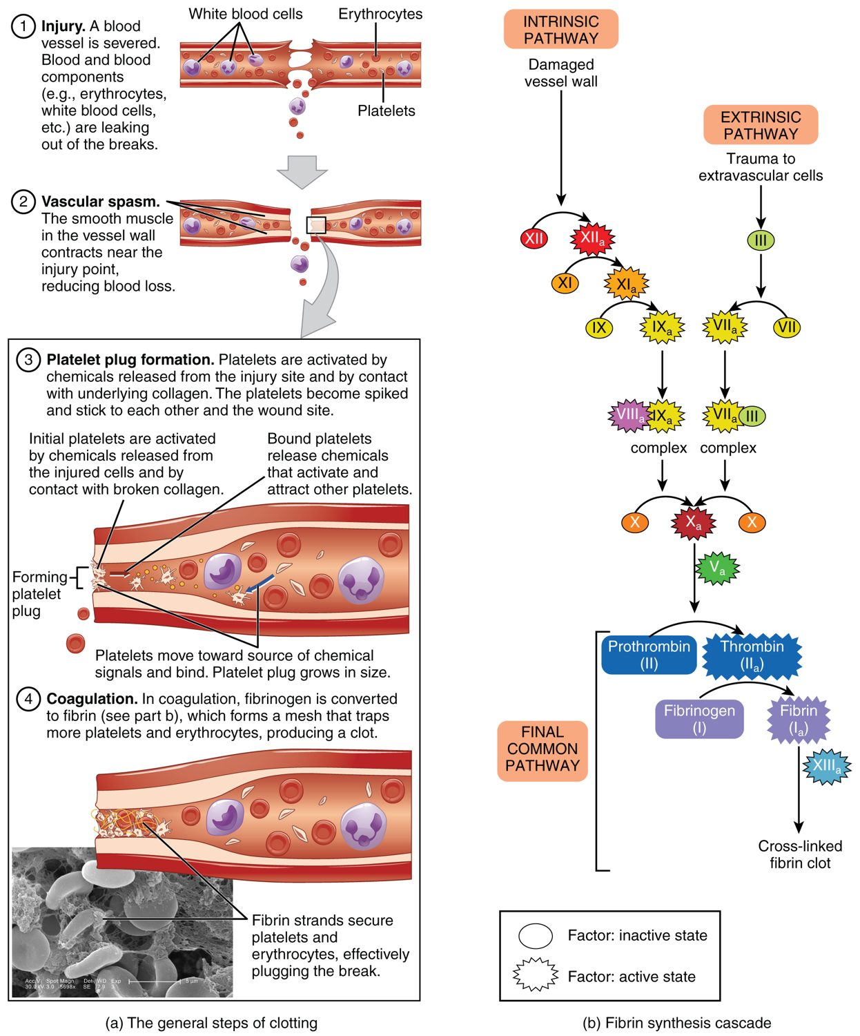
SECTION 18.5
Hemostasis
Stops bleeding in three steps
Vascular spasm narrows the vessel
A platelet plug forms
Coagulation makes a fibrin clot
The steps of hemostasis
PN 104 · Ch 18 — The Cardiovascular System: Blood
15
Notes:
READ ALOUD SCRIPT
Now let's focus on Hemostasis. The steps of hemostasis. Stops bleeding in three steps. Vascular spasm narrows the vessel. A platelet plug forms. Coagulation makes a fibrin clot. Observe for bleeding, bruising, petechiae, blood in urine or stool, and medication-related bleeding risk, and report concerning findings promptly. Take a moment to identify the structure on the image and explain how its form supports its function. This is slide 15 of 21.
[Sources]
- BMHI PN 104 Chapter 18 faculty PowerPoint slide content.

Slide 16
18.6
SECTION
Blood Typing
Blood typing and transfusion compatibility.
Notes:
READ ALOUD SCRIPT
We are now moving into Blood Typing. Blood typing and transfusion compatibility. As we begin this section, listen for the major structures, their locations, and the functions they perform. Then ask yourself what a change in this area might look like during patient care.
[Sources]
- BMHI PN 104 Chapter 18 faculty PowerPoint slide content.

Slide 17
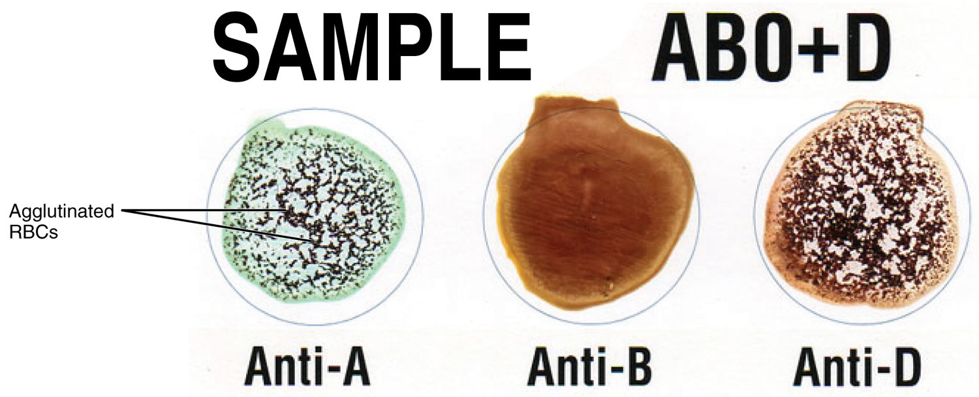
SECTION 18.6
Blood Typing
Blood typing by agglutination
Type set by red-cell surface antigens
ABO system: A, B, AB, O
Rh system: positive or negative
Tested by agglutination
PN 104 · Ch 18 — The Cardiovascular System: Blood
17
Notes:
READ ALOUD SCRIPT
Now let's focus on Blood Typing. Blood typing by agglutination. Type set by red-cell surface antigens. ABO system: A, B, AB, O. Rh system: positive or negative. Tested by agglutination. Blood assessment connects directly with oxygen delivery, infection defense, bleeding risk, circulation, laboratory monitoring, and transfusion safety. Take a moment to identify the structure on the image and explain how its form supports its function. This is slide 17 of 21.
[Sources]
- BMHI PN 104 Chapter 18 faculty PowerPoint slide content.

Slide 18
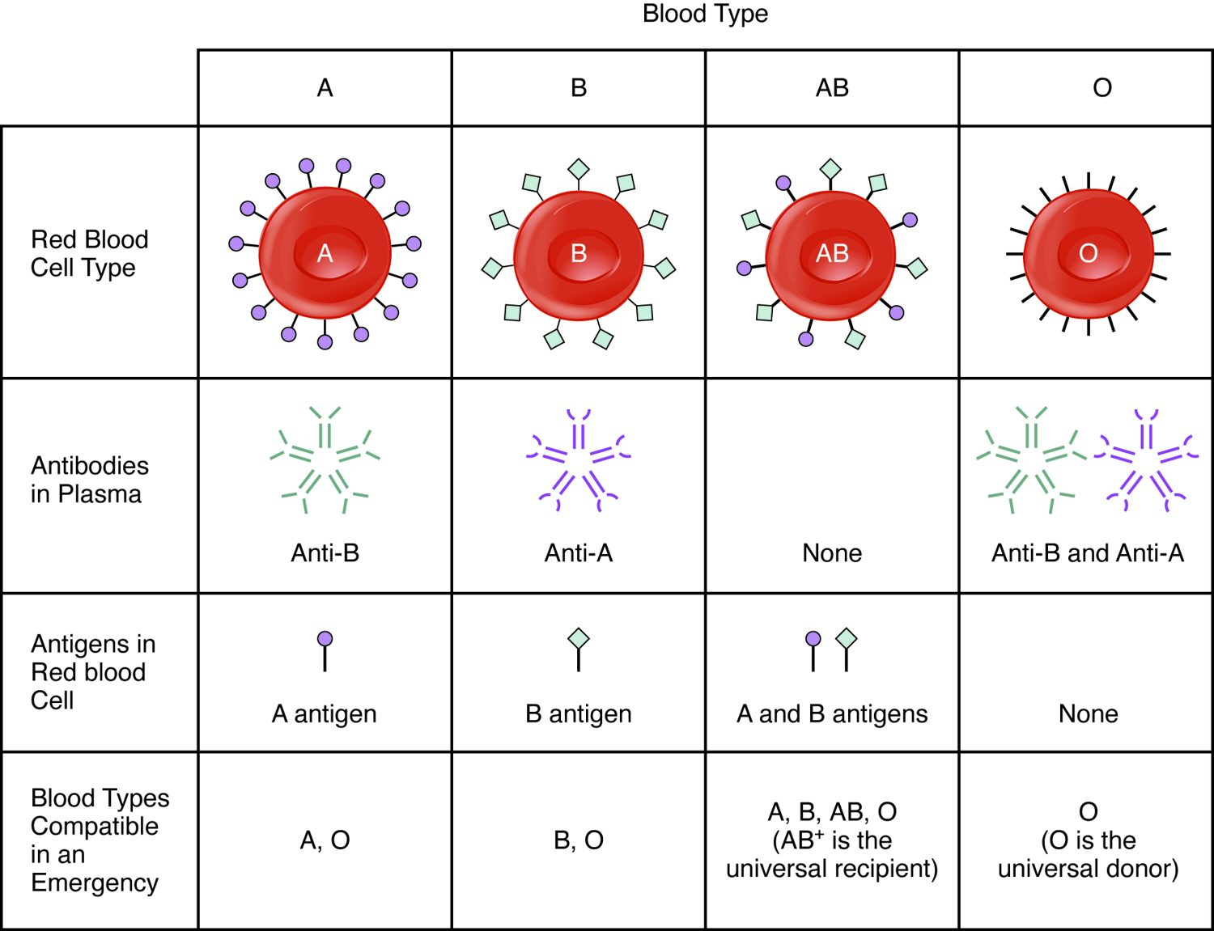
SECTION 18.6
Transfusion Compatibility
Plasma holds antibodies to missing antigens
The wrong type causes agglutination
Type O-negative is universal donor
Type AB-positive is universal recipient
ABO blood type compatibility
PN 104 · Ch 18 — The Cardiovascular System: Blood
18
Notes:
READ ALOUD SCRIPT
Now let's focus on Transfusion Compatibility. Plasma holds antibodies to missing antigens. The wrong type causes agglutination. Type O-negative is universal donor. Type AB-positive is universal recipient. ABO blood type compatibility. Plasma carries proteins, nutrients, hormones, wastes, electrolytes, and water, linking blood composition with fluid balance and organ function. Take a moment to identify the structure on the image and explain how its form supports its function. This is slide 18 of 21.
[Sources]
- BMHI PN 104 Chapter 18 faculty PowerPoint slide content.

Slide 19
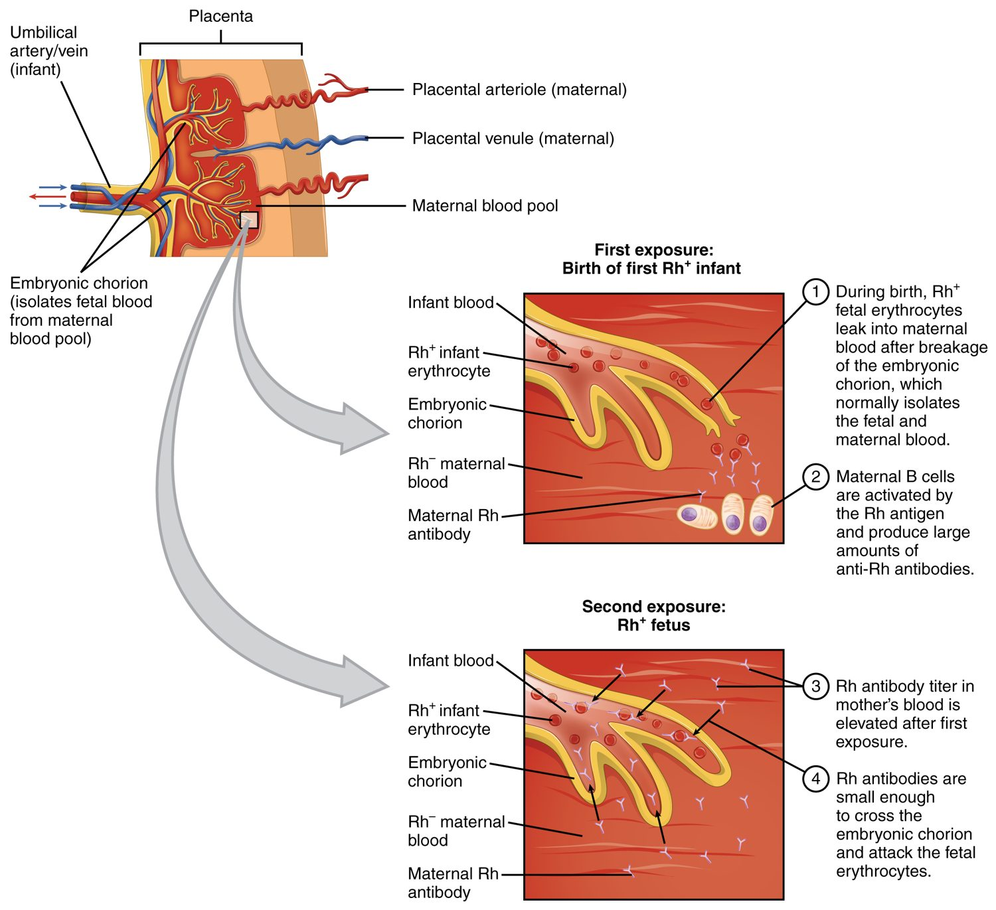
SECTION 18.6
Rh Incompatibility
Rh-negative mother, Rh-positive baby
First exposure sensitizes the mother
Antibodies threaten a later baby
Prevented with Rh immune globulin
Rh incompatibility in pregnancy
PN 104 · Ch 18 — The Cardiovascular System: Blood
19
Notes:
READ ALOUD SCRIPT
Now let's focus on Rh Incompatibility. Rh-negative mother, Rh-positive baby. First exposure sensitizes the mother. Antibodies threaten a later baby. Prevented with Rh immune globulin. Rh incompatibility in pregnancy. Blood assessment connects directly with oxygen delivery, infection defense, bleeding risk, circulation, laboratory monitoring, and transfusion safety. Take a moment to identify the structure on the image and explain how its form supports its function. This is slide 19 of 21.
[Sources]
- BMHI PN 104 Chapter 18 faculty PowerPoint slide content.

Slide 20
CHAPTER 18
Key Takeaways
Blood is plasma plus formed elements — red cells, white cells, and platelets.
All blood cells form in red bone marrow from a single stem cell.
Red cells carry oxygen on hemoglobin and are recycled after about 120 days.
White cells defend against infection; platelets and clotting factors stop bleeding.
Blood type (ABO and Rh) must be matched before transfusion.
PN 104 · Ch 18 — The Cardiovascular System: Blood
20
Notes:
READ ALOUD SCRIPT
Let us review the major takeaways from Chapter 18. Blood is plasma plus formed elements — red cells, white cells, and platelets. All blood cells form in red bone marrow from a single stem cell. Red cells carry oxygen on hemoglobin and are recycled after about 120 days. White cells defend against infection; platelets and clotting factors stop bleeding. Blood type (ABO and Rh) must be matched before transfusion. Before moving on, pause and explain each point without reading the slide. If any statement is difficult to explain, mark that topic for review before the quiz.
[Sources]
- BMHI PN 104 Chapter 18 faculty PowerPoint slide content.

Slide 21
CLINICAL CONNECTIONS
Why Blood Matters in Practical Nursing
Anemia
Complete Blood Count
Too few red cells or too little hemoglobin reduces oxygen delivery.
The CBC is one of the most common diagnostic tests.
Transfusion Safety
Clotting Disorders
Matching ABO and Rh type prevents dangerous reactions.
Too little clotting bleeds; too much causes thrombosis.
Anticoagulants
Infection
Drugs like heparin and warfarin act on the clotting cascade.
A rising white cell count is an early sign of infection.
Notes:
READ ALOUD SCRIPT
This final slide connects Chapter 18 to practical nursing. Anemia. Too few red cells or too little hemoglobin reduces oxygen delivery. Complete Blood Count. The CBC is one of the most common diagnostic tests. Transfusion Safety. Matching ABO and Rh type prevents dangerous reactions. Clotting Disorders. Too little clotting bleeds; too much causes thrombosis. Anticoagulants. Drugs like heparin and warfarin act on the clotting cascade. Infection. A rising white cell count is an early sign of infection. Your role is to observe carefully, protect safety, follow orders and precautions, document objectively, and report changes through the appropriate chain of command. Use these examples to connect anatomy with the care you will provide.
[Sources]
- BMHI PN 104 Chapter 18 faculty PowerPoint slide content.

