Slide 1

CHAPTER 20
Blood Vessels and Circulation
Vessels, blood pressure, exchange, and the circulatory pathways.
Anatomy & Physiology · Broward-Miami Health Institute
FACULTY EDITION

Slide 2
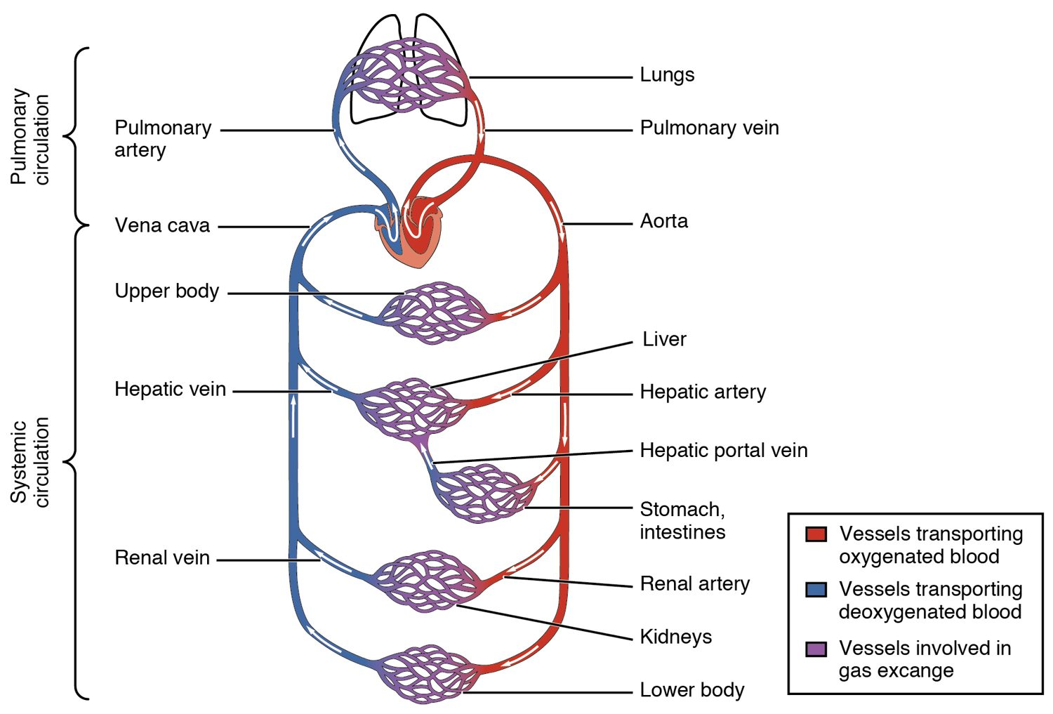
CHAPTER 20
Learning Objectives
After studying this chapter, students will be able to:
1
Compare and contrast the anatomical structure of arteries, arterioles, capillaries, venules, and veins
2
Accurately describe the forces that account for capillary exchange
3
List the major factors affecting blood flow, blood pressure, and resistance
4
Describe how blood flow, blood pressure, and resistance interrelate
5
Discuss how the neural and endocrine mechanisms maintain homeostasis within the blood vessels
6
Describe the interaction of the cardiovascular system with other body systems
The pulmonary and systemic circuits.
PN 104 · Ch 20 — Blood Vessels and Circulation
2

Slide 3
20.1
SECTION
Structure and Function of Blood Vessels
The structure of arteries, veins, and capillaries.

Slide 4
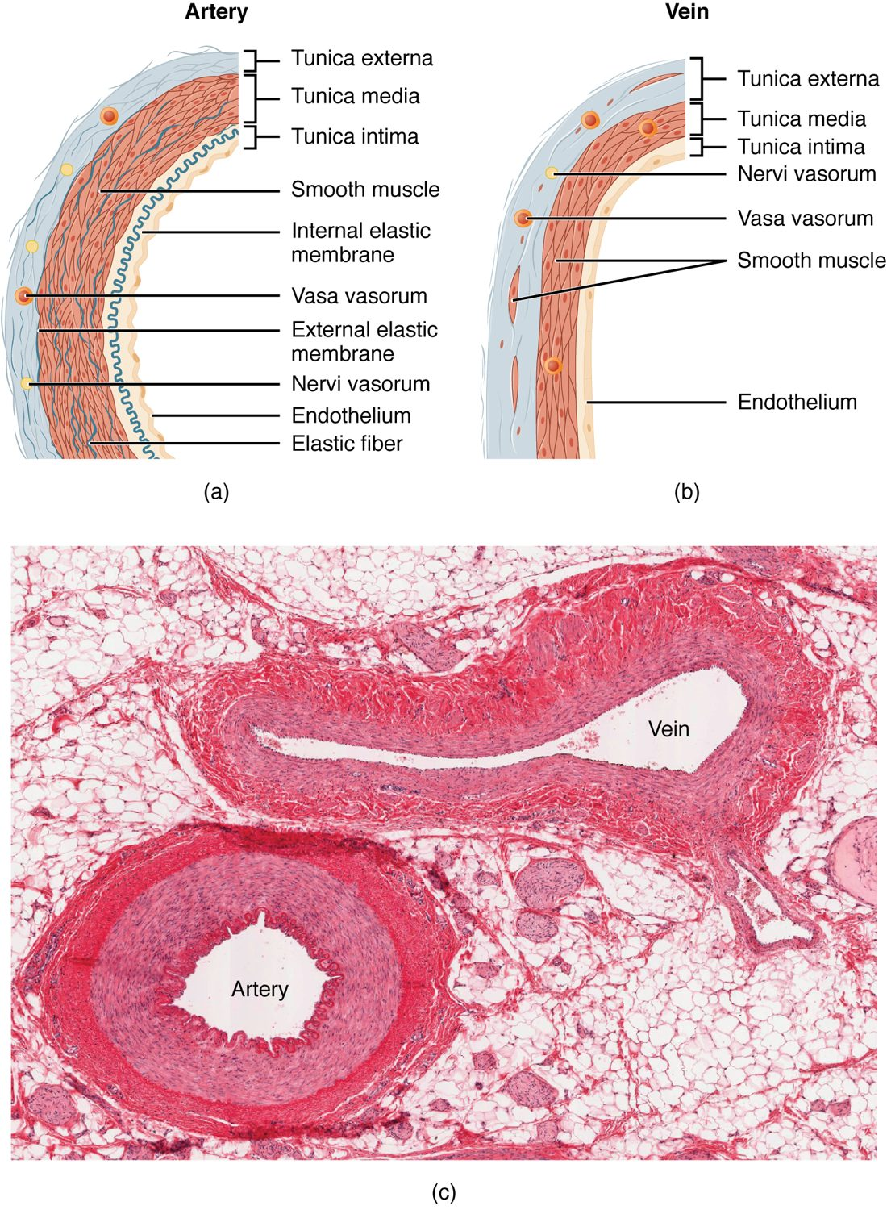
SECTION 20.1
Artery vs. Vein
Both have three wall layers (tunics)
Arteries have thick muscular walls
Veins are thinner, with valves
Valves keep venous blood moving up
The walls of an artery and a vein
PN 104 · Ch 20 — Blood Vessels and Circulation
4

Slide 5
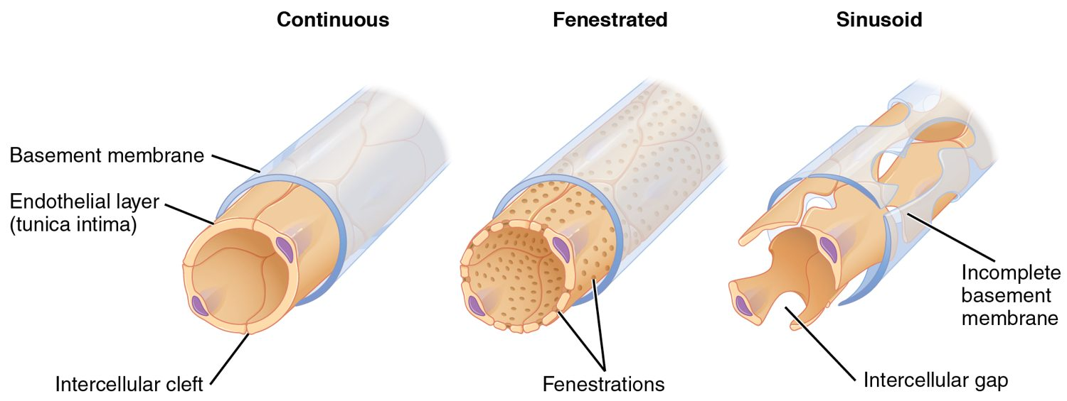
SECTION 20.1
Types of Capillaries
The three types of capillaries
The smallest vessels
Walls just one cell thick
Continuous, fenestrated, sinusoid
The site of all exchange
PN 104 · Ch 20 — Blood Vessels and Circulation
5

Slide 6
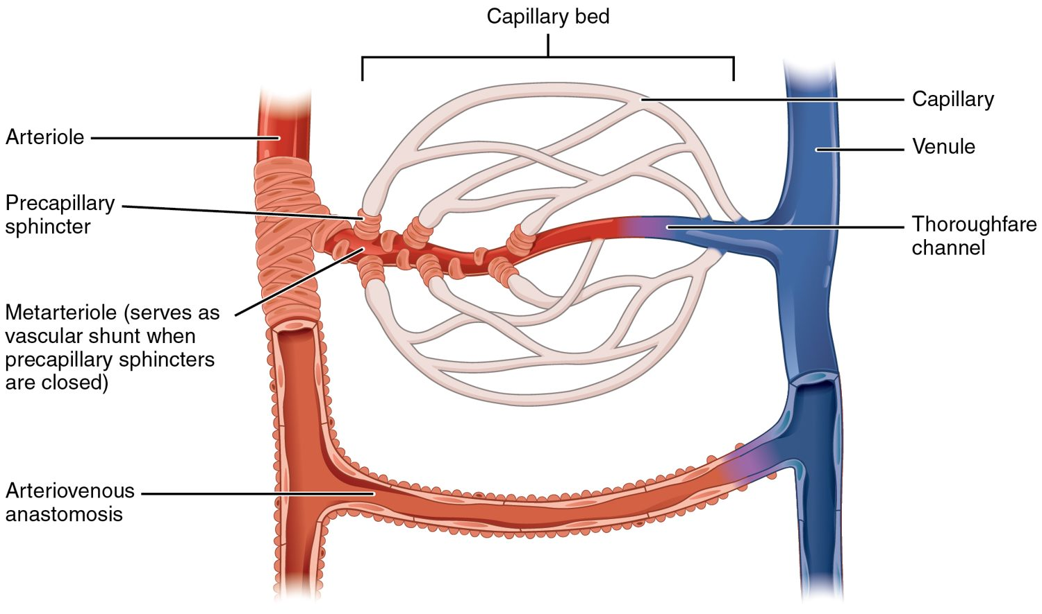
SECTION 20.1
The Capillary Bed
Blood flow through a capillary bed
Capillaries form branching beds
Connect arterioles to venules
Precapillary sphincters control flow
Direct blood where it's needed
PN 104 · Ch 20 — Blood Vessels and Circulation
6

Slide 7
20.2
SECTION
Blood Flow, Blood Pressure, and Resistance
Blood flow, blood pressure, and resistance.

Slide 8
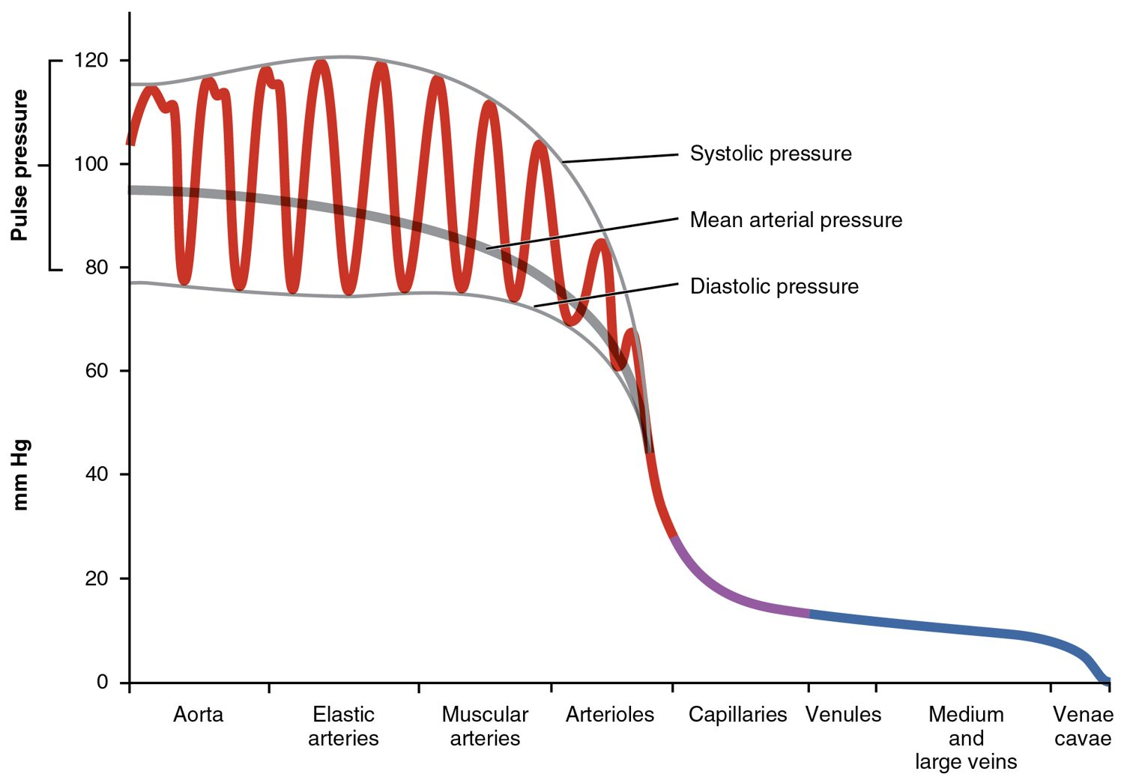
SECTION 20.2
Blood Pressure Across the System
Pressure is highest in the arteries
Drops sharply in the arterioles
Lowest in the veins
The gradient drives blood flow
Blood pressure throughout the circulation
PN 104 · Ch 20 — Blood Vessels and Circulation
8

Slide 9
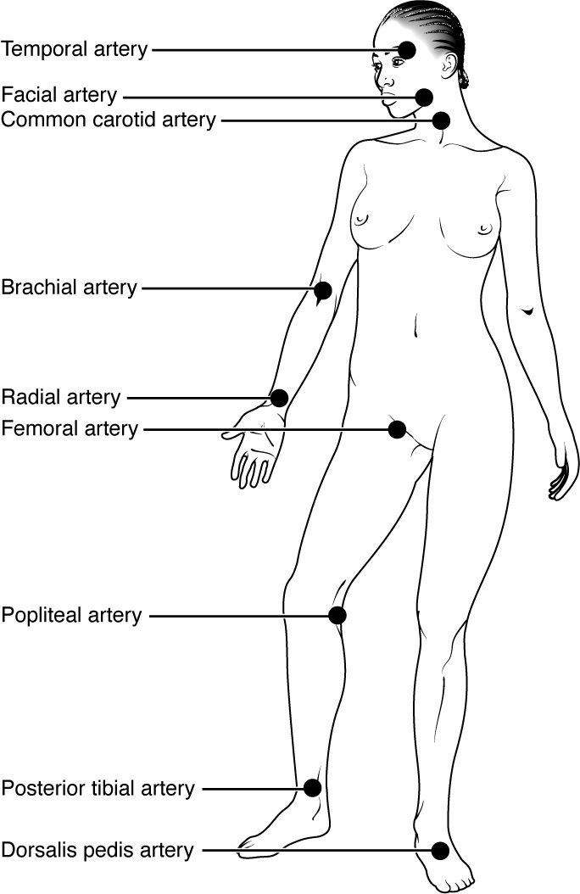
SECTION 20.2
Pulse Points
Pulse = artery expanding with each beat
Felt where arteries are near the surface
Common sites: radial, carotid, femoral
Used to assess rate and rhythm
Pulse points of the body
PN 104 · Ch 20 — Blood Vessels and Circulation
9

Slide 10
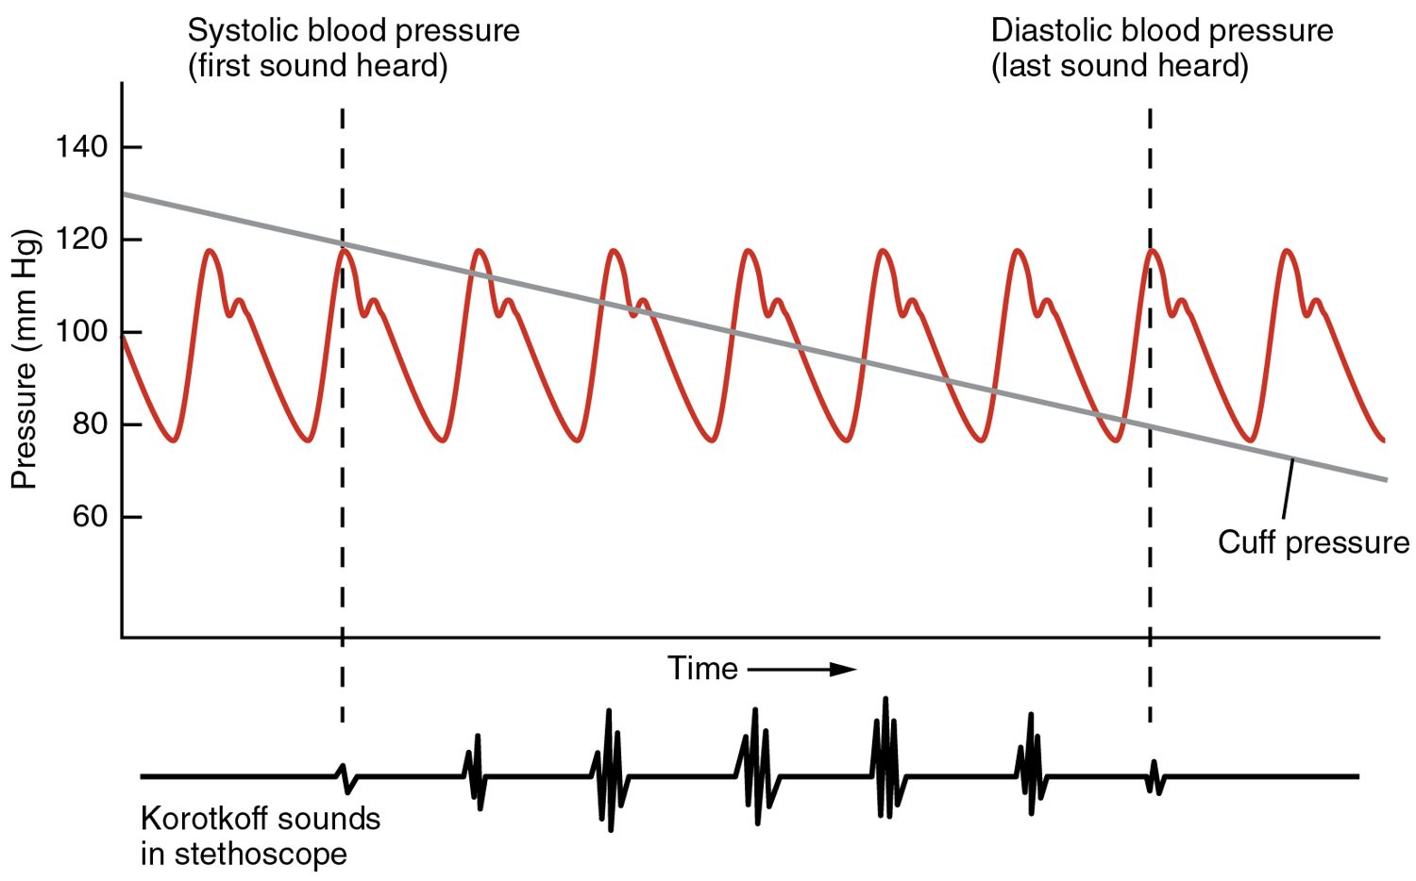
SECTION 20.2
Measuring Blood Pressure
Measuring arterial blood pressure
Measured with a cuff (sphygmomanometer)
Systolic over diastolic
Normal about 120/80 mmHg
A key vital sign
PN 104 · Ch 20 — Blood Vessels and Circulation
10

Slide 11
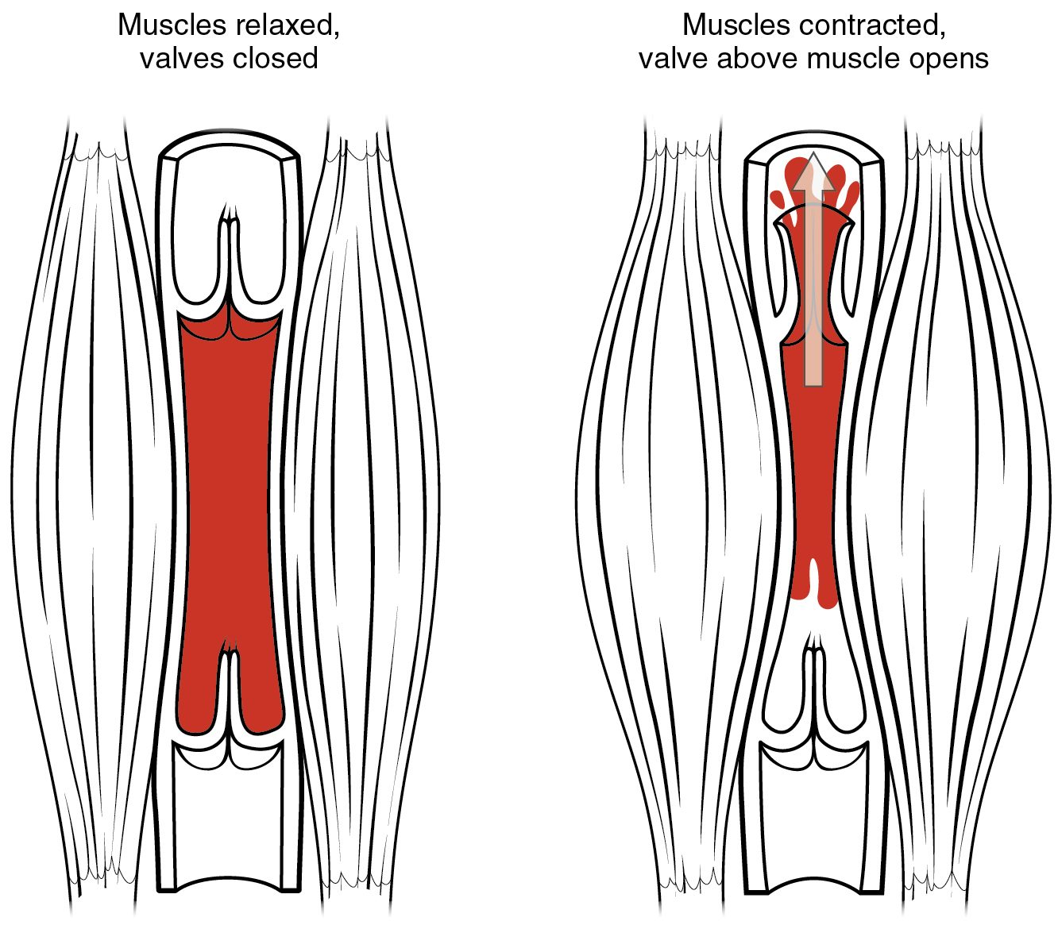
SECTION 20.2
The Skeletal Muscle Pump
Veins need help returning blood
Contracting muscles squeeze veins
Valves keep blood moving up
Aids venous return to the heart
The skeletal muscle pump
PN 104 · Ch 20 — Blood Vessels and Circulation
11

Slide 12
20.3
SECTION
Capillary Exchange
Capillary exchange — where blood serves the tissues.

Slide 13
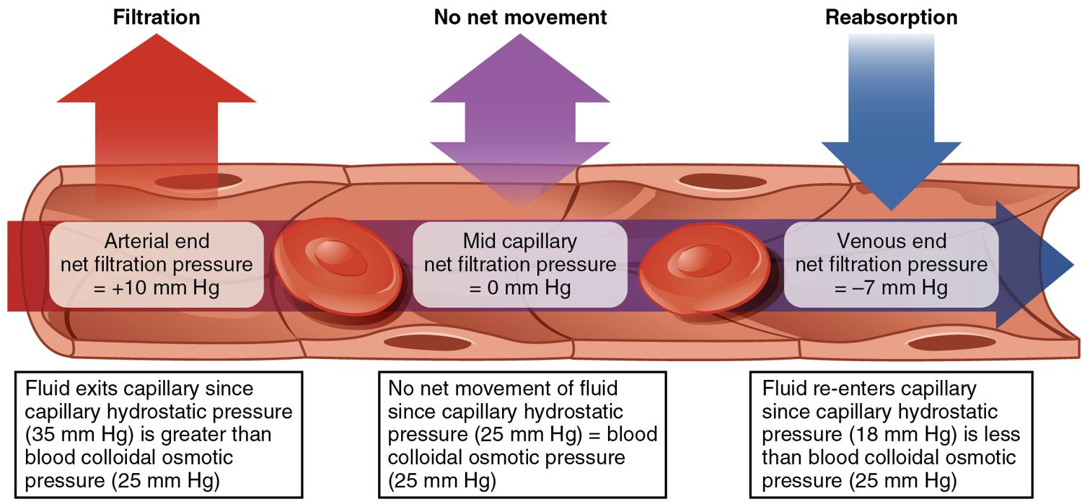
SECTION 20.3
Capillary Exchange
Fluid exchange at the capillary
Materials cross the thin capillary wall
Pressure pushes fluid out (filtration)
Osmosis pulls fluid back (reabsorption)
Delivers nutrients, removes wastes
PN 104 · Ch 20 — Blood Vessels and Circulation
13

Slide 14
20.5
SECTION
Circulatory Pathways
The major arteries, veins, and circulatory pathways.

Slide 15
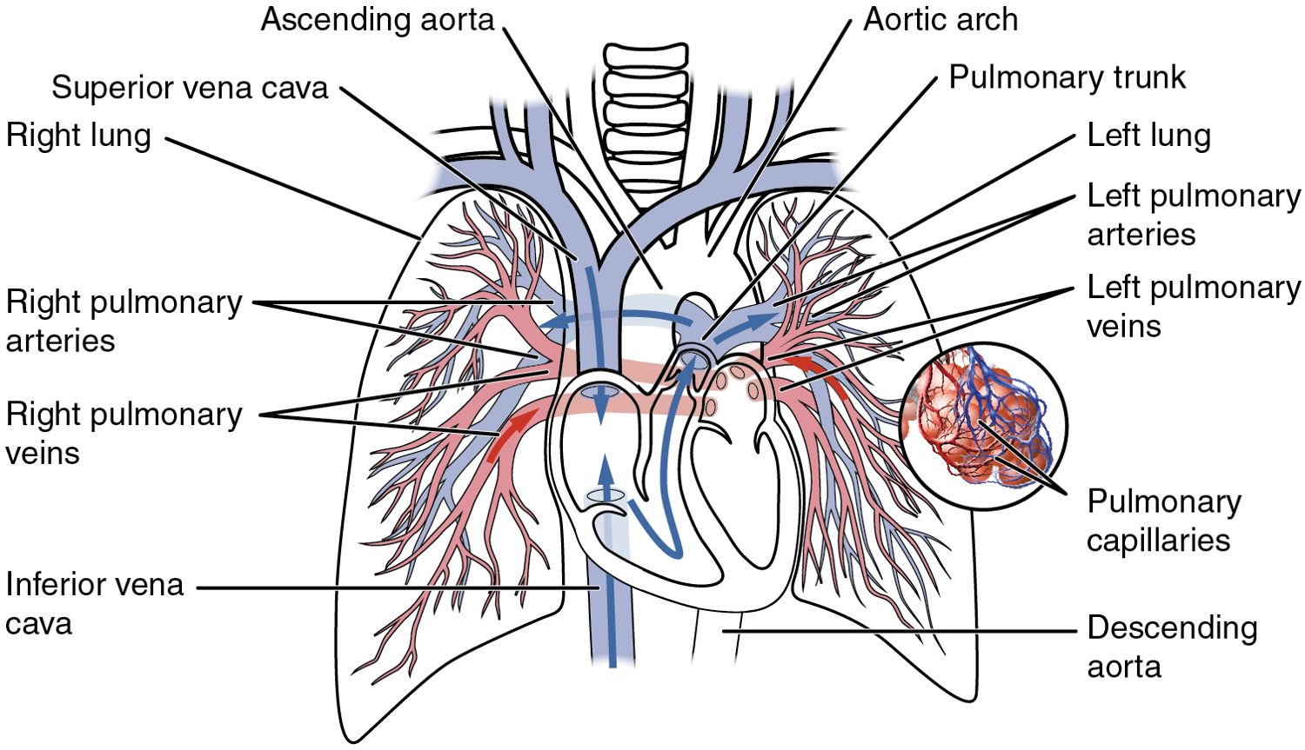
SECTION 20.5
Pulmonary & Systemic Circuits
The pulmonary and systemic circuits
Two linked circuits
Pulmonary: heart ↔ lungs
Systemic: heart ↔ body
Run in series through the heart
PN 104 · Ch 20 — Blood Vessels and Circulation
15

Slide 16
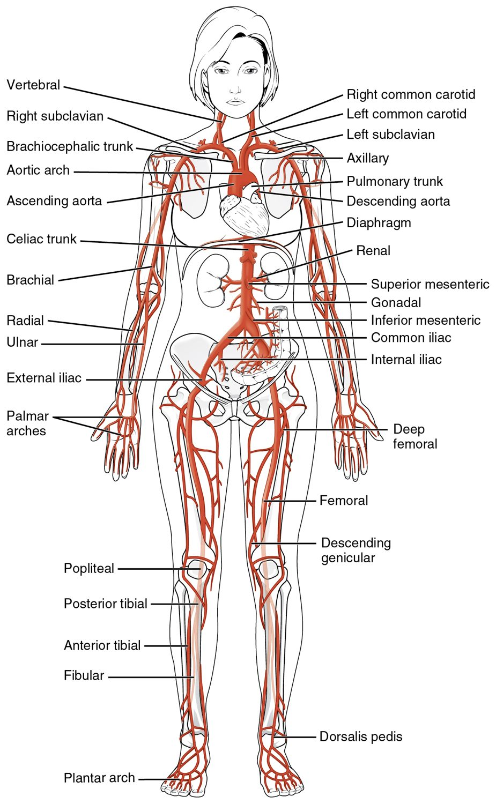
SECTION 20.5
Major Arteries
Arteries carry blood from the heart
The aorta is the largest
Branches supply every region
Usually carry oxygen-rich blood
Major arteries of the body
PN 104 · Ch 20 — Blood Vessels and Circulation
16

Slide 17
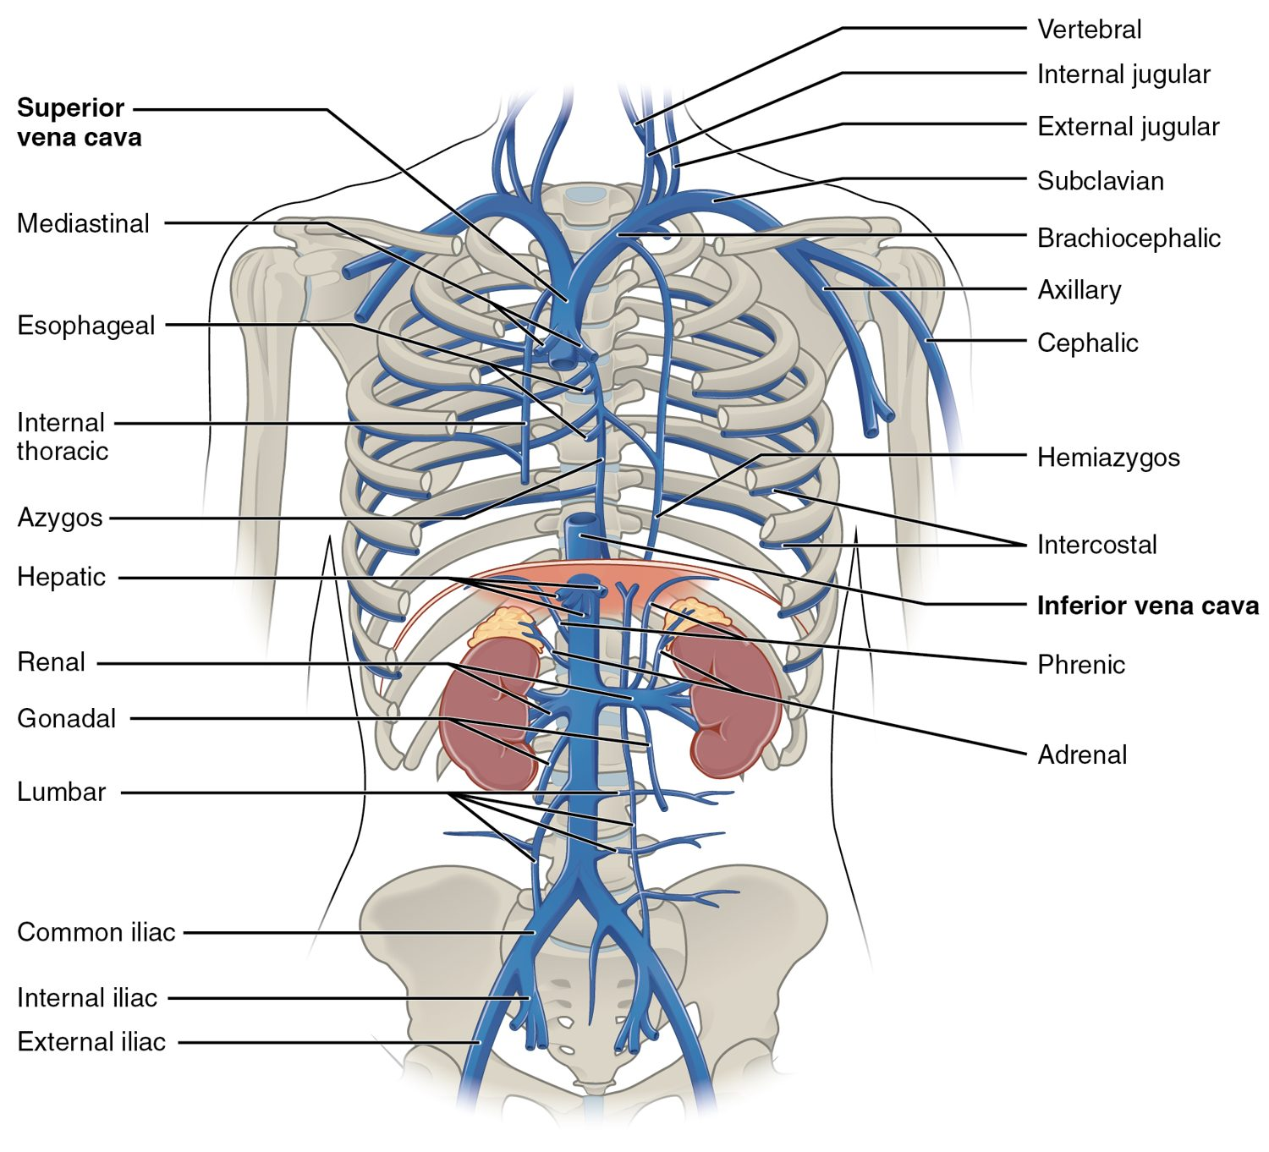
SECTION 20.5
Major Veins
Veins return blood to the heart
The venae cavae are the largest
Drain every body region
Usually carry oxygen-poor blood
Major veins of the body
PN 104 · Ch 20 — Blood Vessels and Circulation
17

Slide 18
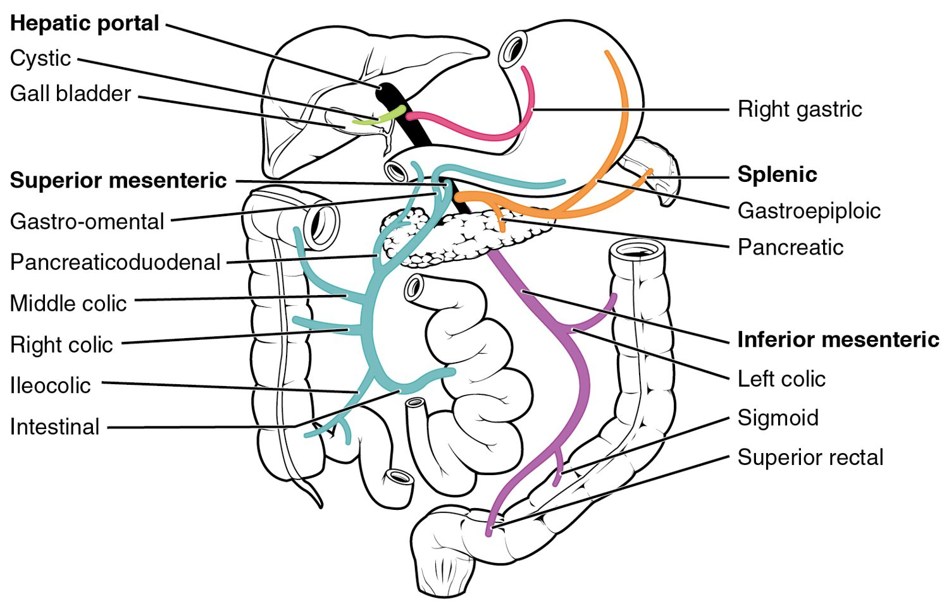
SECTION 20.5
The Hepatic Portal System
The hepatic portal system
A special detour through the liver
Drains the digestive organs
Carries nutrient-rich blood to the liver
Liver processes it before circulation
PN 104 · Ch 20 — Blood Vessels and Circulation
18

Slide 19
20.6
SECTION
Development of Blood Vessels and Fetal Circulation
Fetal circulation before birth.

Slide 20
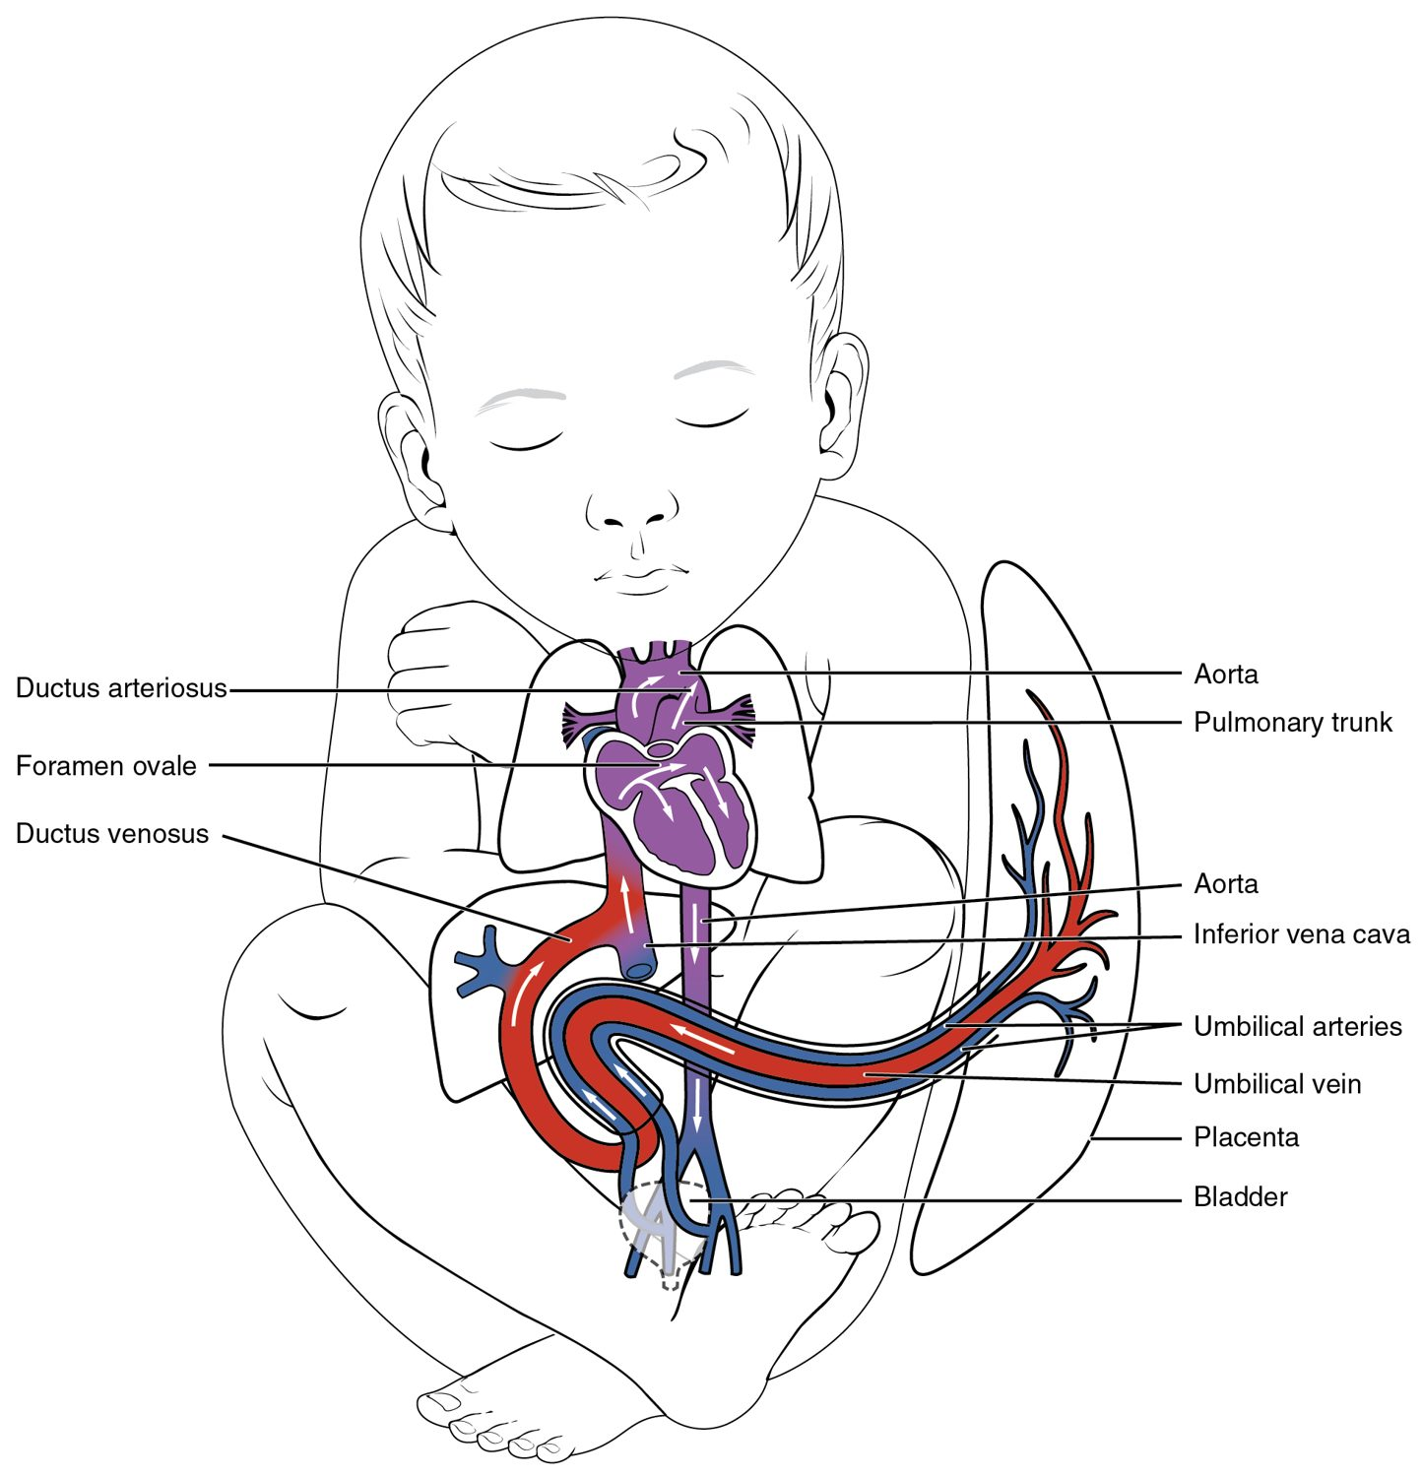
SECTION 20.6
Fetal Circulation
The fetus gets oxygen from the placenta
The lungs are bypassed before birth
Shortcuts: ductus arteriosus, foramen ovale
They close at birth
Fetal circulation
PN 104 · Ch 20 — Blood Vessels and Circulation
20

Slide 21
CHAPTER 20
Key Takeaways
Arteries carry blood from the heart, veins return it, and capillaries are where exchange occurs.
Blood pressure is highest in the arteries and drives flow through the circuit.
Capillary exchange delivers nutrients and removes wastes; imbalance causes edema.
The systemic and pulmonary circuits carry blood to the body and the lungs.
Fetal circulation bypasses the lungs through shunts that close at birth.
PN 104 · Ch 20 — Blood Vessels and Circulation
21

Slide 22
CLINICAL CONNECTIONS
Why Blood Vessels Matter in Practical Nursing
Hypertension
Atherosclerosis
Chronically high blood pressure damages vessels and organs.
Arterial plaque narrows vessels and raises clot risk.
Pulse & BP
Edema
Core vital signs reflecting cardiovascular status.
Fluid leaking from capillaries causes tissue swelling.
Varicose Veins
IV Access
Failed venous valves let blood pool in the legs.
Superficial veins are used for fluids, medications, and blood draws.

