Slide 1
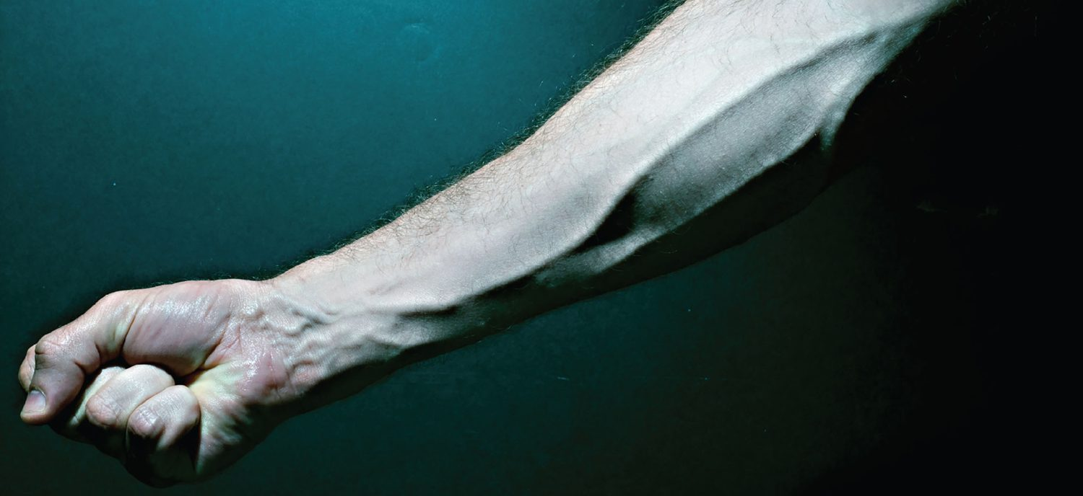
CHAPTER 20
Blood Vessels and Circulation
Vessels, blood pressure, exchange, and the circulatory pathways.
Anatomy & Physiology · Broward-Miami Health Institute
FACULTY EDITION
Notes:
READ ALOUD SCRIPT
Today we are beginning Chapter 20, blood vessels. In this chapter, we will connect the major structures and processes with their functions and with the observations that matter in practical nursing care. As we move through the slides, focus on how this system supports circulation, perfusion, protection, and patient safety. By the end, you should be able to explain the major concepts in your own words and apply them to a patient-care situation.
[Sources]
- BMHI PN 104 Chapter 20 faculty PowerPoint slide content.

Slide 2
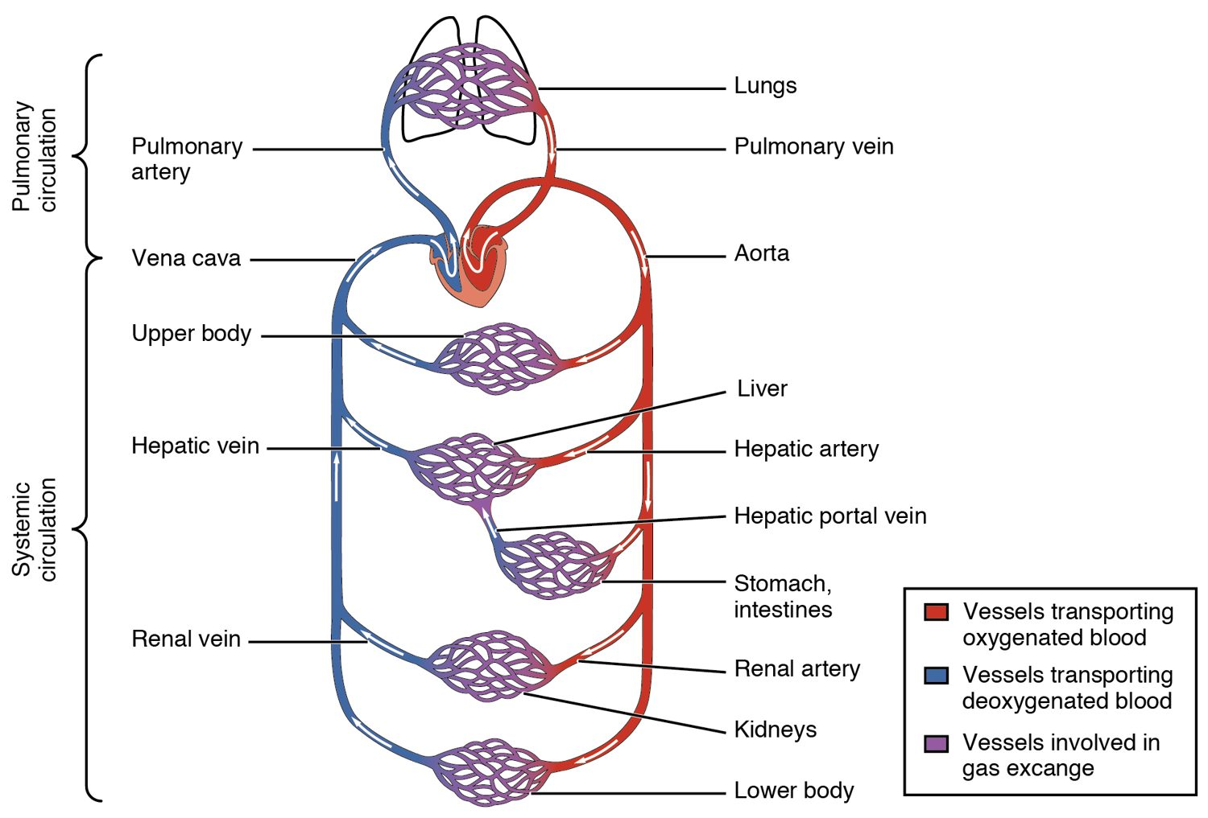
CHAPTER 20
Learning Objectives
After studying this chapter, students will be able to:
1
Compare and contrast the anatomical structure of arteries, arterioles, capillaries, venules, and veins
2
Accurately describe the forces that account for capillary exchange
3
List the major factors affecting blood flow, blood pressure, and resistance
4
Describe how blood flow, blood pressure, and resistance interrelate
5
Discuss how the neural and endocrine mechanisms maintain homeostasis within the blood vessels
6
Describe the interaction of the cardiovascular system with other body systems
The pulmonary and systemic circuits.
PN 104 · Ch 20 — Blood Vessels and Circulation
2
Notes:
READ ALOUD SCRIPT
These are our learning objectives for Chapter 20. By the end of the chapter, you should be able to do the following: Compare and contrast the anatomical structure of arteries, arterioles, capillaries, venules, and veins. Accurately describe the forces that account for capillary exchange. List the major factors affecting blood flow, blood pressure, and resistance. Describe how blood flow, blood pressure, and resistance interrelate. Discuss how the neural and endocrine mechanisms maintain homeostasis within the blood vessels. Describe the interaction of the cardiovascular system with other body systems. Do not treat these as isolated facts. Use them as a checklist for what you should be able to identify, explain, and connect to safe practical nursing care.
[Sources]
- BMHI PN 104 Chapter 20 faculty PowerPoint slide content.

Slide 3
20.1
SECTION
Structure and Function of Blood Vessels
The structure of arteries, veins, and capillaries.
Notes:
READ ALOUD SCRIPT
We are now moving into Structure and Function of Blood Vessels. The structure of arteries, veins, and capillaries. As we begin this section, listen for the major structures, their locations, and the functions they perform. Then ask yourself what a change in this area might look like during patient care.
[Sources]
- BMHI PN 104 Chapter 20 faculty PowerPoint slide content.

Slide 4
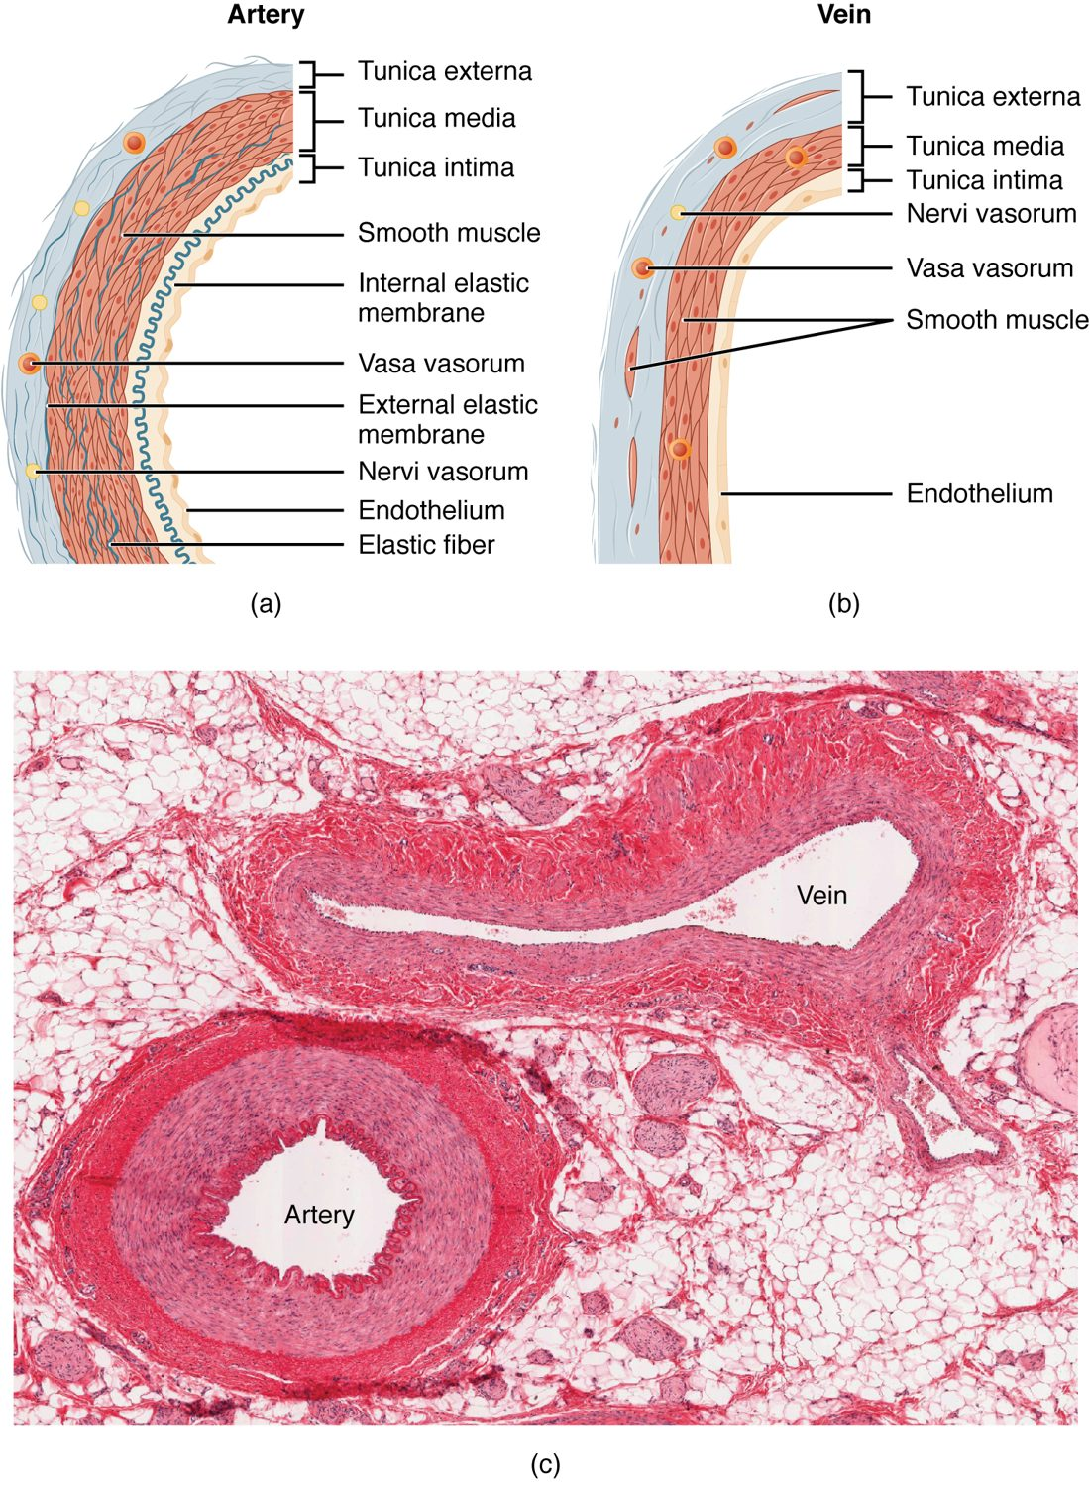
SECTION 20.1
Artery vs. Vein
Both have three wall layers (tunics)
Arteries have thick muscular walls
Veins are thinner, with valves
Valves keep venous blood moving up
The walls of an artery and a vein
PN 104 · Ch 20 — Blood Vessels and Circulation
4
Notes:
READ ALOUD SCRIPT
Now let's focus on Artery vs. Vein. The walls of an artery and a vein. Both have three wall layers (tunics). Arteries have thick muscular walls. Veins are thinner, with valves. Valves keep venous blood moving up. Assess distal color, temperature, pulses, capillary refill, sensation, movement, pain, and swelling when arterial or microcirculatory flow may be impaired. Take a moment to identify the structure on the image and explain how its form supports its function. This is slide 4 of 22.
[Sources]
- BMHI PN 104 Chapter 20 faculty PowerPoint slide content.

Slide 5
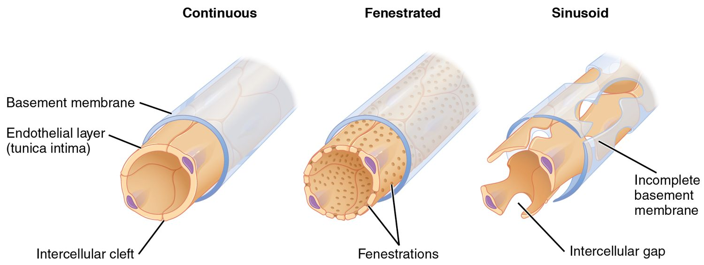
SECTION 20.1
Types of Capillaries
The three types of capillaries
The smallest vessels
Walls just one cell thick
Continuous, fenestrated, sinusoid
The site of all exchange
PN 104 · Ch 20 — Blood Vessels and Circulation
5
Notes:
READ ALOUD SCRIPT
Now let's focus on Types of Capillaries. The three types of capillaries. The smallest vessels. Walls just one cell thick. Continuous, fenestrated, sinusoid. The site of all exchange. Assess distal color, temperature, pulses, capillary refill, sensation, movement, pain, and swelling when arterial or microcirculatory flow may be impaired. Take a moment to identify the structure on the image and explain how its form supports its function. This is slide 5 of 22.
[Sources]
- BMHI PN 104 Chapter 20 faculty PowerPoint slide content.

Slide 6
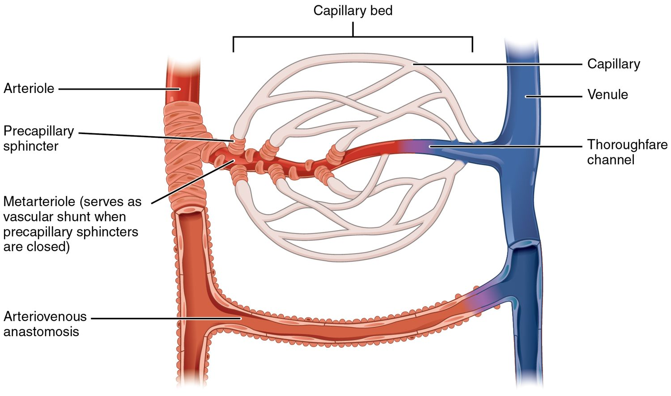
SECTION 20.1
The Capillary Bed
Blood flow through a capillary bed
Capillaries form branching beds
Connect arterioles to venules
Precapillary sphincters control flow
Direct blood where it's needed
PN 104 · Ch 20 — Blood Vessels and Circulation
6
Notes:
READ ALOUD SCRIPT
Now let's focus on The Capillary Bed. Blood flow through a capillary bed. Capillaries form branching beds. Connect arterioles to venules. Precapillary sphincters control flow. Direct blood where it's needed. Assess distal color, temperature, pulses, capillary refill, sensation, movement, pain, and swelling when arterial or microcirculatory flow may be impaired. Take a moment to identify the structure on the image and explain how its form supports its function. This is slide 6 of 22.
[Sources]
- BMHI PN 104 Chapter 20 faculty PowerPoint slide content.

Slide 7
20.2
SECTION
Blood Flow, Blood Pressure, and Resistance
Blood flow, blood pressure, and resistance.
Notes:
READ ALOUD SCRIPT
We are now moving into Blood Flow, Blood Pressure, and Resistance. Blood flow, blood pressure, and resistance. As we begin this section, listen for the major structures, their locations, and the functions they perform. Then ask yourself what a change in this area might look like during patient care.
[Sources]
- BMHI PN 104 Chapter 20 faculty PowerPoint slide content.

Slide 8
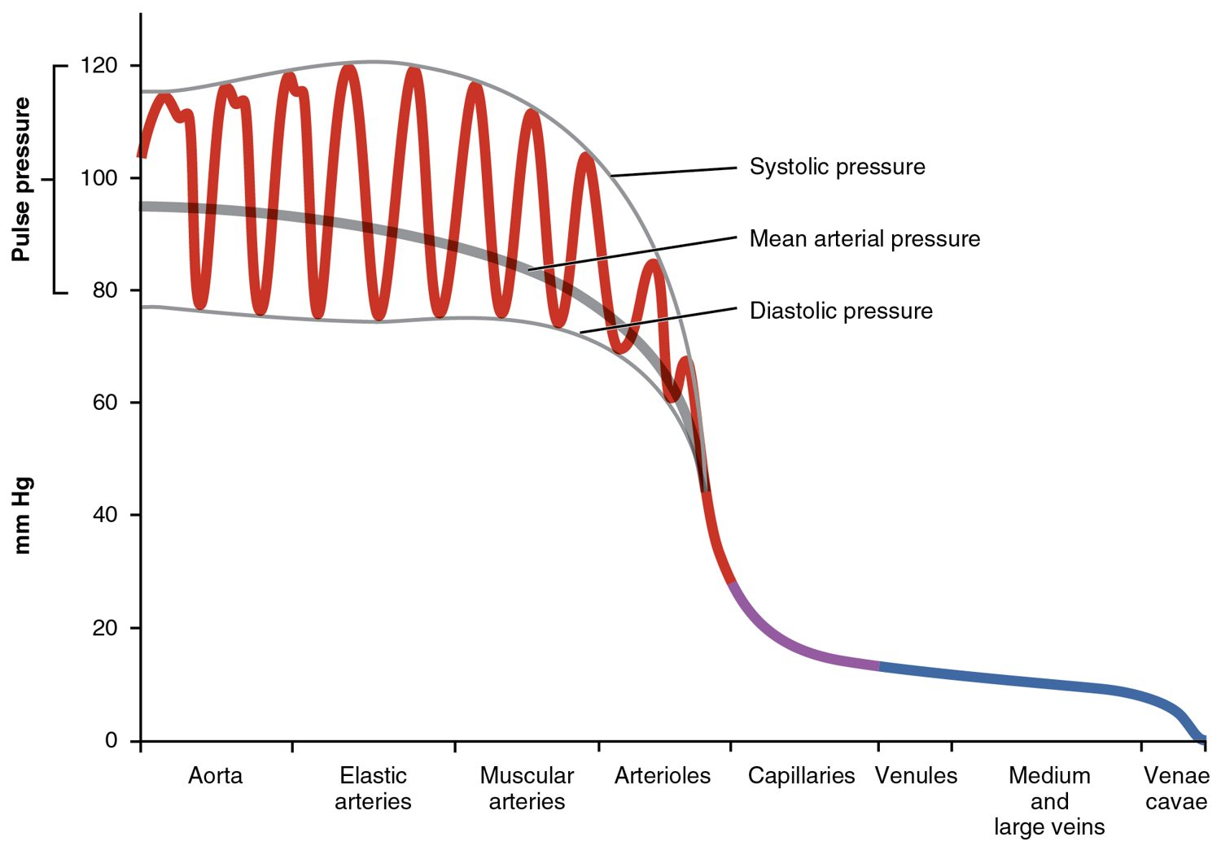
SECTION 20.2
Blood Pressure Across the System
Pressure is highest in the arteries
Drops sharply in the arterioles
Lowest in the veins
The gradient drives blood flow
Blood pressure throughout the circulation
PN 104 · Ch 20 — Blood Vessels and Circulation
8
Notes:
READ ALOUD SCRIPT
Now let's focus on Blood Pressure Across the System. Pressure is highest in the arteries. Drops sharply in the arterioles. Lowest in the veins. The gradient drives blood flow. Blood pressure throughout the circulation. Measure blood pressure with correct positioning and cuff size, compare the result with baseline, and assess symptoms before deciding how urgently to report a change. Take a moment to identify the structure on the image and explain how its form supports its function. This is slide 8 of 22.
[Sources]
- BMHI PN 104 Chapter 20 faculty PowerPoint slide content.

Slide 9
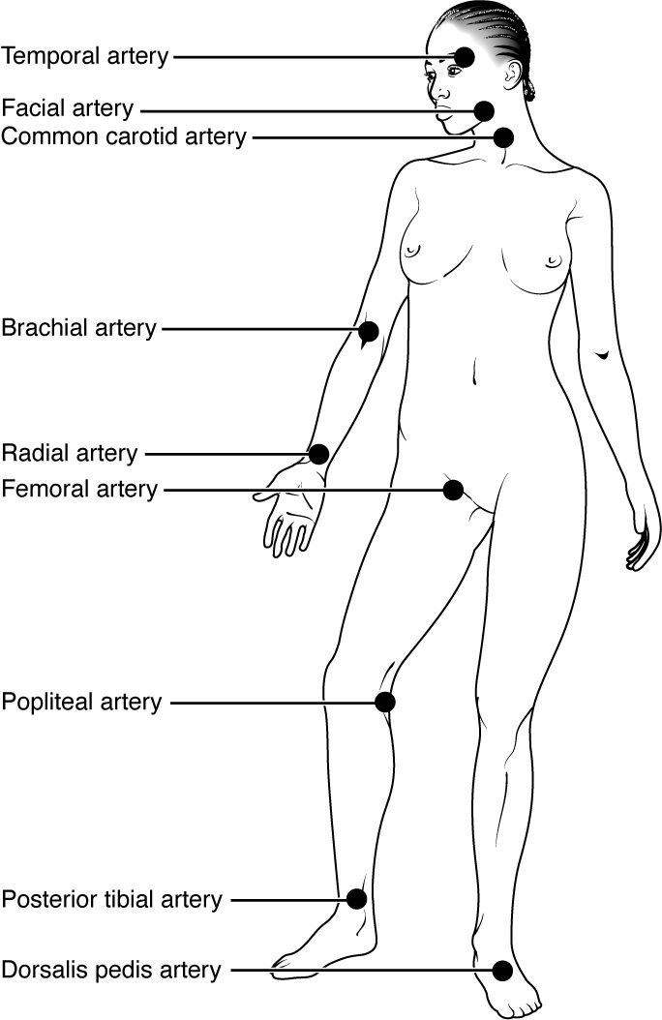
SECTION 20.2
Pulse Points
Pulse = artery expanding with each beat
Felt where arteries are near the surface
Common sites: radial, carotid, femoral
Used to assess rate and rhythm
Pulse points of the body
PN 104 · Ch 20 — Blood Vessels and Circulation
9
Notes:
READ ALOUD SCRIPT
Now let's focus on Pulse Points. Pulse points of the body. Pulse = artery expanding with each beat. Felt where arteries are near the surface. Common sites: radial, carotid, femoral. Used to assess rate and rhythm. Assess distal color, temperature, pulses, capillary refill, sensation, movement, pain, and swelling when arterial or microcirculatory flow may be impaired. Take a moment to identify the structure on the image and explain how its form supports its function. This is slide 9 of 22.
[Sources]
- BMHI PN 104 Chapter 20 faculty PowerPoint slide content.

Slide 10
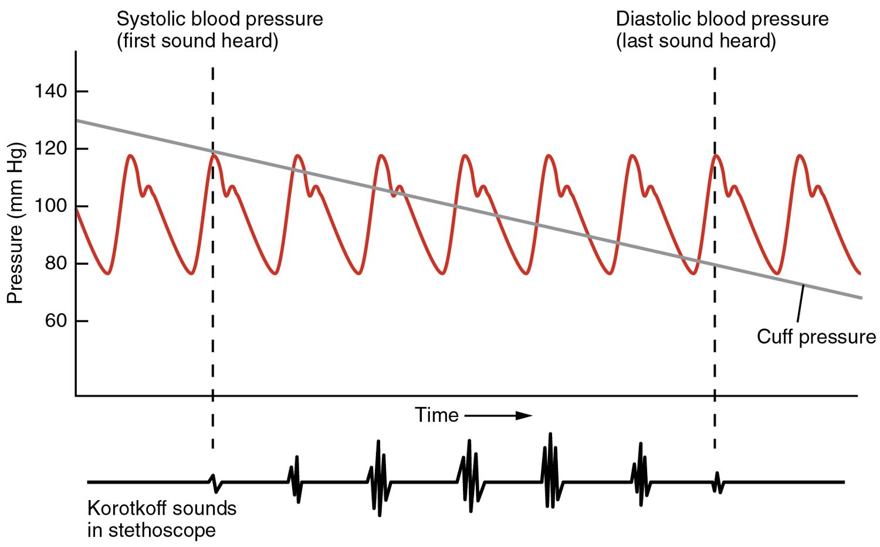
SECTION 20.2
Measuring Blood Pressure
Measuring arterial blood pressure
Measured with a cuff (sphygmomanometer)
Systolic over diastolic
Normal about 120/80 mmHg
A key vital sign
PN 104 · Ch 20 — Blood Vessels and Circulation
10
Notes:
READ ALOUD SCRIPT
Now let's focus on Measuring Blood Pressure. Measuring arterial blood pressure. Measured with a cuff (sphygmomanometer). Systolic over diastolic. Normal about 120/80 mmHg. A key vital sign. Measure blood pressure with correct positioning and cuff size, compare the result with baseline, and assess symptoms before deciding how urgently to report a change. Take a moment to identify the structure on the image and explain how its form supports its function. This is slide 10 of 22.
[Sources]
- BMHI PN 104 Chapter 20 faculty PowerPoint slide content.

Slide 11
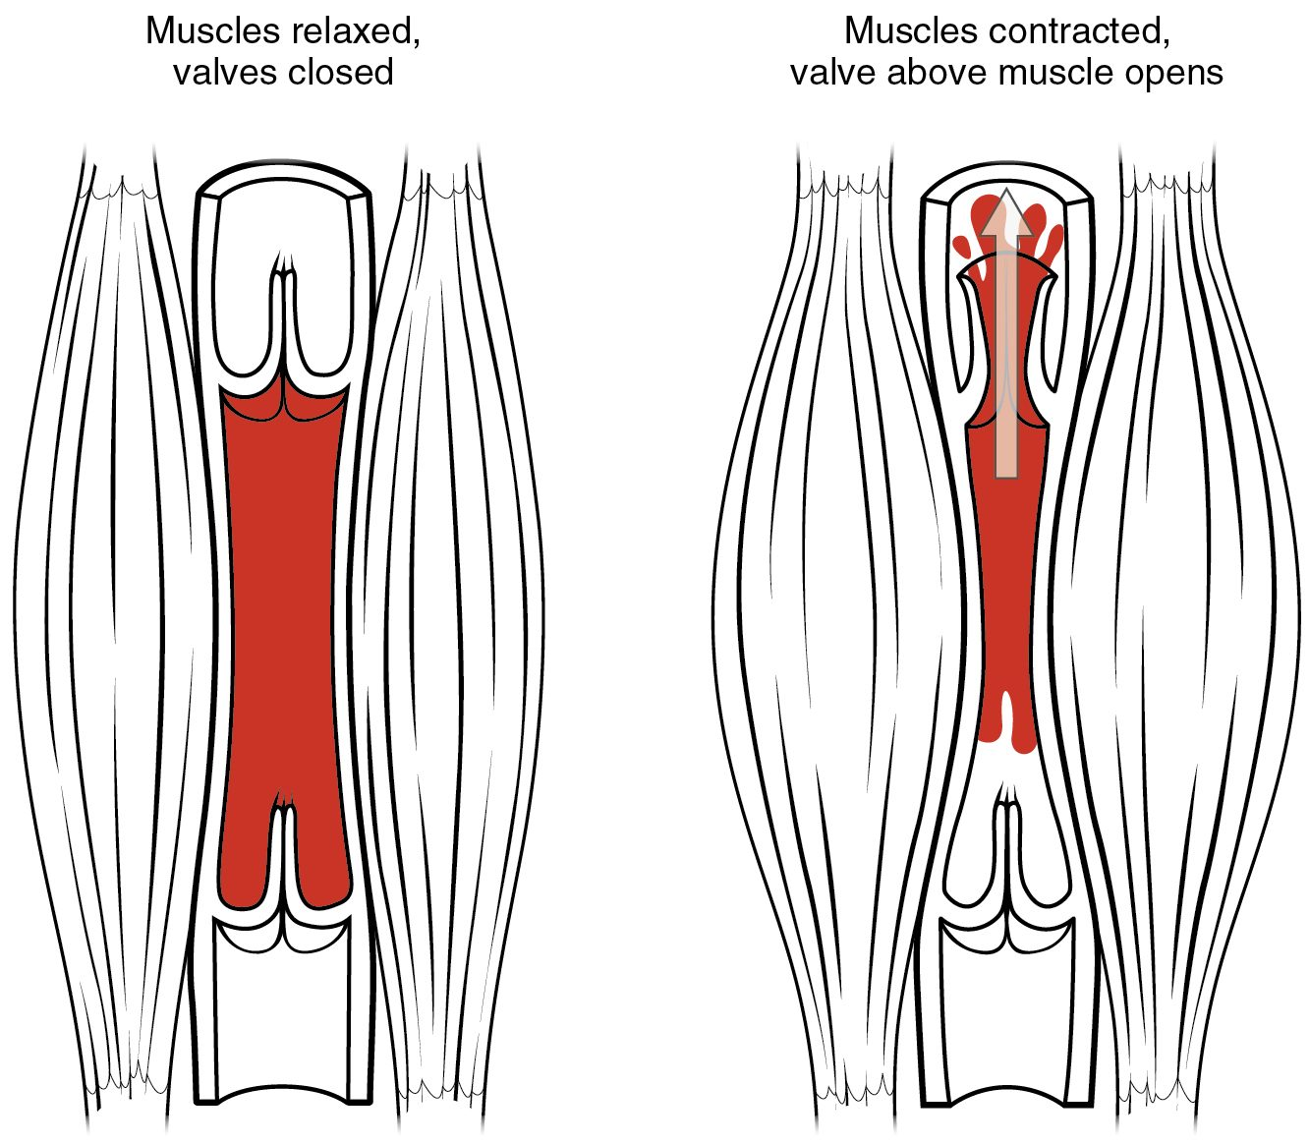
SECTION 20.2
The Skeletal Muscle Pump
Veins need help returning blood
Contracting muscles squeeze veins
Valves keep blood moving up
Aids venous return to the heart
The skeletal muscle pump
PN 104 · Ch 20 — Blood Vessels and Circulation
11
Notes:
READ ALOUD SCRIPT
Now let's focus on The Skeletal Muscle Pump. Veins need help returning blood. Contracting muscles squeeze veins. Valves keep blood moving up. Aids venous return to the heart. The skeletal muscle pump. Observe for dependent edema, skin changes, varicosities, unilateral swelling, warmth, and pain, and report findings that may suggest venous obstruction or thrombosis. Take a moment to identify the structure on the image and explain how its form supports its function. This is slide 11 of 22.
[Sources]
- BMHI PN 104 Chapter 20 faculty PowerPoint slide content.

Slide 12
20.3
SECTION
Capillary Exchange
Capillary exchange — where blood serves the tissues.
Notes:
READ ALOUD SCRIPT
We are now moving into Capillary Exchange. Capillary exchange — where blood serves the tissues. As we begin this section, listen for the major structures, their locations, and the functions they perform. Then ask yourself what a change in this area might look like during patient care.
[Sources]
- BMHI PN 104 Chapter 20 faculty PowerPoint slide content.

Slide 13
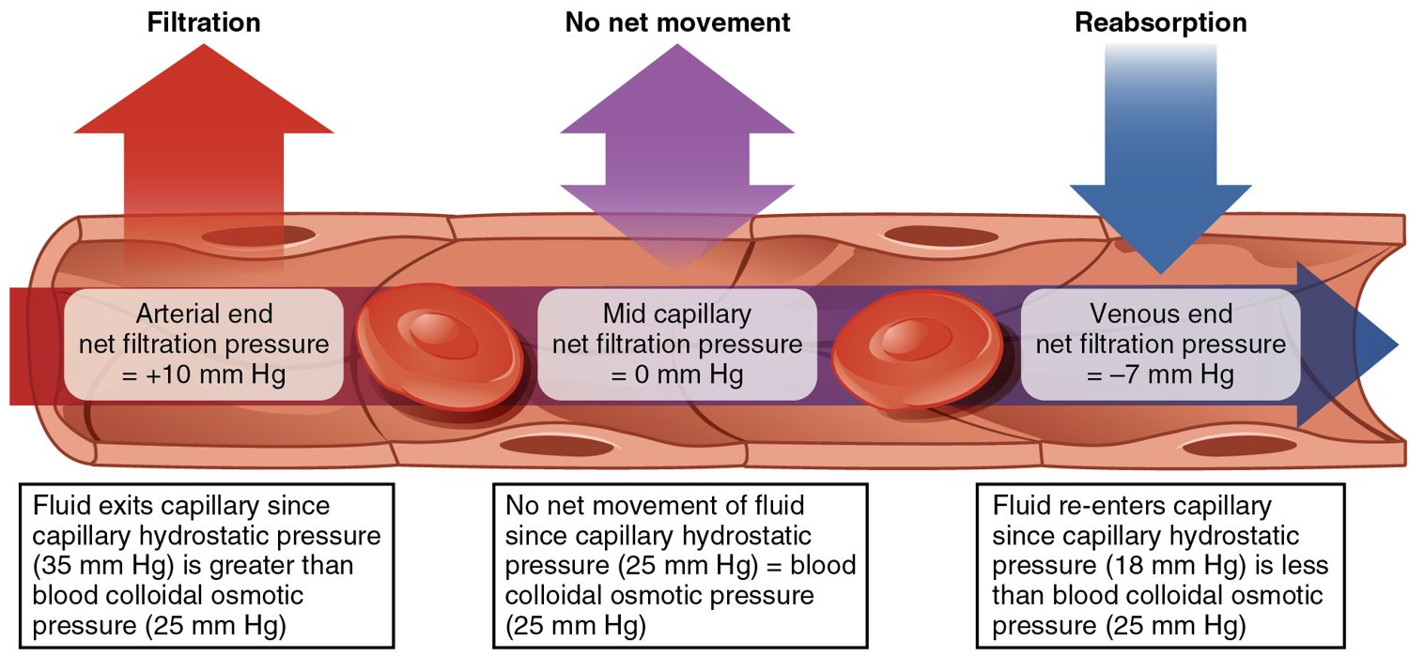
SECTION 20.3
Capillary Exchange
Fluid exchange at the capillary
Materials cross the thin capillary wall
Pressure pushes fluid out (filtration)
Osmosis pulls fluid back (reabsorption)
Delivers nutrients, removes wastes
PN 104 · Ch 20 — Blood Vessels and Circulation
13
Notes:
READ ALOUD SCRIPT
Now let's focus on Capillary Exchange. Fluid exchange at the capillary. Materials cross the thin capillary wall. Pressure pushes fluid out (filtration). Osmosis pulls fluid back (reabsorption). Delivers nutrients, removes wastes. Assess distal color, temperature, pulses, capillary refill, sensation, movement, pain, and swelling when arterial or microcirculatory flow may be impaired. Take a moment to identify the structure on the image and explain how its form supports its function. This is slide 13 of 22.
[Sources]
- BMHI PN 104 Chapter 20 faculty PowerPoint slide content.

Slide 14
20.5
SECTION
Circulatory Pathways
The major arteries, veins, and circulatory pathways.
Notes:
READ ALOUD SCRIPT
We are now moving into Circulatory Pathways. The major arteries, veins, and circulatory pathways. As we begin this section, listen for the major structures, their locations, and the functions they perform. Then ask yourself what a change in this area might look like during patient care.
[Sources]
- BMHI PN 104 Chapter 20 faculty PowerPoint slide content.

Slide 15
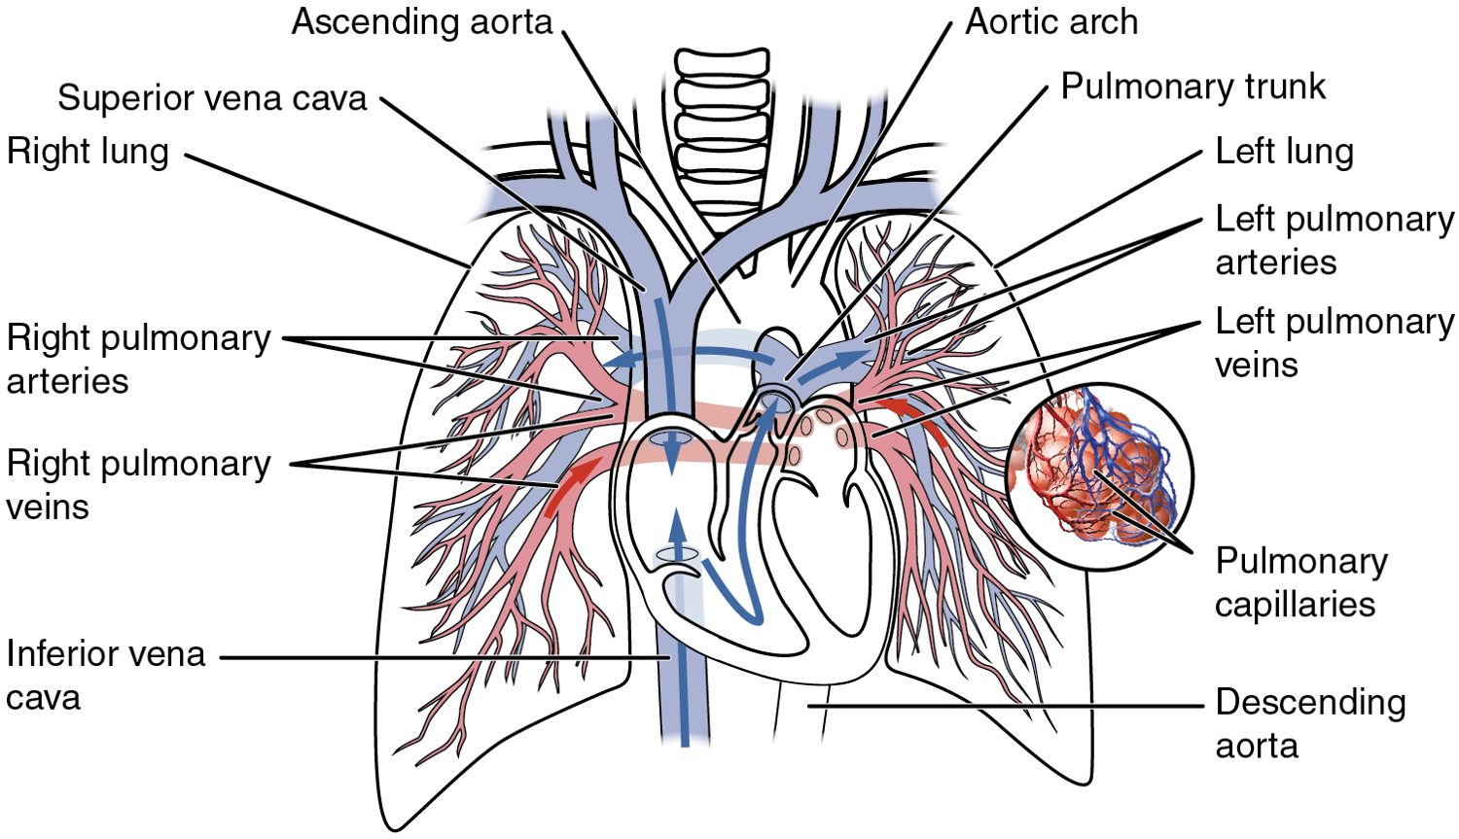
SECTION 20.5
Pulmonary & Systemic Circuits
The pulmonary and systemic circuits
Two linked circuits
Pulmonary: heart ↔ lungs
Systemic: heart ↔ body
Run in series through the heart
PN 104 · Ch 20 — Blood Vessels and Circulation
15
Notes:
READ ALOUD SCRIPT
Now let's focus on Pulmonary & Systemic Circuits. The pulmonary and systemic circuits. Two linked circuits. Pulmonary: heart ↔ lungs. Systemic: heart ↔ body. Run in series through the heart. Blood-vessel function is reflected in perfusion, blood pressure, edema, skin findings, pulses, temperature, capillary refill, and organ function. Take a moment to identify the structure on the image and explain how its form supports its function. This is slide 15 of 22.
[Sources]
- BMHI PN 104 Chapter 20 faculty PowerPoint slide content.

Slide 16
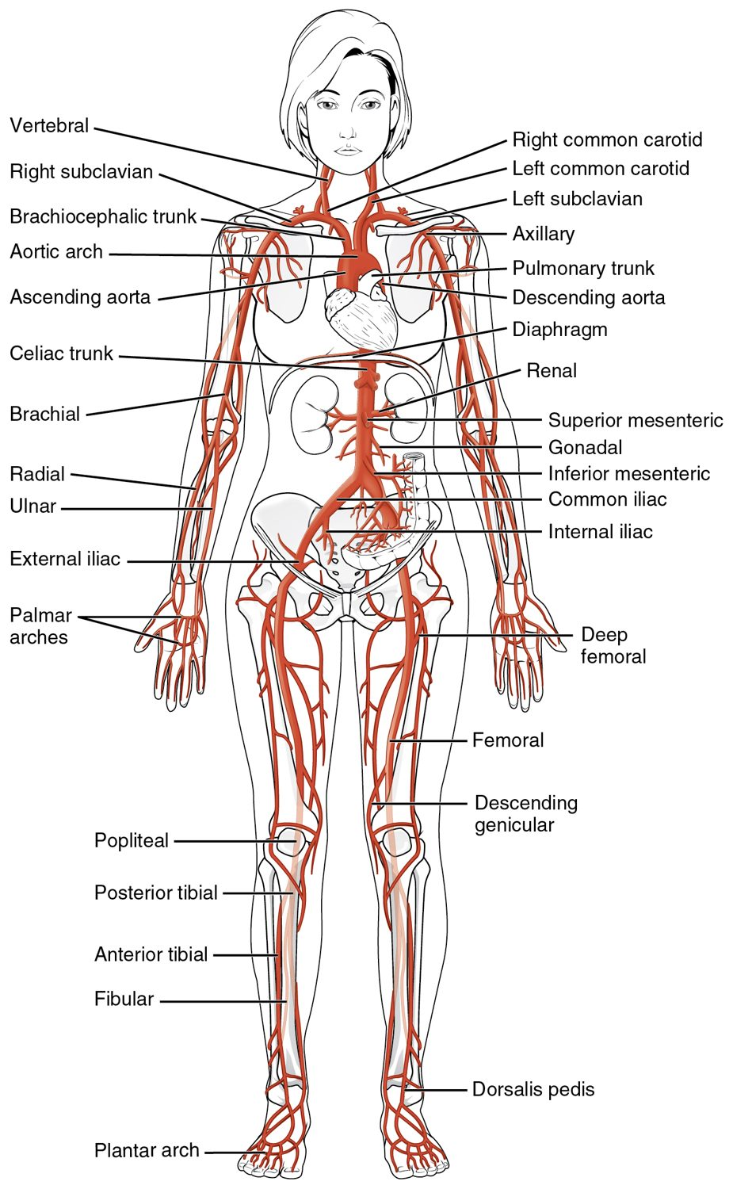
SECTION 20.5
Major Arteries
Arteries carry blood from the heart
The aorta is the largest
Branches supply every region
Usually carry oxygen-rich blood
Major arteries of the body
PN 104 · Ch 20 — Blood Vessels and Circulation
16
Notes:
READ ALOUD SCRIPT
Now let's focus on Major Arteries. Major arteries of the body. Arteries carry blood from the heart. The aorta is the largest. Branches supply every region. Usually carry oxygen-rich blood. Assess distal color, temperature, pulses, capillary refill, sensation, movement, pain, and swelling when arterial or microcirculatory flow may be impaired. Take a moment to identify the structure on the image and explain how its form supports its function. This is slide 16 of 22.
[Sources]
- BMHI PN 104 Chapter 20 faculty PowerPoint slide content.

Slide 17
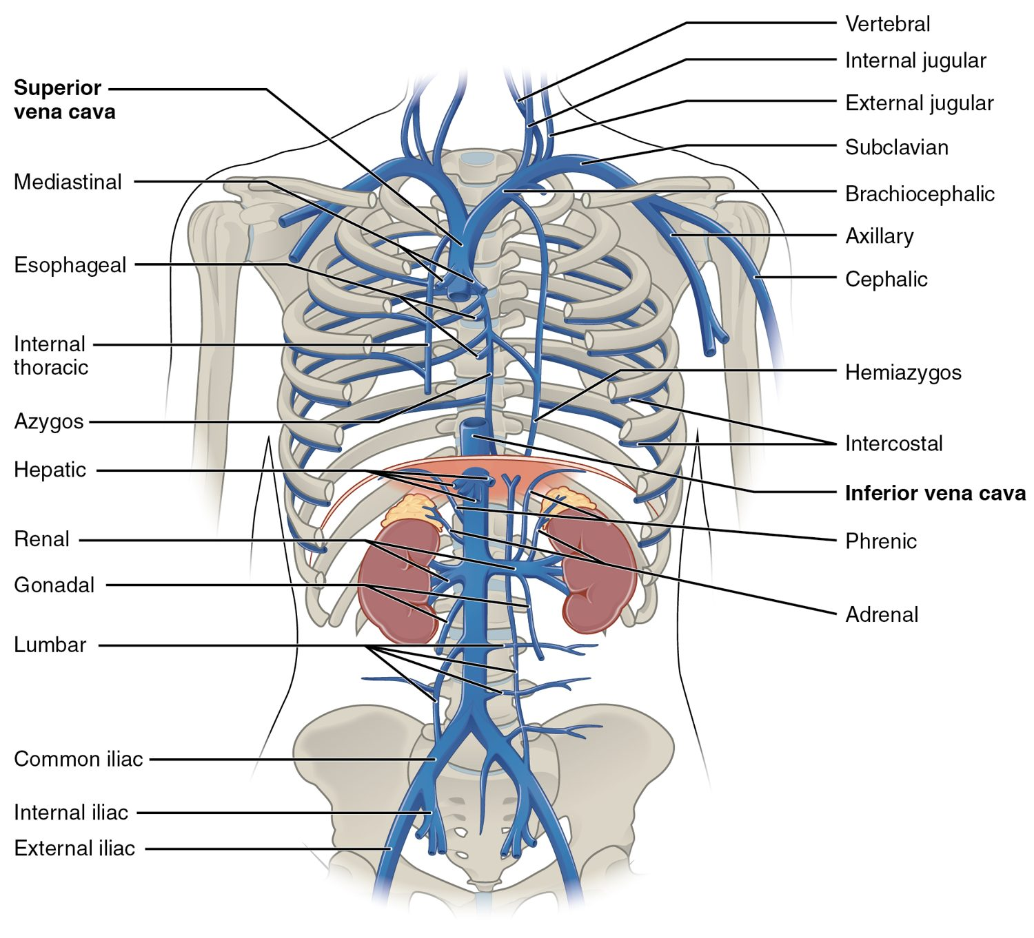
SECTION 20.5
Major Veins
Veins return blood to the heart
The venae cavae are the largest
Drain every body region
Usually carry oxygen-poor blood
Major veins of the body
PN 104 · Ch 20 — Blood Vessels and Circulation
17
Notes:
READ ALOUD SCRIPT
Now let's focus on Major Veins. Veins return blood to the heart. The venae cavae are the largest. Drain every body region. Usually carry oxygen-poor blood. Major veins of the body. Observe for dependent edema, skin changes, varicosities, unilateral swelling, warmth, and pain, and report findings that may suggest venous obstruction or thrombosis. Take a moment to identify the structure on the image and explain how its form supports its function. This is slide 17 of 22.
[Sources]
- BMHI PN 104 Chapter 20 faculty PowerPoint slide content.

Slide 18
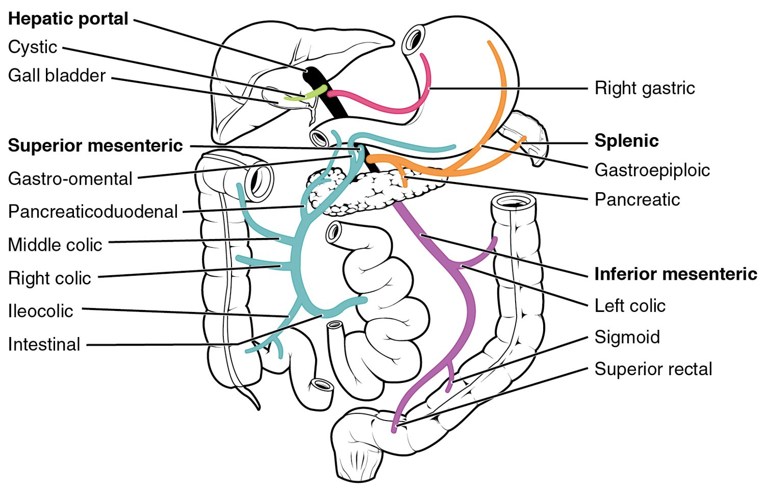
SECTION 20.5
The Hepatic Portal System
The hepatic portal system
A special detour through the liver
Drains the digestive organs
Carries nutrient-rich blood to the liver
Liver processes it before circulation
PN 104 · Ch 20 — Blood Vessels and Circulation
18
Notes:
READ ALOUD SCRIPT
Now let's focus on The Hepatic Portal System. The hepatic portal system. A special detour through the liver. Drains the digestive organs. Carries nutrient-rich blood to the liver. Liver processes it before circulation. Blood-vessel function is reflected in perfusion, blood pressure, edema, skin findings, pulses, temperature, capillary refill, and organ function. Take a moment to identify the structure on the image and explain how its form supports its function. This is slide 18 of 22.
[Sources]
- BMHI PN 104 Chapter 20 faculty PowerPoint slide content.

Slide 19
20.6
SECTION
Development of Blood Vessels and Fetal Circulation
Fetal circulation before birth.
Notes:
READ ALOUD SCRIPT
We are now moving into Development of Blood Vessels and Fetal Circulation. Fetal circulation before birth. As we begin this section, listen for the major structures, their locations, and the functions they perform. Then ask yourself what a change in this area might look like during patient care.
[Sources]
- BMHI PN 104 Chapter 20 faculty PowerPoint slide content.

Slide 20
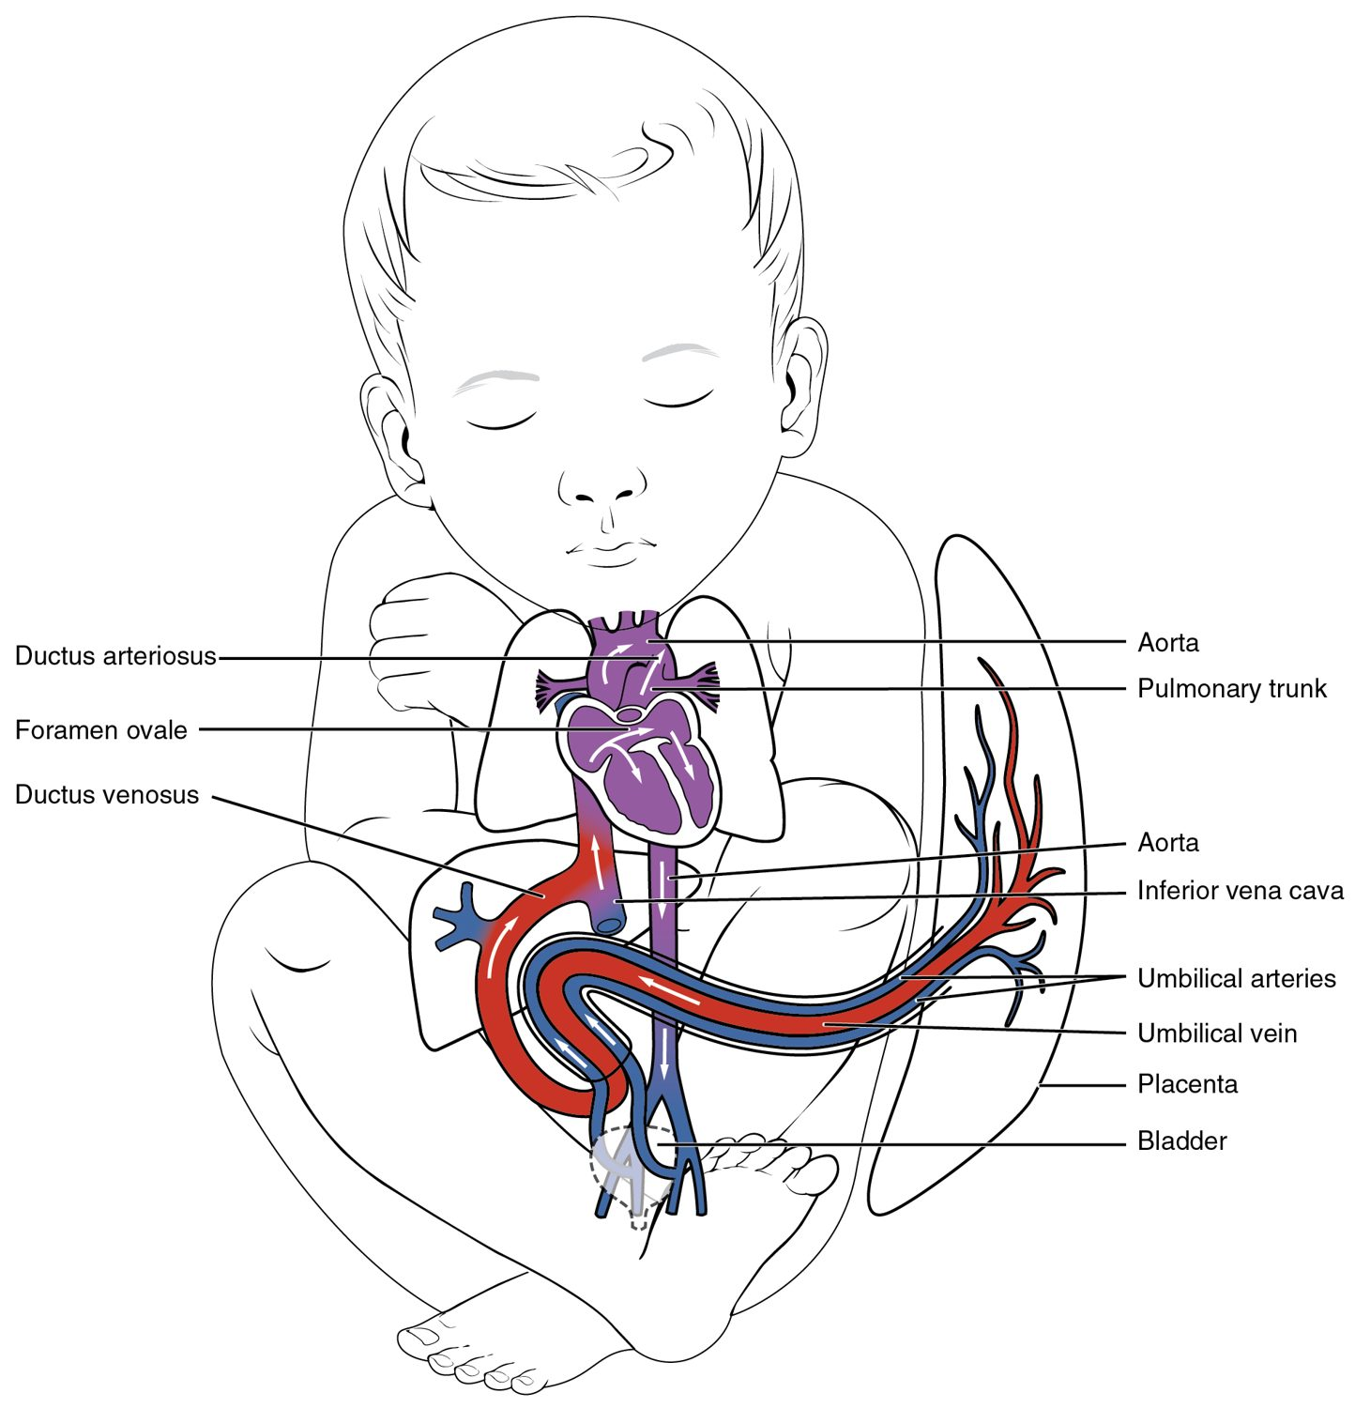
SECTION 20.6
Fetal Circulation
The fetus gets oxygen from the placenta
The lungs are bypassed before birth
Shortcuts: ductus arteriosus, foramen ovale
They close at birth
Fetal circulation
PN 104 · Ch 20 — Blood Vessels and Circulation
20
Notes:
READ ALOUD SCRIPT
Now let's focus on Fetal Circulation. The fetus gets oxygen from the placenta. The lungs are bypassed before birth. Shortcuts: ductus arteriosus, foramen ovale. They close at birth. Fetal circulation. Assess distal color, temperature, pulses, capillary refill, sensation, movement, pain, and swelling when arterial or microcirculatory flow may be impaired. Take a moment to identify the structure on the image and explain how its form supports its function. This is slide 20 of 22.
[Sources]
- BMHI PN 104 Chapter 20 faculty PowerPoint slide content.

Slide 21
CHAPTER 20
Key Takeaways
Arteries carry blood from the heart, veins return it, and capillaries are where exchange occurs.
Blood pressure is highest in the arteries and drives flow through the circuit.
Capillary exchange delivers nutrients and removes wastes; imbalance causes edema.
The systemic and pulmonary circuits carry blood to the body and the lungs.
Fetal circulation bypasses the lungs through shunts that close at birth.
PN 104 · Ch 20 — Blood Vessels and Circulation
21
Notes:
READ ALOUD SCRIPT
Let us review the major takeaways from Chapter 20. Arteries carry blood from the heart, veins return it, and capillaries are where exchange occurs. Blood pressure is highest in the arteries and drives flow through the circuit. Capillary exchange delivers nutrients and removes wastes; imbalance causes edema. The systemic and pulmonary circuits carry blood to the body and the lungs. Fetal circulation bypasses the lungs through shunts that close at birth. Before moving on, pause and explain each point without reading the slide. If any statement is difficult to explain, mark that topic for review before the quiz.
[Sources]
- BMHI PN 104 Chapter 20 faculty PowerPoint slide content.

Slide 22
CLINICAL CONNECTIONS
Why Blood Vessels Matter in Practical Nursing
Hypertension
Atherosclerosis
Chronically high blood pressure damages vessels and organs.
Arterial plaque narrows vessels and raises clot risk.
Pulse & BP
Edema
Core vital signs reflecting cardiovascular status.
Fluid leaking from capillaries causes tissue swelling.
Varicose Veins
IV Access
Failed venous valves let blood pool in the legs.
Superficial veins are used for fluids, medications, and blood draws.
Notes:
READ ALOUD SCRIPT
This final slide connects Chapter 20 to practical nursing. Hypertension. Chronically high blood pressure damages vessels and organs. Atherosclerosis. Arterial plaque narrows vessels and raises clot risk. Pulse & BP. Core vital signs reflecting cardiovascular status. Edema. Fluid leaking from capillaries causes tissue swelling. Varicose Veins. Failed venous valves let blood pool in the legs. IV Access. Superficial veins are used for fluids, medications, and blood draws. Your role is to observe carefully, protect safety, follow orders and precautions, document objectively, and report changes through the appropriate chain of command. Use these examples to connect anatomy with the care you will provide.
[Sources]
- BMHI PN 104 Chapter 20 faculty PowerPoint slide content.

