Slide 1
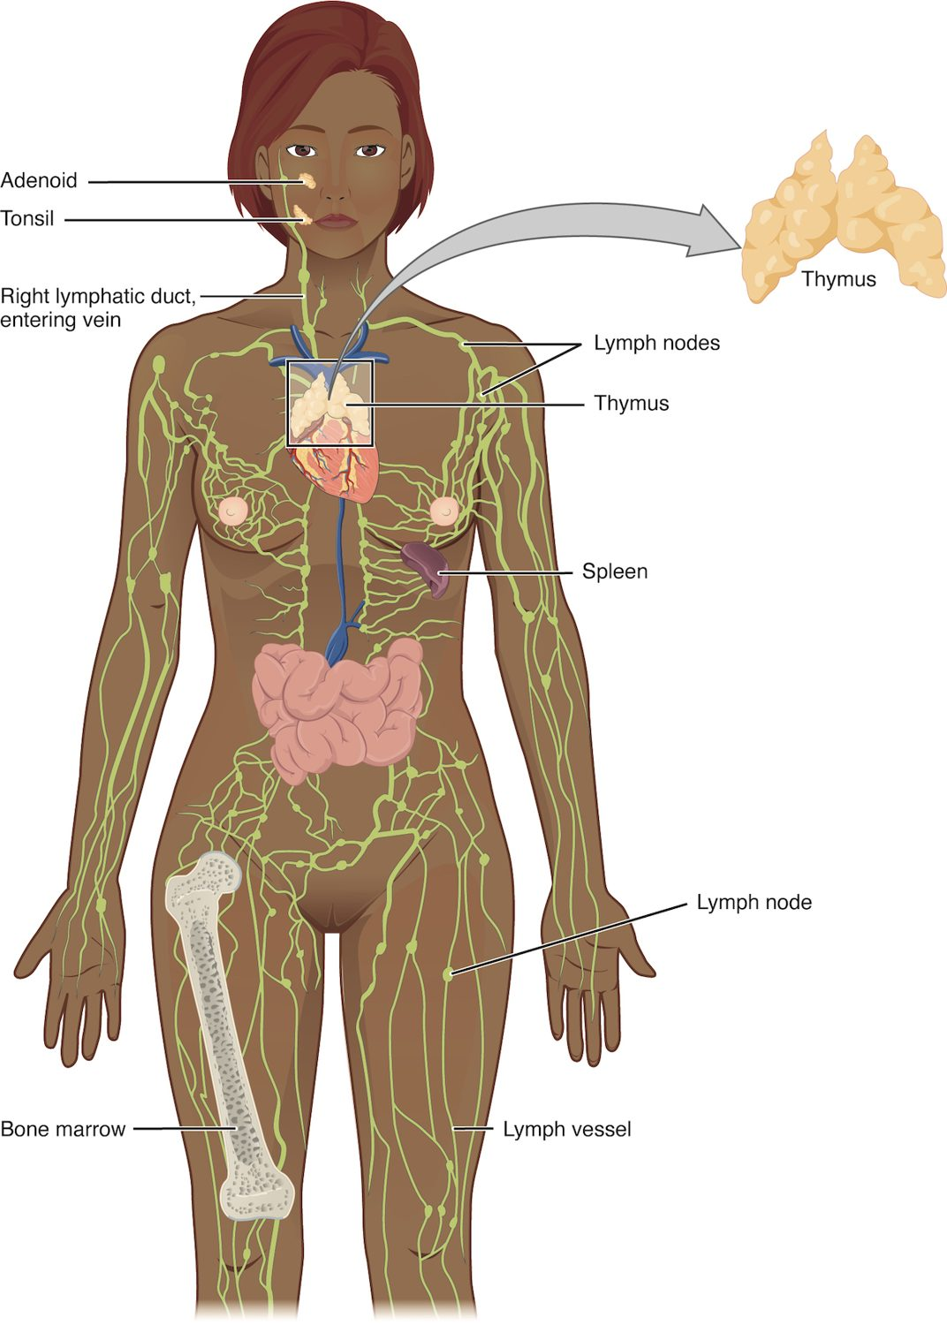
CHAPTER 21
The Lymphatic and Immune System
How the body defends itself against infection.
Anatomy & Physiology · Broward-Miami Health Institute
FACULTY EDITION
Notes:
READ ALOUD SCRIPT
Today we are beginning Chapter 21, the lymphatic and immune systems. In this chapter, we will connect the major structures and processes with their functions and with the observations that matter in practical nursing care. As we move through the slides, focus on how this system supports circulation, perfusion, protection, and patient safety. By the end, you should be able to explain the major concepts in your own words and apply them to a patient-care situation.
[Sources]
- BMHI PN 104 Chapter 21 faculty PowerPoint slide content.

Slide 2
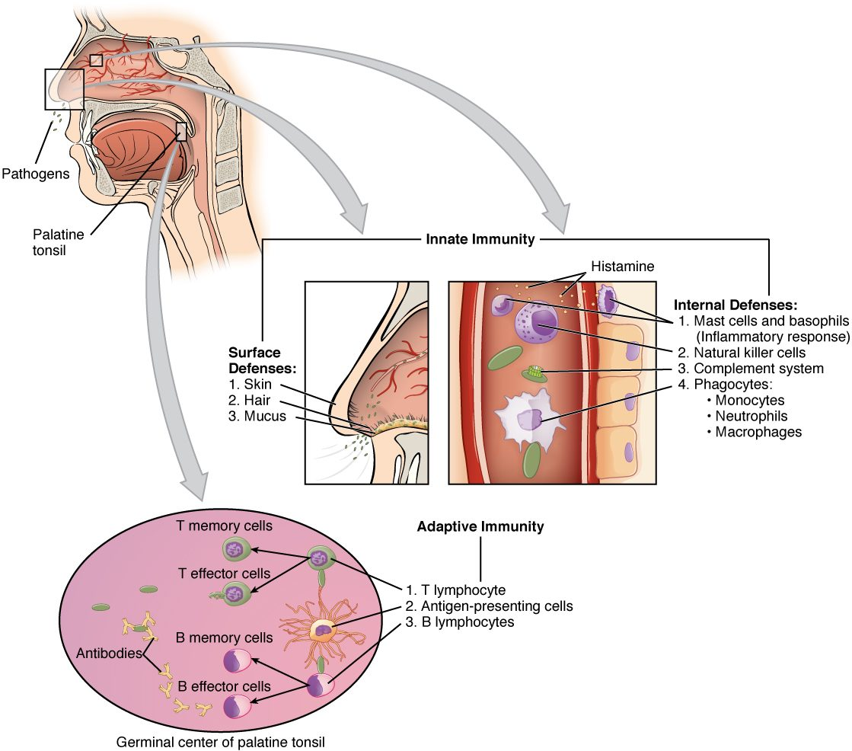
CHAPTER 21
Learning Objectives
After studying this chapter, students will be able to:
1
Identify the components and anatomy of the lymphatic system
2
Discuss the role of the innate immune response against pathogens
3
Describe the power of the adaptive immune response to cure disease
4
Explain immunological deficiencies and over-reactions of the immune system
5
Discuss the role of the immune response in transplantation and cancer
The body's innate and adaptive defenses.
PN 104 · Ch 21 — The Lymphatic and Immune System
2
Notes:
READ ALOUD SCRIPT
These are our learning objectives for Chapter 21. By the end of the chapter, you should be able to do the following: Identify the components and anatomy of the lymphatic system. Discuss the role of the innate immune response against pathogens. Describe the power of the adaptive immune response to cure disease. Explain immunological deficiencies and over-reactions of the immune system. Discuss the role of the immune response in transplantation and cancer. Do not treat these as isolated facts. Use them as a checklist for what you should be able to identify, explain, and connect to safe practical nursing care.
[Sources]
- BMHI PN 104 Chapter 21 faculty PowerPoint slide content.

Slide 3
21.1
SECTION
Anatomy of the Lymphatic and Immune Systems
The lymphatic vessels and organs that drain fluid and house immune cells.
Notes:
READ ALOUD SCRIPT
We are now moving into Anatomy of the Lymphatic and Immune Systems. The lymphatic vessels and organs that drain fluid and house immune cells. As we begin this section, listen for the major structures, their locations, and the functions they perform. Then ask yourself what a change in this area might look like during patient care.
[Sources]
- BMHI PN 104 Chapter 21 faculty PowerPoint slide content.

Slide 4
SECTION 21.1
The Lymphatic System
Vessels, nodes, and lymphoid organs
Returns leaked fluid to the blood
Houses and transports immune cells
Includes spleen, thymus, tonsils
The lymphatic system
PN 104 · Ch 21 — The Lymphatic and Immune System
4
Notes:
READ ALOUD SCRIPT
Now let's focus on The Lymphatic System. The lymphatic system. Vessels, nodes, and lymphoid organs. Returns leaked fluid to the blood. Houses and transports immune cells. Includes spleen, thymus, tonsils. Observe for localized swelling, tenderness, skin changes, impaired drainage, and infection, and protect an extremity affected by lymph-node removal or lymphedema. Take a moment to identify the structure on the image and explain how its form supports its function. This is slide 4 of 20.
[Sources]
- BMHI PN 104 Chapter 21 faculty PowerPoint slide content.

Slide 5
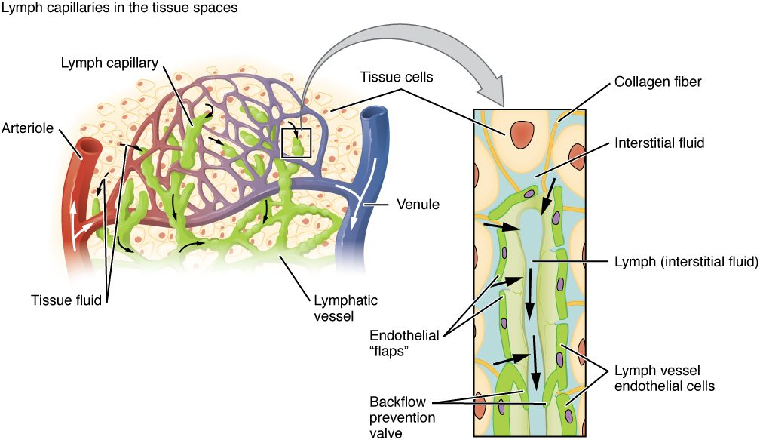
SECTION 21.1
Formation of Lymph
How lymph forms and drains
Capillaries leak fluid into tissues
Lymphatic capillaries collect it
The fluid is now called lymph
It returns to the bloodstream
PN 104 · Ch 21 — The Lymphatic and Immune System
5
Notes:
READ ALOUD SCRIPT
Now let's focus on Formation of Lymph. How lymph forms and drains. Capillaries leak fluid into tissues. Lymphatic capillaries collect it. The fluid is now called lymph. It returns to the bloodstream. Observe for localized swelling, tenderness, skin changes, impaired drainage, and infection, and protect an extremity affected by lymph-node removal or lymphedema. Take a moment to identify the structure on the image and explain how its form supports its function. This is slide 5 of 20.
[Sources]
- BMHI PN 104 Chapter 21 faculty PowerPoint slide content.

Slide 6
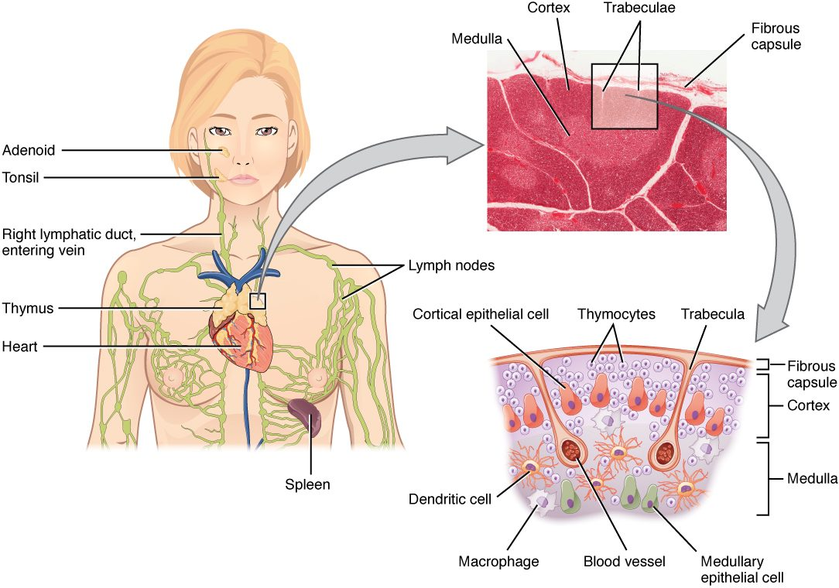
SECTION 21.1
Lymph Nodes
Small filtering organs along the vessels
Trap pathogens and debris
Packed with immune cells
Swell during infection
The structure of a lymph node
PN 104 · Ch 21 — The Lymphatic and Immune System
6
Notes:
READ ALOUD SCRIPT
Now let's focus on Lymph Nodes. Small filtering organs along the vessels. Trap pathogens and debris. Packed with immune cells. Swell during infection. The structure of a lymph node. Observe for localized swelling, tenderness, skin changes, impaired drainage, and infection, and protect an extremity affected by lymph-node removal or lymphedema. Take a moment to identify the structure on the image and explain how its form supports its function. This is slide 6 of 20.
[Sources]
- BMHI PN 104 Chapter 21 faculty PowerPoint slide content.

Slide 7
21.2
SECTION
Barrier Defenses and the Innate Immune Response
The body's first lines of defense — barriers and the innate response.
Notes:
READ ALOUD SCRIPT
We are now moving into Barrier Defenses and the Innate Immune Response. The body's first lines of defense — barriers and the innate response. As we begin this section, listen for the major structures, their locations, and the functions they perform. Then ask yourself what a change in this area might look like during patient care.
[Sources]
- BMHI PN 104 Chapter 21 faculty PowerPoint slide content.

Slide 8
SECTION 21.2
Innate vs. Adaptive Immunity
Two arms of defense
Innate: fast, general, present at birth
Adaptive: slower, specific, learned
Barriers are the first line
Innate and adaptive immunity
PN 104 · Ch 21 — The Lymphatic and Immune System
8
Notes:
READ ALOUD SCRIPT
Now let's focus on Innate vs. Adaptive Immunity. Two arms of defense. Innate: fast, general, present at birth. Adaptive: slower, specific, learned. Barriers are the first line. Innate and adaptive immunity. Connect innate defense and inflammation with redness, warmth, swelling, pain, fever, drainage, and changes in function. Take a moment to identify the structure on the image and explain how its form supports its function. This is slide 8 of 20.
[Sources]
- BMHI PN 104 Chapter 21 faculty PowerPoint slide content.

Slide 9
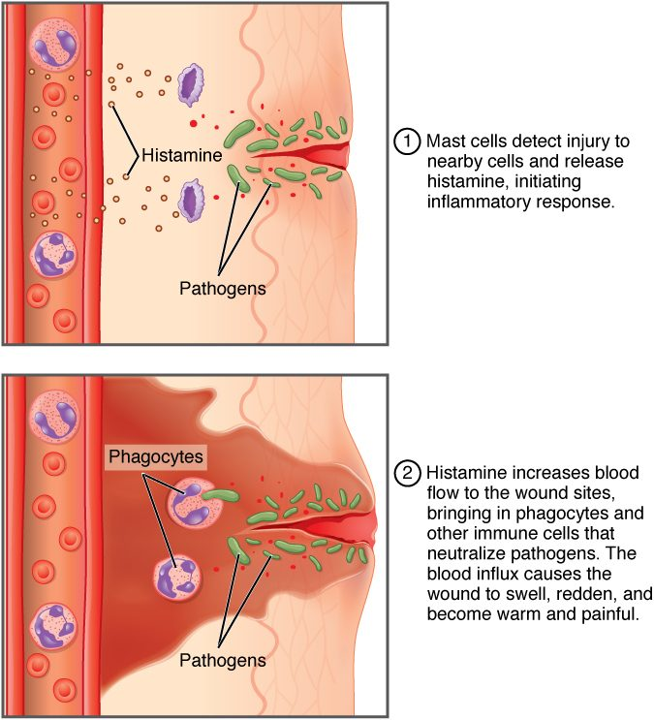
SECTION 21.2
Inflammation
A core innate response to injury
Mast cells release histamine
Vessels dilate and become leaky
Causes redness, heat, swelling, pain
The inflammatory response
PN 104 · Ch 21 — The Lymphatic and Immune System
9
Notes:
READ ALOUD SCRIPT
Now let's focus on Inflammation. The inflammatory response. A core innate response to injury. Mast cells release histamine. Vessels dilate and become leaky. Causes redness, heat, swelling, pain. Connect innate defense and inflammation with redness, warmth, swelling, pain, fever, drainage, and changes in function. Take a moment to identify the structure on the image and explain how its form supports its function. This is slide 9 of 20.
[Sources]
- BMHI PN 104 Chapter 21 faculty PowerPoint slide content.

Slide 10
21.3
SECTION
The Adaptive Immune Response: T lymphocytes and Their Functional Types
Adaptive immunity carried out by T lymphocytes.
Notes:
READ ALOUD SCRIPT
We are now moving into The Adaptive Immune Response: T lymphocytes and Their Functional Types. Adaptive immunity carried out by T lymphocytes. As we begin this section, listen for the major structures, their locations, and the functions they perform. Then ask yourself what a change in this area might look like during patient care.
[Sources]
- BMHI PN 104 Chapter 21 faculty PowerPoint slide content.

Slide 11
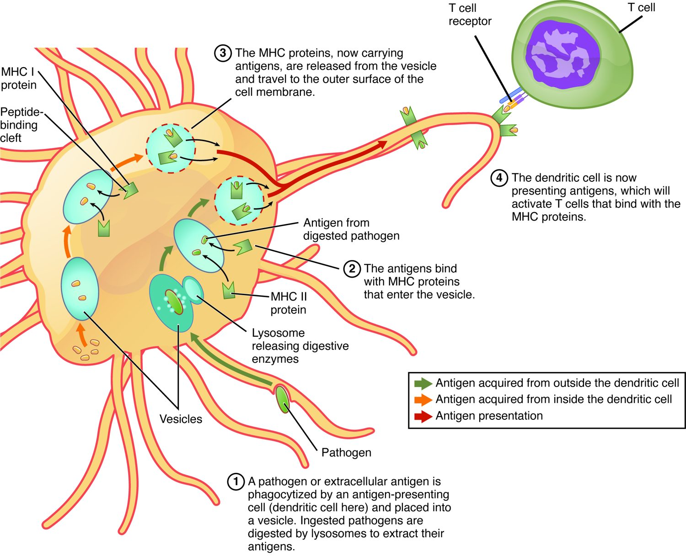
SECTION 21.3
Antigen Presentation
T cells must be shown the enemy
Antigen-presenting cells display antigens
Displayed on MHC molecules
This activates the matching T cell
Antigen presentation to a T cell
PN 104 · Ch 21 — The Lymphatic and Immune System
11
Notes:
READ ALOUD SCRIPT
Now let's focus on Antigen Presentation. T cells must be shown the enemy. Antigen-presenting cells display antigens. Displayed on MHC molecules. This activates the matching T cell. Antigen presentation to a T cell. Immune assessment includes temperature, skin and wound findings, respiratory symptoms, lymph-node changes, fatigue, laboratory results, and precautions for infection risk. Take a moment to identify the structure on the image and explain how its form supports its function. This is slide 11 of 20.
[Sources]
- BMHI PN 104 Chapter 21 faculty PowerPoint slide content.

Slide 12
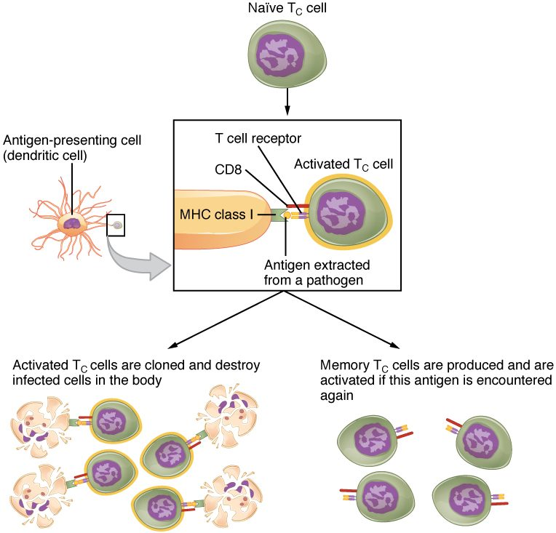
SECTION 21.3
Types of T Cells
Helper T cells coordinate the response
Cytotoxic T cells kill infected cells
Memory T cells remember the pathogen
Central to adaptive immunity
Helper and cytotoxic T cells
PN 104 · Ch 21 — The Lymphatic and Immune System
12
Notes:
READ ALOUD SCRIPT
Now let's focus on Types of T Cells. Helper T cells coordinate the response. Cytotoxic T cells kill infected cells. Memory T cells remember the pathogen. Central to adaptive immunity. Helper and cytotoxic T cells. Adaptive immunity creates targeted responses and memory; relate this process to vaccination, infection history, immune suppression, and laboratory findings. Take a moment to identify the structure on the image and explain how its form supports its function. This is slide 12 of 20.
[Sources]
- BMHI PN 104 Chapter 21 faculty PowerPoint slide content.

Slide 13
21.4
SECTION
The Adaptive Immune Response: B-lymphocytes and Antibodies
Adaptive immunity carried out by B lymphocytes and antibodies.
Notes:
READ ALOUD SCRIPT
We are now moving into The Adaptive Immune Response: B-lymphocytes and Antibodies. Adaptive immunity carried out by B lymphocytes and antibodies. As we begin this section, listen for the major structures, their locations, and the functions they perform. Then ask yourself what a change in this area might look like during patient care.
[Sources]
- BMHI PN 104 Chapter 21 faculty PowerPoint slide content.

Slide 14
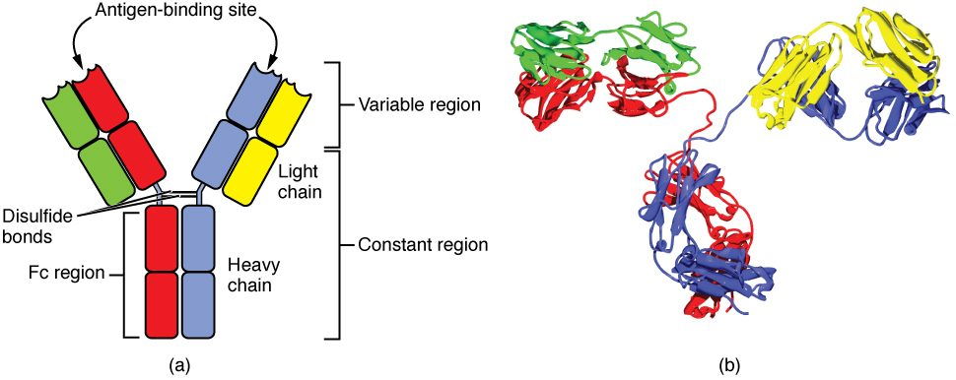
SECTION 21.4
Antibody Structure
The structure of an antibody
Y-shaped proteins made by B cells
Two antigen-binding tips
Each binds one specific antigen
Tag pathogens for destruction
PN 104 · Ch 21 — The Lymphatic and Immune System
14
Notes:
READ ALOUD SCRIPT
Now let's focus on Antibody Structure. The structure of an antibody. Y-shaped proteins made by B cells. Two antigen-binding tips. Each binds one specific antigen. Tag pathogens for destruction. Adaptive immunity creates targeted responses and memory; relate this process to vaccination, infection history, immune suppression, and laboratory findings. Take a moment to identify the structure on the image and explain how its form supports its function. This is slide 14 of 20.
[Sources]
- BMHI PN 104 Chapter 21 faculty PowerPoint slide content.

Slide 15
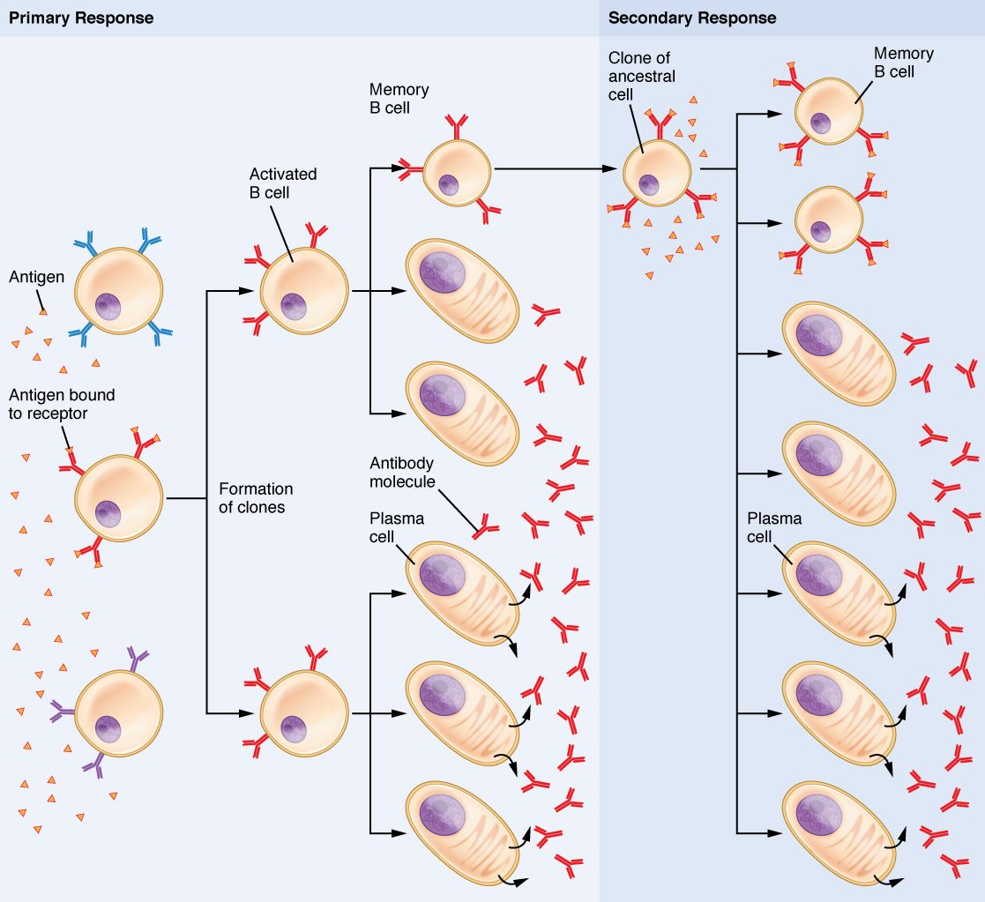
SECTION 21.4
B Cell Activation
B cells make antibodies
Activated B cells become plasma cells
Plasma cells pump out antibodies
Memory B cells remain behind
B cell activation and antibody production
PN 104 · Ch 21 — The Lymphatic and Immune System
15
Notes:
READ ALOUD SCRIPT
Now let's focus on B Cell Activation. B cells make antibodies. Activated B cells become plasma cells. Plasma cells pump out antibodies. Memory B cells remain behind. B cell activation and antibody production. Adaptive immunity creates targeted responses and memory; relate this process to vaccination, infection history, immune suppression, and laboratory findings. Take a moment to identify the structure on the image and explain how its form supports its function. This is slide 15 of 20.
[Sources]
- BMHI PN 104 Chapter 21 faculty PowerPoint slide content.

Slide 16
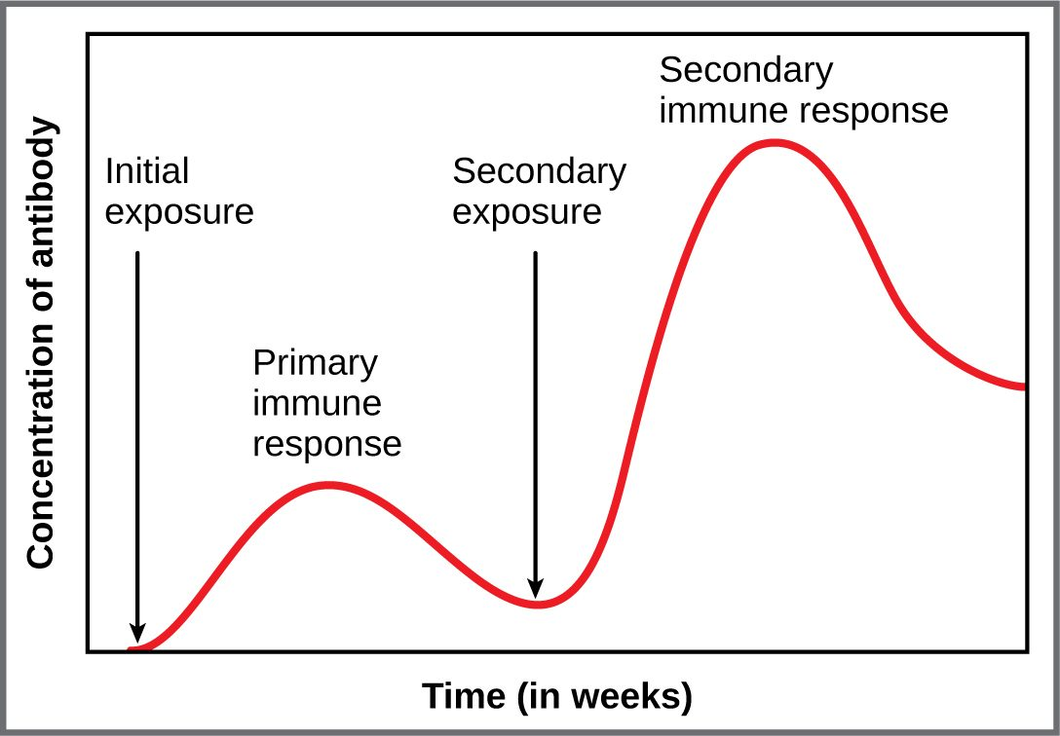
SECTION 21.4
Primary vs. Secondary Response
First exposure → slow, weak response
Memory cells are formed
Second exposure → fast, strong response
The principle behind vaccines
The primary and secondary immune response
PN 104 · Ch 21 — The Lymphatic and Immune System
16
Notes:
READ ALOUD SCRIPT
Now let's focus on Primary vs. Secondary Response. First exposure → slow, weak response. Memory cells are formed. Second exposure → fast, strong response. The principle behind vaccines. The primary and secondary immune response. Immune assessment includes temperature, skin and wound findings, respiratory symptoms, lymph-node changes, fatigue, laboratory results, and precautions for infection risk. Take a moment to identify the structure on the image and explain how its form supports its function. This is slide 16 of 20.
[Sources]
- BMHI PN 104 Chapter 21 faculty PowerPoint slide content.

Slide 17
21.5
SECTION
The Immune Response against Pathogens
How the immune defenses work together against an infection.
Notes:
READ ALOUD SCRIPT
We are now moving into The Immune Response against Pathogens. How the immune defenses work together against an infection. As we begin this section, listen for the major structures, their locations, and the functions they perform. Then ask yourself what a change in this area might look like during patient care.
[Sources]
- BMHI PN 104 Chapter 21 faculty PowerPoint slide content.

Slide 18
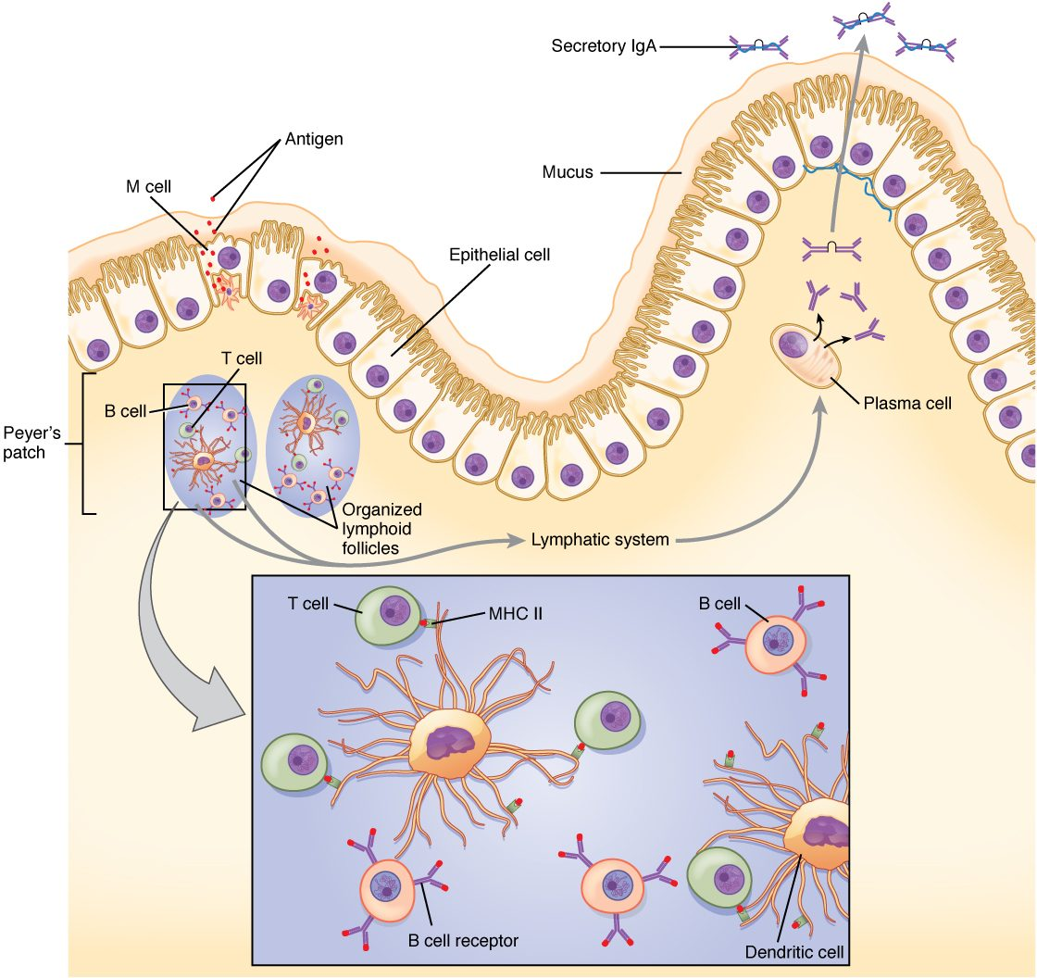
SECTION 21.5
A Coordinated Immune Response
The defenses work as a team
Barriers and innate cells respond first
Adaptive immunity targets the pathogen
Memory protects against reinfection
A coordinated immune response
PN 104 · Ch 21 — The Lymphatic and Immune System
18
Notes:
READ ALOUD SCRIPT
Now let's focus on A Coordinated Immune Response. The defenses work as a team. Barriers and innate cells respond first. Adaptive immunity targets the pathogen. Memory protects against reinfection. A coordinated immune response. Connect innate defense and inflammation with redness, warmth, swelling, pain, fever, drainage, and changes in function. Take a moment to identify the structure on the image and explain how its form supports its function. This is slide 18 of 20.
[Sources]
- BMHI PN 104 Chapter 21 faculty PowerPoint slide content.

Slide 19
CHAPTER 21
Key Takeaways
The lymphatic system drains tissue fluid and houses the immune system.
Innate immunity provides fast, general defense; adaptive immunity is specific and remembers.
Inflammation brings defenses to the site of injury or infection.
T cells coordinate the response and kill infected cells; B cells make antibodies.
Immune memory underlies long-term protection and the success of vaccines.
PN 104 · Ch 21 — The Lymphatic and Immune System
19
Notes:
READ ALOUD SCRIPT
Let us review the major takeaways from Chapter 21. The lymphatic system drains tissue fluid and houses the immune system. Innate immunity provides fast, general defense; adaptive immunity is specific and remembers. Inflammation brings defenses to the site of injury or infection. T cells coordinate the response and kill infected cells; B cells make antibodies. Immune memory underlies long-term protection and the success of vaccines. Before moving on, pause and explain each point without reading the slide. If any statement is difficult to explain, mark that topic for review before the quiz.
[Sources]
- BMHI PN 104 Chapter 21 faculty PowerPoint slide content.

Slide 20
CLINICAL CONNECTIONS
Why the Immune System Matters in Practical Nursing
Vaccination
Allergies
Builds immune memory without causing the disease.
An overactive immune response to harmless substances.
Autoimmune Disease
HIV/AIDS
The immune system attacks the body's own tissues.
The virus destroys helper T cells, crippling immunity.
Lymph Node Exam
Immunocompromise
Swollen nodes can signal infection or, sometimes, cancer.
Weakened immunity raises infection risk in many patients.
Notes:
READ ALOUD SCRIPT
This final slide connects Chapter 21 to practical nursing. Vaccination. Builds immune memory without causing the disease. Allergies. An overactive immune response to harmless substances. Autoimmune Disease. The immune system attacks the body's own tissues. HIV/AIDS. The virus destroys helper T cells, crippling immunity. Lymph Node Exam. Swollen nodes can signal infection or, sometimes, cancer. Immunocompromise. Weakened immunity raises infection risk in many patients. Your role is to observe carefully, protect safety, follow orders and precautions, document objectively, and report changes through the appropriate chain of command. Use these examples to connect anatomy with the care you will provide.
[Sources]
- BMHI PN 104 Chapter 21 faculty PowerPoint slide content.

