Slide 1
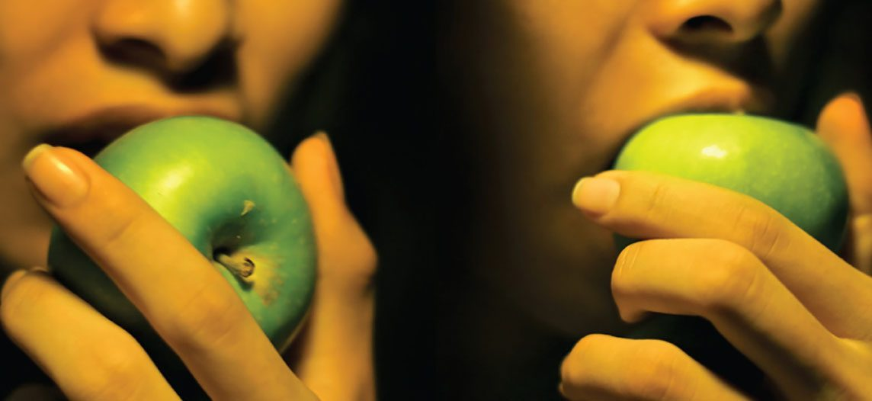
CHAPTER 23
The Digestive System
How the body breaks down food and absorbs nutrients.
Anatomy & Physiology · Broward-Miami Health Institute
FACULTY EDITION

Slide 2
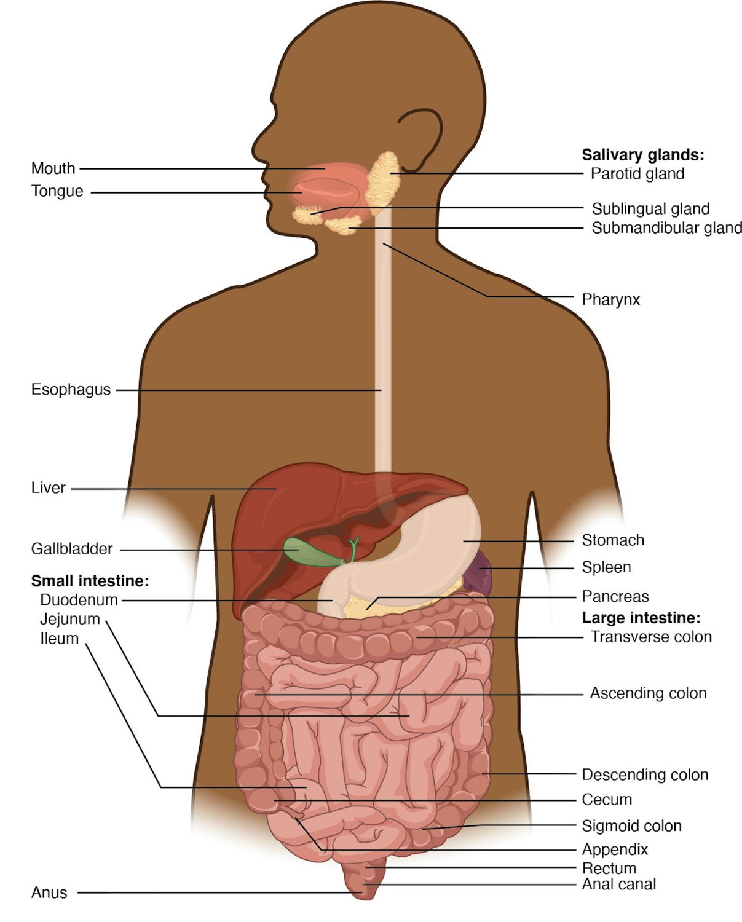
CHAPTER 23
Learning Objectives
After studying this chapter, students will be able to:
1
List and describe the functional anatomy of the organs and accessory organs of the digestive system
2
Discuss the processes and control of ingestion, propulsion, mechanical digestion, chemical digestion, absorption, and defecation
3
Discuss the roles of the liver, pancreas, and gallbladder in digestion
The organs of the digestive system.
PN 104 · Ch 23 — The Digestive System
2

Slide 3
23.1
SECTION
Overview of the Digestive System
The organs of the digestive tract and its accessory glands.

Slide 4
SECTION 23.1
The Digestive System
A long tube from mouth to anus
The GI tract (alimentary canal)
Plus accessory organs
Breaks food into absorbable nutrients
The digestive system
PN 104 · Ch 23 — The Digestive System
4

Slide 5
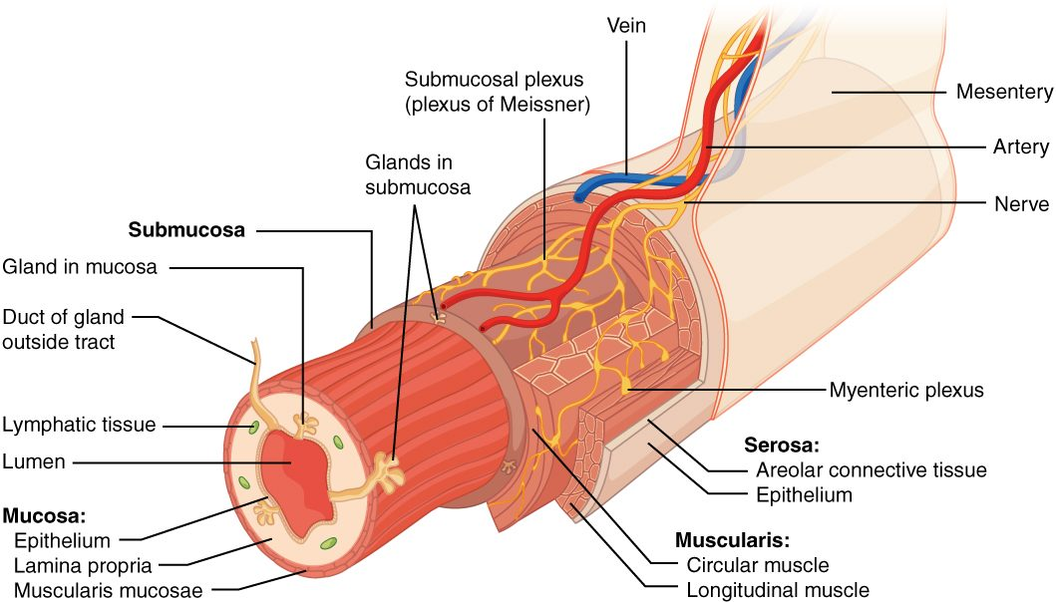
SECTION 23.1
The GI Tract Wall
The layers of the GI tract wall
Four layers throughout the tract
Mucosa lines the lumen
Submucosa carries vessels and nerves
Muscularis moves food along
PN 104 · Ch 23 — The Digestive System
5

Slide 6
23.2
SECTION
Digestive System Processes and Regulation
The processes of digestion and how they are regulated.

Slide 7
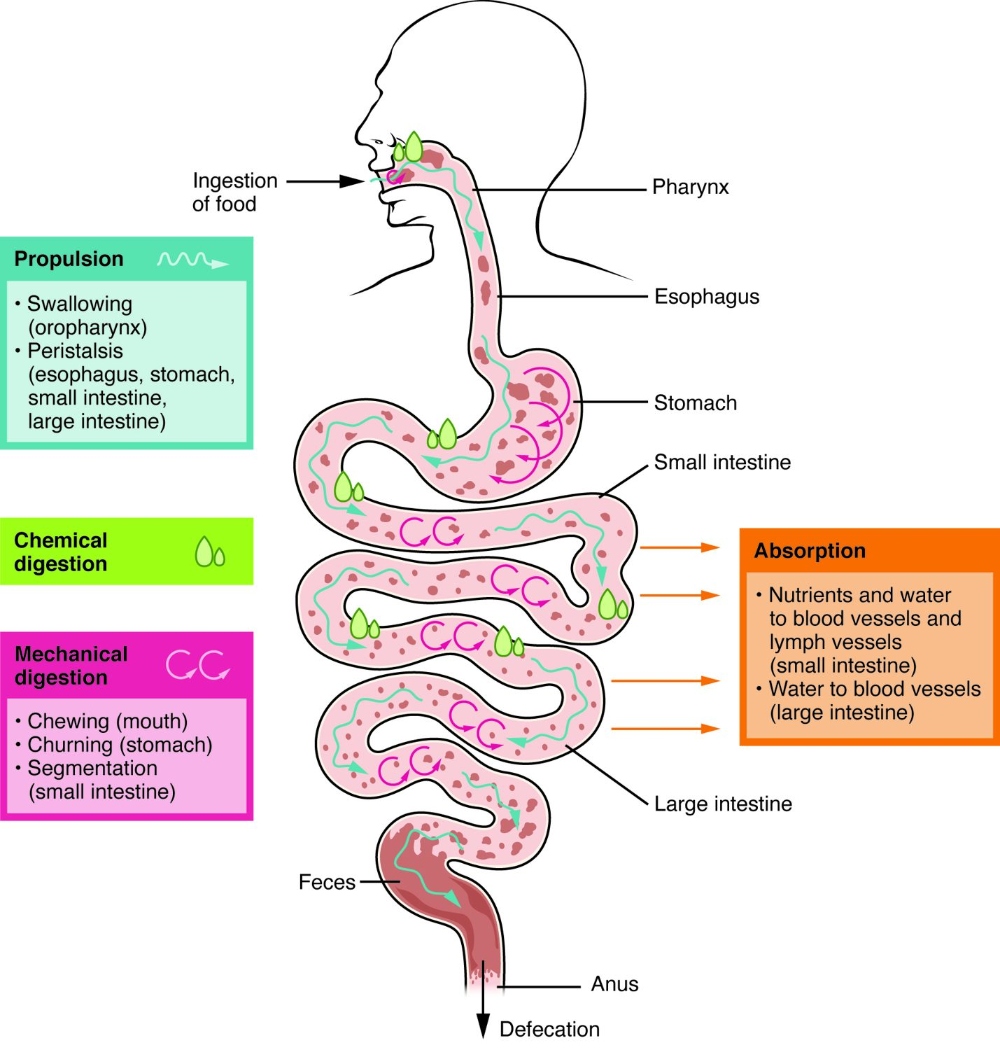
SECTION 23.2
Digestive Processes
Ingestion takes food in
Propulsion moves it along
Mechanical and chemical digestion break it down
Absorption and defecation finish
The processes of the digestive system
PN 104 · Ch 23 — The Digestive System
7

Slide 8
23.3
SECTION
The Mouth, Pharynx, and Esophagus
Where digestion begins — the mouth, pharynx, and esophagus.

Slide 9
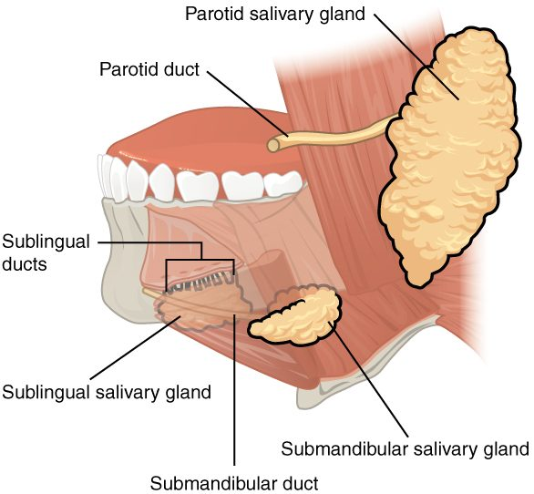
SECTION 23.3
The Salivary Glands
Three pairs of glands
Parotid, submandibular, sublingual
Saliva moistens and begins digestion
Contains an enzyme for starch
The salivary glands
PN 104 · Ch 23 — The Digestive System
9

Slide 10
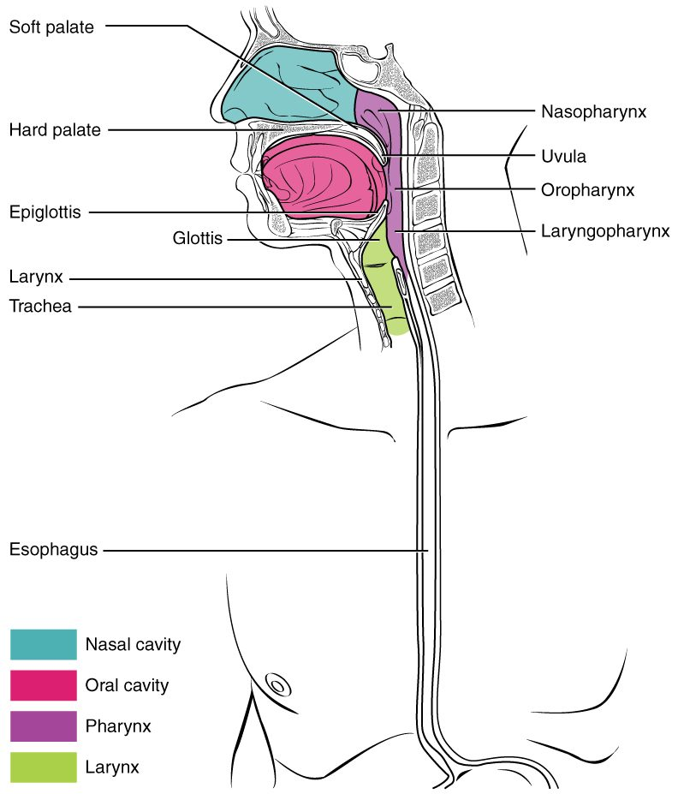
SECTION 23.3
Swallowing & the Pharynx
The pharynx is shared with the airway
Swallowing moves the bolus down
The epiglottis protects the airway
Peristalsis carries food to the stomach
The pharynx and swallowing
PN 104 · Ch 23 — The Digestive System
10

Slide 11
23.4
SECTION
The Stomach
The stomach — storing and digesting food into chyme.

Slide 12
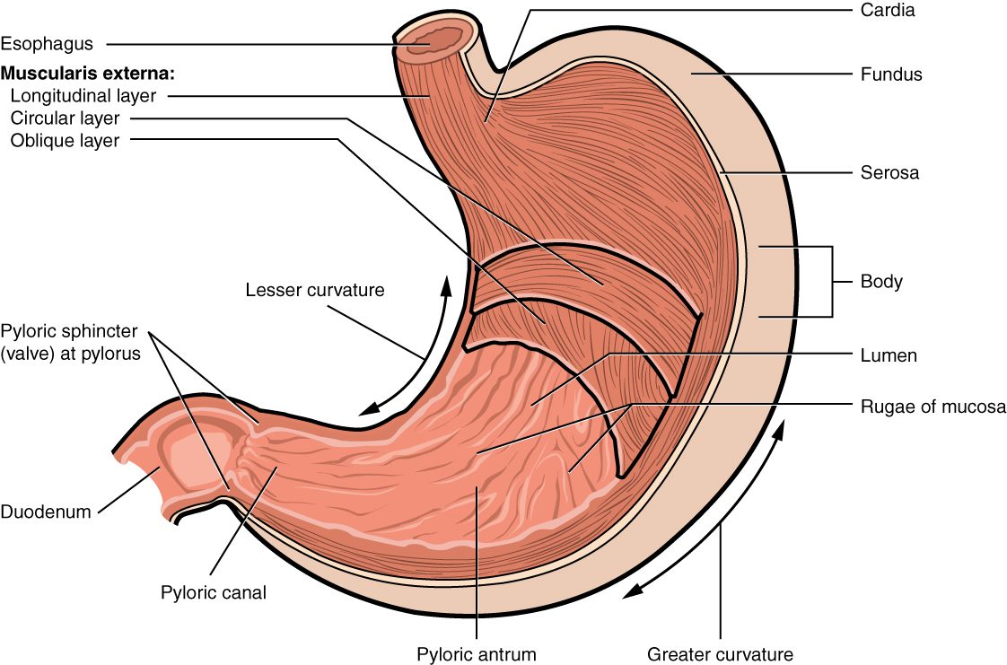
SECTION 23.4
The Stomach
The anatomy of the stomach
A muscular, J-shaped sac
Stores and churns food
Regions: fundus, body, pylorus
Rugae let it expand
PN 104 · Ch 23 — The Digestive System
12

Slide 13
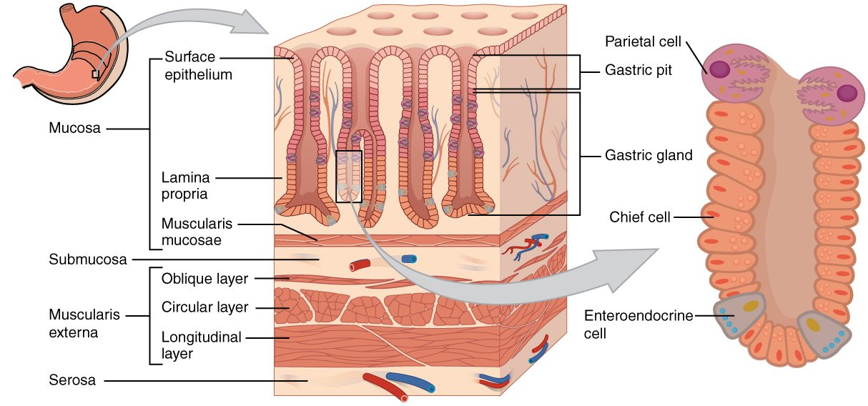
SECTION 23.4
Gastric Glands
The gastric glands
Gastric pits line the stomach
Secrete acid and enzymes
Hydrochloric acid kills microbes
Pepsin digests protein
PN 104 · Ch 23 — The Digestive System
13

Slide 14
23.5
SECTION
The Small and Large Intestines
The intestines — where most digestion and absorption happen.

Slide 15
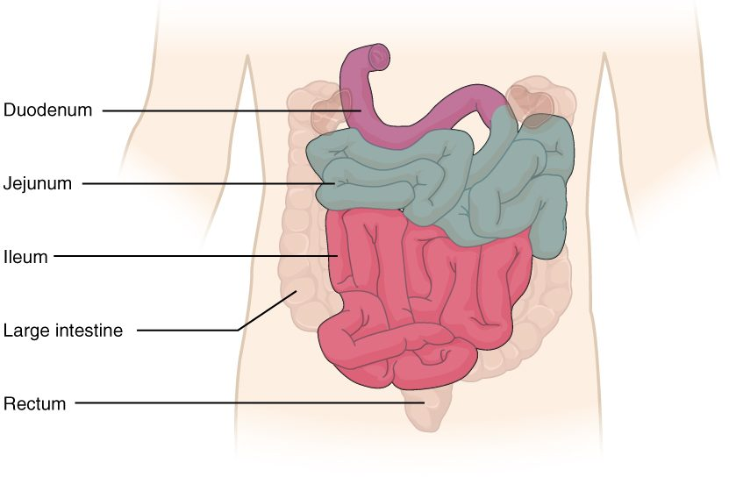
SECTION 23.5
Small & Large Intestines
The small and large intestines
Small intestine: duodenum, jejunum, ileum
Most digestion and absorption happen here
Large intestine absorbs water
Ends at the rectum and anus
PN 104 · Ch 23 — The Digestive System
15

Slide 16
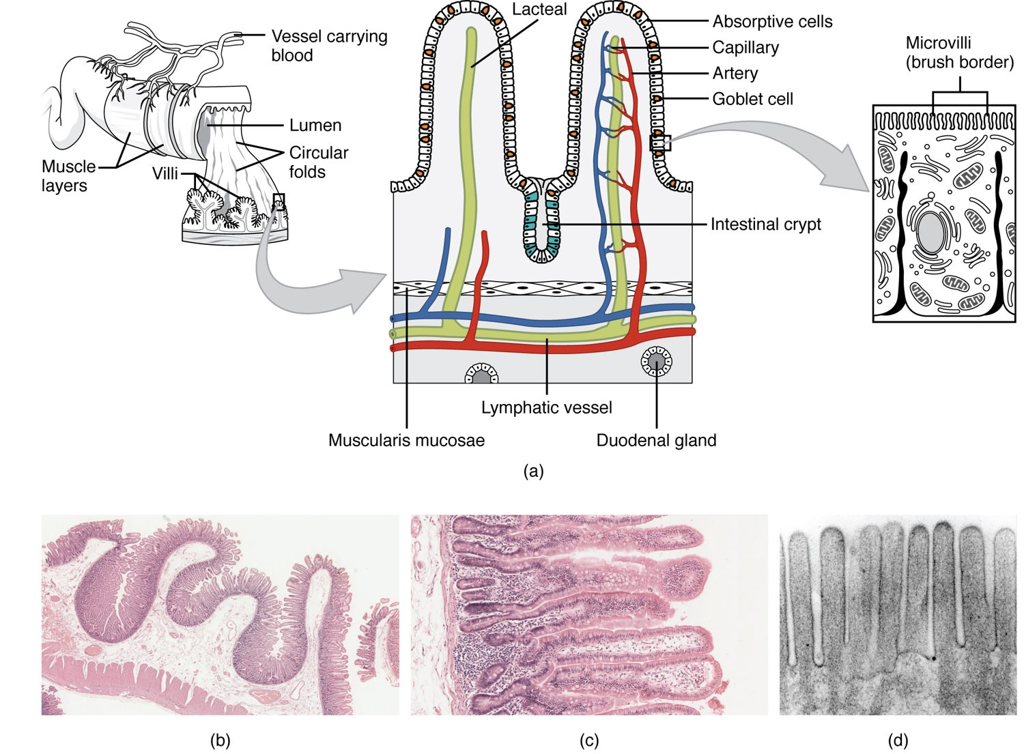
SECTION 23.5
Villi & Absorption
The small intestine maximizes surface area
Folds, villi, and microvilli
A huge area for absorption
Each villus has vessels and a lacteal
Villi of the small intestine
PN 104 · Ch 23 — The Digestive System
16

Slide 17
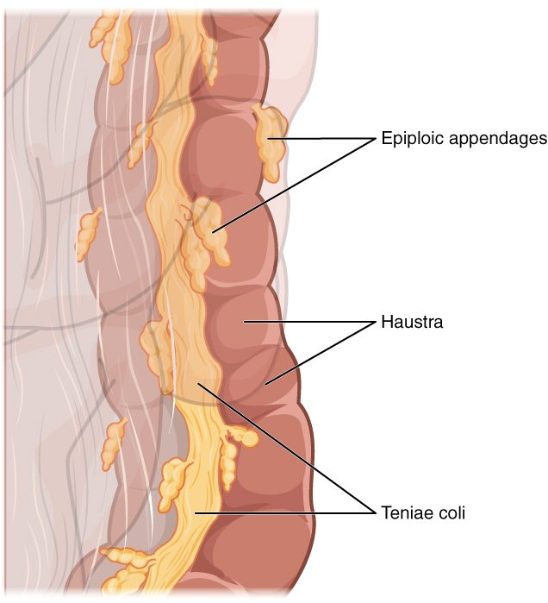
SECTION 23.5
The Large Intestine
Frames the abdomen
Absorbs water and salts
Pouches (haustra) along its length
Bacteria make some vitamins
The large intestine
PN 104 · Ch 23 — The Digestive System
17

Slide 18
23.6
SECTION
Accessory Organs in Digestion: The Liver, Pancreas, and Gallbladder
The liver, gallbladder, and pancreas that aid digestion.

Slide 19
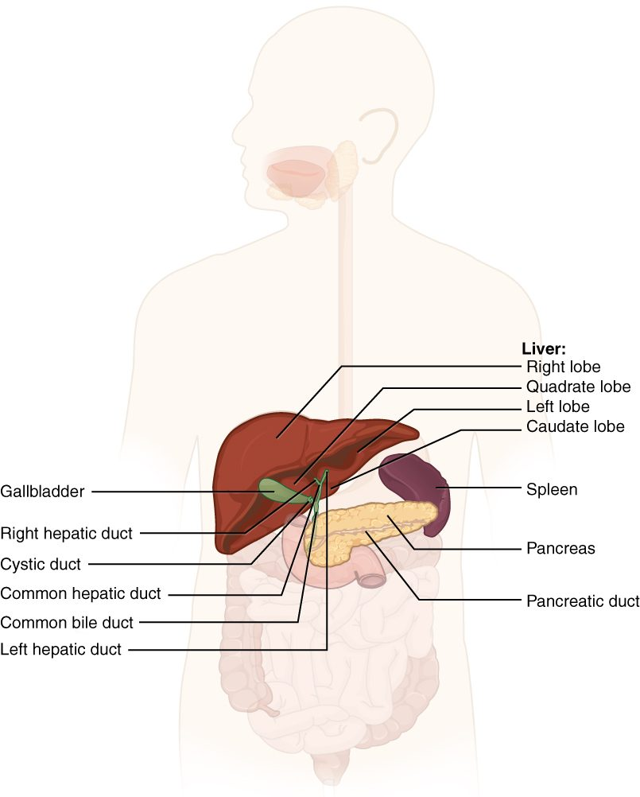
SECTION 23.6
The Accessory Organs
Liver, gallbladder, and pancreas
Secrete into the small intestine
The liver makes bile
The pancreas makes digestive enzymes
Liver, gallbladder, and pancreas
PN 104 · Ch 23 — The Digestive System
19

Slide 20
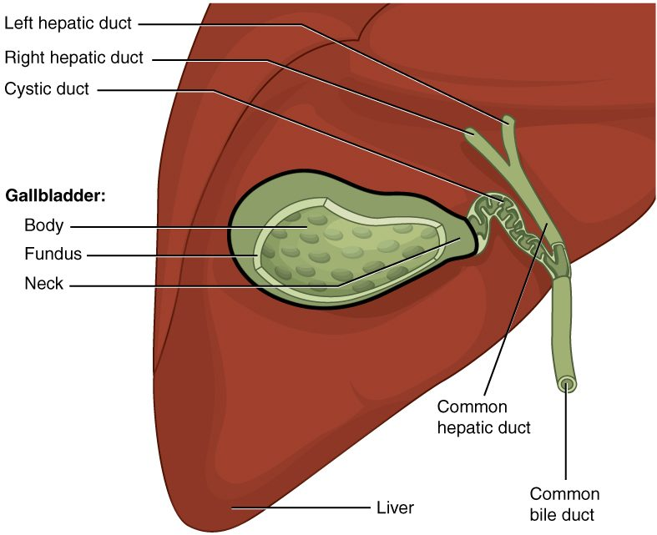
SECTION 23.6
Gallbladder & Bile Ducts
The gallbladder stores bile
Bile emulsifies fats
Ducts carry bile to the intestine
Gallstones can block the ducts
The gallbladder and bile ducts
PN 104 · Ch 23 — The Digestive System
20

Slide 21
23.7
SECTION
Chemical Digestion and Absorption: A Closer Look
How nutrients are chemically broken down and absorbed.

Slide 22
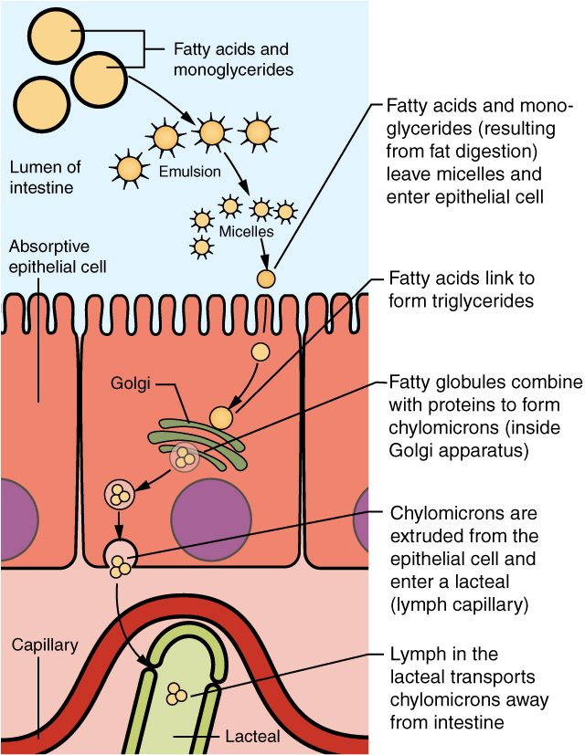
SECTION 23.7
Absorption of Nutrients
Nutrients cross the intestinal lining
Sugars and amino acids enter the blood
Fats enter lymphatic lacteals
Carried to the body's cells
Absorption across the intestinal wall
PN 104 · Ch 23 — The Digestive System
22

Slide 23
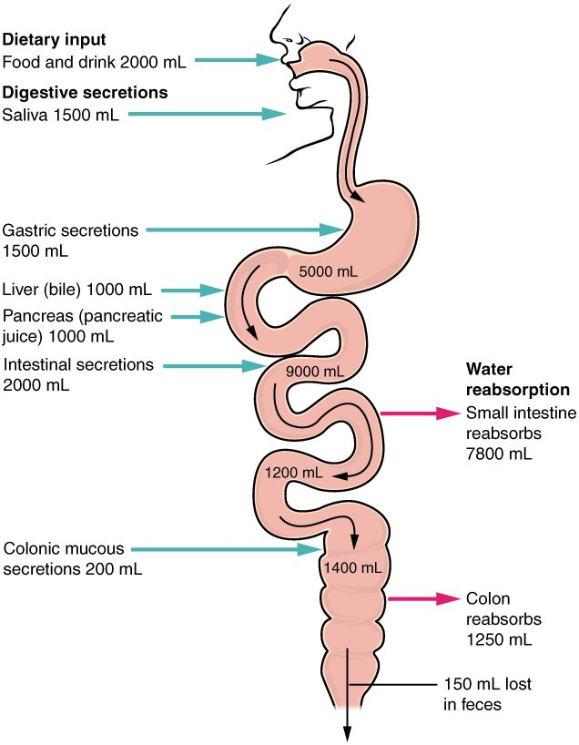
SECTION 23.7
Fluid Balance in Digestion
The gut handles large fluid volumes
Most is reabsorbed, not lost
The small intestine absorbs the most
Diarrhea risks dehydration
Water balance in the digestive tract
PN 104 · Ch 23 — The Digestive System
23

Slide 24
CHAPTER 23
Key Takeaways
The digestive system is a long tract plus accessory organs that process food.
Digestion involves mechanical and chemical breakdown, then absorption.
The mouth and stomach begin digestion; the small intestine completes most of it.
The liver, gallbladder, and pancreas supply bile and enzymes for digestion.
The large intestine absorbs water and forms stool for elimination.
PN 104 · Ch 23 — The Digestive System
24

Slide 25
CLINICAL CONNECTIONS
Why the Digestive System Matters in Practical Nursing
Dysphagia & Aspiration
Peptic Ulcers
Trouble swallowing risks food entering the airway.
Acid damage to the stomach or duodenal lining.
Gallstones
Diarrhea & Dehydration
Hardened bile can block ducts and cause severe pain.
Lost intestinal fluid can quickly unbalance the body.
Nutrition
Liver Function
Digestion and absorption underlie all nutritional care.
The liver is central to digestion, metabolism, and detoxification.

