Slide 1

Beer Machine Learning
Erica Fisher
Jay Hastings
Jenny Kaylor
Joshua Williams

Slide 2


Slide 3

Introduction

Slide 4

The Plan?
Machine Learning
Beer Reviews
Yeah buddy!
Resources:
Kaggle Dataset
3 Files: beers.csv breweries.csv reviews.csv

Slide 5
Word2Vec! Yes

Slide 6
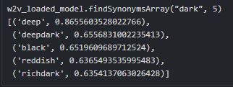
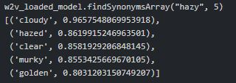
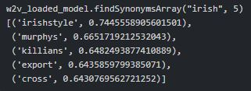
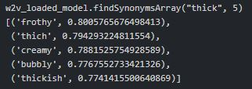
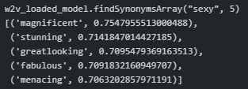
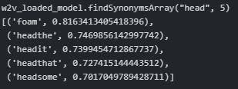
What did we see with Word2Vec?
Dark
Hazy
Irish
thick
sexy
Head

Slide 7
LIVE DEMO

Slide 8
Linear Regression
 | Results
Look | 0.2834
Feel | 0.3485
Smell | 0.3480
Taste | 0.4012
Overall | 0.3594
Score | 0.4536

Slide 9
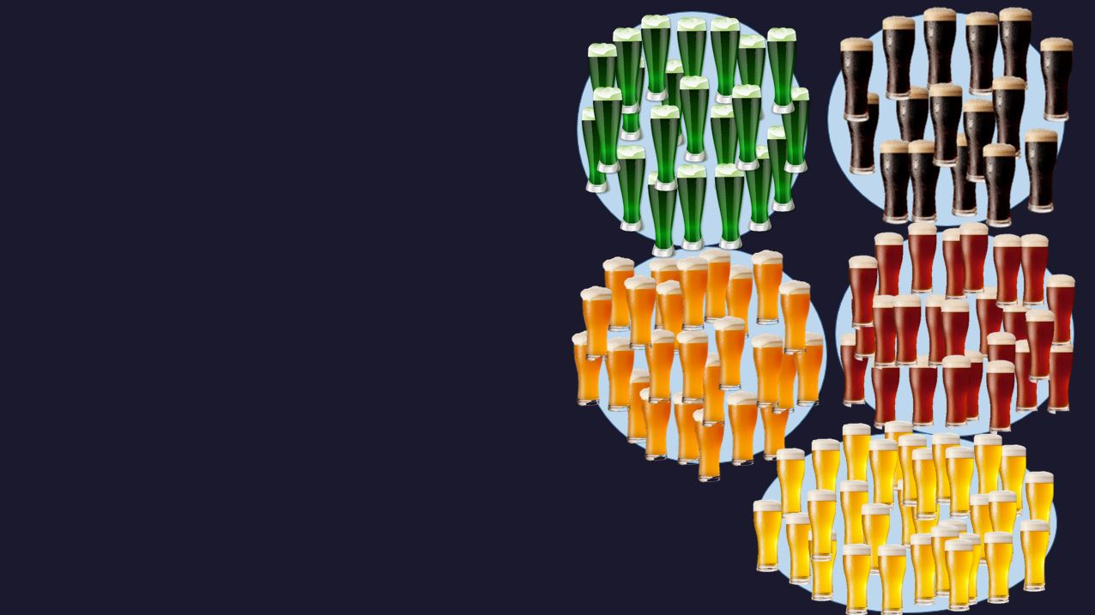
K-Means Clusters

Slide 10
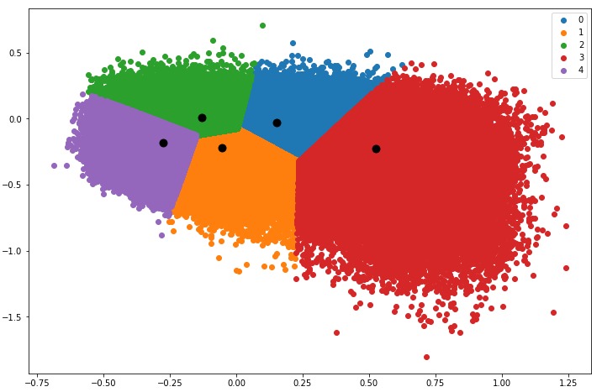
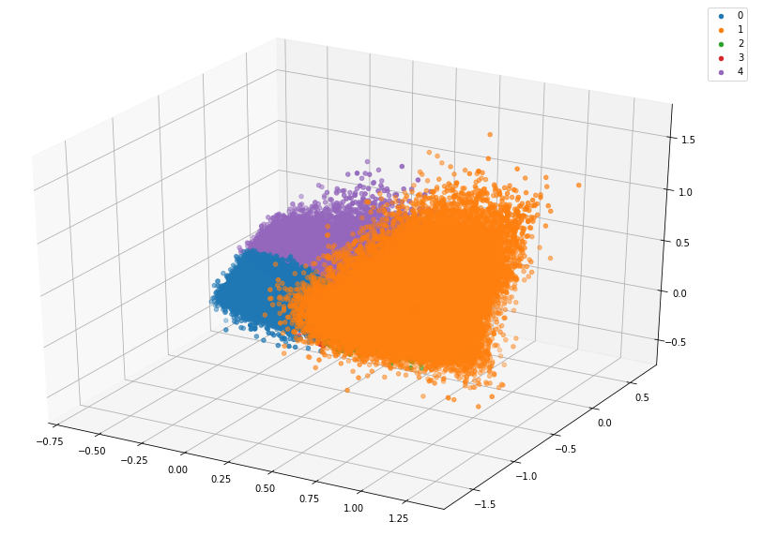
Results
Two Dimensional
3-d
Cosine distance = 0.1127
Cosine distance = 0.2235

Slide 11
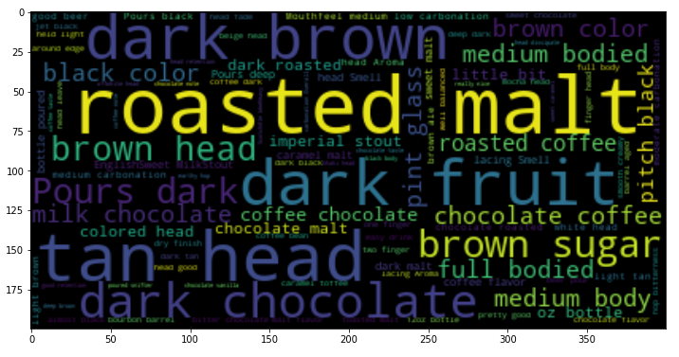
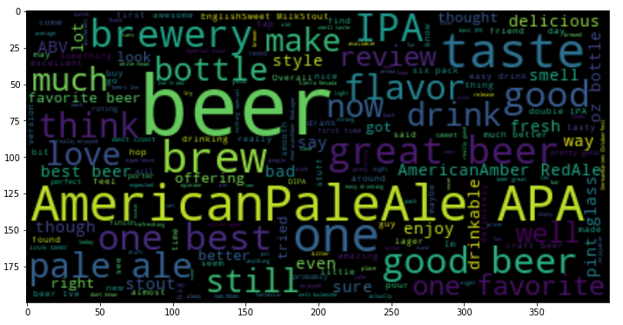
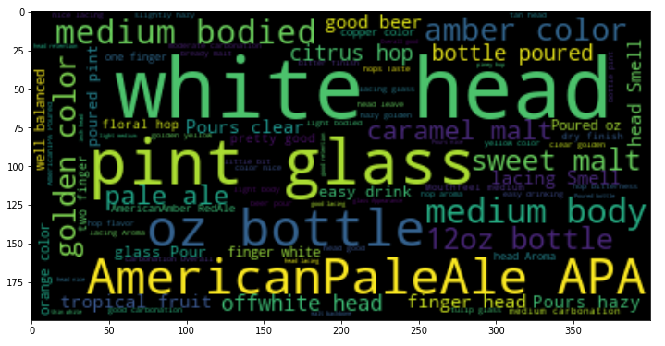
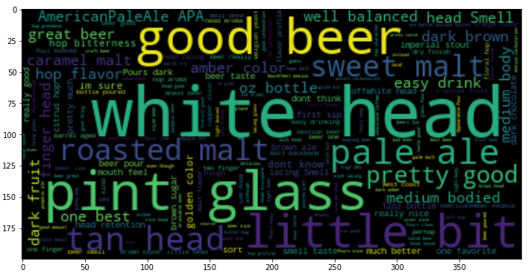
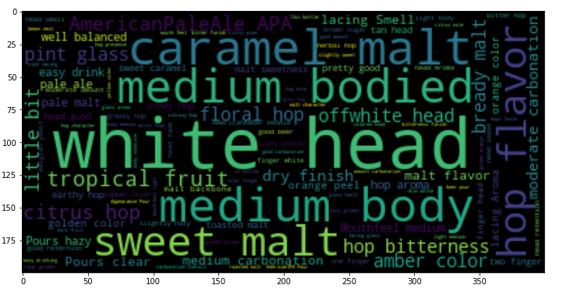
Word Clouds

Slide 12

Logistic Regression
84%

Slide 13
Questions?

