Slide 1

Beer Machine Learning
Erica Fisher
Jay Hastings
Jenny Kaylor
Joshua Williams

Slide 2

Introduction

Slide 3

The Plan
Machine Learning
Beer Reviews
Yeah buddy!

Slide 4
Word2Vec! Yes

Slide 5
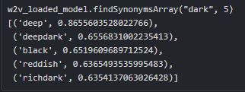
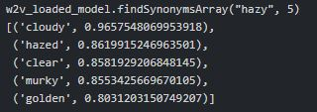
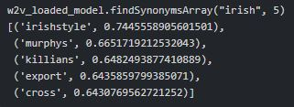
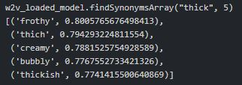
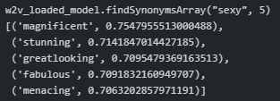
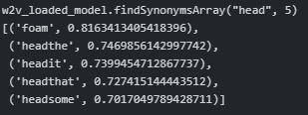
What did we see with Word2Vec?
Dark
Hazy
irish
thick
sexy
Head

Slide 6
LIVE DEMO

Slide 7
Linear Regression
 | Results
Look | 0.2834
Feel | 0.3485
Smell | 0.3480
Taste | 0.4012
Overall | 0.3594
Score | 0.4536

Slide 8

K-Means Clusters

Slide 9
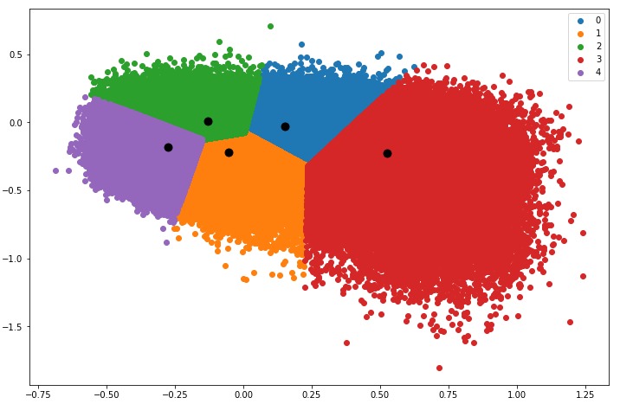
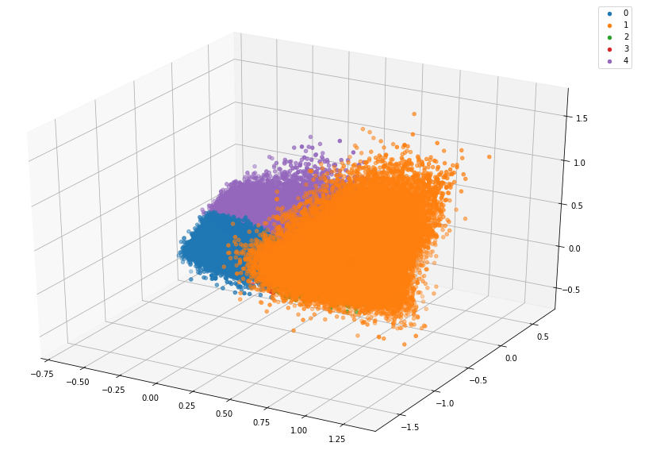
Results
Two Dimensional
3-d
Cosine distance = 0.1127
Cosine distance = 0.2235

Slide 10
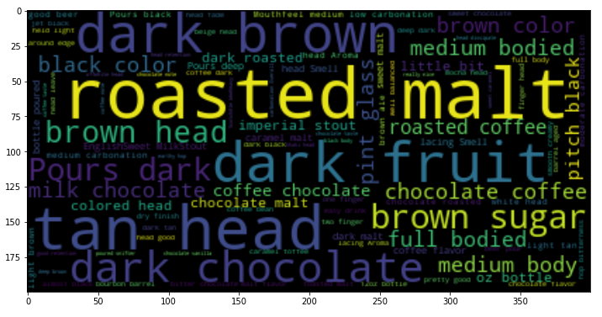
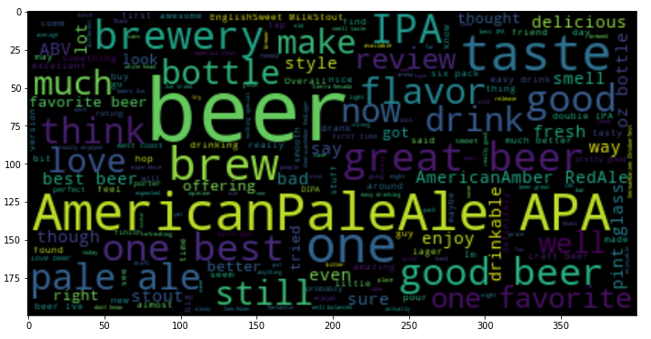
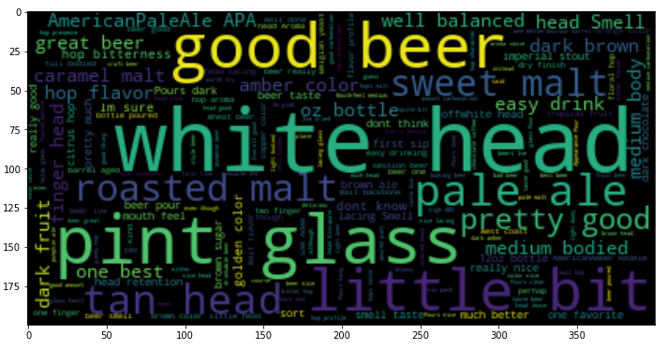
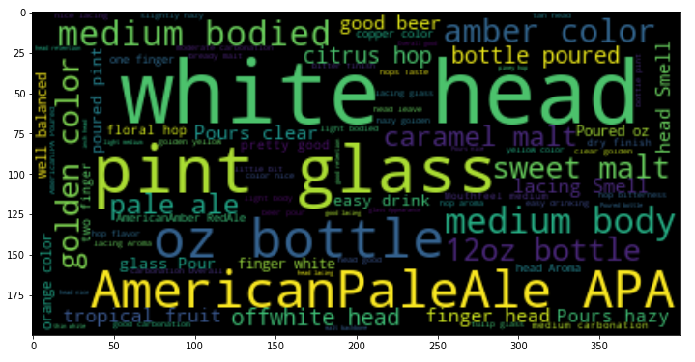
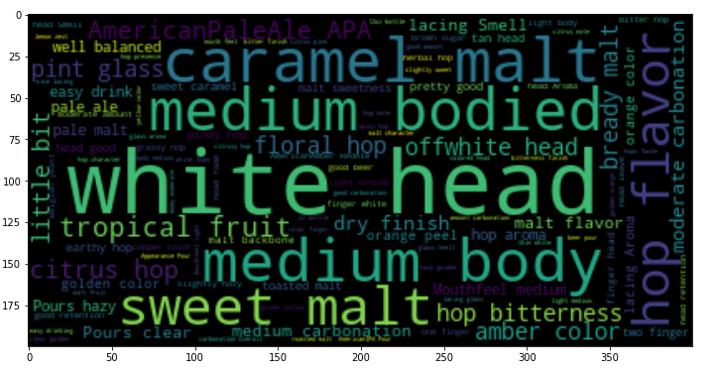
Word Clouds

Slide 11
Logistic Regression
84%

Slide 12
Questions?

