Slide 1

Beer Machine Learning
Erica Fisher
Jay Hastings
Jenny Kaylor
Joshua Williams

Slide 2
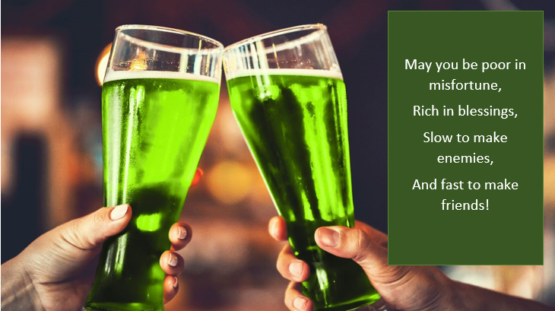

Slide 3
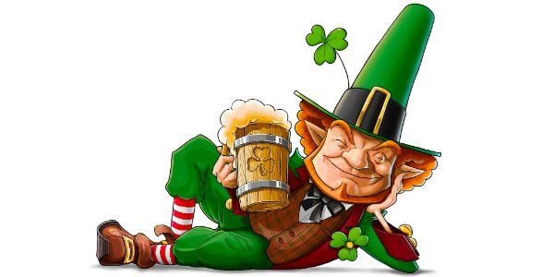
Introduction

Slide 4


The Plan?
We're going to brew the most amazing beer that everyone loves!
Our Secret Sauce:
Machine Learning
Beer Reviews
Yeah buddy!
Resources: 3 Files:
Kaggle Dataset beers.csv breweries.csv reviews.csv

Slide 5
Word2Vec! Yes

Slide 6
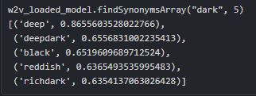
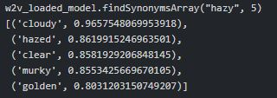
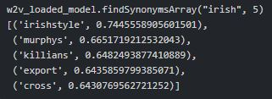
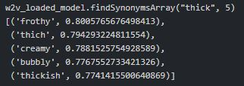
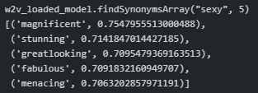
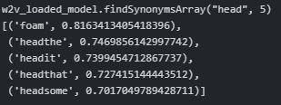
What did we see with Word2Vec?
Dark
Hazy
Irish
thick
sexy
Head

Slide 7
LIVE DEMO

Slide 8
Linear Regression
Category | Results
Look | 0.2834
Feel | 0.3485
Smell | 0.3480
Taste | 0.4012
Overall | 0.3594
Score | 0.4536

Slide 9
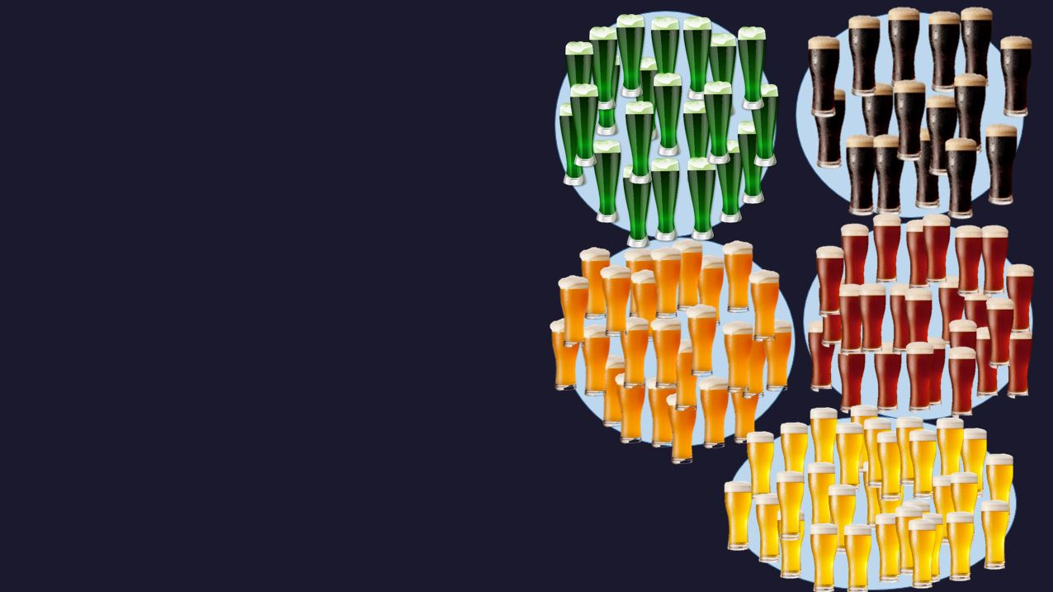
K-Means Clusters

Slide 10
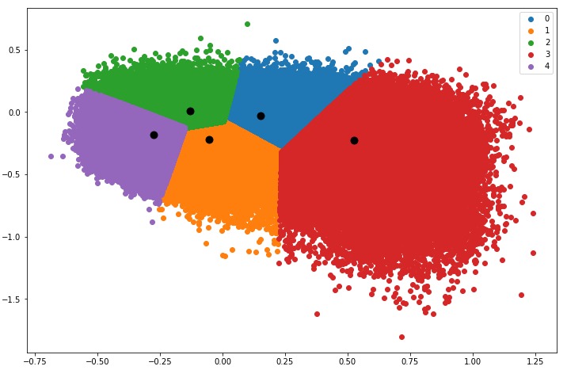
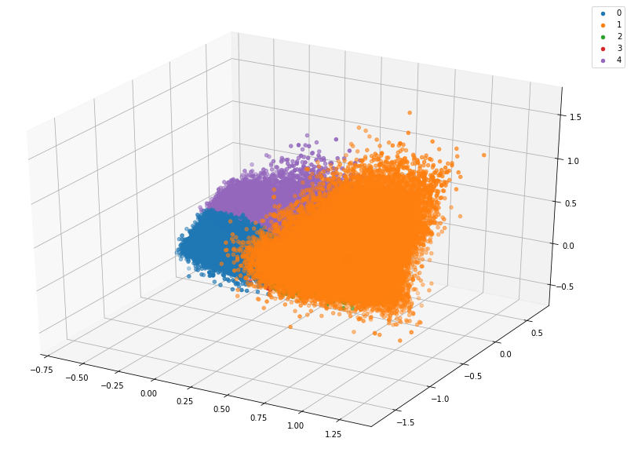
Results
Two Dimensional
3-d
Cosine distance = 0.1127
Cosine distance = 0.2235

Slide 11
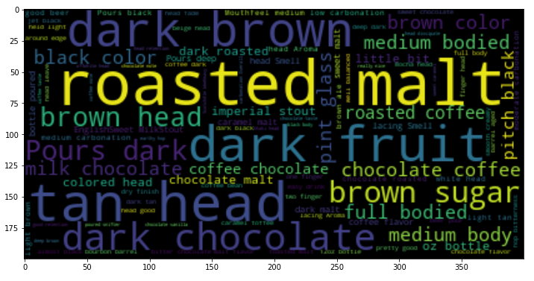
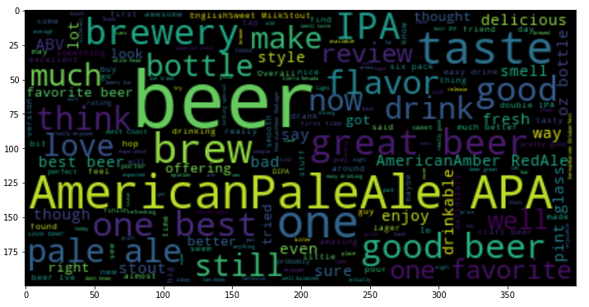
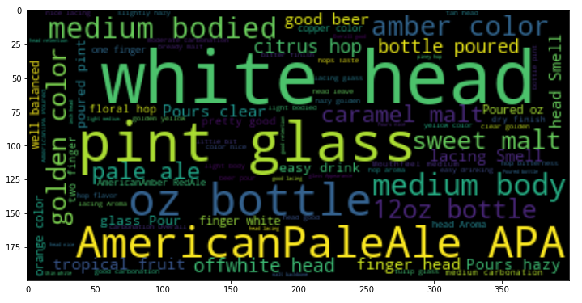
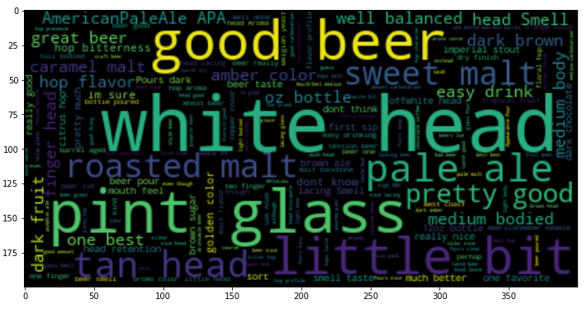
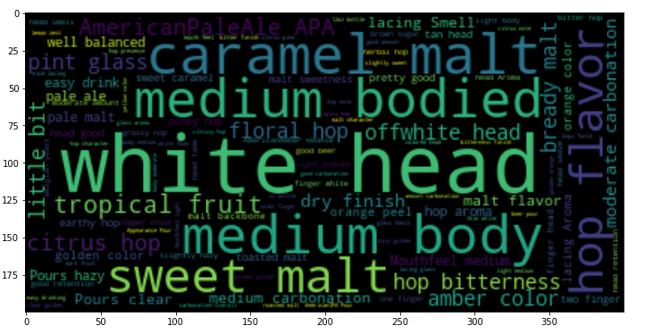
Word Clouds

Slide 12


Logistic Regression
Predicted: Positive
Actual: Negative
Predicted: Negative
Actual: Positive
84%
Score: 2.58
Pretty good for a Red Ale. Not as hoppy as I like but its good
Score: 2.75
Too sweet. Just not good
Score: 4.08
Totally disappointed, very overrated. Tasted very metallic

Slide 13
Questions?
Notes:
At the end, while we might not have found the secret sauce to brewing the best beer ---- we have gained enough beer-snobbery and jargon to know how to sound cool at a craft brew festival.

