Slide 1
COURSE GUIDES 15 AND 25
Consultas de Odontopediatría
Pediatric Dentistry Consultations: a simulator for caries management
JS
Jennifer Samaniego, M.Sc.
UTPL
VC
Dr. Verónica Cepeda
Universidad UTE
Narration generated with an AI voice (ElevenLabs) and reviewed by the authors
Vibe Coding CEDIA 2026 · Universidad UTE · UTPL
1 / 10
Notes:
Slide 1 · Title · 15 s
We are Jennifer Samaniego from U T P L and Doctor Verónica Cepeda from U T E. We present Consultas de Odontopediatría, Pediatric Dentistry Consultations. It is a simulator where students practice caries management in children, decision by decision.

Slide 2
Little practice in clinical reasoning
Connecting risk, findings, diagnosis and management takes practice.
EXAMPLE
Valentina, age 3: night bottle and white spots. Remineralize or restore?
Vibe Coding CEDIA 2026 · Universidad UTE · UTPL
2 / 10
Notes:
Slide 2 · The problem · 35 s
In pediatric dentistry students must connect many pieces at once. Medical history, risk factors, clinical findings, diagnosis and management. In class there is rarely time to practice that reasoning more than once. In the clinic every mistake affects a real child. Think of Valentina, a fictional patient who is three and a half years old. She drinks from a bottle at night. Her mother noticed small white spots on her front teeth. What should the student ask first? Should they remineralize or restore? That decision is learned by practicing.

Slide 3
The tool
1
2
3
Who uses it
What they get
What they deliver
Pediatric dentistry students
Three cases by age
Decisions, competency report
Vibe Coding CEDIA 2026 · Universidad UTE · UTPL
3 / 10
Notes:
Slide 3 · The tool · 30 s
Pediatric Dentistry Consultations is designed for dental students taking pediatric dentistry. Each student receives three cases, one for each stage of childhood. Valentina in early childhood, Mateo at school age and Camila in adolescence. In every case the student makes five clinical decisions. At the end they receive a report by competency with their strengths and what to review. We built it from guides fifteen and twenty five of this course.

Slide 4
How it works
1
2
3
4
Guided practice
Assessment
Our judgment
Report
›
›
›
Theory and hints
10 tokens, 5 rounds
Answers by faculty
4 competencies
Vibe Coding CEDIA 2026 · Universidad UTE · UTPL
4 / 10
Notes:
Slide 4 · How it works · 40 s
Each case has two moments. First comes a guided practice with step by step reasoning, theory and up to three hints. That practice does not count toward the grade. Then comes the unassisted assessment, which does count. The student has ten clinical time tokens for five rounds. Each option costs tokens and earns quality points. There is no luck, only judgment. We used A I to program the simulator and to narrate the cases with ElevenLabs. We wrote the answers and the feedback ourselves, using the content from our classes. The A I does not decide the correct answer.

Slide 5
Evidence and need
16 8th-semester students
12 completed 3 cases
99% mean score
What did they think? Mean 4.8 of 5 (n = 8)
They rated themselves below what they achieved
■ Self-rating ■ Actual performance
Diagnosis
3.6
4.0
Risk
3.5
4.0
Lesions
3.8
4.0
Education
3.4
3.9
Scale: 1 = not yet mastered · 4 = mastered
Gap
Few studies combine simulation, caries and pediatric dentistry
9 of 25 articles selected: Carneiro 2026 · Perez 2023 · Signori 2019 · Wakeling 2026 · Panpisut 2023 · Kuchenbecker 2017 · McMillan 2023 · Nascimento & Warmling 2020 · Skariah 2025
Vibe Coding CEDIA 2026 · Universidad UTE · UTPL
5 / 10
Notes:
Slide 5 · Evidence · 35 s
Sixteen eighth semester students used the simulator. Twelve completed all three cases with an average of ninety nine percent. Eight rated the experience four point eight out of five. They highlighted the clear instructions, the narration and the clinical judgment they gained. In the self assessment everyone rated themselves at or below their actual performance. Since almost everyone reached the top score, we will design harder cases. And almost no study combines simulation, caries and pediatric dentistry. Our simulator addresses that gap.

Slide 6
Limits and responsible use
Does not replace clinical practice or supervision
1
Data fictional patients
2
Next step Canvas and faculty validation
3
Vibe Coding CEDIA 2026 · Universidad UTE · UTPL
6 / 10
Notes:
Slide 6 · Limits and responsible use · 25 s
The simulator does not replace practice with patients or faculty supervision. The patients are fictional and we use no real patient data. It requires an internet connection. The clinical cases must be reviewed when management guidelines change. Our next step is to bring it into Canvas and validate the cases with more pediatric dentistry faculty.

Slide 7
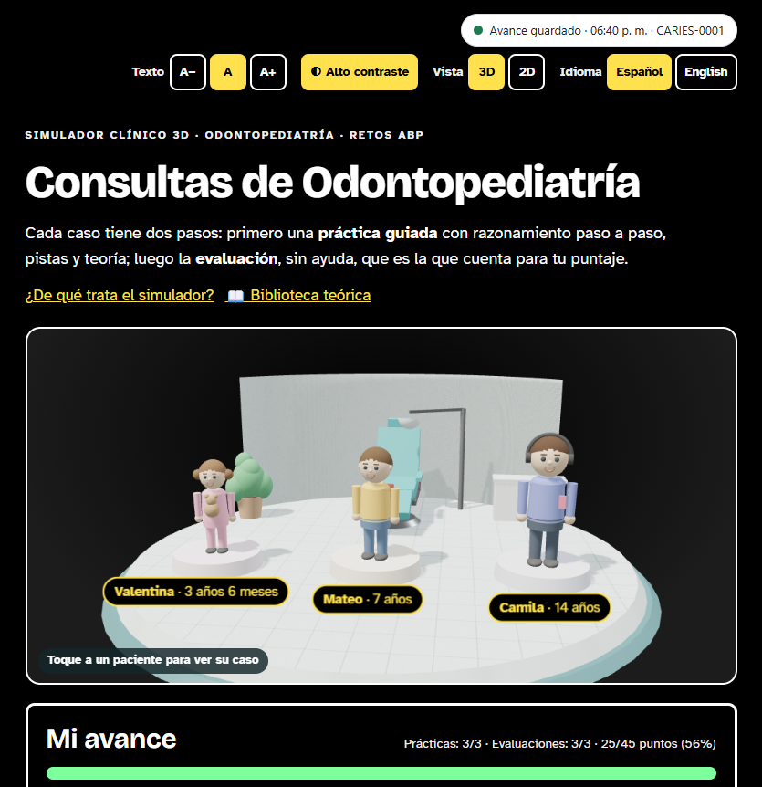
DEMO · ENTRY
Choose a patient
Three ages, accessibility and language (interface in Spanish)
Vibe Coding CEDIA 2026 · Universidad UTE · UTPL
7 / 10
Notes:
Slide 7 · Demo · Entry · 30 s
Let us look at the simulator on screen. This is the entry point. The student sees the clinic in three dimensions with the three patients. They tap one to open that case. At the top they can change the text size and turn on high contrast. They can also switch to a two dimensional view or change the language to English. The screens you see are in Spanish. Each student starts with the age group they need to review.

Slide 8
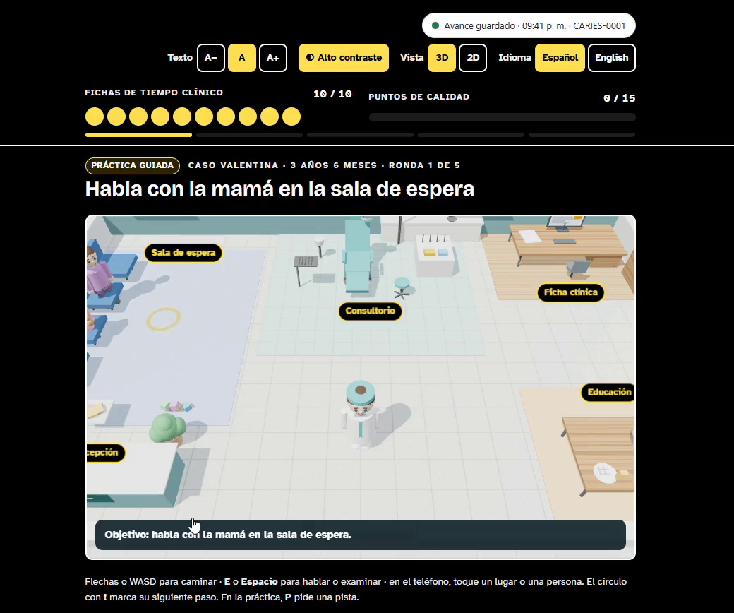
DEMO · DECISION
Decide with tokens
Round 1: talk with the mother
Vibe Coding CEDIA 2026 · Universidad UTE · UTPL
8 / 10
Notes:
Slide 8 · Demo · Result · 35 s
This is the first round of Valentina's case. The student walks through the clinic and talks with her mother in the waiting room. At the top they see their ten clinical time tokens and their quality points. Each conversation or exam with the patient gives them a new piece of clinical information. Then they choose among several options, each with its own cost. After every choice they receive feedback. This way they understand why one option was better than another.

Slide 9
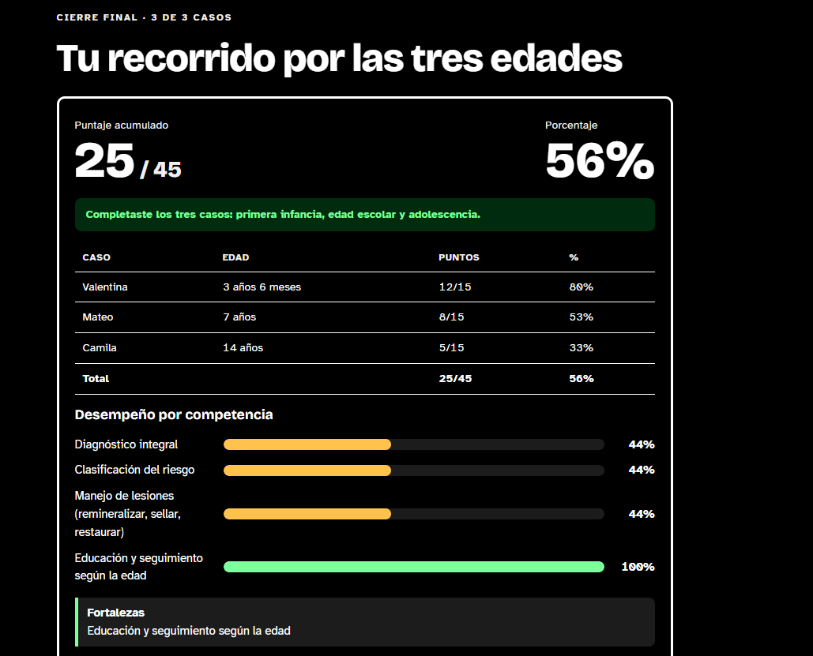
DEMO · REPORT
Review performance
Score by case and by competency
Vibe Coding CEDIA 2026 · Universidad UTE · UTPL
9 / 10
Notes:
Slide 9 · Demo · Review and delivery · 30 s
After finishing the three cases the student reaches the final summary. Here they see their score for each case and their performance in four competencies. Comprehensive diagnosis, risk classification, lesion management and age appropriate education. They also compare how they rated themselves with what they actually achieved. In our pilot half of the students underestimated their mastery of risk assessment. That gap guides our feedback. This way they know what to review.

Slide 10
Practice before treating a child
jennsama.github.io/3D
JS
Jennifer Samaniego, M.Sc.
UTPL
VC
Dr. Verónica Cepeda
Universidad UTE
Vibe Coding CEDIA 2026 · Universidad UTE · UTPL
10 / 10
Notes:
Slide 10 · Closing · 25 s
This simulator changes the way we teach caries. Students can practice clinical reasoning as many times as they need before they treat a real child. We use their reports to decide what to reinforce in class. We invite you to try it yourself at the link on the screen. Thank you very much for your attention.

