Slide 1
Metadata
Learning Analytics (Lax)

Slide 2
Objective
Well-defined data dictionary shared across research (IR) and analytics (LAx) departments.
Inform Analysis
Clarify/Standardize Metrics and Reporting

Slide 3
Current Methods -- Challenges
Excel Spreadsheet (IR)
Confluence Notes (LAx)
Institutional Knowledge (both)
Limited access
Versioning
Exists apart from database
Exists apart from database
Non-intuitive format for column-specific data
Limited access
High time requirement
Needs to be repeated for each individual

Slide 4
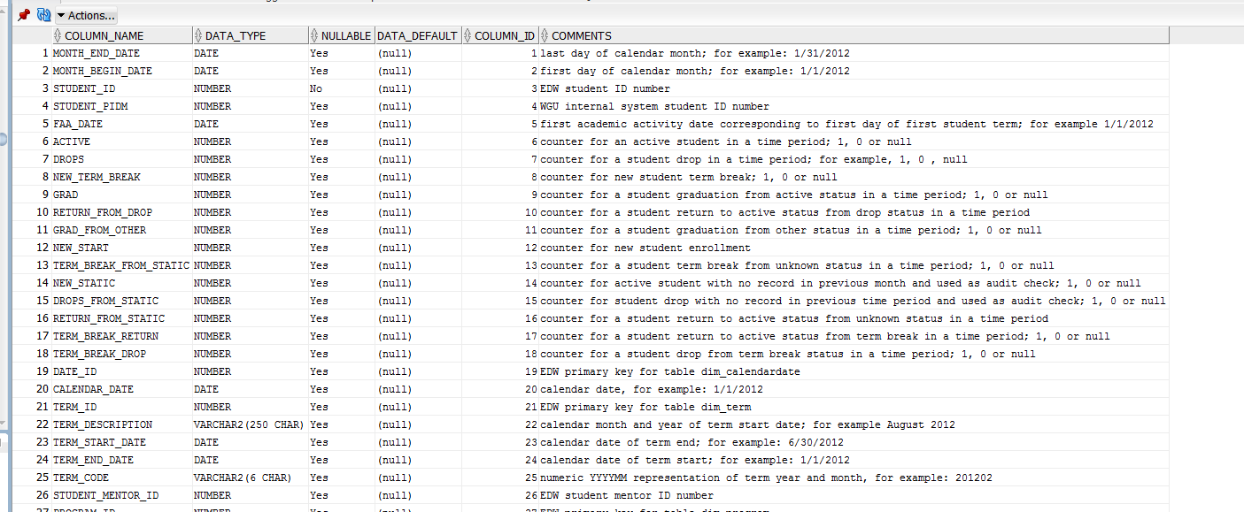
Metadata in RDBMS
Comments stored connected to columns and/or tables
Accessible to anyone with database access
Single copy – consistency & shared workload

Slide 5
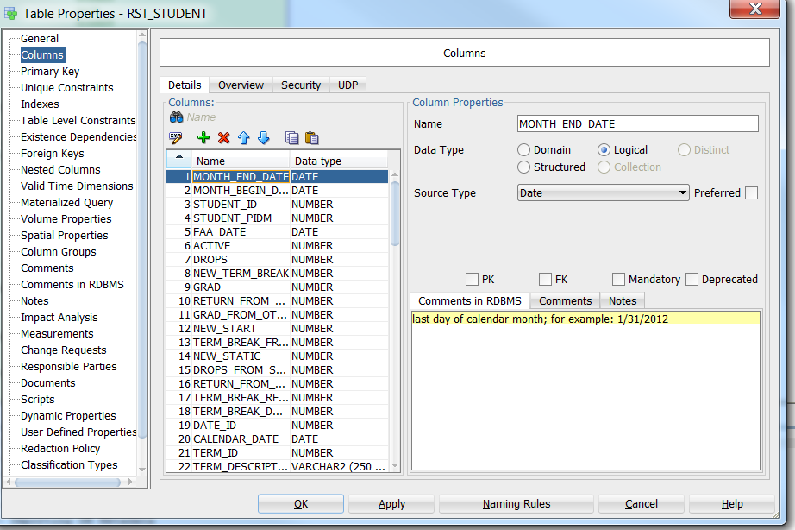
RDBMS Metadata
Read options:
Data Modeler (shown)
Database Object View (previous slide)
EDW Query of columns (or tables) table
Write options:
Data Modeler – generate DDL script
Database Object View (WYSIWYG)
DDL script run against sys tables (requires admin privileges)

Slide 6
New Method & Key Numbers
RDBMS as central data dictionary
Transfer any notes from spreadsheet, confluence, and institutional knowledge
Key numbers (limited to owner = WGUBI):
Total columns in database = 67313
Un-commented columns = 65936
Columns with single, non-NULL description stored in database = 7431
Use code to populate in minutes
Columns with multiple, non-NULL descriptions = 18541
Requires admin review – three options:
Master
Merge
Handle individually

