Slide 1
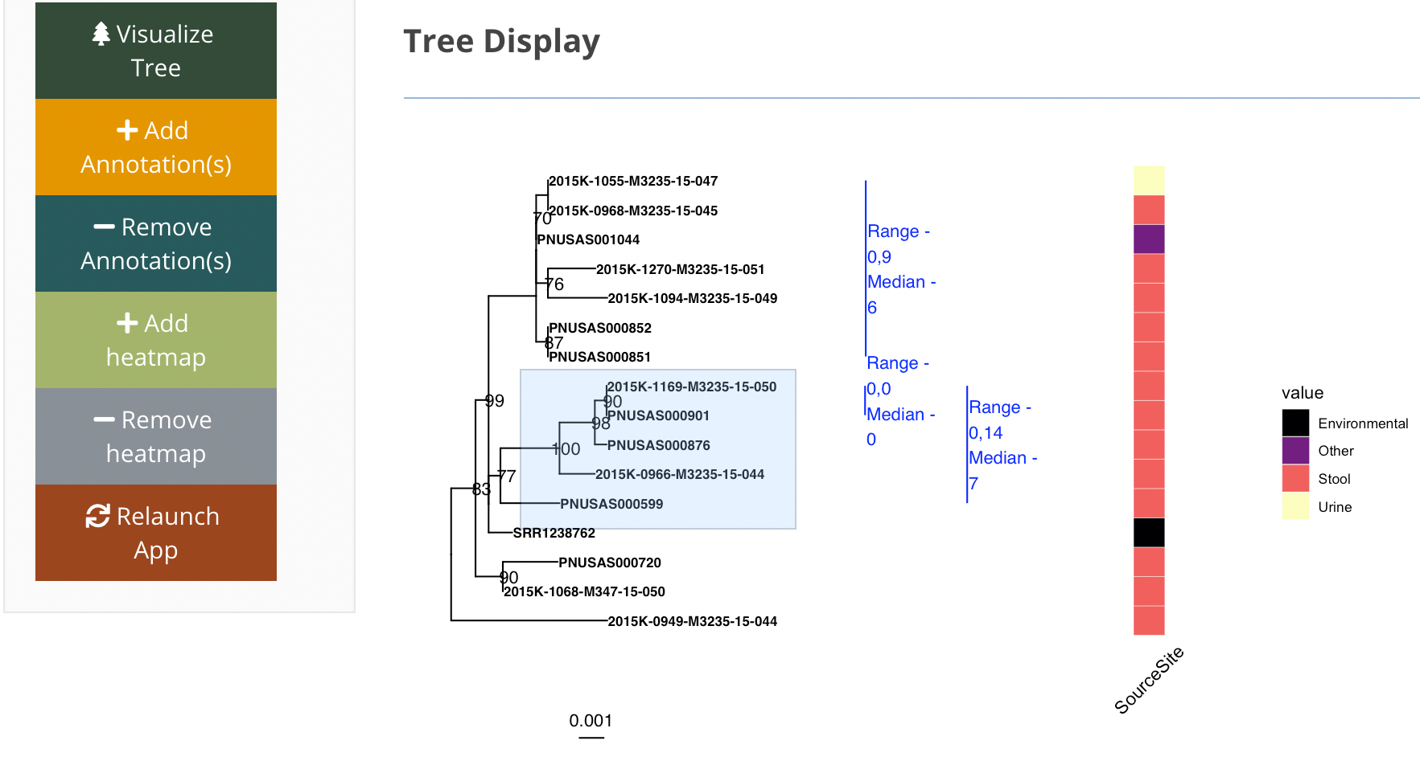
a
b
Run the below code in your R console
requires R >= 3.6
1). Install devtools package
install.packages("devtools", dep=T)
2). Install ggtree and treeio
if (!requireNamespace("BiocManager") install.packages("BiocManager") BiocManager::install("ggtree")
Note – this will install both ggtree and treeio
3). Install & launch the tinselR app
devtools::install_github("jennahamlin/tinselR") library(tinselR) run_app()

