Slide 1
Start Writing Manuscripts in Rmarkdown…
…especially if you already know R Jenna Hamlin - ptx4@cdc.gov

Slide 2
Highlights on our tour of Rmarkdown
What is markdown
What is Rmarkdown
Using a word document template
Equations and other formatting with LaTeX
Analyses using R in Rmarkdown
Integrating references
Formatting using CSL files
Incorporating version control with git/github

Slide 3
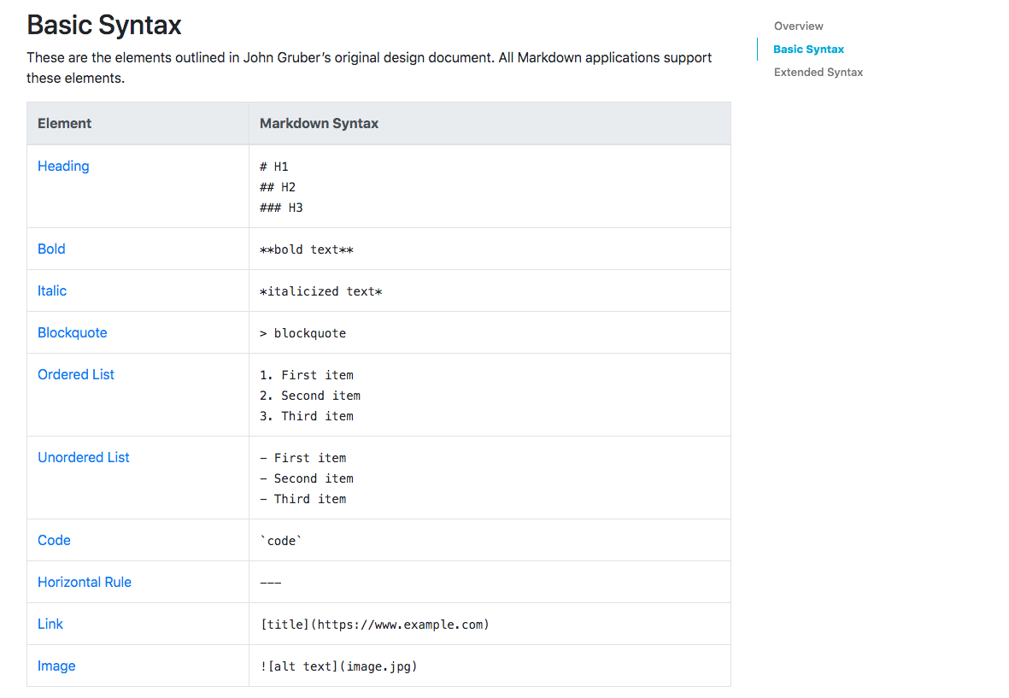
Markdown
Markdown is a lightweight markup language with plain-text-formatting syntax.

Slide 4
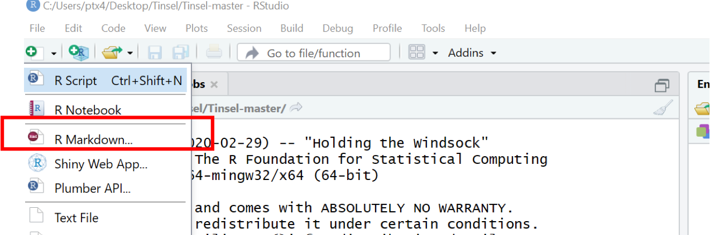
Rmarkdown
Text file that can execute code making reproducibile output in a dozen static and dynamic formats (including this powerpoint).

Slide 5
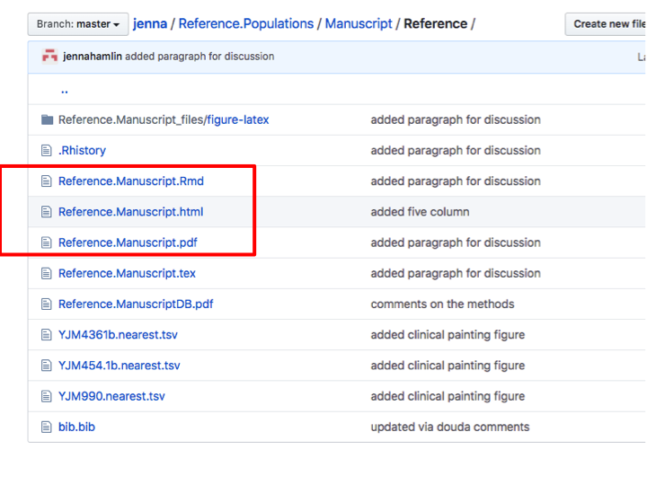
.Rmd files
.Rmd files can be opened and edited in Rstudio, and turned into HTML, PDF, or DOCX files with the push of button.

Slide 6
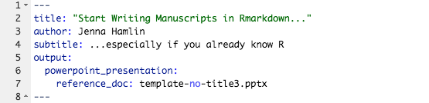
YAML
Yet Another Markup Language (YAML) - specify key information to be used when producing the final document - powerful for formatting.

Slide 7
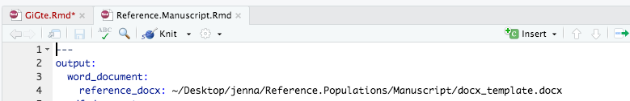
Using a word document template
Many journals and colleagues prefer to read and receive manuscripts as DOCX files. With a template, the created DOCX is formatted as desired every time.

Slide 8
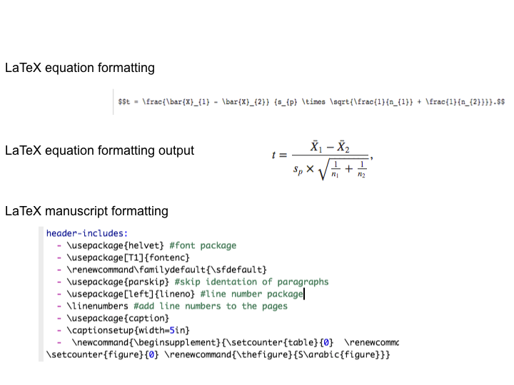
Equations and other formatting with LaTeX
LaTeX produces highly professional looking equations and can be used for additional formatting requirements placed in YAML.

Slide 9
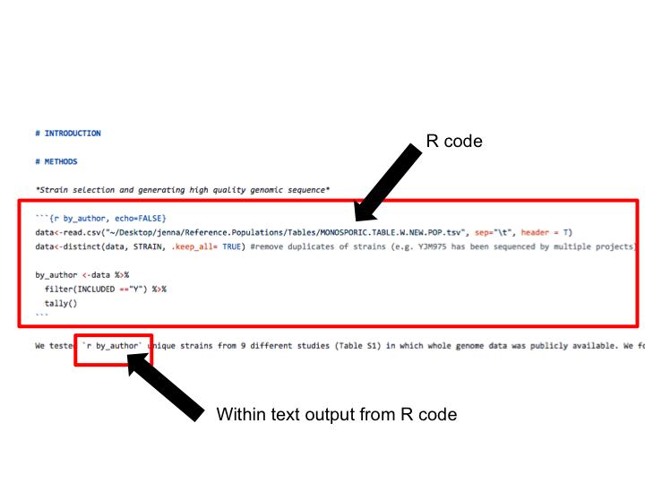
Analyses using R code
Integrate R code (R chunks) directly avoiding the need to awkwardly copy-paste analyses, tables, or figures.

Slide 10
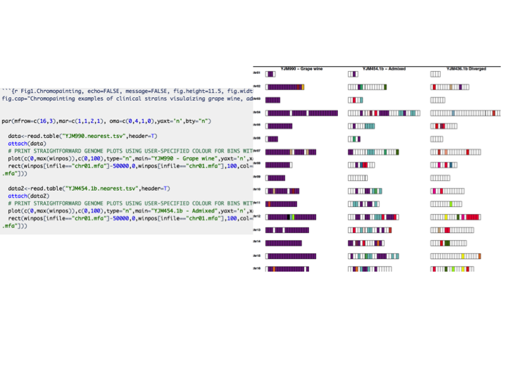
Analyses using R code 2
Embed figures directly into Rmarkdown documents and update code as necesary.

Slide 11
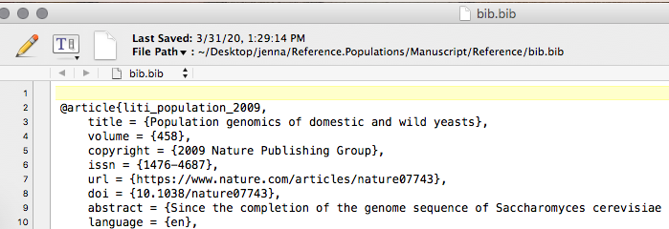
Integrating references with BibTeX
Each reference has a unique ‘key’ used within Rmd files (e.g. [@author]) that will automatically build the reference section.

Slide 12
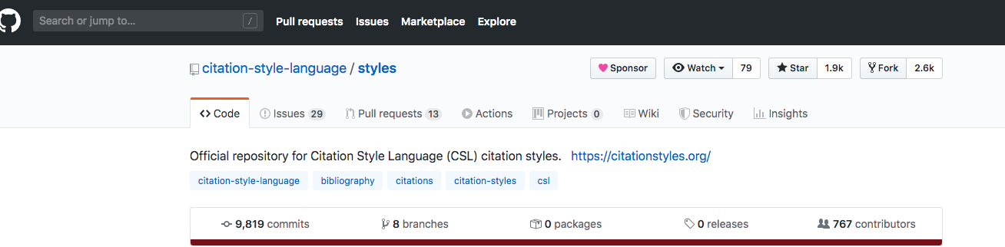
Formatting using CSL files
CSL - Citation Style Language - essentially text files that tell the Rmarkdown file how to use the information in the BibTeX file to build the citations that are journal specific.

Slide 13
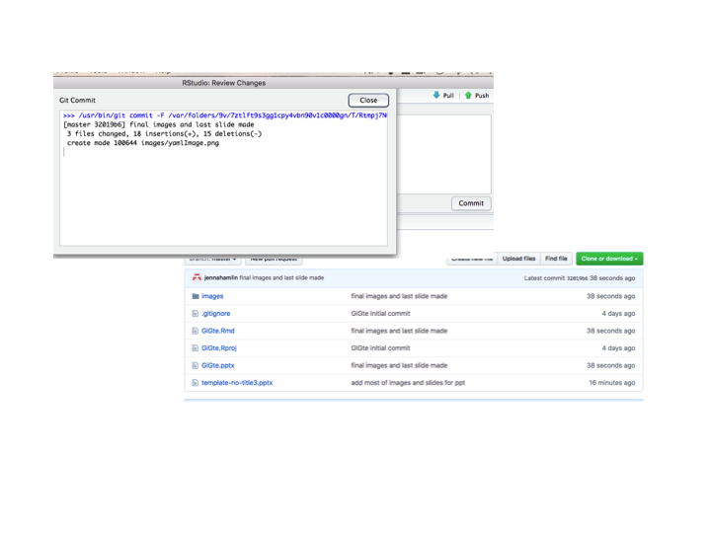
Incorporating version control with git/github
Manage, share, document, file backups, exporsure, collaborate all while using R and Rmarkdown.

Slide 14
Access Rmarkdown at CDC
log onto monolith3.biotech.cdc.gov - I have checked this one
module load R/3.6.1
rstudio

Slide 15
Quick look at a manuscript
Using the dummy Rmarkdown document

Slide 16
Links
markdown https://rstudio.com/wp-content/uploads/2015/03/rmarkdown-reference.pdf)
rmarkdown https://rmarkdown.rstudio.com/lesson-1.html
rmarkdown cheat sheet https://rstudio.com/wp-content/uploads/2015/02/rmarkdown-cheatsheet.pdf

Slide 17
Links page 2
rmarkdown book https://bookdown.org/yihui/rmarkdown/powerpoint-presentation.html#ppt-templates
r chunks https://garrettgman.github.io/rmarkdown/authoring_rcodechunks.html
version control with git/github https://happygitwithr.com/

Slide 18
Links page 3
equations https://en.wikibooks.org/wiki/LaTeX/Mathematics
references https://rmarkdown.rstudio.com/authoring_bibliographies_and_citations.html
csl https://github.com/citation-style-language/styles

Slide 19
Links page 4
template https://support.office.com/en-us/article/create-a-template-86a1d089-5ae2-4d53-9042-1191bce57deb
helpful site https://stirlingcodingclub.github.io/Manuscripts_in_Rmarkdown/Rmarkdown_notes.html

