Slide 1
Start Writing Manuscripts in Rmarkdown…
…especially if you already know R Jenna Hamlin

Slide 2
Highlights on our tour of Rmarkdown
What is markdown
What is Rmarkdown
Analyses using R in Rmarkdown
Integrating references using BibTeX
Equations and other formatting with LaTeX
Formatting references using CSL files
Incorporating version control with git/github

Slide 3
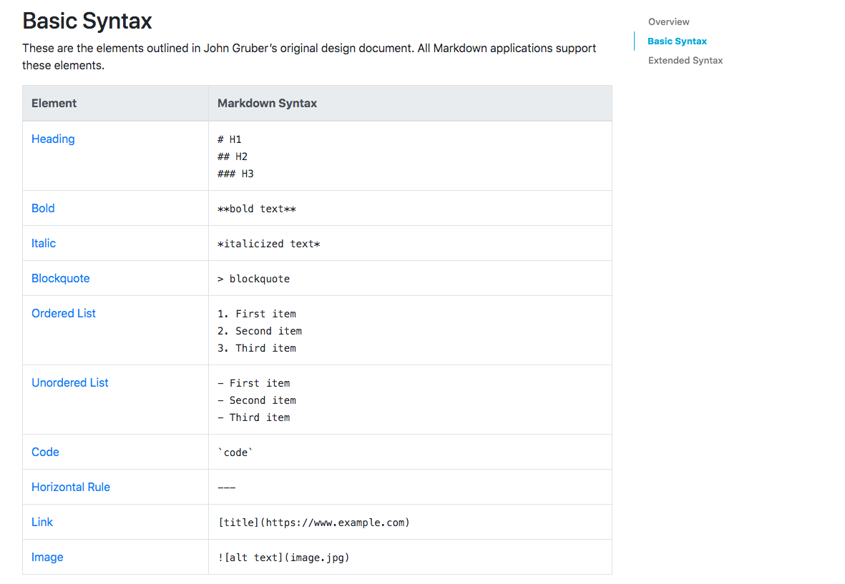
Markdown
Markdown is a lightweight markup language with plain-text-formatting syntax

Slide 4
link

Slide 5
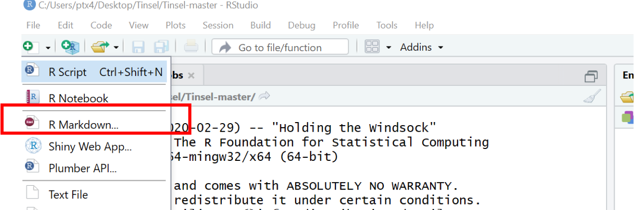
Rmarkdown
Rmarkdown is a text file that can generate high quality reports and execute code which allows reproducibility for output in a dozen static and dynamic formats (including this powerpoint).

Slide 6
https://rmarkdown.rstudio.com/lesson-1.html

Slide 7
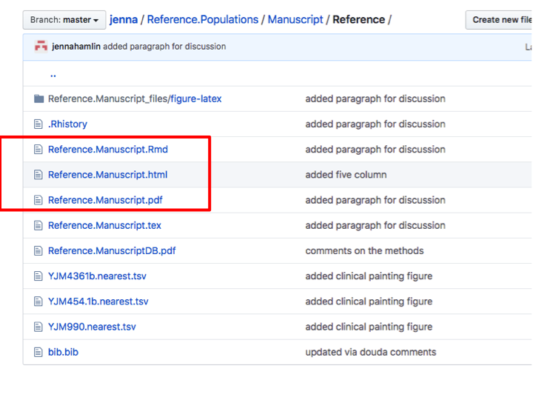
.Rmd files
.Rmd files can be opened and edited in Rstudio, and turned into HTML, PDF, or DOCX files with the push of button

Slide 8
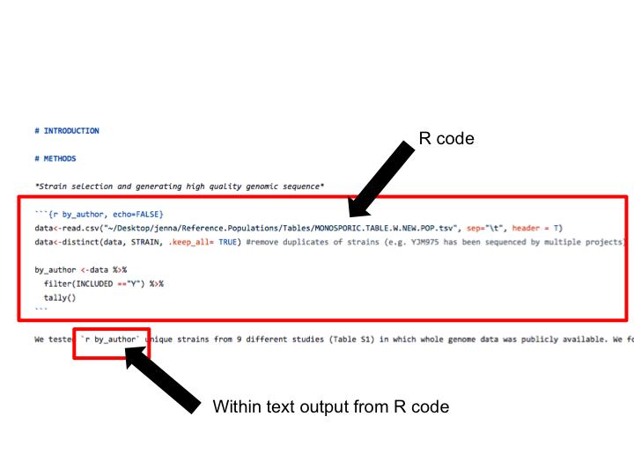
Analyses using R code
Integrate R code directly (avoiding the need to awkwardly copy-paste analyses, tables, or figures)

Slide 9
Data science is an exciting discipline that allows you to turn raw data into understanding, insight, and knowledge. The goal of “R for Data Science” is to help you learn the most important tools in R that will allow you to do data science.
#[]R(markdown.open.png)

