Slide 1
Start Writing Manuscripts in Rmarkdown…
…especially if you already know R Jenna Hamlin

Slide 2
Highlights on our tour of Rmarkdown
What is markdown
What is Rmarkdown
Integrating references using BibTeX
Analyses using R
Equations and other formatting with LaTeX
Formatting references using CSL files
Incorporating version control with git/github

Slide 3
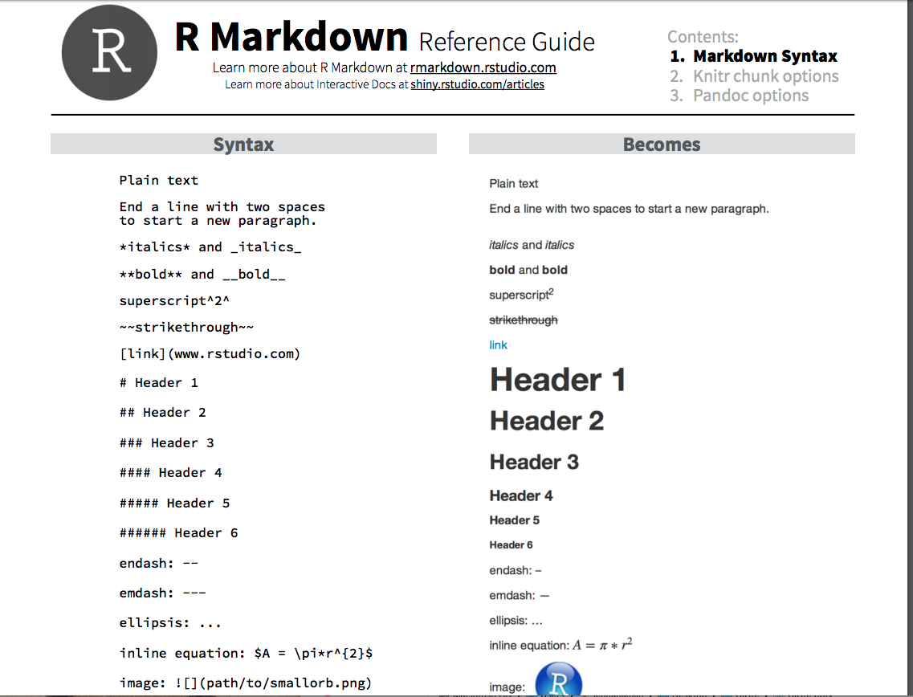
Markdown
Markdown is a lightweight markup language with plain-text-formatting syntax

Slide 4
link to pdf

Slide 5
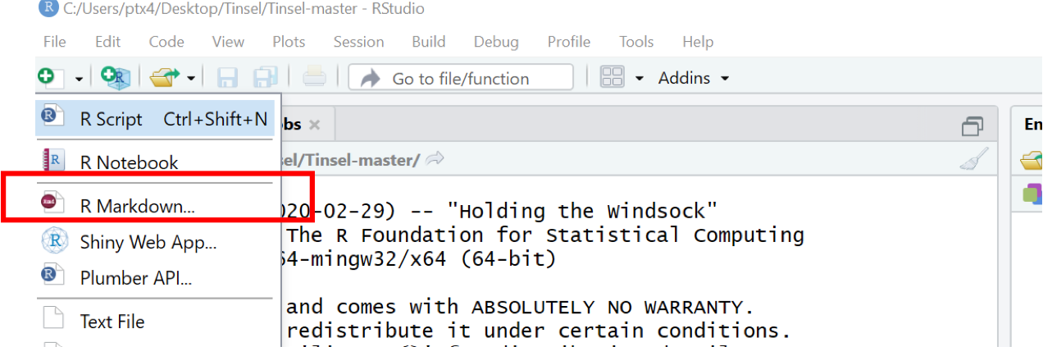
Rmarkdown
provides an authoring framework for data science. You can use a single R Markdown file to both save and execute code generate high quality reports that can be shared with an audience R Markdown documents are fully reproducible and support dozens of static and dynamic output formats.

Slide 6
link to Rmarkdown

Slide 7
Data science is an exciting discipline that allows you to turn raw data into understanding, insight, and knowledge. The goal of “R for Data Science” is to help you learn the most important tools in R that will allow you to do data science.

