Slide 1

Does News Media
Spread Fear of AI?
RAISE 2024 Competition
Team: Ainsight
March 2024
ⓒSaebyeol Yu. Saebyeol’s PowerPoint

Slide 2
Table of Contents
1
Introduction – Our team & Project
2
Exploratory Data Analysis & Visualization
3
Analysis & Interpretation
Sentiment Analysis
Emotion Analysis
4
Conclusion
ⓒSaebyeol Yu. Saebyeol’s PowerPoint

Slide 3

Part 1
Introduction
Our team & Project

Slide 4



Part 1
Introduction – Our team & Project
Project Objective
Team member
Our project seeks to answer the intriguing question: 'Is the media spreading fear about AI?’.
We delved into this by first preprocessing and exploring a dataset of 10,000 headlines. Our journey continued with a thorough analysis using three sentiment analysis models to assign emotions to these headlines.
We focused on tracking the shift in sentiment in AI-related articles from May to November 2023.
The culmination of our research not only sheds light on the emotional trends in media but also offers a critical evaluation of the models used and provides insights that could guide the media's narrative around artificial intelligence.
Nayeon Kwak
Bentley University
Master of Business Analytics, candidate
Hyomin Yoo
University of Illinois, Urbana-Champaign
Master of Statistics, candidate
Kyungjin Kwak
Illinois Institute of Technology
Master of Data Science, candidate

Slide 5
Part 2
Exploratory Data Analysis

Slide 6
Part 2
Exploratory Data Analysis & Visualization
1. Load Data
Data Load & Clean
2. Check
shape of dataset & data type
&
Find null values & duplicated values
3. Divide ‘translated title’: ‘news title’ & ‘news source’
Dataset 10K
1. Top 10 new title analysis
Exploratory
Data
Analysis
2. Top 10 news source analysis
3. Monthly & Quarter Analysis

Slide 7
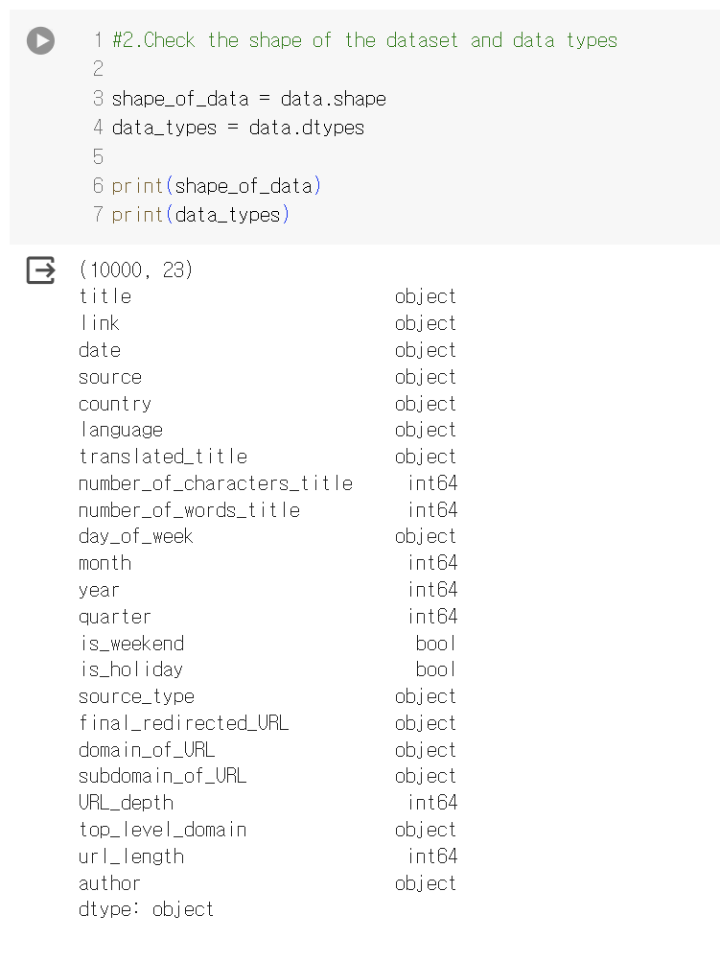
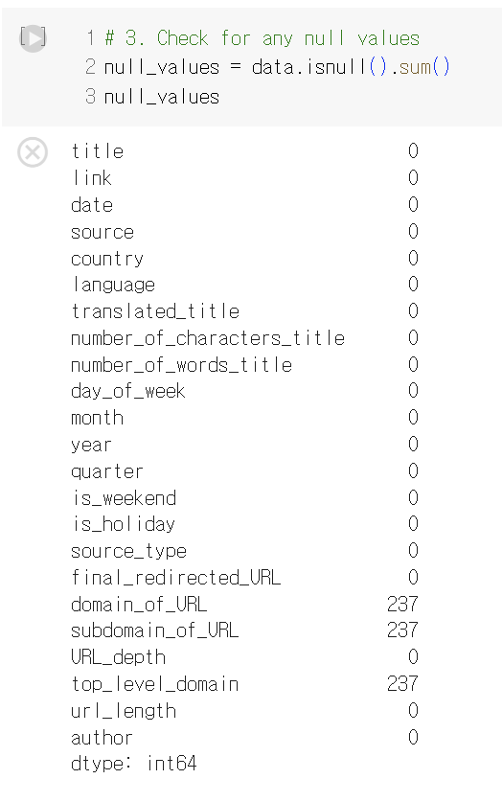
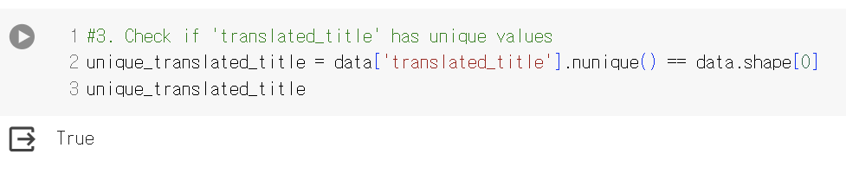
Part 2
Exploratory Data Analysis & Visualization
Feature Data type check: We changed data type of ‘date’ column. ‘object’ -> ‘datetime’ Missing value check: We find that total of 237 article URLs were missing. But we primarily focused on the content of the news titles for our main analysis, so the missing URL values were not a significant issue. Check if all the ‘translated_title’ values are unique.

Slide 8
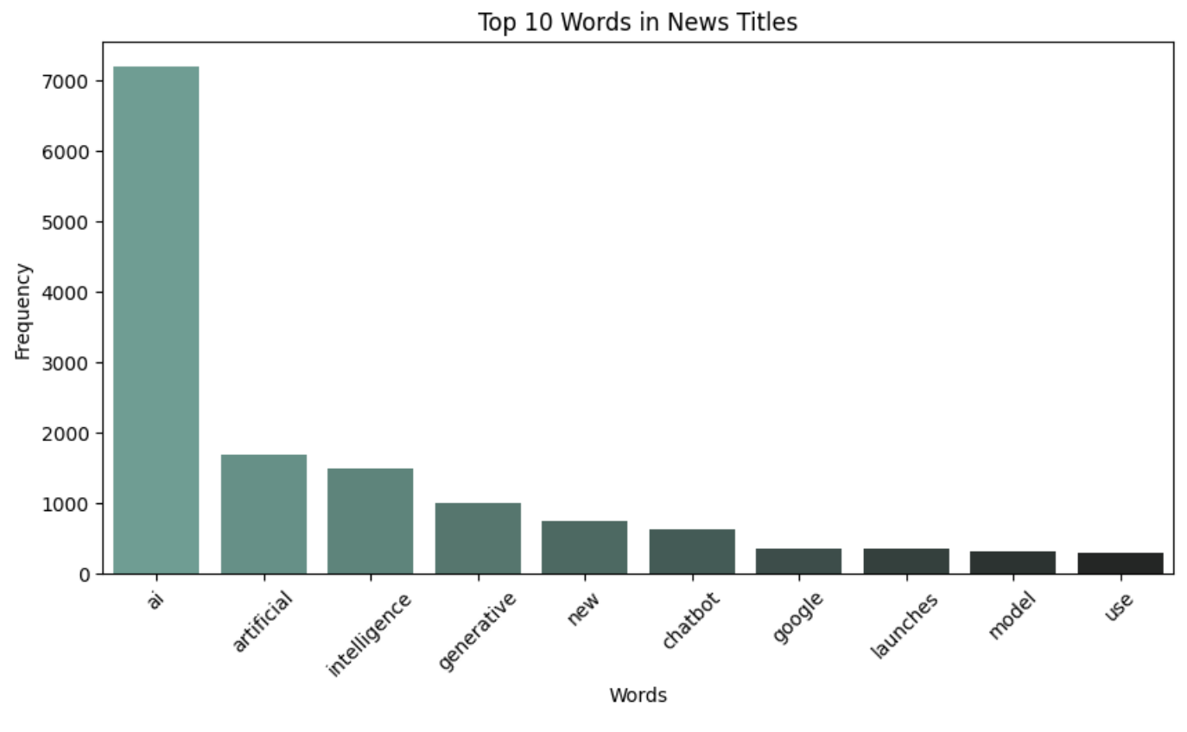
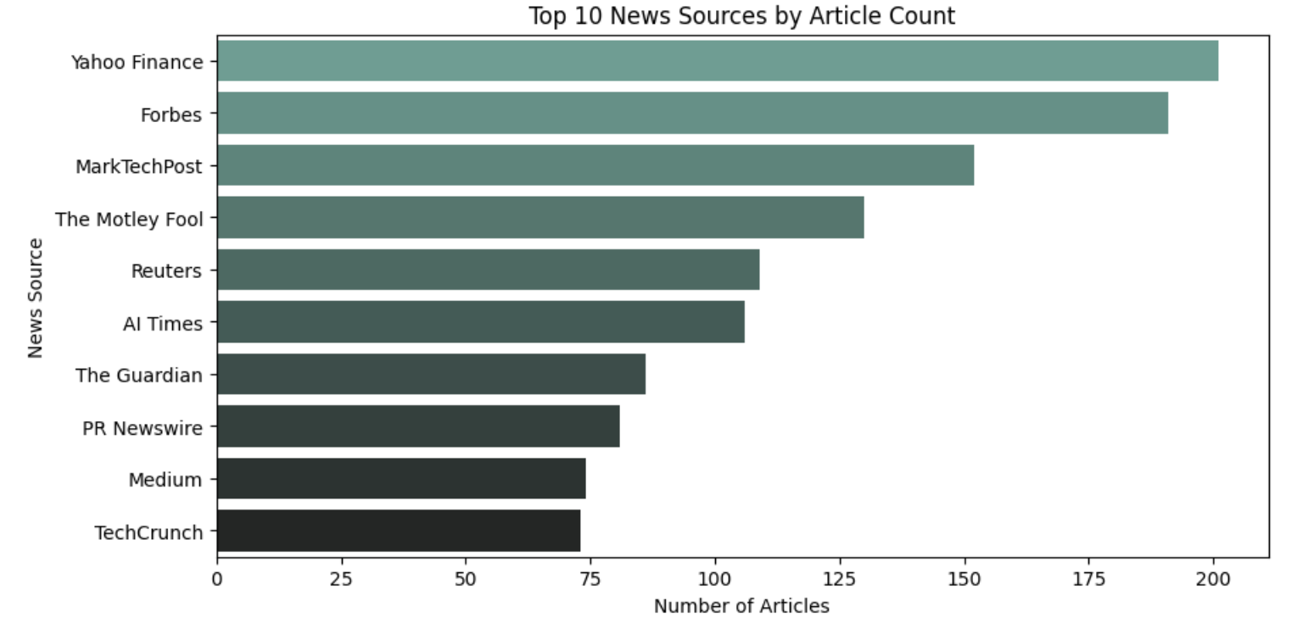
Part 2
Exploratory Data Analysis & Visualization
1) Top10 news title words Analysis
News Title Word Analysis: The word 'AI' ranked as the most frequent term, exhibiting more than double the frequency of the second most common word, 'artificial.' However, the term 'AI' itself does not convey a fear or negative impression. News Source Analysis(1): Yahoo Finance was the top source. However, it represented only 200 out of 10,000 articles, which is 2%, making it challenging to regard it as having a significant influence on the overall media representation of AI.

Slide 9
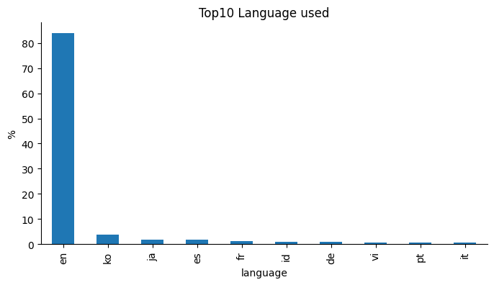
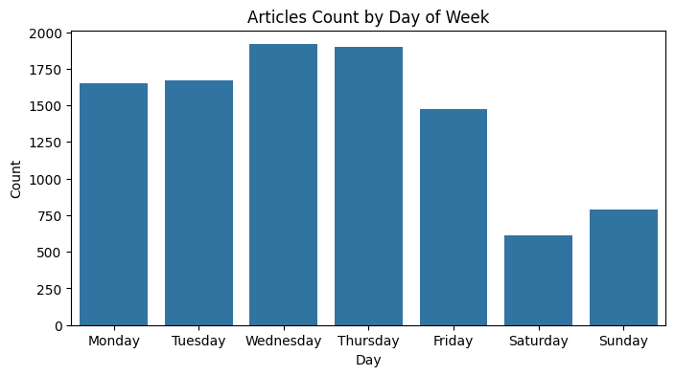
Part 2
Exploratory Data Analysis & Visualization
2) Top10 New source Analysis
New Source Analysis(2): In our analysis of the top 10 languages used in news titles, we found that over 80% were in English. Korean and Japanese follow but accounted for less than 5% each, which does not significantly influence the analysis. New Source Analysis(3): When examining news release patterns by day, we found that the number of articles is fairly consistent across weekdays. However, the data revealed that significantly fewer articles are published on weekends.

Slide 10
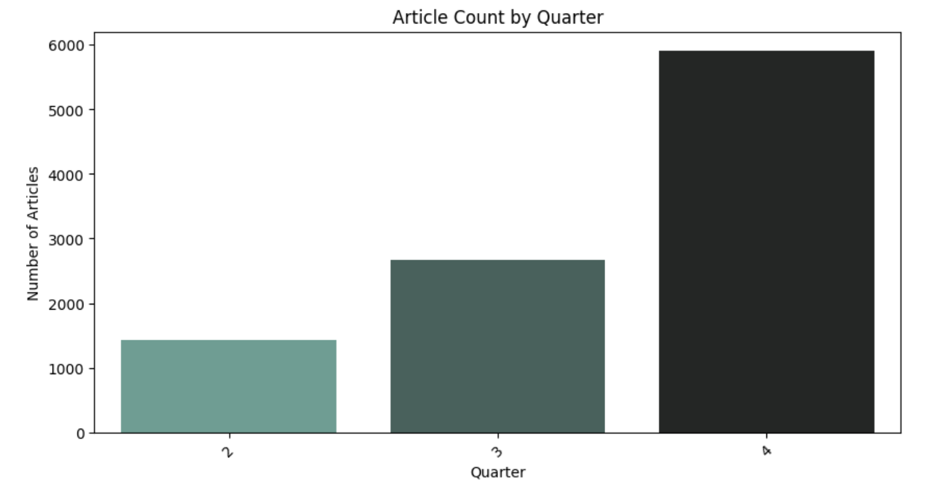
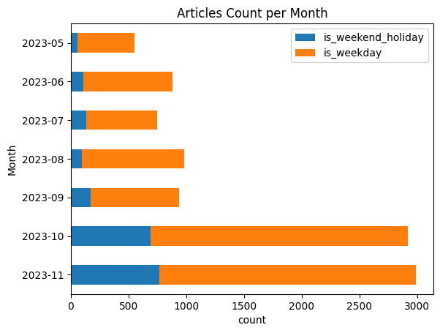
Part 2
Exploratory Data Analysis & Visualization
2) Articles by Month & Quarter
Occurrence of Articles by Quarter: In our dataset of 10K, approximately 6K articles, which constitute around 60%, are concentrated within 4Q. In our forthcoming text analysis, we examine whether there are significant variations in sentiment and emotion by quarter. Occurrence of Articles by Month: Similar to the quarterly article occurrence, we observed that around 6K articles are concentrated in October and November over the seven months from May to November. We plan to investigate whether there are pronounced changes in fear and emotion in the headlines of articles published in October and November.
Seeing that the count of articles changes, we became curious about how media might spread fear.
So, we're now looking into 'How fear spreads over time.’ in the next chapter.

Slide 11
Part 3
Analysis & Interpretation

Slide 12
Part 3
Analysis & Interpretation
Sentiment Analysis
Figuring out the news title by sentiment, ‘Negative’, ‘Neutral’, and ‘Positive’

Slide 13
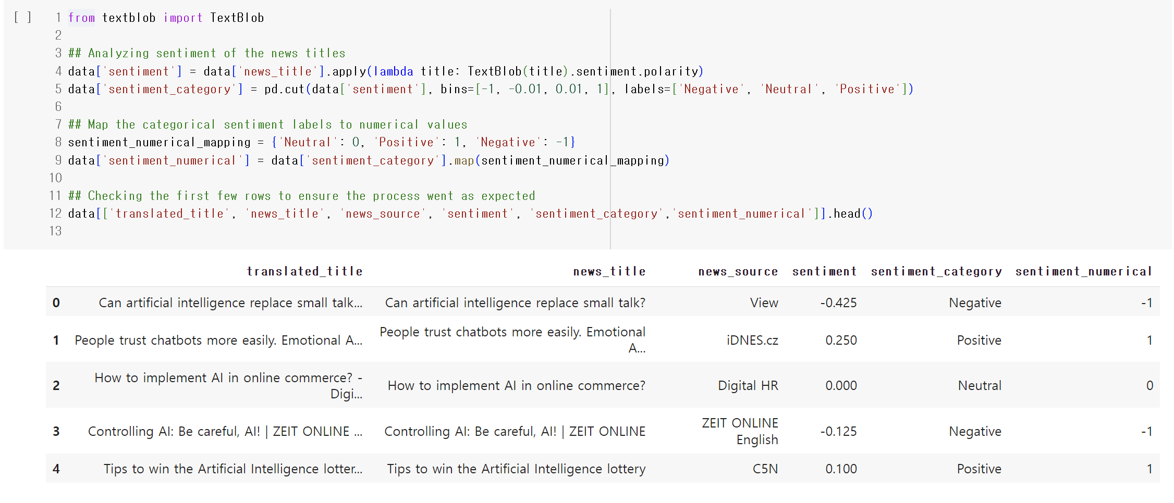
Part 3
Analysis & Interpretation
1) Sentiment Analysis using ‘Textblob’
We categorize original data’s ‘translated_title]’into 'news title' and 'news source’, to analyze news title.
Utilizing the 'textblob' library, we analyze the sentiment of the news title and categorize it into 'Negative,' 'Neutral,' and 'Positive.’
Based on the sentiment category, we assigned a sentiment numerical value of -1 for 'negative,' 0 for 'neutral,' and 1 for 'positive.

Slide 14
Part 3
Analysis & Interpretation
1) Analyzing Average Sentiment Score by Month
We aimed to examine clear emotional differences in news titles on a monthly basis. Each month's average sentiment for news titles, characterized by -1 for Negative, 0 for Neutral, and 1 for Positive, is presented alongside.
- May 2023: The sentiment is slightly positive, almost neutral.
- June 2023: The sentiment turned slightly negative.
- July 2023: July experienced a more pronounced negative sentiment compared to June.
- August 2023: The sentiment in August shifted back towards positive, though still close to neutral.
- September 2023: September witnessed a positive sentiment, marking an improvement from August.
- October 2023: October displayed a significantly positive sentiment, the most substantial within this period.
- November 2023: The sentiment in November remained positive but was less pronounced than in October.
Date | Average Sentiment
2023-05-31 | 0.001818
2023-06-30 | -0.031891
2023-07-31 | -0.050667
2023-08-31 | 0.008172
2023-09-30 | 0.020343
2023-10-31 | 0.085420
2023-11-30 | 0.055221

Slide 15
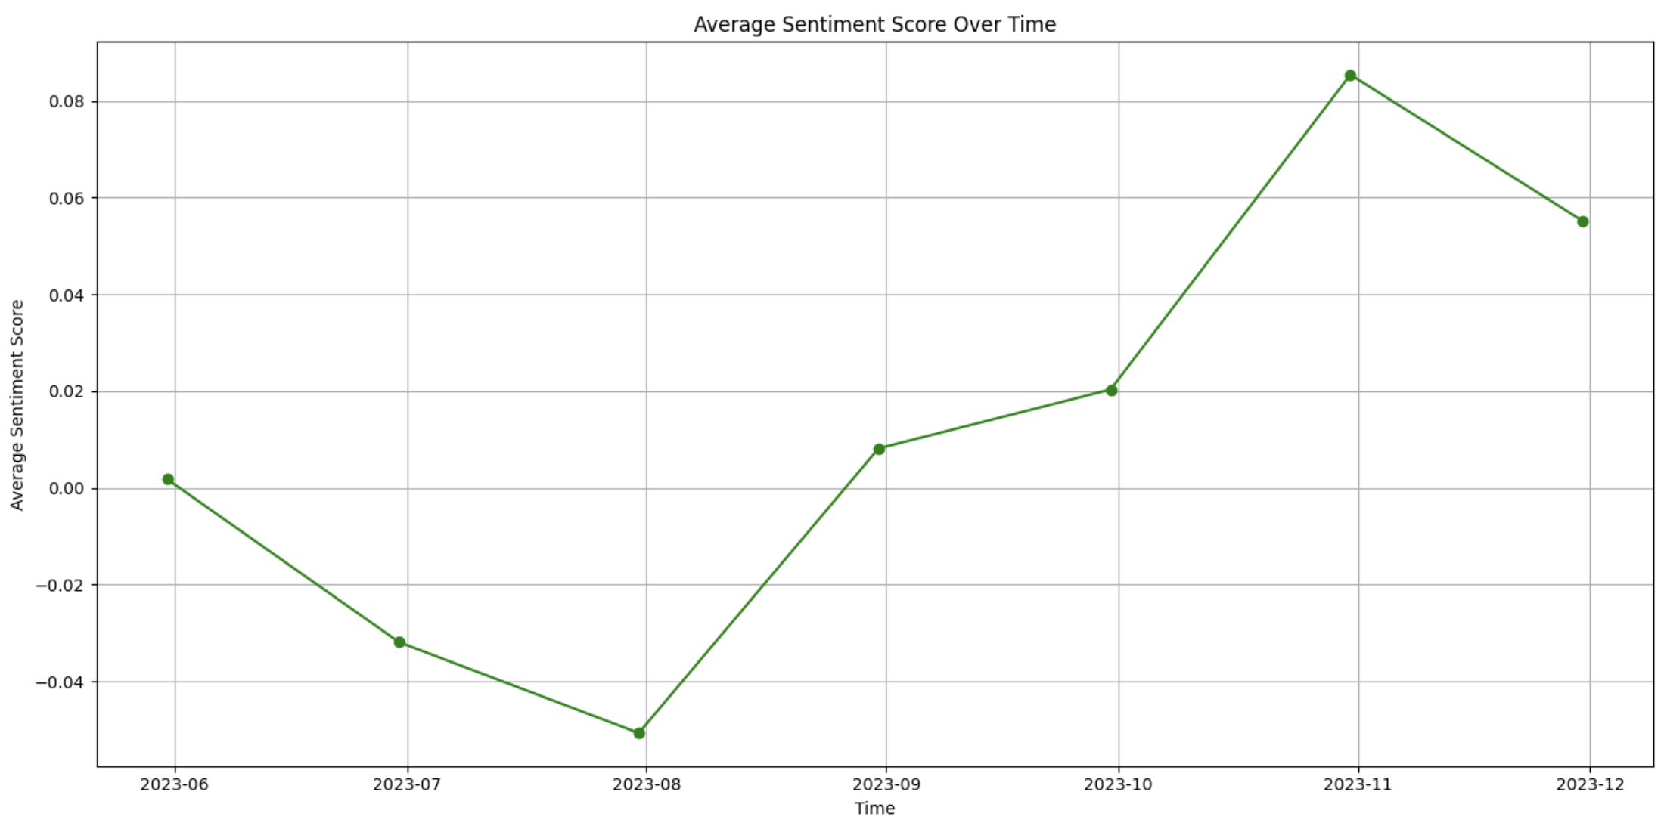
Part 3
Analysis & Interpretation
1) Analyzing Average Sentiment Score by Month
Overall, this sentiment analysis reveals a trend. Initially, media reporting about AI started with a generally neutral to slightly positive tone.
Mid-year, there was a dip towards a more negative sentiment, which then improved over time.
This pattern informs us that, while the media's portrayal of AI has been largely neutral, there is a gradual shift towards a more positive portrayal as time progresses.

Slide 16
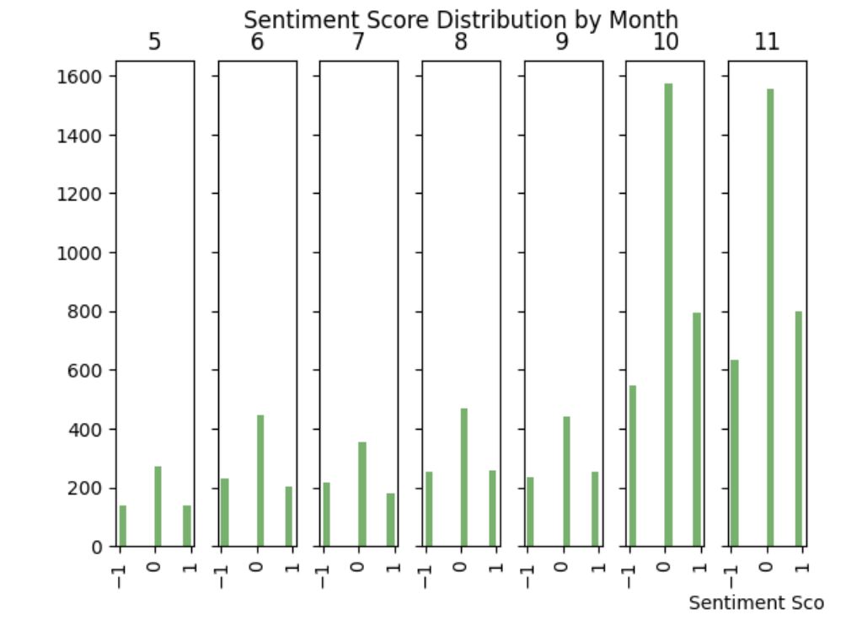
Part 3
Analysis & Interpretation
1) Analyzing Average Sentiment Score by Month
As shown in the sentiment score distribution, the most dominant sentiment for all months is neutral. This is consistent with the analysis of average sentiment scores, which showed an increasing number of positive news titles as we moved into October and November.
Thus, through sentiment analysis,
we have concluded that:
1. The overall impression of AI-related news titles is predominantly neutral.
2. Over time, the general trend in AI-related news titles is shifting towards a more positive tone.
To analyze the news titles in greater detail and to understand the nuances of public sentiment towards AI, we have begun emotion analysis.

Slide 17
Part 3
Analysis & Interpretation
Emotion Analysis
Figuring out the news title in dept level of Emotion;
Bart-large-mnli with Zero shot classification and Text Blob
Emotion-English-distilRoBERTa

Slide 18
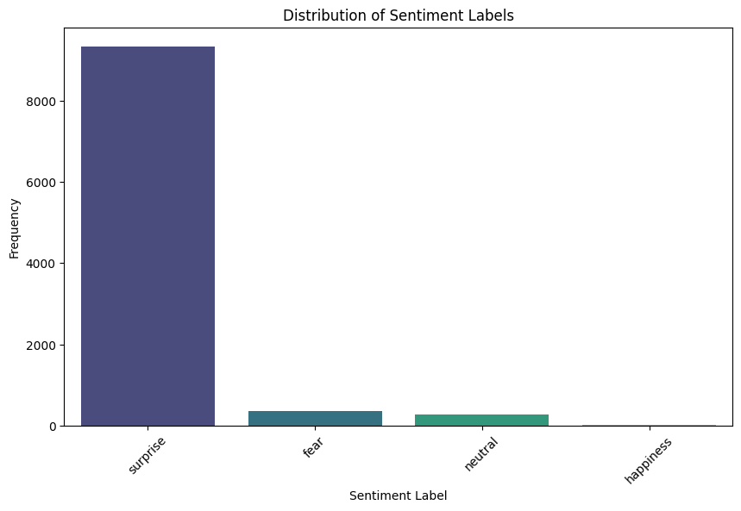
Part 3
Analysis & Interpretation
1) Bart-large-mnli with Zero shot classification & Text Blob
We applied the Zero-shot classification to Bart-large-mnli model to determine the emotions in the headlines. The classification labels were set as Surprise, Fear, Neutral, and Happiness.
The results revealed that Surprise is predominant emotion of the headlines among four emotions. Following that, Fear and Neutral appeared in a similar frequency, ranked as the second and third most common categories, respectively.

Slide 19
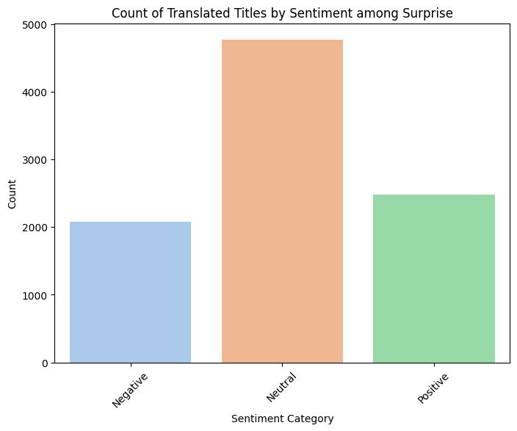
Part 3
Analysis & Interpretation
1) Bart-large-mnli with Zero shot classification & Text Blob
To further analyze the titles previously classified as expressing 'Surprise,' we isolated these specific titles and conducted a sentiment analysis to determine whether they were Negative, Neutral, or Positive.
As the figure indicates, 'Neutral' is the most common sentiment associated with 'Surprise.' The counts for Negative and Positive titles are similar, with Positive titles being slightly more numerous.
Based on these results, we concluded that the Bart-large-mnli model indicates that the number of titles with Negative emotions overall is comparatively low.

Slide 20
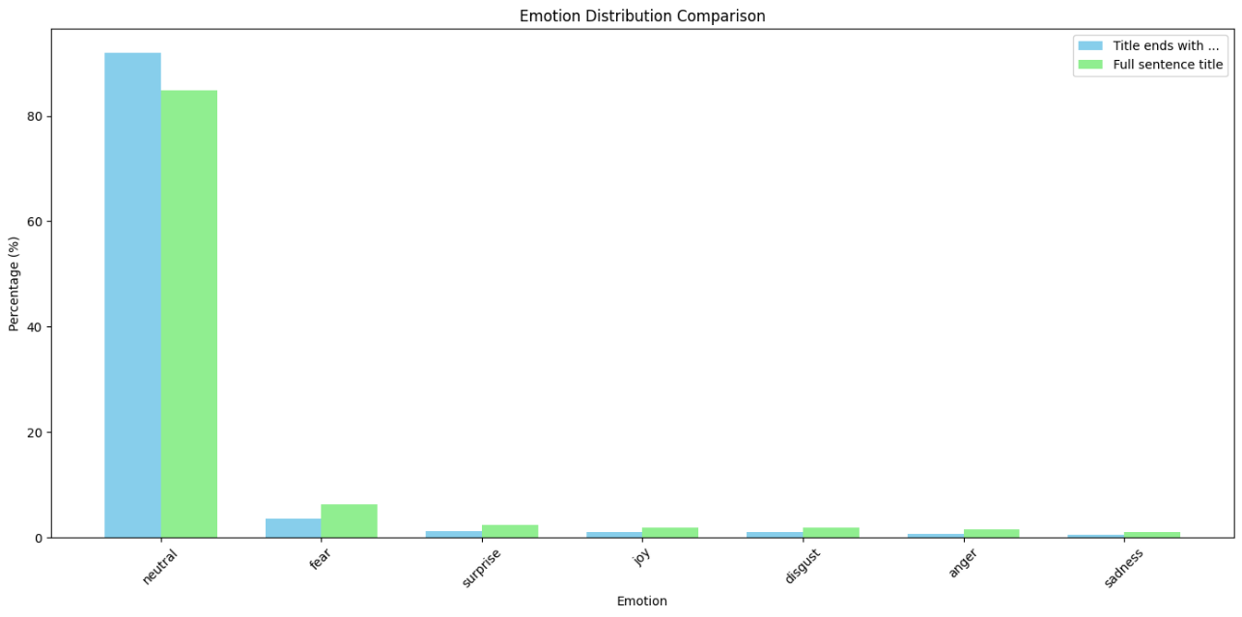
Part 3
Analysis & Interpretation
2) Emotion-English-DistilRoBERTa-base Model
Type | Title Example
Full sentence title | Can artificial intelligence replace small talk?
Title that ends with ‘…’ | Emotional AI will also help doctors...
We compared incomplete titles, those ending with '...', to those with complete sentences to ascertain if the lack of completion affected the model's output.
The analysis revealed a trend where titles not ending in a full sentence were more often categorized as neutral. Consequently, we decided to conduct further analysis using the 7309 headlines where the entire sentence was provided.

Slide 21
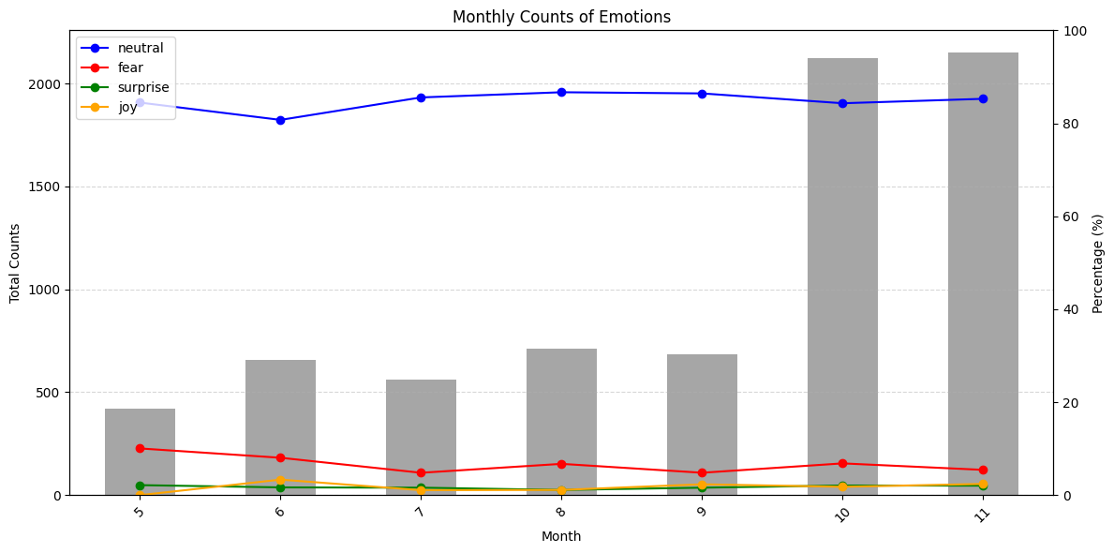
Part 3
Analysis & Interpretation
2) Emotion-English-DistilRoBERTa-base Model
This figure shows the proportion of the four emotions (Neutral, Fear, Surprise, Joy) and the number of new media grouped by month.
Neutral accounts for more than 80% in every month. The red line which indicates fear, decreases from May to July, followed by small fluctuations. In October, when there was a sharp increase in the number of news media, fear only showed a slight increase. Throughout the entire period, Surprise and Joy maintained percentages close to zero.
From this, we conclude that news media titles are predominantly neutral and that the variations in fear, surprise, and joy have not been significantly influenced by the changes in news media numbers.

Slide 22
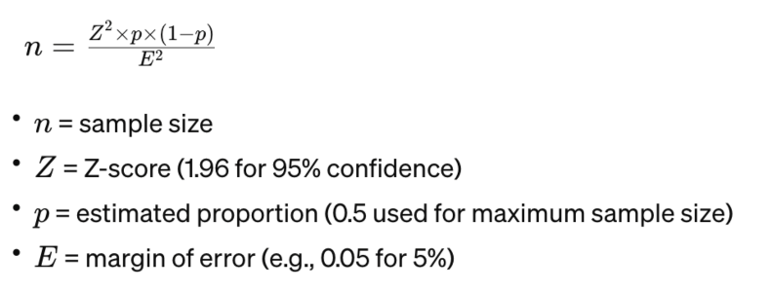
Part 3
Analysis & Interpretation
3) Emotion-English-DistilRoBERTa-base Model (w/ Human Scoring)
A sample of 385 headlines was chosen based on the Central Limit Theorem to represent the original dataset.
Tokenizer max length: 512 (max length of 10,000 headlines is significantly smaller than 512)
Hyperparameter: learning rates(2e-5, 3e-5, 5e-5), number of epoch = 8, batch size = 8
For this analysis, we chose to include headlines ending with '...' as we intended to apply our selected fine-tuned model to the original dataset of 10,000 headlines.
* Inherent assumption
We conducted Model Training with human scoring based on our assumption that:
1) The perception of AI can evoke varied emotions across people depending on personal background, and
2) The base model, already fine-tuned, is generally known to yield favorable results. Yet, it's also prone to discrepancies, such as interpreting an emotion as positive when a human might perceive it as fear.

Slide 23
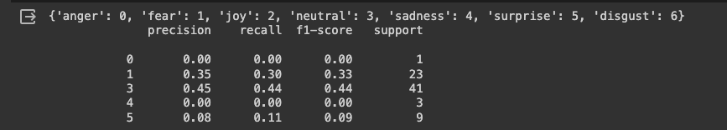
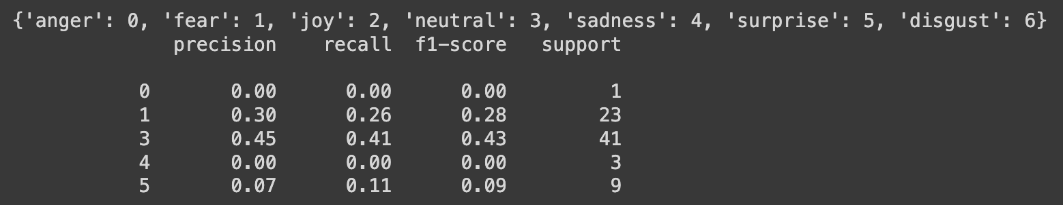
Part 3
Analysis & Interpretation
3) Emotion-English-DistilRoBERTa-base Model (w/ Human Scoring)
We aimed at enhancing emotion analysis from the previous model using a rigorous hyperparameter.
Achieving high accuracy, F1 scores, precision, and recall proved challenging due to the imbalanced emotion of the dataset in the first place.
After tuning the hyperparameters, we opted for a model with a learning rate of ‘5e-5'. Although the performance metrics were similar across different parameters, the model with a learning rate of ‘5e-5' demonstrated a lower validation loss compared to the others.
Metrics results (learning rate: 2e-5, epoch = 8, batch size=8)
* notes
This outcome was not entirely unexpected.
We tried two different sets of human scoring from two individuals.
However, given the overlapping nature of emotions such as anger, fear, sadness, and disgust, it was quite hard to give emotion scores even for our team due to their subtle differences.
Metrics results (learning rate: 5e-5, epoch = 8, batch size=8)

Slide 24
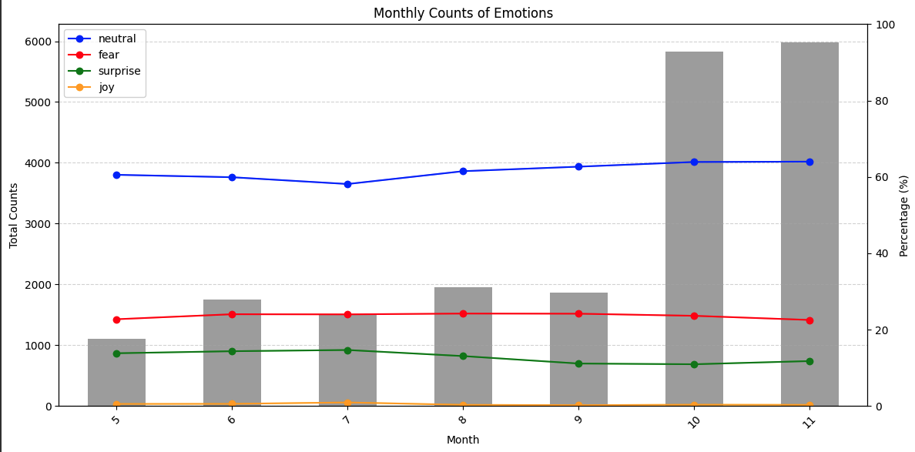
Part 3
Analysis & Interpretation
3) Emotion-English-DistilRoBERTa-base Model (w/ Human Scoring)
When focusing solely on the most frequently occurring emotions—neutral, fear, and surprise, we can see that majority of the articles are neutral toned, fear is 20~25%, and surprise is 15~20%

Slide 25
Part 4
CONCLUSION

Slide 26

Part 4
Conclusion - Key Takeaways
<Key Takeaways and our Final Thoughts>
From the model we used, we have found that, The sentiment of 'neutral' predominates, accounting for 60-65% of the emotions, Using the fine-tuned 'emotion-English-distilroberta-base' model, the proportion of fear detected was under 10%. But after tuning the hyperparameters, it went up to about 20%. This suggests that the way humans and machines understand fear in the development of AI is different. To the question 'Is the media spreading fear of AI?', the answer seems to be ‘not quite'. We see that as the number of articles grows in October and November, the emotion of fear decreases or remains the same. While this analysis gives us good insights on news media’s impact to the public, to get a more complete picture, we should also look at social media, YouTube, podcasts, and other forms of media, since they also shape public perception. Broader analysis across these platforms would provide a more accurate reflection of sentiment towards AI.
Media's Portrayal of AI
Given the fact that headlines are generally neutral, focusing on AI advancements, but possibly leading to a more positive public perception, it is important for media to also address the challenges associated with AI, including ethical concerns, potential job displacement, and privacy issues.
Therefore, our recommendation for media is to continue providing a balanced narrative that includes the benefits and challenges of AI to ensure a comprehensive public understanding.

