Slide 1

City of Minneapolis Police Use of Force
Project 2 Group 8
Frank Duffy, Guy Nasser Bssoume, John Russell and Jenna Murphy

Slide 2
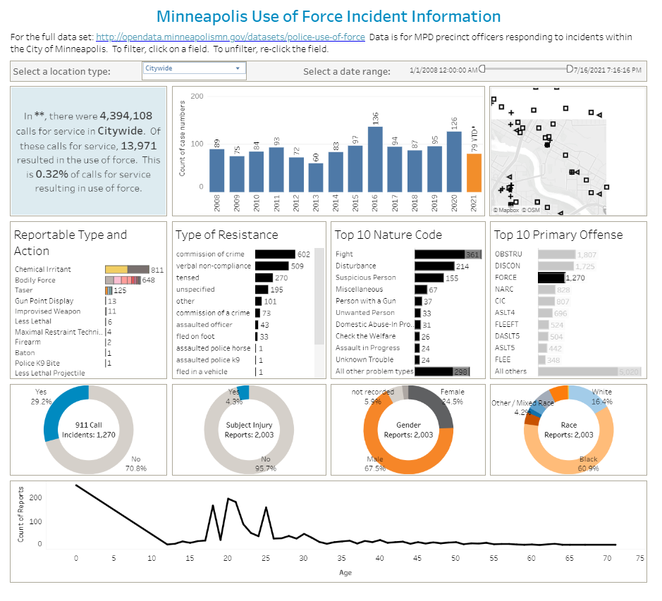
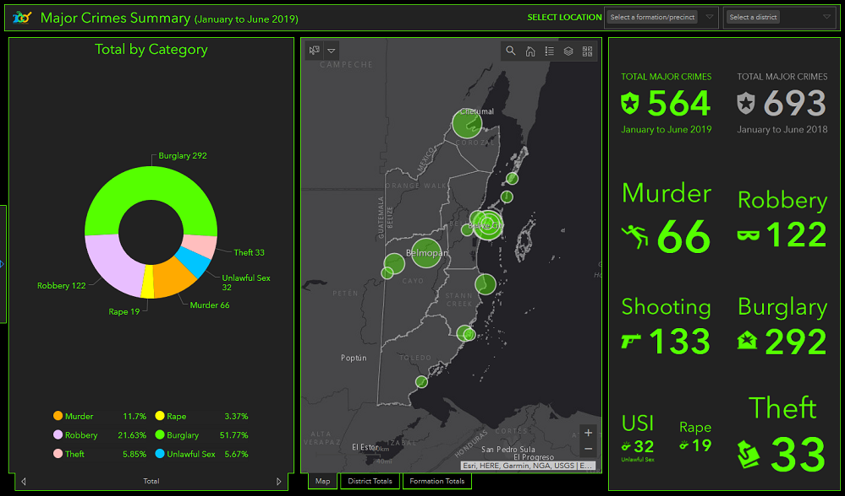
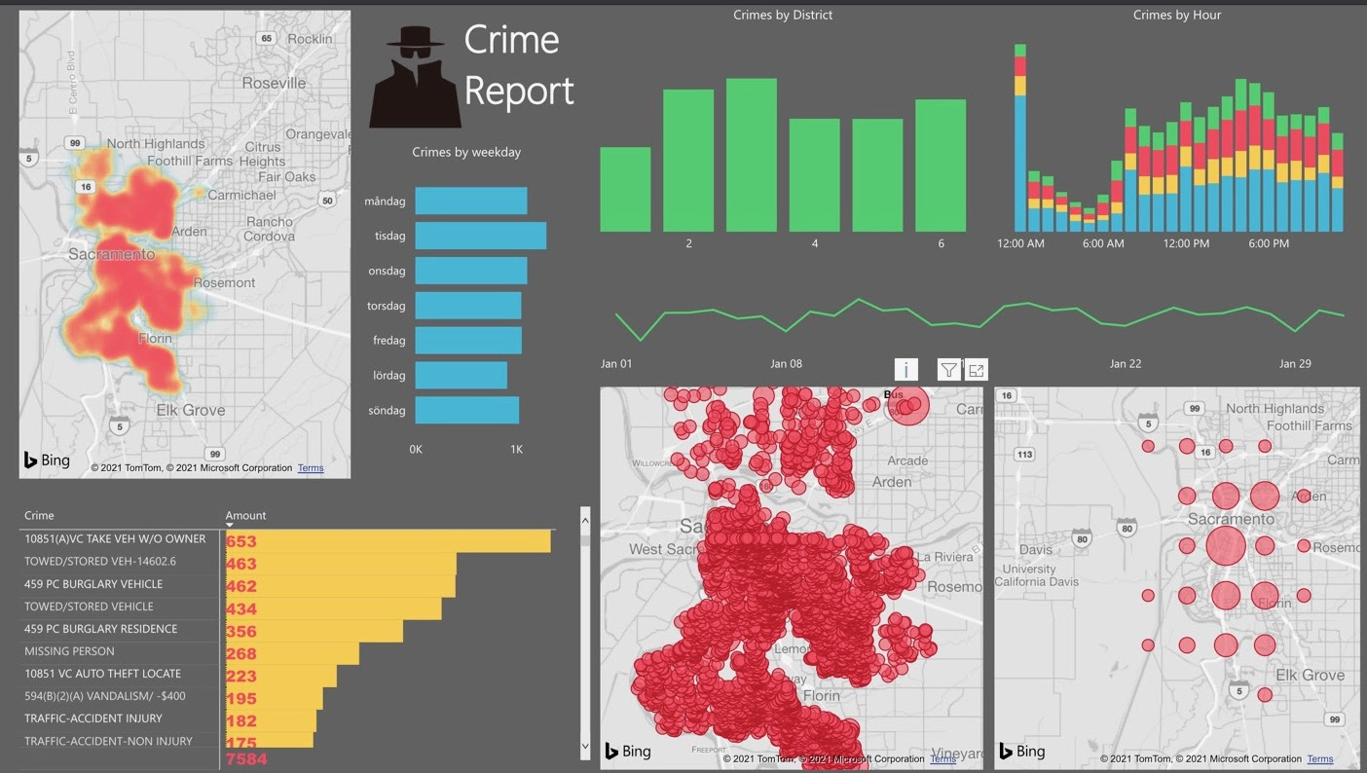
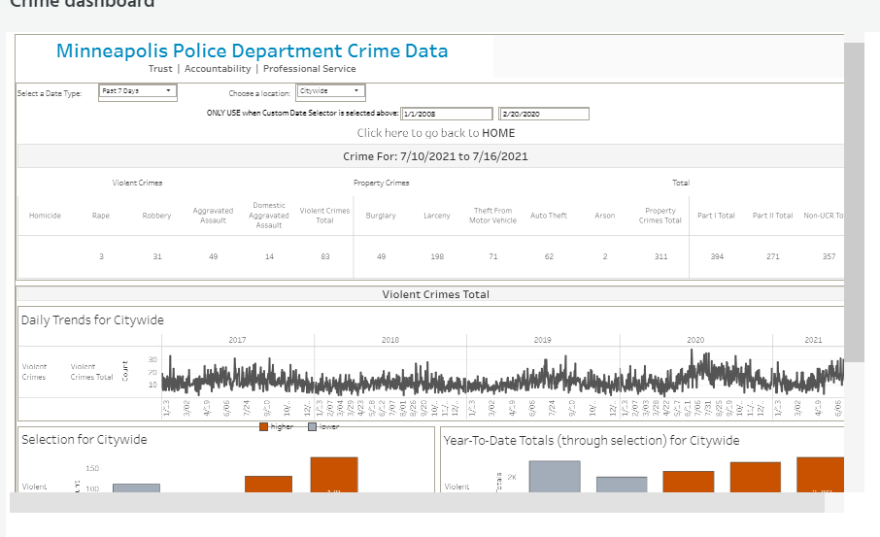
Project Motivation
Dashboard Interaction
Focus on Local Minneapolis Issues
Data Source: Open Data Minneapolis,
Link: https://opendata.minneapolismn.gov/datasets/police-use-of-force/
API: https://opendata.arcgis.com/datasets/6d8110617c4b4971a270ff0834971b89_0.geojson

Slide 3
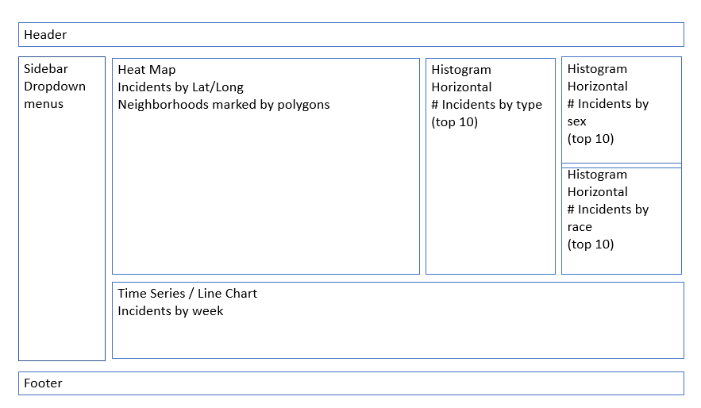
Project Requirements
REQUIREMENTS | MET (?)
Your visualization must include a Python Flask–powered API, HTML/CSS, JavaScript, and at least one database (SQL, MongoDB, SQLite, etc.). | SQlite
Your project should fall into one of the below four tracks: ○ A custom “creative” D3.js project (i.e., a nonstandard graph or chart) ○ A combination of web scraping and Leaflet or Plotly ○ A dashboard page with multiple charts that update from the same data ○ A “thick” server that performs multiple manipulations on data in a database prior to visualization (must be approved) | Yes: A dashboard page with multiple charts that update from the same data
Your project should include at least one JS library that we did not cover. | Chart.js
Your project must be powered by a data set with at least 100 records | 30K+ Records
Your project must include some level of user-driven interaction (e.g., menus, dropdowns, textboxes) | Dropdown Menu
Your final visualization should ideally include at least three views. | Three Charts: Vertical Bar Chart, Horizontal Bar Chart, and Doughnut Chart

Slide 4
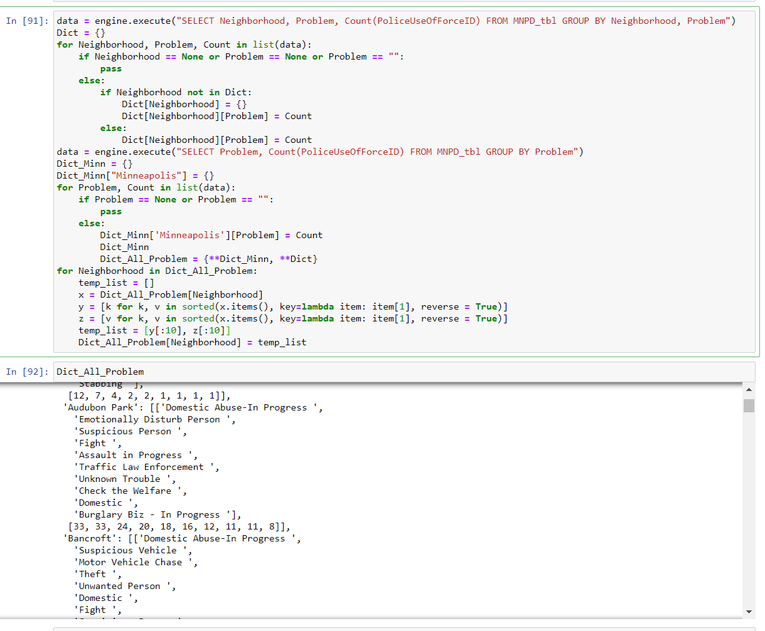
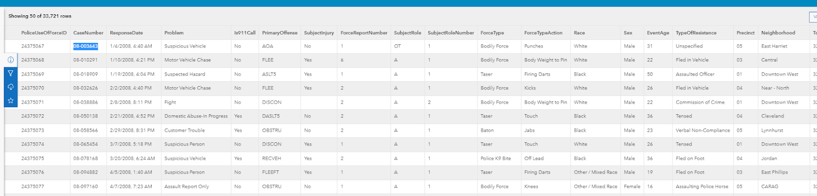
Data Cleaning
Filtered/cleaned geoJSON from source API – parsed data format [Python, Pandas, Jupyter Notebook => get_data.py)
SQLAlchemy query for each chart – then adapted for specific chart – (see left) => SQL, Python
Left very little data manipulation in JavaScript!!!

Slide 5
Difficulties
Web API (geoJSON)
Over complicated
Connecting and Setting up the Database
Accessing the data through JavaScript
Solution: jsonify() data pushed to data route so we can call from JavaScript file
Understanding Chart.js
.destroy()
Had to put all data references inside .then(function)
Wrangled Data (Python)
Create SQLite DB (Python)
Flask => index.html
SQLAlchemy => Python
jsonify => /data
D3.json(../data)
JavaScript / Chart.js

Slide 6

If we had more time…
Overlay data on map of Minneapolis e.g. choropleth
Filter by Date range
Create additional charts for analyzing use of force in regard to Gender and Race.

Slide 7
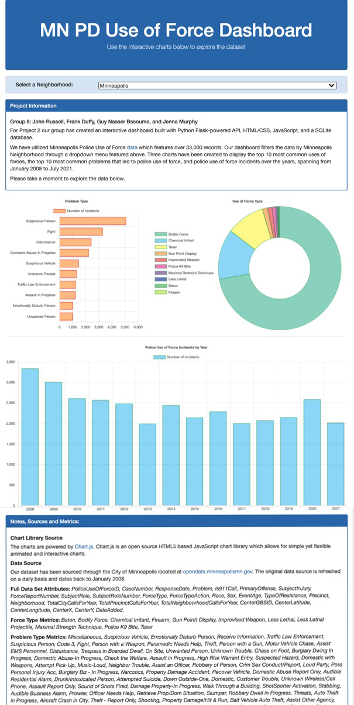
Demo Time!

