Slide 1

City of Minneapolis Police Use of Force
Project 2 Group 8
Frank Duffy, Guy Nasser Bssoume, John Russell and Jenna Murphy

Slide 2
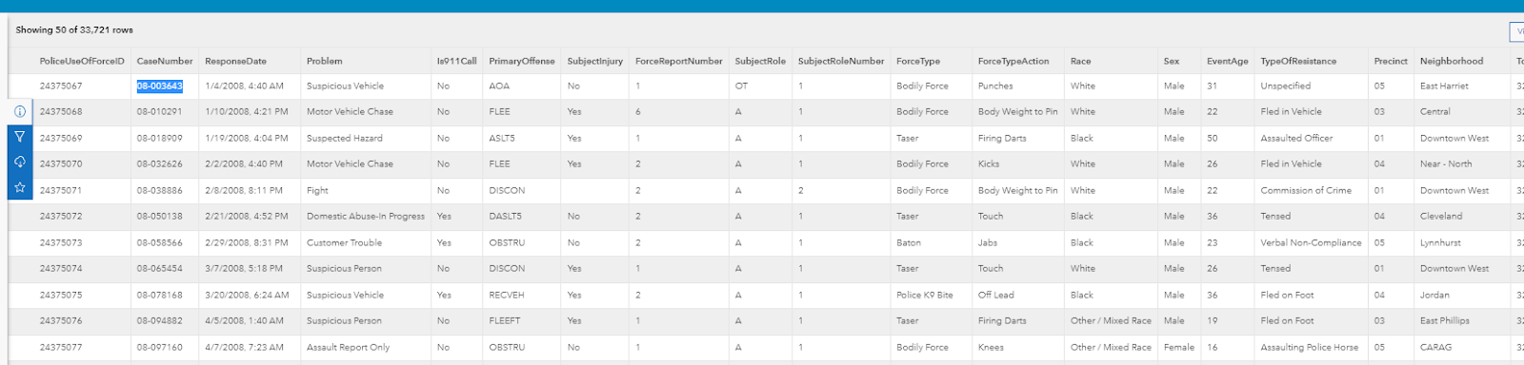
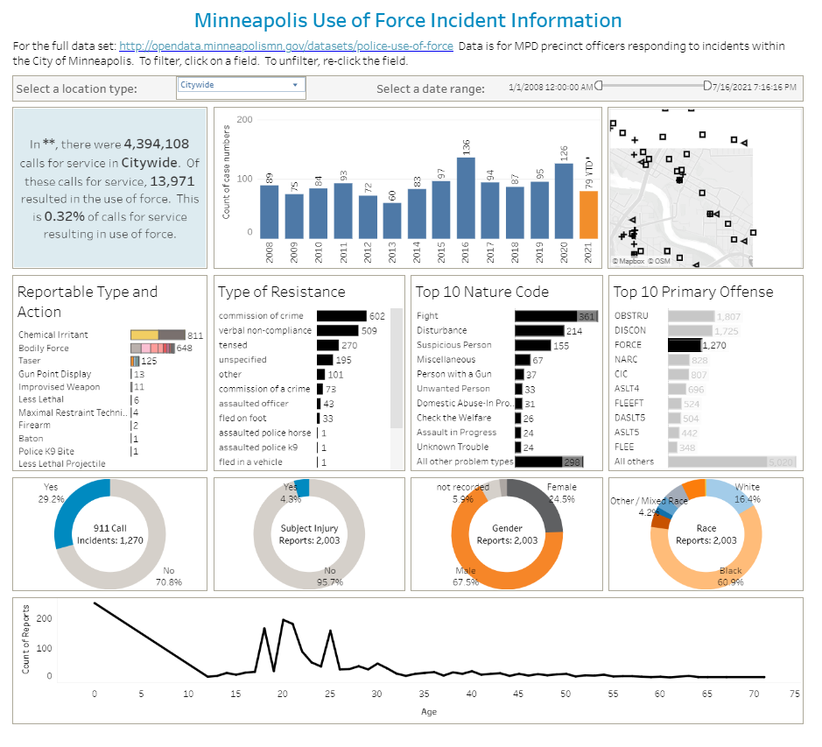
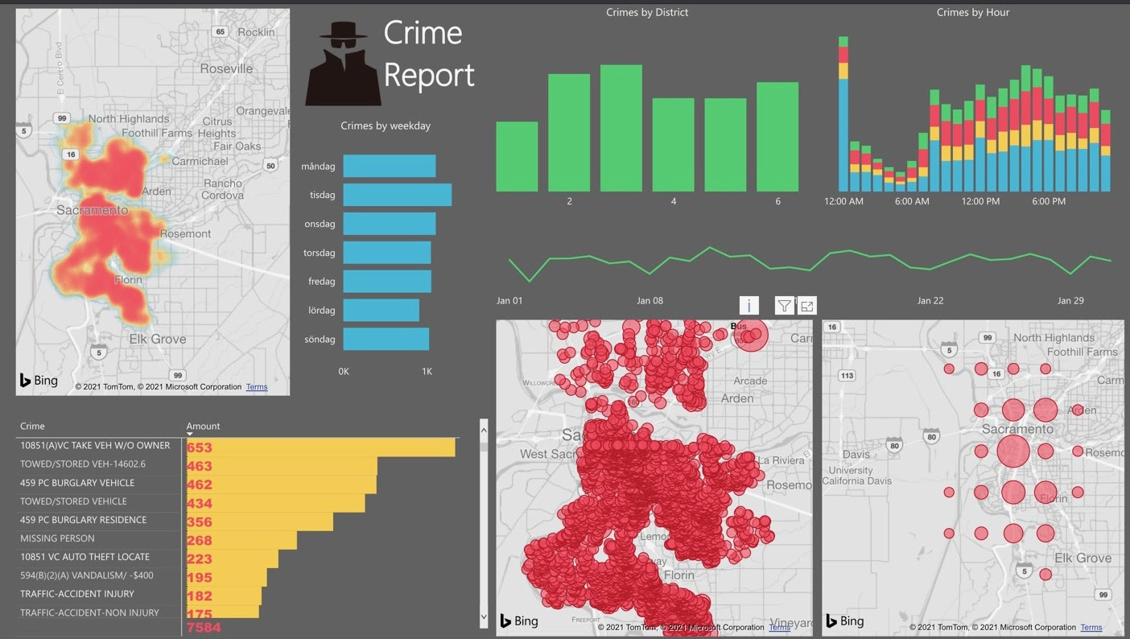
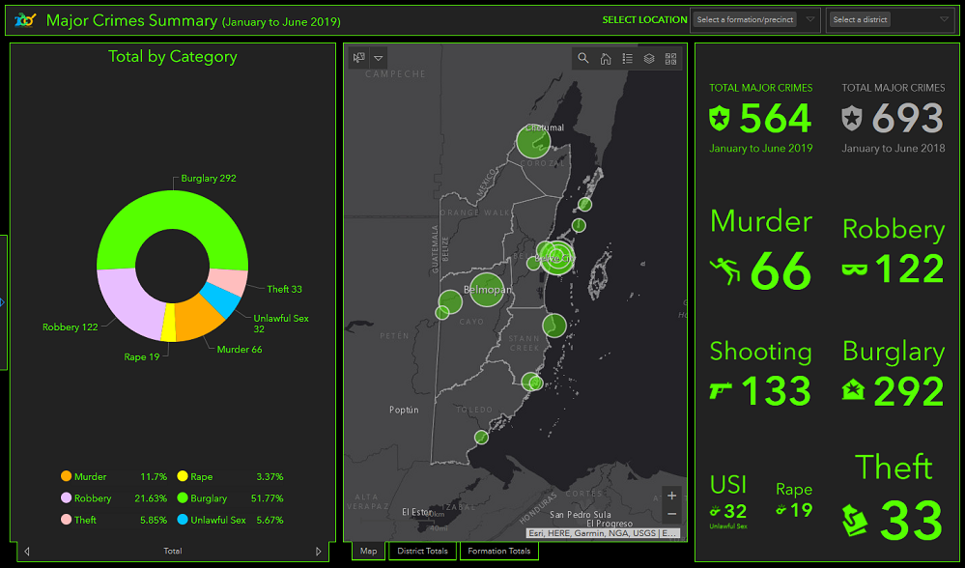
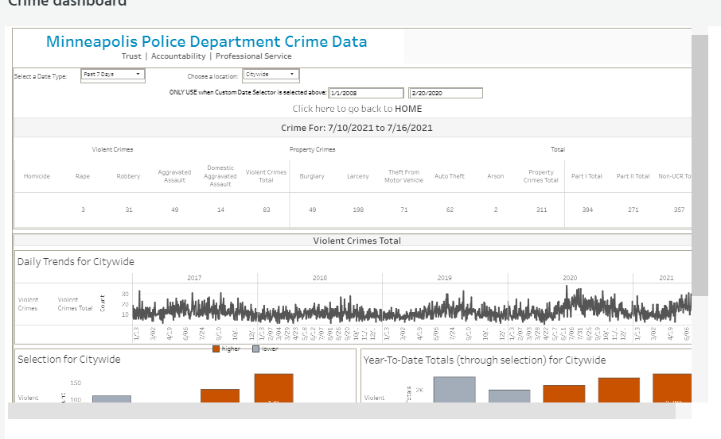
Project Motivation
Dashboard Interaction
Focus on Local Issues
Data Source: Open Data Minneapolis,
Link: https://opendata.minneapolismn.gov/datasets/police-use-of-force/
API: https://opendata.arcgis.com/datasets/6d8110617c4b4971a270ff0834971b89_0.geojson

Slide 3
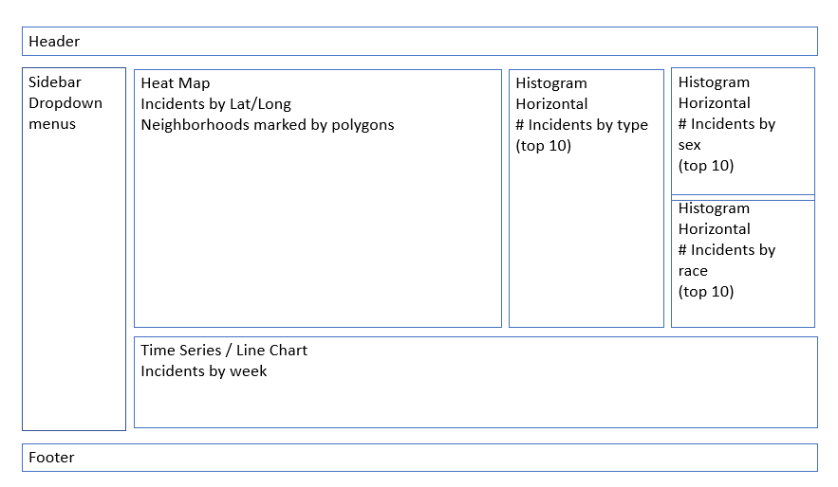

Design/Requirements
Bootstrap for responsive layout
Dashboard page with multiple charts
Filters (by Dropdown and Slider)
Filter on date range
Type of crime/use of force
Neighborhood/precinct
Sex and Race
Charts
Time Series (incident Count)
Heatmap (location of incidents)
Histograms (Type of incident, sex, race)
SQlite Database
Javascript Library: Chart.js
Data Source has 30K+ Records
5 Charts on Dashboard

Slide 4
Backend Setup

Slide 5
Flask App Set Up

Slide 6
Front End Setup

