Slide 1
Culture of Competition: Coke vs Pepsi
Data 400
Jenna and Malena

Slide 2
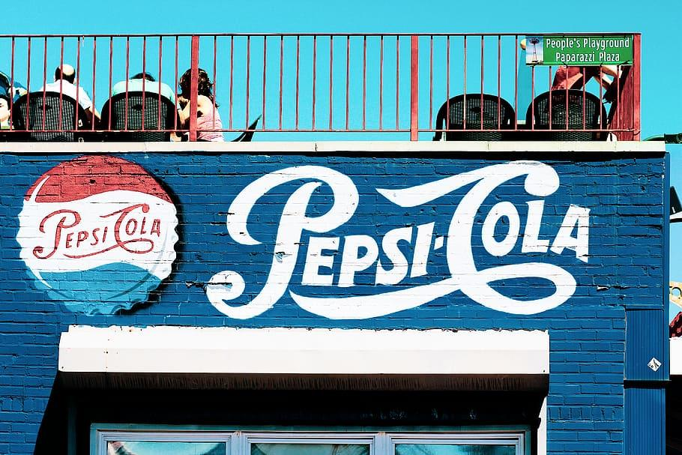
1
Tractable Data & Research Question

Slide 3
Coke vs Pepsi:
What effect do seasonal marketing campaigns (such as the Santa Campaign and sponsoring the SuperBowl) have on sales, stocks and consumer engagement?
Pepsi
Pepsi sponsored the SuperBowl halftime show until 2022, allowing them positive advertisement. Looking into the most recent ten years (2012-2022), how does this affect their sales and stocks.
Coca-Cola
Similarly, Coca-Cola has a well-known and established Christmas-themed and Santa Campaign annually. This increase in marketing during the months of November-January 1st could lead to an effect in sales and stocks.
Rivalry/Why?
How do these two compare? Who is more successful? Are there seasonal trends?
Testing to see if these months contribute to higher sales and stock prices?

Slide 4
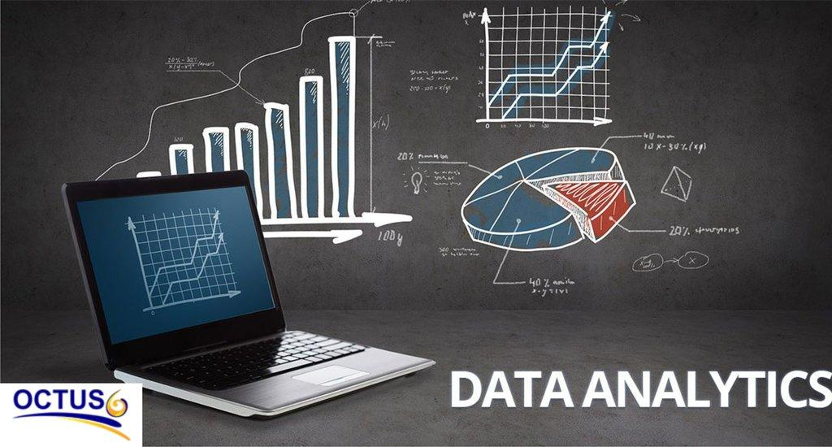
2
Data Retrieval

Slide 5
Analyzing the Rivalry
Google Searches
Stock Prices
Sales
Seeing how this marketing (in specified time frame) translates to an increase, decrease, or plateau in sales in both Coke and Pepsi.
Macrotrends with cross analysis with Coke’s website. Pepsi does not release this information online.
Looking into the difference in google searches can allow us some insight into how many people are interested in Coke or Pepsi.
Google Trends grants us data internationally from a range of dates and times.
We will be limiting it to Pepsi in February (when Super Bowl occurs 2012-2022); and Coke Nov-Jan 1st 2012-2022.
Looking into the difference of stock prices of Coke vs Pepsi.
Especially, an incline vs decline around these timeframes.
Sources: utilizing yahoo finance package for latest stock prices
These three data sources allows us to gain an understanding to how the marketing of Coca-Cola and Pepsi translates to positive growth for each company. Also, allowing us to see trends and more over time.

Slide 6

3
Models Used

Slide 7
Models
When analyzing trends, sales, and stock prices over time, there are many potential approaches.
Sales
Stocks
Google Trends
Time Series analysis with simple line plots as well as ML
Linear regression to see Q1 and Q4 relationship.
Seeing how Sales is affected during these time frames and seeing the comparison of the two companies.
Monthly log returns to analyze relative changes over time.
Examined how closely the two stocks moved together using a 6-month rolling correlation.
Seasonal event windows analysis, tested for significance of effect of campaigns
Frequency line plot with clean data.
Why not ML / Linear Regression?
Only needed the frequency of how often people are searching; we can see the rate of change and such with the steepness of the graph.

Slide 8
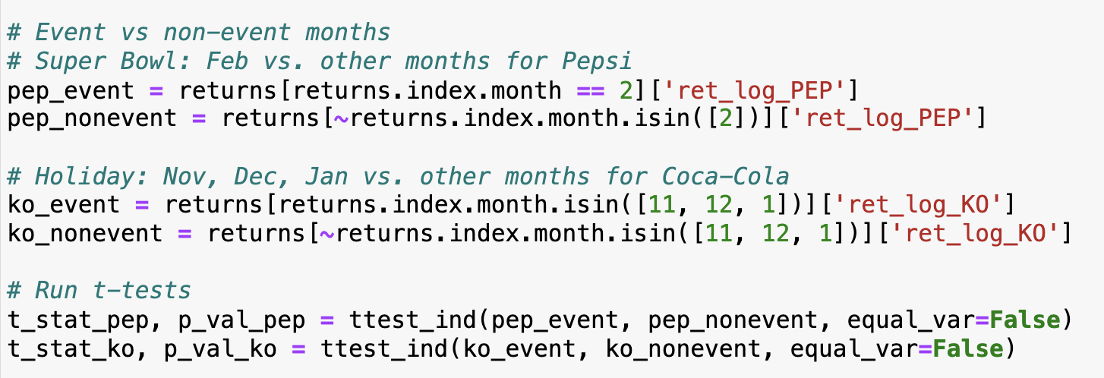
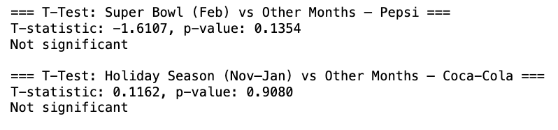

Slide 9
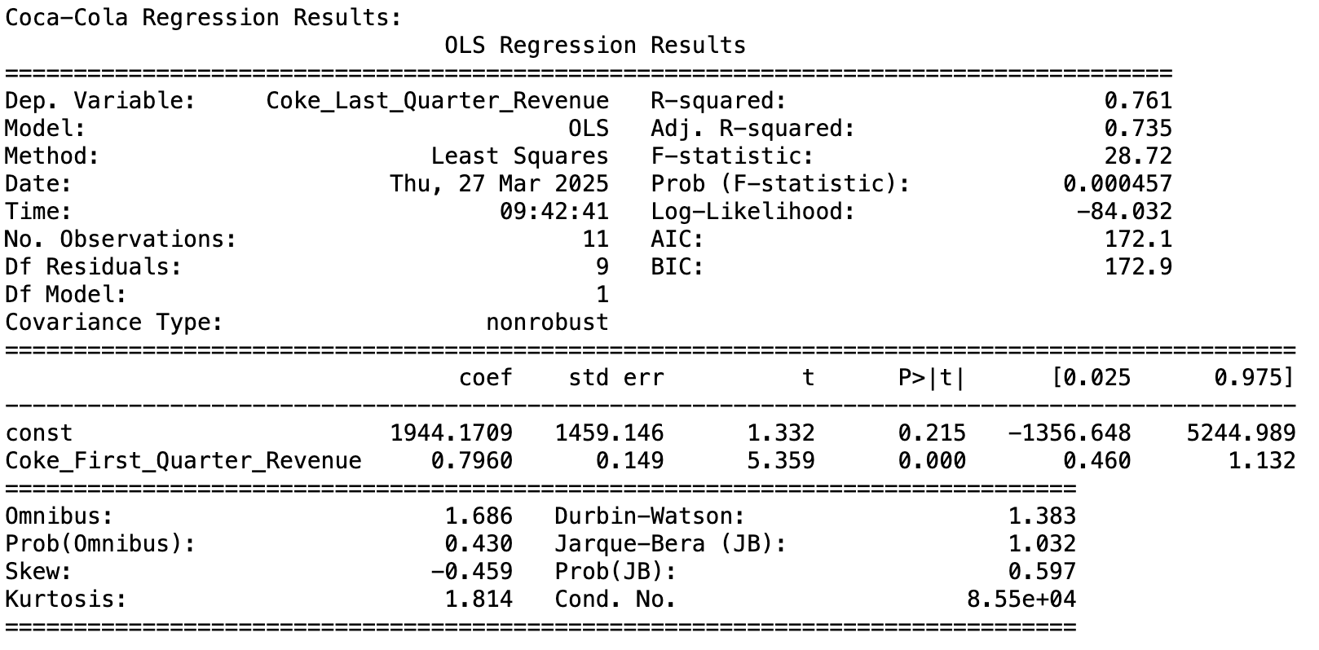
How well Q1 revenue predicts Q4.
-The strength of the linear relationship (via R-squared values) -The slope coefficients, showing how much Q4 revenue changes per unit increase in Q1 revenue -The statistical significance (p-values) of the relationships -The intercepts, which show expected Q4 revenue when Q1 is zero ( not always meaningful in business contexts)

Slide 10
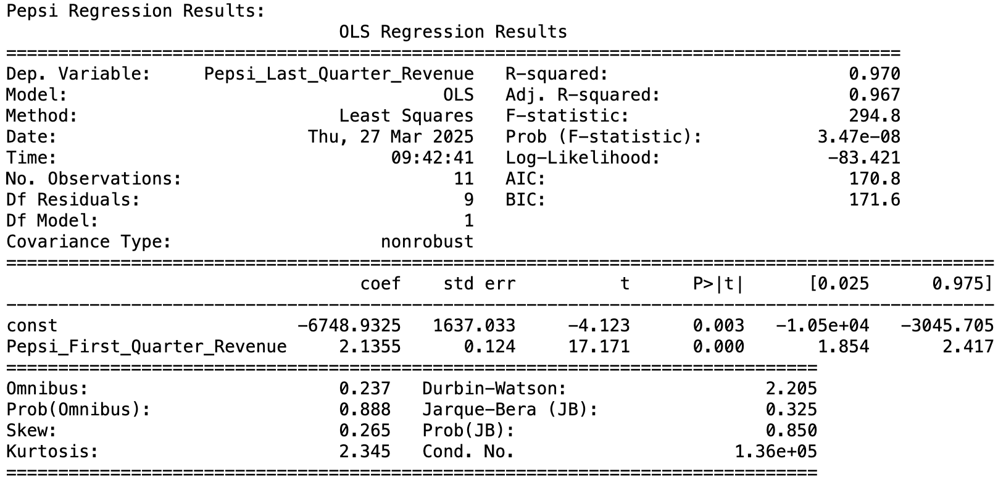
How well Q1 revenue predicts Q4.
-The strength of the linear relationship (via R-squared values) -The slope coefficients, showing how much Q4 revenue changes per unit increase in Q1 revenue -The statistical significance (p-values) of the relationships -The intercepts, which show expected Q4 revenue when Q1 is zero ( not always meaningful in business contexts)

Slide 11
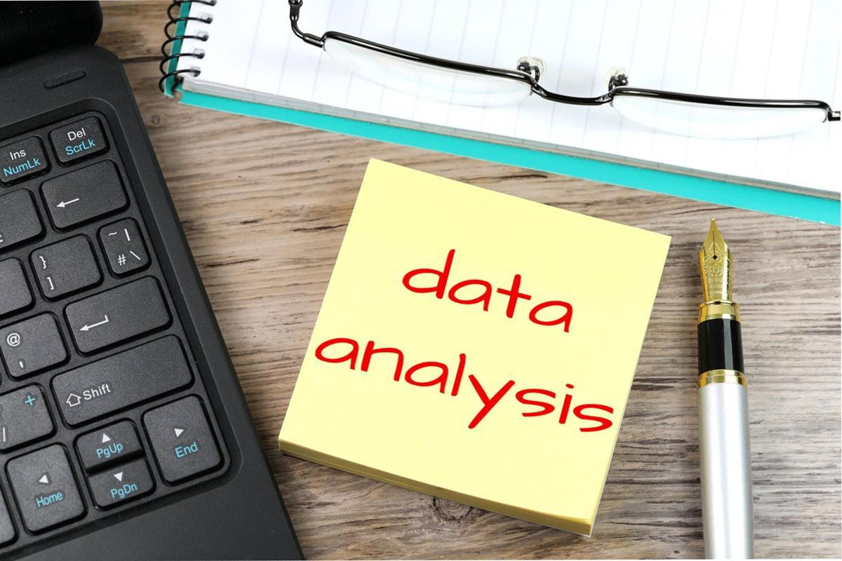
4
Results

Slide 12
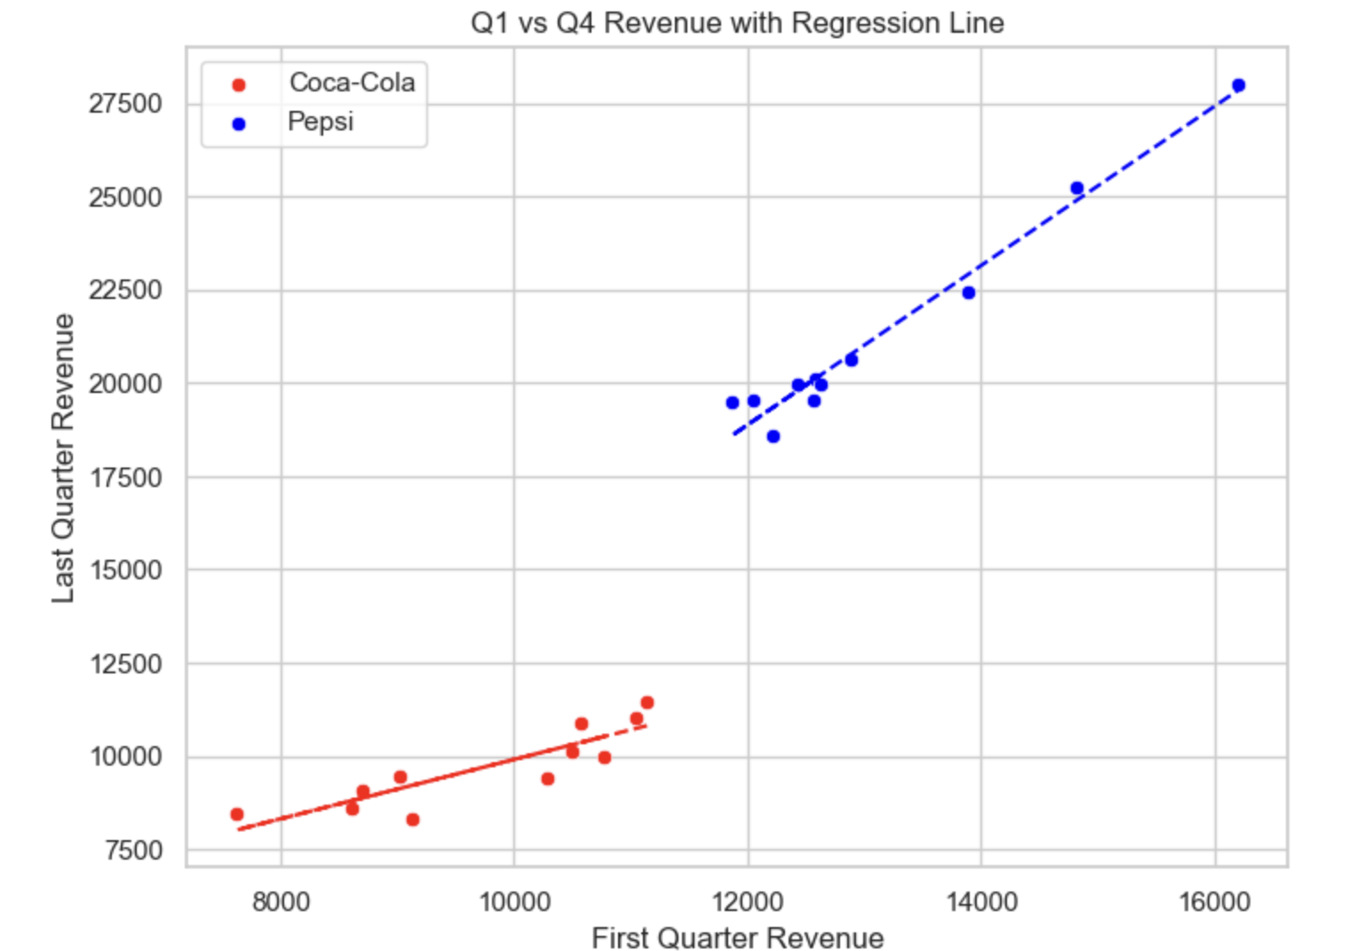

Slide 13
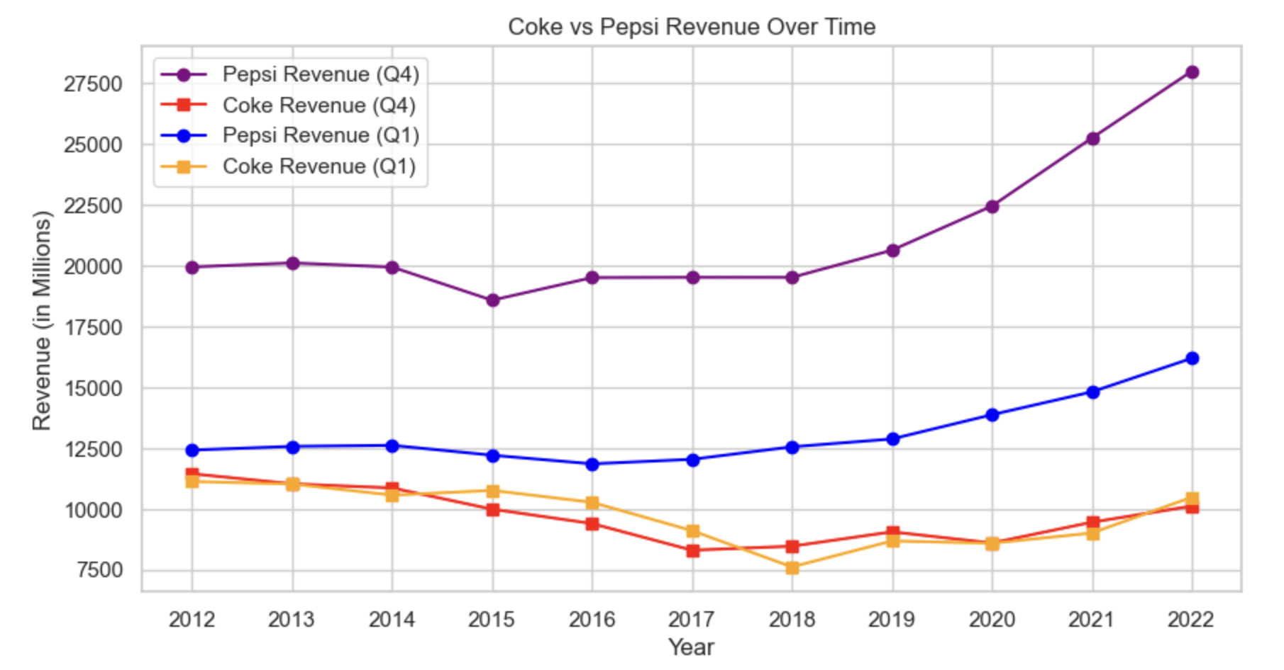

Slide 14
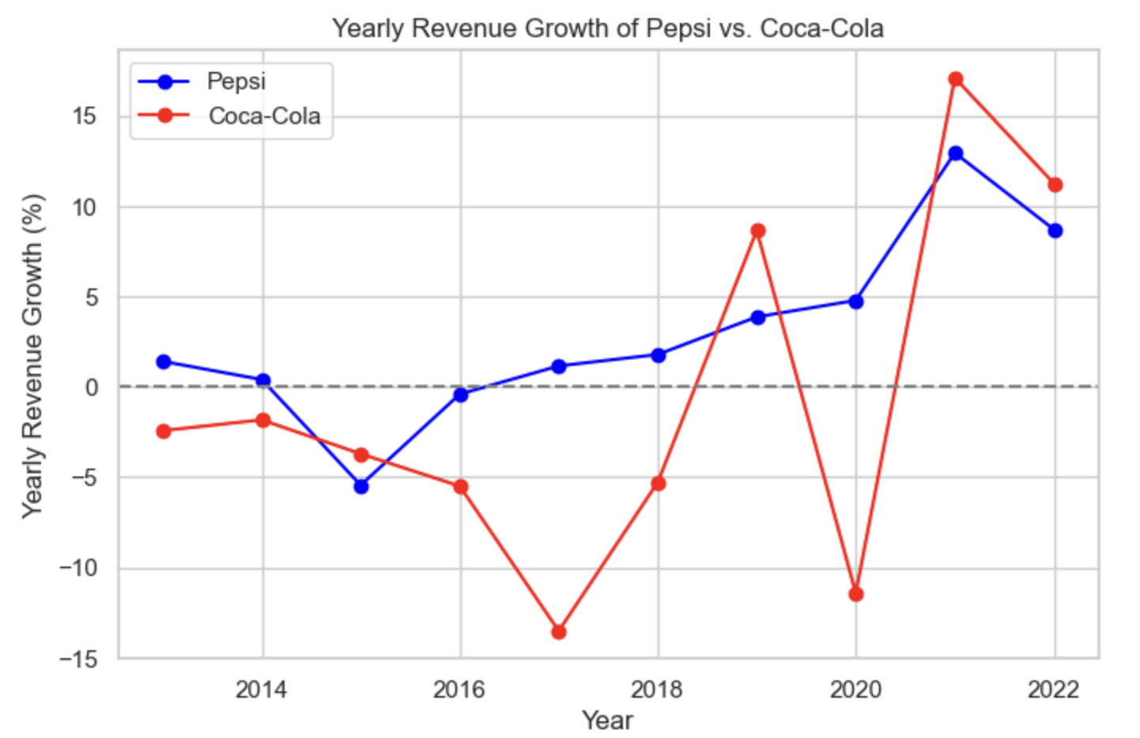

Slide 15
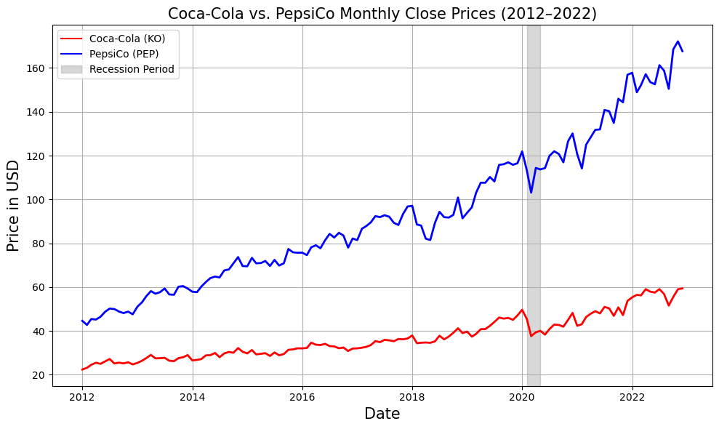

Slide 16
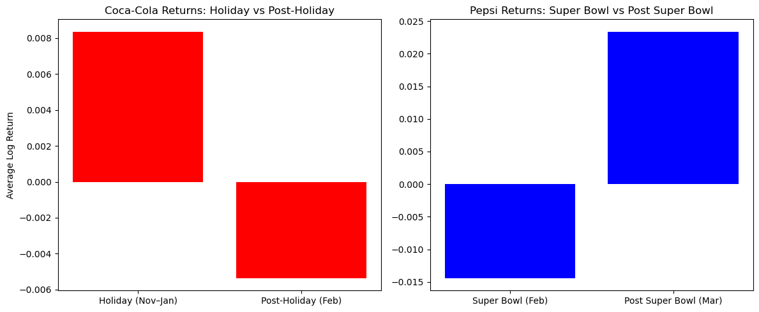
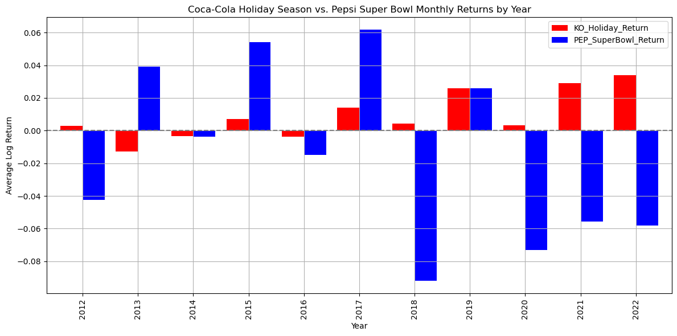

Slide 17
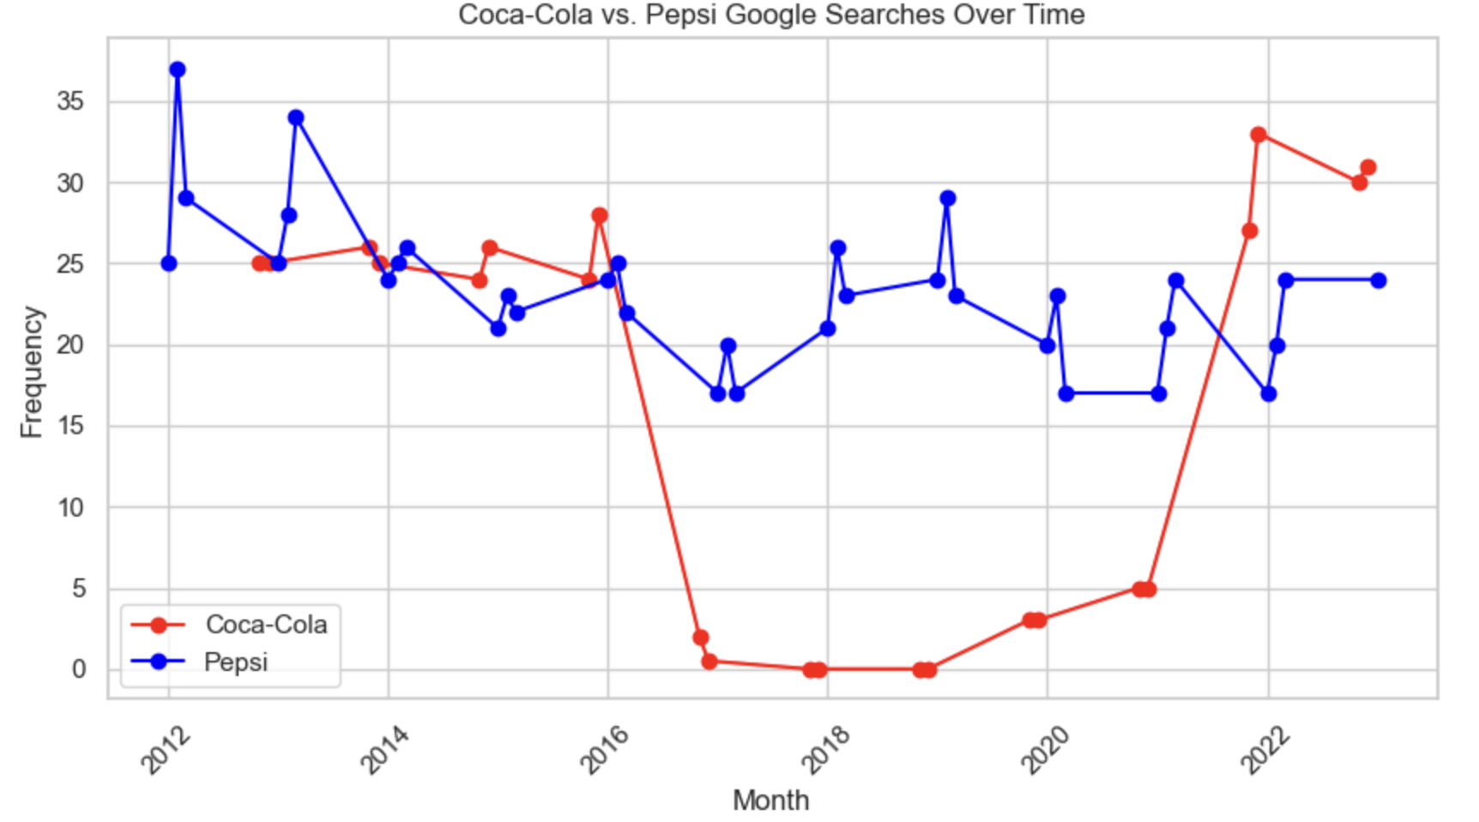

Slide 18
Takeaways
Stocks
Takeaways
Takeaway
Sales
Google
There was no direct translation that these events lead to an increase in revenue.
Pepsi makes far more revenue than Coca-Cola.
Lay’s Chips, Cheeto’s, Gatorade, etc.
While Coke stays in the beverage world.
Pepsi had the highest consumer engagement the first two years of they sponsored the Super Bowl Halftime show.
Coca-Cola had much fewer searches due to the strictness of the counting as a search. “Coca-Cola” vs “Coke” etc.
PepsiCo maintained a higher stock price, while Coca-Cola showed slower but stable growth.
Coca-Cola gained during the holidays, while PepsiCo saw returns post–Super Bowl, showing different seasonal impacts.

Slide 19

5
Implications to Stakeholders

Slide 20
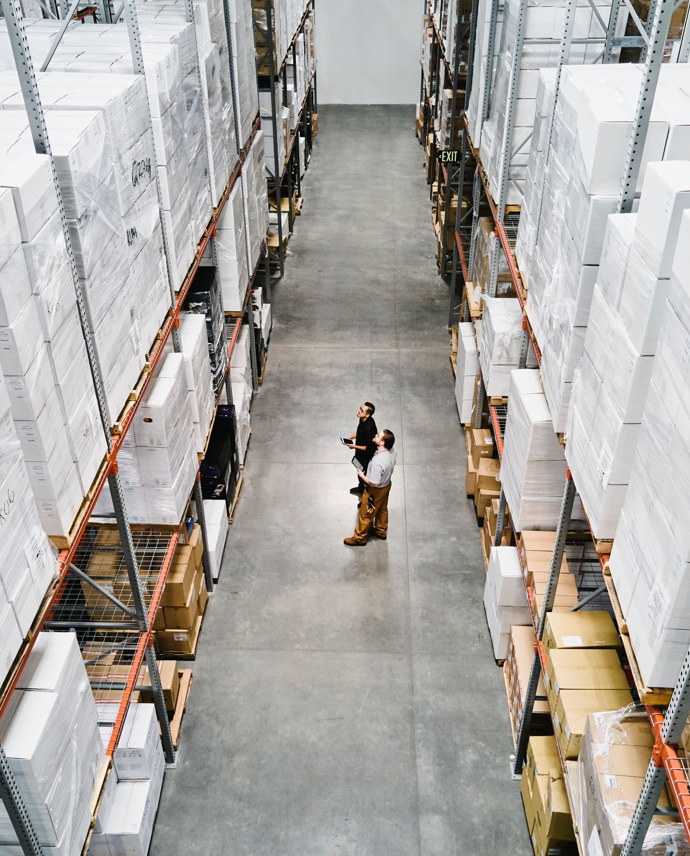
Stakeholders
Coca-Cola
Coca-Cola would like to learn how well their marketing campaigns are translating to sales - if it worth it? etc.
Pepsi
Pepsi could gain insights to see if they should bring back another major marketing opportunity like the Super Bowl. (Have not held the Super Bowl halftime show since 2022 once it was sold to Apple Music). Should they look into a similar situation or was it proven to not be worth their resources?
Everyday Consumers
American consumers have a keen interest in rivalries - Coke vs Pepsi, McDonald’s vs Burger King, Del Taco vs Taco Bell, etc. This is a fun and insightful way to learn how different companies benefit off certain marketing strategies.

Slide 21

6
Ethical, Legal, Societal Implications

Slide 22
Ethical
Societal
Legal
Societal
Ethical
Legal
Consumers should be aware of how marketing influences their perception and consumption of a product.
No major legal implications given that all the data is legal and readily available online.
Information is power!!!!
Granting the everyday American information about how their purchases have real effects on different companies.
Potential investors can use this knowledge to adapt new strategies when buying and selling Coca-Cola and PepsiCo stocks.

Slide 23

7
Next Steps

Slide 24
Sales
Stocks
Google
Stocks
Sales
Google
Beneficial to look into the breakdown of sales; exclude Pepsi’s revenue from Lay’s Chips, etc.
What are the numbers of the dark soda drink.
Seeing the effect of Pepsi once they stopped sponsoring the Halftime show.
The data was very strict, so seeing the difference of including “Coke”, etc.
Seeing how we could handle typos such as “Ckoe” - Google suggests “did you mean? —-” however, is this included if only if they click the blue font?
Maybe considering if the difference between campaign month(s) and other months was significant or not by year. We only tested the difference over the 10 year period.

Slide 25
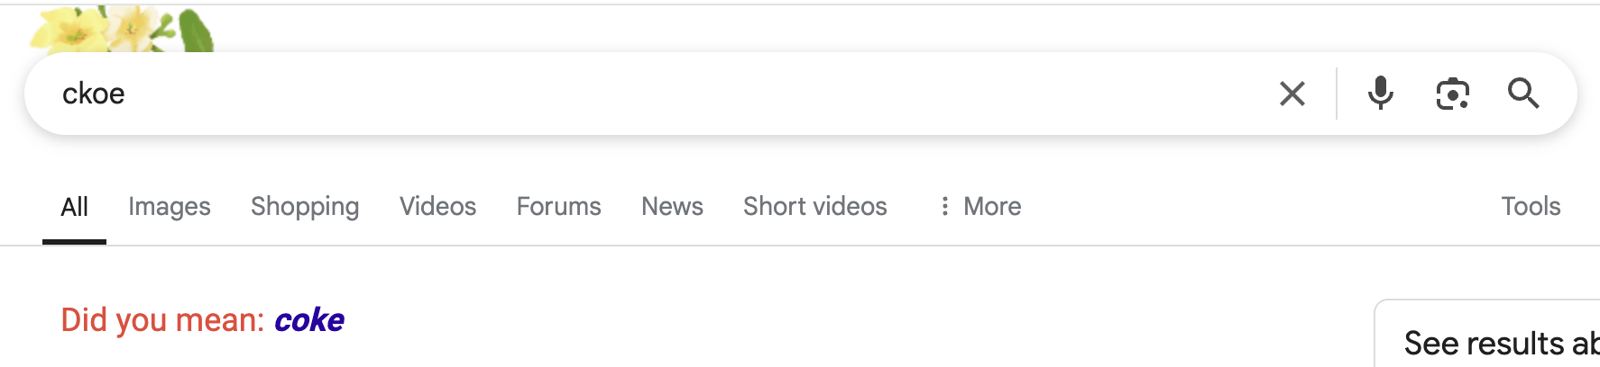

Slide 26
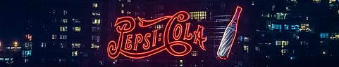
THANK YOU
Jenna and Malena

