Slide 1
BERGHS / PROGRAMMING & METHODS
From creative brief
to portfolio layout
Building a portfolio with SvelteKit, Neon & OpenRouter
Jenna Slikkerveer · November 2026
Notes:
INTRO (15–20 seconds): My project is a personal portfolio that I made as my Programming & Methods assignment. Today I will show the site and explain the most interesting technical idea: using OpenRouter to help generate the structure of a portfolio case study. I will distinguish tested features from the newer project-builder work in progress.

Slide 2
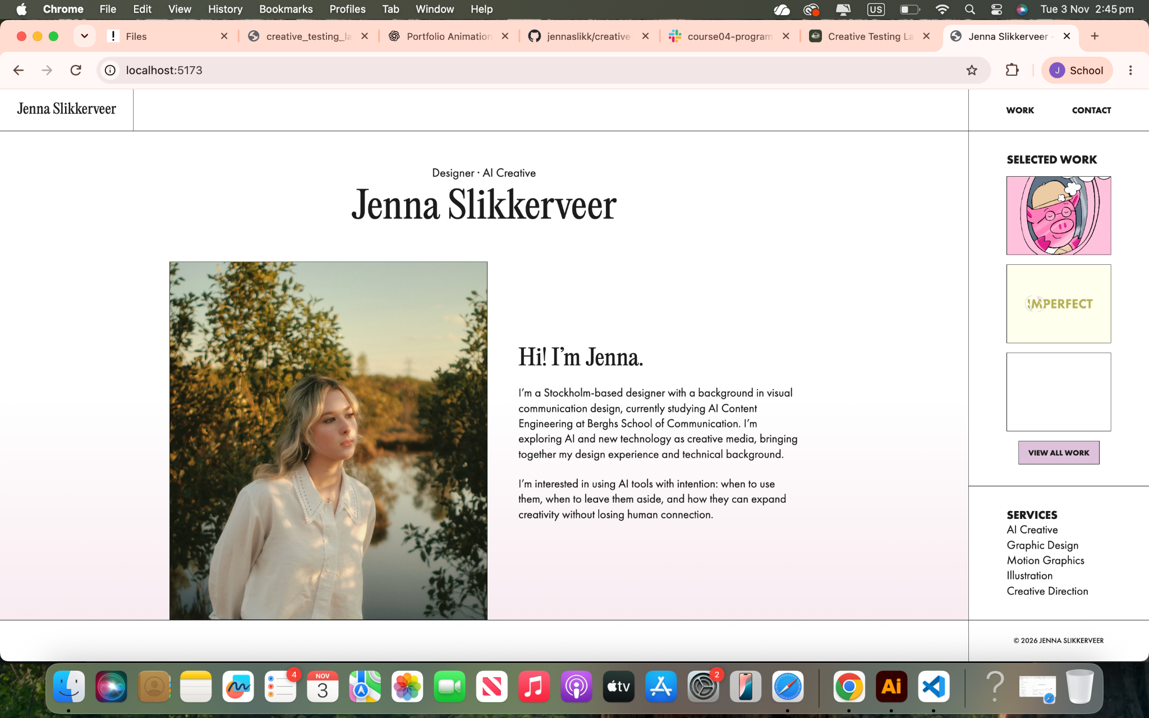
JENNA SLIKKERVEER / PROGRAMMING & METHODS
01 / WEBSITE DEMO
A portfolio, and a private Studio
A design-led public site with tools to manage and present creative projects.
PUBLIC PORTFOLIO
Selected work
Project pages
Responsive layout
Filtering
02
Notes:
WEBSITE DEMO (~60 seconds): Open the real homepage and Work page in your browser. Briefly show the design, filtering, and one project detail page such as Fruity Pigs. The screenshot is a fallback if internet or the local server is unavailable. Explain that I kept the public site separate from my private Studio.

Slide 3
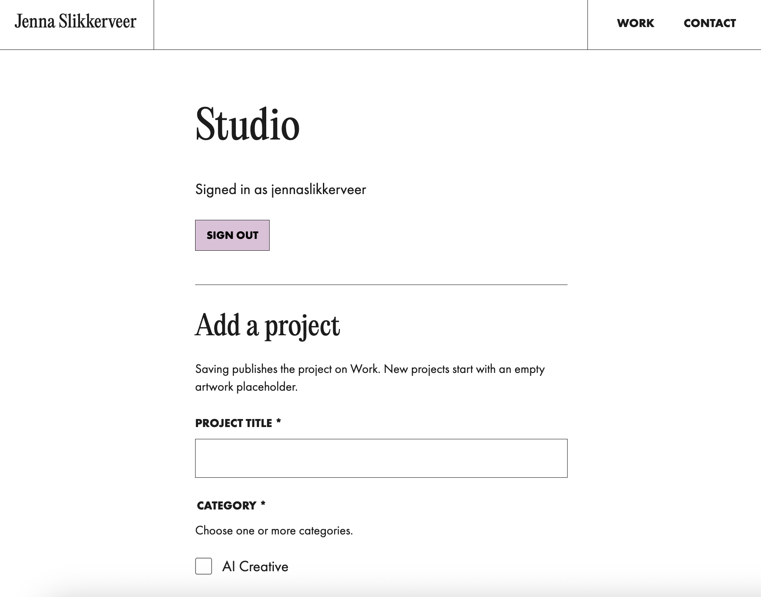
JENNA SLIKKERVEER / PROGRAMMING & METHODS
01 / WEBSITE DEMO
The Studio: where projects are created
A private workspace protected by a username and password.
01
Add project details
02
Create & store content
03
Generate an AI summary
04
Explore color palettes
03
Notes:
WEBSITE DEMO (~60 seconds): Show /studio while signed in. Point out project creation, comments, Color API, and AI summary. Do not display any secrets or .env. Explain that user/password login and server-side access control protect this area. The newer visual layout builder was under development; do not claim all draft/publishing actions are finished unless you test them live.

Slide 4
JENNA SLIKKERVEER / PROGRAMMING & METHODS
02 / TECHNICAL FOCUS
The idea: a creative assistant for case studies
I wanted AI to help decide how to tell the story of a project—not design random pages.
YOU PROVIDE
AI SUGGESTS
Title
Project type
Short description
→
Introduction · Process
Storyboard · Final outcome
Creative direction remains mine. The website controls the visual design.
04
Notes:
TECHNICAL SECTION (~45 seconds): My problem was that portfolio case studies require a lot of thinking: which images go first, how much process to show, and how to keep visual consistency. Instead of asking AI to build arbitrary HTML, I give it a clear choice of allowed sections. It proposes structure; I can edit it. This is the project generator concept and implementation in progress.

Slide 5
JENNA SLIKKERVEER / PROGRAMMING & METHODS
02 / TECHNICAL FOCUS
How OpenRouter fits into my site
OpenRouter is a service my server calls to access an AI model.
STUDIO
SVELTEKIT
OPENROUTER
PREVIEW
Project brief
+ Generate click
→
Validates request
Uses private key
→
AI model returns
a proposed outline
→
Approved sections
in my design
Only the server sends the API key • Never the browser
05
Notes:
TECHNICAL SECTION (~60 seconds): This is the route an API request takes. The form lives in the browser, but the secret key is NOT in the browser. The SvelteKit server checks that the user is signed in, validates the text, sends a POST request to OpenRouter, and receives an answer. OpenRouter connects to a model such as Gemini Flash Lite. The returned suggestions are validated and shown in our own components. This diagram is the intended generator flow, building upon a verified OpenRouter summary integration.

Slide 6
JENNA SLIKKERVEER / PROGRAMMING & METHODS
02 / TECHNICAL FOCUS
The key technique: structured output
Instead of asking for a whole website, I ask AI for a list my code understands.
EXAMPLE RESPONSE / SIMPLIFIED
WHY THIS MATTERS
{
"sections": [
{ "type": "introduction" },
{ "type": "storyboard" },
{ "type": "animation-highlights" },
{ "type": "final-outcome" }
]
}
Predictable sections
Consistent design
Easier editing
No AI-generated CSS
Illustrative schema, not a copied response from the live app.
06
Notes:
TECHNICAL SECTION (~75 seconds): Explain JSON as a structured format: keys and values, like a carefully organized list. In this simplified example sections is a list, and each item has a type. My server rejects types it does not support. The renderer uses existing styles to decide what the section looks like. AI chooses WHAT belongs on a page, but the code decides HOW it looks. This is safer and keeps the portfolio visually consistent. Point out this slide is an illustrative schema, not proof that the generator has been fully saved and published.

Slide 7
JENNA SLIKKERVEER / PROGRAMMING & METHODS
02 / TECHNICAL FOCUS
From the AI suggestion to a real page
Four layout patterns can cover many kinds of creative work.
01
02
03
04
Aa
Aa
▶
Text & context
Text + media
Image groups
Video
Introduction · Concept
Research · Creative process
Illustration · Storyboard
Animation · Final film
One shared renderer → same look in Studio preview and published pages.
07
Notes:
TECHNICAL SECTION (~55 seconds): The page does not need 12 unique designs. I can reuse a few patterns: text, text with images, image galleries, and video. The AI can ask for different combinations, but the Svelte components keep the margins, typography, and sticky sidebar consistent with Fruity Pigs. Building a shared renderer is preferable to generating HTML because I can maintain it and preview it.

Slide 8
JENNA SLIKKERVEER / PROGRAMMING & METHODS
02 / TECHNICAL FOCUS
What I tested—and what is still in progress
An important part of programming is knowing what has actually been verified.
✓ VERIFIED
↗ PROJECT GENERATOR
Real AI summary generated
Saved in Neon PostgreSQL
Displayed after refresh
API key absent from browser build
Visual layout proposals
Editable project sections
Saved drafts & publishing
Media upload workflow
The generator was under active development; its full draft-to-publish flow was not yet verified.
08
Notes:
TECHNICAL SECTION (~55 seconds): This distinction is important. I verified the real API connection using the summary feature: generated text, saved it to Neon, and retrieved it after reloading. The more ambitious visual generator uses the same integration approach but was still being built. Draft persistence and complete publishing needed additional checks. If you have finished these features by presentation day, update this slide only after a real test.

Slide 9
JENNA SLIKKERVEER / PROGRAMMING & METHODS
02 / TECHNICAL FOCUS
What I learned
Coding became a way to design a creative workflow, not just a website.
01
APIs
02
SERVER-SIDE SECURITY
A way to connect my application to another service.
Keep keys private and verify who is making requests.
03
DATABASES
04
DESIGN SYSTEMS
Store content so it survives refreshes and browser sessions.
Let AI suggest structure while reusable components preserve identity.
09
Notes:
TECHNICAL SECTION (~45 seconds): The main lesson was learning to separate the interface, the server, and the outside services. I also learned that AI output should be treated as a suggestion, not blindly trusted. The most valuable design decision was giving the AI a constrained list of sections, keeping the aesthetic in my hands.

Slide 10
QUESTIONS?
Portfolio · SvelteKit · Neon · OpenRouter
Jenna Slikkerveer
Notes:
Q&A (~2 minutes). Possible questions: Why not let AI generate HTML? (security, predictability, design quality). Why use OpenRouter? (one API interface for hosted models). Why store in Neon? (persistence across refresh). Why keep key on server? (avoid exposing credentials). What remains? (fully verified visual draft and media publishing workflow).

