Slide 1

Notes:
So you may be wondering what cute rotten bananas have to do with Sustainability
Well, we just like this picture

Slide 2

Reducing Food Waste with
SPOIL ALERT
IOT Hackathon 2018
Team #6
Jenna Tucker, Janessa Munt, Oliver Fu, Corey Stone, Nick Riehl, Julie Shih
Notes:
So we call ourselves: Spoil Alert
Developers:

Slide 3
Business Objectives
Meal plan & monitor food waste
Reduce Methane from Food Waste in the in the Atmosphere
“Smart” Containers
Integration into “Smart” Refrigerators in
Homes
Farms
Stores
Integrate and improve product capability
Sustainabili
SUSTAINABILITY
Sustainabili
SCALE
Sustainabili
CONTINUOUS DELIVERY
Notes:
Read from slides
“If I consume this food, I won’t release methane into the environment!”

Slide 4
The food waste problem in the US
The U.S. generates 133 billion tons of waste per year!
That’s $2,500 annual waste per household
28% of this wasted is at the consumer level
http://www.sustainabletable.org/5664/food-waste
Notes:
Problem Statement:
So let’s talk about the Food Waste problem in America
America wastes roughly 40 percent of its food which is the equivalent of about $165 billion per year.
On top of this, its estimated that 133 billion pounds of food that goes to waste every year is perfectly edible and nutritious.
In landfills, food gradually breaks down to form methane, which is a greenhouse gas that's at least 25 times more powerful than carbon dioxide.
So what is needed is a comprehensive report on food loss in the US to identify opportunities and establish benchmarks against which progress can be measured
Americans need a behavior change! A Nudge

Slide 5
What makes food waste a big problem?
Public Awareness is limited
“You don’t know what you don’t know”
Major Contributors to Food Waste Include:
Food Spoilage
Over Preparing
Date Label Confusion
Overbuying
Notes:
Public awareness about food waste in most of the US is limited and is a huge contributor to the problem.
Major contributors to household food waste include:
Food Spoilage (Issues such as Lack of visibility, improper planning, or simply not using food)
Another contributor is Over Preparing… which is Cooking too much food and preparing large portions)
Americans also suffer from Date Label Confusion (Sell By/Use By dates on produce are not federally regulated and are only suggested for “peak quality”
Lastly, overbuying which is caused by promos and sales at super markets.

Slide 6
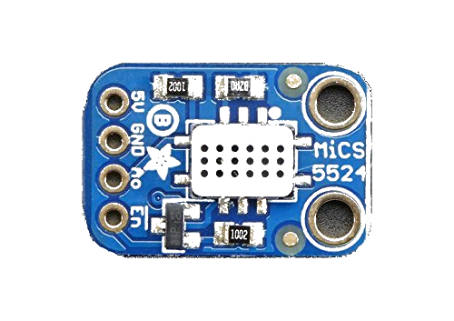


Our solution - MiCS-5524 Gas Sensor
Project Goal:
Create an IoT device to monitor the ripening of fruits and vegetables by detecting Ethylene gas levels
inside a container or drawer.
This device will alert customers via text that they will need to consume or eventually compost the food.
Notes:
Enter our solution:
Our hope is that this device will change the behavior of consumers and allow for research of food waste.

Slide 7

Benefits
Simple to Use
1. Put the device in your produce container
2. Go online and enter your phone number to start receiving alerts
IoT
Allows you to track data on food waste to monitor and change your habits
Environment
Changing human behavior reduces methane in the atmosphere
Notes:
Benefits
· Simple to use
o Place the monitoring device in a container with the produce you want to monitor
o Go online and enter your phone number to start receiving notifications
· Allows you to track data on your food waste to monitor and change your habits
· Reduces environmental impacts by reducing the release of methane gas into the atmosphere

Slide 8


Demo
SPOIL ALERT
Notes:
Present our solution
https://io.adafruit.com/cstone01/dashboards/food-waste-gas-feed

Slide 9
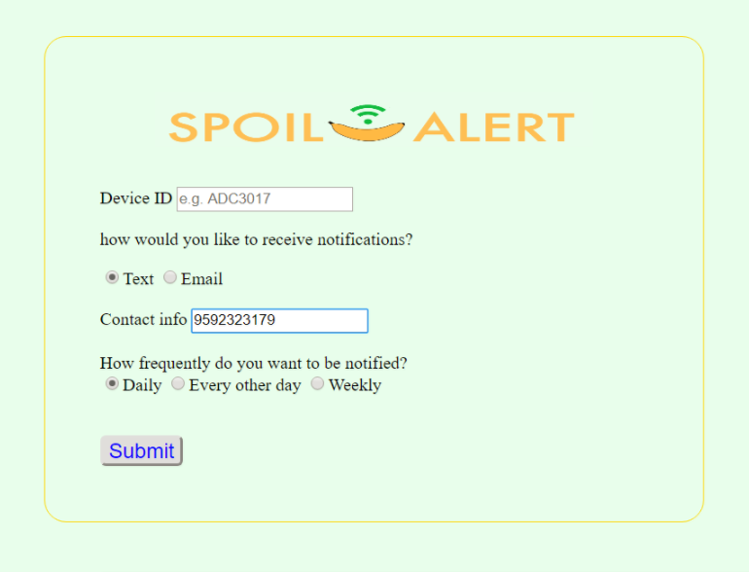
User Interface
Enter your contact information to receive alerts
Notes:
Present our solution
https://io.adafruit.com/cstone01/dashboards/food-waste-gas-feed

Slide 10
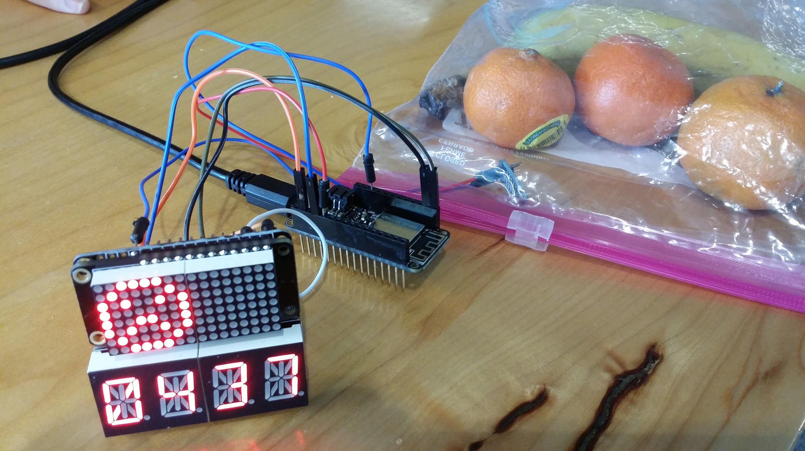
Thank you for your time!
Github Link: https://github.com/jmtucker7/wwcode_hackathon_project
Online Monitoring Tool: https://io.adafruit.com/cstone01/dashboards/food-waste-gas-feed

