Slide 1
Designing Course Games with AI for Any Modality
Same Game, Different Room
Jennifer Coon, CIA, CFE
Professor of Accounting, Tyler Junior College

Slide 2
I had a room of bored students.
So, I went home and opened a search bar.

Slide 3
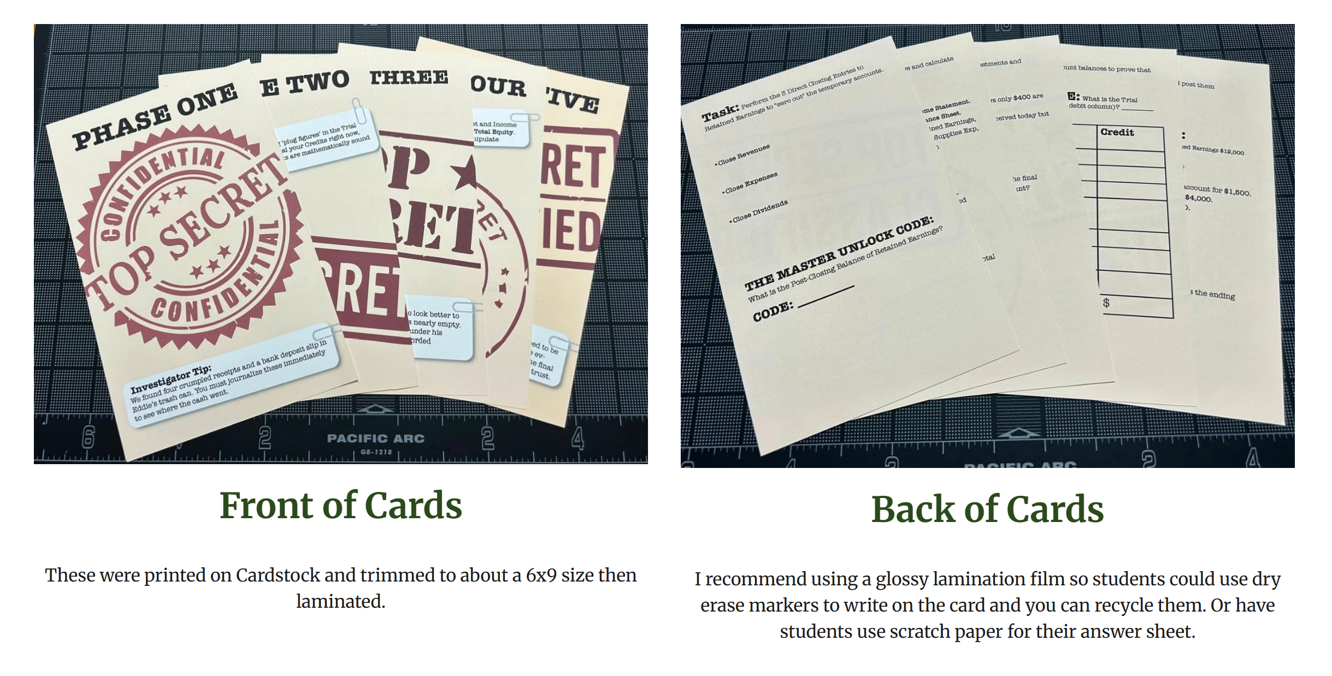
Escape Room

Slide 4
They played it.
And came alive.

Slide 5
They found their own gaps.
Scores increased.
They said accounting was fun!

Slide 6
Then I asked myself the harder question.
What about my online students?
?
IN PERSON
ONLINE

Slide 7
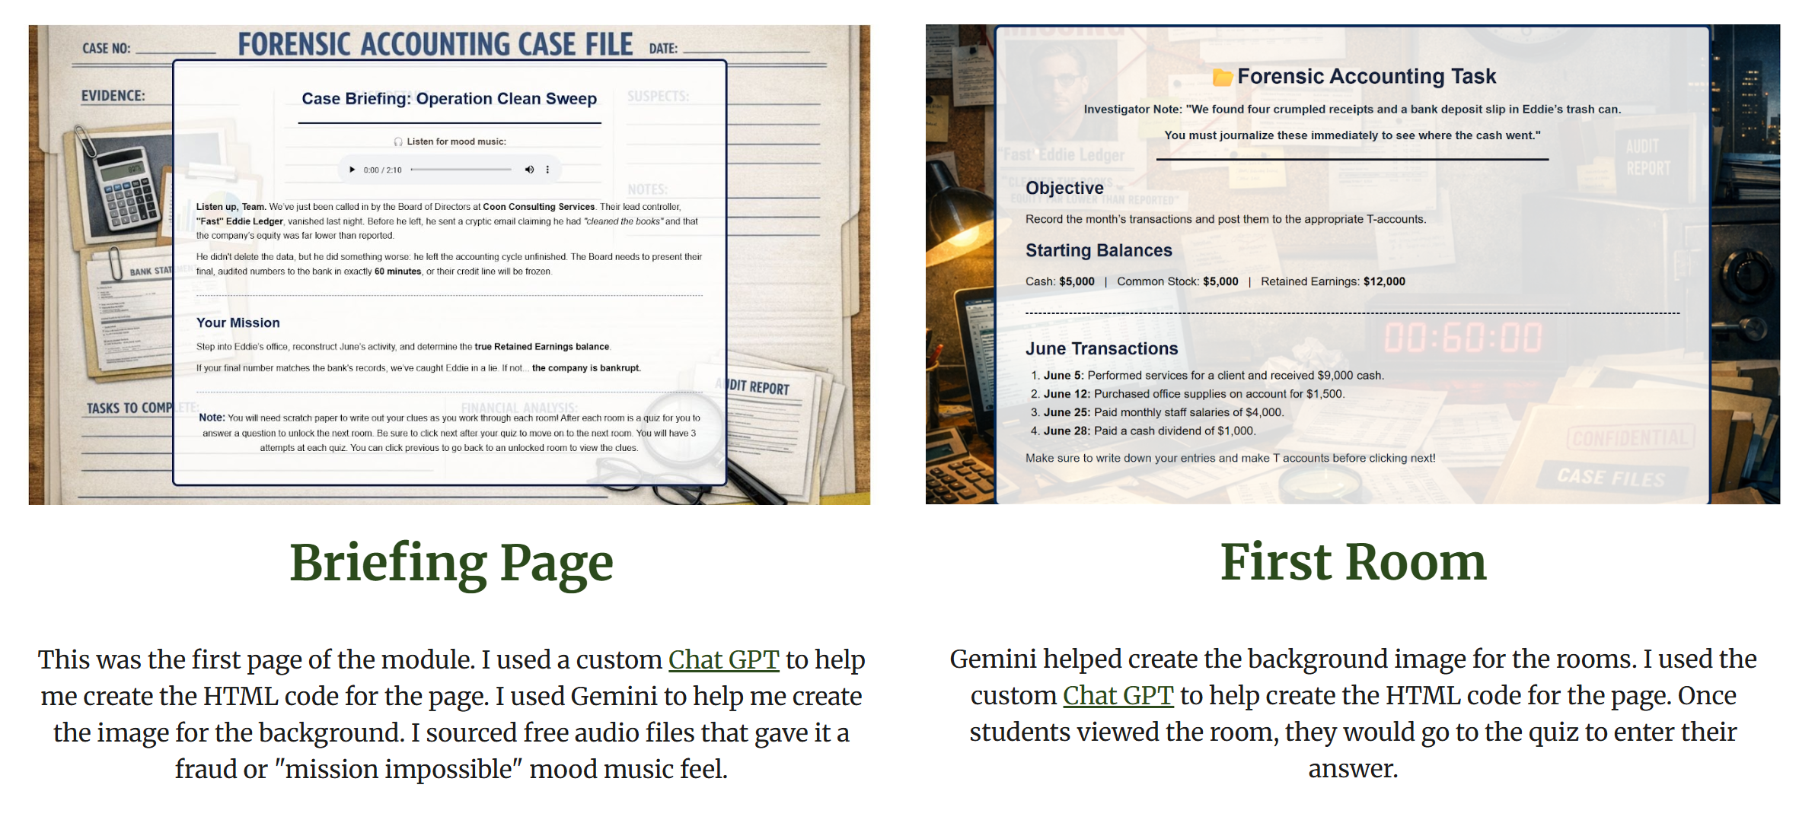
Modules

Slide 8
Interactive HTML/SCORM

Slide 9
Four games
EXAM 1
EXAM 2
Ghost Controller
Forensic escape room
BADGE: Cycle Buster
The Heist
Six-station image
BADGE: The Clean Sweep
EXAM 3
FINAL
The Evidence Room
Jenga-style draw
BADGE: Evidence Secured
The Settlement Table
Deal or No Deal
BADGE: The Final Deal
In-person + asynchronous online SCORM. Same game.

Slide 10


See them both.
IN PERSON
ONLINE
exam-review-games
online-exam-review-games

Slide 11

Build your own!
jenncoon.github.io/OLCElevate/design-brief

Slide 12
Jennifer Coon, CIA, CFE
Professor of Accounting, Tyler Junior College
Jennifer.Coon@tjc.edu
linkedin.com/in/jennifercoonciacfe
Jcoondesign.com

