Slide 1
Designing Course Games with AI for Any Modality
Same Game, Different Room
Jennifer Coon, CIA, CFE
Professor of Accounting, Tyler Junior College

Slide 2
I had a room of quiet students.
So, I went home and opened a search bar.

Slide 3
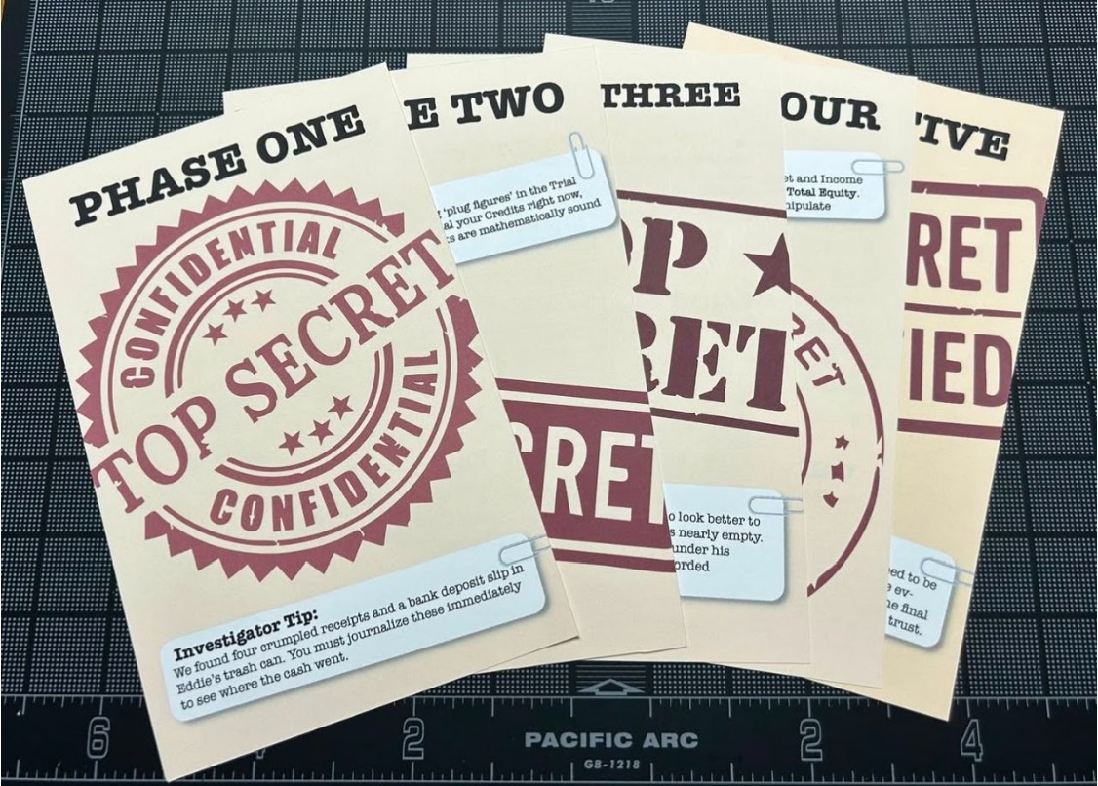
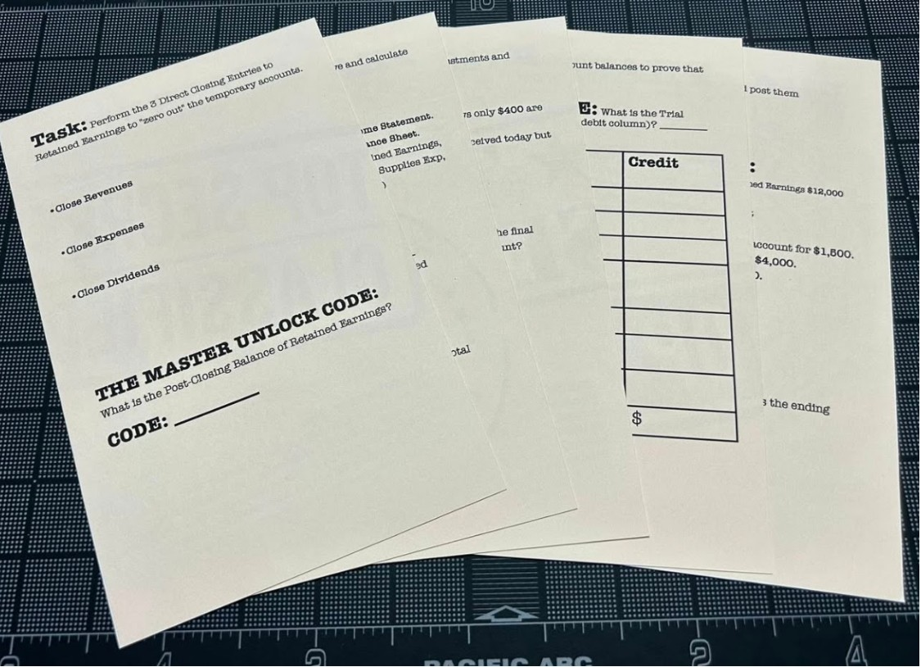
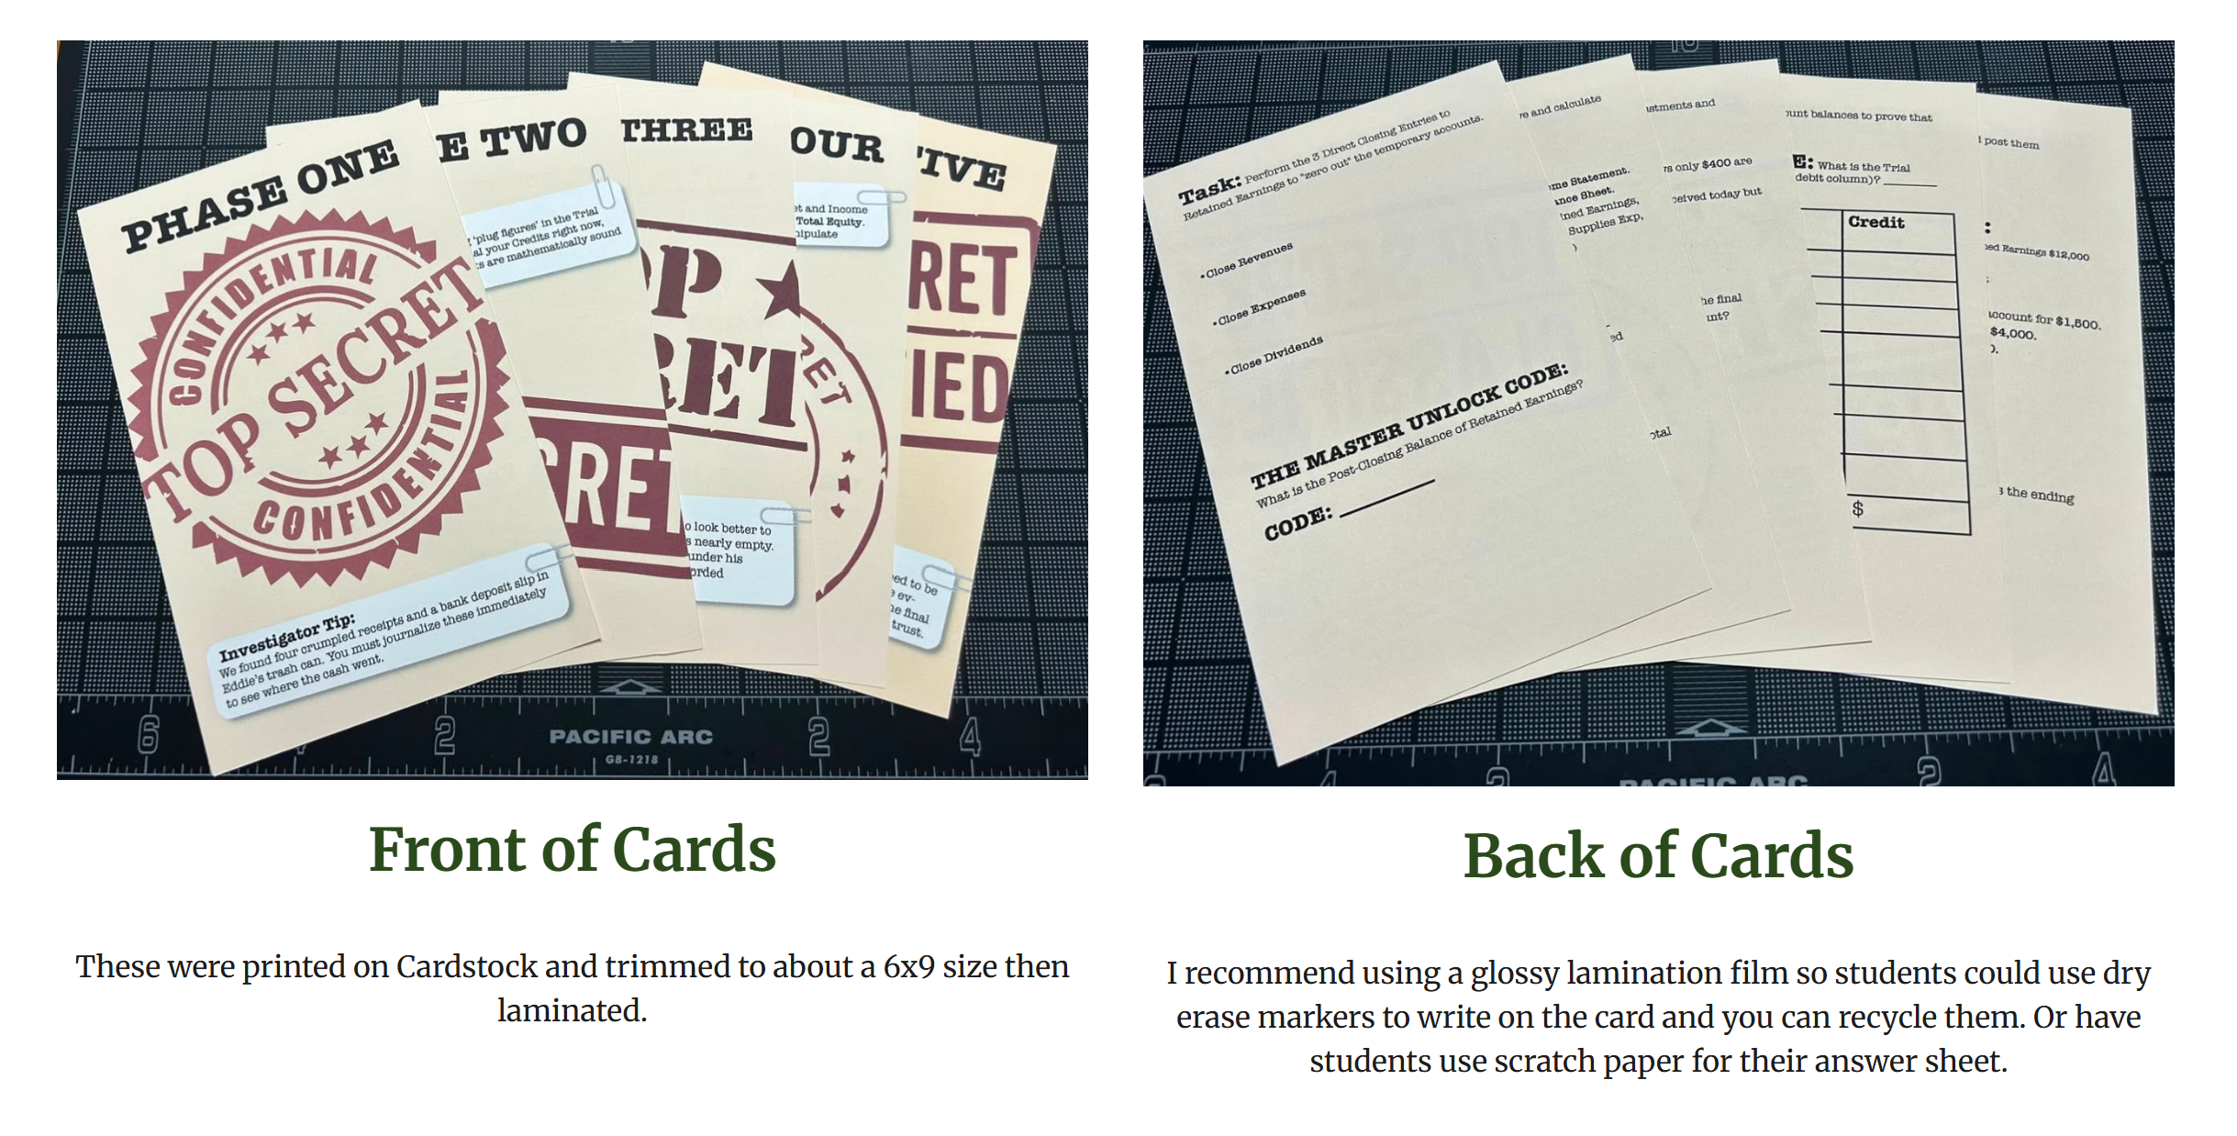
Escape Room
Front of Cards
Back of Cards
These were printed on cardstock and trimmed to about a 6x9 size, then laminated.
I recommend using a glossy lamination film so students can use dry erase markers to write on the card and you can recycle them. Or have students use scratch paper for their answer sheet.

Slide 4
They played it.
And came alive.

Slide 5
They found their own gaps.
Scores increased.
They said accounting was fun!

Slide 6
Then I asked…
What about my online students?
?
IN PERSON
ONLINE

Slide 7
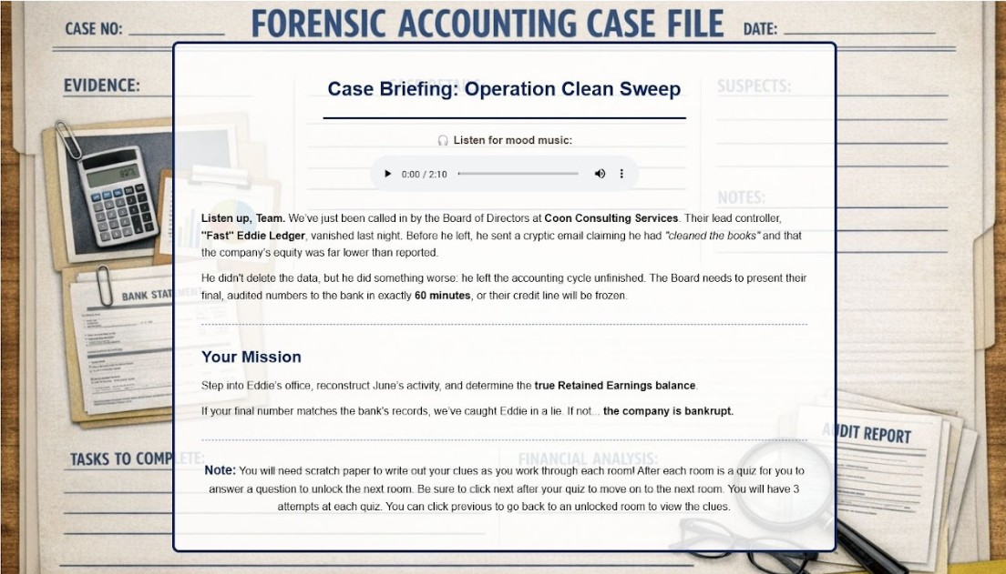
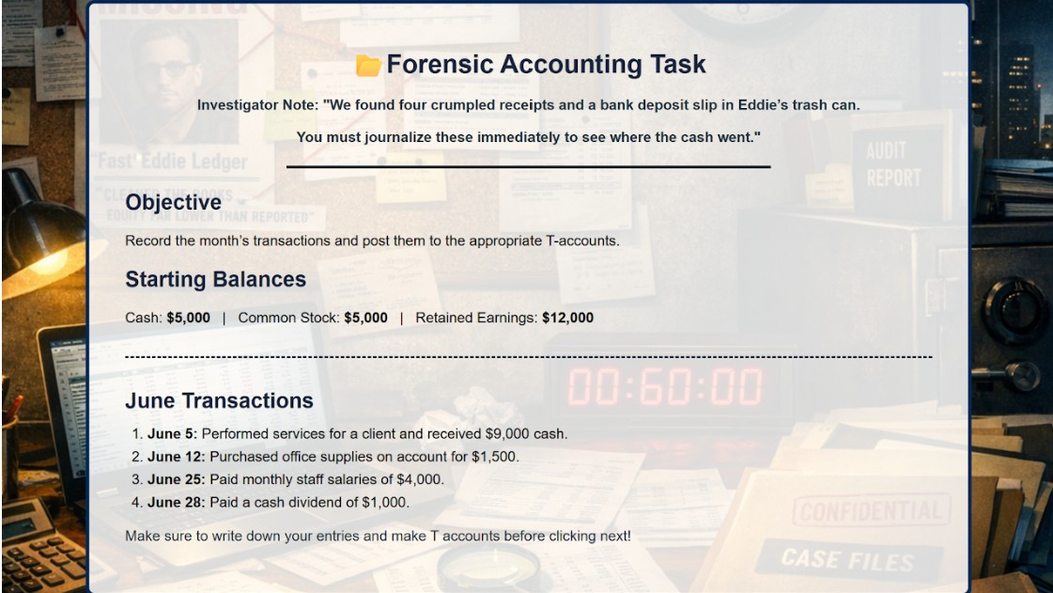
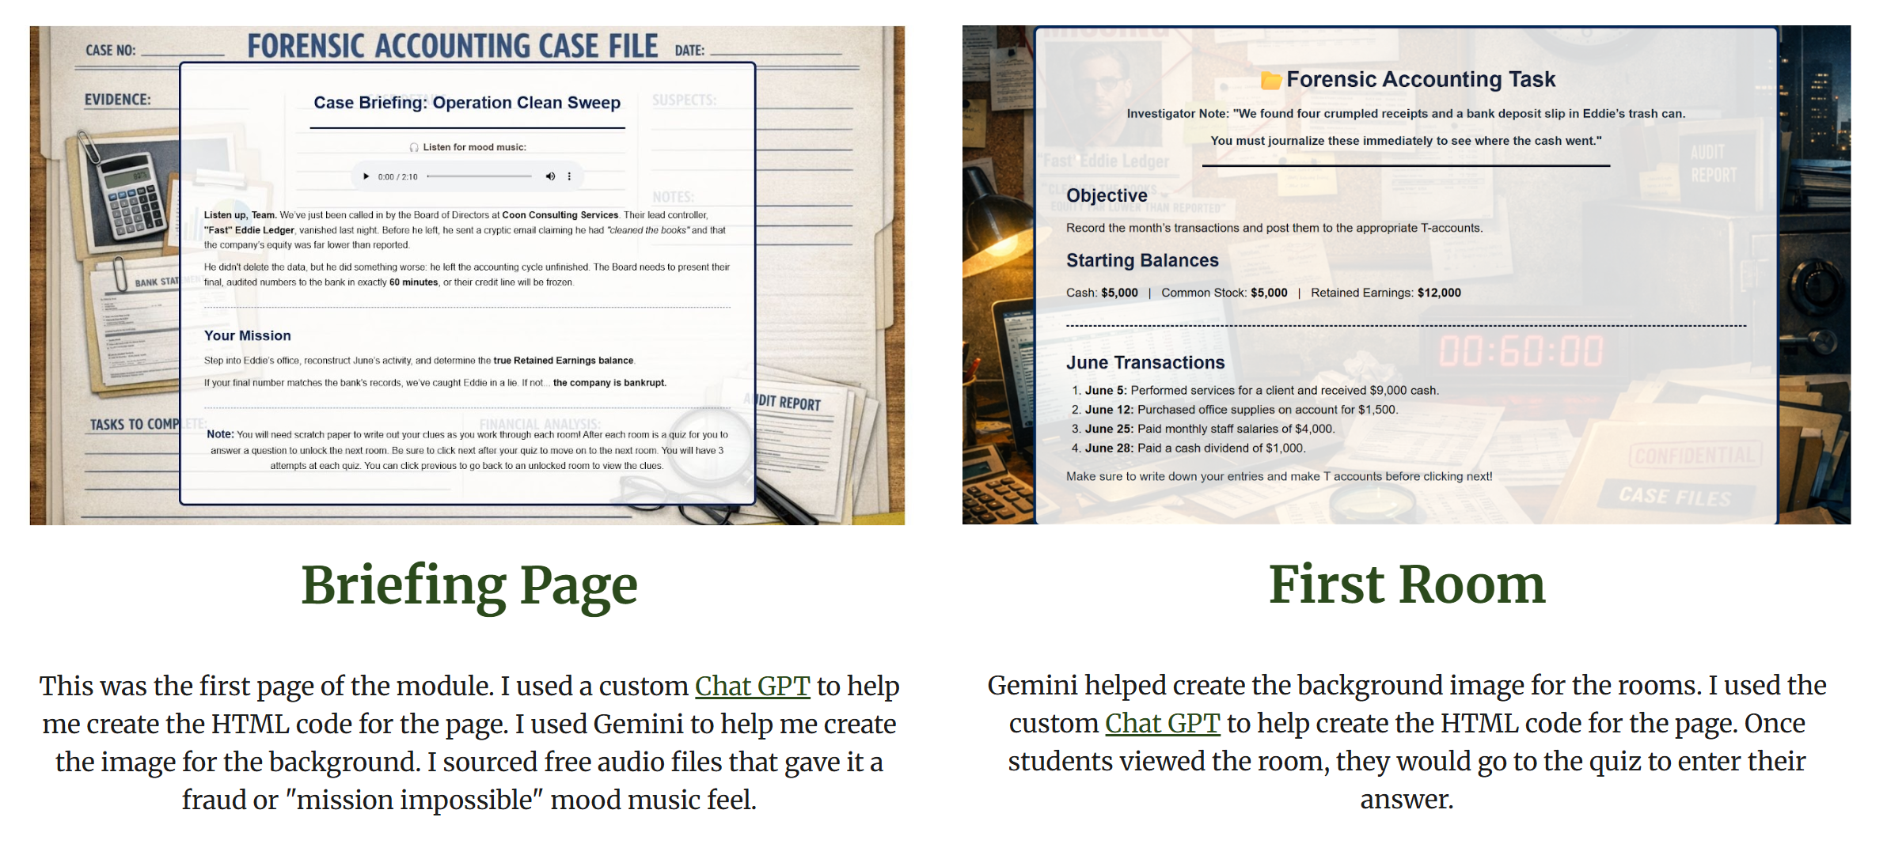
Modules
Briefing Page
First Room
This was the first page of the module. I used a custom Chat GPT to help me create the HTML code for the page. I used Gemini to help me create the image for the background. I sourced free audio files that gave it a fraud or "mission impossible" mood music feel.
Gemini helped create the background image for the rooms. I used the custom Chat GPT to help create the HTML code for the page. Once students viewed the room, they would go to the quiz to enter their answer.

Slide 8

Interactive HTML/SCORM
https://jenncoon.github.io/Spark26/

Slide 9
Four games
EXAM 1
EXAM 2
Ghost Controller
Forensic escape room
BADGE: Cycle Buster
The Heist
Six-station image
BADGE: The Clean Sweep
EXAM 3
FINAL
The Evidence Room
Jenga-style draw
BADGE: Evidence Secured
The Settlement Table
Deal or No Deal
BADGE: The Final Deal
In-person + asynchronous online SCORM. Same game.

Slide 10

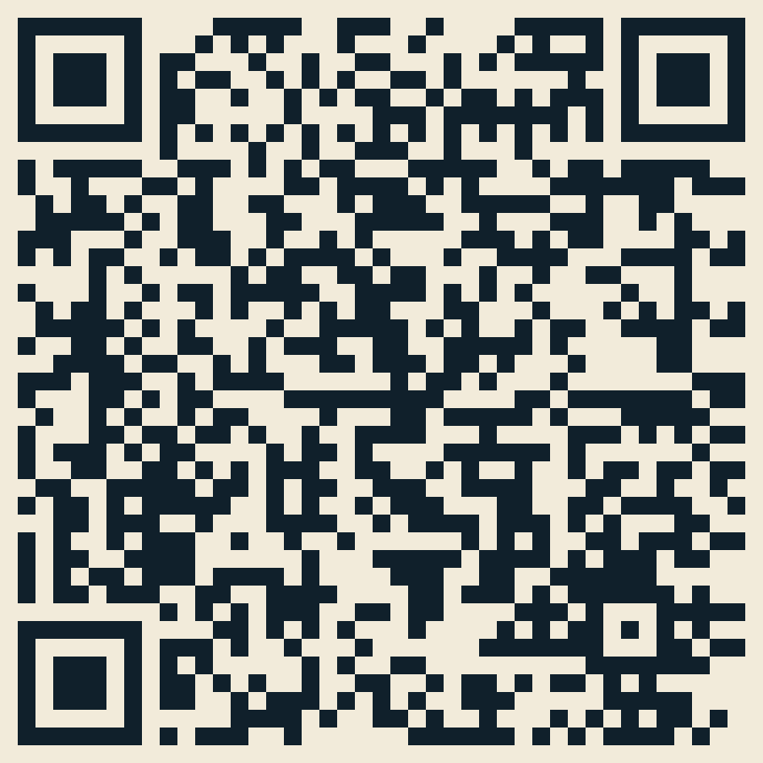
See them both.
IN PERSON
ONLINE
sites.google.com/view/jennifercoon/
the-engagement-lab/exam-review-games
sites.google.com/view/jennifercoon/
the-engagement-lab/online-exam-review-games

Slide 11

Build your own!
https://jenncoon.github.io/Conferences/tpoc-2026/designing-course-games/

Slide 12
Jennifer Coon, CIA, CFE
Professor of Accounting, Tyler Junior College
Jennifer.Coon@tjc.edu
linkedin.com/in/jennifercoonciacfe
Jcoondesign.com

