Slide 1
Major FOSS Licenses and Their Features
OSI has approved more than 50 licenses for Open Source Software.

Slide 2
Intentions of Open Source Software
The main intentions for the OSD are described in the article "Open source licensing, Part 1: The intent" [1] by Martin Streicher and are summarized below.
 | Intention | Explanation
1 | Licensees are free to use open source software for any purpose whatsoever. | This basically means that the licensee need not justify the usage of the open source software
2 | Licensees are free to make copies of open source software and are free to distribute those copies without payment of royalties to a licensor. | This implies that the licensee can redistribute the software at a cost or free of charge.
3 | Licensees are free to create derivative works of open source software and are free to distribute those works without payment of royalties to a licensor. | This allows the licensee to modify the open source software and then redistribute it with or without charge. The licensee is in no way liable to pay any amount to the licensor for this neither can the licensor pose any restrictions on the derivative works. A pre-requisite for intention 3 to occur is the pre-existence of intention 4.
4 | Licensees are free to access and use the source code of open source software. | This means the source code is freely available.
5 | Licensees are free to combine open source and other software. | This gives the licensee the ability to mix open source software with other software.

Slide 3
GNU General Public License (GNU GPL)
An excerpt of the GNU license
The sentence "You may modify your copy or copies of the Program or any portion of it, thus forming a work based on the Program, and copy and distribute such modifications or work" indicates that licensees are free to access, and use open source software for any purpose and that they are free to create and distribute derivative works (Intention 1, 3, 4 and 5). In the same sentence, the clause "copy and distribute such modifications or work" further indicates that licensees are free to make copies of the open source software (Intention 2).
Notes:
The GNU’s General Public License, or GPL, is one of the foundation open source licenses. Created by the Free Software Foundation (FSF), which has made many contributions to open source coding, it is the preferred license for projects authorized by the FSF, including the GNU Emacs Editor and the GNU C Compiler, among literally scores of others, including the GNU/Linux kernel.
The intentions behind the license and the premise underlying it are explained in the license’s preamble, which is included here in its entirety. The preamble follows the copyright notice,† and a notice that prevents modifications, ironically enough, to the license itself: “Everyone is permitted to copy and distribute verbatim copies of this license document, but changing it is not allowed.” While the license permits the creation of derivative works from the licensed code, it does not permit the creation of derivative licenses from the license itself.

Slide 4
Types of Open Source Licenses
Restrictive (aka Copyleft, reciprocal)
Permissive

Slide 5
Types of Open Source Licenses
1. Restrictive (aka Copyleft, reciprocal)
Requires licensor to make improvements or enhancements available under similar terms
• Licenses establish a specific trigger for sharing obligation
• Example is the GPLv2: Licensee must distribute “work based on the program” and cause such works to be licensed at no charge under the terms of the GPL

Slide 6
Types of Open Source Licenses
2. Permissive
Modifications/enhancements may remain proprietary
• Distribution in source code or object code permitted provided copyright notice & liability disclaimer are included and contributors’ names are not used to endorse products
• Examples: Berkeley Software Distribution (BSD), Apache Software License

Slide 7
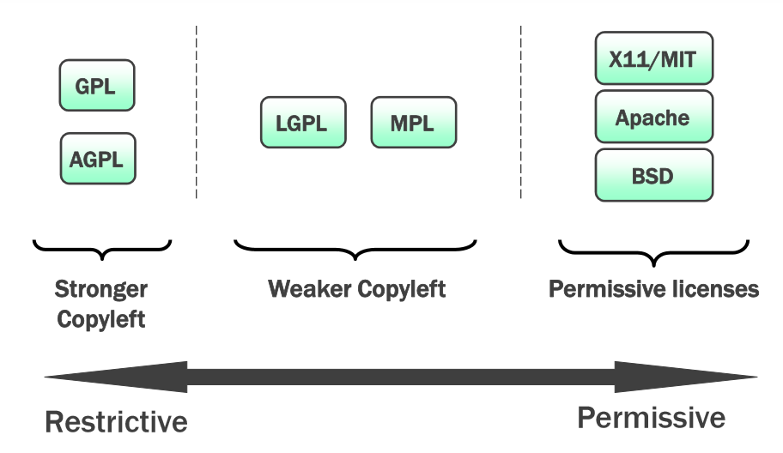

Slide 8
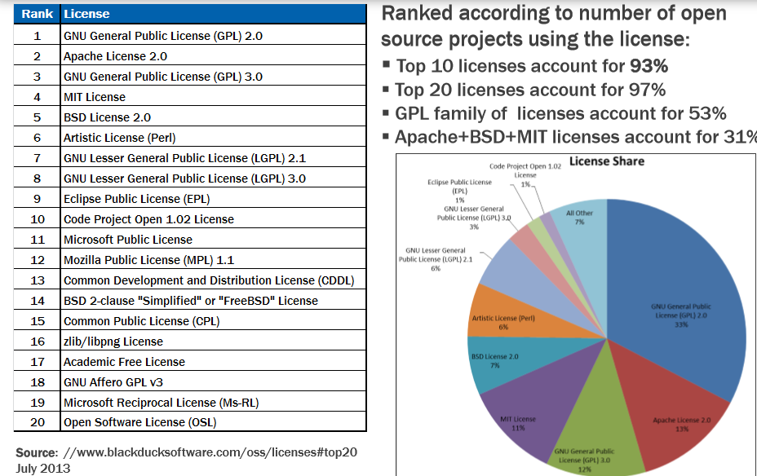

Slide 9
OSI Approved Licenses
These are examples of OSI--approved licenses that are popular and widely-used or with strong communities:
GNU General Public License (GPL)
GNU Lesser General Public License (LGPL)
MIT license (MIT)
Mozilla Public License 2.0 (MPL-2.0)
Apache License 2.0 (Apache-2.0)
Berkeley Software Distribution (BSD) License
BSD 3-Clause "New" or "Revised" license
BSD 2-Clause "Simplified" or "FreeBSD" license
Common Development and Distribution License (CDDL-1.0)
Eclipse Public License (EPL-1.0)

