Slide 1
Implementing a file system
Jennica Ramones

Slide 2

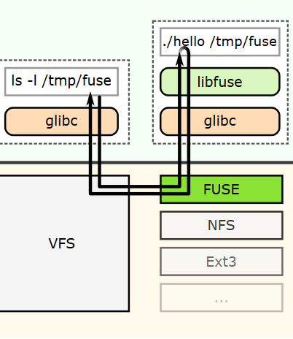
Research on the FUSE library
FUSE → Filesystem in Userspace
Linux and MacOS
Fuse kernel model & libfuse library
Allows the creation of file systems without coding anything in the kernel space
File system is implemented in userspace while the library ‘bridges’ the code to the actual kernel interfaces

Slide 3
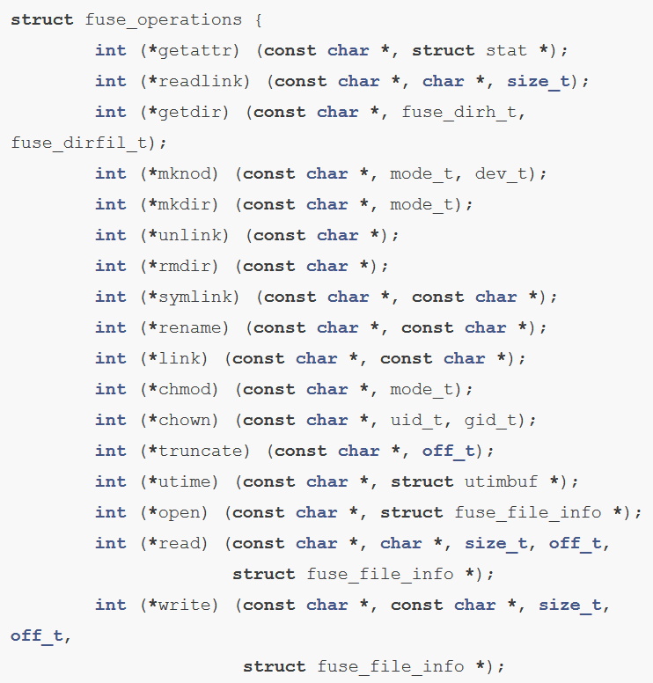
Important Components
FUSE offers two APIs: a “high-level” and “low-level” API
fuse_operations structure
These pointers will be called by FUSE when something happens on the file system
The functions of this structure need to be defined with the pointers of your own implemented functions

Slide 4
My Project
a simple file system that reads the contents of a directory

Slide 5
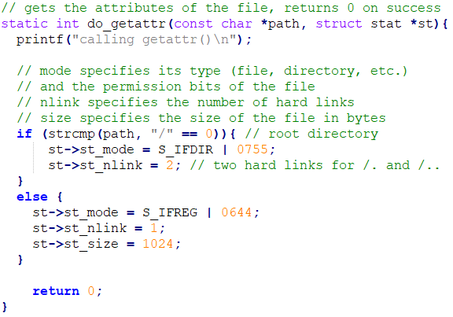
Implementing getattr()

Slide 6
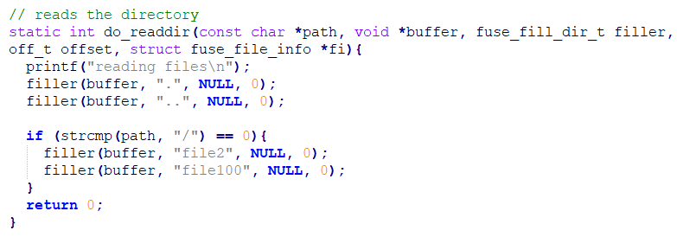
Implementing readdir()

Slide 7
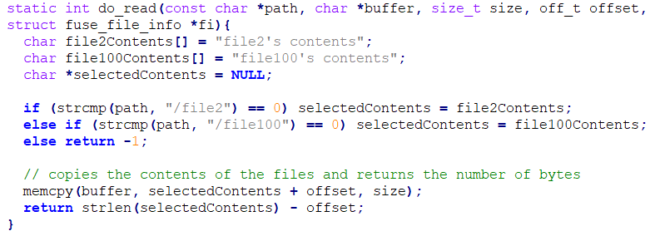
Implementing read()

Slide 8
Debugging
Couldn’t mount the actual file system
fuse: missing mountpoint parameter

Slide 9

Resources
https://github.com/libfuse/libfuse
http://www.maastaar.net/fuse/linux/filesystem/c/2016/05/21/writing-a-simple-filesystem-using-fuse/

