Slide 1
Implementing a file system
Jennica Ramones

Slide 2
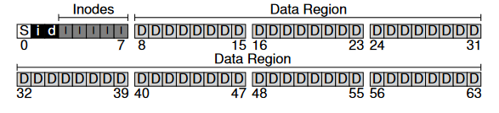
Background
Purpose of my project:
Implement a simple file system

Slide 3
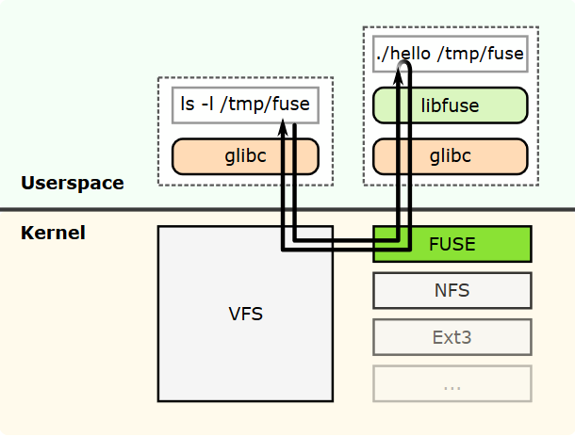
Research on the FUSE library
FUSE → Filesystem in Userspace
Can be implemented in linux and MacOS
Fuse kernel model & libfuse library
Allows the creation of file systems without coding anything in the kernel space
File system is implemented in userspace while the library ‘bridges’ the code to the actual kernel interfaces

Slide 4
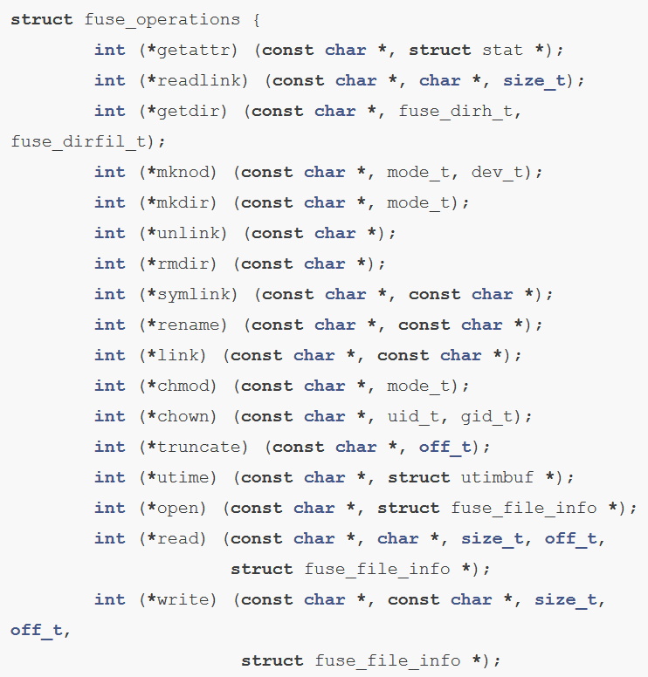
Important Components
FUSE offers two APIs: a “high-level” and “low-level” API
Explain the difference
fuse_operations structure
All the fields in this structure are pointers to functions; these pointers will be called by FUSE when something happens on the file system
In order to implement the FS, you need to define the functions of this structure with the pointers of your implemented functions
…

Slide 5
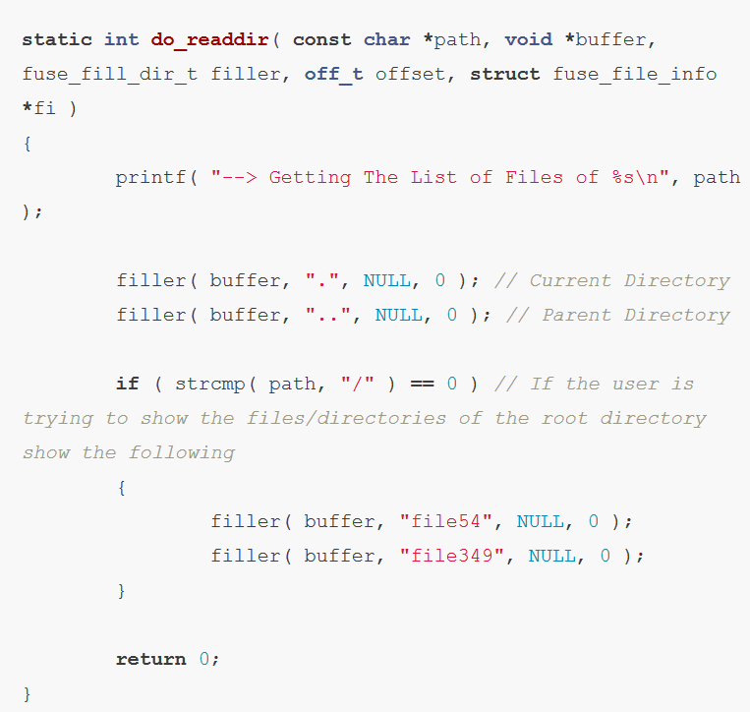
Implementing readdir()
readdir() lists the files/directories inside a specific directory
readdir() has five parameters

Slide 6
My Project
Wanted to create a simple file system that reads the contents of a directory
Explain my code

Slide 7
Examples of FUSE File Systems
WikipediaFS

Slide 8
Resources
https://github.com/libfuse/libfuse
http://www.maastaar.net/fuse/linux/filesystem/c/2016/05/21/writing-a-simple-filesystem-using-fuse/

