Slide 1
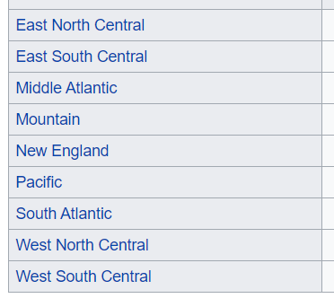
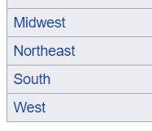
Evaluation
Death Rate
Correct for age
Show death rate for > 65 by state
Correct for excess deaths
Sensitivity analysis
Correct for start date
Sensitivity analysis
Group “like” States
Geographical location/Climate
Population density / population / urban v rural
Covid start date *
Diversity
Politics
Age > 65
Hospital beds / insurance cover
Identify best and worst from each group
Compare between groups best on score relative to group mean
ANOVA?
Need database of states with all this information
Iterate different analysis scenarios

Slide 2
Part 2 – by group
Health & Health Care
Beds, health insurance
Prevalence of comorbidities
Population density
Urban/rural => is this a break down within state (so much seems to depend on it)
%population in cities > 100K
Preventative
Lock downs
Masks
Time series / phases
Vaccinations
Demographics
Race, sex, income

Slide 3
Technique
Weekly update (automatic)
Define functions for commonly used stuff:
Bar chart with multiple overlays
Inputs x, y1, y2, y3
Scatter plot annotated with states + regression line
Common look
Pull data into big data frames
Update those data frames
Iterative analysis – change parameters in steps and see what happens

