Slide 1
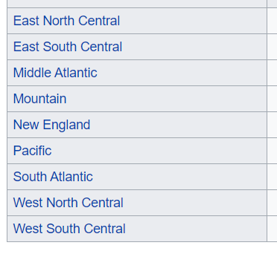
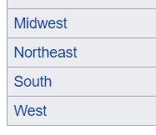
Evaluation
Death Rate
Correct for age
Show death rate for > 65 by state
Correct for excess deaths
Sensitivity analysis
Correct for start date
Sensitivity analysis
Group “like” States
Geographical location/Climate
Population density / population / urban v rural
Covid start date *
Diversity
Politics
Age > 65
Hospital beds / insurance cover
Identify best and worst from each group
Compare between groups best on score relative to group mean
ANOVA?
Need database of states with all this information
Iterate different analysis scenarios

Slide 2
Part 2 – by group
Health & Health Care
Beds, health insurance
Prevalence of comorbidities
Population density
Urban/rural => is this a break down within state (so much seems to depend on it)
%population in cities > 100K
Preventative
Lock downs
Masks
Time series / phases
Vaccinations
Demographics
Race, sex, income

Slide 3
Technique
Weekly update (automatic)
Define functions for commonly used stuff:
Bar chart with multiple overlays
Inputs x, y1, y2, y3
Scatter plot annotated with states + regression line
Common look
Pull data into big data frames
Update those data frames
Iterative analysis – change parameters in steps and see what happens

Slide 4
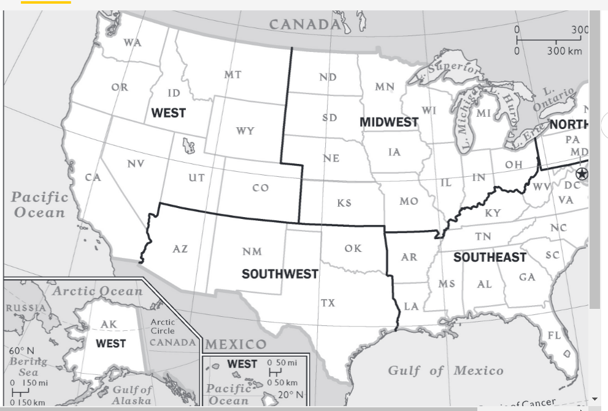
The United States is split into seven regions based on physical characteristics, cultures, politics and history of the states. The regions are split from east to west across the entire United States. These regions are numbered from one to seven and give an idea about the climate and conditions of the states.
New England Region
New England is the easternmost part of the United States regions and is the first region that goes from east to west. The states in New England are Maine, Rhode Island, Vermont, Connecticut, New Hampshire and Massachusetts. Geographically, New England is part of the Atlantic-Gulf Coastal Plain, which stretches from the east to the Rio Grande.
Mid-Atlantic Region
The Middle Atlantic States, which are also called the Mid-Atlantic States, are the second region of the United States and are south and west of the New England States. The Mid-Atlantic Sstates are New York, New Jersey and Pennsylvania. The Mid-Atlantic is also part of the Atlantic-Gulf Coastal Plains geographic locations.
Southern Region
The Southern states make up the third region of the United States. These states are to the south and west of the mid-Atlantic states. The states in the Southern Region include Virginia, West Virginia, Kentucky, Delaware, Maryland, North and South Carolina, Tennessee, Arkansas, Louisiana, Florida, Georgia, Alabama and Mississippi. These states are part of the Appalachian Highlands geographic region.
South-West Region
The South-West Region of the United States is located directly west of the Southern Region. Geographically, it is part of the Atlantic Gulf Coastal Plain. The states in the South-West Region include Texas, Arizona, New Mexico and Oklahoma.
Rocky Mountains
The Rocky Mountain Region is made up of the states that run through the Rocky Mountains. These states are to the north of the South-West region and West of the Mid-West Region of the United States. The Stated included in the region are Montana, Idaho, Colorado, Utah, Wyoming and Nevada. Geographically, these are both the Rocky Mountain region and the Intermontane Region of the United States.
Pacific Coastal Region
The Pacific Coastal Region is made up of the states which lie along the Pacific Ocean. Geographically, the Pacific Coastal Region is considered the Pacific Mountain System. The states in the Pacific Coastal Region are California, Oregon and Washington.

