Slide 1
Billionaires and World Bank Data
ETL PROJECT
Group 7: Geoffrey Flynn, Jenna Murphy, John Russell, Jennie Cinelli, Elie Tumaini

Slide 2
Extract: Comparing extreme wealth versus country basics
Billionaires Worldwide (~3000 worldwide), Source: Kaggle, Format: CSV
Name
Net worth
Education
Citizenship / location
Source of wealth
World Bank Country Data (~300), Source: World.Data, Excel Spreadsheet
Country Name
Region Code
Country Code
GDP, PPP (Current International $)
Population Total
Population CAGR
Internet Users (per 100 people)
Population Largest City % of Urban Pop
2014 Life Expectancy at Birth, Total (years)

Slide 3
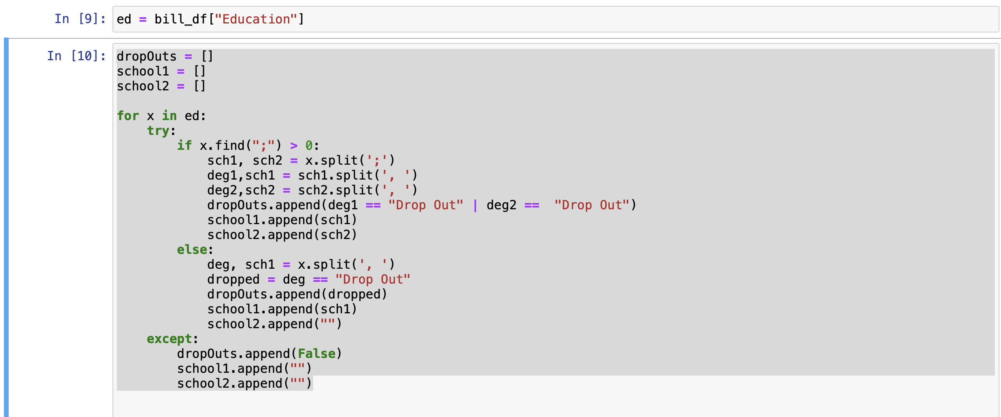
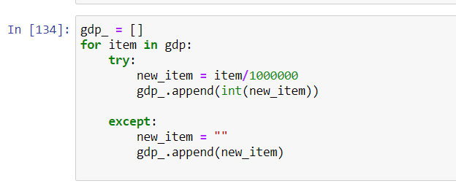
Transform
Drop columns
Leave NaN fields blank by using Try /Except to keep but not drop
Separating out fields with multiple entries
Education
Deg, school; Deg2, school2
Deg could be “Drop Out”
Residence
City, State or City, Country

Slide 4
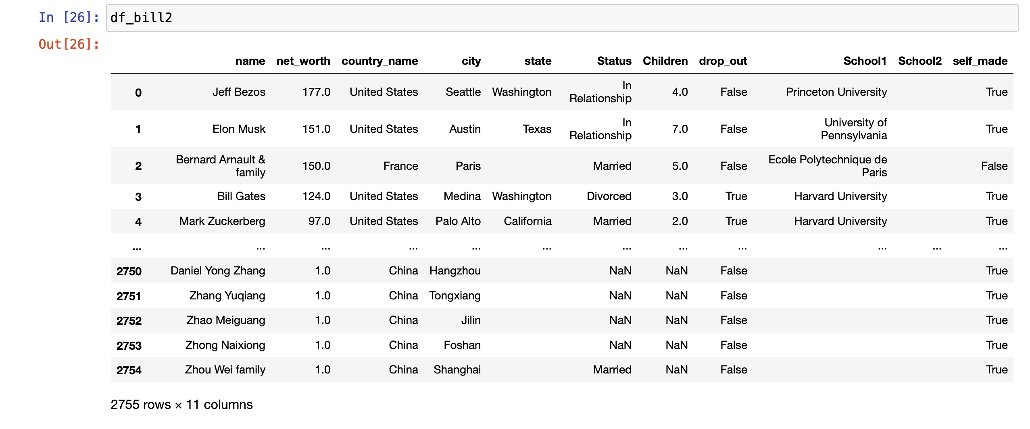
Transform Output

Slide 5
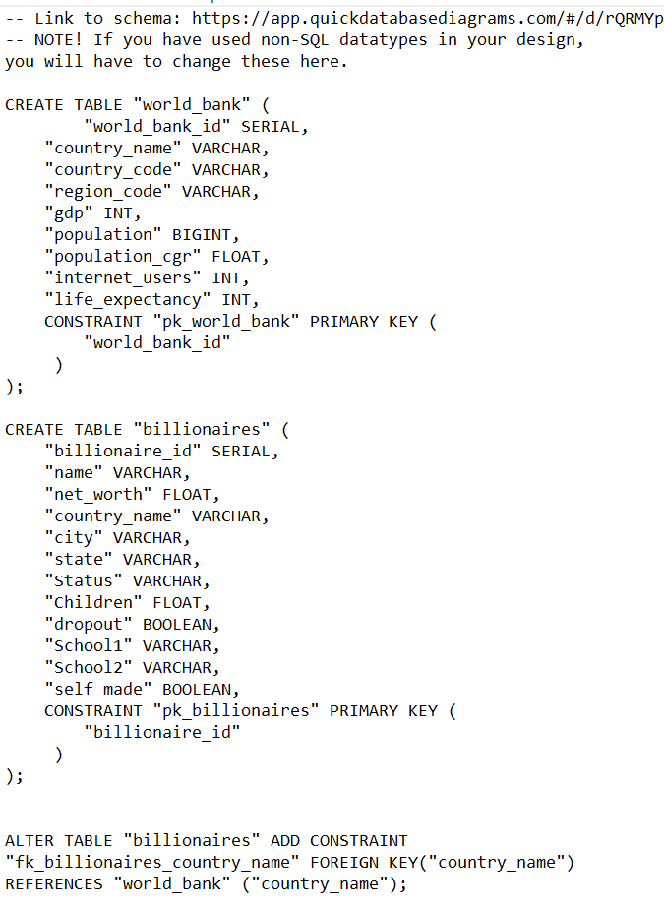
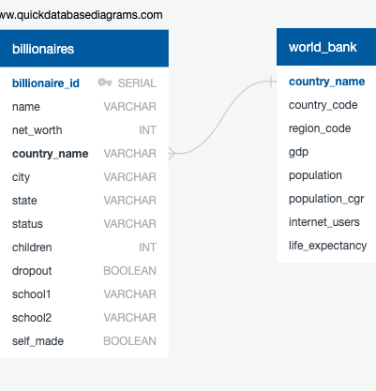
Load
Load Steps
Created ERD with https://app.quickdatabasediagrams.com/
Exported PostgreSQL file
Ran SQL file to create tables in pgAdmin 4
Imported newly created CSV files into tables
Query tests to make sure tables can join on Country Name
Problems Encountered
Originally created with Not Null for all columns, which ultimately needed to be removed in order to import the CSV files.
DataTypes had to be adjusted, such as Population needed to be adjusted from INT to BIGINT
Tried to create a foreign key that was not based off of a primary key, ultimately foreign keys were removed

Slide 6
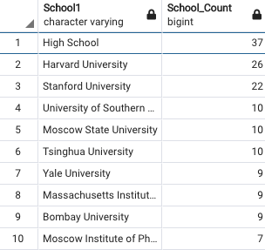
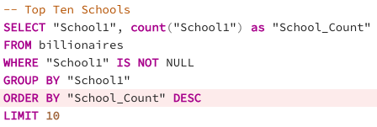
Queries

Slide 7
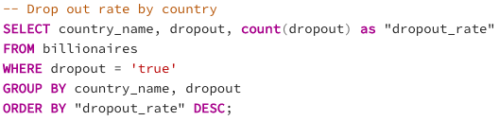
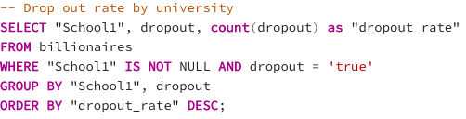
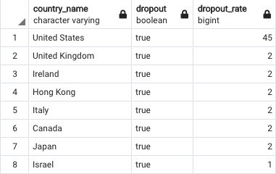
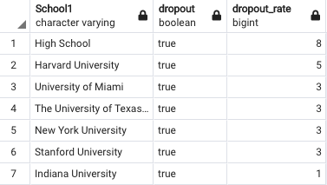
Queries

Slide 8
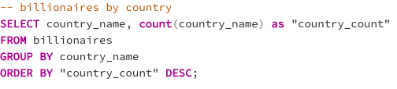
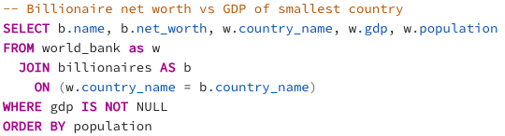
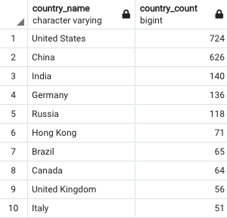
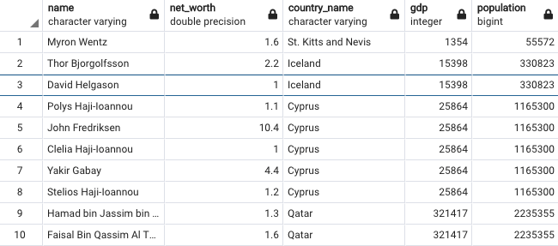
Queries

Slide 9
Summary
Why we selected PostgreSQL
Originally planned to have more tables
Time Constraints
We did not have images or documents, most data was tabular

