Slide 2
JFK
EWR
LGA

Slide 3
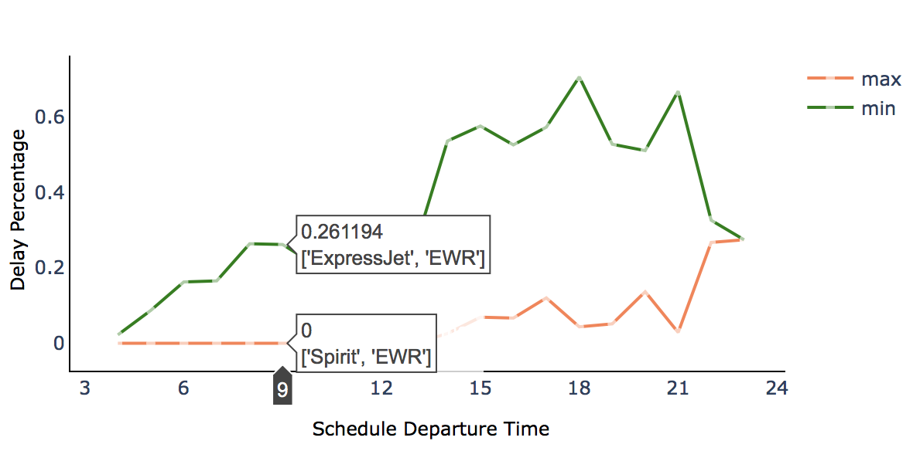
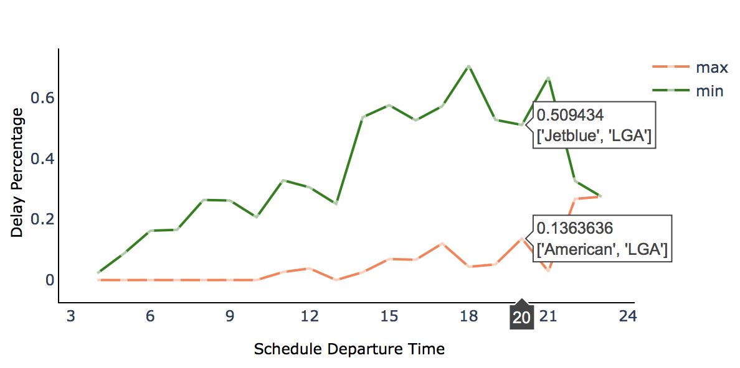
Airline Delay Percentage
Airline Delay Change with Time
How to Choose the Best Airline ?

Slide 4
JFK
EWR
LGA

