Slide 1
IMAGE VECTORIZATION
Pixels into
paths
A practical tutorial on color tracing, Bézier curves, SVG, and CAD export
UNC COMP 523 · Team E · November 4, 2026
Notes:
Presenter: Jennifer Lee
Exact script:
Hello. We are Team E, and our topic is image vectorization. During the next twenty minutes, we will explain how a raster logo made of pixels becomes scalable paths, why color boundaries and curve quality matter, and how SVG geometry can become CAD output. We will use our Adcut Logo Vectorizer as the running example. Adcut needs to turn customer artwork into separate closed regions that can represent flooring or turf materials and later support water jet cutting. We will finish with a short demonstration that you can repeat from our public repository. Our goal is to show both the useful workflow and the limitations that still require engineering judgment.

Slide 2
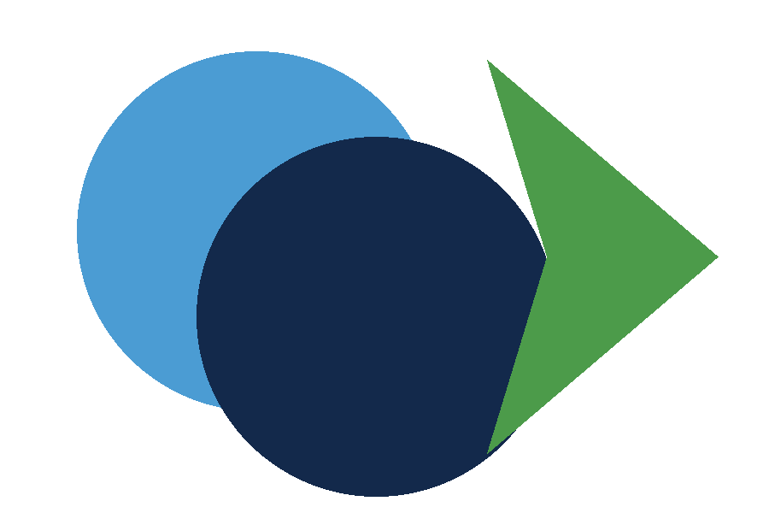
IMAGE VECTORIZATION
02
Raster images and vector paths
→
RASTER
VECTOR
grid of colored samples
geometry that scales
UNC COMP 523 Team E · Jennifer Lee
Notes:
Presenter: Jennifer Lee
Exact script:
A raster image stores color on a fixed grid. JPEG, PNG, WEBP, and GIF files are common raster formats. When we enlarge that grid, we enlarge its pixels, so edges can look jagged. A vector file stores geometry instead. An SVG path can describe straight segments and curves with coordinates and commands. The same path can render at many sizes because the renderer recalculates the pixels. Vectorization is the process of estimating that geometry from the raster evidence. This matters for our project because water jet preparation needs boundaries and scale, not only a picture that looks correct on a screen.
Sources:
- W3C SVG Paths: https://www.w3.org/TR/SVG/paths.html
- MDN SVG Paths: https://developer.mozilla.org/en-US/docs/Web/SVG/Tutorials/SVG_from_scratch/Paths

Slide 3

IMAGE VECTORIZATION
03
Why logo tracing becomes difficult
Color boundaries
A visible edge may separate two materials, not just foreground from background.
Topology
Holes must stay open, paths must close, and neighboring regions should not create duplicate cuts.
Geometry
Too many short line segments can preserve pixels while producing poor CAD curves.
Ambiguous input
Gradients, compression, transparency, and low resolution weaken the evidence.
UNC COMP 523 Team E · Jennifer Lee
Notes:
Presenter: Jennifer Lee
Exact script:
Logos look simple, but tracing them creates several different problems. First, each color can represent a different material. The boundary between blue and gold therefore matters just as much as the outer silhouette. Second, topology matters. A hole inside a letter must remain a hole, every cut path should close, and adjacent regions may share an edge that we should avoid cutting twice. Third, geometry matters. A tracer can approximate a smooth curve with hundreds of tiny segments, but CAD and fabrication workflows often benefit from native curves. Finally, the input can be ambiguous because of gradients, compression artifacts, transparency, or low resolution. A useful vectorizer must expose those limits instead of hiding them.

Slide 4
IMAGE VECTORIZATION
04
The vectorization pipeline
1
→
2
→
3
→
4
→
5
Decode
Reduce colors
Trace
Review
Export
pixels + transparency
material candidates
closed SVG paths
topology + scale
SVG + DXF
Every stage changes the evidence. Keep the source, settings, preview, and exported file together so another person can reproduce the result.
UNC COMP 523 Team E · Hamsini Tankala
Notes:
Presenter: Hamsini Tankala
Exact script:
A practical vectorization pipeline has five stages. We first decode the upload and normalize orientation and transparency. We then reduce the number of colors so small pixel variations do not become separate materials. The tracer fits closed SVG paths around those color regions. A human reviews the preview, warnings, topology, and physical scale. The exporter then writes SVG for direct path inspection and DXF for CAD. These stages are linked, so an early decision changes every later result. For example, aggressive color reduction can merge two materials before tracing starts. Reproducibility therefore requires the original file, the settings, and the output together.
Sources:
- VTracer project: https://github.com/visioncortex/vtracer

Slide 5
IMAGE VECTORIZATION
05
Color reduction and region tracing
The color limit controls how many clusters the tracer may keep.
Too many colors
Noise and anti-aliasing can become extra regions.
Too few colors
Distinct material boundaries can disappear before tracing.
The preview is evidence, not automatic approval.
UNC COMP 523 Team E · Hamsini Tankala
Notes:
Presenter: Hamsini Tankala
Exact script:
Color reduction turns millions of pixel values into a smaller set of region candidates. This is necessary because anti-aliasing creates blended edge colors that usually do not represent real materials. In our build, the maximum-colors control limits VTracer's clustering. If we allow too many colors, tiny variations can create extra paths. If we allow too few, two intended materials can merge. The dominant border option can remove a uniform outer background, but that rule can also be wrong when the border itself matters. The operator must compare the preview with the source and understand what each retained color means in the real product.
Sources:
- VTracer project: https://github.com/visioncortex/vtracer

Slide 6

IMAGE VECTORIZATION
06
Bézier curves preserve smooth boundaries
M 24 60
move to a starting point
C 40 10, 90 10, 108 60
cubic curve with two controls
Z
close the current path
Cubic curves store shape with a few control points instead of a chain of pixel-sized segments.
UNC COMP 523 Team E · Hamsini Tankala
Notes:
Presenter: Hamsini Tankala
Exact script:
SVG paths use compact commands. M moves to a starting coordinate. L draws a line. C draws a cubic Bézier curve using two control points and an endpoint. Z closes the path. A cubic curve can represent a smooth boundary with fewer meaningful controls than a dense chain of straight segments. Our development build asks VTracer for spline output and preserves cubic and quadratic commands through structured SVG parsing. The simplification setting changes how closely the fitted curve follows the source pixels. Higher simplification reduces detail and control points. Lower simplification retains more local variation. Neither direction is automatically correct. We judge the result against the intended artwork and fabrication needs.
Sources:
- W3C SVG Paths: https://www.w3.org/TR/SVG/paths.html
- MDN SVG Paths: https://developer.mozilla.org/en-US/docs/Web/SVG/Tutorials/SVG_from_scratch/Paths

Slide 7
IMAGE VECTORIZATION
07
Topology determines what gets cut
CLOSED
HOLE
SHARED EDGE
one continuous boundary
inside remains empty
avoid duplicate cuts
A file may look correct while containing open paths, filled holes, or two copies of the same boundary.
UNC COMP 523 Team E · Vibhas Nair
Notes:
Presenter: Vibhas Nair
Exact script:
Topology describes how paths connect and nest. A closed path returns to its start, which lets software interpret a complete region. A hole requires an inner boundary with the correct relationship to the outer path. Adjacent material regions may share one physical boundary, but independent color tracing can produce two coincident curves. A preview can hide these problems because both curves render in the same place. For fabrication, duplicate edges may cause a machine to revisit a cut. Our current build counts closed paths and preserves traced curves, but exact hole handling and shared-edge deduplication still require validation. This is one reason we warn users that successful export does not equal fabrication readiness.

Slide 8
IMAGE VECTORIZATION
08
SVG and DXF serve different checks
SVG
DXF R2000
Readable path data
Browser preview
Physical width and height
Original curve commands
CAD units and layers
Native SPLINE entities
Downstream import check
Requires CAD validation
R12 cannot carry the native spline representation used by the current exporter, so the build requires R2000 or newer.
UNC COMP 523 Team E · Vibhas Nair
Notes:
Presenter: Vibhas Nair
Exact script:
SVG and DXF answer different questions. SVG gives us an inspectable web vector. We can open it in a browser, read its path commands, and confirm the declared physical dimensions. DXF moves the geometry into a CAD workflow. Our exporter creates one named layer per detected color, sets inches or millimeters, and preserves curved sections as native SPLINE entities. It uses DXF R2000 because R12 does not support this spline representation. A syntactically valid DXF still needs a downstream import check. We must confirm scale, layer names, closed geometry, entity support, and appearance in the client's actual software before anyone treats the file as production ready.
Sources:
- ezdxf path documentation: https://ezdxf.readthedocs.io/en/stable/path.html

Slide 9
IMAGE VECTORIZATION
09
Live demonstration
1
Upload holes-and-curves.png
2
Set 10 in, 4 colors, 1.5 px
3
Compare source and SVG preview
4
Download SVG and DXF
5
Inspect DXF entity types
Fallback: use the captured samples and test output if the live server fails.
UNC COMP 523 Team E · Vibhas Nair
Notes:
Presenter: Vibhas Nair
Exact script:
Now I will demonstrate the workflow. I start the local application and upload examples slash holes-and-curves dot png. I set the output width to ten inches, keep four maximum colors, use one point five pixels of simplification, and ignore the dominant border color. The left side shows the raster source. The right side shows the SVG curve preview. Below that, the application reports the number of color regions, closed paths, curve segments, and physical dimensions. I download SVG and DXF. The SVG opens in a browser. For the DXF, I run the prepared inspection command and confirm that the model space contains native spline or polyline entities on named region layers. I still do not claim that this output is ready to cut. If the live server fails, I will use the captured output on this slide and explain the same sequence.

Slide 10
IMAGE VECTORIZATION
10
Quality checks before fabrication
Visual fidelity
Do intended boundaries match the source?
Topology
Are paths closed, holes preserved, and shared edges singular?
Physical meaning
Do units, scale, layers, and material colors match the job?
Downstream behavior
Does the confirmed CAD software import the expected entities?
Current gaps: exact circle and arc recognition, shared-edge cleanup, manual correction tools, and client CAD/cutting validation.
UNC COMP 523 Team E · Alex Tang
Notes:
Presenter: Alex Tang
Exact script:
We evaluate vectorization at four levels. Visual fidelity checks whether the traced boundary follows the intended artwork. Topology checks closure, holes, nesting, and duplicate shared edges. Physical meaning checks output size, units, color layers, and the relationship between those layers and materials. Downstream behavior checks the actual CAD import and, when approved, physical cutting. Our automated tests can verify parsing, scaling, closed commands, entity types, and file serialization. They cannot replace client acceptance. The current known gaps include exact circle and arc recognition, shared-edge cleanup, manual correction controls, and validation in the client's confirmed AutoCAD and IGEMS versions. We track those gaps instead of presenting them as completed features.

Slide 11
IMAGE VECTORIZATION
11
Open-source implementation and verification
VTracer
color clustering + SVG spline tracing
17
svgelements
structured path parsing
ezdxf
units, layers + native CAD curves
automated tests
Streamlit
local browser interface
Windows · Linux · macOS
Python 3.11 · 3.12 · 3.13
uv
locked environment + commands
Pillow decodes uploads. It does not trace logo boundaries.
UNC COMP 523 Team E · Alex Tang
Notes:
Presenter: Alex Tang
Exact script:
The implementation uses open-source components with separate responsibilities. VTracer clusters colors and produces spline-based SVG paths. svgelements parses path commands as geometry instead of treating SVG as an image. ezdxf writes units, layers, splines, and polylines. Streamlit provides the local interface. uv locks dependencies and runs the same commands across operating systems. Pillow only decodes and normalizes uploads. It does not trace the logo. The repository currently has seventeen automated tests. GitHub Actions runs the locked project on Windows, Linux, and macOS with Python three point eleven through three point thirteen. These tests catch code regressions, but CAD import and physical cutting still need separate evidence.
Sources:
- VTracer: https://github.com/visioncortex/vtracer
- svgelements: https://github.com/meerk40t/svgelements
- ezdxf: https://ezdxf.readthedocs.io/
- uv: https://docs.astral.sh/uv/

Slide 12
IMAGE VECTORIZATION
12
Repeat the tutorial
1
Clone the public repository
Takeaways
2
uv sync --locked --dev
Vectorization estimates geometry from pixels.
Color, topology, curves, and scale all matter.
A valid export still needs downstream validation.
3
uv run streamlit run app.py
4
Use examples/holes-and-curves.png
Questions?
UNC COMP 523 Team E · Alex Tang
Notes:
Presenter: Alex Tang
Exact script:
You can repeat the tutorial with four steps. First, clone our public development repository. Second, run uv sync dash dash locked dash dash dev. Third, run uv run streamlit run app dot py. Fourth, upload examples slash holes-and-curves dot png and use the settings shown during the demonstration. The project website also includes the exact procedure and technical references. The main takeaways are these. Vectorization estimates geometry from pixels, so the input and settings shape the result. Color, topology, curves, and physical scale all matter when a logo becomes CAD geometry. Finally, a valid SVG or DXF file still needs downstream validation before fabrication. Thank you. We are ready for questions.
Sources:
- Project repository: https://github.com/jennifer566/adcut-logo-vectorizer
- Project website: https://jennifer566.github.io/adcut-logo-vectorizer-site/tech-talk.html

