Slide 1

Improving clinical outcome predictions using convolution over medical entities with multimodal learning Batuhan Bardak & Mehmet Tan Artificial intelligence in Medicine 0933-3657/© 2021 Elsevier B.V. All rights reserved
Final Project Presentation
CS 598 – Deep Learning for Healthcare
Jennifer Hajduk – Spring 2023

Slide 2
Paper Contribution
This paper entitled “Improving clinical outcome predictions using convolution over medical entities with multimodal learning” contributed to Deep Learning in Healthcare by claiming that using their proposed convolution model over named entity relationship (NER) data can improve prediction accuracy for certain mortality and length-of-stay outcomes.

Slide 3
General Problem
Clinical notes in healthcare provide a wealth of information regarding a patients care. These notes are written by medical professionals and can be heavily laden with medical jargon and ancillary data that may not necessarily be useful for predicting certain medical outcomes.

Slide 4
General Problem
By using a pre-trained NER model, med-7, to extract medical entities from clinical notes, the model proposed by the authors can increase prediction accuracy in mortality, and length-of-stay using a CNN model.

Slide 5
Compute Power
1. EVGA 3080 TI FTW 3 GPU
2. 24 core AMD Ryzen Threadripper 3960X (overclocked to 4.3 Ghz for each core)
3. 32GB RAM CORSAIR VENGENCE 3600 MHz DDR4
4. Paging file set to 256 GB

Slide 6
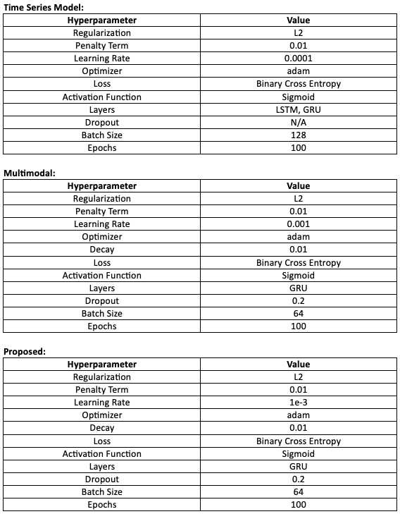
Architectures

Slide 7

Ablation Studies
I performed the following ablation studies in order to test the proposed model in different ways:
1. Remove the final Conv1D Layer on the proposed model to see if the accuracy is affected
2. Remove final two Conv1D layers on the proposed model to see if the accuracy is affected
3. Change the filter size on the proposed model.
Change the learning rate from 1e-3 to 1e-4
Use LSTM rather than GRU on the proposed model
Focal Loss

Slide 8
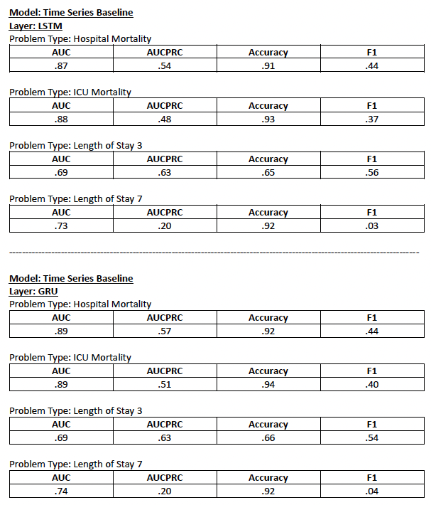
Baselines GRU vs. LSTM

Slide 9
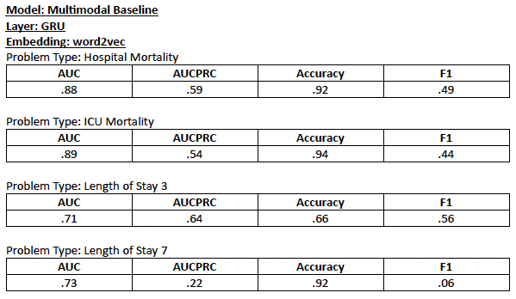
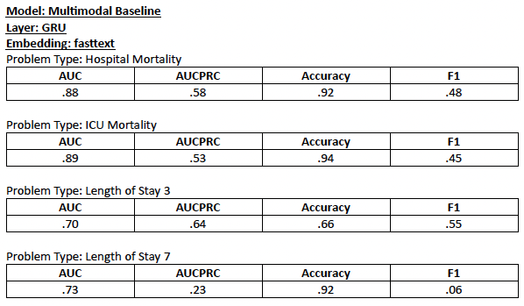
Baseline Multimodal

Slide 10
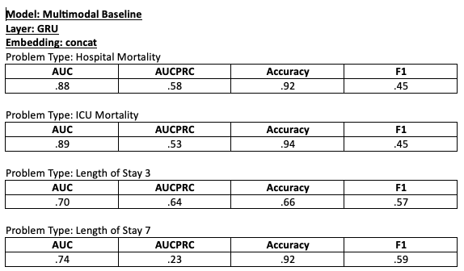
Baseline Multimodal (cont’d)

Slide 11
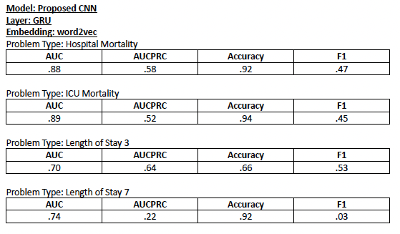
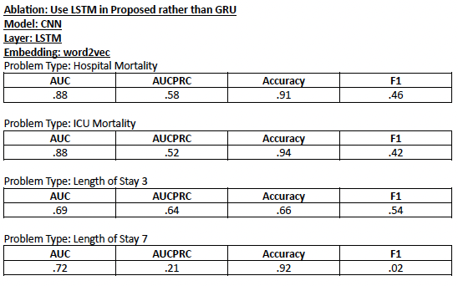
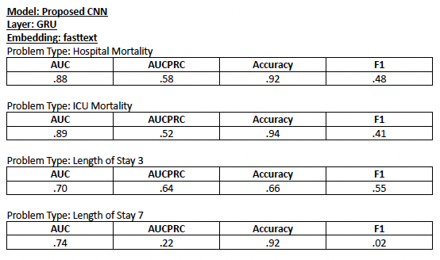
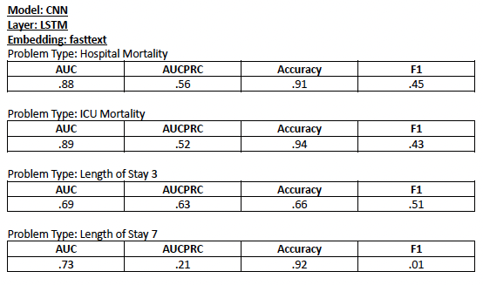
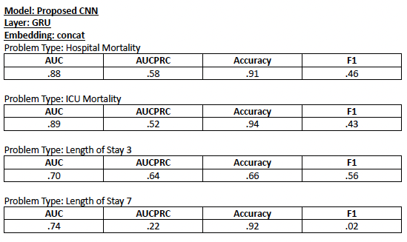
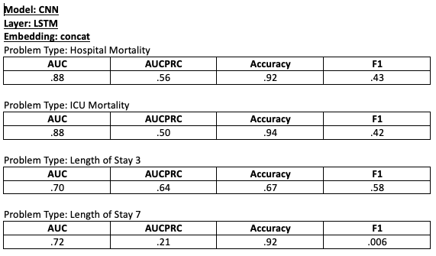
Using LSTM for the proposed model

Slide 12
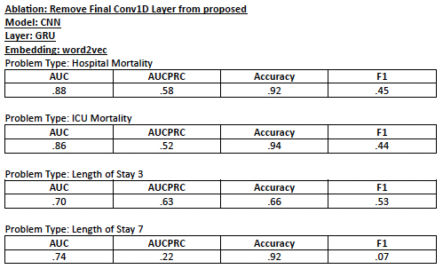
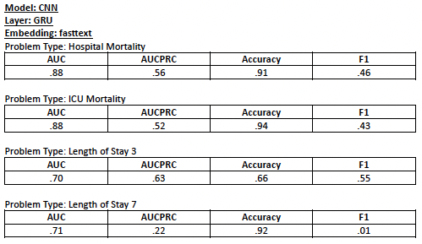
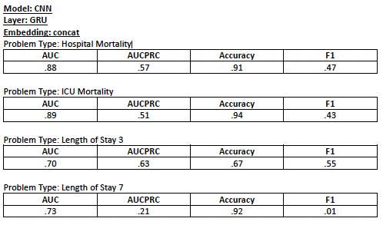
Removing the final layer from the proposed model

Slide 13
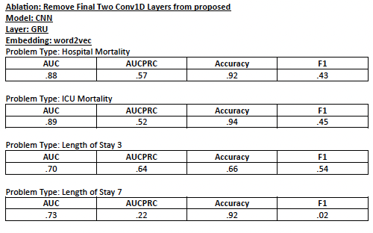
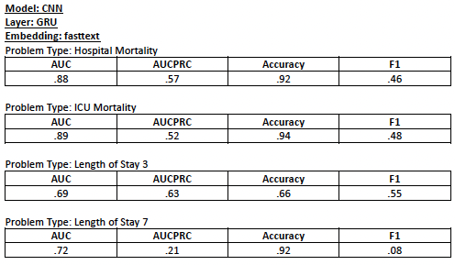
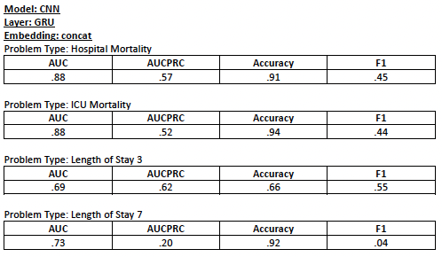
Removing final two layers from proposed model

Slide 14
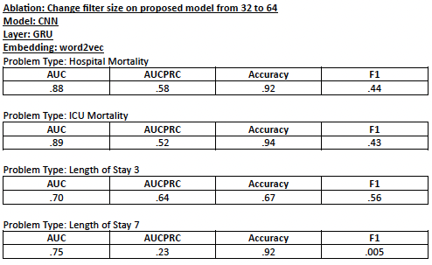
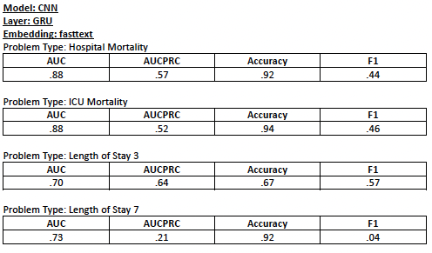
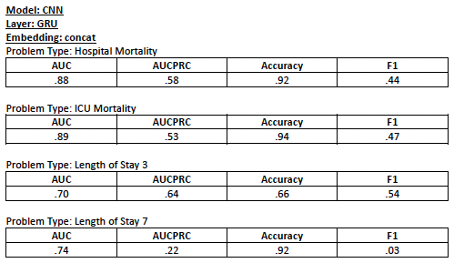
Changing the filter size from 32 to 64

Slide 15
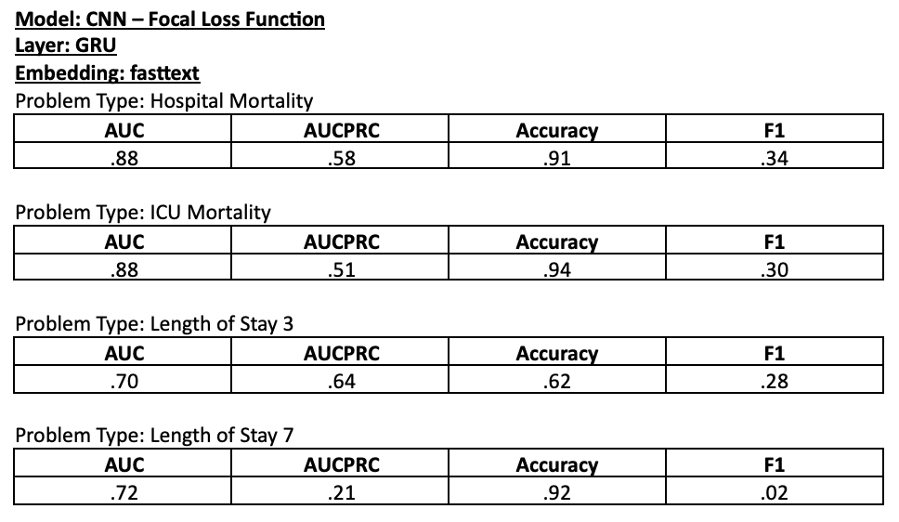
Focal Loss

Slide 16
Changing Learning Rate
By changing the learning rate of the proposed model, the model took more than 1455 minutes to complete. I chose to interrupt the model before letting it complete due to unreasonable run times.

Slide 17
Conclusions
GRU performs better that LSTM with a simpler architecture. This was supported by the experiments on the time series baseline model.
The proposed model performs better than baseline models. This was not supported by the experiment or ablations studies that I ran as the model performed similarly to the baseline models. I did not observe any significant improvements
F1 scores are rather low across all models for length of stay longer problems
Writing a new Focal Loss loss function made the proposed model perform worse than original results!

