Slide 1

Introduction to PCA for the analysis of language variation Download files from: https://jenniferhay.github.io
Jen Hay
Joshua Wilson Black

Slide 2


James Brand, Jen Hay, Lynn Clark, Kevin Watson, Márton Sóskuthy (2021) Systematic co-variation of monophthongs across speakers of New Zealand English, Journal of Phonetics, Volume 88, 2021.
Joshua Wilson Black, James Brand, Jen Hay and Lynn Clark. (in press) Using Principal Component Analysis to explore co-variation of vowels. Language and Linguistics Compass
ME:
Collaborator on the above papers.
A user of PCA for various projects. Not:
An expert in the statistical underpinnings
An expert in R

Slide 3
Agenda for today
Intuitive overview
Walkthough of two simple examples
Rmarkdown with one of the examples worked through.
Letting you loose on trying to recreate the second!

Slide 4
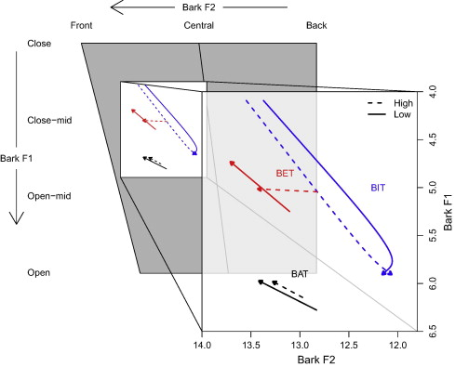
Intuitive overview of PCA
Example toy data:
mean F1 for 100 New Zealand English
speakers for TRAP, DRESS, and KIT in
New Zealand English
Context:
The NZE short front vowel shift

Slide 5
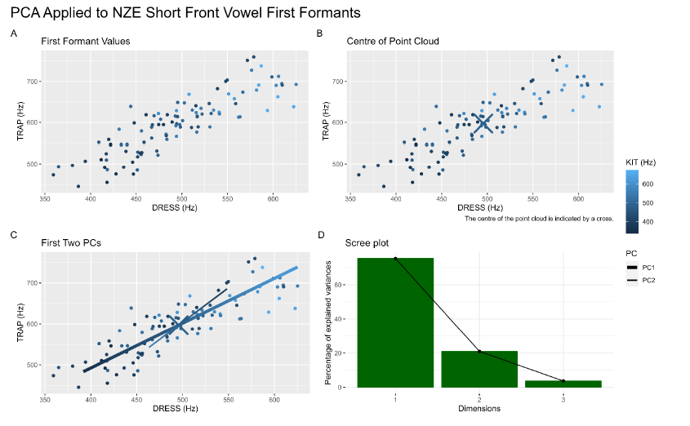

Slide 6
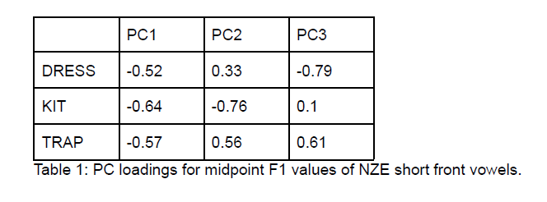
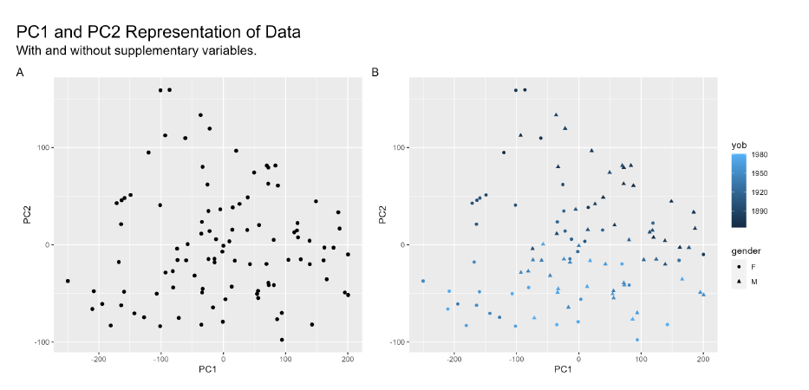
An Interpretation:
PC1: physiological factors
PC2: short front vowel shift

Slide 7
May seem overkill when dealing with 3 variables. Couldn’t we just look at all the pairwise correlations?
Maybe…… but this doesn’t scale up as we get more and more variables!

Slide 8
From 'the textbook':
The central idea of principal component analysis (PCA) is to reduce the
dimensionality of a data set consisting of a large number of interrelated variables,
while retaining as much as possible of the variation present in the data set.
This is achieved by transforming to a new set of variables, the principal components (PCs),
which are uncorrelated, and which are ordered so that the first few retain most of the variation
present in all of the original variables. (Jolliffe, 2002)

Slide 9
Four data-sets
What attitudes and exposure to participants have toward te reo Māori? (want to reduce dimensionality of independent variables then use to predict pronunciation)
What acoustic variables covary in ‘dis/mis’ triphones? (want to reduce dimensionality of dependent variables, then investigate whether prefix status affects pronunciation)
What vowels cluster together in terms of how sociolinguistically advanced they are, across speakers? (want to explore degree to which things are associated).
What vowels cluster together across time, in individuals’ monologues (want to explore degree to which things are associated).

Slide 10
Four data-sets.
What attitudes and exposure to participants have toward te reo Māori? (want to reduce dimensionality of independent variables then use to predict pronunciation)
What acoustic variables covary in ‘dis/mis’ triphones? (want to reduce dimensionality of dependent variables, then investigate whether prefix status affects pronunciation)
What vowels cluster together in terms of how sociolinguistically advanced they are, across speakers? (want to explore degree to which things are associated).
What vowels cluster together across time, in individuals’ monologues (want to explore degree to which things are associated).
EXTRACT PC scores for SPEAKERS
EXTRACT PC scores for VOWEL TOKENS
INVESTIGATE ASSOCIATIONS BETWEEN
LOADINGS WITHIN PCA

Slide 11

Hashimoto, D. (2019). Loanword phonology in New Zealand English: exemplar activation and message predictability. University of Canterbury PhD Thesis. Question: How do people’s answers to a set of survey questions affect whether they will use structure from Māori in their pronunciation of Māori loanwords? Problem: The survey contains too many potential predictors for a regression model, and they’re probably all correlated. Solution: PCA

Slide 12
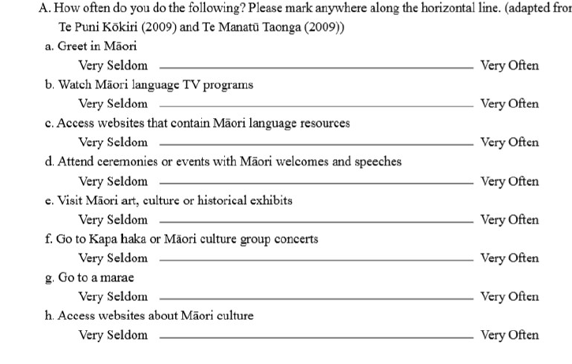
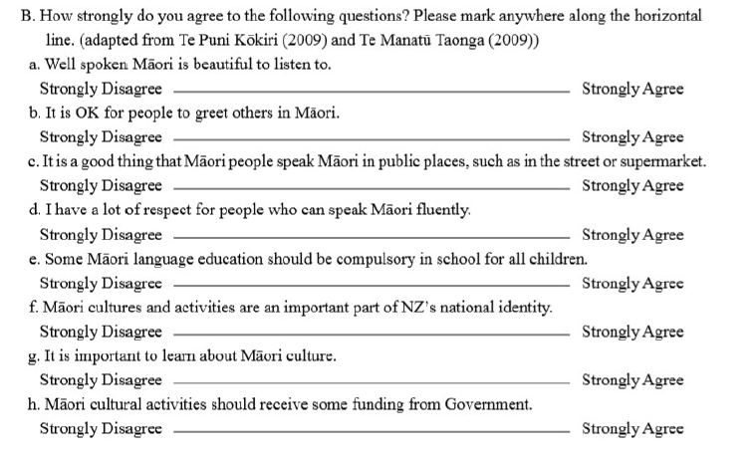
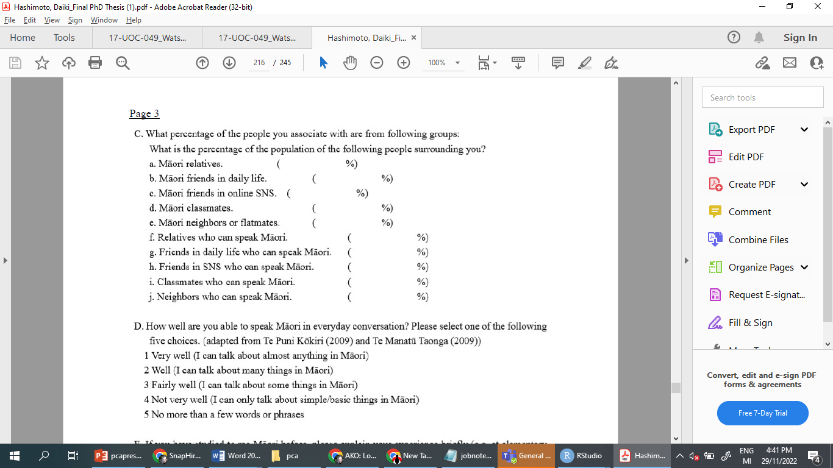

Slide 13
Questions we should ask ourselves:
(1) Is PCA appropriate?
(2) How many PCAs should I consider?
(3) Which variables (here, questions) are relevant to the interpretation of these PCs?
Then we extract relevant PC scores for the speakers for use in our regression model.

Slide 14
We need:
A row per ‘observation’
A column for each measurement applying to the observation. This should be numeric, and there should not be any missing measurements.
If there are – consider excluding the row, or imputing the measurement.
Careful consideration of whether the dataframe contains a known source of covariation that is not what we’re are looking for. Consider ways of ‘normalizing’ or removing this. (we’ll see examples of this later).

Slide 15
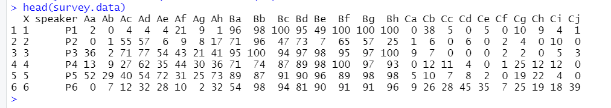
Our dataframe
Based on Hashimoto’s data (not identical).
96 rows (one per participant)
26 columns (one per question – rating from 0 to 100).
We need to feed just the numeric columns into the PCA
This is simple data, we don’t need to control any spurious variation in the dataframe.

Slide 16
Is PCA appropriate?
PCA will find covariation in anything, even if it’s not really there. So we should check our data and check that there is some structure in it that is above chance. If so, then it is a good candidate for dimension reduction.

Slide 17
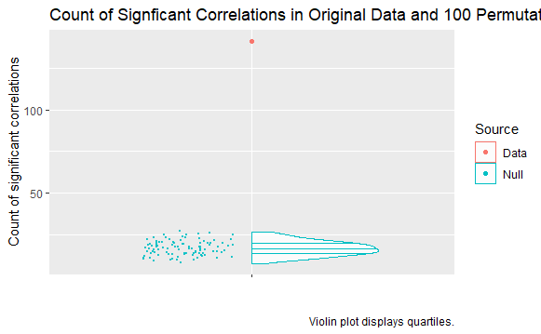

Slide 18
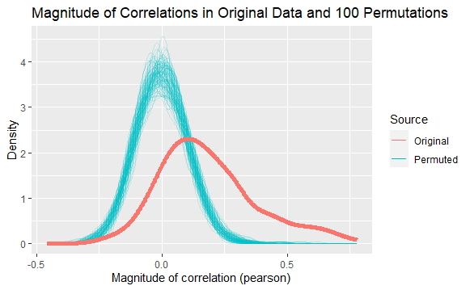

Slide 19
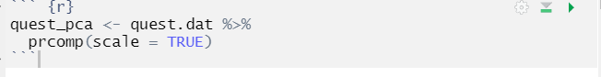
(1) Is PCA appropriate?
From the above plots, we see that we have non-random structure in our correlations, both in terms of magnitude and statistical significance.
We conduct PCA!

Slide 20
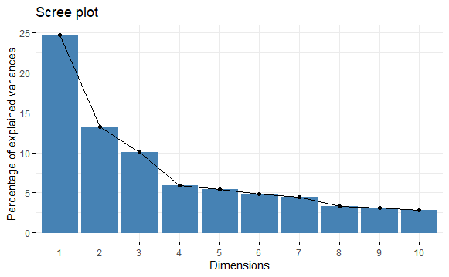
(2) How many PCs should I consider?
‘Elbow’ rule

Slide 21
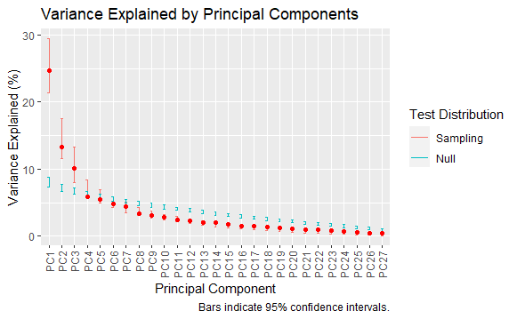

Slide 22
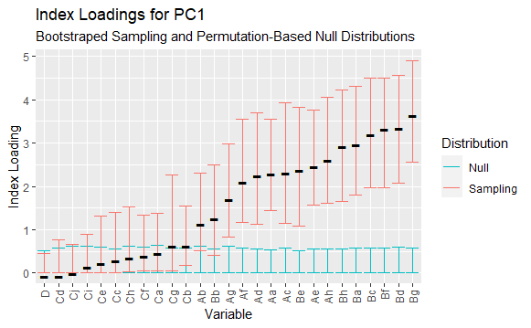
(3) Which variables (here, questions) are relevant to the interpretation of these PCs?

Slide 23
If confidence bars overlap,
include a filtering step on
your interpretation
plot.

Slide 24
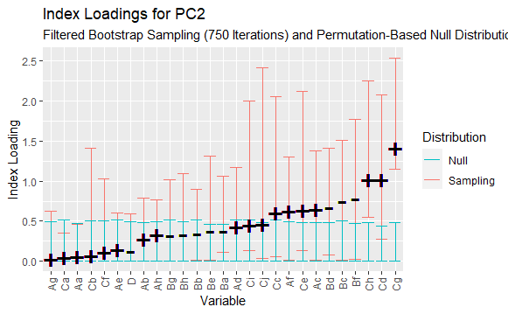

Slide 25
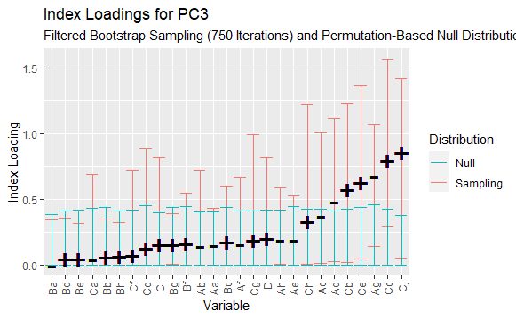

Slide 26
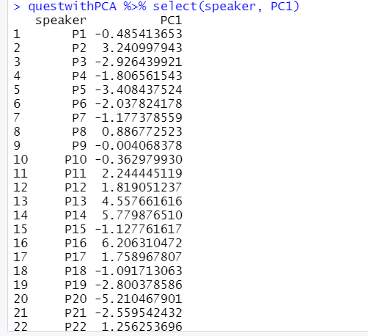
We can then extract the speaker scores, for use in our subsequent analysis.

Slide 27
Summary
Reduced questionnaire down to just a couple of predictors.
We reduced the dimensionality of independent variables to use to predict pronunciation in another model.
Questions before we go onto another example?

Slide 28




Example 2.
What acoustic variables covary in ‘dis/mis’ triphones? (want to reduce dimensionality of dependent variables, then investigate whether prefix status affects pronunciation)
Data from manuscript in progress. Collaborators:
Sarah Hawkins, Jane Stuart-Smith, Rachel Smith, Robert Fromont.

Slide 29
Example 2. 14 different acoustic measures of mis or dis triphones. We are interested in whether the acoustics is affected by whether the phonemes are a prefix or not. 14 different models seems overkill, and lots of these are correlated. Can we reduce dimensionality so we only have a few dimensions as the dependent variables?
Measure | Description
tri-dur | Duration of the full mis or dis triphone.
o-dur | Duration of the first syllable onset, [m] or [d]
i-dur | Duration of the vowel.
s-dur | Duration of [s].
s:i-ratio | Ratio of s-dur to i-dur.
F1 | Frequency of F1 (Hz) at midpoint of vowel.
F2 | Frequency of F2 (Hz) at midpoint of vowel.
F2-F1 | Difference between F2 and F1 frequencies (greater in more peripheral vowels).
s-freqM | The frequency of the highest-amplitude spectral peak in the mid-frequency range (3-7 kHz).. Probably closely correlated with the lower-frequency cutoff described from spectrograms.
s-freqH | Frequency of the peak amplitude in the high-frequency range (> 7 kHz).
s-freqMH | Overall peak frequency, indicating which of s-freqM and s-freqH has higher amplitude.
s-ampDiff | Peak amplitude in the mid-frequency band (3-7 kHz) minus the minimum amplitude in the low-frequency band (0.55-3 kHz).
s-levelDiff | Relative spectral balance in the mid- and high-frequency ranges, taking into account the whole spectral shape in each range.
s-var | Variance of the multitaper [s] (the second spectral moment, or square of the standard deviation of the spectral spread around the spectral centre of gravity) above 550 Hz.

Slide 30
What needs controlling?
The data is from multiple dialects.
Speaker gender will likely have a significant effect on factors such as formants.
We are interested in detecting the effect of prefixedness, when these things are controlled.
We z-score each variable within each gender+dialect. The data is then a number for how extreme the token is within its local distribution.
This z-scored data is the data that we conduct PCA on.

Slide 31
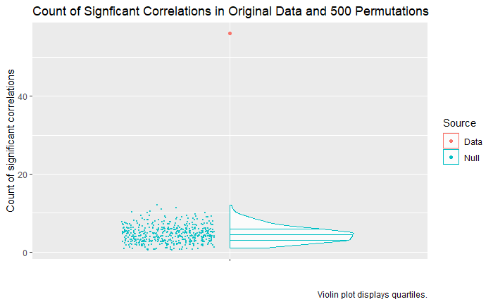
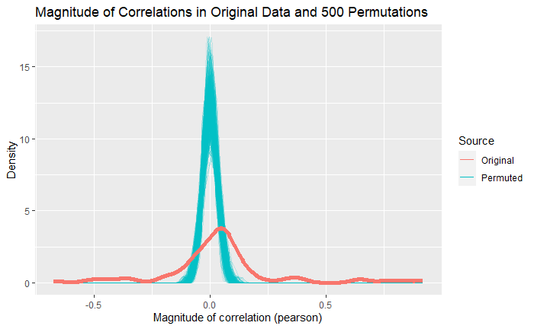
(1) Is PCA appropriate?

Slide 32
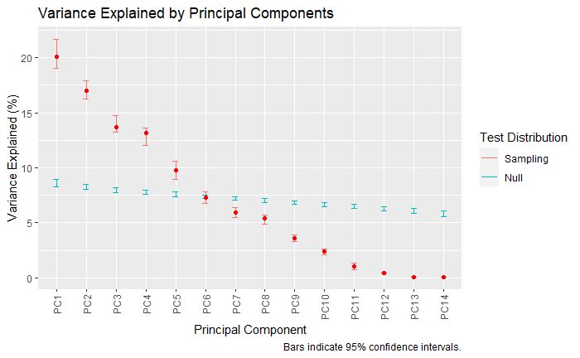
(2) How many PCAs should I consider?

Slide 33
(3) Which variables (here, acoustic properties) are relevant to the interpretation of these PCs?

Slide 34
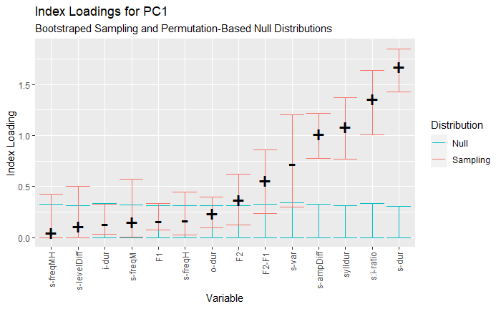
PC1: s-duration and ‘peakiness’

Slide 35
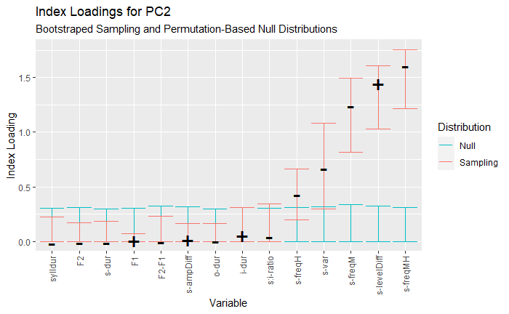
PC2: [s] spectral balance

Slide 36
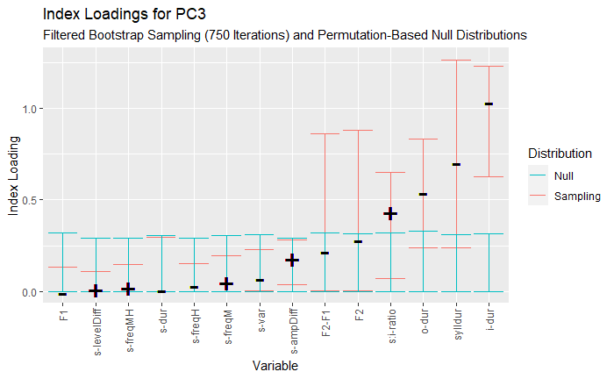
PC3: Vowel duration

Slide 37
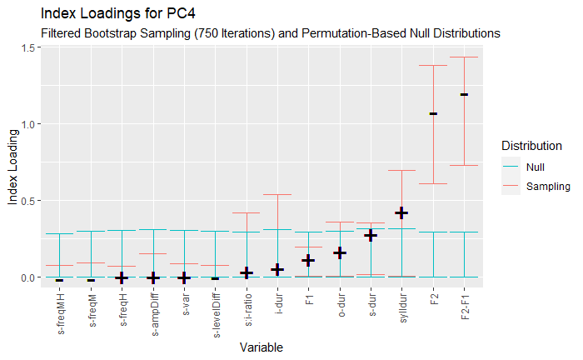
PC4: Vowel formants

Slide 38
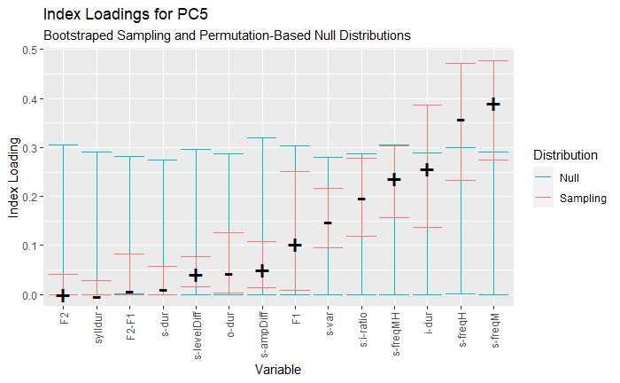
PC5 – nothing reliable.

Slide 39
What acoustic variables covary in ‘dis/mis’ triphones? (want to reduce dimensionality of dependent variables, then investigate whether prefix status affects pronunciation)
We extracted the first 4 PCs for each token. Then we did 4 regression models (rather than 14) investigating the degree to which prefix status affects each PC.
We have reduced the 14 sets of measurements down to 4 coherent, interpretable, PCs.

Slide 40
Your turn
Files are at: https://jenniferhay.github.io
Download everything into the same folder.
Open the file PCAMaterials.Rmd
Go through and read the Rmarkdown, and execute all the code.
I can’t wander around and see your screens, but don’t leave me bored. Ask me if you have questions!
You have the code for the survey example.
Once you have gone through this, you can try and recreate it for the dis/mis example.

