Slide 1
APP-independent sleep disturbances in aged Dp16 mice
Crnic Institute Down Syndrome Research Symposium
Jennifer Lawrence, 2nd Year PhD student
Hoeffer Lab, University of Colorado Boulder

Slide 2
Background
Down Syndrome
Sleep
Previous work with RCAN 1
APP

Slide 3
Down Syndrome
Background
Caused by an extra copy of chromosome 21 in humans
~ 1 in 700 births in the United States
100’s of gene dosage differences
Multisystem consequences
Psychological
Cognitive
Physiological
Greater risk of dementia and Alzheimer’s disease
Notes:
One of the most common birth defects in the U.S.
And other diseases such as heart disease

Slide 4
Individuals with Down Syndrome experience sleep disturbances
Background
Can be contributed to obstructive sleep apnea (OSA)
>70% of individuals with DS experience sleep disturbances
but not all sleep problems are OSA-driven
↑ Sleep fragmentation
↓ Sleep efficiency
↑ Sleep latency
↓ Circadian robustness
↑ Cases of insomnia and daytime sleepiness
↓ Time in REM sleep
Notes:
Interdaily stability and intradaily variability

Slide 5
Background
Suggests sleep disturbances in DS may also arise from disruption of sleep-wake mechanisms
Due to alterations in gene expression?
Disrupted neural sleep-wake circuitry?
Interactions with aging?

Slide 6
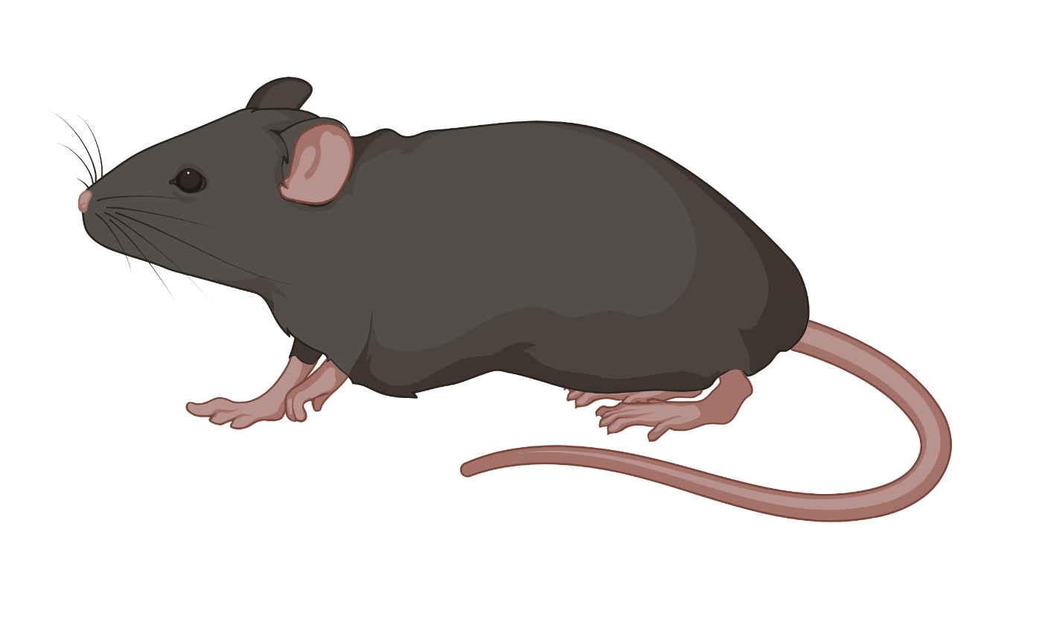
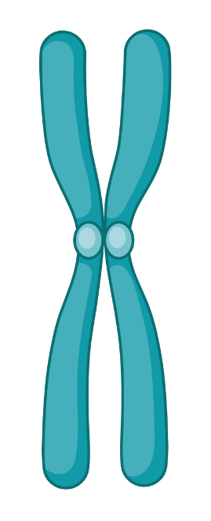
The Dp16 mouse model
Background
Extra copy of chromosome 16 (Chr21 homolog in mice)
WT
Dp(16)1Yey/+
Chr16
Chr16

Slide 7
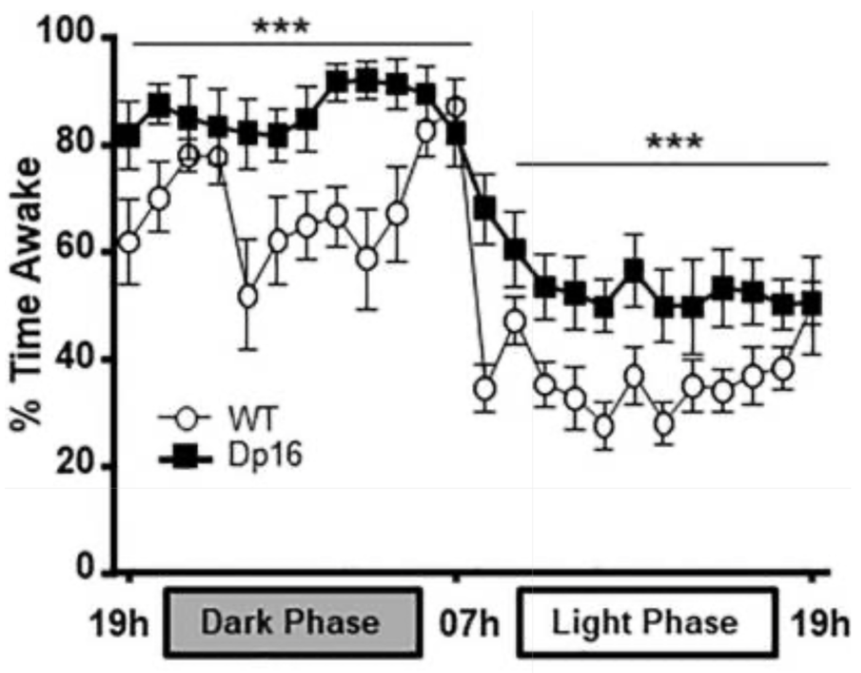
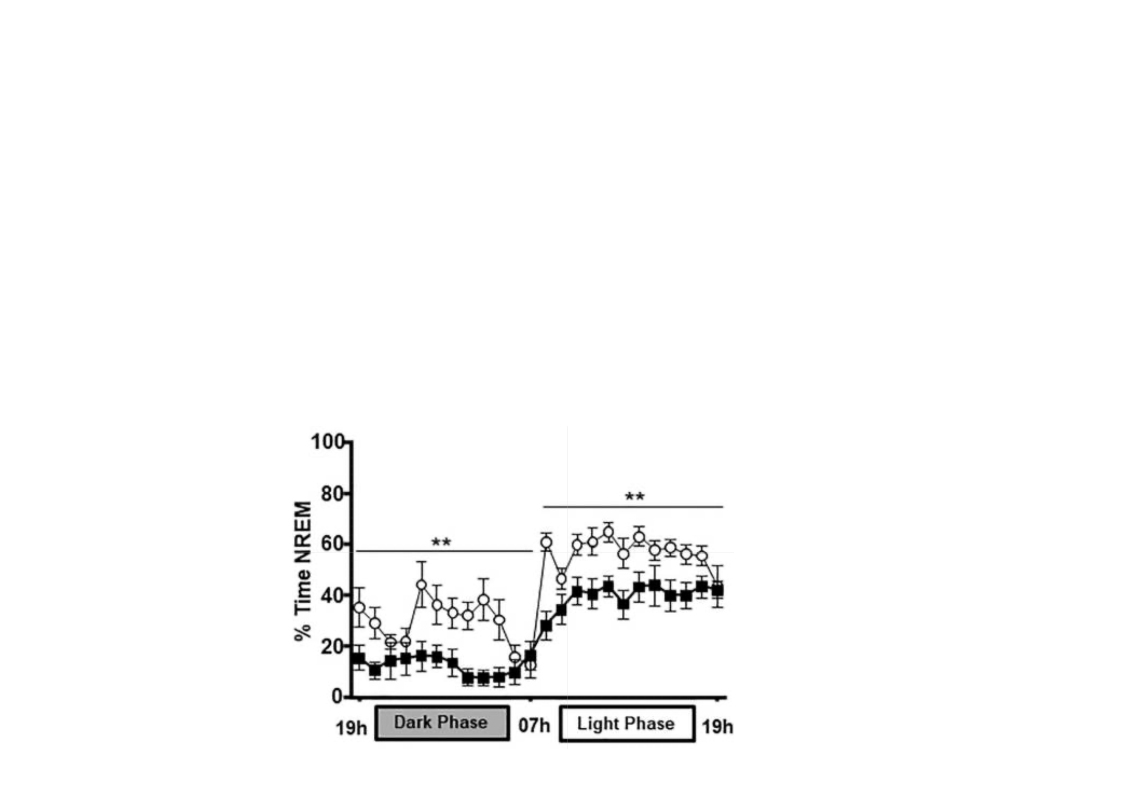
Aged Dp16 mice have a pronounced sleep phenotype
Background
↑ Time awake in both phases
↓ Time in NREM in both phases
(Adapted from Levenga et al., 2018)
Notes:
These results in Dp16 mice are consistent with sleep disturbances found in individuals with DS, and the abnormal EEG oscillations in aged Dp16 mice suggest a potential role for GABAergic activity in these sleep and EEG abnormalities.

Slide 8
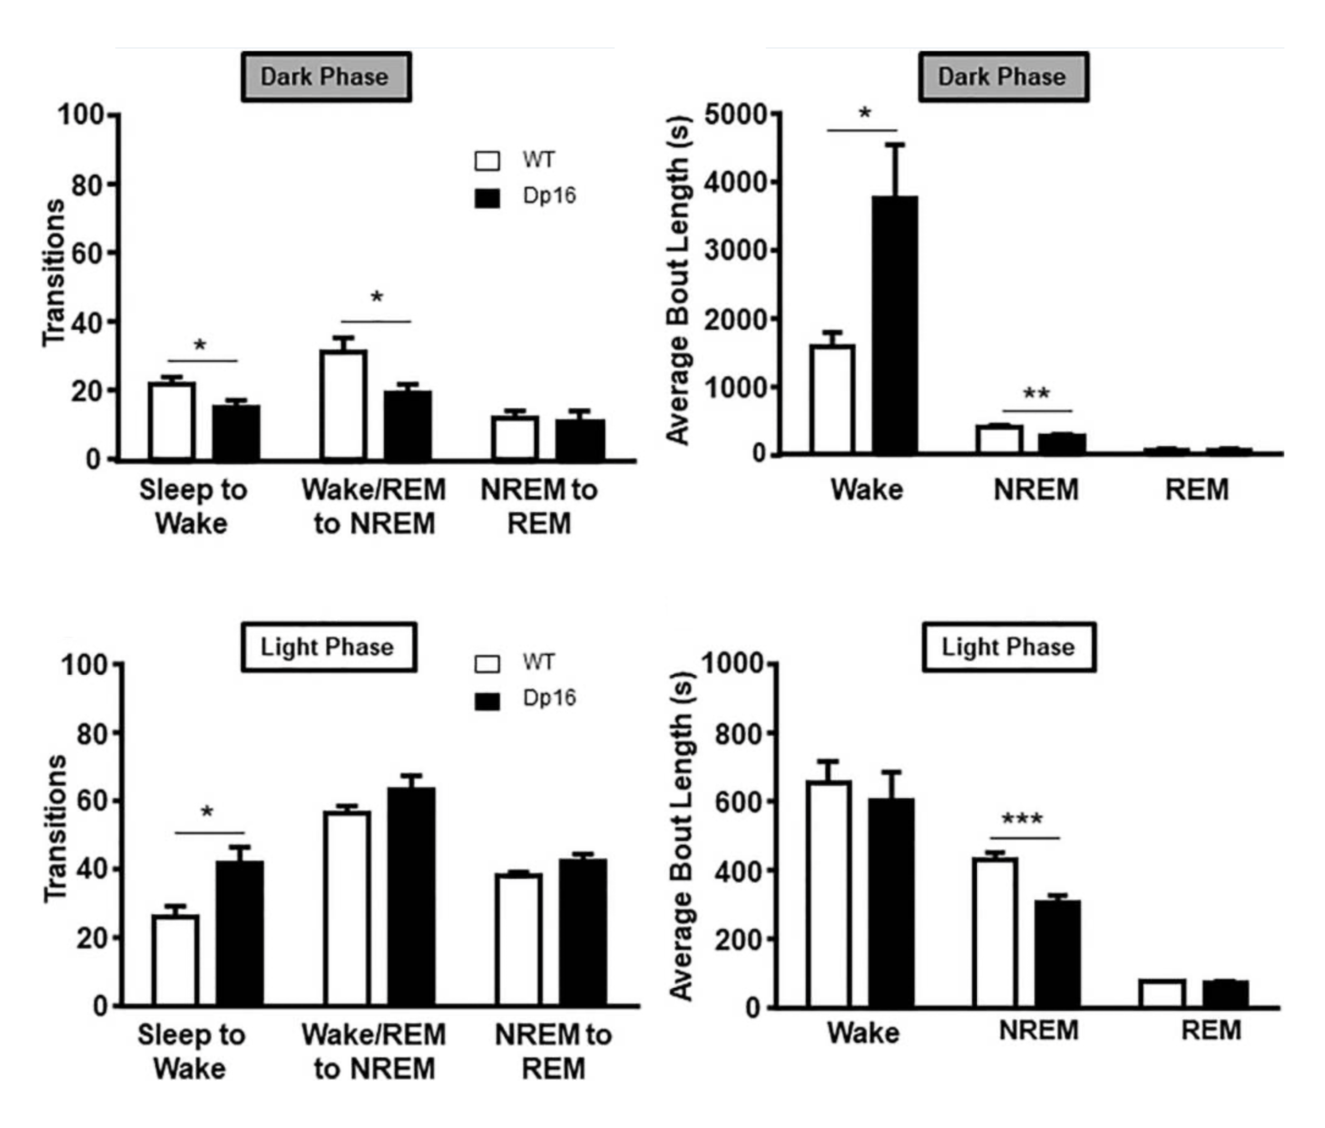
Background
(Adapted from Levenga et al., 2018)
Notes:
These results in Dp16 mice are consistent with sleep disturbances found in individuals with DS, and the abnormal EEG oscillations in aged Dp16 mice suggest a potential role for GABAergic activity in these sleep and EEG abnormalities.

Slide 9
Restoring RCAN1 gene dosage partially restores these sleep disturbances
Background
(Adapted from Cain et al., 2026)
Notes:
These results in Dp16 mice are consistent with sleep disturbances found in individuals with DS, and the abnormal EEG oscillations in aged Dp16 mice suggest a potential role for GABAergic activity in these sleep and EEG abnormalities.

Slide 10
APP is triplicated in Down Syndrome and linked to sleep
Background
APP (amyloid precursor protein) is a Chr21 gene in humans
APP cleaves to form AB a key neuropathological hallmark of Alzheimer’s disease (AD)
DS individuals will often develop early AD neuropathology
APP alone can disrupt sleep
Prime candidate gene that contributes to sleep disturbances in Down Syndrome

Slide 11
Study Design & Key Methods
Main question & hypothesis
Current N’s
Acquisition of sleep metrics

Slide 12
Can the RCAN1 partial rescue be replicated with APP?
Study Design
APP is triplicated on mouse Chr 16
Can dosage correction of APP to 2 copies mitigate sleep disturbances – similarly to RCAN1?

Slide 13
Study Design
QUESTION:
Does restoring APP to disomic levels rescue sleep and EEG deficits in aged Dp16 mice?
HYPOTHESIS:
APP is a contributing to DS-associated sleep disturbances in Dp16 mice; restoring APP dosage will normalize sleep architecture and EEG power.

Slide 14
Current sample size per group
Study Design
10-14 months old
WT
N = 13
APP2N
N = 6
Dp16
N = 9
Not stratified by sex as of now (working on that- standby)
Notes:
Ignore adding sex to this just have to wait until sleep is scored

Slide 15
Acquisition of sleep metrics
Methods
1
EEG head mount surgery; EEG and EMG recordings
2
2 week recording period; 1 week habituation : 1 week recording
3
Data processing; ML- based scoring
4
Time in sleep stage; EEG spectral data

Slide 16
Machine learning based scoring methods
Methods

Slide 17
APP dosage correction – Results
Sleep and EEG power
Bulk RNA sequencing

Slide 18
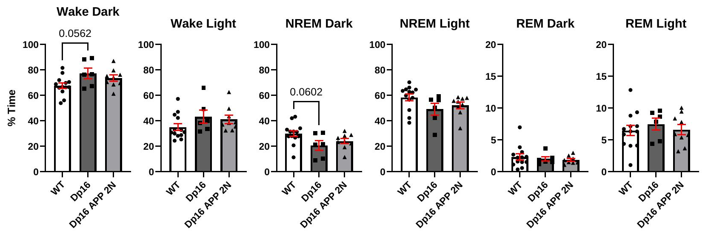
Background
APP does not restore sleep disturbances in Dp16 mice

Slide 19
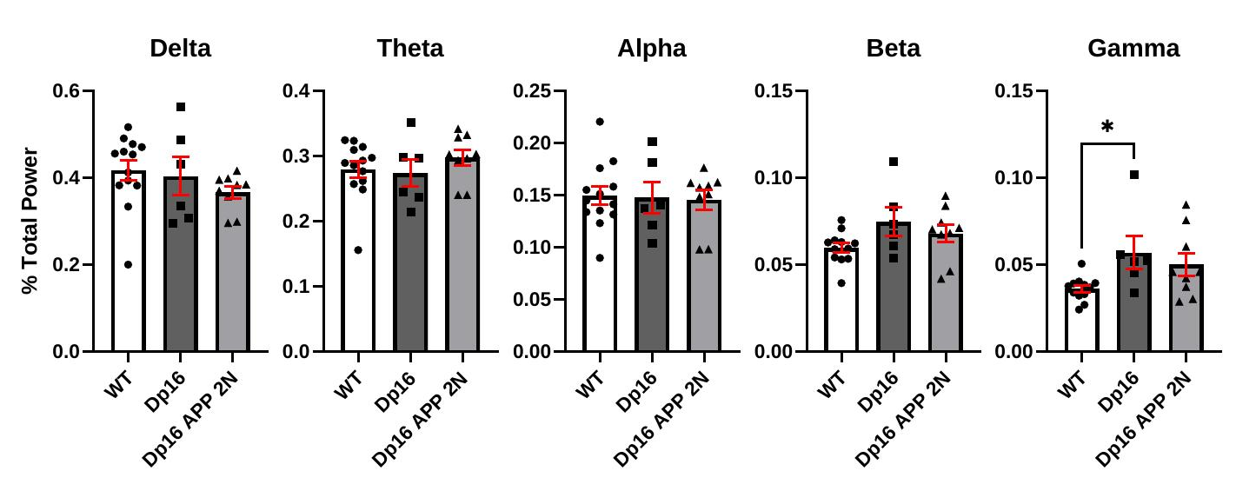
Background

Slide 20
Bulk RNA Sequencing
Background
1
RNA extraction from hippocampus and hypothalamus
2
Statistical model – contrasts by sex and genotype
3
Differentially expressed genes (DEG’s) and enriched pathways

Slide 21
Why the hippocampus & hypothalamus?
Background
Hippocampus
Hypothalamus

Slide 22
Modeling sex explicitly through sequencing
Background

Slide 23
Methods
Differentially expressed genes in both regions
 | Hippocampus |  | Hypothalamus
Contrast | Up | Down | Up | Down
Male WT vs Dp16 | 96 | 24 | 89 | 22
Male WT vs APP2N | 165 | 98 | 200 | 140
Male Dp16 vs APP2N | 0 | 0 | 0 | 0
Female WT vs Dp16 | 85 | 25 | 83 | 14
Female WT vs APP2N | 115 | 49 | 193 | 49
Female Dp16 vs APP2N | 1 | 0 | 1 | 0

Slide 24
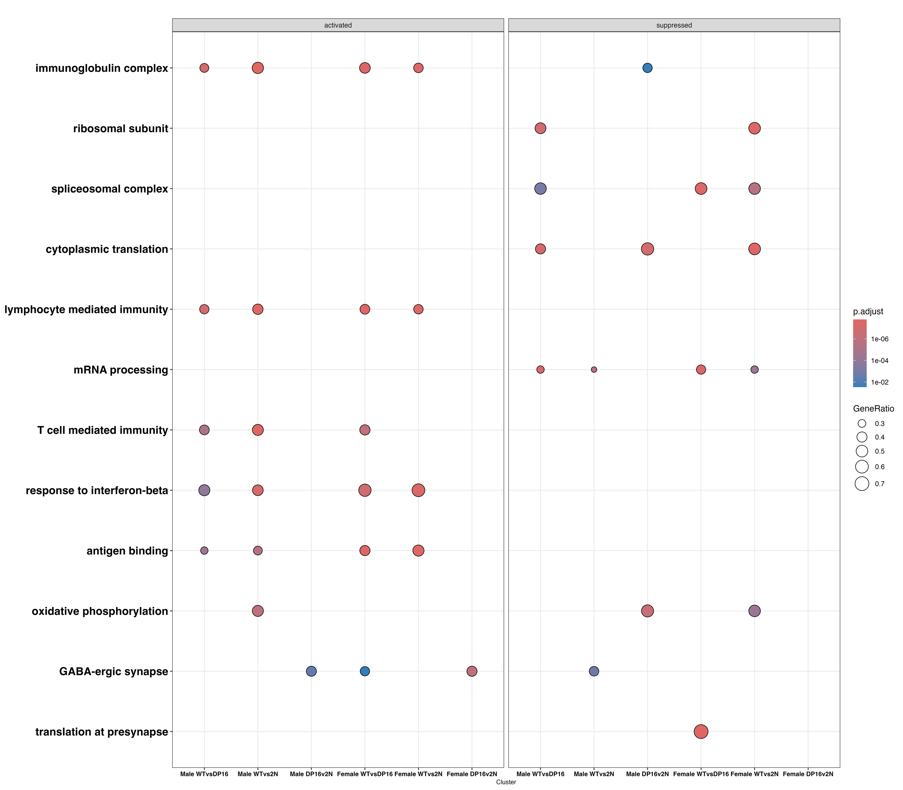
Discussion
Hippocampus

Slide 25
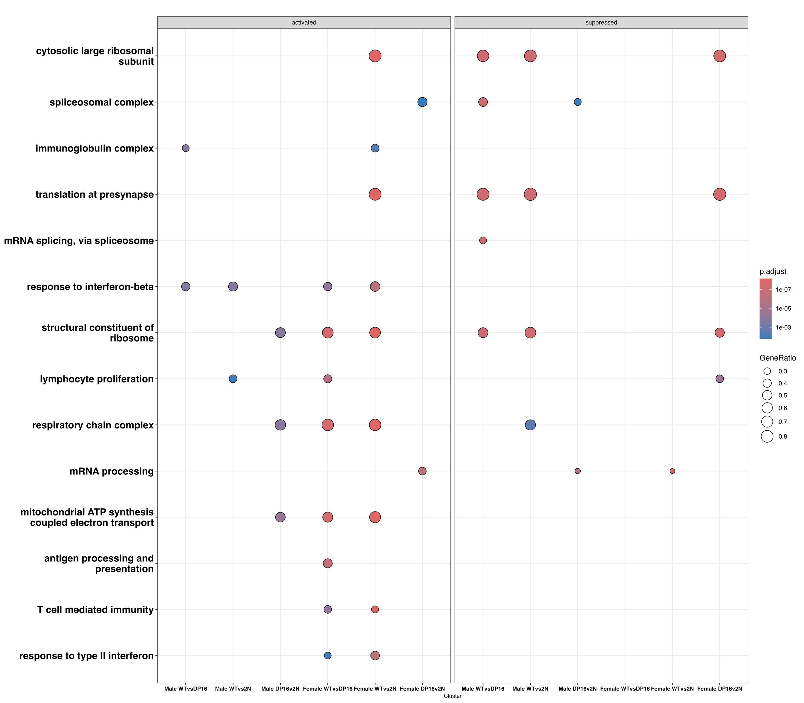
Discussion
Hypothalamus

Slide 26
Discussion
Pathway comparisons across studies
Pathway category | RCAN1 study (hippocampus) | This study (hippocampus) | This study (hypothalamus)
GABAergic / synaptic | Implicated (EEG gamma-power link) | Replicates strongly | Does not replicate
Interferon / immune | Not reported | Replicates strongly | Replicates strongly — all 4 contrasts
mRNA-splicing / OXPHOS | Not reported | Replicates, mixed direction | Replicates, even stronger
Notes:
“Sleep regulation is polygenic, so it is unlikely that any single trisomic gene explains DS-associated sleep dysfunction in full.”
— Cain, Milstead, Griffioen et al. 2026

Slide 27
Future Directions

Slide 28
Acknowledgements

